Slide 1
The European World, 1500-1700
Popular Politics case study:
Riots and public executions in early modern England
Naomi Pullin
naomi.wood@warwick.ac.uk

Slide 2
Popular politics?
Ordinary people often overlooked as actors in political process.
Cultural historians, e.g. E. P. Thompson ‘The moral economy of the English Crowd’ – food rioters not just upset about loss of resources, but identifying what customs and practises violated.
Patrick Collinson – a ‘new political history, which is social history with the politics put back in, or an account of political processes which is social’.

Slide 3
Case study: The Oxfordshire Rising, 1596
Key themes:
Meaning attached to it by both participants and state
What it reveals about the early modern political process
The place of public execution in popular politics.

Slide 4
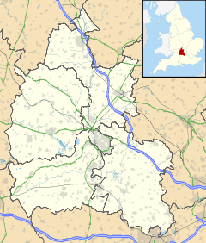
Oxfordshire, 1596
Bartholomew Steer, a carpenter, plans an uprising against local gentry
The plan:
to meet 21 Nov. on Enslow Hill
‘a rising of the people to pulle down the enclosures’
Would march to London and get support from London apprentices
But plan changes:
Plot to raid homes of gentry responsible for enclosure and assassinate them and families
Only four men showed up, wait for 2hrs, then disband
Enslow

Slide 5
A Rising of the People?
Rebels described as a ‘rising of the people’.
Arrested, tried for high treason and sentenced to be hanged, drawn and quartered
The setting of the revolt:
Four years of harvest failure > high prices and food shortages
1590s – discontent across England. Food riots in Kent and London.
September 1596 – people of Oxfordshire petition Lord Lieutenant, Lord Norris, for relief. Complain about illegal enclosures pushing up rental costs, but petition ignored.
Riot = extension of the petitionary dialogue.

Slide 6
The rule of ‘custom’
Enslow Hill chosen to stage protest = site of another popular uprising in Oxfordshire in 1549.
Plans to attract London apprentices, showing awareness of political climate in rest of country
21 Nov. chosen because local yeoman would be absent from the county to sit on King’s Bench

Slide 7
The response to the rising
Conspirators and ringleaders arrested, brought to London, tortured and then tried by Sir Edward Coke.
Lord Norris sends petition to London.
Tudor state takes action against enclosure – anti-enclosure statutes issued 1597.
Men sentenced for high treason and to be hanged, drawn and quartered at the site of the rebellion on Enslow Hill.

Slide 8
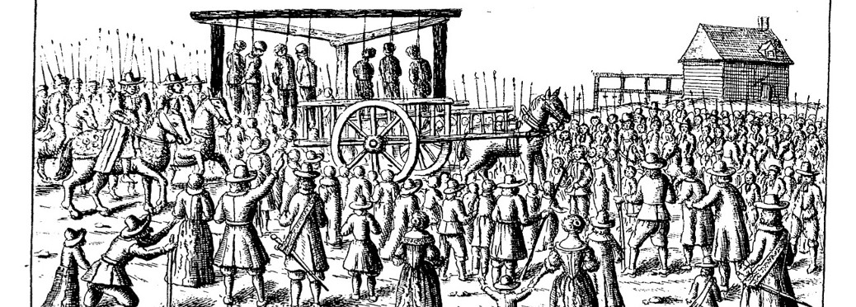
Crowds and public executions
Execution = means for Tudor state to reassert authority.
Being hanged, drawn and quartered reflects damage caused to body politic.
Public execution = ceremony and ritual
Drama of execution enhanced through pardons.
Dying words reinforced values and ideas about good behaviour, obedience and repentance.

Slide 9
The place of the crowd?
Michel Foucault: executions ‘a theatre of punishment’; ‘spectacles of power with the physical strength of the sovereign beating down upon the body of his adversary and mastering it’.
But does the crowd have any agency in these spectacles of punishment?
Thomas Laquer: crowd = central and willing participants.
Crowd has some influence over who was pardoned.

Slide 10
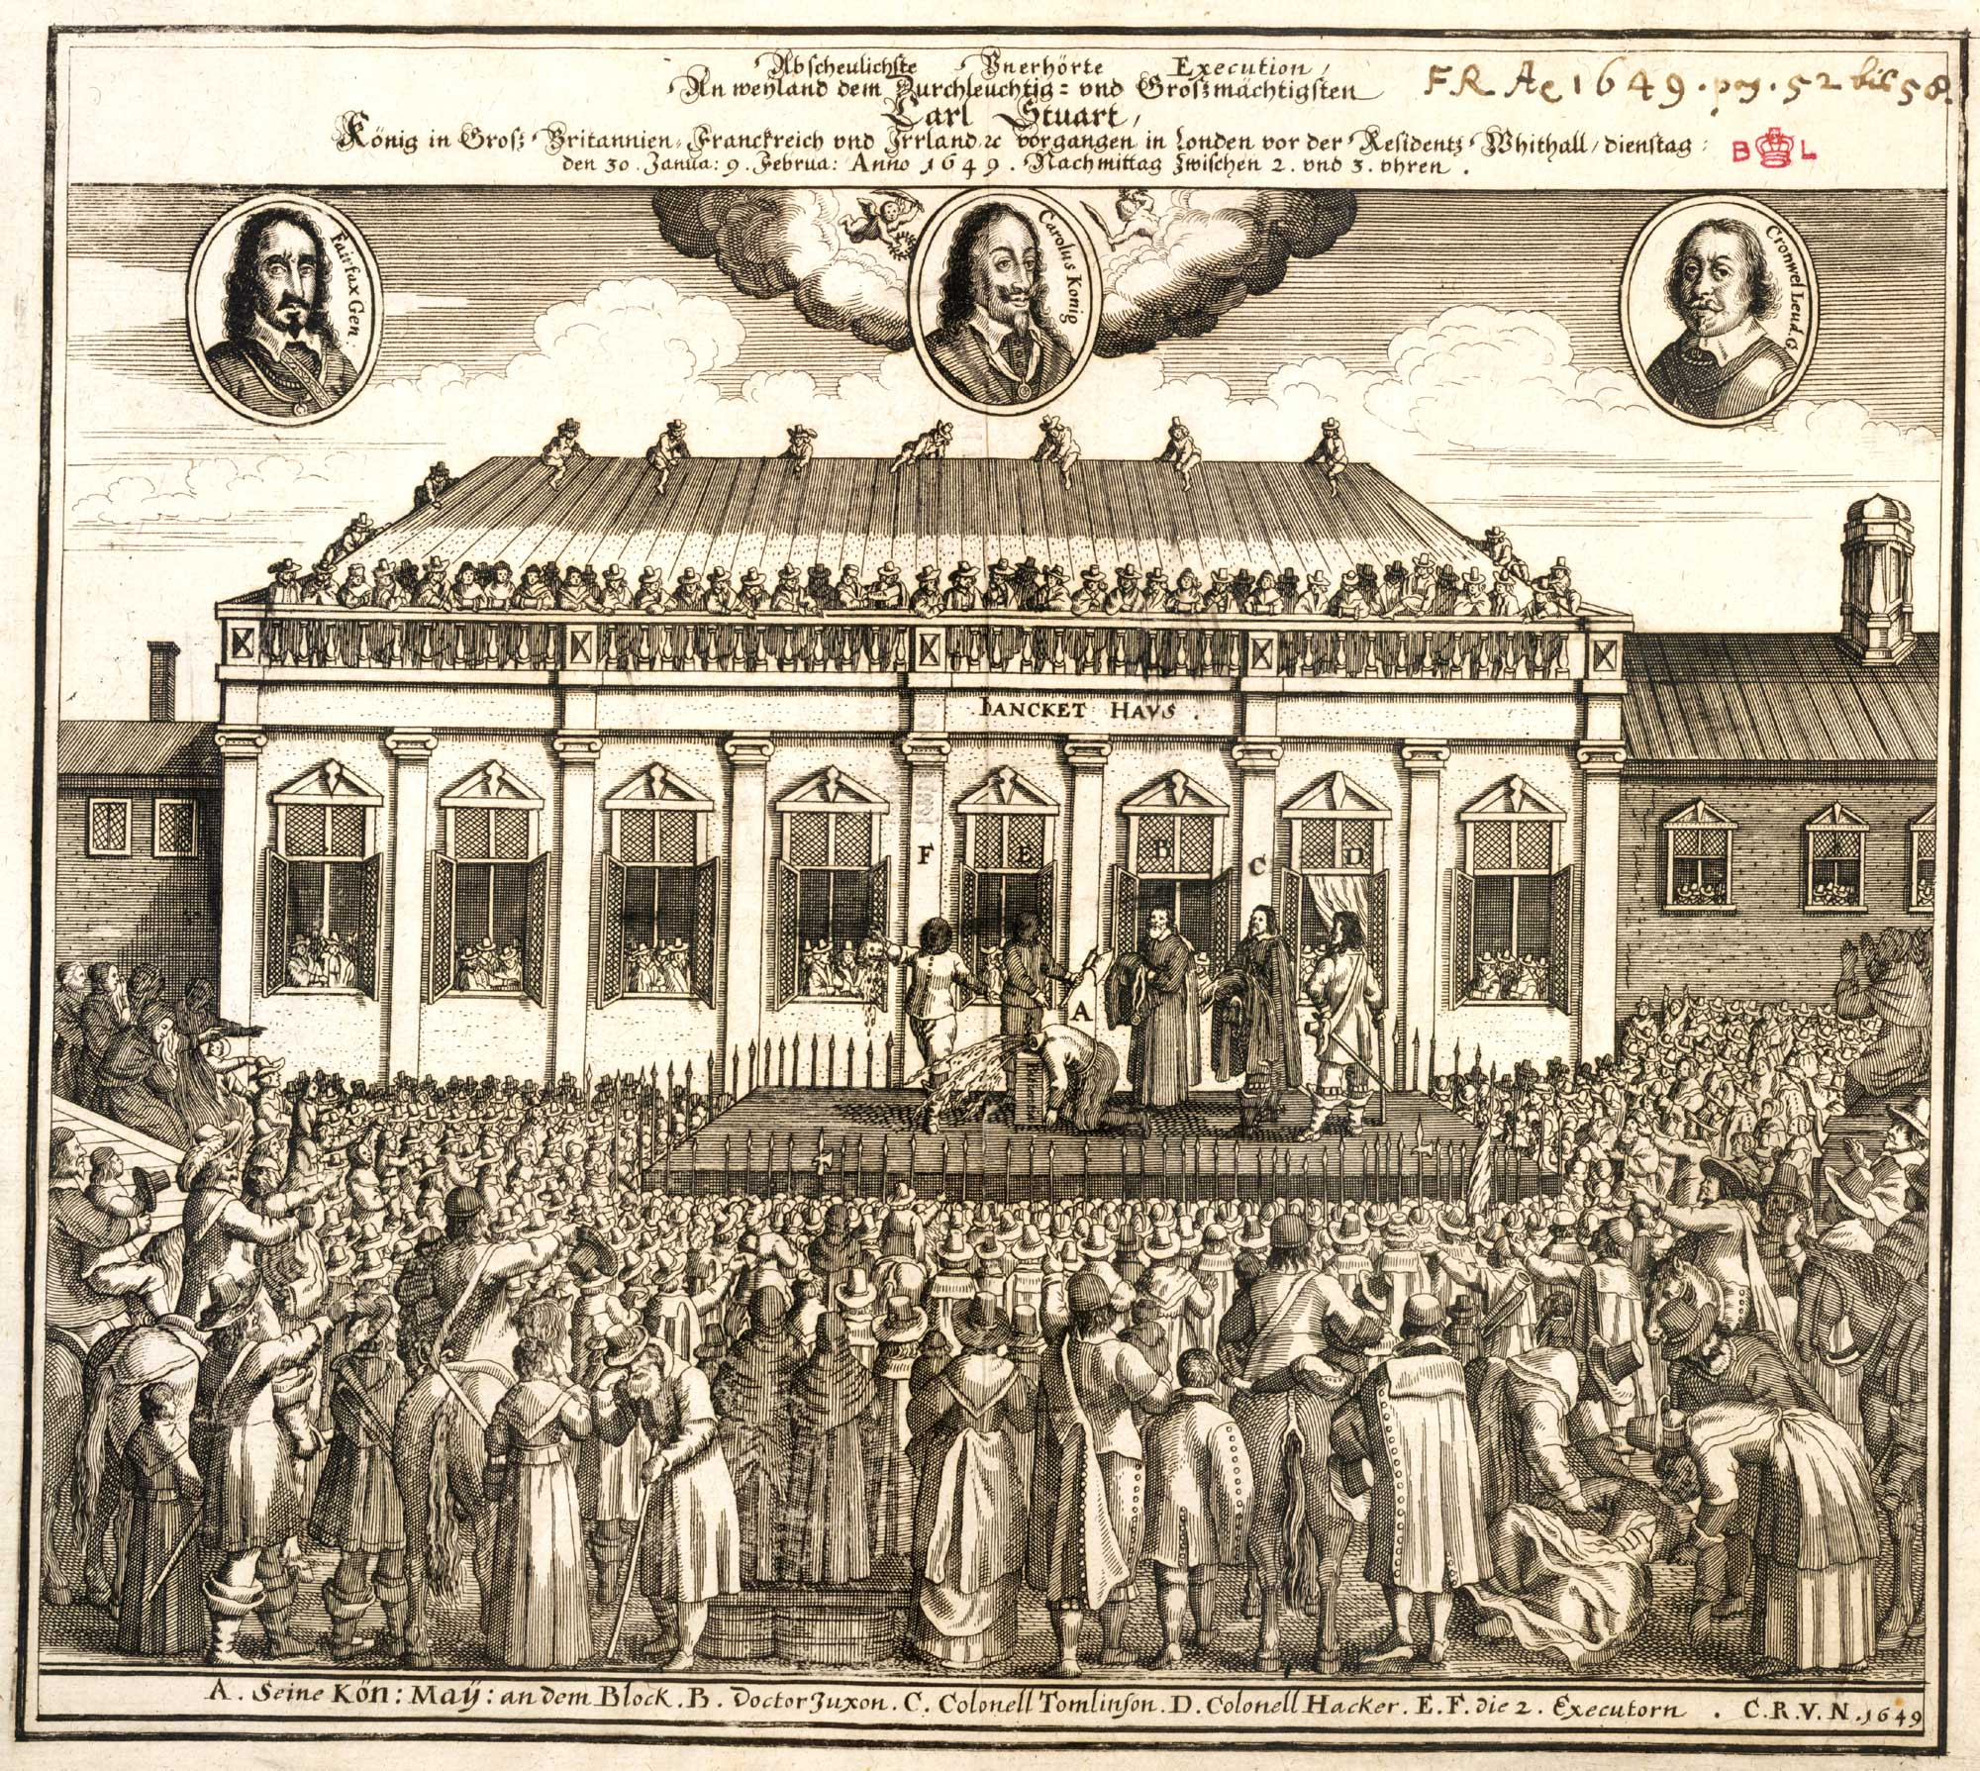
The execution of Charles I, 30 Jan. 1649

Slide 11
Conclusions?
Ordinary people active in political process: as petitioners and rioters; have knowledge of wider political climate
Custom and identity in popular politics.
Disproportionate gov. response reveals fragility of power

