Slide 1
The Radical Reformation
European World

Slide 2
Problems of Definition – Radical Reformation (G. H. Williams) as rejection
of magisterial (Mainstream) Reformation. But not end of ‘spectrum’ – distinctive ‘third force’
How did this identity come about?
What was distinctive about radicals’ beliefs; why were they so hated & feared?
Did they matter?

Slide 3
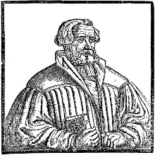
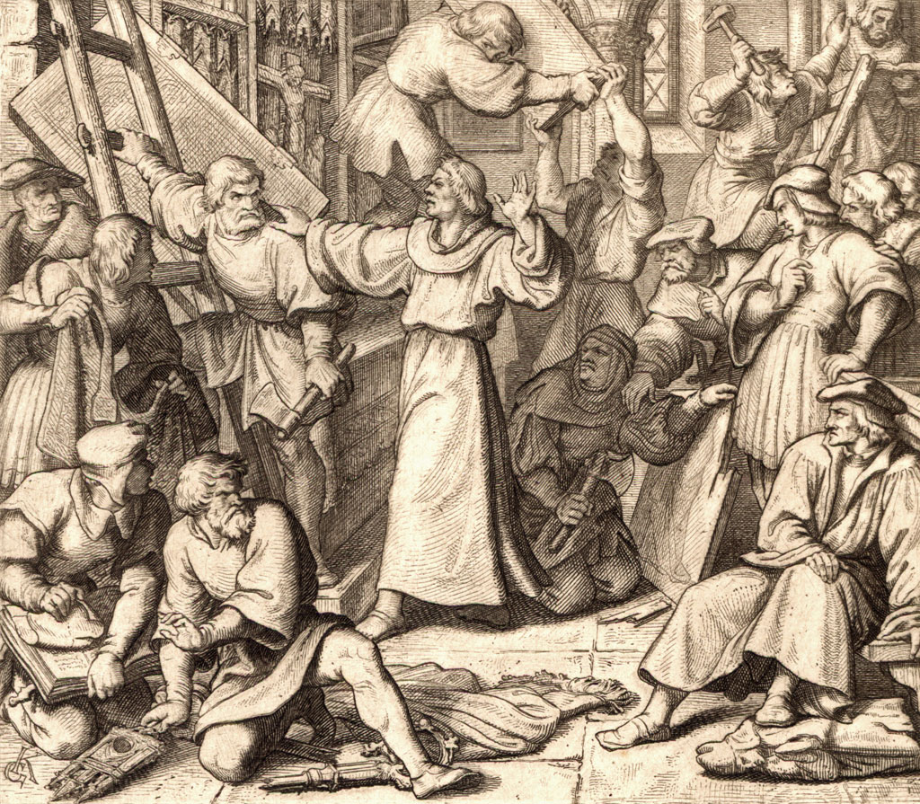
Luther’s first evangelical critic: Andreas von Karlstadt

Slide 4
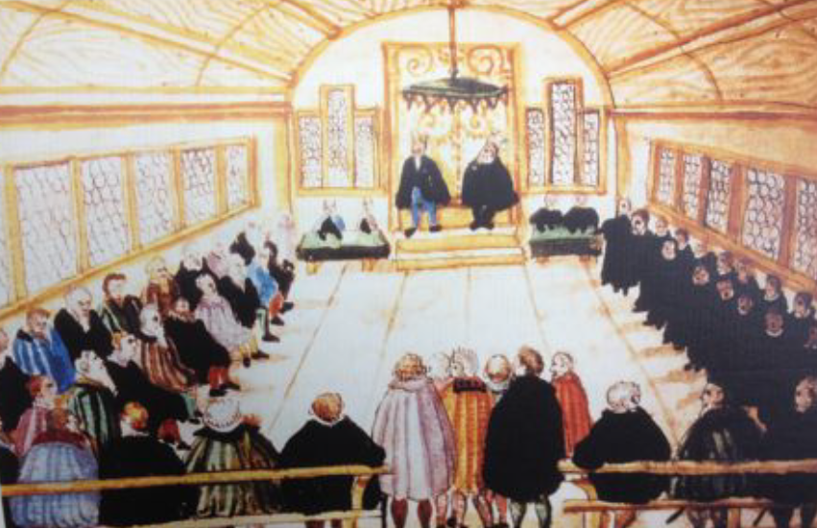
Zwingli disputes with Anabaptist leaders before Zurich city council, 1525

Slide 5
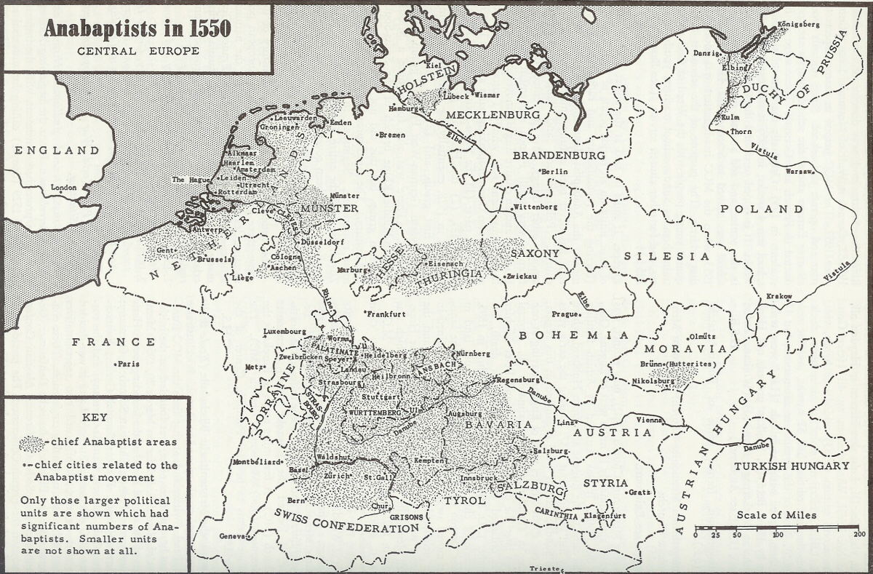

Slide 6
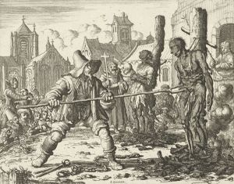
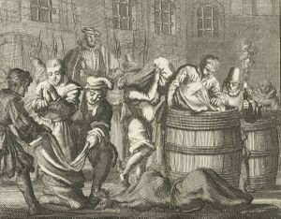
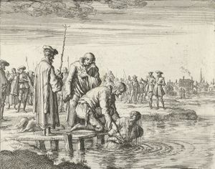
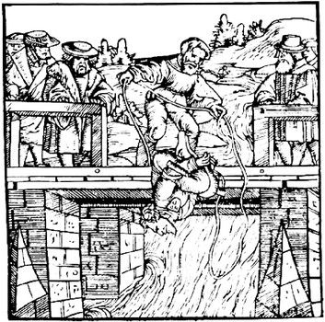
Anabaptist martyrdoms

Slide 7
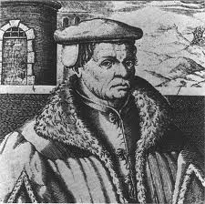
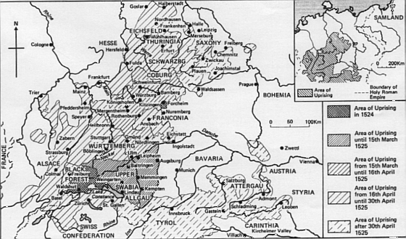
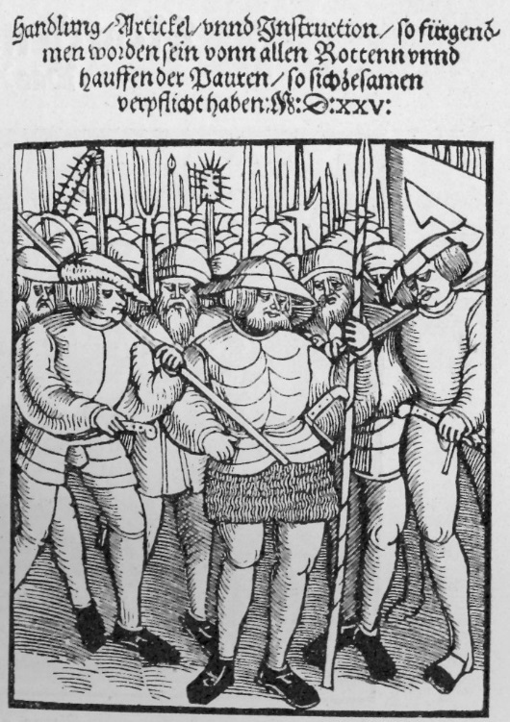
Thomas Müntzer and the German Peasants’ War

Slide 8
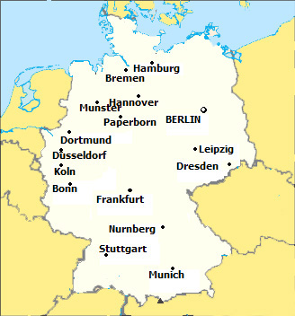
Anabaptist kingdom: Munster, 1535

Slide 9
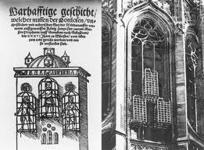
Reprisals at Munster: Anabaptist leaders tortured, executed, then raised in cages on city cathedral

Slide 10
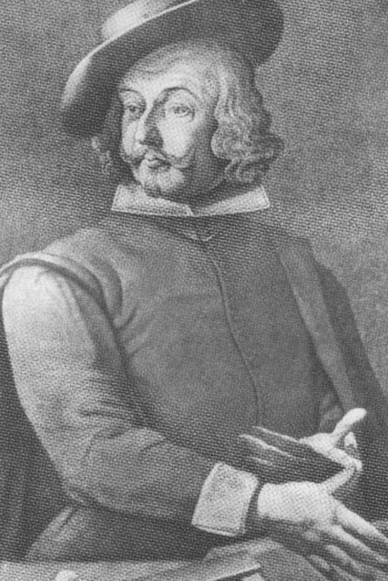
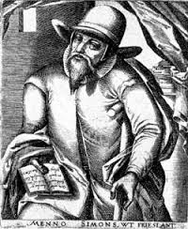
Peaceful Anabaptists: Mennonites and Hutterites
Menno Simons
Jacob Hutter

Slide 11
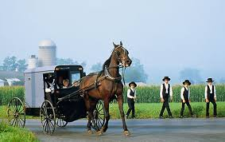

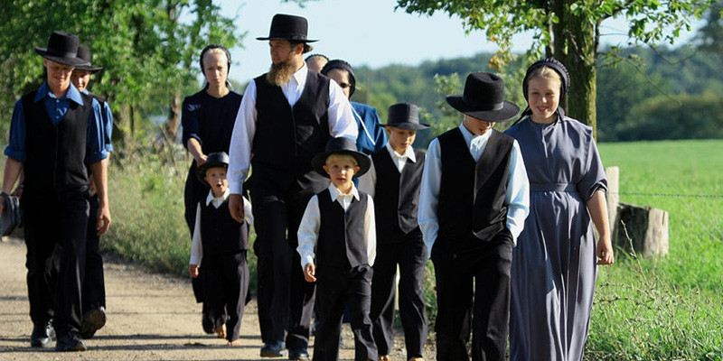
Anabaptist Legacy: The Amish in Pennsylvania

