Slide 1
The European World 1500-1750 Theme 4: Politics POPULAR POLITICS: THE VACANT SEE IN EARLY MODERN ROME Jonathan Davies (Powerpoint and handout are on the website)

Slide 2
… When the Capitoline bell sounded, the captain of my Rione . . . came to my house, since I was the caporione of Campitelli [the Rione in which the Capitol was located], with many soldiers and with two drums. Accompanied by them, I went to the Capitol, where a large crowd had gathered; ascending the stairs of the Senator's palace I went to the prisons, which were immediately opened and the keys turned over to me. I had all the prisoners come before me and, with the soldiers and drums, I went out followed by all the prisoners one by one. [Giacinto Gigli]

Slide 3
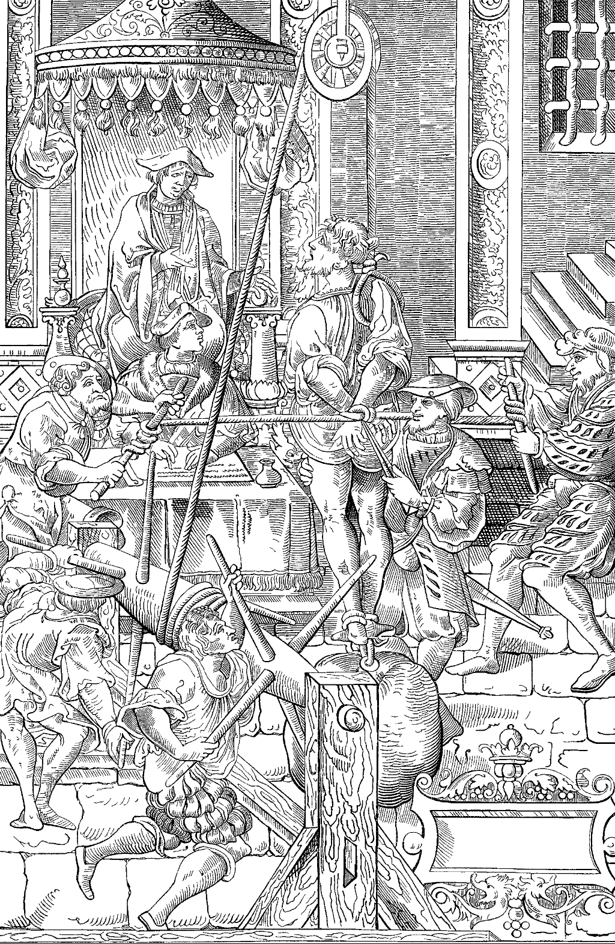

Slide 4
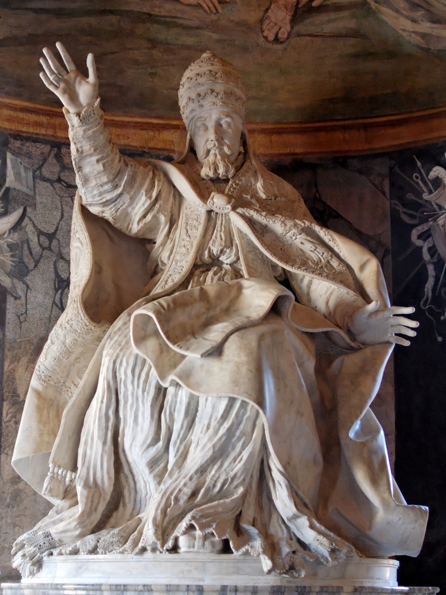
Gian Lorenzo Bernini, Pope Urban VIII, 1635-1640

Slide 5
… During [these weeks] the people vented themselves against dead Pope Urban VIII and the Barberini with injurious words and with the pen, writing of him every evil; wherewith were published an infinite number of compositions in Latin and in the vulgar tongue, in prose and in verse, so that I do not believe there has ever been anything like it. Some were bizarre and facetious, others satirical and stinging, and others too sharp and unworthy of a Christian. In sum, whoever had a fine wit and was an eloquent writer or good poet showed it in speaking ill of Urban and his nephews. [Giacinto Gigli]

