Slide 1
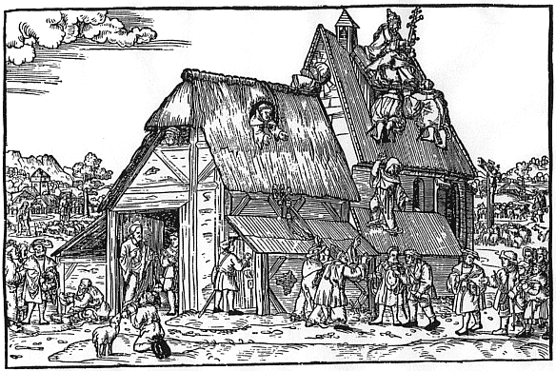

‘Germany in the Age of the Reformation’ – Lecture Week 1
The Political Landscape
of the Holy Roman Empire
Notes:
WELCOME TO OUR LECTURE SERIES FOR ‘GERMANY …’
UNUSUAL TIME WITH MANY CHALLENGES
BY BEGINNING OF WEEK YOU WILL FIND MATERIALS
THESE PROVIDE SOME BASIC INFO ON PROCESSES & HISTORIO AS A FRAMEWORK FOR CLASS DISCUSSION & PREPARATION FOR ASSIGNMENTS
PLEASE BRING ANY QUESTIONS & COMMENTS TO SEMINARS

Slide 2
OUTLINE OF PART I
1. Introduction to the Module
2. The Holy Roman Empire
Handout
Notes:
WE START WITH A SURVEY OF THE POL LANDSCAPE
PART I DEALS WITH THE SPATIAL SETTING, i.e. the HRE
ON THE PROGRAMME PAGE YOU FIND HO WITH MAIN POINTS & REFERENCES

Slide 3
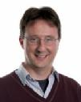

1. INTRODUCTION
Teaching Team
Module
Website
Beat Kümin
Maria Tauber
Notes:
So, WHAT KIND OF JOURNEY ARE WE EMBARKING ON?
Discovery of Reformation in its original homeland. We’re examining the rel upheaval which triggered the single most significant set of transformations in early modern Europe. Religion and confessional allegiance shaped the social, economic and political culture of the Continent for centuries to come. Last but not least, the protagonist of the German Reformation, Martin Luther, is universally recognised as one of the outstanding historical figures of all times.
In our MODULE, we focus on the late MA background, the dissemination of new religious ideas and socio-cultural impact of the Reformation. Over the course of the year, the programme is STRUCTURED in 4 parts: EVE of REFORMATION / REFORMATIO CULTURE / SOCIAL IMPACT / LEGACIES
WHAT ARE OUR INTENDED LEARNING OUTCOMES:
greater understanding of the importance of religion in early modern society and the socio-cultural impact of confessional change.
enhanced critical skills through evaluation of contrasting historiographical views (particularly by participating in debates and writing a book review).
better awareness of the contributions of different historical sub-disciplines –ecclesiastical history, sociology of religion, gender studies, and others – to an understanding of the Reformation.
PLEASE FAMILIARIZE YOURSELF WITH HI242 WEBSITE:
- INFO: Organizat, Assessment, Programme, Sem Materials
- RESOURCES: Printed + Digital, Teams Channel, FORUM
- Also TALIS reading list from UL
- OK – LET’S GO !

Slide 4
2. THE HOLY ROMAN EMPIRE
Definition and geography
Notes:
· Let’s start with basics: WHAT IS HOLY ROMAN EMPIRE OF GERM NATION? Name evokes: Christianity, Roman glory, shared lang.
ORIGINS: founded by Charlemagne [HO] in 800 (hence: claim to Euro-wide leadership of all Christians); then division into 3 parts 843.
MA LANDMARK: Golden Bull 1356 agreed by Ch IV and major princes = regulated election of the ‘King of the Romans’ by 7 Electors, who – at the same time – gained rights of jurisdiction and lordship over their territories (gradually expanded to other principalities); the document also regulated the ceremonial order and prohibited any leagues not explicitly formed for the preservat of peace
END: 1806 in wake of Napoleonic reorganization of Euro landscape.
WHAT HELD EMPIRE TOGETHER? 3 main bonds: RELIGION, FEUDALITY, INSTITUTIONS
1) CHRIST/CATH REL: up to 16thC still crowned by Pope (1530 Bologna)
2) FEUDAL TIES: various parts of Empire linked together by complex feudal relationships (Lehensverband). Empire like a pyramid, with Emperor at the top, and sequence of major and minor lords tied together in system of mutual obligations (grants of land in return for support and deference)
3) INSTITUTIONS: esp. IMPERIAL DIETS = chief pol forum for leading estates of realm and insitutionalized by late 15thC:
Members summoned by Emp to meet in major city such as Nuremberg, Regensbg or Augsbg
Diet meets in 3 ‘colleges’: 7 Electors / almost 100 Territ Princes / 87 free and imp. Cities [meet from 1471, with somewhat lower status / voting rights!]
Powers: granting tax and milit aid

Slide 5
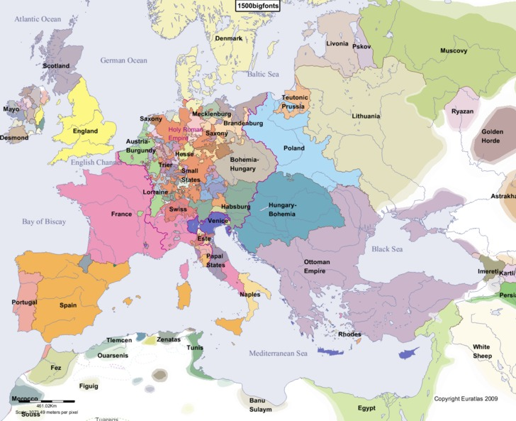
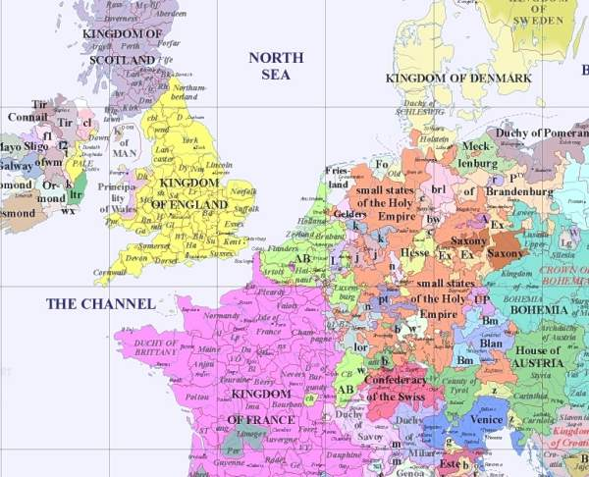
North-Western Europe in 1500
Notes:
Next, we need to familiarize with POLITICAL GEOGRAPHY:
BORDERS: somewhat hazily defined. Core area = present-day Germany, but also Austria, LUX, BEL, Netherlands, parts of Denmark, patches left of Rhine (Lorraine, Alsace); Bohemia / Moravia.
FORMALLY still MEMBERS, BUT by 16thC MARGINAL: Swiss Confederat (break from Swabian War of 1499); N-ITALY (‘Imperial Italy’ from Savoy via Milan to Venice, with feudal ties) more historically than in reality (IT ever more under Sp influence); NL (later Dutch Rep)
OUTSIDE altogether: Prussia, Hungary
GEN CHARACTER? enormously fragmented, some 400 units. Creates tensions, image of ‘failed nation state’, BUT also remark modern / multicultural ‘Europe of Regions’. Some hist like Georg Schmidt define it as ‘Complementary Empire State’, thus diff route to E/F who achieve higher centralizat.
NB: great PRESTIGE and diplomatic PREEMINENCE!

Slide 6
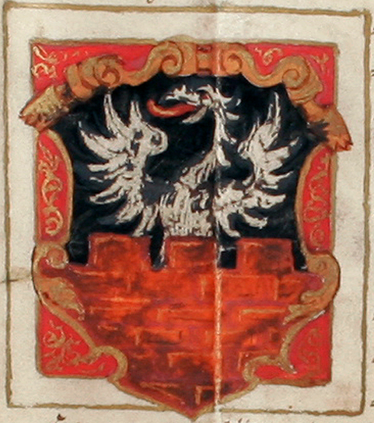
2. THE HOLY ROMAN EMPIRE
3 levels of political activity:
imperial, territorial, local
2 kinds of membership:
immediate and intermediate
Coat of arms of the imperial village
of Gochsheim (granted in 1568)
Notes:
Studying the Empire, we have to distinguish different levels of political activity and different kinds of membership:
3 LEVELS OF POL ACTIVITY:
IMPERIAL: central, empire-wide affairs (chiefly defence and foreign policy, dynastic issues, empire-wide legislation, highest law courts).
TERRITORIAL: politics within different member states
LOCAL: activities on level of individual manors, towns and villages
Alongside, another important distinction: 2 WAYS OF BELONGING TO EMPIRE, namely either in a DIRECT relationship or in one MEDIATED through another member:
a) UNITS DIRECTLY SUBJECTED TO EMPEROR KNOWN AS ‘immediate’ / reichsunmittelbar MEMBERS, I.E. TYPICALLY
TERRITORIAL PRINCES LIKE DUKE OF BAVARIA: real power rests here, most like ‘modern’ state authority, with strong princes and much autonomy.
b) UNITS INDIRECTLY RELATED TO EMPEROR KNOWN AS ‘intermediate’ MEMBERS: namely REGIONAL / LOCAL entities which are first and foremost SUBJECTED TO a TERRITORIAL LORD, e.g. a monastery within a principality, a manor of a nobleman or a territorial town.
[IMAGINE 3 LAYERS OF PYRAMID: Loc – Territ - Imp !!] COMPLEX, esp. considering period communicat !!

Slide 7
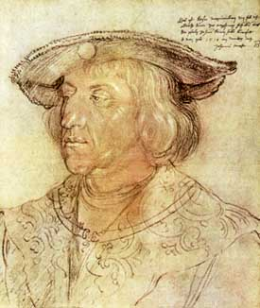
Albrecht
Dürer,
‘Emperor
Maximilian’
(1518)
‘[your image is] not rendered according to the content of our command and according to the exemplar that you have in your hand … so that we are greatly displeased’:
L. Silver, Marketing Maximilian, 2008, 84
imperial
Notes:
TOP LAYER=Emperors; very imp: get job NOT by inherit, but ELECT! Several dynasties involved in MA; from 1437 effect Habsbg monopoly.
Here last pre-Refo ruler MAXIMILIAN (1493-1519). His reign saw intensive involvement in Italian Wars and major reform efforts. Also renowed for his ‘modern’ PR concerns. Recent book on ‘Marketing Max’ by Larry Silver studies his representation and finds very delib patronage of arts, use of coins and printing press as PROPAGANDA to solidify Habsbg position and to present himself as worthy successor of Charlemagne + Caesar. He’s known to have told off court artists if their portraits did not conform to his instructions or ideals [READ quote]. This pic by no lesser figure than DÜRER = greatest artist of Northern Renaissance!
WHAT POWERS and PRIORITIES?
· a) PERS/FEUDAL: Emperor stands at the top of a complex pyramid of dependencies. As feudal overlord: prerogative of assigning vacant lands, creating nobles, defence of imp Church. Very strong personal bonds!
· b) DOMESTIC POL: Presides over his household and imperial law courts. He can summon IMP DIET to discuss and direct legislat, judicial, fiscal and milit affairs of Empire. Other powers include the banning of outlaws.
· c) FOREIGN RELATIONS: Like most Emp, Max wants to follow Charlemagne ideal, aspiring to rel and pol unity of Christendom, thus many foreign pol distractions. Key role in international diplomacy. Pursues successful dynastic marriage policy, ultimately resulting in the gain of Burgundy, Bohemia, Silesia and eventually Sp monarchy for his successor CHARLES V. Claim for German leadership in Europe, however, challenged by other nat ambitions (esp. F).
COMPLICATING FACTOR: Habsburg princes not only elected EMPERORS but also TERRITORIAL PRINCES with their own inherited lands to look after (Austria, Bohemia etc). CLASH OF INTERESTS = SOURCE OF TENSION
To carry out all these duties, access to a range of RESOURCES: income from territorial lands, revenue from feudal dues (mostly pawned by 15thC) and extraord income through taxation.

Slide 8
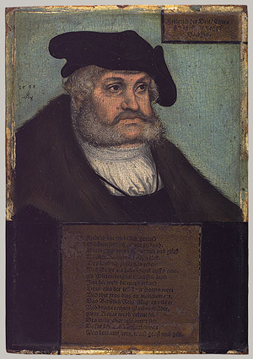
Lucas Cranach the Elder (attrib.),
Elector Frederick III the Wise of Saxony
(1533)
immediate
Notes:
NEXT LAYER DOWN = Principal sub-units or estates of Empire
One prominent example = SAXONY, here represented by Elector FREDERICK THE WISE = Representative of most important secular princes (= immediate territorial layer). We’ll encounter him as the crucial patron of early Luther.
The principal immediate ‘estates’ were composed of:
7 electors: Arch-Bfs of Trier, Mainz, Cologne + rulers of BOH, Ernestine SAX. BBG, Palat; have right to elect Emp and – from 1519 - negotiate his capitulation
other principalities like Bavaria or Hesse;
Imperial knights: small nobles wth estates directly sub Emp
imperial free cities like Augsburg / Nuremberg & some villages;
2 distinct government systems: monarchical, republican
Princes represent hierarch-vertic principle of feudal inequality [GESTURE!]
Cities & villages represent egalit-horizont principle of republican constitut
All units have separate instit: courts, diets and legal tribunals
All focus on securing peace and upholding law in their lands
All keen to protect own rights and privileges, so-called German ‘liberties’ (eg. Elector’s Privilege of Non-Appealing), and highly suspicious of any centralising attempts. Hence dualism of Emperor vs territorial princes/free cities one of fundamental characteristics and issues throughout the period, with balance gradually tipping in princes’ favour! Spare a thought for poor Maximilian trying to rule over 100s of heterogeneous units at time when mass medium of print only just invented!

Slide 9
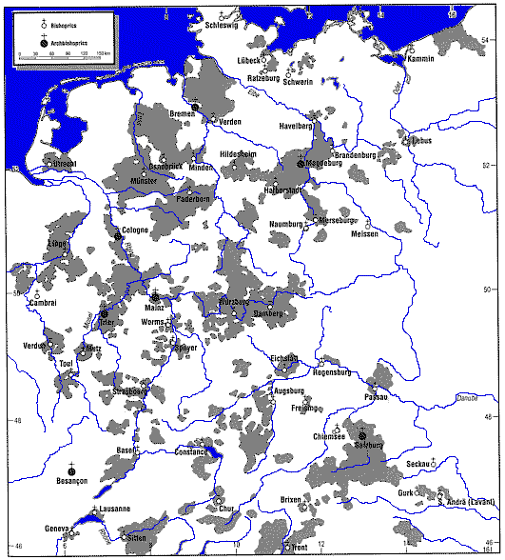
Ecclesiastical Territories in the Empire
immediate
Handout
Notes:
[Hans. J. Hillerbrand (ed.), The Oxford Encyclopaedia of the Reformation, vol. 4 (1996), 333]
Further COMPLICATING feature: within ranks of immediate estates not only SECULAR RULERS like Frederick the Wise, but also ECCLESIASTICAL TERRITORIES, i.e. units governed by prelates of the Catholic Church! Just see how many areas affected [Map also on HO]!
Most striking example of an ecclesiastical ruler, of course, POPE himself, who not only headed the Catholic Church, but also governed a stretch of lands in Central IT (papal state).
Within Empire itself, we find some 50 eccl princes (typically bishops exercising political authority over extensive territories) and 83 prelates (heads of rel houses with substantial lands over which they govern).
As you can imagine, the balance between spiritual duties and pragmatic politics was a difficult one to strike for the early modern clergy. Large eccl princes preoccupied by diplomatic and secular affairs in their own territory, rather than the spiritual welfare of their populations!
Fate of their status, land and wealth will become major issue in Reformation as well as Thirty Years War in 17thC

Slide 10
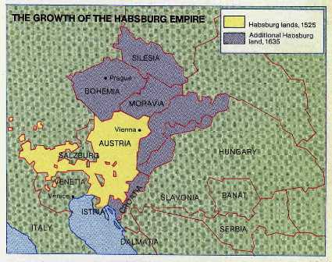
Composite Units within the Habsburg Territory
intermediate
Notes:
MOVING TO a more local/regional level and examples of INTERMEDIATE members, we could examine the various individual components of any of the main principalities.
In this case, we see a breakdown of the various distinct Habsburg possessions, namely Bohemia, Moravia, Silesia and Austria itself. All of these entities – as also territorial towns and smaller manors – are subject first and foremost to the Habsburg principality and thus only intermediate members of the Empire.

Slide 11
2. THE HOLY ROMAN EMPIRE
Political Life
Notes:
Moving next to key aspects of POLITICAL LIFE, the first thing we have to understand is that the:
Fundamental principle of EM pol organization was INEQUALITY, vertical organization, patronage and divine-right monarchy. Hence, no modern ‘democracy’, no emphasis on pol rights of individuals in general and women in particular!
BUT NOT THE FULL PICTURE: feudal bonds of reciprocity involve a degree of consensus and mutual obligation. Important decisions require consultation and enforcement dependent on active support of those affected. Alongside monarchical-feudal subordination also a tradition of collective-federal association, be it in the form of local political communities or federations like Switzerland and the League of the Hanseatic Cities.
THUS MIX OF VERTICAL AND HORIZONT TIES !!

Slide 12
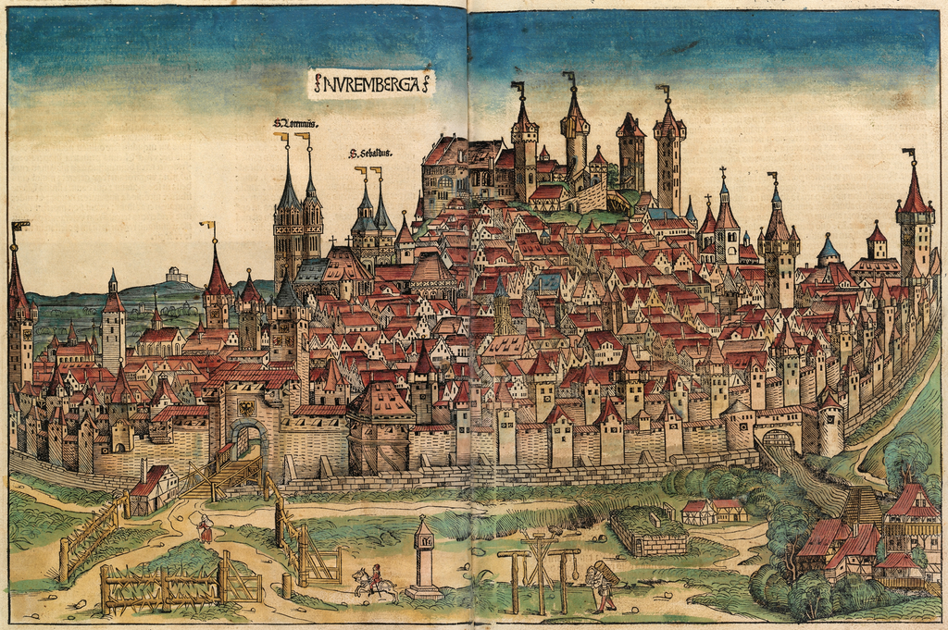
City of Nuremberg (Schedel’s World Chronicle, 1493)
urban
Notes:
Although they are in theory without formal influence, members of the 3rd estate (i.e. common people) are by no means politically inactive.
One factor which allowed pol agency to a wider cross-section of the populat was the rise of urban communes in late ma D. By 1500, 65 had reached the highest rank of ‘imperial free cities’ with extensive self-government and autonomy.
EXAMPLE here: Nuremberg, a leading trade metropolis in early 16thC! So here, no direct noble or princely rule, but:
GOVERNMENT typically based on householder assembly which takes basic decisions. For everyday affairs election of a large council (200 members), for executive business a small council (executive of c. 24). Figurehead= mayor
ILLUSTRATION taken from Nuremberg Chronicle by the Nuremberg humanist Hartmann Schedel contains 3 telling symbolic messages: [CLICK] (1) towering role of rel, with 2 main churches, St Sebald and St Lorenz, highlighted by name; (2) distinct topographical and architectural setting demarcated by encircling town walls. Plus (3) note the gallows in the foreground, sign of the city’s pol and legal autonomy.
REPRESENTAT OF GROWING CIVIC PRIDE AND ASSERTION !! Another imp factor behind Refo !!

Slide 13
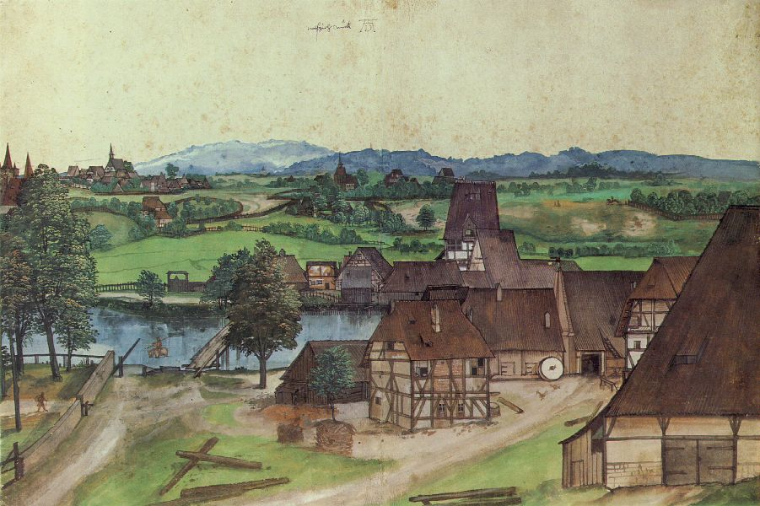
Albrecht Dürer, ‘Wiredrawing Mill’ (drawing, 1489)
rural
Notes:
Yet overwhelming majority of people live in RURAL AREAS:
In the countryside, main units are VILLAGES – typically under the rule of a noble LoM or monastery but also with a degree of communal power, e.g. over agricultural organization and local administration. For that, like in towns, they elect officials, hold assemblies and represent their interests through petitions and (in most serious cases) rebellions.
So much for structure of HRE: From this preliminary survey, let’s remember
Dominance of monarchical government (with republican alternative in cities)
Highly fragmented and complex character of pol organisation
3 main layers of pol activity (imperial, territorial, local) and 2 ways of belonging (immediate, intermediate)
A degree of popular infl in towns, villages, diets and rebellions.
THIS CONLUDES PART I OF POL LANDSCAPE

