Slide 1
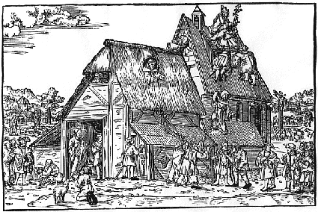
Reformation, Politics & Rebellion
Writing Workshop
EVALUATION

Slide 2
General Conclusions
Range of resources, utility for essays ...
Items

Slide 3
Workshop Format
Arrangement, Content, Outcomes ...
Items

Slide 4
Other Comments
Items

