Slide 1
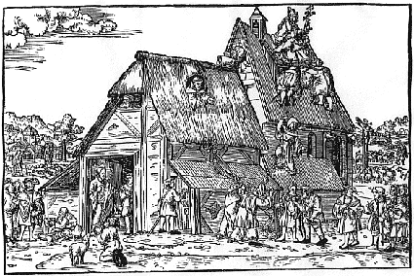
Reformation, Politics & Rebellion
Reformation Writing Workshop
Group:
Topic:

Slide 2
Conclusions

