Slide 1
Women and Politics after 1850

Slide 2
Overview
Women and Local Government
Women and the Liberal Party
Women and the Conservative Party
Women and Socialism
Conclusion

Slide 3
Local Government
Population growth and increasing urbanisation prompted reforms in local government:
Poor Law Amendment Acts in 1834 and 1844 established Boards of Guardians elected annually to administer the new Poor Law.
Municipal Corporation Act of 1835 reformed the government of around 200 towns and cities, replacing municipal corporations with elected councils.
Local Government Act in 1888 reformed rural government providing for county councils.
1870 Education Act set up 2000 elected school boards in England and Wales (extended to Scotland in 1872)

Slide 4
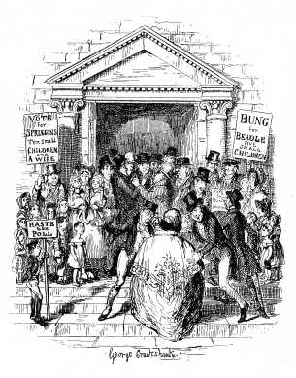
Dickens parodied the notion of women’s voters in local government
‘The Election for Beadle’ by George Cruikshank, front flypage in Charles Dickens, Sketches by Boz

Slide 5
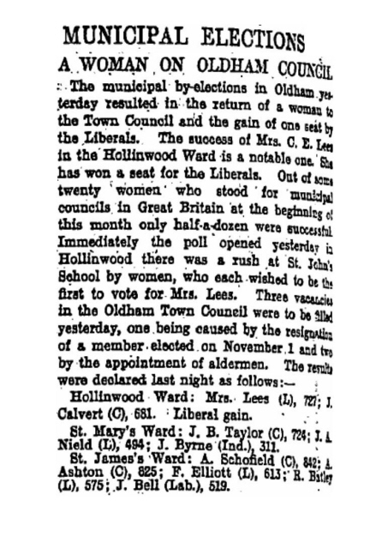
First woman, Mrs Constance Lees, to be elected to Oldham Council in 1907

Slide 6
School Boards
Eleven women elected at the first school board contests in 1870
By 1902 when the school boards were abolished in England and Wales there were around 370 women members.
In Scotland 17 women were elected in the first school board elections in 1873
Some observers were concerned about women standing for election others argued feminine influence on school boards was desirable
Most candidates had considerable educational experience

Slide 7
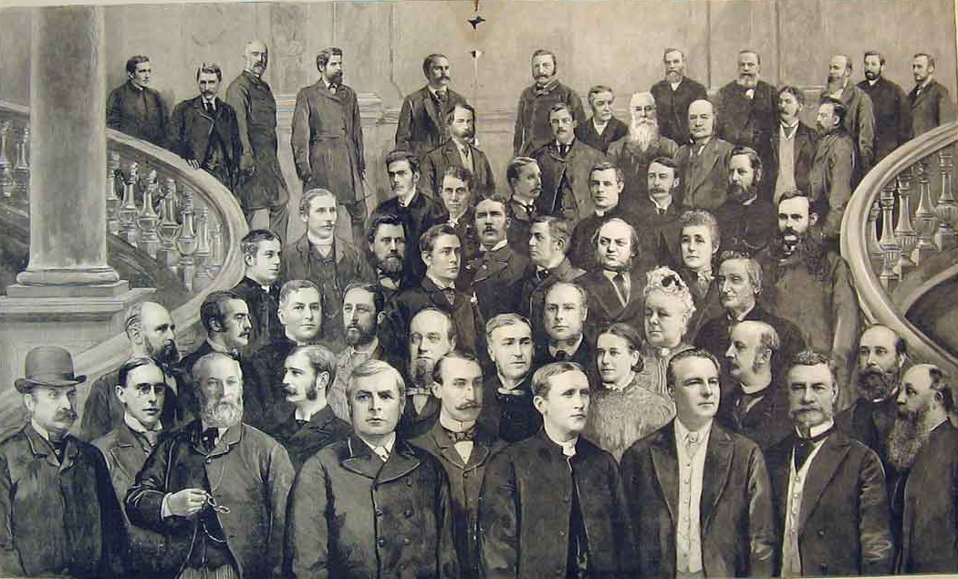
The First London School Board

Slide 8
Boards of Guardians
Boards of Guardians administered the Poor Law
Guardians dealt with the mentally unstable, the morally suspect, and the workhouse
1875 first woman, Martha Merrington, was elected as a poor law guardian
Many male guardians argued that women were unsuited because of the subjects that would be discussed.
Women countered that managing workhouses was akin to household management
Numbers of guardians rose steadily to around 900 by 1895

Slide 9
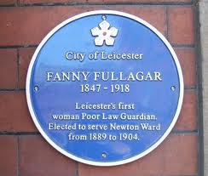
Why should women be on a Board of Guardians?
Because the larger number of Paupers are women and children. Because the care of the poor, the aged, the sick, and the miserable devolves on Guardians. An important part of the work of Guardians is the election of nurses and female servants. In the great matters of housekeeping, clothing, and education the matron and the house committee are obviously entitled to the assistance of WOMEN GUARDIANS.
Campaign poster from Louisa Edwards, St Pauls Parish, Bedford, 1887

Slide 10
Councillors
London County Council established as a result of the 1888 County Councils Act.
The 118 councillors were elected by household suffrage with female ratepayers eligible to vote
New County Councils Act stated that ‘every person shall be qualified to be a councillor who is qualified to elect to the office of a councillor’.
The Society for Promoting the Return of Women as County Councillors put forward Jane Cobden as a Progressive candidate in Bow and Bromley, with Lady Sandhurst standing for Brixton. Both women were elected and the Council then co-opted Emma Cons a prominent Liberal philanthropist as an alderman.

Slide 11
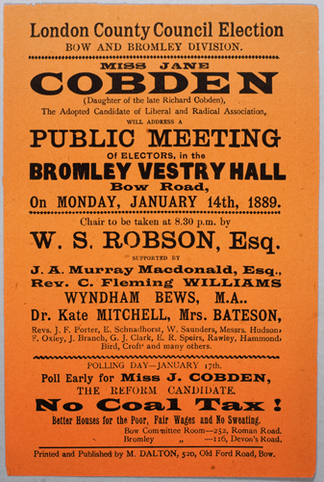

Slide 12
Knowing that the Council, as a body, did not wish to exclude women from their rights of citizenship, I have done my best to justify the confidence they placed in me by serving them to the best of my ability during the past year, though under extremely disadvantageous circumstances… My feelings on the subject of women councillors are as strong as ever, and I shall neglect no means in my power to secure a perfect freedom of choice to the ratepayers, and equal municipal rights for women as for men. It is a bitter experience when one for the first time fully realizes that even a long life spent in the service of one’s fellow citizens is powerless to blot out the disgrace and crime (in the eyes of the law) of having been born a woman.
Emma Cons

Slide 13
Women and Liberal Party
National Liberal Federation established in 1887
Westminster Review reported that over 10,000 women joined local groups
In 1886, Sophia Fry drew local associations into a single affiliate organisation
Catherine Gladstone was its figurehead president
Membership was 75,000 in 1892, peaking at 133,215 in 837 local associations in 1912
Aimed to be inclusive and attract a diverse membership
Local branch subscriptions were kept low and could be waived for less affluent members.
Women with more radical views and working-class activists were not tempted to join instead joining local socialist groups

Slide 14
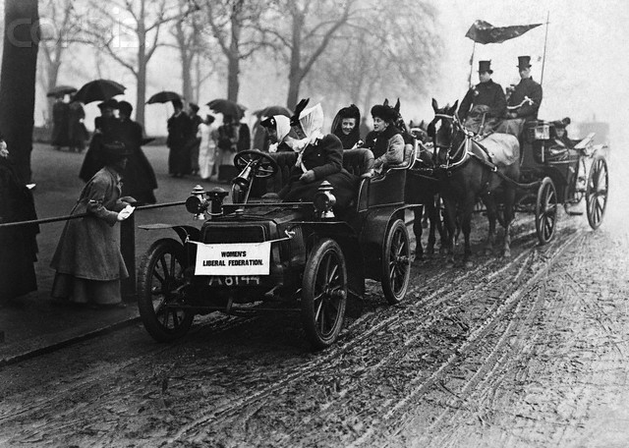

Slide 15
Women and Conservatism
After 1918 success of the Conservative party in electoral terms was due to female members and voters
Gerry Maguire cautioned history of feminism should not be the history of left-wing feminism alone
Attractions of conservatism for many female activists included imperialism and maternalist policies
Female conservatives wary of being labelled as women’s rights campaigners
Emily Davies and Frances Power Cobbe preferred quiet lobbying rather than mass meetings

Slide 16
Primrose League
Primrose League characterised by Martin Pugh as a party within a party
Founded in 1883 in England and 1884 in Scotland
Had a vague ideology of defending tradition which focused around crown, church and empire
League embraced medieval terms and language: branches were termed habitations and members Knights or Dames. It was ruled by a Grand Council and members paid an annual tribute rather than a membership fee
By the early 20th century membership exceeded 1 million
By 1892 the Ladies Grand Council had its own touring propaganda van. Primrose Cycling Corps enabled women to undertake mobile propaganda closer to home.
Suffrage issue divided Conservative women, just as it did Liberals.
In 1908 a group of suffragists formed the Conservative and Unionist Women’s Franchise Association

Slide 17
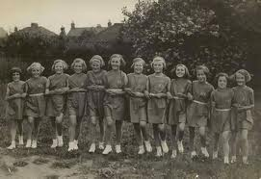
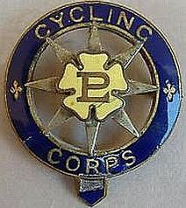
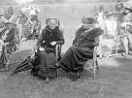
Primrose League Cycling Corps badge
The Headington Buds (junior Primrose League group)
Primrose League tea party

Slide 18
Women and Socialism
Socialist views shaped by international discussions on the woman question which led to equal structures being established in the Independent Labour Party and Social Democratic Federation.
Socialist women demanded inclusion in politics on more radical terms than those used by Conservative or Liberal women.
But equality difficult to achieve: Hannah Mitchell said embarking on political activism was like having to work ‘with one hand tied behind us’. Women rarely took on key branch roles
Key discussion was if there should be separate women’s organisations. Women’s groups began to attach to local branches of the ILP and SDF in the 1890s.
Women’s Labour League founded in 1906 had 100 branches by 1911. This was founded by Mary Fenton McPherson who was active in the Railway Women’s Guild an organisation for the female relatives of unionised railwaymen.

Slide 19
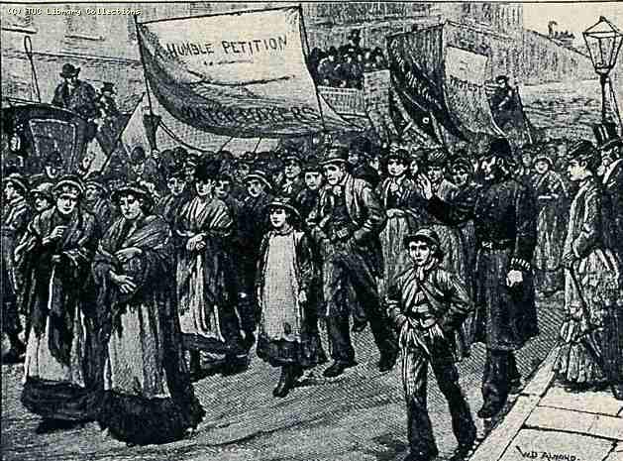
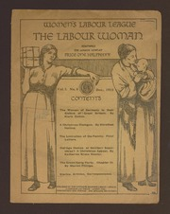
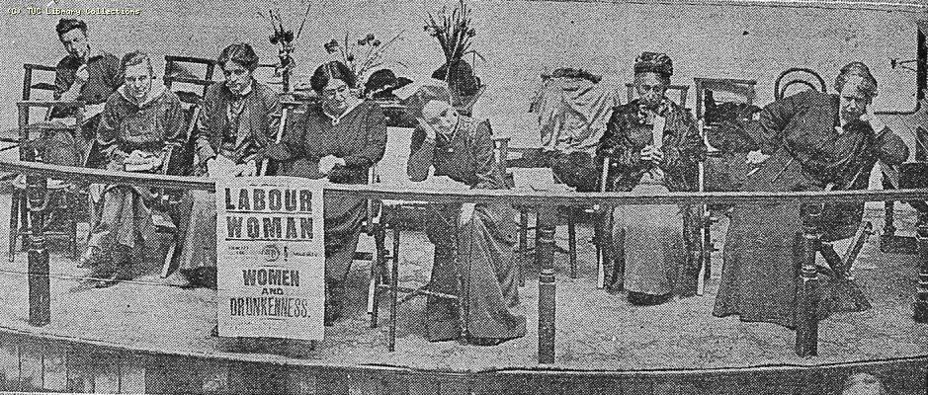
Bryant and May Match Girls Strike 1888
Women’s Labour League Conference 1916 (left) and pamphlet (above)

Slide 20
Conclusion
Women’s political activism due to rising number of parliamentary voters after the Reform Acts of 1832, 1867 and 1884; rise in local government organisations; rise in contested elections and transformation of political parties
Women remained outside the political establishment but had more opportunities to engage in collective political activism
Political activism dominated by middle-class and elite women
Philanthropic work bridge to local government
Women drawn to suffrage campaigns as they became acutely aware of the lack of women’s political rights and the limitations of their activism

