Slide 1
Slavery and Abolition
Sarah Richardson

Slide 2
Slavery
Slave trade defined as the enforced migration of people across national boundaries over long distances to bondage in a different setting
Ancient empires of Egypt, Greece and Rome all utilised slave labour
Within Europe Portugal and Spain had a slave trade by the sixteenth century.
English began to exploit the possibilities of slave labour after 1580

Slide 3
British Empire
England settled colonies in West Indies and North America from the seventeenth century onwards.
Initially scattered along the eastern seaboard of North America and throughout the Caribbean
Later acquired Jamaica and American territories in Carolina, East and West Jersey and Pennsylvania.
Colonies = markets for manufactured goods and providers of raw materials
Large agricultural plantations were the most cost-effective way of maximising output.
Transatlantic slave trade offered answer to need for labour

Slide 4
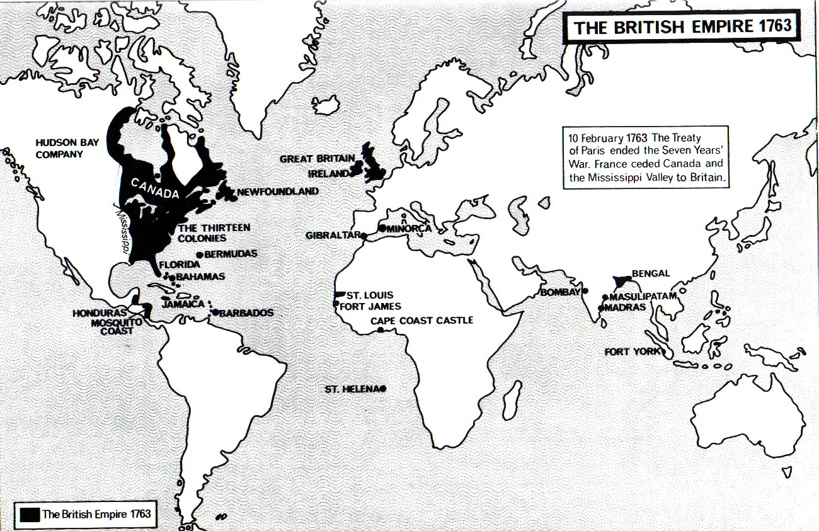

Slide 5
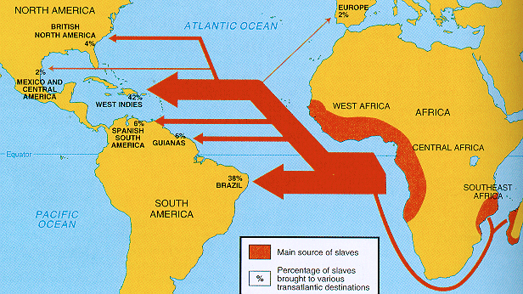
Atlantic Slave Trade
Economic and Racial factors
c.12m Africans transported, 1500-1900
Only 5% to North America
Up to 25% mortality during voyage

Slide 6
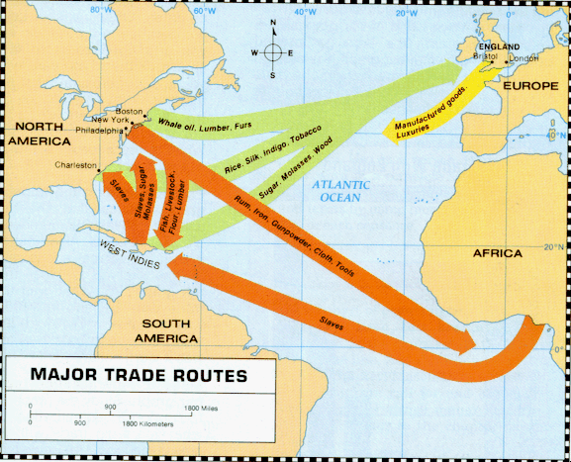
Triangular Trade

Slide 7
Justifications
Economic: need for labour on plantations
Plantations in America produced rice and tobacco. In British Caribbean mainly produced sugar although some produced coffee
Cultural: based on blatant racial prejudice against black Africans
Justified because of its presence in the ancient world and in the scriptures.
Hobbes and Locke both accepted slavery
But helped that slaves generally resided overseas. Thus values of freedom and liberty could be upheld on English soil

Slide 8

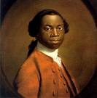
Slave Life
Apart from uncertainty about his early years, everything Olaudah Equiano describes in his autobiography The Interesting Narrative of the Life of Olaudah Equiano or Gustavus Vassa, the African can be verified. In 1786 he became involved in the movement to abolish slavery as a prominent member of the 'Sons of Africa', a group of 12 black men who campaigned for abolition. In 1792 he married an Englishwoman, Susanna Cullen, and they had two daughters. Equiano died on 31 March 1797.

Slide 9
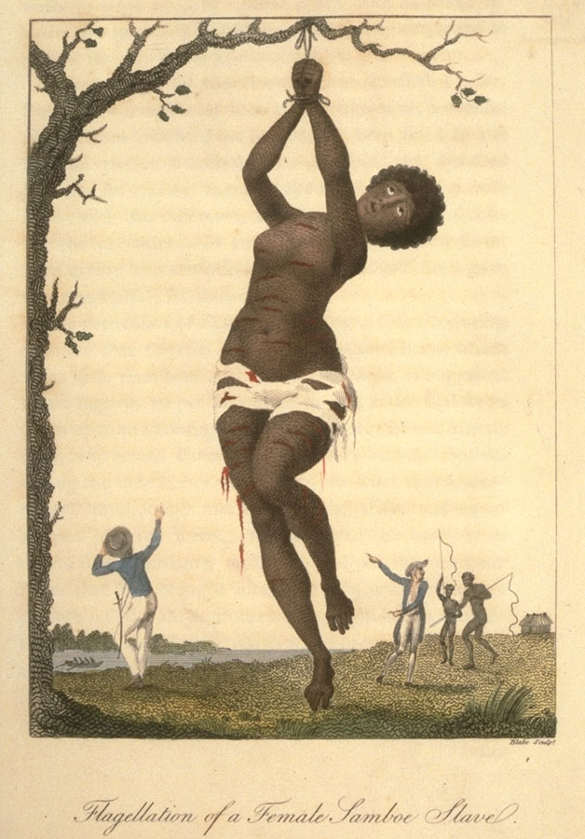
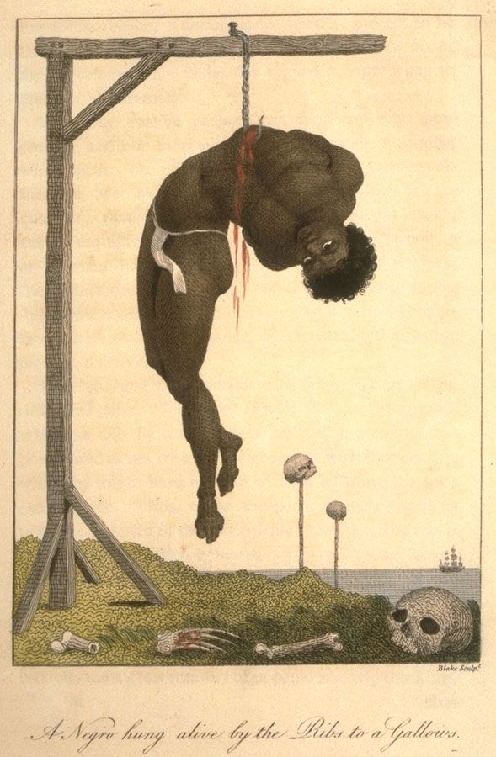

Slide 10
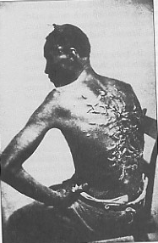
A brutally beaten slave with heavy scarring on his back, (Photograph taken in 1863. From the US National Archives)

Slide 11
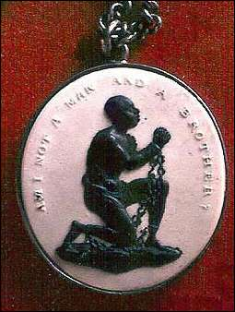
Josiah Wedgwood’s famous medallion: ‘Am I not a man and a brother?’

Slide 12
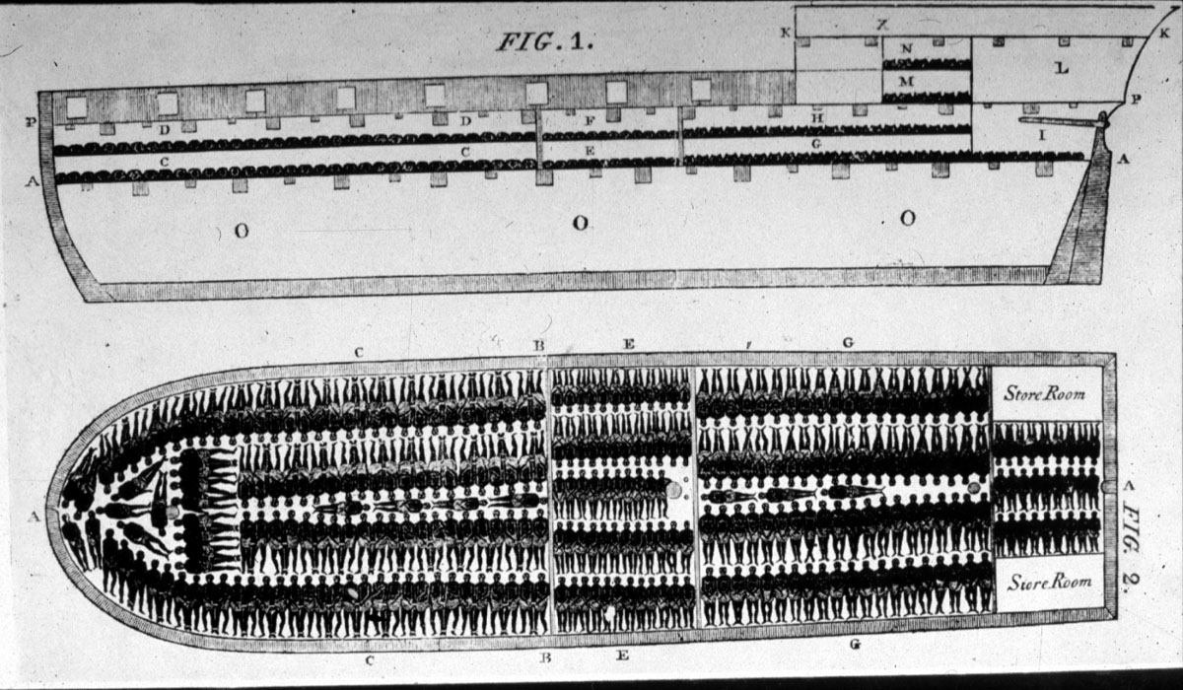
Plan of the Liverpool slave ship, the Brookes

Slide 13
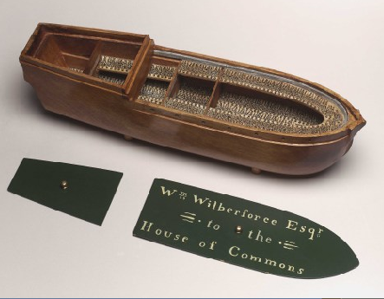
Wilberforce had a model of the Brookes made as evidence to the Commons

Slide 14
Abolitionist tactics
Petitioning movement. Between 1787 and 1792 petitions were signed by 1.5 million people in Britain (almost 1/6 of the total population)
Abolitionists established a free black colony in Sierra Leone
Outpouring of anti-slavery tracts, hymns, novels, poems and pamphlets.
Two leading members of the black community in London: Olaudah Equiano and Ottabah Cugoano also publicised the movement.
Equiano wrote a best-selling autobiography and Cugoano authored Thoughts and Sentiments which described the afflictions of the black people.
Art forms propagated the message including tokens, medals, engravings and paintings.

Slide 15
Women & Anti-slavery
Historians and literary critics have recently begun to recover the significant part played by women
Recovery rewrites history of the anti-slavery movement and our understanding of gender roles in the late-18th and early 19th centuries.
According to Vron Ware it also provides an arena to trace the connections that women themselves made between the social relations of race, class and gender.

Slide 16
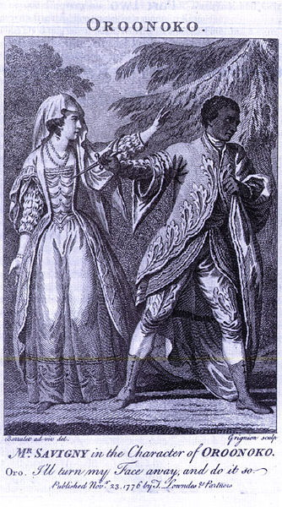
Aphra Behn's novel, Oroonoko - or the Royal Slave which was published in 1678, the first novel to be published in English by a woman. Behn changed the way in which black slaves were treated in literature and by the public
Women writers' interest in the issues raised by the existence of slavery in a number of sentimental novels and poems which stress the benevolence of the West Indian planters, sometimes contrasting their humane masculinity with figures of feminine corruption and ignorance.

Slide 17
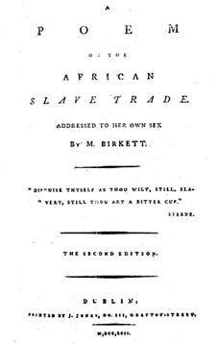
Mary Birkett Card, A Poem on the African Slave Trade. Addressed to her own Sex
So tides of wealth by peace and justice got,
Oh, philanthropic heart! will be thy lot.
Plant there our colonies, and to their soul,
Declare the God who form'd this boundless whole;
Improve their manners - teach them how to live,
To them the useful lore of science give;
So shall with us their praise and glory rest,
And we in blessing be supremely blest;
For 'tis a duty which we surely owe,
We to the Romans were what to us Afric now.
Hibernian fair, who own compassion’s sway,
Scorn not a younger sister’s artless lay;
To you the Muse would raise her daring song,
For Mercy’s softest beams to you belong;
To you the sympathetic sigh is known,
And Charity’s sweet lustre - all your own;
To you gall'd Mis'ry seldom pleads in vain,
Oh, let us rise and burst the Negro’s chain!
Yes, sisters, yes, to us the task belongs,
'Tis we increase or mitigate their wrongs.
If we the produce of their toils refuse,
If we no more the blood-stain'd lux’ry choose;

Slide 18
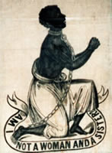
Wedgwood’s cameo of 1828: ‘Am I not a woman and a sister?’

Slide 19
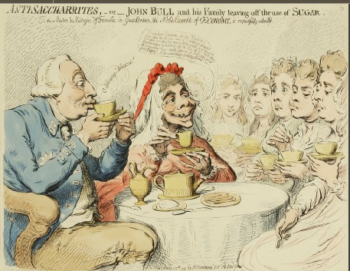
George III was opposed to abolition. Gillray's cartoon hints the king was more interested in saving money than promoting the abolition of the slave trade:
‘… you'll save the poor Blackamoors by leaving off the use of it! and above all, remember how much expence it will save your poor Papa!’

Slide 20
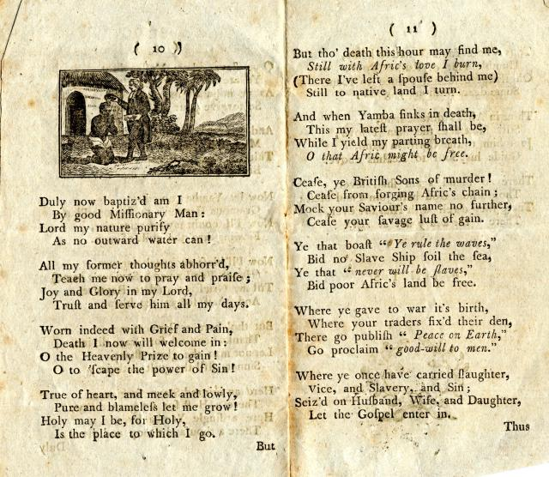
Hannah More, Sorrows of Yamba
Cease, ye British Sons of murder!
Cease from forging Afric's Chain;
Mock your Saviour's name no further,
Cease your savage lust of gain.
Ye that boast "Ye rule the waves,"
Bid no Slave Ship soil the sea,
Ye that "never will be slaves,"
Bid poor Afric's land be free.
Where ye gave to war it's birth,
Where your traders fix'd their den,
There go publish "Peace on Earth,"
Go proclaim "good-will to men."
Where ye once have carried slaughter,
Vice, and Slavery, and Sin;
Seiz'd on Husband, Wife, and Daughter,
Let the Gospel enter in.

Slide 21
Women’s Activism
Women played extensive role in anti-slavery ladies' associations, through involvement in widespread national petitioning, and in their writing and campaigning.
Between 1825 and 1833 at least 73 such ladies associations were active.
Such associations had as their models middle-class pressure groups, and philanthropic and charitable societies.
Birmingham society appointed its own paid agents, all men, as travelling anti-slavery lecturers.
Raised money for relief and educational work eg Sunday schools, female refuges, the purchase of books, benevolent societies for the black populations of the British West Indies. They also gave funds to help individual slaves and free black men and women. Their work was often linked to missionary activity, although they were anxious also to maintain their primary aim, the abolition of slavery.

Slide 22
Elizabeth Heyrick
Leicester Quaker and District Treasurer for the Female Society of Birmingham.
She was deeply involved in the renewal of the campaign to abstain from sugar, and urged ladies associations to promote abstention from sugar and force planters to move from slaves to free labour.
In her pamphlet Immediate, not Gradual Abolition; or an Inquiry into the shortest, safest, and most effectual means of getting rid of West-Indian Slavery written in 1824, she called for immediate action through mass abstention, attacking the leadership for placing political expediency ahead of Christian principles and the natural rights of all.
Followed up her pamphlet by personally carrying out a door-to-door survey of households in her home town of Leicester finding support for the idea of a consumer boycott. Many of the ladies associations followed her call and finally from 1830, the national policy shifted.

Slide 23
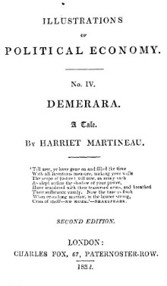
Post-1830s
National female petition in 1833 with 187,000 signatures
Cultural movement including Rawson’s collection of poetry Bow in the Cloud (1834)
Links with feminism? But also natural rights; free market labour eg Martineau

Slide 24
Conclusion
The slave trade was a key part of Britain’s economy for over two centuries
Trade was primarily a private enterprise
Supported for economic, cultural & intellectual reasons
Abolition response to changed intellectual climate
Movement for abolition developed strategies for pressure group politics. Women were key part of later anti-slavery campaign
Reasons for abolition: economic? Changed intellectual/cultural climate? International context? Humanitarianism?

