Slide 1

Gender, Industrialisation and Employment
Week 7

Slide 2
Overview
Significance
Impact of Industrialisation.
Diversity
  Regional variations
  Class
  Masculinity
Primary Sources

Slide 3




Significance

Slide 4
Gender in the workplace today
  47% UK workforce.
  57% of graduates with 1st
  63% girls achieve 5A* at GCSE (54% boys)
  1 in 3 female graduates studied health or education (1 in 11 men)
  YET…
  Male graduates will earn on average 20% more than female counterpart.
  28,000 successful equal pay claims each year.
  10,000 sex discrimination claims.
  29% MP’s, 9.2% Professors, 17% FTSE 100 directors.
(www.bitc.org)

Slide 5
Politicisation
  Working mothers
  Female capability
  Suffrage (L.A. Tilly)
  Unemployed men
Notes:
38% of working women have children/ 29% fathers took more than 2 weeks paternity/ RW Connell - Masculinities

Slide 6
RW Connell: Masculinities (1995)

Slide 7
Impact of Indutrialisation

Slide 8
Pessimism
Alice Clark:
  17th century a Golden Age.
  Family economy gave women more power.
  Industrialisation marginalised women.
Louise Tilly and Joan Scott supports Clark.
  Family economy - Family wage economy
  Specialism restricted female role and widened gender gap.
  Breadwinner/homemaker model est.
Judith Bennet, Katrina Honeyman, Jordan Goodman – industrialisation cemented patriarchal power.

Slide 9
Optimism
Ivy Pinchbeck
  Long term benefit (1930s)
  Women had choice to leave home to find work.
  Those at home only had domestic chores.
Bridget Hill
  focus on patriarchy casts women as victims.
  Women were oppressors as well as oppressed.
Nuanced approach needed.
Conclusions difficult due to diversity.

Slide 10
Diversity: Regionalism

Slide 11
Agriculture
Subsistence to commercial farming
Specialisation of roles
Female Tasks: Low skilled and casual

Slide 12
Textile
Dundee: A woman’s town. (Jan Merchant)
1911: 65% of occupied females engaged in textile mills and factories.
Independent but morally dubious.
Paid enough ‘to resist the authority of husband and father, but never enough to coax them into respectability’.
Strike action and trade unions.

Slide 13
Workers in the Cotton Industry by Age and Gender, 1833

Slide 14
However sexual division of labour intensified
Spinning Jenny and Crompton’s Mule – heavier machinery, technical knowledge and assistants - need strength, skill, and supervisory abilities.

Slide 15
Coalfields
Families worked below ground.
1842 Children’s Employment Commission- Mines and Collieries Act.
Morality or Patriarchy?
Scotland: 200 out of 4,200 found work within 3 years.
Pithead workers- masculine and rough.
Notes:
Barnsley

Slide 16
Diversity: Class
Working class- factories, mines, agriculture, nursing, servants and retail.
Middle class- governess, lady helps, clerical, nursing and retail staff.
Professional women- writers, doctors, teachers.

Slide 17
Masculinity
  Male Role: Breadwinner
  Masculinity increasingly associated with public sphere (J.Tosh)
  Masculinity equated with manual, supervisory or educated positions
  Living In: Deferential and Restricted.

Slide 18
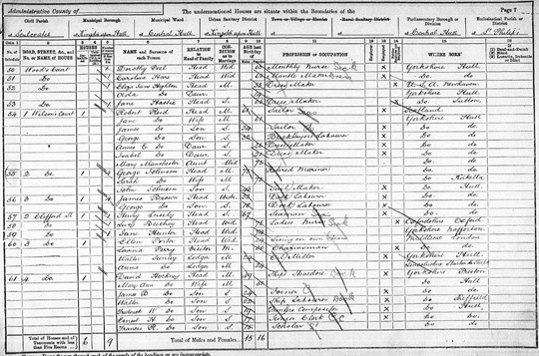
Sources
Census
Company Records
Trade Directories
Archive Collections
Newspapers and journals
Novels
Oral History

Slide 19
Conclusion
Change momentous for both genders
Pessimist/ optimist debate too simplistic
Increasing recognition of multiple experiences of industrialisation.
Need to consider how problematic sources potentially distort our perception of the way industrialisation impacted on women.
Employment not yardstick for emancipation.

