Slide 1
Enlightenment Thinkers and Gender
Sarah Richardson

Slide 2
Outline
What is the Enlightenment?
Historiography
Geography
Women and the Enlightenment
Rousseau and Gender
Men and Feminism

Slide 3
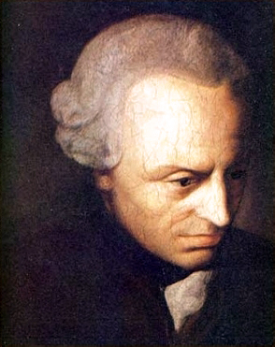
What is the Enlightenment?
Summed up by Immanuel Kant’s slogan: ‘Dare to know!’
Offered new perspectives on topics such as: political theory, economics, science and medicine, philosophy, education, literature, and history.
Aimed for general progress of humanity.
Referred to as an ‘Age of Reason’
Modern scholarship suggests instead thinkers began to trust in experience and empirical testing

Slide 4
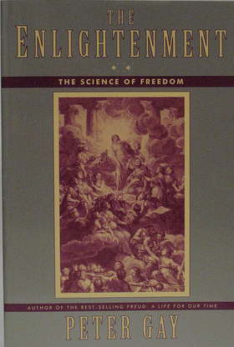
Historiography
Peter Gay came to the conclusion that ‘there was only one Enlightenment’. Gay focused on the elites of the Enlightenment, which raised questions of how deeply the Enlightenment actually penetrated society.

Slide 5
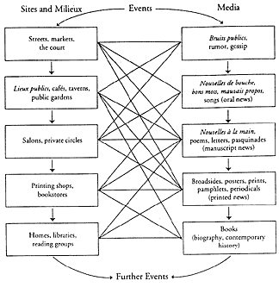
Historiography
Robert Darnton argued Enlightenment was a ‘social history of ideas’.
Darnton identified a ‘high’, and ‘low’ Enlightenment.
High: access to learned academies, money and printing facilities
Low: earned their livings as hacks who were lucky if they were published at all.
Darnton questioned ‘the overly highbrow, overly metaphysical view of intellectual life in the eighteenth century’.
A schematic model of a communication circuit. From Robert Darnton, The Forbidden Best-Sellers of Pre-Revolutionary France (New York, 1995)

Slide 6
Historiography
In his ground-breaking work on the ‘public sphere’, The Structural Transformation of the Public Sphere (1956; trans 1989), Jürgen Habermas argued a new civic society had emerged in the eighteenth-century
A space where state power could be publicly monitored
Coffee houses allowed unfettered opinion to develop

Slide 7
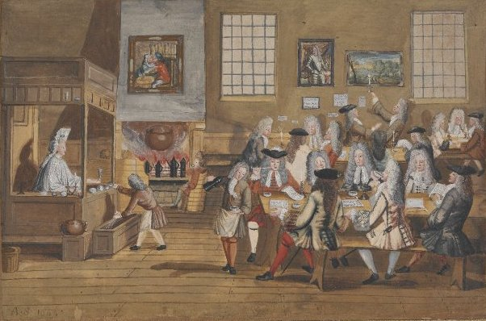
Coffee houses. In 1739 there were c. 551 coffee houses, 207 inns and 447 taverns in London

Slide 8
Geography
Are rich national and regional variations of Enlightenment
France is considered the centre but are distinct branches in Scotland, the Germanic states, the Italian city states, Austria, Switzerland, Russia, Spain, Portugal, and the North American colonies
Scottish Enlightenment was identified in the 1960s as a unique expression of enlightened ideas
Alasdair MacIntyre envisaged a hierarchy of enlightenments which relegated France to the most backward of the enlightened countries
Roy Porter cited the French philosophes’ admiration for their English predecessors, as an example of the importance of the English enlightenment.
There is a danger in insular and nationalistic approaches

Slide 9
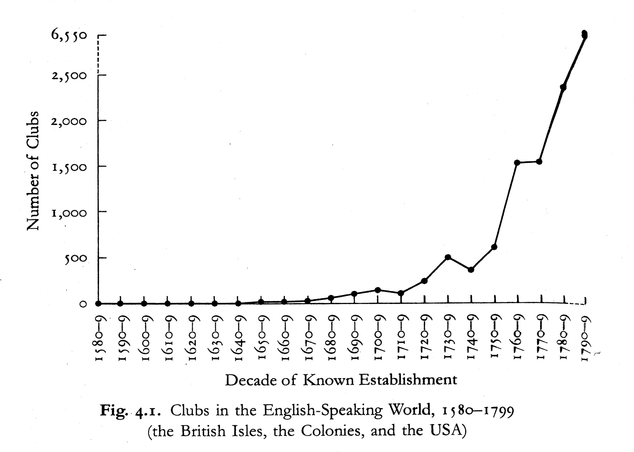

Slide 10
Women and the Enlightenment
Often Enlightenment viewed as overwhelmingly masculine ‘a conspiracy of dead white men in periwigs to provide intellectual foundations for western imperialism’. (Hobsbawm)
Traditionally ‘men seen as misogynists in new dress’ while women like Wollstonecraft were seen as ‘colluding with oppressors’ (Taylor and Knott).
Enlightenment did not improve social conditions of women or increase intellectual opportunities.

Slide 11
Women and the Enlightenment
Women have been established as active participants in the Enlightenment process
Salons in France and England provided an access point for women who wished to engage in the philosophical discussions of the age
Coffee Houses also provided venue for enlightened discussion
Women also took part in debating societies
Carla Hesse demonstrated that women were involved in publishing their writing

Slide 12
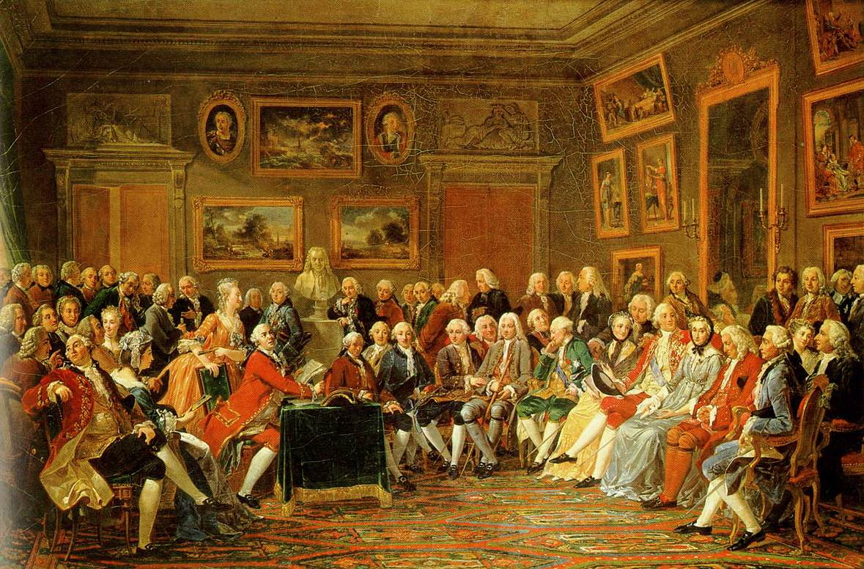
Salon of Madame Geoffrin
Voltaire
Diderot
Rousseau
Madame Geoffrin
Montesquieu

Slide 13
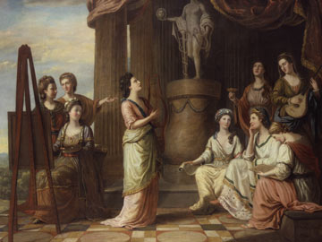
Nine Living Muses including Elizabeth Montagu, Angelica Kauffman, Catharine Macaulay

Slide 14
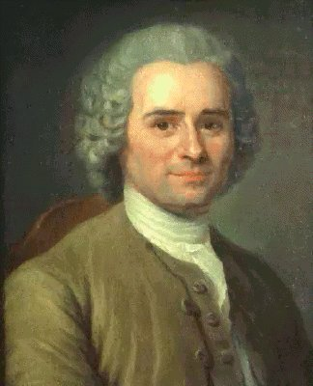
Rousseau
Born in Geneva in 1712
1728 left Switzerland travelled through France, Italy, England and Switzerland.
1750 published Discourse on the Arts and Sciences in which he argued that morality had declined with the progress of culture
Discourse on Inequality attacked private property
Social Contract (1762) offered a model of man's political redemption
Emile a treatise on education written in 1762
Died in 1778 near Paris

Slide 15
Rousseau and Gender
Clear distinction made between men and women
Natural and hierarchical order in the family predicated on sexual difference which denies women any directly public role
Women should be trained for their particular role in a manner different from that of men
General Will an ideal and not necessarily something expressed as the will of the majority
Society needs to be governed by good laws which provide the initial education that will set the people on their way to civic virtue
Most obvious conclusion is that women should participate as citizens if the general will is to manifest itself
Yet in Emile it is made clear that participatory citizenship is to be a specifically male prerogative
In Social Contract Rousseau promotes the patriarchal family as the only natural society.

Slide 16
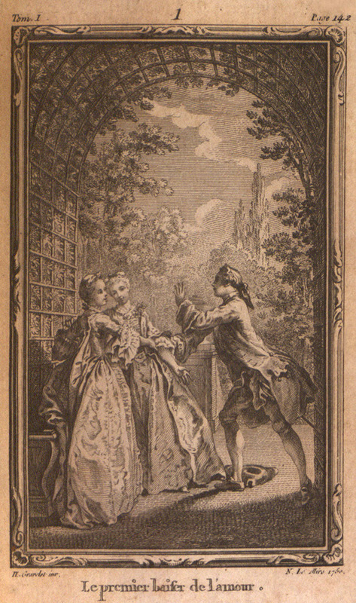
Julie, or the New Heloise
Story of romantic frustration.
Written in the form of epistolary exchanges Rousseau reconceptualized the relationship of the individual to the collective and articulated a new moral paradigm
Complex tones made it a commercial success and a continental sensation when it first appeared in 1761
Rousseau writes in his preface, "the subtleties of heart of which this work is full."
As with Emile, Julie portrays the tension and power inherent in domestic life.
Rousseau chose illustrations: http://brynmawrcollections.org/home/exhibits/show/beyondthetext/rousseau

Slide 17
Emile
Account of women and education occurs primarily in book 5 of Emile although also in the novel, Julie ou La Nouvelle Héloise.
Men are strong and active, evincing power and will
Women are weak and passive, lacking resistance
Her duties are to please, attract, counsel and console her mate to make his life pleasant and happy.
She has rights only so that she might perform her duties better.
If a woman possessed true literary or artistic talents she should not aspire to cultivate them at the expense of her domestic duties

Slide 18
Sophie
Her dress is extremely modest in appearance, and yet very coquettish in fact: she does not make a display of her charms, she conceals them; but in concealing them, she knows how to affect your imagination. Everyone who sees her will say, There is a modest and discreet girl; but while you are near her, your eyes and affections wander all over her person, so that you cannot withdraw them; and you would conclude, that every part of her dress, simple as it seems, was only put in its proper order to be taken to pieces by the imagination.

Slide 19
Wollstonecraft’s critique
Wollstonecraft used the ‘association of ideas’ to counter Rousseau’s views: Everything they see or hear serves to fix impressions, call forth emotions and associate ideas, that give a sexual character to the mind… this cruel association of ideas which everything conspires to twist all their habits of thinking, or to speak with more precision, of feeling, receives new force when they begin to act a little for themselves; for then they perceive that it is only through their address to excite emotions in men, that pleasure and power are to be obtained.
She also argues against Rousseau's dictum that The male is only a male now and again, the female is always a female, or at least all her youth; everything reminds her of her sex; the performance of her functions requires a special constitution
For Wollstonecraft: 'women would not always remember they were women, if they were allowed to acquire more understanding'.

Slide 20
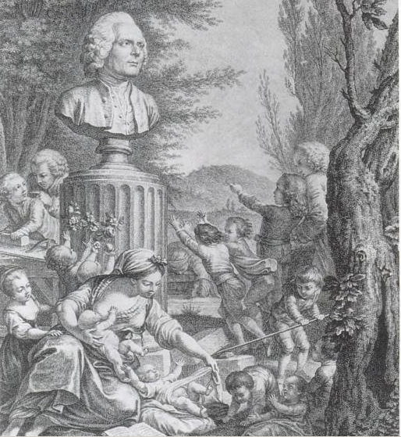
Engraving by de Launay as frontispiece for 1782 edition of Emile.

Slide 21
Assessment
Rousseau ultimately displays contradictions and ambiguities in his writing on gender roles and on sexual politics.
Views on gender are too complex to reduce to one coherent system. Rousseau himself admits the contradictory nature of his thinking, writing in the Preface to Julie: You want us always to be consistent; I doubt this is humanly possible; but it is possible always to be truthful and frank and that is what I hope to be.
It is possible that the very ambiguities of Rousseau’s writings on women and the possibility for multiple readings gave him widespread appeal to contemporaries.

Slide 22
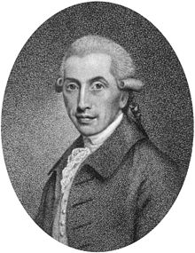
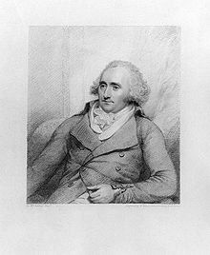
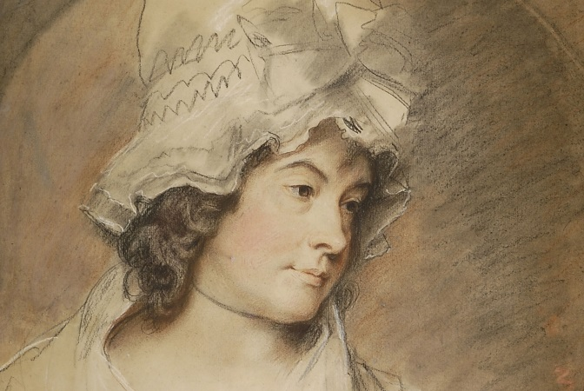
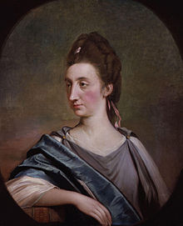
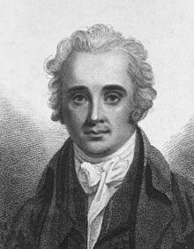
Men and Feminism
John Jebb – religious and political reformer
Charlotte Smith – Romantic novelist, poet and political writer
Thomas Cadell - publisher
Thomas Garnett – lecturer, physician and natural philosopher
Catherine Macaulay – historian

Slide 23
Some conclusions
Enlightenment associated with male philosophers, ideals directed towards men.
However, some women were contributing and were publically acknowledged.
Impact, influence and legacy of female writers questionable.
Most male philosophers had a complex and contradictory stance on women.
Female writers needed co-operation of men to succeed.
Not all ‘proto feminists’ were female, some men actively supported female cause.
Enlightenment – increased public role of women in the literati even if fundamental position of women more widely in society changed little.

