Slide 1
Gender and Education

Slide 2
Overview
Education provision before 1870
Pioneers
Teacher training
Working class education
Literacy
Middle class education
Higher education
Conclusion

Slide 3
Education pre-1870
Almost all writers at beginning of the 19th century were agreed on its deficiencies: the poor quality of basic education and the attention paid to ornamental accomplishments and superficial learning.
Evangelical writers were concerned with the upbringing of children from their earliest years
Republicans and revolutionaries of the 1790s had seen education as the key to the rearing of future generations of citizens.
Liberal and ‘enlightened’ writers were concerned with process of education.
Were common themes : education as preparation for motherhood, the social importance of motherhood, the vital importance of nurturing and training in the early years of childhood and the emphasis on the relationship between mothers and daughters.
Notes:
In the early 19th century, educationalists whether evangelical, rationalist or romantic in their approach stressed the role of family and parents, especially the mother, in imprinting good and moral lessons upon the child in infancy, and in drawing out what was best in the child’s nature. So ‘maternal education’ or the task of the mother as educator and as socialiser became the focus for much important work. In particular, mothers were expected to pay particular attention to the next generation of educators – their daughters. This theme fitted into the domestic ideology which was prevalent at the beginning of the century but some interested in the quality of women’s education, took the argument further: was women’s education only to be undertaken for the sake of future generations, or should there be concentration on the women themselves and what they could achieve through self-culture and self-improvement. By mid-century the emphasis shifted as education for middle-class girls began to be associated with the need for women’s employment. Working class girls whose levels of literacy remained low through this period, did share in the expansion of elementary education and of cheap private schooling together with the development of teacher-training institutions.
Almost all writers at the beginning of the 19th century were agreed on its deficiencies: the poor quality of basic education and the attention paid to ornamental accomplishments and superficial learning. More important was the attention paid to the purpose and method of the education of women, at least in educational theory. Evangelical writers were profoundly concerned with the upbringing of children from their earliest years. Republicans and revolutionaries of the 1790s had seen education as the key to the rearing of future generations of citizens. Liberal and ‘enlightened’ writers were concerned to investigate the insights of Locke and Rousseau and to develop further their philosophical understanding of the process of education. In the early 19th century all these approaches had themes in common: education as preparation for motherhood, the social importance of motherhood, the vital importance of nurturing and training in the early years of childhood and the emphasis on the relationship between mothers and daughters.

Slide 4
Pioneers - Edgeworth
Maria Edgeworth in Letters for Literary Ladies focussed on the issue of women’s education
Themes: to enlighten judgement, cultivate understanding and increase domestic happiness and the delights of home and family
In Practical Education written with her father, she detailed concern for the upbringing of young children from the earliest years, an upbringing which should be a gradual process of cultivating the moral instincts of the child, not just academic prowess.
She was criticised for neglecting the role of religious instruction in developing a child’s morals.
Notes:
Edgeworth’s Letters for Literary Ladies focussed on the issue of women’s education, not to further women’s rights but to enlighten their judgement, cultivate their understanding and increase domestic happiness and the delights of home and family. However despite its limits, Edgeworth was countering assumptions of the natural inferiority of women’s minds. In Practical Education written with her father, she detailed concern for the upbringing of young children from the earliest years, an upbringing which should be a gradual process of cultivating the moral instincts of the child, not just academic prowess. The Edgeworths philosophy was child centred, based on the home and parents and especially directed towards the mother. However, she drew upon an optimism about human potential and a belief in an individual’s capacity for moral judgement. She was criticised for neglecting the role of religious instruction in developing a child’s morals.

Slide 5
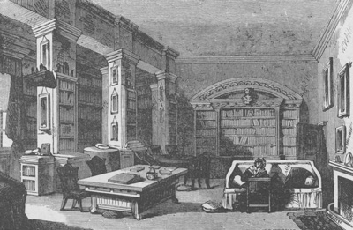
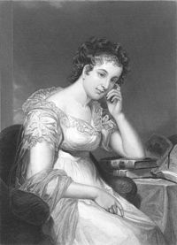
Maria Edgeworth's father was married four times and had twenty-two children. She was the eldest, and her family responsibilities enabled her to practise the precepts she embodied in her writings

Slide 6
Pioneers - Hamilton
Elizabeth Hamilton wrote from Christian and moralist viewpoint.
Focused on ‘philosophy of common sense’
Drew on new educational theories and the psychology of childhood.
Hamilton aimed to raise mothers from their ‘lethargy of quiescent indolence’:
Nor can I, perhaps, plead the cause of my sex more effectively, than by explaining the influence of early education; and thus rendering it evident to every unprejudiced mind, that if women were so educated as to qualify them for the proper performance of this momentous duty, it would do more towards the progressive improvement of the species, than all the discoveries of science and the researches of philosophy.
Notes:
Elizabeth Hamilton on the other hand wrote from a profoundly Christian and moralist viewpoint. Hamilton was interested in the ‘philosophy of common sense’ expounded by the Professor of Moral Philosophy at Edinburgh University which argued for an essential moral sense in every human being on philosophical and religious grounds. She also drew on new educational theories and the psychology of childhood. Hamilton aimed to raise mothers from their ‘lethargy of quiescent indolence’ to exert those faculties with which they were endowed. Like Edgeworth she wished to encourage education through children’s natural interest and curiosity, while guiding their feelings and developing their moral principles. Such principles were to be founded upon the Christian religion but based on a rational approach rather than on ‘creeds, catechisms and homilies’. Again although not challenging women’s subordinate status, Hamilton nevertheless regarded mothers as having a central role:
Nor can I, perhaps, plead the cause of my sex more effectively, than by explaining the influence of early education; and thus rendering it evident to every unprejudiced mind, that if women were so educated as to qualify them for the proper performance of this momentous duty, it would do more towards the progressive improvement of the species, than all the discoveries of science and the researches of philosophy.

Slide 7
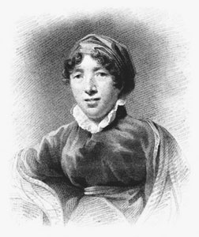
Gary Kelly has summarized Hamilton's legacy as a writer who aimed “to intellectualize women's culture by popularizing, novelizing, and thereby disseminating philosophy, theology, and history, and doing so in a way that offered herself as model for the new intellectual-domestic woman.”

Slide 8
Pioneers
Hannah More in Strictures of Female Education exhorted women of rank to encourage useful and principled education ‘to qualify them for the practical purposes of life’.
Richard Wright in 1799 in his ‘Letters on Women’ in the Unitarian periodical Univeralists Miscellany argued that women’s training for domestic life should not exclude them from intellectual or cultural activity.
In 1822 Harriet Martineau’s article ‘On Female Education’ put the case for the education for women which gave much greater scope for the development of their potential. Martineau hoped to create a race of ‘enlightened mothers’ and ‘rational companions’ for men.
William Bridges Adams in his essay, ‘On the condition of women in England’ denounced levels of education received by women at all levels of society, for: ‘women must be regarded and treated as the equals of men, in order to work the improvement of man himself’.
Mary Leman Grimstone a radical Unitarian and Owenite argued the right kind of education would allow women to provide for themselves, marrying when they wished.
Notes:
From the 1770s Hannah More had argued that in spite of some improvements in female education girls were not prepared at an early age for the reception of religious truths. In her Strictures of Female Education she exhorted women of rank to encourage useful and principled education for women ‘to qualify them for the practical purposes of life’. More took a less positive view of the role of the mother than Hamilton or Edgeworth. The aim was not to nurture the best instincts of the child but to require obedience and submissiveness in preparation for conversion – and these qualities were required most of all from girls.
Other writers, particularly from the radical nonconformist tradition defended the right of women to a liberal education. Richard Wright in 1799 in his ‘Letters on Women’ in the Unitarian periodical Univeralists Miscellany argued that women’s training for domestic life should not exclude them from intellectual or cultural activity. The Monthly Repository another Unitarian publication also consistently argued for the education of women. In 1821 it opposed Brougham’s education bill not only because it made few concessions to dissenters but because it did not provide for the education of girls. In 1822 Martineau’s article ‘On Female Education’ put the case for the education for women which gave much greater scope for the development of their potential since it was impossible to know how the relative achievements of the two sexes depended on the differences in their early training. When women’s talents were given freer rein, they might prove comparable to men’s. Martineau hoped to create a race of ‘enlightened mothers’ and ‘rational companions’ for men. The education she proposed was wide ranging including history, natural philosophy, the philosophy of the mind and modern languages. Such an education, she argued would not detract from domestic duties or feminine qualities but would lead to the appropriate powers of mind and judgement informed by Christian humility. Martineau extended her arguments in her Household Education of 1849. She argued that to maintain a proper household women needed the best possible education, for ignorant women were the worst housekeepers. Every girl’s potential should be fully exploited especially since not every woman would be supported by a husband or father. In the 1830s a more radical call for reform came from William Bridges Adams. In his essay, ‘on the condition of women in England’ he denounced the levels of education received by women at all levels of society, for: ‘women must be regarded and treated as the equals of men, in order to work the improvement of man himself’. Another anonymous writer called for the education of women both for domestic duties and to provide the foundation for more varied employment for those who did not marry.
Mary Leman Grimstone a radical Unitarian and Owenite carried on Martineau’s arguments. She denounced the image of women created by men and perpetuated by women’s education as vapid, passive and uninspiring. The right kind of education would allow women to provide for themselves, marrying when they wished.

Slide 9
Teacher training – Governesses and Higher Education
In 1843 the Governesses’ Benevolent Institution was founded which rapidly found itself involved in the qualifications of governesses.
In 1847 F D Maurice and Charles Kingsley Maurice helped to organise a series of courses by nine lecturers connected with King’s College, London. Lectures were open not only to governesses but to all ladies. Examinations followed although the standard was more akin to secondary schools than to universities.
By 1848 Queen’s College was established in Harley Street. Within 6 months Bedford College was founded through the initiative of a wealthy widow, Elizabeth Reid who had initiated a series of lectures at her house in 1847 and from then on hoped to see her foundation achieve university status.
These initiatives were crucial to women of the early feminist movement. Among the original students at Queen’s college were Adelaide Procter, founding member of the Langham Place circle, Sophia Jex-Blake, the medical pioneer, Julia Wedgwood who became a lecturer at Girton College, Frances Mary Buss who founded North London Collegiate School for Girls and Dorothea Beale who transformed Cheltenham Ladies’ College. Barbara Bodichon also attended some of the early classes at Bedford College.
Notes:
Again the impetus for teacher training came from the need for employment for single women. Mary Leman Grimstone argued that
For those women, whom early widowhood, or other causes consign to celibacy, I see not why civil offices should not be open, especially chairs of science in colleges endowed for their education of their own sex. Why should moral philosophy come with less power from the lips of woman than of man? Why may she not fill a professorship of poetry as well as he?
An anonymous article put the case for a college whose curriculum would include the mathematical and physical sciences, metaphysics, astronomy and mechanics for women. The domestic arguments for the improvement in women’s education though remained the most widely accepted. The idea of a college for governesses was first brought forward by the Honourable Amelia Murray, a maid of honour to the queen who had attempted to interest the College of Preceptors in the idea. In 1843 the Governesses’ Benevolent Institution was founded which rapidly found itself involved in the qualifications of governesses. In 1847 F D Maurice and Charles Kingsley Maurice helped to organise a series of courses by nine lecturers connected with King’s College, London. Lectures were open not only to governesses but to all ladies. Examinations followed although the standard was more akin to secondary schools than to universities. By 1848 Queen’s College was established in Harley Street. Within 6 months Bedford College was founded through the initiative of a wealthy widow, Elizabeth Reid who had initiated a series of lectures at her house in 1847 and from then on hoped to see her foundation achieve university status. She hoped the organisation of her college would be entrusted primarily to women, though this proved to be impossible. However women retained a greater share in the administration of Bedford College than of Queen’s. in spite of the limitations, the education offered at these establishments were crucial to women of the early feminist movement. Among the original students at Queen’s college were Adelaide Procter, founding member of the Langham Place circle, Sophia Jex-Blake, the medical pioneer, Julia Wedgwood who became a lecturer at Girton College, Frances Mary Buss who founded North London Collegiate School for Girls and Dorothea Beale who transformed Cheltenham Ladies’ College. Barbara Bodichon also attended some of the early classes at Bedford College.

Slide 10
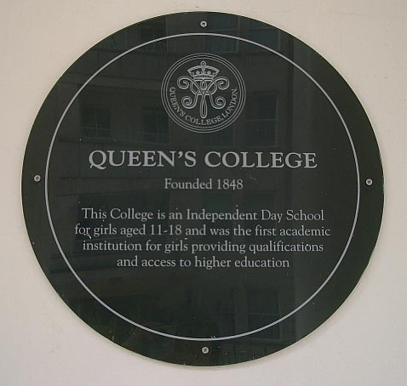
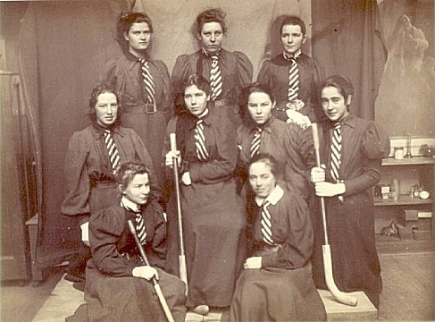
Bedford College Hockey team (1886/7) and Plaque commemorating foundation of Queen’s College

Slide 11
Teacher training - schools
Monitorial schools founded by the National Society for Promoting the Education of the Poor in 1811 and the British and Foreign Schools Society in 1814.
Leading members of these societies were concerned with the educational standards of teachers and had set up small training departments attached to schools as in Joseph Lancaster’s Borough Road School and the National Society’s Central School.
Early training colleges included Home and Colonial Training College. The college trained 1500 teachers in a decade, mainly single women in a course gradually extended to 6 months.
Between 1839 and 1846 on the initative of Sir James Kay Shuttleworth, a network of 20 residential colleges for men and women were established.
In 1846 Kay Shuttleworth’s scheme for pupil-teachers offered those who could pass an examination, a subsidy of 4/5 of the cost of their teacher training. Between 1849 and 1859, the number of pupil-teachers in schools rose from 3580 to 15224, and the proportion of female teachers rose from 32-46%.
Notes:
Certainly by the 1840s the climate of opinion had shifted towards a recognition of the extremely poor level of teaching offered to middle class girls one exception to this universal poor standard of education though was in early teacher training. In the early 19th century elementary schools for working class children were either private or dame schools, Sunday schools or monitorial schools. The latter were founded by the National Society for Promoting the Edication of the Poor in 1811 and the British and Foreign Schools Society in 1814. Leading members of these societies were concerned with the educational standards of teachers and had set up small training departments attached to schools as in Joseph Lancaster’s Borough Road School and the National Society’s Central School. The new movement for infant education also realised the necessity of trained teachers and in spite of objections to women teachers, most instruction in infant schools was by women. The most successful of the early training colleges was the Home and Colonial Training College. The college trained 1500 teachers in a decade, mainly single women in a course gradually extended to 6 months. Between 1839 and 1846 after government recognition and on the initative of Sir James Kay Shuttleworth, a network of 20 residential colleges for men and women were established. In 1846 Kay Shuttleworth’s scheme for pupil-teachers offered those who could pass an examination, a subsidy of 4/5 of the cost of their teacher training. Between 1849 and 1859, the number of pupil-teachers in schools rose from 3580 to 15224, and the proportion of female teachers rose from 32-46%. Such work was initially not considered suitable for middle class women, though a certified teacher could earn more money and earn greater independence than a governess.

Slide 12
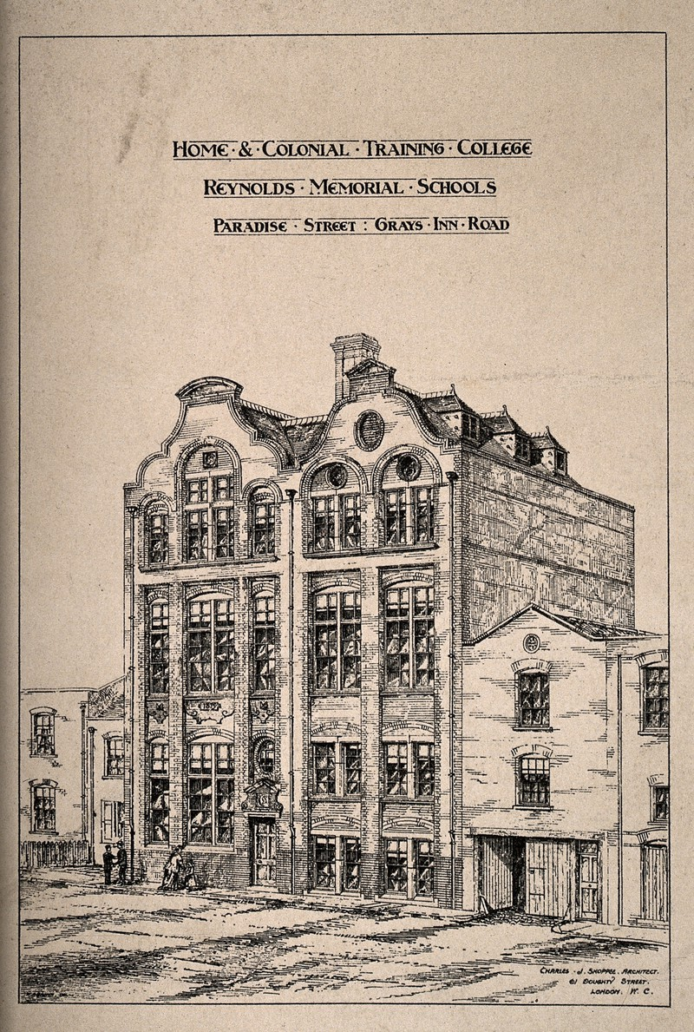
The Home and Colonial Training College trained 1500 teachers in a decade and developed a teacher-training course lasting six months.

Slide 13
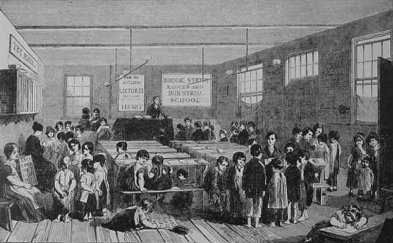
Brook Street Ragged School, Hampstead Road, founded 1843, employing the monitorial system

Slide 14
Pupil-teacher system
Pupil-teacher scheme aimed at bright working class girls, yet in 1851, around 10% of teacher trainees were from professional backgrounds and around half were from lower middle class families.
There were some protests at the assumption that the destination of young unemployed women should be the teaching profession. Lady Ellis argued:
It is contrary to all observation and experience to suppose that all persons are calculated to obtain the means of subsistence by being taught to teach. There are other pursuits of a noble and elevating character which the female mind is capable of comprehending if the means are afforded of so doing. The limited view of female power and usefulness which we have just alluded to, operates very prejudicially with regard to the happiness of young females who have a certain position in society, and who are nevertheless, compelled by narrow circumstances to have recourse to daily exertion for support.
Barbara Bodichon in the Englishwoman’s Journal explicitly argued that women should be educated not so they would be better wives or mothers or to become teachers but to open up a range of occupations to middle class women.
Notes:
The pupil-teacher scheme was aimed at bright working class girls, yet early recruitment did not necessarily bear this out. In 1851, around 10% of teacher trainees were from professional backgrounds and around half were from lower middle class families.
There were some protests at the assumption that the destination of young unemployed women should be the teaching profession. Lady Ellis argued:
It is contrary to all observation and experience to suppose that all persons are calculated to obtain the means of subsistence by being taught to teach. There are other pursuits of a noble and elevating character which the female mind is capable of comprehending if the means are afforded of so doing. The limited view of female power and usefulness which we have just alluded to, operates very prejudicially with regard to the happiness of young females who have a certain position in society, and who are nevertheless, compelled by narrow circumstances to have recourse to daily exertion for support.
She suggested it would be more valuable to nurture the individual talents which women might have than to concentrate so narrowly on teaching. This call was taken up by Barbara Bodichon and the Englishwoman’s Journal which explicitly argued that women should be educated not so they would be better wives or mothers or to become teachers but to open up a range of occupations to middle class women.

Slide 15
Types of schools
Educational provision was fragmented and patchy and ranged from the excellent to the rudimentary
Were new initiatives in the foundation of schools and colleges for girls of the middle classes. Eg Abbey House school in Reading, attended by Jane Austen and Caroline Lamb which included French, Latin, Greek, Italian, History, literature and geography.
Majority of schools were small private establishments, often run as an ‘extended family unit’
Most took less than 30 pupils, some as few as 7 or 8. The School’s Inquiry Commission of the 1860s uncovered 500 such establishments.
Working class children received education from trained and certified teachers and essentially a co-educational curriculum
Notes:
There were new initiatives in the foundation of schools and colleges for girls of the middle classes. In the early 19th century there were only a few girls’ schools offering academic subjects in the curriculum. One of the best known was Abbey House school in Reading, attended by Jane Austen and Caroline Lamb which included French, Latin, Greek, Italian, History, literature and geography. The majority of schools however, were small private establishments, often run as an ‘extended family unit’ than as an academy. Most took less than 30 pupils, some as few as 7 or 8. The School’s Inquiry Commission of the 1860s uncovered 500 such establishments.
The girls schools that existed for middle class girls were usually small establishments with around 30 students. When the Royal Commission on Secondary Education reported in 1864 their revelations revealed a catalogue of incopmpetence and ignorance:
Want of thoroughness and foundation; want of system; slovenliness and showy superficiality; inattention to rudiments; undue time given to accomplishments and those not taught intelligently or in any scientific manner; want of organisation.
In contrast to the middle class, working class girls did at least receive education from trained and certified teachers and essentially a co-eduactional curriculum whilst for middle class girls the norm was governesses or small private boarding schools offering little more than basic accomplishments in French, music, drawing and deportment.
The education of those outside the economic and cultural elites demonstrates the fractured and diverse character of individual experiences in the pre-1870 period.
For example, Sarah Pearce, a 13 year-old munitions worker from London related that she:
[w]ent regularly to a week school, since she was four or five years old, till she came to work here … Can read ‘very well’, quite long words in the Bible. Can write on the slate very well. Mother is just teaching her to write a letter on paper in the evenings after work. Can ‘add and take from and do sums with them two lines’.
However for other working-class children the situation was more varied as the memorials of these teenage coal-miners from the 1840s show. John Watson had started at the pit at the age of 6; he ‘[o]nly knows his a, b, c; cannot write at all. Goes to no school now … Was at school before he went down the pit for a year and could read the Bible then; now he has forgotten everything.’ James Brady did ‘not know exactly what age I am. It is 16, 17 or 18 … I cannot read much, some little. I have read the Testament. I have read the Spelling-Book and Ready-ma-daisy (Reading Made Easy).’ Isaac Tipton first went underground when he was 7: ‘I am 16 years of age … I read middling … I read the Bible sometimes … I have read Reading Made Easy. I have read about Turpin and Jack Sheppard; I have read about Robin Hood. I read song-books … I have read a bit of Robinson Crusoe. I have read about the pigs and cows dying of distemper.’
Such fragments convey something of the impact which education and learning might make upon the lives of working people in the first half of the nineteenth century. This is an important recognition which has major historiographical implications. Educational histories, whether they have conceived the growth of mass schooling in terms of social progress or of class domination, have overwhelmingly been written in terms of the development of formalized educational supply and its gradual systematization. What is often lacking is an analysis of the popular demand for education which was insatiable in this period.

Slide 16
Literacy
Education provision was often poor and girls received a worse education than boys.
Female literacy rates lagged behind those of men eg in the 1780s 68% of men but only 39% of women could sign the marriage register.
Thomas Laquer has argued that industrialisation retarded literacy rates arguing that in Manchester female literacy rates fell to 19% in 1810-20.
By 1844 rates had started to rise again but were still 37% for men and 48% for women.
Notes:
For the working class population education provision remained poor and girls received a worse education than boys. Female literacy rates lagged behind those of men eg in the 1780s 68% of men but only 39% of women could sign the marriage register. Thomas Laquer has argued that industrialisation retarded literacy rates arguing that in Manchester female literacy rates fell to 19% in 1810-20. Literacy was not a prerequisite for the labour force. By 1844 rates had started to rise again but were still 37% for men and 48% for women.

Slide 17
Occupational differentiation (Humphries)
Notes:
Trades refer to father’s occupations. Note that those children with father’s in service received the longest period of schooling in the early 19th century.

Slide 18
Literacy rates in rural parishes (Barry Reay)
Notes:
These figures look at those able to sign marriage registers (not a test of functional literacy. For gentry and farmers both men and women were 100% literate by this test in the period 1871-90. Note the higher levels of female literacy in the craft and agricultural sectors in the 1801-50 period.

Slide 19
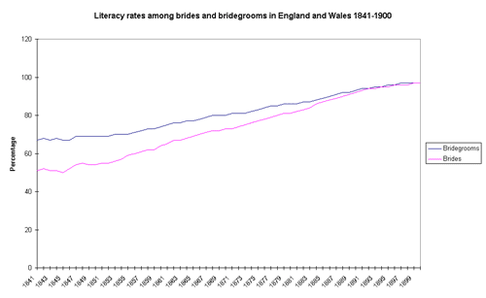
Notes:
Show literacy rates reaching nearly 100% by the end of the century

Slide 20
Working-class girls’ education
Sarah Trimmer, the leading advocate of women’s place in the home, recommended girls should be taught carding and spinning wool, knitting stockings and needlework.
Aims of schools were to make ‘good working servants, wives and mothers’.
Quality of education was often limited and not much better than that offered by the charity schools especially for girls. At the Hackney Road Girls School for example, the curriculum was reading, writing and needlework, training in morality and industry. At Kennington the girls spent four afternoons a week on needlework while the boys did more arithmetic and reading. Early reports from schools inspectors reflected the poor quality of teaching:
In some of the girls’ schools very few of the children could write, and the writing was very bad; while even in the boys’ schools, where more attention is paid to this important art, there were very few boys who had attained to a running hand without the use of lines. In several of the girls’ schools the children do not learn arithmetic at all
Notes:
The early charitable schools had a dual objective for girls: they should be able to read the scriptures and should be able to maintain themselves in suitable employment. Thus Sarah Trimmer, the leading advocate of women’s place in the home recommended that girls should be taught carding and spinning wool, knitting stockings and needlework. Such employment was deemed more favourable than work in agriculture or any work outside the home. The aims of such schools were to make ‘good working servants, wives and mothers’. Elementary education was developed rapidly during the early 19th century under the monitorial system of Andrew Bell and John Lancaster. Two voluntary societies were formed to oversee elementary education, the National Society for promoting the education of the poor in the principles of the Church of England in 1811 and the British and Foreign Schools Society in 1814 with the backing of nonconformists supporting non-denominational schools. These societies dominated educational provision in England and Wales for the next 30 years. The quality of education though was often limited and not much better than that offered by the charity schools especially for girls. At the Hackney Road Girls School for example, the curriculum was reading, writing and needlework, training in morality and industry. At Kennington the girls spent four afternoons a week on needlework while the boys did more arithmetic and reading. Early reports from schools inspectors reflected the poor quality of teaching:
In some of the girls’ schools very few of the children could write, and the writing was very bad; while even in the boys’ schools, where more attention is paid to this important art, there were very few boys who had attained to a running hand without the use of lines. In several of the girls’ schools the children do not learn arithmetic at all.

Slide 21
1870 Education Act
The growing interest the state took in the provision of education did not result in many improvements in girls’ education.
Education Act of 1870 provided a national system of secondary education and implemented elected School Boards. A successive act of 1876 attempted to impose compulsory attendance.
Working-class girls were educated principally to a domestic role with classes in laundry, home management and needle skills
Ethel Dudley was the examiner for the London School Board and wrote the 1914 standard school book Knitting for Infants and Juniors. She suggested lesson plans and instructions for patterns suitable for varying ages such as the following for five year olds:
‘Duster for school blackboards. Needles 5. Number 8 cotton. 30-40 minutes.
Cast on 18 stitches. K (chain edge) 36 rows.
Cast off and make chain of 12 stitches to hang up.’
Notes:
The growing interest the state took in the provision of education did not result in many improvements in girls’ education. The Education Act of 1870 provided a national system of secondary education and implemented elected School Boards. A successive act of 1876 attempted to impose compulsory attendance. In effect, compulsory education meant that working-class girls attending state schools were educated principally to a domestic role with classes in laundry, home management and needle skills. This can be summed up by a rhyme published in a Quarterly Review article on ‘Female Education’:
‘For nothing lovelier can be found
In a woman than to study household good,
And good works in her husband to promote’
In the emergent private sector, schools rub on feminist inspired ideas offered a similar curriculum to boys schools. However, commentators such as Carol Dyhouse and Sara Delamont have challenged the idea that these private schools were necessarily challenging accepted norms, arguing instead that they perpetuated gender stereotypes. Delamont goes further in arguing that earlier the division between working class and middle class schools was effectively reversed. Earlier in the century schools for the working class taught a basic skills to both girls and boys, whilst middle class girls schools concentrated on accomplishments whereas after 1870, it was the state schools which offered a sex-specific curriculum and the private girls schools which offered a wider choice. Thus in spite of the government’s intentions to provide a basic system of national education, the result was to widen the gap between the education of children from different classes. In tandem with the Endowed Schools Act of 1869, it gave impetus to the rise of many new fee paying schools and it was in these rather than the state schools that the feminist ideas towards education could be implemented.

Slide 22
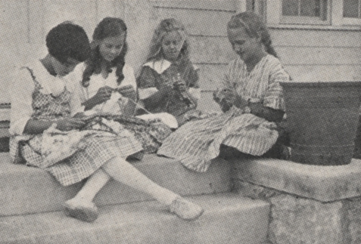
Hand knitting was brought formally into the British school syllabus with the 1870 Education Act. By 1914, knitting was a required element of girls’ education and of many boys’ too.

Slide 23
Middle class education (boys)
Rise of English public school shifted education for middle and upper class boys in the middle of the century.
Public schools had been few in number and catered primarily for the sons of the landed elite.
By the 1860s attendance at a public school was essential for the sons of the professional and business classes.
Over 30 new public schools had been added to the original 7 to provide for this increased demand.
Thomas Arnold’s development of a reformed model of a public school at Rugby in the 1830s received widespread publicity.
New schools were more academic and orderly than their predecessors. Focused on ‘moral manliness’, physical toughness and endurance

Slide 24
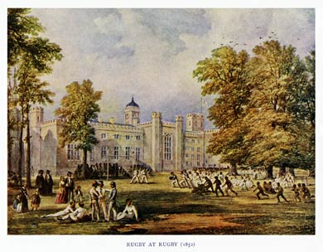

Slide 25
Middle class education (girls)
Creation of proprietary schools for girls.
Pioneer establishments had been the North London Collegiate School and Cheltenham Ladies' College in the 1850s.
1872 a Girls' Public Day School Company was formed and already by 1880 it had opened eleven schools in the London area and eleven elsewhere.
A few new girls' schools, such as Cheltenham, Wycombe Abbey, St Leonard's and Roedean, were boarding, modelling themselves more or less on boys' public schools, but the vast majority were day schools.

Slide 26
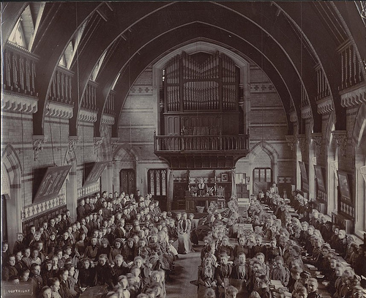

Slide 27
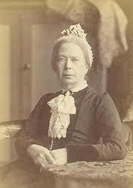
Pioneer – Frances Buss
Educated at a private day school
Established own private school with her mother in Kentish Town, in 1845
Attended Queen's College in Harley Street, London
1850 school renamed the North London Collegiate School for Ladies
Viewed competitive external examinations as the best preparation
Many pupils went on to study at the women's colleges founded at Cambridge; twelve were at Girton in 1879
Clara Collet became the first former North London Collegiate pupil to obtain a degree when she took a London BA in 1880

Slide 28
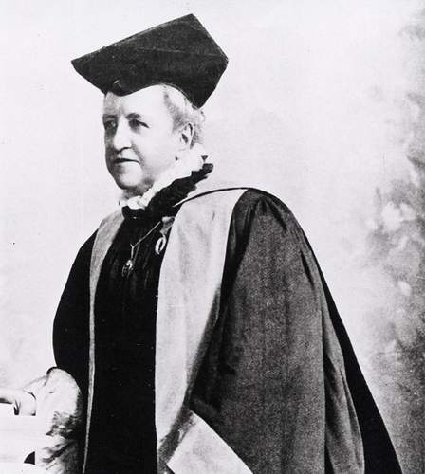
Pioneer – Dorothea Beale
Sporadically educated in schools in England and France
Taught herself Greek and mathematics.
1858 elected principal of Cheltenham Ladies' College
Were external examinations annually and strict discipline in the classroom
By 1880 Cheltenham Ladies' College was teaching a full syllabus including mathematics and classics.

Slide 29
School Boards
The 1870 Act did introduced a means by which women could influence state schooling policy by membership of school boards.
There were 128 women elected to English and Welsh school boards between 1892 and 1895. Many of those who stood for election were active feminists and many concerned chiefly with the field of education. Emily Davies and Elizabeth Garrett were the first two women to sit on the London School Board and remained the only two until their resignation in October 1873. Emily Davies later wrote:
We were willing to do our best, but when it is remembered that the Board consisted of 47 gentlemen and 2 ladies, it will not be a matter of surprise that the 2 ladies have proved incapable of doing their half of the work.
Women on School Boards were commonly assigned to committees such as the Needlework sub-committee. Their wide brief to oversee all state education also meant that they were often unable to raise the profile of girls education.
Notes:
The 1870 Act did however introduce one means by which women could influence state schooling policy and that was through membership of school boards. In the 1870s many women took local government office including membership of School Boards. There were 128 women elected to English and Welsh school boards between 1892 and 1895. Many of those who stood for election were active feminists and many concerned chiefly with the field of education. Emily Davies and Elizabeth Garrett were the first two women to sit on the London School Board and remained the only two until their resignation in October 1873. Emily Davies later wrote:
We were willing to do our best, but when it is remembered that the Board consisted of 47 gentlemen and 2 ladies, it will not be a matter of surprise that the 2 ladies have proved incapable of doing their half of the work.
The women on School Boards were commonly assigned to committees such as the Needlework sub-committee. Their wide brief to oversee all state education also meant that they were often unable to raise the profile of girls education.

Slide 30
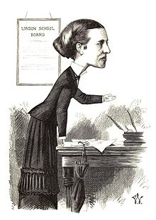
Cartoon of Elizabeth Garrett (Anderson) by Frederick Waddy, 1872.
She topped the poll for the election of the first London School Board in 1870

Slide 31
Early universities
Most vibrant and inclusive universities were in Scotland. There were four (Edinburgh, Glasgow, St Andrew's and Aberdeen) in contrast with only two for England (Oxford and Cambridge).
In 1825-6 the total Scottish student population was estimated at about 4,500. There was an exceedingly diverse student body.
In contrast, Oxford and Cambridge were intellectually moribund and student numbers were low.
By 1820-9 annual admissions to Oxford colleges averaged 400 and to Cambridge colleges, 440 giving a total student population only half that in Scotland.
Students taught either classics or mathematics and drawn exclusively from the gentry and aristocracy.

Slide 32
London University
In 1828 'the godless institution of Gower Steet', which was to become University College, London, opened its doors.
In 1831 King's College in the Strand established.
In 1832 another Anglican University was established at Durham.
In 1836 the Whig government created by charter a University of London simply an examining and degree-giving body, under whose umbrella University College and King's College - and any number of institutions and individuals - could gather.
Already by 1850 the number of candidates successfully meeting its matriculation requirements was just short of 200 a year.
The Whigs and radicals who established the University of London accepted the need to challenge the social and denominational narrowness of Oxbridge.

Slide 33
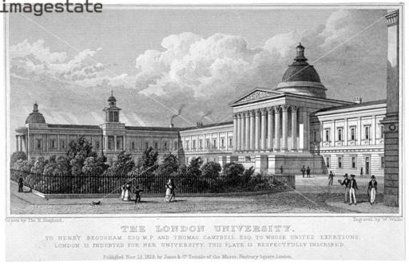

Slide 34
Oxbridge reform
Admissions to Oxford and Cambridge began to increase from the 1870s. In 1901 the male student populations of Oxford and Cambridge were 2,537 and 2,880.
1870s saw the arrival at Oxford and Cambridge both of dissenters and of women.
Abolition of University Tests in 1871 opened undergraduate places and fellowships to all religious denominations.
Emily Davies's College was founded at Hitchin in 1869 and moved to Girton, near Cambridge, in 1873. Henry Sidgwick and Anne Jemima Clough opened the residence which became Newnham College, in 1871. In Oxford, 1879 brought the foundation of Somerville, Lady Margaret Hall and the Society for Home Students, which eventually became St Anne's; followed in 1886 by St Hugh's and in 1892 by St Hilda's.
In 1900-1, there were 296 women students at Cambridge and 239 at Oxford. Women did not become full members of the university in Oxford until 1919 and in Cambridge until 1948.
Formal curriculum also changed with the creation of the Natural and Moral Sciences Triposes in Cambridge and of undergraduate courses in History andLaw in both universities.

Slide 35
Formation of new universities
1851 Owen's College, Manchester
1871 Newcastle
1872 University College of Wales, Aberystwyth
1874 Leeds
1874 Mason College, Birmingham
1876 Bristol
1879 Firth College, Sheffield
1881 Liverpool
1881 Nottingham
1883 Cardiff
1883 Bangor
1892 Reading
1902 Southampton
Full-time students (outside Oxford and Cambridge)
England = 7,943
Wales = 1,253
Scotland = 5,151
Total = 14,347
2,749 were women.

Slide 36
Social Composition of Oxford students (male)

Slide 37
Social Composition of Oxford students (female)

Slide 38
Women in universities
University of London in 1878 was the first university to admit women and University College London laid claim to be the first institution to run co-educational lessons.
Women had attended classes prior to this date. Some institutions eg St Andrews University had offered a higher certificate the LA, later LLA, Lady Literate in Arts to women students from 1876.
Apart from Oxford and Cambridge, Durham was the last university in England to admit women to its degrees.
In Scotland legislation between 1889 and 1892 empowered the four Scottish universities to admit women to classes and gain degrees.
The charter of the university of Wales, granted in 1893 stipulated women’s eligibility for degrees and also offices, stating specifically that they should be treated as full members off the university.
Women were almost universally excluded from studying medicine

Slide 39
Women Graduates
In Glasgow, 4 medical students received degrees from Queen Margaret College in 1894 and 2 received arts degrees in 1895.
In Aberdeen 4 women students obtained a BA in 1898.
4 women obtained degrees from the University of London in 1880 and 4 from Manchester in 1887.
From around 1900 the number of female students rose steadily, especially in arts departments.
Women represented 16% of students in 1900; 24% in 1920 and 27% in 1930.

Slide 40
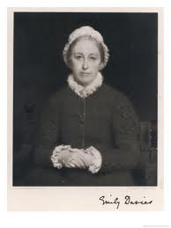
Pioneer – Emily Davies
Emily and her elder sister Jane were denied any serious schooling either at home or outside it
Linked to influential feminists: the Langham Place group in London.
Was secretary to the committee to secure the admission of women to university examinations.
1866 published The Higher Education of Women
1868 rented a villa at Hitchin, Hertfordshire, and the first five students taught by Cambridge dons came into residence there in October 1869. Thus began Girton College, Emily Davies's most enduring memorial.

Slide 41
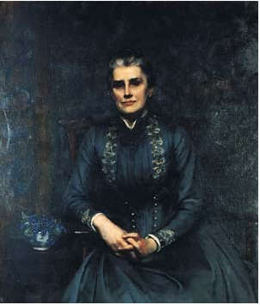
Pioneer – Elizabeth Wordsworth
Educated by governesses
Became principal of Lady Margaret Hall
Established St Hughes
Member of anti-suffrage campaign

Slide 42
Conclusion
For working class children 19th century was not necessarily one of progress
After 1870 curriculum (particularly for girls) in state schools became more limited
For middle class girls and women the 19th century was a century of progress in education.
Institutional focus in the new breed of private girls’ schools and the new women’s colleges.
Where the two sexes were segregated then, women were able to sustain educational advances, however this retarded the progress and the standards of education of co-educational institutions.
Public schools reinvigorated education of middle-class boys and instituted new culture of muscular Christianity and ‘moral’ manliness.
Education reform linked with rise of feminism but not invariably so.

