Slide 1
Marriage and Divorce

Slide 2
Overview
Victorian marriage and the law
Two case studies: Queen Victoria and George Eliot
Cohabitation
Divorce Law and Caroline Norton
Conclusion

Slide 3
Marriage and the Law
Matrimonial law underwent great change during the 19th century.
Became more secular as Parliament created provision for civil marriage (in 1836) and divorce (in 1857).
Married women achieved greater legal status, particularly with regard to their property and fathers lost their exclusive right to the custody of their children.
Victorian jurists also tried to ease the plight of working class women by allowing local magistrates courts to issue judicial separations.
Were regular efforts to loosen the prohibited degrees of kinship, particularly the law prohibiting marriage to a deceased wife’s sister.
Marriage law differed in Scotland where an exchange of vows was sufficient to solemnise a marriage.

Slide 4
Harriet Taylor & John Stuart Mill
When John Stuart Mill married Harriet Taylor in 1851 he wrote a formal protest against the laws that would govern their marriage objecting to:
‘the whole character of the marriage relation as constituted by law... for this amongst other reasons, that it confers upon one of the parties to the contract, legal power and control over the person, property, and freedom of action of the other party, independent of her own wishes and will... having no means of legally divesting myself of these odious powers... I feel it my duty to put on record a formal protest against the existing law of marriage, in so far as conferring such powers; and a solemn promise never in any case or under any circumstances to use them.’

Slide 5
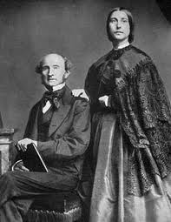
Harriet Taylor & John Stuart Mill

Slide 6
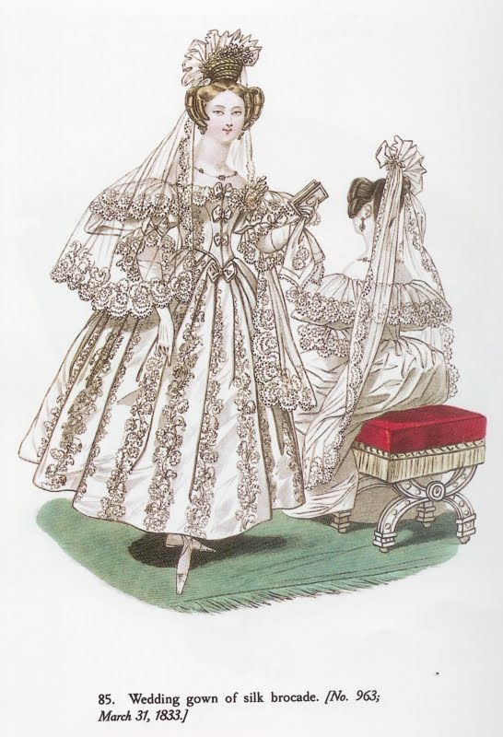
Marriage and courtship rituals increased during Victorian era

Slide 7
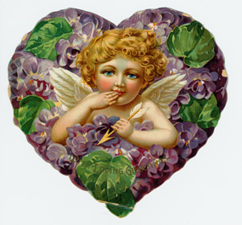
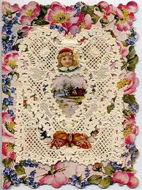
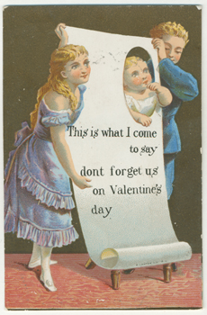
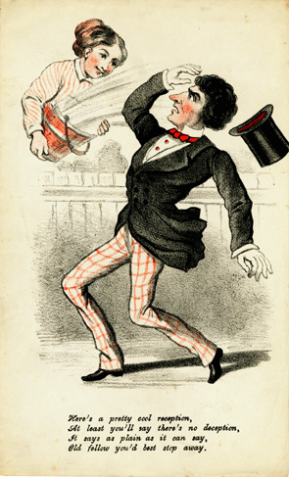
Printed Valentine cards first appeared in the 18th century, simple sheets with a written verse. Soon afterwards the traditional symbols began to appear - Cupid, flowers and hearts. The sending of Valentine cards rapidly increased in the 19th century as improvements in printing techniques and the postal service made it more affordable.

Slide 8
An idealised marriage: Queen Victoria and Prince Albert
Arranged marriage with her cousin, Prince Albert of Saxe-Coburg and Gotha
Victoria was initially reluctant to marry but quickly fell in love with Albert
Marriage changed her from wilful and assertive to passive and submissive. She embraced the prevalent view of the correct relationship between the sexes, and especially between husband and wife: women were by nature inferior and dependent, and it was their duty to submit to and adore their husbands.
His patriarchy aided by her multiple pregnancies
In 1861 Albert died of typhoid fever leaving behind a wife who never fully recovered from his death.

Slide 9
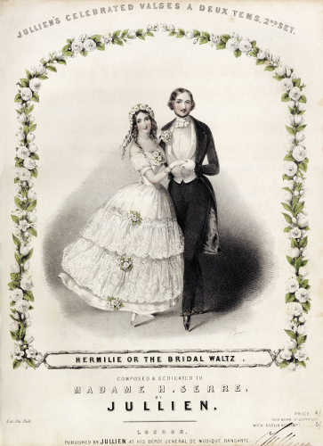
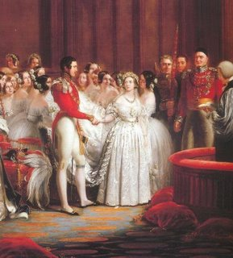

Slide 10
An unconventional union: George Henry Lewes and Marian Evans
Lewes married Agnes Jervis in 1841 but embraced the notion of ‘free love inside marriage’ embarking on numerous affairs.
His wife followed suit, having a relationship with his friend, Thornton Hunt (who was also married). They remained married because of the cost and complexity of divorce.
Lewes met Marian Evans when they were both working for the Westminster Review and they eloped to Germany in 1854 beginning a 24 year long union.
Were condemned both publicly and privately by their friends because their union was open and public. Marian's reputation suffered most.
Yet Lewes and Evans behaved to all intents and purposes as if they were married. Neither opposed marriage in itself but dissented from marriage law.
Their union came to end when in November 1878 Lewes died.
Evans unconventional approach continued when less than 18 months after Lewes’ death she married John Cross more than twenty years her junior though the marriage was short lived as she died a few months after the wedding.

Slide 11
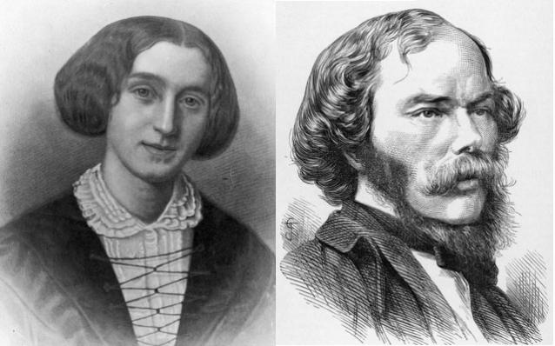

Slide 12
Cohabitation
Recent work by Ginger Frost has established that the 19th century was a period that experienced marital nonconformity amongst couples of all social classes.
Frost identifies three major groups of cohabitation. 1) men and women who lived together because they could not marry due to earlier marriages or because they were related to each other by blood. 2) couples who did not marry due to a variety of reasons including a lack of concern with social pressure and disinterest in marriage 3) men and women who positively chose not to marry
More working-class than middle-class couples cohabited and more so did so if they lived in urban rather than rural areas. Men suffered far less social discrimination than women did as a result of these relationships.
Cohabitation to involved financial and emotional commitments supported by courts
Reactions to illegal unions could vary. Middle–class women willing to take the risk were often independently wealthy, others needed more protection. Most families supported unconventional relationships and even the state implicitly, if not explicitly, supported these unions
Were 5,327 bigamy trials between 1857 and 1904 which averaged out at 95 per annum probably making up about 1 in 5 of the proportion of bigamous relationships that existed.

Slide 13
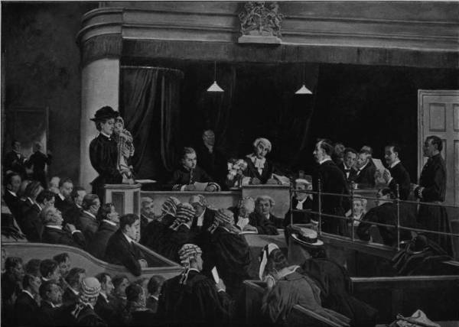
Eyre Crowe’s Trial for Bigamy (1897): The first wife, a comely young woman with a child in her arms, is in the witness-box, and nervously gives evidence against the culprit, who does not seem to like his position. The second wife and a sympathetic friend or sister are seated in the lower part of the court… The jurymen differ as much as they ought to differ, and every face in the box is full of character; and so are the queer visages of the 'public', all of them more or less unwashed and vulgar. (Athanaeum)

Slide 14
Divorce and the Law
Ecclesiastical law governed divorce proceedings prior to 1857.
Marriage was for all intents and purposes indissoluble although the ecclesiastical courts could nullify marriages and grant separations.
A divorce a mensa et thoro (from bed and board) was granted for adultery, extreme cruelty or desertion; it allowed neither party to re-marry. Divorce a vinculo (from the bonds of marriage) was a nullification of marriage
A civil divorce could only be obtained by a private act of Parliament. After 1800 some ten divorce bills were passed in Parliament each year; only three were ever awarded to women.
In 1857 the Divorce and Matrimonial Causes Act created the Probate and Divorce Court in London which took over many of the functions of the ecclesiastical courts.
A new provision allowed divorce for the adultery of a wife or for a husband’s adultery combined with cruelty, bigamy, incest or bestiality.

Slide 15
Law reform
Matrimonial Causes Act of 1878 authorised magistrates courts to grant protection orders to wives whose husbands had been convicted of aggravated assault
Maintenance of Wives (desertion) Act of 1886 empowered magistrates to order a husband to maintain his wife
Summary Jurisdiction (Married Women) Act of 1895 allowed magistrates to issue a protection order to a woman who was driven from her home by a husband’s cruelty or failure to maintain her and her children.
Divorce Act granted an average of 148 divorces each year while the magistrates courts dispensed about 8,000 protection orders (judicial separations).

Slide 16
Caroline Sheridan Norton
Caroline Sheridan Norton is credited for bringing the issue of divorce and custody of children to public and parliamentary scrutiny and was instrumental in achieving passage of the Infant Custody Act of 1839 and the Divorce and Matrimonial Causes Act of 1857.
Grand-daughter of Richard Brinsley Sheridan and married George Norton in 1827 bearing three sons.
In 1836 George Norton sued William Lamb, Lord Melbourne, for damages for ‘criminal conversation’ (adultery) with Caroline Norton, the necessary first step to obtaining divorce by Act of Parliament. The jury acquitted Melbourne but Caroline Norton’s reputation was damaged and her legal vindication made divorce impossible.
George Norton took their three sons out of England and forbade Norton to see them
Norton began a series of campaigns to reform the laws asking for legal protection for women similar to that recently provided for paupers, the insane, prisoners, and other helpless classes.

Slide 17
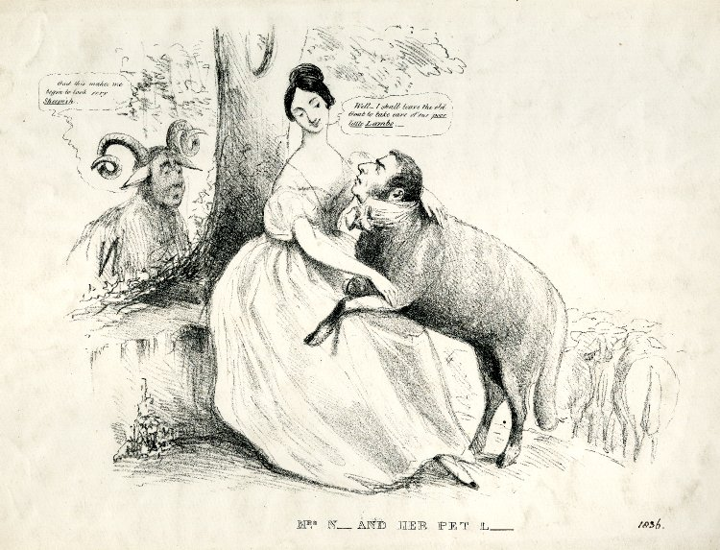

Slide 18
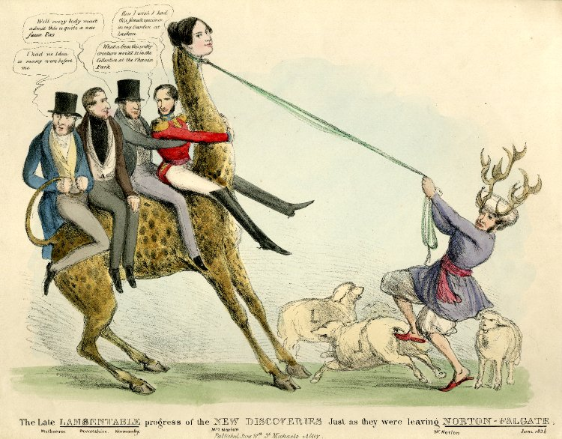

Slide 19
Married Women’s Property
Married women’s property rights finally granted in acts of 1870 and 1882
Constituted a major change in women’s rights under English law giving every married woman for the first time the right to hold property in her own name.
Efforts for reform led by a Married Women’s Property Committee headed by Elizabeth Wolstenholme Elmy and Ursula Mellor Bright.
The first act in 1870 was a partial measure which gave married women the right to possess the wages earned during their marriage, money invested in certain specified ways (including savings banks), and legacies of less than £200. All other property still belonged to their husbands.
The 1882 act gave a married woman possession of all the property she held before or after her marriage as her ‘separate estate’.
Married Women’s Property Acts did not abolish other aspects of coverture: a married woman could not have a legal residence apart from her husband, spouses could not sue one another, and since they were one legal person, husband and wife could not be held to have conspired together.

Slide 20
Conclusion
In spite of substantial changes during the Victorian period, marriage law continued to grant more rights to men than to women at the turn of the century. The grievances usually cited by women’s rights campaigners were the unequal grounds for divorce and the fact that divorce could only be granted for adultery and not for other marital faults.

