Slide 1
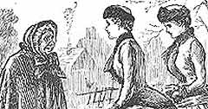
Philanthropy
Punch cartoon – Extending benevolence to neighbours

Slide 2
Overview
Historiographical trends
Women and philanthropy
Case Studies
Temperance
Prison reform and visiting societies
Mary Carpenter and juvenile offenders
Hannah Kilham’s missionary work
Conclusion

Slide 3
Historiographical trends
Frank Prochaska, in Women and Philanthropy in the 19th Century provides a female model of benevolence to complement traditional studies such as David Owen’s English Philanthropy
Philanthropy is part of a shared bourgeois identity
Social control theses focus on middle-class authority over the poor

Slide 4
Gender and philanthropy
Male philanthropists are seen to provide the ideological motivations in debates on the poor and the state eg Mandler’s ‘Christian political economy’
Is argued that women had an informal and casual relationship with charitable work
Exception is focus on philanthropy as part of the construction of women’s imperial identities

Slide 5
Separate spheres
Catherine Hall and Leonore Davidoff in Family Fortunes use the term to describe the accentuation of gender difference among the middle classes
Public life seen as an exclusively male domain, domestic environment female
Ideals originally expressed in England by Clapham Sect
Has been challenged by Linda Kerber and Amanda Vickery who have argued that ‘separate spheres’ was neither new nor restricted to a single social class.
In certain fields, notably philanthropy, the public/private dichotomy blurred

Slide 6
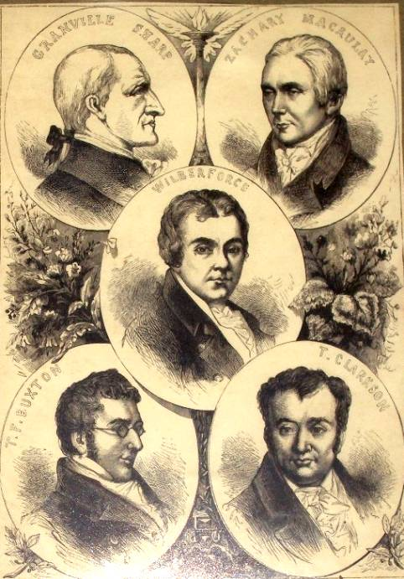
Members of the evangelical Clapham Sect

Slide 7
Female philanthropy
Woman’s Mission suited them for charitable work. Their specific traits were thought to be: moral, modest, attentive, gentle, patient, sensitive, perceptive, compassionate, self-sacrificing, instinctive and mild.
Women applied their domestic experience and education to the world outside the home.
It was an occupation for middle class women inseparable from a notion of superiority of class, education and race
Sarah Lewis, the writer of Woman’s Mission: women’s charitable spirit was simply ‘the flow of maternal love’.
Wesley reminded women of Phoebe’s work in the early church and concluded ‘whenever you have the opportunity, do all the good you can, particularly to your poor, sick neighbour. And everyone of you likewise shall receive your own reward, according to your own labour’.

Slide 8
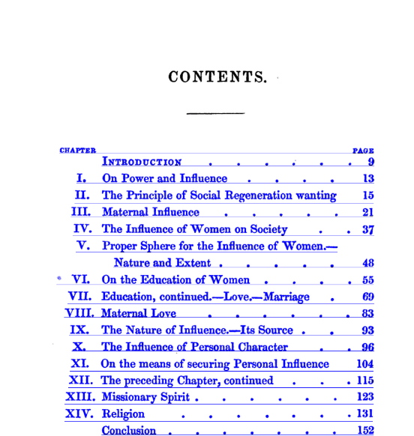
Woman’s Mission

Slide 9
Scale
There were vast numbers of women engaged in charitable work.
Louisa Hubbard estimated that 500,000 women laboured ‘continuously and semi-professionally’ in philanthropy and another 20,000 were paid officials in charitable societies
Women’s contributions to charities and female charities grew between 1790 and 1830. Only one society existed before 1795 and 17 were founded and managed by women between 1795 and 1830.
Prochaska traced a dramatic rise in the percentage of women contributors to these charities. Eg among contributors to Sir Thomas Bernard’s Society for bettering the Condition of the Poor, the proportion of female contributors rose from 13% to 31% between 1798 and 1805.

Slide 10
Temperance
Earliest temperance associations in 1830s were built on a foundation of evangelicalism and humanitarianism but the campaign had a complex history.
By 1853 with the foundation of the UK Alliance a strong case was made by radical reformers of all classes for legislative intervention.
Strong feminist tone to campaign with the argument that resources should be diverted from purely male pleasures to expenditure that could benefit the whole family.
Chartist leaders believed that temperance was an issue of particular interest to women, and a number of Female Chartist Abstinence Unions were established which ran Chartist Temperance Tea Parties.
Focus on children. Anne Carlile, applied term ‘Band of Hope’ to children committed to temperance. By 1847 the new Band of Hope was founded with some 4000 children under 16 taking the pledge.

Slide 11
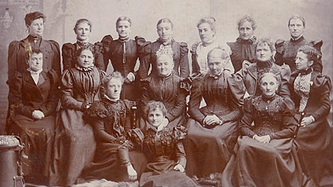
Members of the North Wales Women’s Temperance Union in 1892

Slide 12
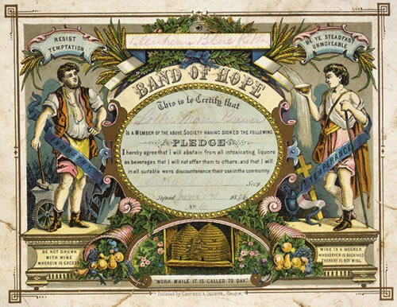
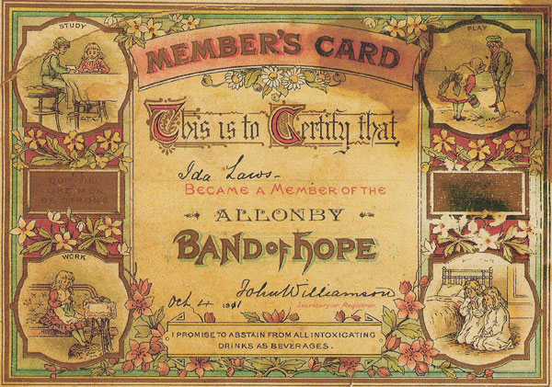
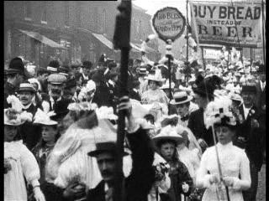
Band of Hope Pledge cards and marches

Slide 13
Visiting societies and prison reform
Visiting societies first established in 1785 and by the middle of the 19th century there were hundreds supported by all churches.
They were concerned both to aid the sick and needy or women lying in after having their children but also to foster the virtues of domestic life. There was often a difficult relationship between the visitors and the visited: To enter a labourer’s cottage to put the wife and mother there through a catechism before her own children as to what she has to live upon, how she manages, filled up with reproaches as to why she does not keep her children cleaner and her cottage more tidy, has always seemed to me both unladylike and uncharitable, and that it effects no good purpose I am also morally convinced. The poor woman is most likely thinking in her heart ‘If you had as much to do as me, ma’am, I daresay you would not be any more tidy’; and it is very likely as soon as the visitor’s back is turned that she may mutter ‘Does she think that poor and rich are two different flesh that she talks to me so?’
Some women did try to face up to these issues. Ellen Ranyard conceived of the idea of the Bible Woman By 1862 there were 170 bible women in 76 districts of London.

Slide 14
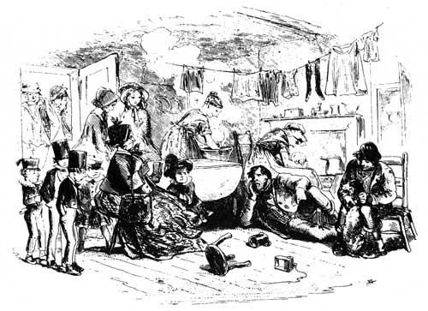
Mrs Paradiggle visiting the poor (from Bleak House)

Slide 15
Women active in visiting the institutions where the poor and destitute were to be found.
Prison visiting. Sarah Martin, a dressmaker of Great Yarmouth first visited Yarmouth Gaol to read the Bible to prisoners in 1819
Elizabeth Fry and the British Society of Ladies for promoting the Reformation of Prisoners founded in 1821 brought ‘cleanliness, godliness and needlework’ to women in Newgate.
Such women faced hostility from male authority. The report of the Commission on Prisons set up in 1835 was unfavourable to Elizabeth Fry’s reforms and role of women visitors was reduced.
Attempts to visit workhouses, which often revealed appalling conditions were resisted by local Boards of Guardians.
Louisa Twining began charitable visiting of workhouses against considerable resistance in 1847 and founded Workhouse Visiting Society in 1858.

Slide 16
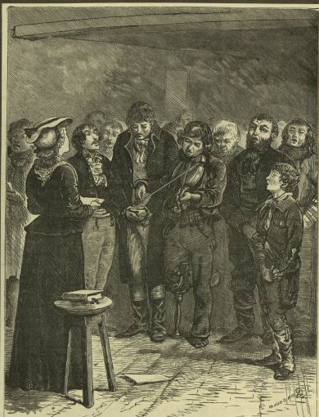
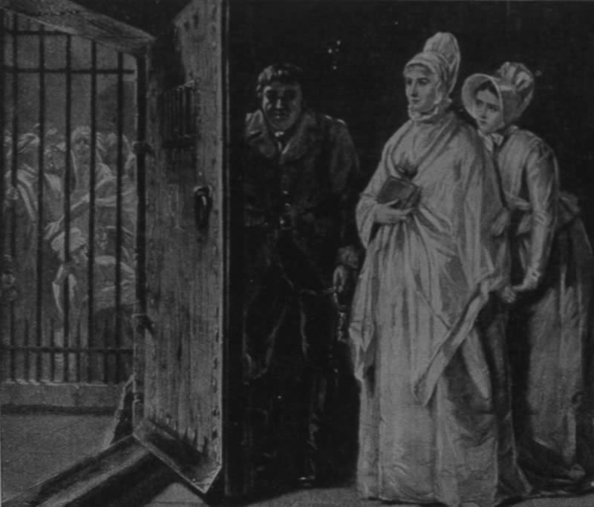
Elizabeth Fry at Newgate and Sarah Martin at Yarmouth prison

Slide 17
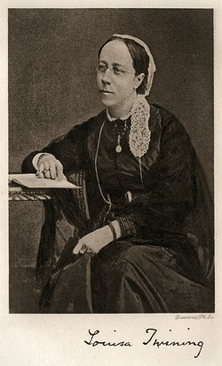
UCL Bloomsbury Project

Slide 18
Mary Carpenter and juvenile offenders
Carpenter’s work for the ragged and criminal children of Bristol in the 1840s and 1850s made her an international celebrity.
In 1846 forms privately run school for ragged children in the Lewin’s Mead slum of Bristol. Four years later she founded a reformatory school at Kingswood and opened a girls’ reformatory at Red Lodge.
Carpenter opposed state-initiated welfare schemes and distrusted all forms of government interference.
She published Reformatory Schools for the Children of the Perishing and Dangerous Classes and for Juvenile Offenders in 1851 and captured a national audience for her work and ideas
In 1852 she and Matthew Davenport Hill organised the first national conference on Juvenile Delinquency.
She testified before the House of Commons Select Committee on Criminal and Destitute Children and many of her ideas were incorporated into the 1854 Act which established the national system of reform schools
Although she had triumphed in influencing state policy she had ceded her power (and those of other female reformers) to male politicians, governors and inspectors.

Slide 19
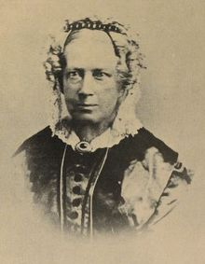
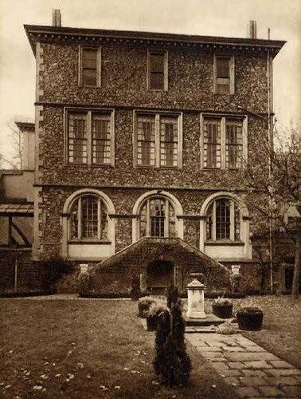
Mary Carpenter and the Red Lodge Reformatory School, Bristol

Slide 20
Hannah Kilham and missionary work
Hannah Kilham had a missionary impulse from her religious background
In Sheffield she assisted in running New Connexion Sunday School in Sheffield and opened her own day and boarding school for daughters of wealthy Quakers.
She was a founding member of the Sheffield Society for Bettering the Condition of the Poor and became active in the Society for Superseding the Necessity for Climbing Boys, the Sheffield Bible Association, the Society for Visiting and Relieving Aged Females and the Girls’ Lancasterian School

Slide 21
Kilham’s Family Maxims was a small book devoted to such themes as self-discipline, honesty, forbearance, watchfulness, neglect and happiness
In Ireland she travelled as a member of the British and Irish Ladies’ Society for improving the condition and promoting industry and welfare of the female peasantry in Ireland
Middle class women’s superiority was heightened in Ireland because they were English and Protestant and the women they worked with were Irish (and colonised) and Catholic. They were thus regarded as a lower form of civilisation.

Slide 22
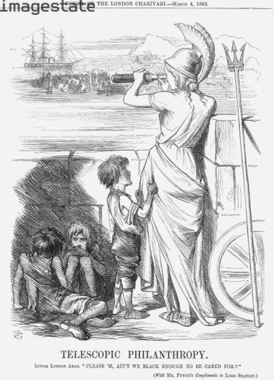
Focus on charity overseas brought condemnation from commentators eg Dickens’ Mrs Jellyby who ignores her own children at the expense of helping those in Africa

Slide 23
Conclusions
Connection between women, philanthropy and politics. Role women played as policy makers, care providers and clients in the construction of the British welfare state has been overlooked.
Women were influential in the localities as elected and appointed officials and as members of voluntary societies that addressed every conceivable social programme.
Victorian middle-class women’s voluntary associations linked the private female world of household and family to the public male dominated world of politics.
Class connotations: much attention has been given to the role of middle class women and their motivations, however working class women were also involved in charity work
Much emphasis has been put on woman’s mission and the qualities that supposedly linked women and charitable work. This work – like teaching and nursing – is seen as suited to women’s caring and gentle tendencies. However, the role of men in philanthropy, and what that says for masculinity, has not yet been fully researched

