Slide 1
Property and consumption

Slide 2
Outline
Women's property rights in the 18th and early 19th centuries
Discuss their impact on women in practice
Consider the role consumption played to fuel the industrial revolution
Assess gender differences in consumption practices
Discuss some of the source material for analysing consumption

Slide 3
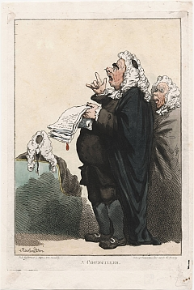
Women and the Law
Four separate bodies of law administered by four different sets of courts:
Common law
Equity
Ecclesiastical law
Maritime law
Jurisdictions confused and overlapping

Slide 4
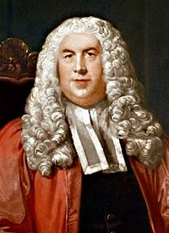
Women and the Law
William Blackstone, 'in law husband and wife are one person and the husband is that person... she is therefore called in our law a feme covert.'

Slide 5
Women and the Law
Common law recognised distinction between real property (property in land) and personal property. Common law gave wives considerable protection with regard to real property but none at all for personal property.
All personal property belonging to a woman at marriage belonged to her husband absolutely.
Exception was paraphernalia, that is the clothing and personal ornaments a woman possessed at the time of her marriage or that her husband gave her during marriage.
Technically a married woman could enter no contracts in her own name but could enter into contracts in her husband's name as his agent.
Under the law of agency, a woman could pledge her husband's credit with tradesmen for the supply of necessaries

Slide 6
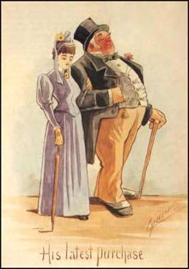
The law in practice
Married women used law as a strategy to evade the control of their husbands. Margot Finn argues women could evade the theoretical constraints of the law.
Davidoff and Hall in Family Fortunes underscore the limitations on women's economic opportunities before the Married Women's Property Acts
Tim Meldrum argued that there was an increasing feminisation in the business of the consistory court

Slide 7
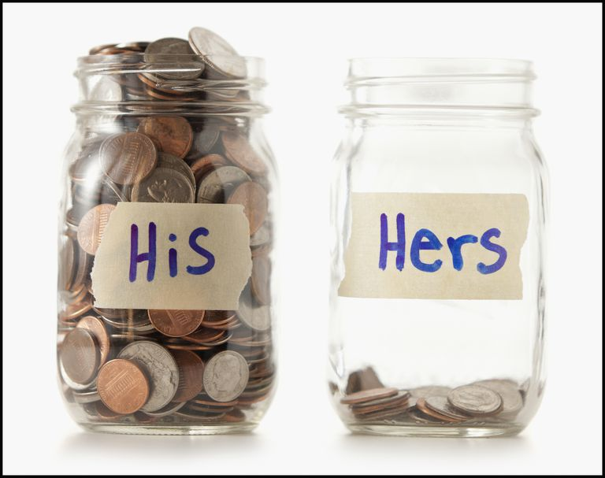
The law in practice
law of necessaries: married women could make contracts on their husbands behalf
use of the law of necessaries as an instrument of credit
actions in the court of requests and the county courts which acted as small claims courts
women made up only a small proportion of insolvent debtors at Lincoln 4.7% of debtors were women, at Lancaster 2%
Small traders could be prosecuted for the debts of their estranged wives

Slide 8
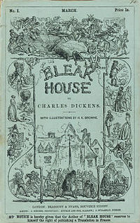
Equity
Equity developed the trust settlement of property. Trusts enabled landowners to make provision for their wives and children after their death
Court of Chancery allowed the creation of a special category of property, the so-called separate property or separate estate of a married woman
Only applied to wealthy women (10%) as was impractical to tie up small sums of money in trust settlements
Amy Erickson found that at least 10% of non-elite married women protected their property with informal settlements

Slide 9
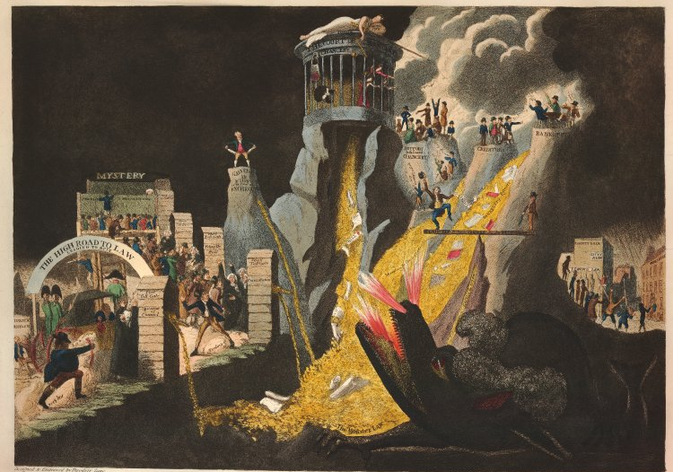
Law gorging on the spoils of fools & rogues & honest men among folly & knavery producing repentence & ruin. Or the fatal effects of legal rapacity.
On the left a doorway "The high road to law", in the centre a mountain "The court of Chancery" from which gold coins flow, and in the right foreground a dragon labelled "The monster law"

Slide 10
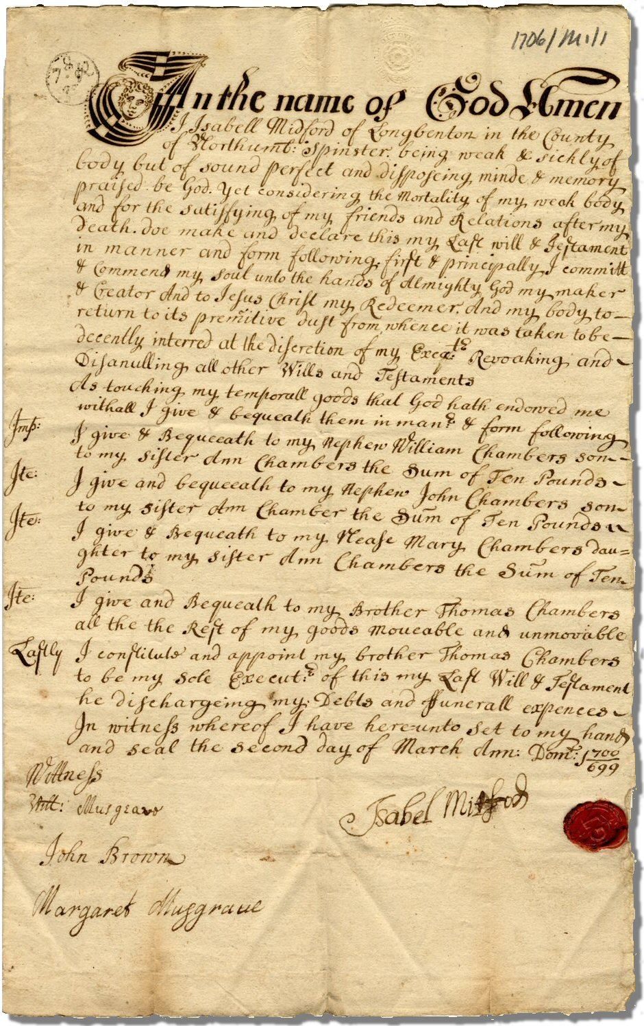
Wills
Of women leaving wills in Birmingham and Sheffield around 47% owned real property ie land or houses. In Birmingham nearly three-quarters owned more than one piece of land or property.
Women also bequeathed personal property in their own wills.
Women's goods were often emotionally significant to them: the clothing women left was frequently described in some detail, including colour and type of cloth. Household goods such as china and jewellery were described often with their dynastic connotations, and left to family members as a means of cementing the family heritage.
Will of Isabel Mitford, 1706
http://familyrecords.dur.ac.uk/nei/NEI_feature.htm

Slide 11
Will of Isabel Mitford, 1706
http://familyrecords.dur.ac.uk/nei/NEI_feature.htm

Slide 12
Consumption
To complement this work on women's property, recent research has begun to examine in more detail the consumption of a widening range of commodities in the 18th century.
Attention has been focused not only on standard household goods but on the emerging luxury commodities. Food such as tea, coffee, sugar; fine china, pewter, wigs and clothing accessories.
This concentration on the demand side of the economy has been developed as a counter to economic historians past emphasis on manufacturing and production.

Slide 13
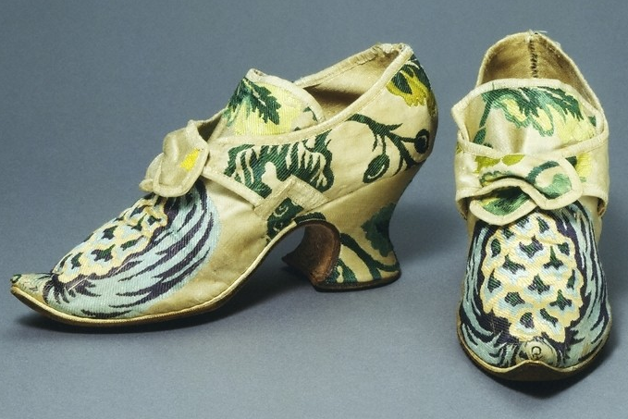
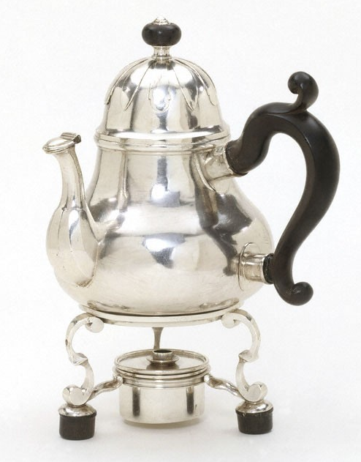
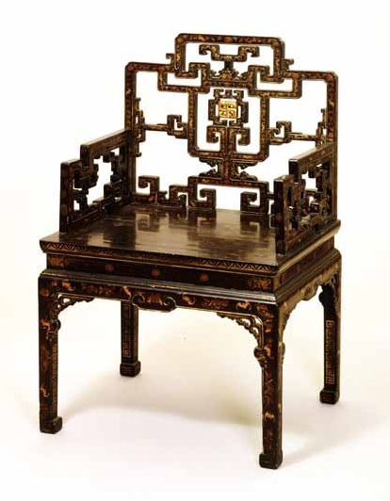
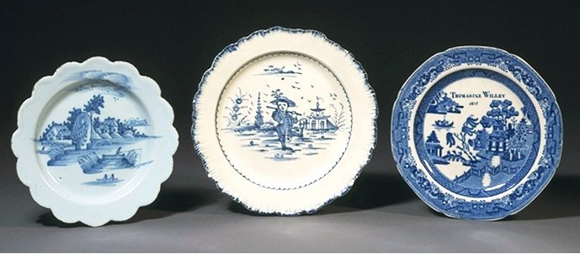
Luxury goods supplying consumer revolution

Slide 14
Historiography
McKendrick called explosion in consumer demand a consumer revolution.
Peter Earle who uses probate inventories and documents 'an almost revolutionary change in the types of clothes worn by both sexes' and a major upgrading of the interiors of houses among the middling sort.
De Vries argues changes in household behaviour led to what he calls an 'industrious revolution' driven by commercial incentives that led the way for the industrial revolution.
Reasons: increasing specialisation; rural families worked harder, shifted their crop mix towards marketable products, and used underemployed reserves of child and female labour to expand production of both agricultural and industrial goods; households redeployed their labour and reduced leisure time to increase their production and their income.
In McKendrick's view, the consumer revolution was fuelled by the earnings of these women and children.

Slide 15
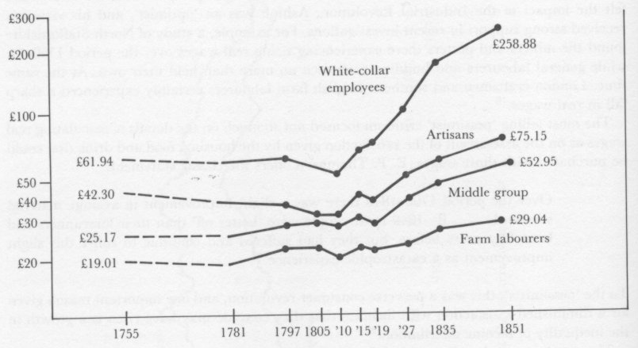
Average adult male earnings

Slide 16
Women and consumption
Prejudices against the female consumer emerge in the work of both contemporaries and historians
Women seen as obsessed by material goods, ostenatious, parasitic
Much feminist scholarship has been suspicious of the world of commodities, viewing fashion in negative terms as emblematic of women's decorative dependence
Historians have focused on model of social emulation to explain consumption
Weatherill’s analysis of probate inventories ascribes motives of consumers linked to functional rather than fashionable imperatives

Slide 17
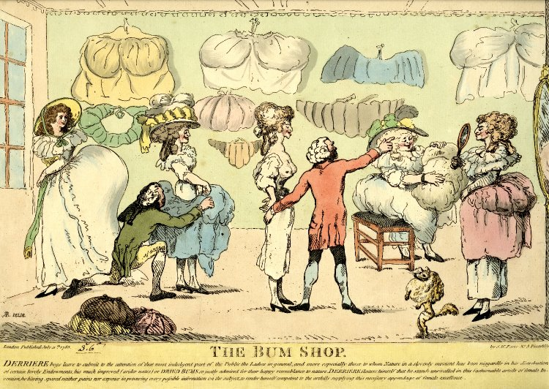
Caricatures document obsessive and ridiculous fashions often for women who were depicted as particularly susceptible to vanity and absurdity

Slide 18
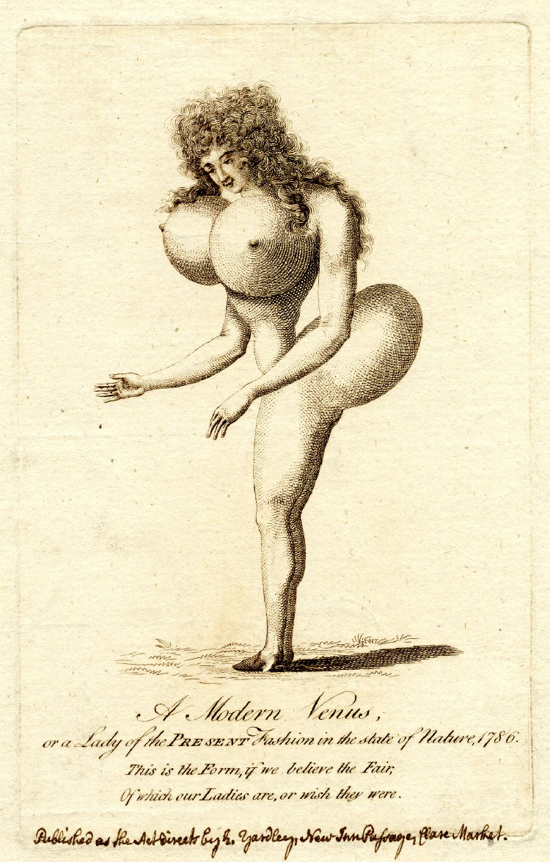
A Modern Venus or a Lady of the Present Fashion in the State of Nature, 1786

Slide 19
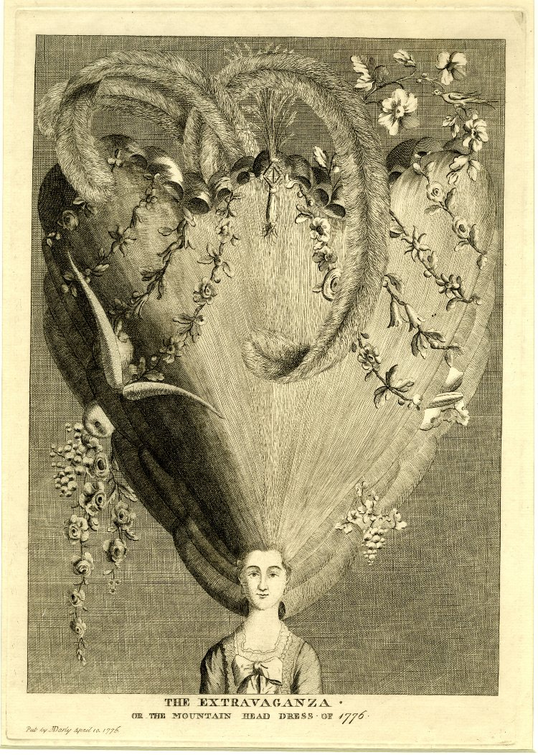
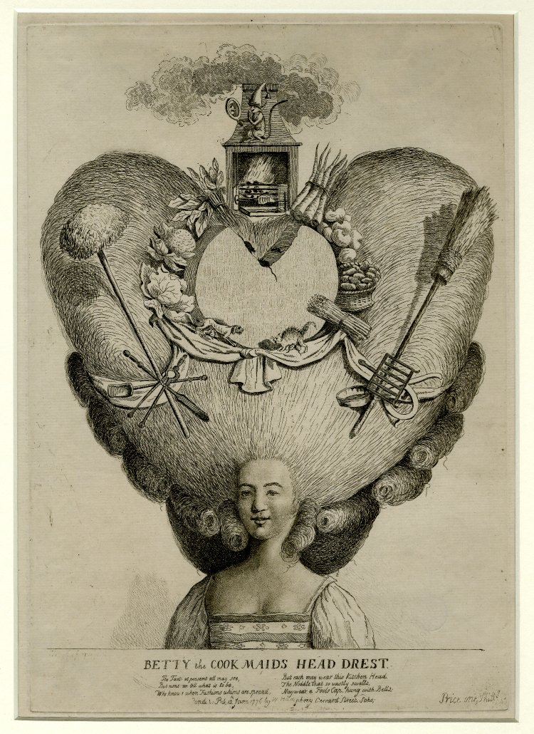

Slide 20
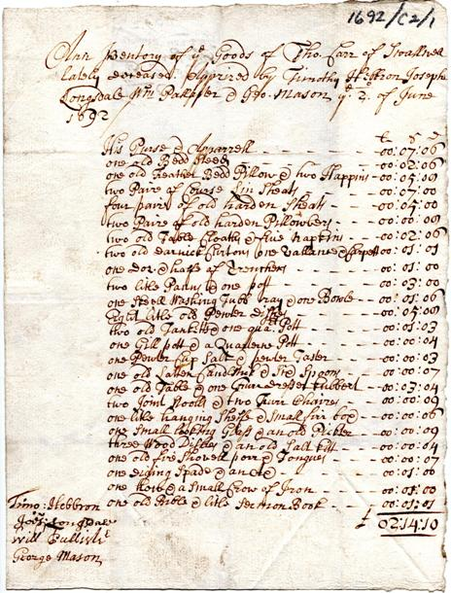
 | L s. d.
His Purse & Apparrell | 00 : 07 : 06
one old Bedd Steed | 00 : 02 : 06
one old Feather Bedd Pillow & two Happins | 00 : 05 : 08
two Paire of Coarse Lin[en] Sheats | 00 : 07 : 00
four paire of old harden Sheats | 00 : 05 : 00
two Paire of old harden Pillowbers [pillowcase] | 00 : 00 : 08
two old Table Cloaths & five Napkins | 00 : 02 : 06
two old Darnick Curtons one old Vallance & Carpett | 00 : 01 : 01
one Dozen & halfe of Trenchers | 00 : 01 : 00
two little Panns & one pott | 00 : 03 : 00
one Skeel Washing Tubb tray & one Bowle | 00 : 01 : 06
Eight little old Pewter Dishes | 00 : 05 : 08
two old Tanketts & one quart pott | 00 : 01 : 03
one Gill pott & a Quarterne Pott | 00 : 00 : 04
one Pewter Cup Salt & pewter Taster | 00 : 00 : 03
one old Latten Candlstick & Six Spoons | 00 : 00 : 07
one old Table & one Furr Dresser kubbert | 00 : 03 : 04
two Joint Stoolls & two Furr Chaires | 00 : 00 : 09
one little hanging Shelfe & small firr box | 00 : 00 : 06
one small looking Glass & an old Pickter | 00 : 00 : 09
three Wood Dishes & an old Salt kitt | 00 : 00 : 04
one old fire Shovell porr & Tongues | 00 : 00 : 07
one Diging Spade & an Ax | 00 : 01 : 00
one how & a small Crow of Iron | 00 : 01 : 00
one old Bible & little Sermon Book | 00 : 01 : 01
£ | 02 : 14 : 10
Inventory of Thomas Carr of Swallwell1692

Slide 21
Male and female consumption
Vickery uses micro history to study the habits of one female consumer - Eliza Shackleton of Lancashire – includes letters, diaries, and household account books
Papers show men and women were both skilful consumers but of different sorts of products. Eg Bessy Ramsden bought the 'gowns, caps, ruffles and such like female accoutrements' and her husband 'the wafers, paper and pocket book.' Women bought the humdrum groceries, whilst men the snuff, good tea, wine, game and oysters. NB: criticised by Margot Finn
Vickery sums up male and female consumption patterns thus: 'while female consumption was repetitive and relatively mundane, male consumption was by contrast occasional and impulsive, or expensive and dynastic.'
Stana Nenadic's study of Edinburgh and Glasgow uses probate inventories supplemented by diaries and household accounts in her study of Edinburgh and Glasgow
These illustrate that for most of the middle ranks of the population, the purchase of household objects and especially luxuries, was a relatively rare event not undertaken without considerable planning.
Notes trend towards 'affectionate consumption', that is the collection of items which provided their owners with tangible reminders of links with their relatives, their friends or a reminder of a past life.

Slide 22
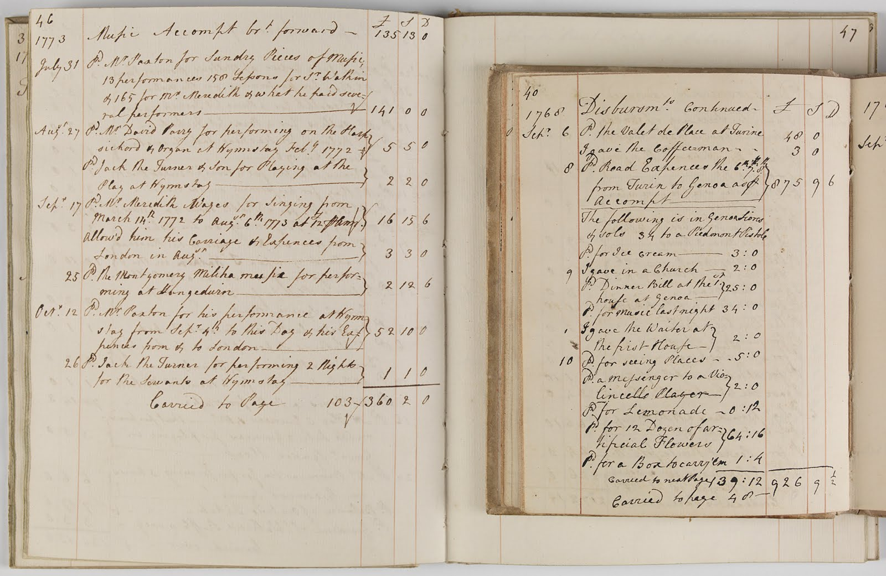
Account book of Sir Watkin Williams Wynn, 1768-1773

Slide 23
Lorna Weatherill’s analysis of social status and ownership of goods (John Brewer & Roy Porter, Consumption and the World of Goods)
Social Status | Cooking pots | Pewter | Earthenware | Books | Clocks | Pictures | Table Linen | China | Silver
Gentry | 84 | 93 | 39 | 39 | 51 | 33 | 60 | 6 | 61
Trades of high status | 75 | 95 | 53 | 45 | 34 | 35 | 63 | 11 | 51
Trades of intermediate status | 77 | 94 | 49 | 24 | 25 | 29 | 58 | 9 | 38
Yeomen | 69 | 95 | 33 | 18 | 19 | 4 | 35 | 1 | 13
Trades of low status | 74 | 96 | 42 | 17 | 18 | 15 | 50 | 3 | 23
Husbandmen | 57 | 89 | 28 | 4 | 4 | 0 | 16 | 0 | 2
Labourers | 79 | 89 | 43 | 4 | 0 | 4 | 18 | 4 | 0
Widows/Spinsters | 66 | 89 | 33 | 18 | 13 | 12 | 46 | 4 | 37
Other trades | 82 | 88 | 50 | 32 | 29 | 32 | 61 | 11 | 46
Unknown | 70 | 88 | 27 | 17 | 14 | 18 | 40 | 5 | 23
Total | 70 | 93 | 37 | 19 | 19 | 13 | 42 | 4 | 23

Slide 24
Conclusions
Analysis of women's property holding and their consumption of goods is more complex than historians such as Davidoff and Hall have painted
Davidoff and Hall charted rise of the cult of domesticity and focus on the fact that legally married women could own no property
Recent research has challenged that view and uncovered a gulf between legal theory and practice
Consumer revolution/industrious revolution brought explosion in the types and range of goods women and men possessed
Research challenges previously accepted models of gender relations

