Slide 1
Prostitution and Vice

Slide 2
Overview
Extent of Prostitution
Contemporary Reactions
Contagious Diseases Acts
Social Purity movements
Analyses
Conclusion

Slide 3
Contemporary approaches
a Calvinist condemnation of the prostitute as a temptress whose sin must be suppressed
an evangelical piety seeing the prostitute as a victim of poverty and male lust as well as her own sin
a ‘social science’ approach which accepted prostitution as a necessity and called for its regulation in order to safeguard public health

Slide 4
Representations
Missionaries and charity officials treated common-law wives, deserted unmarried mothers, victims of rape and street-walkers all as fallen women living in sin
For the working class cohabitation, premarital pregnancy, illegitimacy and bigamy were common
Sexual commerce linked to the conditions of women’s work and economy
Prostitution was seasonal rising in the winter and falling in the summer
Prostitution had a certain glamorous appeal

Slide 5
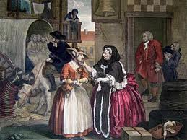
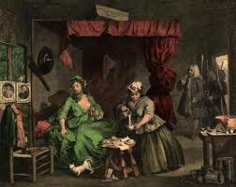
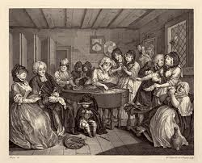
Hogarth’s Harlot’s Progress, 1733
From procurement to death at the age of 23

Slide 6
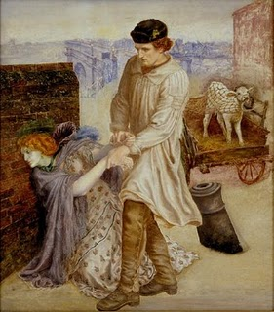
Daniel Rosetti, Found?

Slide 7
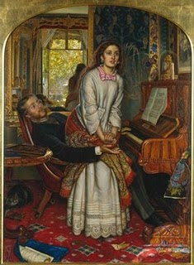
Holman Hunt, The Awakening Conscience

Slide 8
Locations
Some lived in brothels although these declined as a result of police prosecution
In London were 933 in 1841 to 410 in 1857
Common lodging houses to ‘service’ men they had picked up on the street
Male prostitution also continued throughout the period
Pimps were rare until late in the century
Majority of customers were working men

Slide 9
Numbers
Difficulties: ‘clandestine’ prostitution; numbers fluctuated with economic conditions; seasonal variations
Colquhoun in Treatise on the Police of the Metropolis, 1797 estimated there were 50,000 prostitutes in London
Talbot and Ryan of one of London’s major prostitute rescue societies put the figure at 80,000 in the 1830s.
Whitehorne in 1858 postulated that one-sixth of unmarried women between the ages of 15 and 50 were prostitutes which would amount to a figure of around 83,000
French commentators of the 1860s estimate up to 220,000 in London

Slide 10
Year | London | England & Wales
1839 | 6,371 | -
1841 | 9,409 | -
1857 | 8,600 | -
1858 | 7,194 | 27,113
1859 | 6,649 | 28,743
1860 | 6,940 | 28,927
1861 | 7,124 | 29,572
1862 | 5,795 | 28,449
1863 | 5,581 | 27,411
1864 | 5,689 | 26,802
1865 | 5,911 | 26,213
1866 | 5,554 | 24,717
1867 | 5,628 | 24,299
1868 | 5,678 | 24,311
Police Estimates

Slide 11
Contemporary reactions
Before 1839 street walkers arrested under vagrancy legislation
In 1839 a clause in the Police Act introduced the notion of a ‘common prostitute’
1830s and 1840s witnessed resurgence in public sympathy for the prostitute
From 1840s social investigators used new statistical techniques to produce several detailed studies of prostitution eg William Tait, Magdalenism (1840), W R Greg, ‘Prostitution’ in Westminster Review (1850) and William Acton, Prostitution (1870)

Slide 12
Contagious Diseases Acts
Venereal disease became a public issue most evident among the military
Contagious Diseases Acts passed in 1864 and amended in 1866 and 1869
Policemen given mandate to identify women as common prostitutes; submit them to fortnightly internal examination; if gonorrhoea or syphilis found detained women in lock hospitals for 3-9 months
Acts first applied to 11 garrison and port towns and then to a further 5 districts

Slide 13
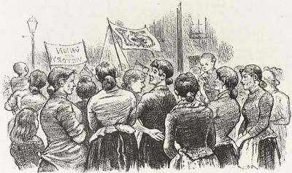
Women demonstrating against Contagious Diseases Acts, Illustrated London News, 1889

Slide 14
Resistance
Repealers published around 520 books and pamphlets on the topic with those arguing for their retention generating a similar number
The National Association for the Repeal of the Contagious Diseases Acts, founded in 1869 joined together provincial nonconformists and metropolitan radicals
Ladies’ National Association also founded in 1869. Led by Josephine Butler, a feminist of strong religious convictions, the LNA gathered together women in 104 local branches by 1884.

Slide 15
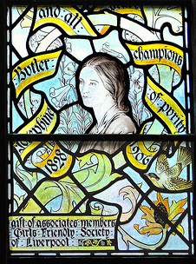
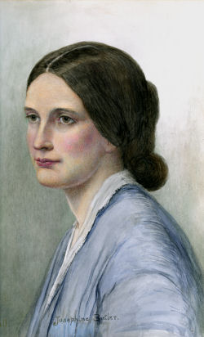
Josephine Butler depicted in the ‘Noble Women’ windows, Liverpool Cathedral 1910 and in a drawing of 1851

Slide 16
Approach of LNA
Made efforts to ‘protect’ working class women but also empowered them
Formed alliances with working class men who perceived Acts as aristocratic sexual exploitation of poor girls
Butler frequently presented the Acts as a ‘slave code’ imposed on women drawing a close parallel with the abolition of slavery.
Male supporters and organisers discouraged active participation of women
1870-1885 were over 17,000 petitions with around 2.6 million signatures; 900 public meetings matched again by meetings held by their opponents
Liberal government suspended the Acts and they were repealed in 1886

Slide 17
‘Technologies of Power’
Judith Walkowitz argues that ‘technologies of power’ transformed the structure of prostitution
Lesley Mahood claims similar technologies existed in Scotland eg Lock Hospitals; magdelene asylums; police repression of prostitutes
Moral reformers created non-statutory female penitentiaries to entice women into direct care early in their careers and to supervise their moral reformation
Subjected to moral education and industrial training and expected to conform to middle class standards of femininity

Slide 18
Disposition of Inmates Glasgow & Edinburgh Magdelene Institutions
Disposition | Glasgow | Edinburgh
Satisfactory | 40% | 55%
Diverted to other institutions | 24% | 7%
Unsatisfactory | 35% | 36%
Died or sent abroad | 1% | 2%
Satisfactory = those restored to family and friends or placed in domestic service
Other institutions = sent to House of Refuge, poorhouses, Lock hospitals, infirmaries or insane asylums
Unsatisfactory = those discharged as intractable, disobedient or insubordinate, those who absconded or those who left voluntarily

Slide 19
Maiden Tribute of Modern Babylon
1885 a white slavery scandal was generated by W T Stead in the Pall Mall Gazette
Stead arranged to purchase a 13 year old girl, Eliza Armstrong from her mother and had her drugged and examined for virginity
Outcry against the sexual exploitation of poor girls led to the foundation in 1885 of the National Vigilance Association
Criminal Law Amendment Act, 1885 raised the age of consent from 13 to 16.
Also increased police powers to suppress brothels and arrest procurers of prostitutes

Slide 20
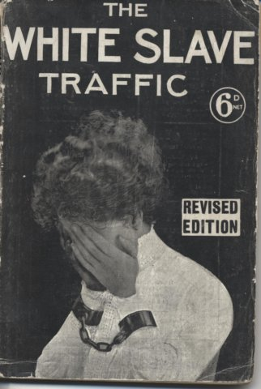
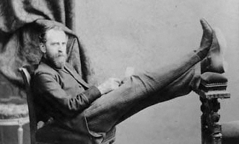

Slide 21
Social Purity movements
Social Purity campaigners isolated prostitutes from working class communities
By 1890s energies were directed against prostitutes themselves
Campaigners against the CD Acts went on to be active in the suffrage movement
Were specific campaigns directed towards the marriage laws and rape within marriage
Josephine Butler also waged campaigns against the CD Acts in India
Antoinette Burton claimed Butler helped shape a brand of maternal imperialism

Slide 22
Analyses
Double standard model: the belief that it is pardonable for men to engage in premarital or extra marital sex but a matter of grave concern for women. Historians who adopt this model attempt to establish a causal model between the double standard and prostitution
Oppression model: Finnegan’s study of prostitution in York typifies this model. Argues that studies of prostitution frequently concentrate on the institutional aspects rather than on the prostitutes themselves and the biting poverty that drove them to prostitution. Demonstrated that prostitution did not fit the double standard model of middle class demand and working class supply. Her data indicated that 73% of the men reported as associating with prostitutes belonged to the working class. Walkowitz opposes the portrayal of prostitutes as silent victims of social injustice and male oppression
Problematisation model locates prostitution within the larger economic, social and cultural structures of the 19th century.

Slide 23
Conclusion
Empirical studies of prostitution are problematic if they do not take into account the political, social and historical construction of the category of prostitute
Definition of a prostitute is contested
Study of prostitution has implications for women’s historians who alternatively study women as victims and the oppressed or who look for evidence of women’s agency
Social purity campaigners made links between women’s oppression and their lack of the vote
But were prostitutes mere bystanders in the campaigns?

