Slide 1
The Victorian Family

Slide 2
Overview
Ideals of the family
Middle-class families
Working-class families
Family structures
Roles of parents
Conclusion

Slide 3
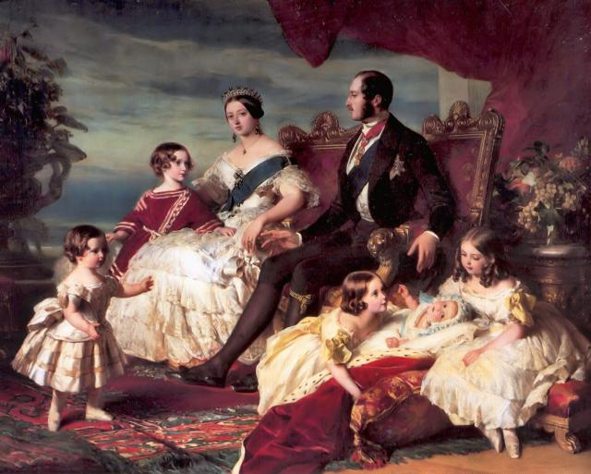
Queen Victoria and her Family (1846) by Franz Xavier Winterhalter

Slide 4
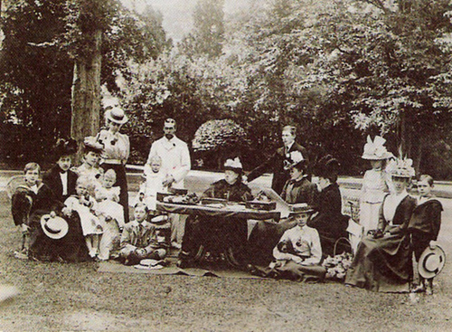
Queen Victoria and Family at Osborne House

Slide 5
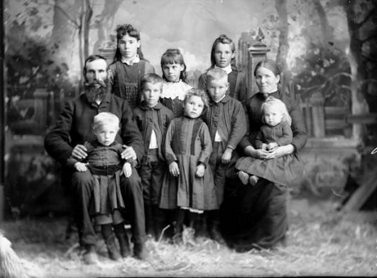
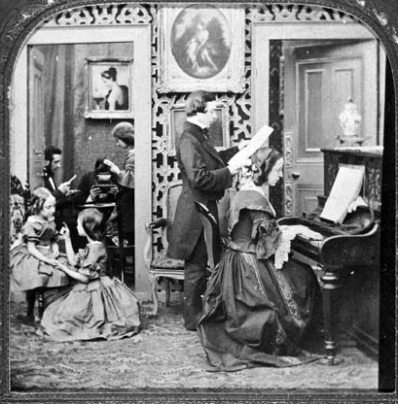
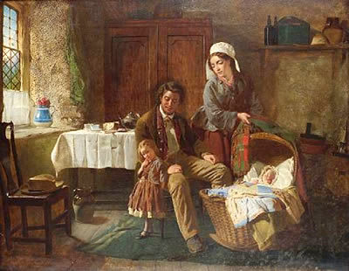
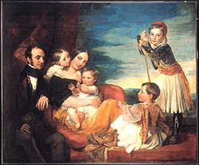

Slide 6
Ideal of the Family
Family provided retreat from stress and turmoil of industrial world
Idealised as centre of stability
Pleasures and virtues of home life were major theme in art and literature.
Household viewed as separate from the world of work fostering love, co-operation, and peace
Differentiation of sexual spheres: men in public sphere and married women in the home: ‘There can be no security to society, no honour, no prosperity, no dignity at home, no nobleness of attitude towards foreign nations, unless the strength of the people rests upon the purity and firmness of the domestic system’ (Shaftesbury)

Slide 7
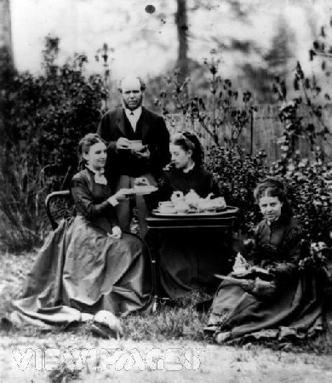
Middle-class Family
Middle-class family taking tea.
Note: unmarried daughters usually remained within the home until married.

Slide 8
Middle-class family
Family structure was primarily nuclear.
Family more isolated from its larger kinship network, although unmarried women often lived with married siblings
Aristocratic families had closer kinship ties beyond nuclear core
Working class families less privatised for they often housed lodgers within the home and extended family relationships were important for mutual support in times of dislocation and crisis

Slide 9
Companionate Marriage
Companionate marriage was norm with participants exercising free choice based on mutual love, subject only to parental veto.
Choice of marriage partners narrowed in 1835 by Lord Lyndhurst’s Act not modified until 1907
Romantic ideal of Victorian marriage not based on equality
Families conceived as child-centred because their needs determined domestic activity.
Mothers usually undertook the bulk of instruction of infants whilst fathers were in charge of discipline and added their own specific instructions.
Needed seclusion and dedicated family, domestic space.

Slide 10
Home
Hippolyte Taine, Notes on England:
‘Every Englishman has, in the matter of marriage, a romantic spot in his heart. He imagines a ‘home’, with the woman of his choice, the pair of them alone with their children. That is his own little universe, closed to the world.’
John Ruskin, In Queen’s Gardens (1864), described the ideal home as:
‘the place of Peace: the shelter, not only from all injury but from all terror, doubt and division… it is a sacred place, a vestal temple, a temple of the hearth watched over by Household Gods.’

Slide 11
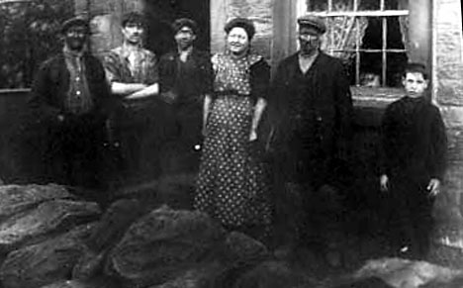
Working-class Family
Mining family from Flockton, Yorkshire

Slide 12
Working-class Family
Subject of intense debate
Anxieties raised on issues such as child care, birth control, and gender roles exposing contradictions in ‘separate spheres’ ideology
Used model of the family to assert masculine privilege and the rhetoric of masculinity was used throughout the Chartist movement
Letter from ‘Blandini’ to the Bradford Observer in 1871 typifies this. He called for the adoption of a 9 hour day for men and a 6 hour day for women and children, justifying this difference by arguing that:
‘wives and daughters shall be restricted to six hours per day, to give them a chance to learn domestic duties, for why should females be employed outside the domestic hearth. The domestic hearth is the only sphere in which they can shine in all their brilliance. What business have they outside of it?’

Slide 13
Working-class Mothers
Working class mothers singled out for particular approbation.
Factory women’s lives rendered them suspect for their important role as mothers.
Her poor cooking, inadequate cleaning and thriftlessness slowed the improvement of conditions for her family.
These commentaries blamed the poor for their problems and offered a solution on an individual basis.
Blame for social ills could be moralised, personalised and transferred from the public sphere of politics and the market to the private sphere of the family.

Slide 14
Family Structure
In 1861 67% of families were headed by husbands and wives; 18% by widows/widowers and 15% by bachelors/spinsters. For the remainder of cases the head was absent.
For families with children the average was 2.94 children per family. A quarter had 4 or more children at home.
From around 1870 there were changes in the composition of families. The mortality rate began to fall due to improving standard of living, better nutrition, public health reforms, and the decline in death by infectious diseases.
Also fall in the birthrate which meant number of children in families fell. Marriages in the late 1860s produced an average of 6.16 children by 1881 this had fallen to 5.27 and by 1914 much more dramatically to 2.73. 43% of women married in 1870-9 had between 5 and 9 children and 18% had ten or more.
There were important social differentials in this decline in fertility and mortality.

Slide 15
Family statistics from the census (www.histpop.org)

Slide 17
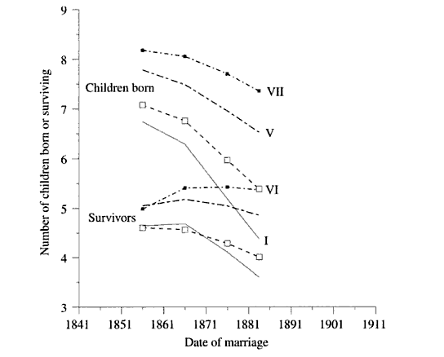

Slide 18
Parental roles
Parental roles became more sharply defined in the Victorian period
Father’s pre-eminent role was frequently being usurped by the mother in the Victorian period and therefore the fatherhood was profoundly redefined.
Roberts work on Victorian fathers uncovered three common characteristics: remoteness, sovereignty, and benevolence.

Slide 19
Conclusion
The privatised emotionally bonded family was the dominant model and characterised all levels of society
It was enduring and engendered strong feelings of both love and rage. So in reality was often a source of tension and disquiet.
Victorian family may be viewed as a self-sufficient unit and inward looking. But there was an interplay between the public and domestic roles.
Contemporary debates about the family focused attention on issues of domesticity rather than on unequal burdens of gender roles.
Middle class blamed social ills on the problems of family life among the working class.
Working class men accepted the legitimacy of domestic ideology but sought to turn that ideology on its head by blaming the competitive system for forcing the working class family away from its preferred ideal and mothers out to work.
Neither group attempted to reconcile their beliefs with the reality of family life.

