Slide 1
Enlightenment Thinkers and Gender
Mary Wollstonecraft and Hannah More

Slide 2
Introduction
Debate on gender often confused and contradictory
Growing number of female writers entering debate
Focus on role of women, their education, and their participation in the public sphere
‘Feminist’ Mary Wollstonecraft is seen as polar opposite of conservative Hannah More
Lecture will explore role of women writers and the Enlightenment

Slide 3
Mary Wollstonecraft, 1759-97
Came from the urban middling classes
Her father lost land and capital through failed investments
1783 MW and her two sisters were faced with the prospect of having to support themselves
Only option was to take up posts as governesses or to set up a small shop or school
Her unhappy experiences as a governess influenced Thoughts on the Education of Daughters
Eventually managed to support herself in London as a woman of letters
Published her first political work Vindication of the Rights of Men in 1790
Notes:
MW came from the urban middling classes. Although her father had inherited land and capital he lost these through a series of failed investments so in 1783 MW and her two sisters were faced with the prospect of having to support themselves. Although they had only a little formal education themselves the only option open to them was to take up posts as governesses or to set up a small shop or school. Her resultant unhappy experiences as a governess to the family of the Earl and Countess of Kingsborough in 1786-7 were to influence her early work: Thoughts on the Education of Daughters. She eventually, with the help of a sympathetic publisher managed to support herself in London as a woman of letters. She lived among a small group of intellectuals some of whom were already greatly interested in the situation of women eg the historian Catharine Macaulay who in her Letters on Education of 1790 wrote a plea for equal moral standards in the education of boys and girls and Thomas Holcroft who used the form of the novel to plead the cause of women. MW published her first political work Vindication of the Rights of Men which was among the first replies to the conservative Edmund Burke in 1790.

Slide 4
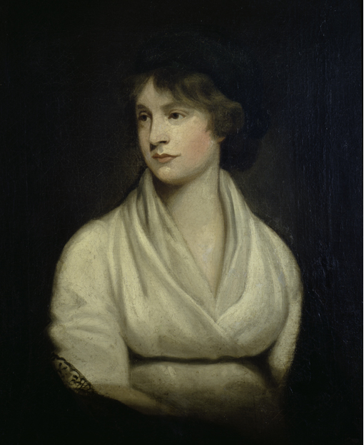
Mary Wollstonecraft (1759-1797)
Portrait by John Opie, c. 1797

Slide 5
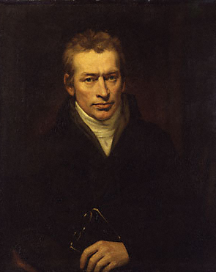
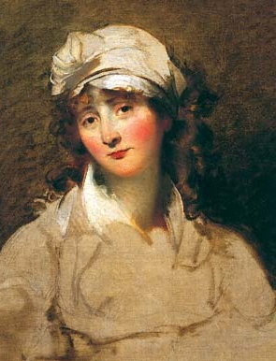
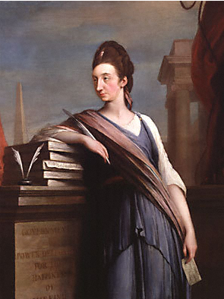
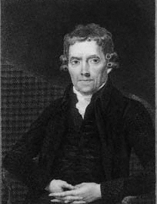
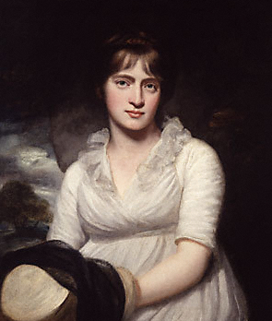

Elizabeth Inchbald - writer
Catharine Macaulay - historian
Thomas Holcroft - writer
Mary Wollstonecraft’s circle in London
Joseph Johnson - publisher
William Godwin - philosopher
Amelia Opie – poet and novelist

Slide 6
Richard Price
In 1789 Dr. Richard Price, a Unitarian minister preached a largely innocuous sermon "On the Love of Country." (commemorating 1688)
Congratulated French National Assembly, for opening new possibilities for religious and civil freedom
Price spoke of being a citizen of the world with the rights that citizenship implied.
Argued for doctrine of perfectability – that world can be made better through human effort. Justified social reform
Notes:
The debate had begun in 1789, when Dr. Richard Price, a Unitarian minister in England, preached a largely innocuous sermon "On the Love of Country." In this sermon he congratulated the French National Assembly, for the Revolution had opened up new possibilities for religious and civil freedom. Price argued that ‘civil governors are properly the servants of the public, and a king, is no more than the first servant of the public, created by it and responsible to it…’ The French Assembly's "Declaration of the Rights of Man and of the Citizen" was, indeed, a landmark in world history, especially following the 1776 American Declaration of Independence which would lead to a great global reformation. Price spoke of being a citizen of the world -- with the rights that citizenship implied. He fleshed out further his doctrine of perfectability -- that the world can be made better through human effort. This doctrine was the theological and philosophical justification for social reform, for striving in this world for social change.
The responses to this sermon are perhaps better known than the initial sermon itself. Edmund Burke, appalled at the substitution of the rights of man for the rights of kings, for the institution of liberty at the expense of traditional authority, responded with his Reflections on the Revolution in France. Burke argued that the overthrow of authority in France would bring on chaos and disorder. His arguments answered and denied Price's assertions of natural rights and Price's doctrine of perfectability.

Slide 7
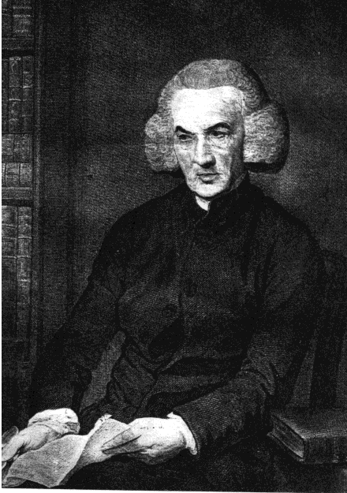
Richard Price (1723-1791)
Unitarian Minister, philosopher, political radical

Slide 8
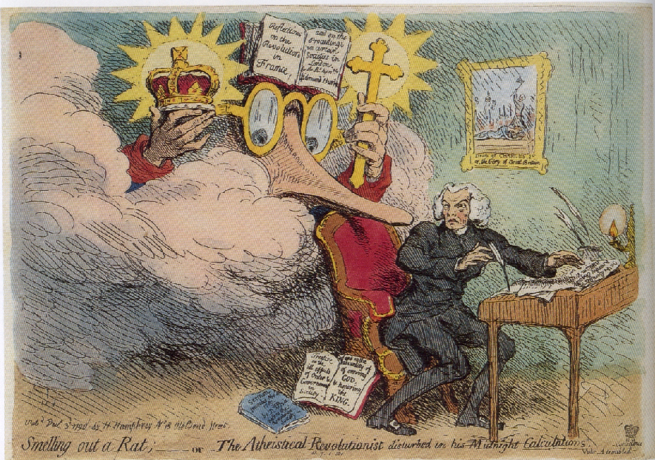
Burke haunting Richard Price: Smelling out a rat; - or - the atheistical-revolutionist disturbed in his midnight calculations by James Gillray, published by Hannah Humphrey, 3 December 1790

Slide 9
Responses: Burke
Responded with Reflections on Revolution in France
Argued overthrow of authority in France would bring chaos and disorder. He denied Price's assertions of natural rights and doctrine of perfectability.
Viewed himself as moderate. Argued Reflections had gradualist reform agenda
Reform in France should recognise Europe was already improving
Praised reforming institutions eg Church, arts, commerce and the landed gentry.
Notes:
Burke's Reflections on the Revolution in France had initiated an important debate on the nature of revolution in France. His account was exaggerated and sensational and intended to warn the British to reject the French example. His aim was to defend the existing social order through his appeal to the importance of custom, habit and tradition in politics.

Slide 10

Edmund Burke (1729/30-1797)
Portrait by Joshua Reynolds, 1774

Slide 11
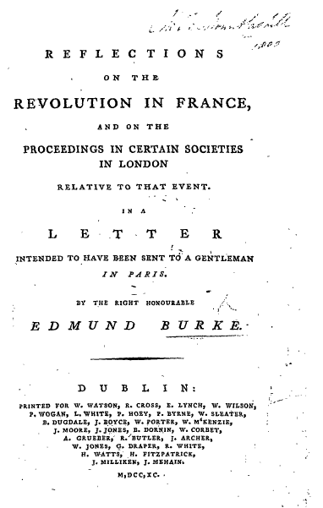

Slide 12
Response to Burke: Wollstonecraft
Member of Price’s congregation wrote: A Vindication of the Rights of Men, published in 1790.
Presented Burke as former reformer, grown old and confused, basically a good man but one corrupted by the English establishment.
Argued for rights of civil and religious liberty. Aristocracy displaced in France was decadent.
Criticized Burke's sympathy for women of the displaced aristocracy in France – particularly his eulogising of Marie Antoinette – as selective, ignoring the many more thousands of women who suffered under the old regime
She supported his notion of gradualism of reform.
Considered the present as a prelude to a brighter age
Notes:
MW response was concerned less with a defence of the revolution, although other female writers such as Helen Maria Williams, Anna Laetitia Barbauld and Catherine Macaulay were active spokeswomen for the revolution, but with a direct attack on Burke himself, whom she attacked for his belittlement of the poor.
MW presented Burke as a former reformer, grown old and confused, basically a good man but one corrupted by the English establishment. His position, she argued, came to little more than ‘reverence for the rust of antiquity’. In her angry rebuttal of Burke she argued for what she considered God-given rights of civil and religious liberty. She spoke of the aristocracy that was being displaced in France as decadent. She criticized Burke's sympathy for the women of the displaced aristocracy in France – particularly his eulogising of Marie Antoinette – as selective, ignoring the many more thousands of women who suffered under the old regime:
"your tears are reserved, very naturally considering your character, for the declamation of the theatre, or for the downfall of queens, whose rank alters the nature of folly, and throws a graceful veil over vices that degrade humanity; whilst the distress of many industrious mothers, whose helpmates have been torn from them, and the hungry cry of helpless babes, were vulgar sorrows that could not move your commiseration, though they might extort an alms".
Gary Kelly has noted that MW used both manner and style to reinforce her points. But MW supported Burke’s notion of gradualism of reform. Against his pessimism she considered the present as a prelude to a brighter age: ‘the revolution was the natural consequence of intellectual improvement, gradually proceeding to perfection in the advancement of communities, from a state of barbarism to that of polished society.’ Burke and MW did however, disagree on a number of significant issues including their views of reason, equality, feminism and education.

Slide 13
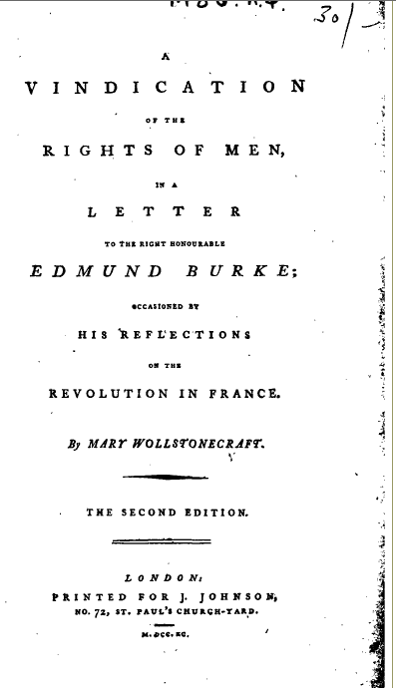

Slide 14
Vindication of the Rights of Woman
Published in 1792
Wove together hostility to privilege and inequality, sense of the corrupting effects of unequal education and expectations on women and vision of the possibility of a new political and moral order in which women too were equal citizens
Dedicated to Abbé Talleyrand
Specifically addressed the Vindication to the women of the middle class 'because they appear to be in the most natural state' rejecting both the luxury of wealthy women and the drudgery of poor women
Notes:
In the Vindication of the Rights of Woman, published in 1792 MW drew together her hostility to privilege and inequality, her sense of the corrupting effects of unequal education and expectations on women and her vision of the possibility of a new political and moral order in which women too were equal citizens. Her work was dedicated to Abbé Talleyrand in the hope that it might influence legislation on education in France. Her work also identified with the optimism of so many Englightment writers, rooted in their belief in the use of human reason and the diffusion of knowledge. She shared in the sense of progress of European civilisation, though women might not have achieved their share of its benefits. She specifically addressed the Vindication to the women of the middle class 'because they appear to be in the most natural state' rejecting both the luxury of wealthy women and the drudgery of poor women.
MW subsequently visited France and as she watched the events of the Terror came to feel less optimistic about the possibilities of radical political transformation. Whilst there she had an affair and lived with the American adventurer, Gilbert Imlay and gave birth to her first daughter, Fanny. In her last work, Maria or the Wrongs of Woman which was set in an asylum to which the heroine was confined by her husband, she was to explore the oppressive conditions of marriage for the middle class woman and the situation of the poor woman through the depiction of the life of the servant in the asylum, Jemima. Maria was never completed and was posthumously published after MWs death in childbirth, by her husband, William Godwin. Godwin's Memoirs of the Author of the Rights of Women published in 1798 told the story of MWs private life, yet associated her name indelibly with sexual freedom and notoriety.

Slide 15
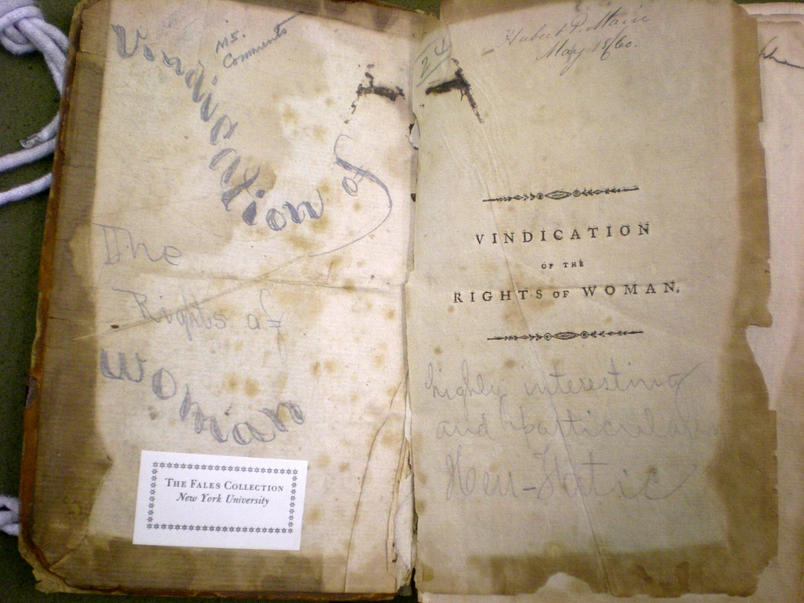

Slide 16
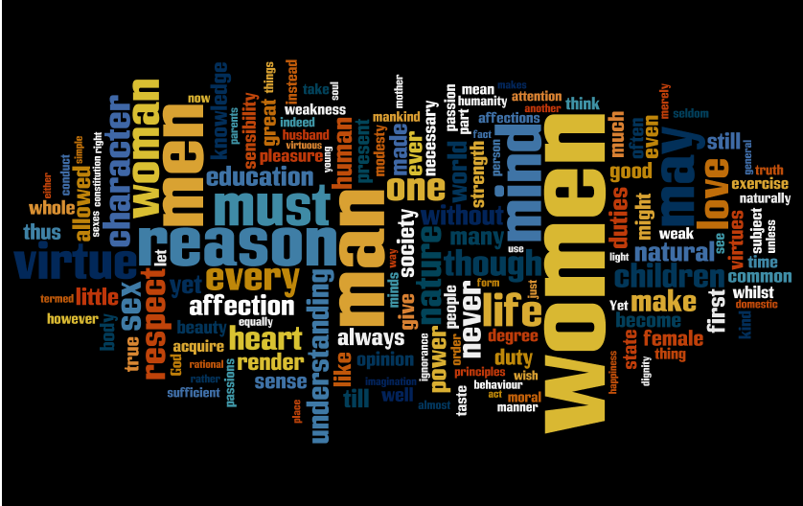

Slide 17
Themes: Education
Attacked number of earlier writers, including Rousseau, who had written suggested girls’ interests be subordinated to boys and were unable to attain the same levels of virtue
Accepted view that women had been corrupted by expectation that they would be governed by their feelings, their vanity, their pursuit of accomplishments to attract men
Argued pursuit of reason would subdue female passions
Right kind of education with it right association of ideas could transform the female character
Planned new system of universal national education
Notes:
The majority of the Vindication focuses on the education of women. MW attacked a number of earlier writers, including Rousseau, who had written on the education of grils suggesting that their interests be subordinated to boys and suggested that girls were unable to attain the same levels of virtue. MW was though equally critical of women. She accepted the common contemporary view that women had been corrupted and degraded by the general expectation that they would be governed by their feelings, their vanity, their pursuit of accomplishments to attract men. She condemned the way that women's lives were dominated by a sense of 'sexual character' by the denial of reason to them. She put the case that the pursuit of reason would subdue female passions. Thus the right kind of education bringing with it the right association of ideas could transform the female character. She planned a new system of national education, in which all, rich and poor, girls and boys, would be educated together until the age of 9.

Slide 18
Themes: Rights
Natural rights arguments combined with claims concerning social benefits of sexual equality
Women should be accorded civil and even political rights :
I still insist that not only the virtue but the knowledge of the two sexes should be the same in nature, if not in degree, and that women, considered not only as moral but as rational creatures, ought to endeavour to acquire human virtues (or perfections) by the same means as men, instead of being educated like a fanciful kind of half being - one of Rousseau's wild chimeras.
Argued 'make women rational creatures and free citizens and they will quickly become good wives and mothers'.
Looks forward to the time when all women are active citizens
Notes:
MW's Vindication combined natural rights arguments with utilitarian claims concerning the social benefits of sexual equality. She argued that women, 'one half of the human race' should be accorded civil and even political rights but recognised that the argument should also be applied to relations in the family arguing 'the divine right of husbands, like the divine right of kings, may, it is hoped, in this enlightened age, be contested without danger'. In order to establish her claims MW needed to refute Rousseau's description of women possessing reason and virtue that naturally differed from men's. MW argues that Rousseau is influenced by decadent aristocratic Frenchwomen. She shares his distaste for women who ignore their motherly duties but equally she condemns those who emulate Sophie. She sees both types of women as created by poor education and patriarchal culture which encourage development of the senses at the expense of reason. She argues
I still insist that not only the virtue but the knowledge of the two sexes should be the same in nature, if not in degree, and that women, considered not only as moral but as rational creatures, ought to endeavour to acquire human virtues (or perfections) by the same means as men, instead of being educated like a fanciful kind of half being - one of Rousseau's wild chimeras.
MW tries to show men that women's liberation from the Rousseauian ideal would actually benefit men supplementing her rights argument with an appeal to social utility. Thus: 'make women rational creatures and free citizens and they will quickly become good wives and mothers'. If they fail she argues that social decay must follow. The only way to eliminate the fear Rousseau had of women is to cultivate their reason so that they will identify with the universal aims of the enlightenment and perform the civil task given to them. MW looks forward to the time when all women are active citizens… equally intent to manage her family, educate her children, and assist her neighbours. This requires a revolution in female manners. MW assertion that women were an oppressed group must be seen as relatively new - neither Rousseau nor Locke had recognised this fact instead arguing they were protected by the patriarchal world. MW is thus a pioneer in this area. She views 18th century womanhood as an artificial construct crafted by a male culture with erroneous ideas of the natural woman. She despises the reduction of women to 'alluring objects' and 'insignificant objects of desire'.

Slide 19
Themes: Reformation of Manners
A 'revolution in female manners' would transform political and moral world for all
Called for political representation of all citizens
Tentatively suggested possibility of a political role for women
Debate on female manners part of more general discussion
Women provided a focal point for moral regeneration
Notes:
A further underlying theme of the Vindication was that a 'revolution in female manners' would help to transform the political and moral world for all and not only for women. It called for the political representation of all citizens recognising the fact that the majority of the British population male and female enjoyed no political rights. Tentatively and very briefly she suggested the possibility of a political role for women. Her hopes of citizenship drew upon the republican idea that the state had only a negative role to play in the maintenance of order, but a more positive one in allowing individuals and a society to fulfil a higher moral purpose. This concentration of female manners was part of more general debate taking place around the time of the French revolution. The female population were recognised as central to the nations well-being. Women provided a focal point for moral regeneration. The pamphleteer John Bowles connected female chastity to the welfare and safety of civil society. Women moralists too called for a revolution in female manners for a reconstituted domestic ideal as a means of preserving and purifying the country.

Slide 20
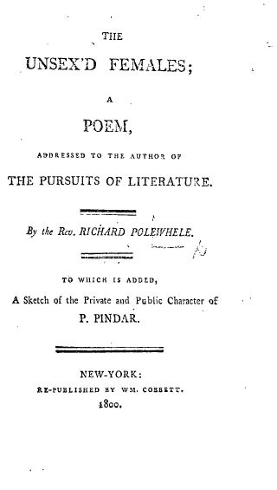
Compares female political writers particularly Wollstonecraft but also Anna Laetitia Barbauld, Mary Robinson, Charlotte Smith, Helen Maria Williams and Ann Jebb with approved writers including Elizabeth Carter, Frances Burney, Hester Chapone and above all, Hannah More
Notes:
Often MWs Rights of Woman is portrayed as encouraging a female backlash led by educators like Hannah More who lauded a newly created standard of womanly excellence, the model female. Hannah More has often been presented as the polar opposite to MW, not least in a contemporary satirical poem, The Unsex'd Females, by Richard Polwhele, a conservative who asserted the domestic idea. More stressed the importance of feminine difference and called upon their audience to accept woman's subordinate position and stake all upon the bargaining power of sexual attraction.

Slide 21
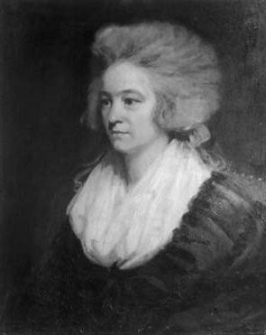
Hannah More, 1745-1833
Born in Bristol and educated in a largely female environment.
Ran a boarding school with her sisters
Had literary talent which took her to London
Active member of Elizabeth Monatgu’s bluestocking salon
Wrote Essays on Various Subjects, Principally Designed for Young Ladies, published anonymously in 1777
Her definitive work on female education: Strictures on the Modern System of Female Education (2 vols., 1799)
Novel Coelebs, in Search of a Wife (1809)
Notes:
Hannah More was born in Bristol and educated in a largely female environment. She ran a boarding school with her sisters but also had a literary talent which took her to London and she was an active member of Elizabeth Monatgu’s bluestocking salon. The experience that More had gained as a teacher at her sisters' school provided the material for Essays on Various Subjects, Principally Designed for Young Ladies, published anonymously in 1777. The eight essays dealt topics such as dissipation, conversation, sentimental connections, education, and religion. More called for greater attention to be paid to the intellectual, sentimental, and religious education of girls. Twenty-two years later, she was a household name and wrote her definitive work on female education: Strictures on the Modern System of Female Education (2 vols., 1799) Her work was extremely popular and seven editions were printed in the first year alone. In her review of her contemporary attitudes towards female education she criticized both Jean-Jacques Rousseau's doctrine of sensibility, which turned women into creatures of mere sentiment, and Mary Wollstonecraft's belief in female rights, which encouraged women to adopt an aggressive independence.
Her only novel, Coelebs in Search of a Wife (1809), also succeeds more as a treatise on female manners and education than as a work of fiction. Coelebs is essentially a parable about marriage that More specifically wrote for ‘the subscribers to the circulating library’ as an alternative to the romantic novels usually on offer. Charles, a young bachelor of independent fortune, meets countless young women who prove themselves to be unsuitable as his wife and, after much guidance from his late father's friend Mr Stanley, an evangelical, about the qualities and character of the ideal wife, he meets and marries the personification of female virtue, Lucilla Stanley, the eldest daughter of his mentor. Despite poor reviews Coelebs was More's most successful work to date and sold ‘ten large impressions in the first six months’
Coelebs 'celebrates the ideal woman… devoted to domestic duties, religious, modest in dress, silent unless spoken to, deferential to men, devoted to good works'. Thus for Lawrence Stone, among others, late 18th century feminism died a sudden and natural death not to be revived again until the 20th century.

Slide 22
Other Key Figures
Anna Laetitia Barbauld
Catherine Macaulay
Charlotte Smith
Helen Maria Williams

Slide 23
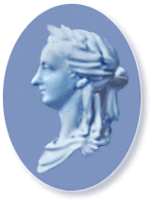
Barbauld
1769 ‘Corsica’
1790 An Address to the Opposers of the Repeal of the Corporation and Test Acts
1791 An Epistle to William Wilberforce, esq. … on the Rejection of the Bill for Abolishing the Slave Trade
1793 Sins of Government, Sins of the Nation
1812 Eighteen Hundred and Eleven
Eighteen Hundred and Eleven
And think'st thou, Britain, still to sit at ease,
An island Queen amidst thy subject seas,
While the vext billows, in their distant roar,
But soothe thy slumbers, and but kiss thy shore?
To sport in wars, while danger keeps aloof,
Thy grassy turf unbruised by hostile hoof?
So sing thy flatterers; but, Britain, know,
Thou who hast shared the guilt must share the woe.
Nor distant is the hour; low murmurs spread,
And whispered fears, creating what they dread;
Ruin, as with an earthquake shock, is here
Notes:
Anna Letitia Barbauld was educated in the famous Warrington Academy. She was a prolific poet writing on subjects as diverse as zoology, animal rights and religion. But her work also had a political edge. In 1769 she wrote the poem ‘Corsica’ for a subscription in aid of Corsican independence and in 1790 riled by Edmund Burke's attacks on the French Revolution and parliament's failure to repeal the Test and Corporation Acts she penned the powerful tract, An Address to the Opposers of the Repeal of the Corporation and Test Acts (1790), in which she hailed the French Revolution as sublime evidence of human improvement. In 1791 she responded to parliament's failure to abolish the slave trade with satirical verse satire, An Epistle to William Wilberforce, esq. … on the Rejection of the Bill for Abolishing the Slave Trade. In 1793 she denounced the British government's entry into war against France in a sermon, Sins of Government, Sins of the Nation. Her last publication and most ambitious work was Eighteen Hundred and Eleven (1812), a poem deploring Britain's participation in the seemingly endless, apparently disastrous war against Napoleonic France and foretelling Britain's economic decline while, however, asserting its cultural dominion over the coming American empire. This poem met with extreme hostility from the tory press but is considered a major poem of the Romantic era.

Slide 24
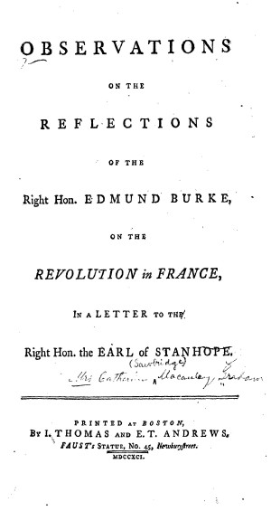
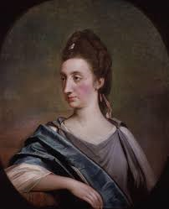
Macaulay
1763-83 Eight-volume History of England.
1770 Observations on a pamphlet entitled ‘Thoughts on the cause of the present discontents’
1790 Letters on Education
1790 Response to Burke's Reflections on the Revolution in France
Notes:
Macaulay is best known for her eight-volume History of England. When the first volume was published in 1763 it was greeted with acclaim. Overnight she became ‘the celebrated Mrs Macaulay’. But behind the praise she received there was condescension and the belief that the writing of history was not for women. The Monthly Review for example expressed the wish that ‘the same degree of genius and application had been exerted in more suitable pursuits’, for the writing of history was not recommended ‘to the practice of our lovely countrywomen’ In her fourth volume published in 1768, that dealt with the trial and execution of Charles I, she described the Commonwealth she saw as ‘the brightest age that ever adorned the page of history’. Her Observations on a pamphlet entitled ‘Thoughts on the cause of the present discontents’ published in 1770 brought her into direct conflict with the Whigs and particularly Edmund Burke. They differed fundamentally in their views of the causes of the political corruption which both believed threatened liberty. Burke believed in the perfection of the constitution established by the revolution settlement of 1688–9 and thought that the causes of the ‘present discontents’ lay in the recent resurgence of the power of the crown from which only strong and principled government of the Rockingham whigs could save the country. Macaulay thought that the revolution settlement itself had been the work of those who called themselves whigs but were in reality the ‘enemies of public liberty’ and had diverted the revolution from its original radical course. Her proposed cures involved reactivating their radical programme by introducing shorter parliaments, a system of rotation of office, a place bill, and a more extended and equal power of election.
In 1790 she published Letters on Education. It covered a wide range of ideas. She was in favour of co-education and called on parents to reject ‘the absurd notion, that the education of females should be of an opposite kind to that of males’ She expressed enlightened views on the upbringing of children. Children, she wrote, should be fed on fruit, eggs, and vegetables, and only very occasionally should be given meat. Sugar was bad for the teeth. They should be encouraged to wash regularly. It was a mistake to use baby talk in addressing them. She also argued passionately against capital punishment, and declared that if there had to be executions they should not be public events. She also argued in favour of reform of penal law and the abolition of slavery, decrying the deplorable ‘treatment given by some of our countrymen to their African slaves’. On the position of women, Macaulay argued that if it was better than it had been under slavery, ‘we … have no great reason to boast of our privileges, or of the candour and indulgence of the men towards us’ She criticized women for their passive acceptance of the claimed natural superiority of men. Women's weaknesses were the result of ‘situation and education only’. The education of women was an essential ingredient to a happy marriage. In 1790 Catharine Macaulay also published an impassioned response to Burke's Reflections on the Revolution in France (1790). This gave rise to a brief correspondence between her and Mary Wollstonecraft, in which both praised the other's work. Her answer to Burke raised once again their very different interpretations of the revolution of 1688 and what, if anything, it had achieved.

Slide 25
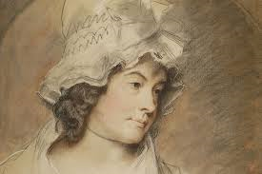
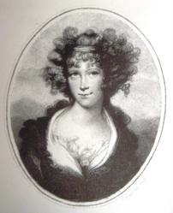
Charlotte Smith & Helena Maria Williams
French Revolution and its aftermath provided some of her main themes. She was a republican sympathizer but later modified her opinion as a result of the terror.
Wrote on the abolition of the slave trade in the and the campaign to repeal the Test and Corporation Acts.
Most famous for Letters From France eight volumes of eyewitness accounts of Revolution (1790–96).
Ran a salon or conversazione. Naturalized as a French citizen in 1817.
Notes:
Charlotte Smith
Her husband was a debtor and Charlotte wrote poems and novels as a means of raising money. She was involved in radical English circles; the French Revolution and its aftermath provided some of her main themes. She was a republican sympathizer but later modified her opinion as a result of the terror. Her fourth novel, Desmond (1792), adopts the epistolary form to tell the story of the title character who travels to revolutionary France and is persuaded by arguments he hears there for revolution abroad and reform in England. She repeatedly sympathized with those who endured social oppression.
Helena Maria Williams
Williams was an important and well connected poet. She wrote on the abolition of the slave trade in the late 1780s and the campaign to repeal the Test and Corporation Acts. In 1789 after the fall of the Bastille Williams included a poem on the subject in her novel Julia (1790). She went to France in the summer of 1790, and her enthusiastic book about her travels, Letters Written in France (1790), would become the first of eight volumes of eyewitness accounts, later known as the Letters from France (1790–96). She explained in her first book that the historic Bastille day celebration in Paris was ‘not a time in which distinctions of country were remembered. It was the triumph of human kind … and it required but the common feelings of humanity to become in that moment a citizen of the world’.
When she returned to Paris in August 1792 she was shocked by the increase in violence and her next work severely criticized Robespierre and lamented the execution of Louis XVI. The reign of terror meant that these two new volumes of Letters from France (1793) had to appear anonymously. The series earned her the appellation ‘English historian of the French Revolution’ but reviews were characteristically divided along party lines, with some finding her ‘a misguided female’ and others a ‘friend of liberty’.
She ran a salon or conversazione, although her disillusionment with Napoleon Bonaparte meant it was for a time placed under police surveillance. She was naturalized as a French citizen in 1817.

Slide 26
More and Wollstonecraft
Part of spectrum of woman writers on female education encompassing conservatives like More and Sarah Trimmer, radicals like Mary Hays and Catherine Macaulay and moderates like Barbauld and Maria Edgeworth
Both writers promote female heroism
Wollstonecraft: women should become 'more observant daughters, more affectionate sisters, more faithful wives, more reasonable mothers - in a word better citizens'.
More puts her faith in women of middle rank. The profession of ladies is as daughters, wives, mothers and mistresses of families but she also argues for a public role: looking after the poor.
Both appeal to female example so that women by 'labouring to reform themselves to reform the world'.
Notes:
More is thus seen as mainstream, MW as the lonely exception. But are there more similarities between them in practice? MW's demands are typical of a wide spectrum of woman writers. Female educators, encompassing conservatives like More and Sarah Trimmer, radicals like Mary Hays and Catherine Macaulay and moderates like Barbauld and Maria Edgeworth, vigorously attacked the deficiencies of fashionable training and values and sought to give the woman's role more competence, dignity and consequence. Women were thus encouraged to achieve more than the accomplishments necessary to secure a good marriage and were being educated to become good citizens. The work of More then has been seen to have done more to subvert the established order than to uphold it. This revised view of Evangelicalism puts the stress on it as a vanguard of emergent middle class consciousness. Mary Berry noted that More and MW 'agree on all the great points of female education'. Domesticity in both More's and MWs view is seen as proffering women an opportunity for an active role and is defined in terms of social responsibility. MW and More were striving to replace the ideal of pliant, unproductive urbanity with socially functional middle class models. Both wanted a more respectable and powerful status for women, underscoring their need for purposeful work whether paid or unpaid, endowing them with weighty authority as mothers and educators. At the heart of the work of both writers is a pattern of female heroism. They indict what they call the Mohammedan view of women as docile catering to masculine appetites, exemplified by Rousseau's Sophie.
MW calls middle class women to eschew the static role and turn to nature, virtue and reason to become 'more observant daughters, more affectionate sisters, more faithful wives, more reasonable mothers - in a word better citizens'. Her manifesto remains middle class motherhood in a radical framework of economic independece, legal equality and freer access to jobs and professions. She seeks to aggrandise the maternal mission making motherhood the lynchpin off the new society. Although she does not suggest that woman's only possible place was in the home motherhood provides a rationale for better female education. The more enlightened understanding women achieve, the more they will advance common welfare. In carrying out her communal obligations she earns her keep, maintains her self-respect and develops her own moral character.
More like MW puts her faith in women of middle rank. She attests to women's potency to undermine or save their country. Women bear special civil and social responsibilities. Although she sees 'the profession of ladies as daughters, wives, mothers and mistresses of families she also argues for a public role: looking after the poor. More was a female crusader infinitely more successful than MW or other female radicals. Both More and MW appeal to female example so that women by 'labouring to reform themselves to reform the world'. Women were now the reformers of public manners rather than the refiners.

Slide 27
Conclusion: Wollstonecraft – Liberal or Radical?
Some argue her agenda is typically Liberal: education, civil rights, an opportunity to compete for access to occupations, political representation
Rational education is important : 1) to transform female identity, 2) it is a right, 3) a proper education prepares women for their role as citizens.
She associates freedom with the deployment of the rational will.
However, Barbara Taylor has argued that Wollstonecraft’s work is not part of the liberal tradition rather it is an exploration of the 'distinction of sex' and its implications for women's experience
Places Wollstonecraft within 'the utopian wing of eighteenth-century progressivism
Ironically owing much to Rousseau's radical ideas
Notes:
MW's agenda according to Coole and a range of other writers is a typically Liberal one: education, civil rights, an opportunity to compete for access to occupations, political representation. Of these education is the most important. A rational education is important for women on a number of levels: 1) it is needed to transform female identity, 2) it is a right, as rational beings all individuals deserve the opportunity to develop their faculties in order to achieve self-determination, autonomy and virtue 3) a proper education prepares women for their role as citizens. MW idea of liberty is always of the positive variety which associates freedom with the deployment of the rational will. She avoids the dichotomy between the state as a public domain and the family as a private haven where the state is absent and public concerns have no place which led to the dominance of domestic ideology but sees that duties within the family and community have a wider significance. However, Barbara Taylor has argued that MW's work is not part of the liberal tradtion and that Vindication is not concerned with the position of middle-class women as subordinate members of a newly ascendant class, nor even with women's lack of legal, political or economic rights. Rather she argues the book is an exploration of the 'distinction of sex' and its implications for women's experience. She places MW within 'the utopian wing of 18th century progressivism - a brand of democratic radicalism deeply influenced by Rousseau. Ironically MW then owes much to Rousseau's radical ideas and indeed acknowledges her debt to him. The contradictions and tensions inherent in his work, especially his view of women, were to be played out when the 19th century bourgeoisie attempted to follow his blueprint and confine women to the private space of the home and keep them out of the public arena.

