Slide 1
Antisemitism

Slide 2
Introduction
Origins of the term ‘antisemitism‘
Antijudaism, antisemitism and the challenges of modernity
Assimilation and antisemitism
Antisemitic tropes
Interpretations and outlook

Slide 3
Anti-Semitism or antisemitism?
'Semitic‘referred originallyto a language family – Semitic languages (Aramaic, Hebrew and Arabic are Semitic languages). The term was coined by German orientalist August Ludwig von Schlözer in 1791.
‘Antisemitic‘: a 19th century invention, first used (‘antisemitisch‘) by Austrian Jewish scholar Moritz Steinschneider in 1860 referring to views of Ernest Renan.
‘Antisemitic‘ (‘antisemitisch‘) widely used since the last third of 19th century. German journalist Wilhelm Marr and historian Heinrich von Treitschke used term ‚Semitic‘ interchangeably with Jewish – their views were qualified as ‘antisemitic‘
Some scholars propose as an alternative the term ‚Jew-hatred‘ while anti-Judaism refers to religiously motivated hatred of Jews as a religious group.
Antisemitism is a compromise: term has long been introduced – attempt to decouple it from Semitic denoting a family of languages.
Antisemitism – essentialisation of Jewishness – as a ‚race‘, not as a religion drawing on “scientific” anthropology and physiology, coincides with emergence of nationalism
easily adapted to other tasks and easily absorbs earlier anti-Jewish rhetorics

Slide 4
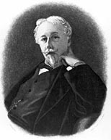
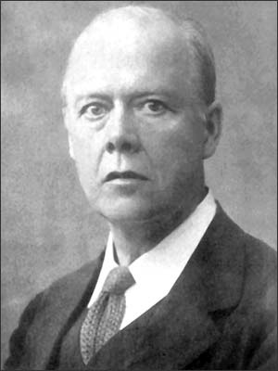

Arthur de Gobineau (1816-1882)
Houston Stuart Chamberlain (1855-1927

Slide 5
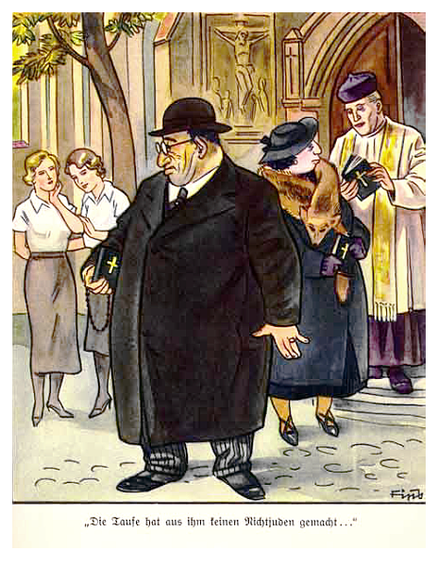
Anti-Judaism becomes antisemitism –
Page from the antisemitic German children's book, "Der Giftpilz" ( The Poisonous Mushroom), Nuremberg 1935. The text reads, "Baptism didn't make him into a non-Jew..."
Photo Source: United States Holocaust Memorial Museum Published Source: Der Giftpilz: Erzahlungen [The Poisonous Mushroom] - Hiemer, Ernst - Der Sturmer

Slide 6
Jewish Responses to emancipation and rise of modern nations
Assimilation
Reform
Tradition
Converting to Christianity
Ultra- Orthodox
Modern Orthodox
Jewish Poles, Russians, Ukrainians, Germans, French etc
Yiddishism
Zionism
Labour (Socialist) Z.
Secular Z.
Religious Z.
Hasidism
Atheism
Socialism/Communism

Slide 7
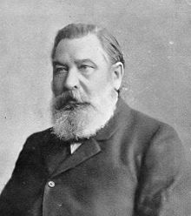
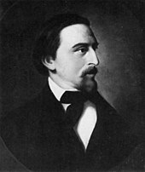
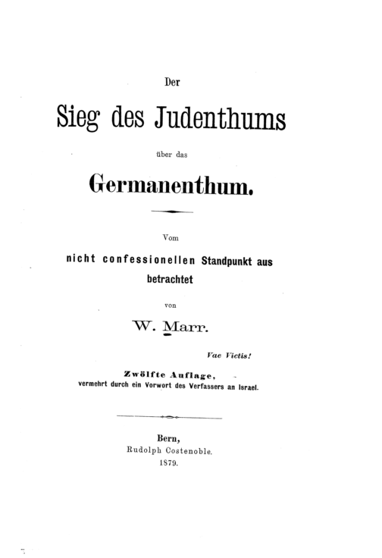
Heinrich von Treitschke, 1834-1896
Wilhelm Marr, 1819-1904
Shulamit Volkov, Antisemitism as a Cultural Code: Reflections on the History and Historiography of Antisemitism in Imperial Germany, The Leo Baeck Institute Year Book, Volume 23, Issue 1, January 1978, Pages 25–46, https://doi.org/10.1093/leobaeck/23.1.25

Slide 8
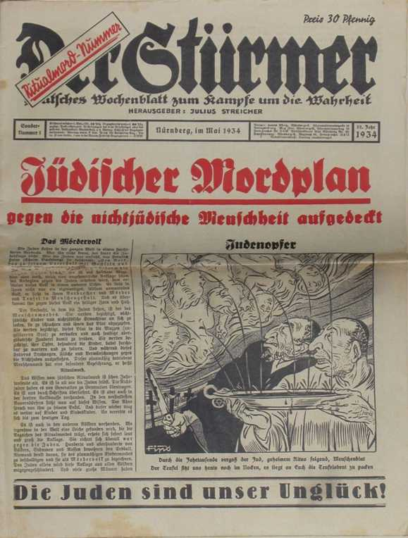
Antisemitic newspaper from Nazi Germany (1934)
Note the quote at the bottom: ‘The Jews are our misfortune’.
Quote from famous German historian von Treitschke, whose antisemitic texts helped to make antisemitism ’respectable’ in the German middle classes.

Slide 9
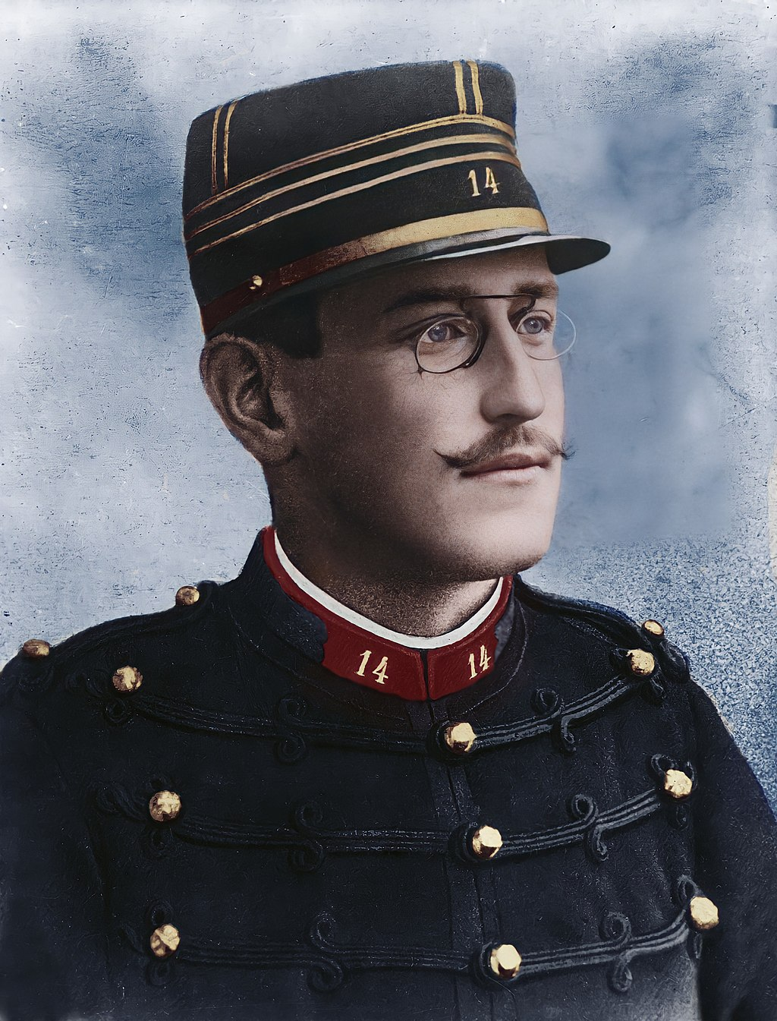
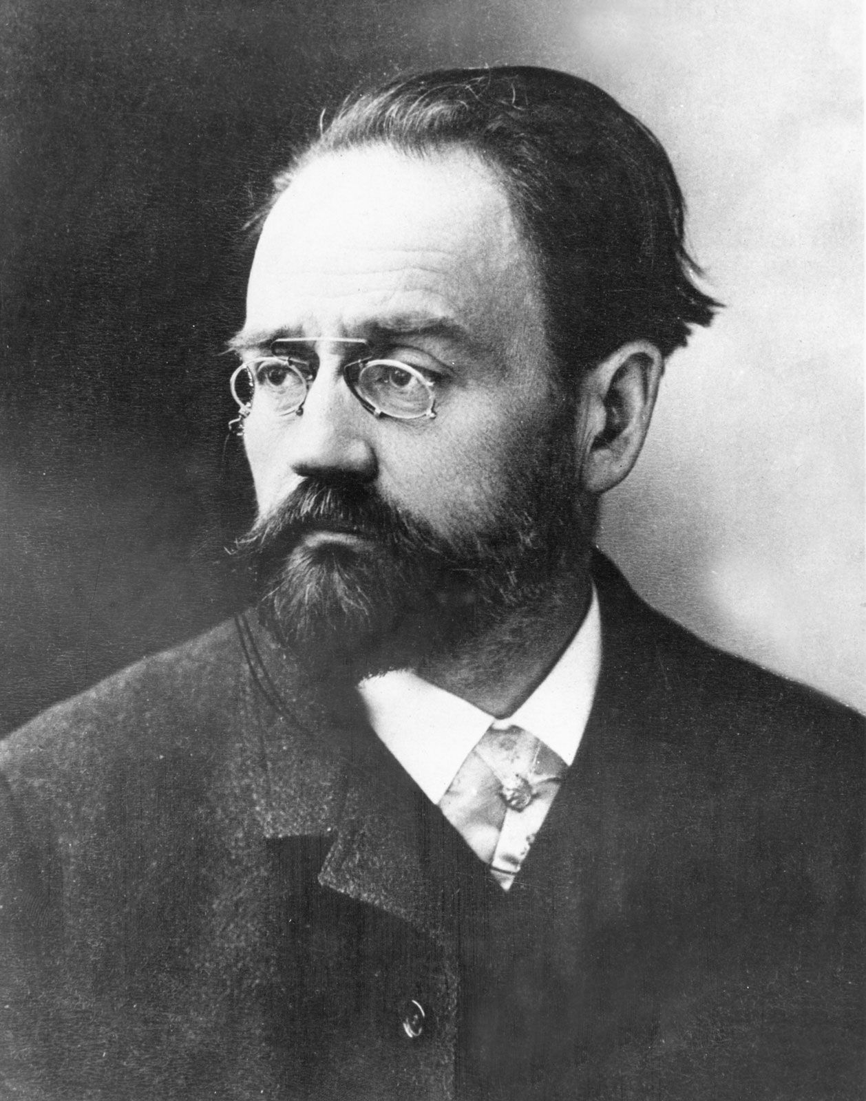
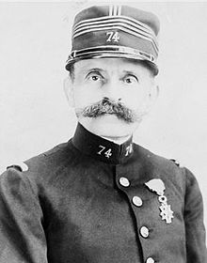
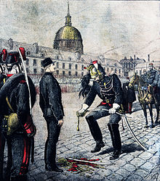
Marie Charles Ferdinand Walsin-Esterhazy
Alias
Count Voilement
Émile Zola (1840-1902) J‘accuse
(1847-1923 – in Harpenden)
Alfred Dreyfus (1859-1935)
Expulsion from French Army (Paris, 5 January 1895)

Slide 10
Pogroms in Russian Empire
In Odessa: 1821 and 1859 perpetrators mainly Greeks, in 1871 many Russians joint Greeks, 1905 over 400 Jews killed (perpetrators, Russians, Greeks, Ukrainians)
1881-1884 over 200 anti-Jewish events in Russian Empire, pogroms in Kiev, Warsaw, Odessa, etc.)
1903-1906 more pogroms, compared to earlier pogroms, many more Jews were killed
Pale of Settlement

Slide 11
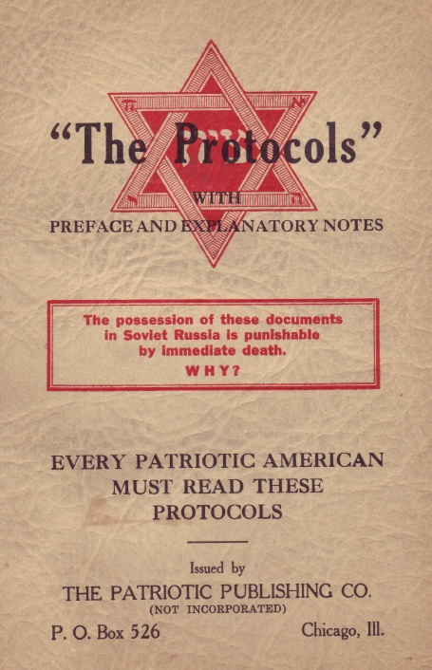
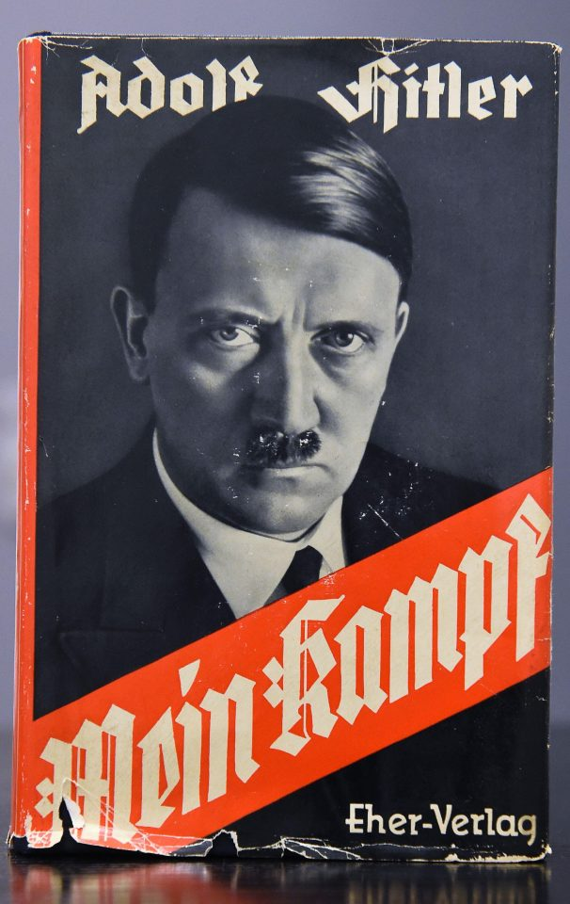

Slide 12
The ‘Jewish Problem’
economic, legal, political,
Can Jews be fully integrated in the German, French, Russian, Polish etc. nation?
Will they be loyal, unconditionally support the respective nation?
Need/craving for self-definition and self-expression

Slide 13
Jewish Responses to emancipation and rise of modern nations
Assimilation
Reform
Tradition
Converting to Christianity
Ultra- Orthodox
Modern Orthodox
Jewish Poles, Russians, Ukrainians, Germans, French etc
Yiddishism
Zionism
Labour (Socialist) Z.
Secular Z.
Religious Z.
Hasidism
Atheism
Socialism/Communism

Slide 14
Jewish nationalism
Leon Pinsker, Auto-Emancipation! (1882)
Territorialism – Antisemitism as ‘illness’, Jews need a state as they will always be outsiders
Diaspora Nationalism
historical: Simon Dubnow
socialist: Bund
Zionism
political: Herzl
cultural: Ahad ha-Am (Asher Ginzberg)
Secular vs religious Zionism

Slide 15
Diaspora Nationalism (late 19th/early 20th centuries)
Jews as separate ethnic group
achieve minority rights within multi-national empires
give up claim to independent state in return for national status
Organise Jewish self-defense

Slide 16
Simon Dubnow
Jewish people evolved from racial-ethnic to territorial-political to cultural-historical
For the last - spiritual - stage a state with land, language, and sovereignty is not needed
the nation must redefine itself through secular institutions
error of religious reformers to define the group religiously
Volkspartei (People’s Party)

Slide 17
Bund
Jewish socialists: language Yiddish but strong connection to Russian Social Democratic Party
Algemeyner Yidisher Arbeiter Bund in Lite, Poylin und Rusland (General Worker’s Union in Lithuania, Poland and Russia)
est. 1897 in Russian Empire (Vilnius one of main centres)
aim to escape particularism and parochialism
young socialists are shocked by popular antisemitism and its acceptance by the left
Jewish masses suspicious of assimilationists
Jewish interests are separate

Slide 18
Zionism in the 19th century
From biblical ”Zion”, often synonymous with Jerusalem and the Land of Israel (Eretz Yisrael)
= Jewish nationalism, Jewish national movement
Definition of the Jews as an ethnic group
Response to antisemitism and perceived failure of assimilation
Inspired by and developing parallel to French, German, Polish etc. nation building
Solution: homeland, preferably in Palestine
For the moment: organisation of Jewish self-defense

Slide 19
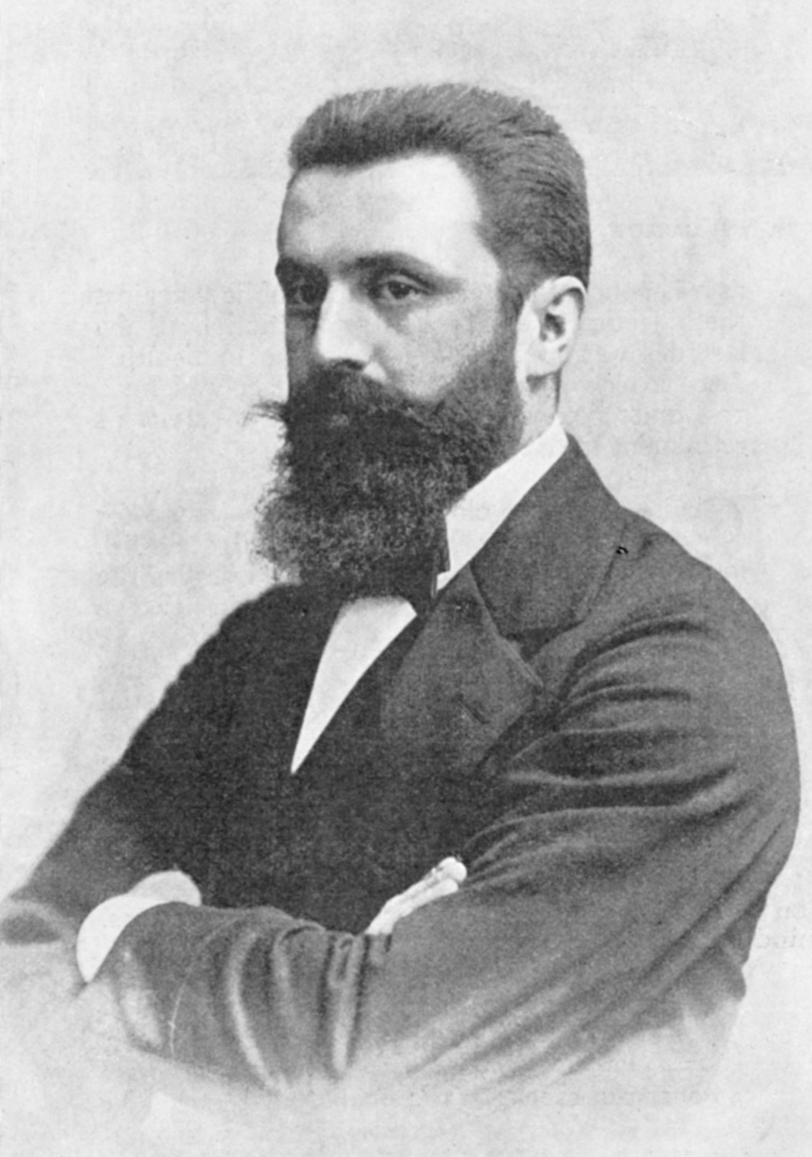
Theodor Herzl
Pogroms 1881 and May Laws (confirming restriction for Jews and Pale of Settlement)
Dreyfus trial 1896
Jewish State 1896
First Zionist Congress 1897 in Basle
Theodor Herzl (1860 – 1904)

Slide 20
Scape goats
Anti-Jewish violence during and after Plague – Jews accused of having poisoned wells – classic anti-Jewish and antisemitic stereotype: Jews as ‚Brunnenvergifter‘
Pattern there: fed into Jews blamed for all ills of modernity, maybe also because after emancipation some of them flourished, some make careers in free professions etc.
Nazi manachaeism – Jews identified with all which is evil, the abstract, money, the modern, the intellectual, the international

Slide 21
Antisemitic newspaper from Nazi Germany with antisemitic cartoon, evoking blood libel and feeding conspiracy theory about a global Jewish conspiracy
Note the quote at the bottom: ‘The Jews are our misfortune’.
Quote from famous German historian von Treitschke, whose antisemitic texts helped to make antisemitism ’respectable’ in the German middle classes.

Slide 22
Jew-hatred (anti-Judaism, antisemitism)…
A unique phenomenon, endemic at least in European history, society, culture (Shmuel Ettinger)
A contextual phenomenon, not intrinsic in European or whatever culture (Hannah Arendt)
Part of and comparable to racism, xenophobia, and all sorts of prejudice (Scott Ury)
A cultural code signifying more than just the enmity against Jews (Shulamit Volkov)

Slide 23
Post-war developments
Foundation of state of Israel
Expulsion of 700,000 Arabs
Israel identified as ‚Jewish state‘
Antisemites hold Jews collectively responsible for actions of Israeli government
Many attempts to differentiate between antisemitism and anti-Zionism and to qualify when criticism of Israeli government is legitimate and justified and when does it become antisemitic
Ability of antisemitism to link with other ideologies

Slide 24
Jerusalem declaration, 25 March 2021, responds to International Holocaust Remembrance Allaince (IHRA) definition from 2016.
Preamble: We, the undersigned, present the Jerusaem Declaration on Antisemitism, the product of n initiative that originated in Jerusalem. We include in our number international scholars working in Antisemitism Studies and related fields, including Jewish, Holocaust, Israel, Palestine, and Middle East Studies…
Critical of IHRA definition – of 11 examples of antisemitism, 7 focus on the State of Israel.
… we hold that while antisemitism has certain distinctive features, the fight against it is inseparable from the overall fight against all forms of racial, ethnic, cultural, religious, and gender discrimination.

Slide 25
Antisemitism
Whether an action or a speech act is antisemitic depends on
The speaker/actor
The context
The audience
The intention
‚So, for example, hostility to Israel could be an expression of an antisemitic animus, or it could be a reaction to a human rights violation, or it could be the emotion that a Palestinian person feels on account of their experience at the hands of the State. In short, judgement and sensivitivity are needed in applying these guidelines to concrete situations (From Jerusalem Declaration)
Guidelines
A. General
1. It is racist to essentialize (treat a character trait as inherent) or to make sweeping negative generalizations about a given population. What is true of racism in general is true of antisemitism in particular.

Slide 26
Jerusalem Declaration
B Israel and Palestine: examples that, on the face of it, are antisemitic
6. Applying the symbols, images, and negative stereotypes of classical antisemitism (see guidelines 2 and 3) to the State of Israel
7. Holding Jews collectively responsible for Israel‘s conduct or treating Jews, simply because they are Jewish, as agents of Israel
8 Requiring people, because they are Jewish, publicly to condemn Israel or Zionism (for example, at a political meeting)
9 Assuming that non-Israeli Jews, simply because they are Jews are necessarily more loyal to Israel than to their own countries.
10. Denying the right of Jews in the State to exist and flourish collectively and individually, as Jews, in accordance with the principle of equality.
Points 11-15 give examples was ‚on the face of it‘ , are not anitsemitic, they can be boiled down to the principle that Israel, its government and policy can be criticised and held to count in the same way as the policy of any other state – but this needs to be considered together with points 6 to 10.

Slide 27
To what extent is antisemitism also today a ‘cultural code‘?
Anti-Zionism (or antisemitism?) as cultural code signifying anti-Americanism, anti-liberalism, anti-capitalism
(Left)
Antisemitism as cultural code signifying anti-emancipation, anti-immmigration, xenophobia, racism, anti-LGBT (Right)
Complication: On the extreme right – people who are simultaneously supporters of Israel and antisemitic

