Slide 1
The historical background of the Russian attack on Ukraine
Christoph Mick, University of Warwick

Slide 2
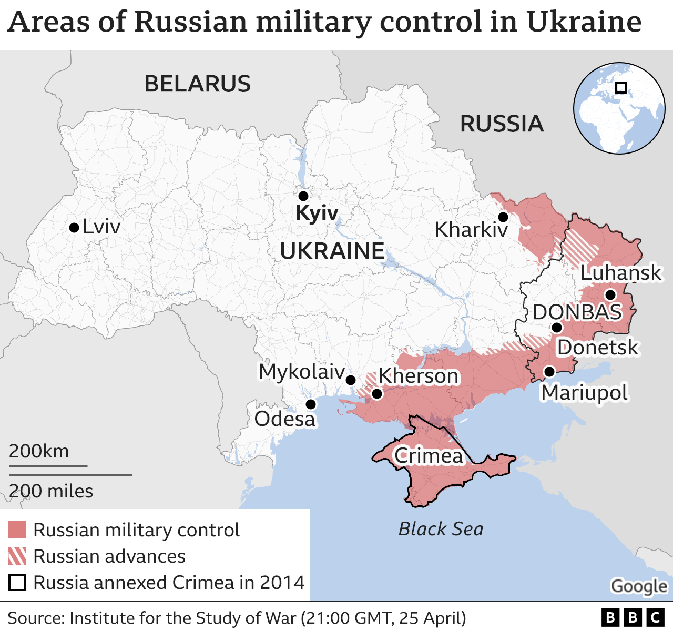

Slide 3
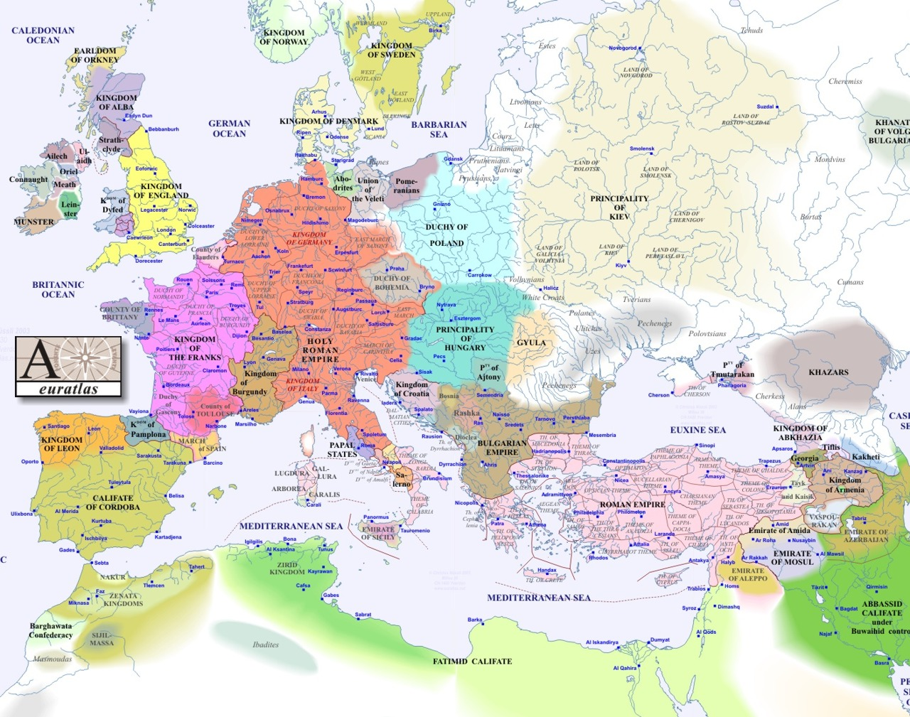
1000

Slide 4
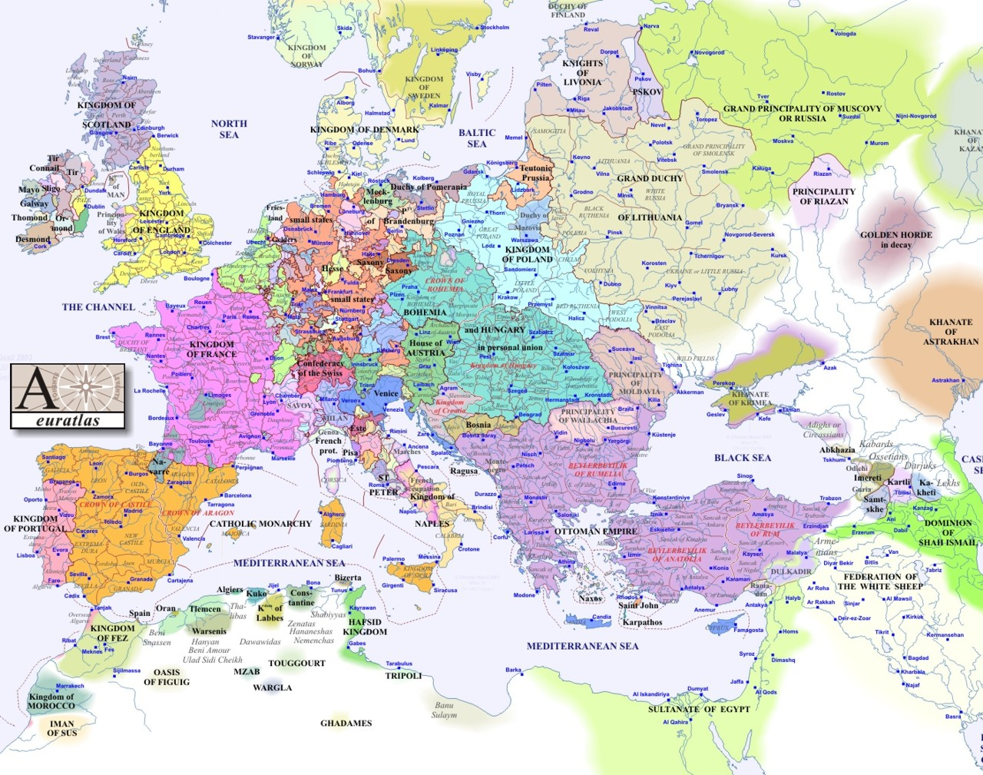
1500
Notes:
4
4

Slide 5
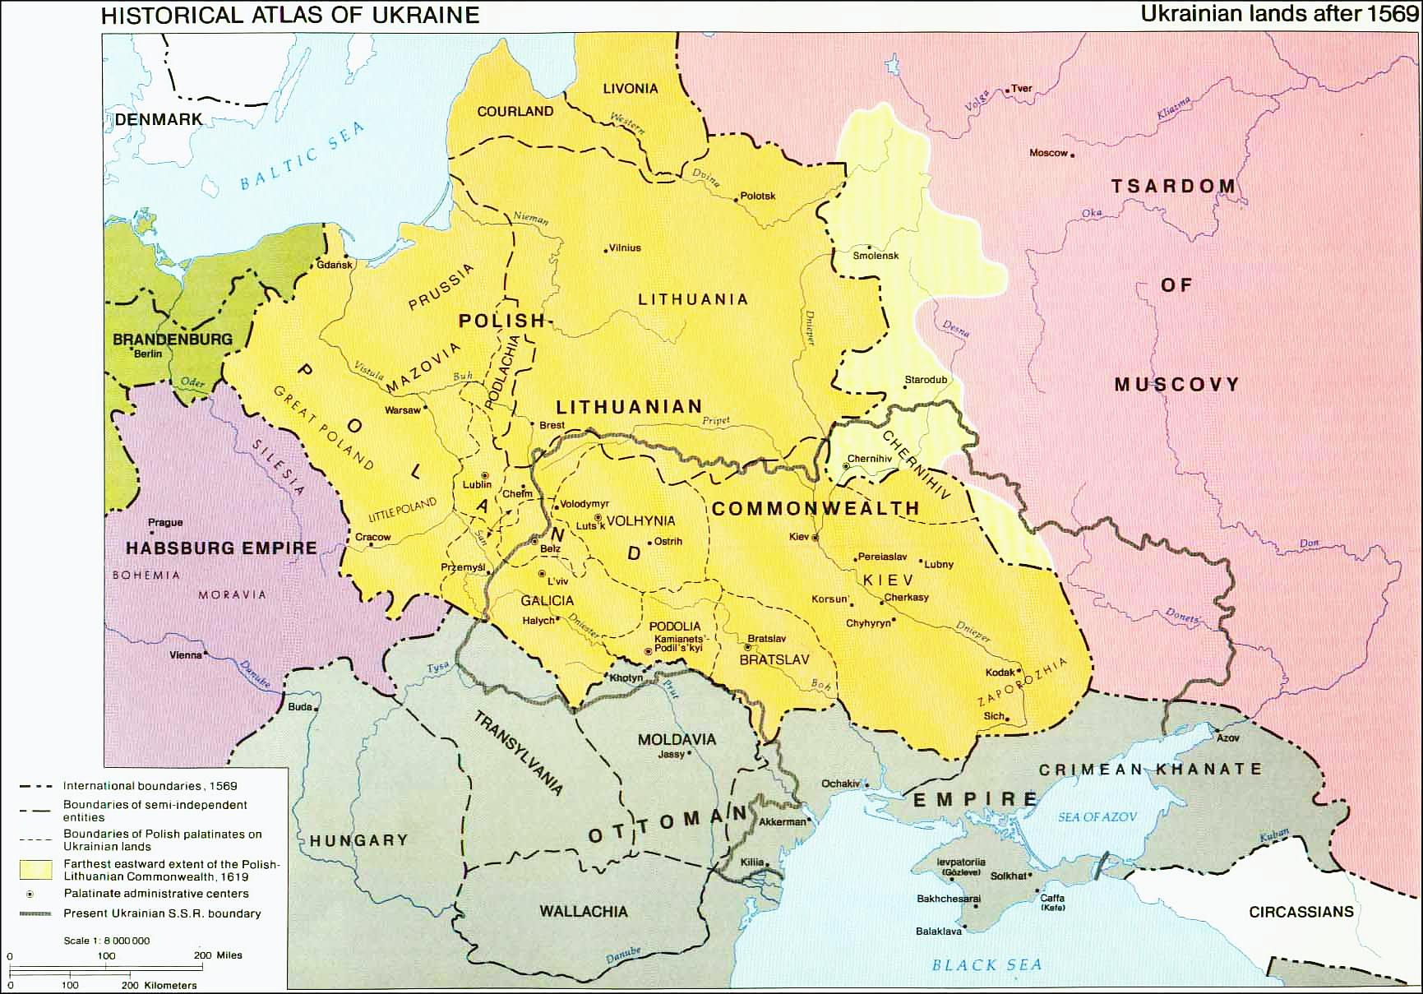
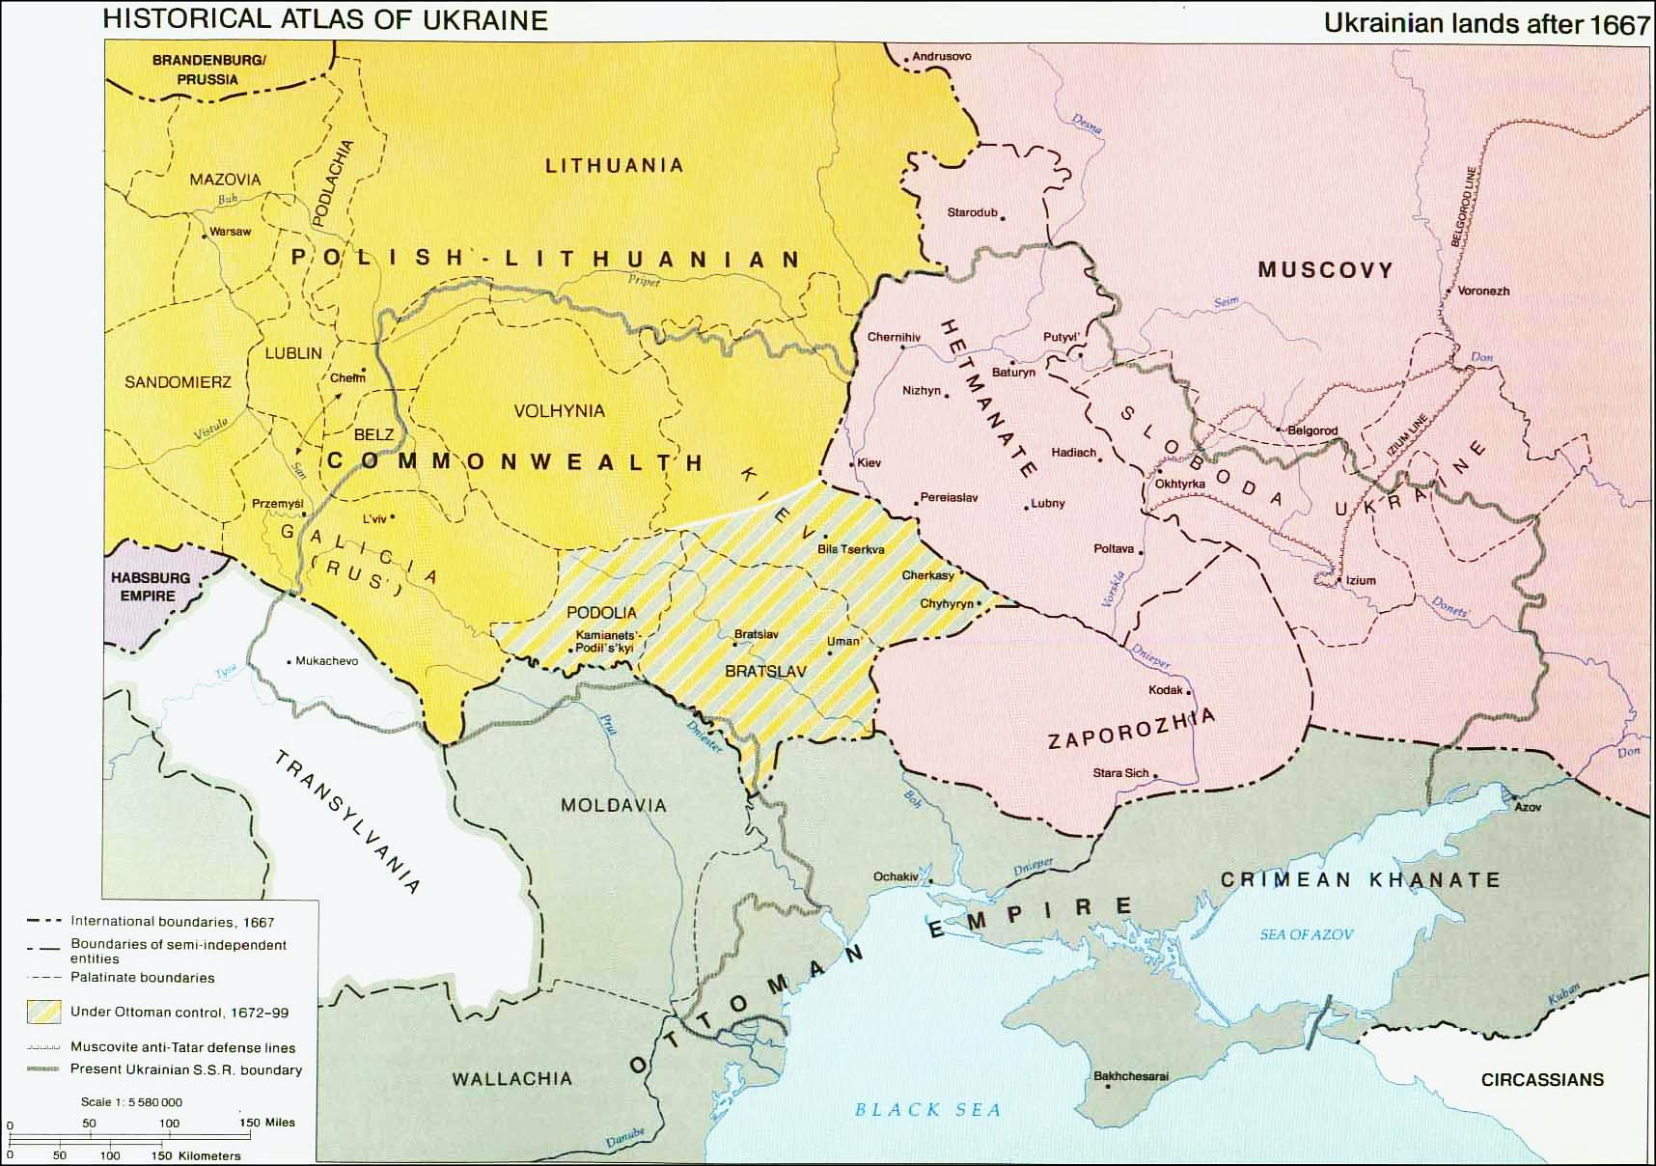
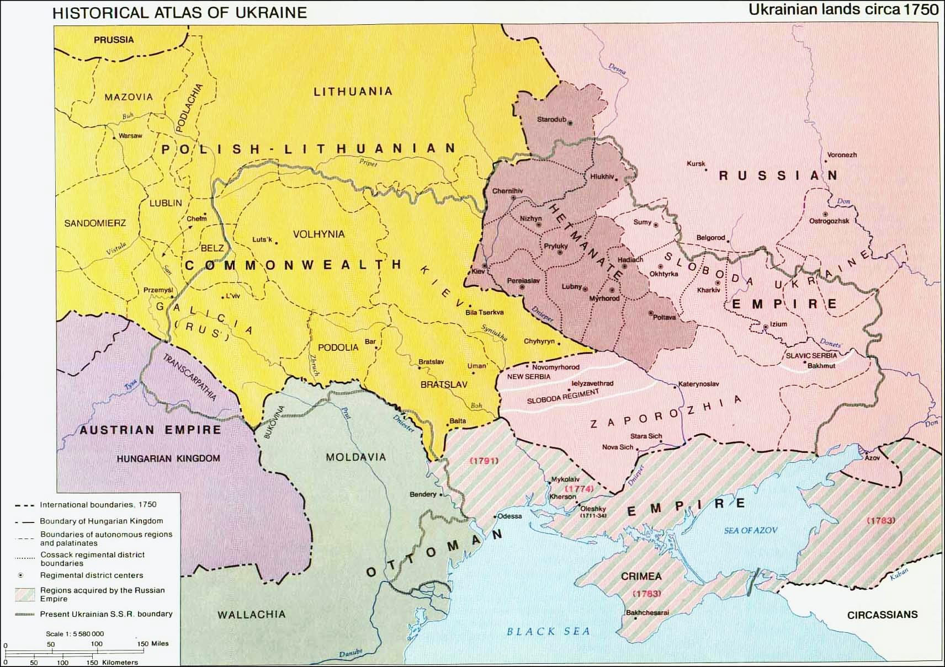
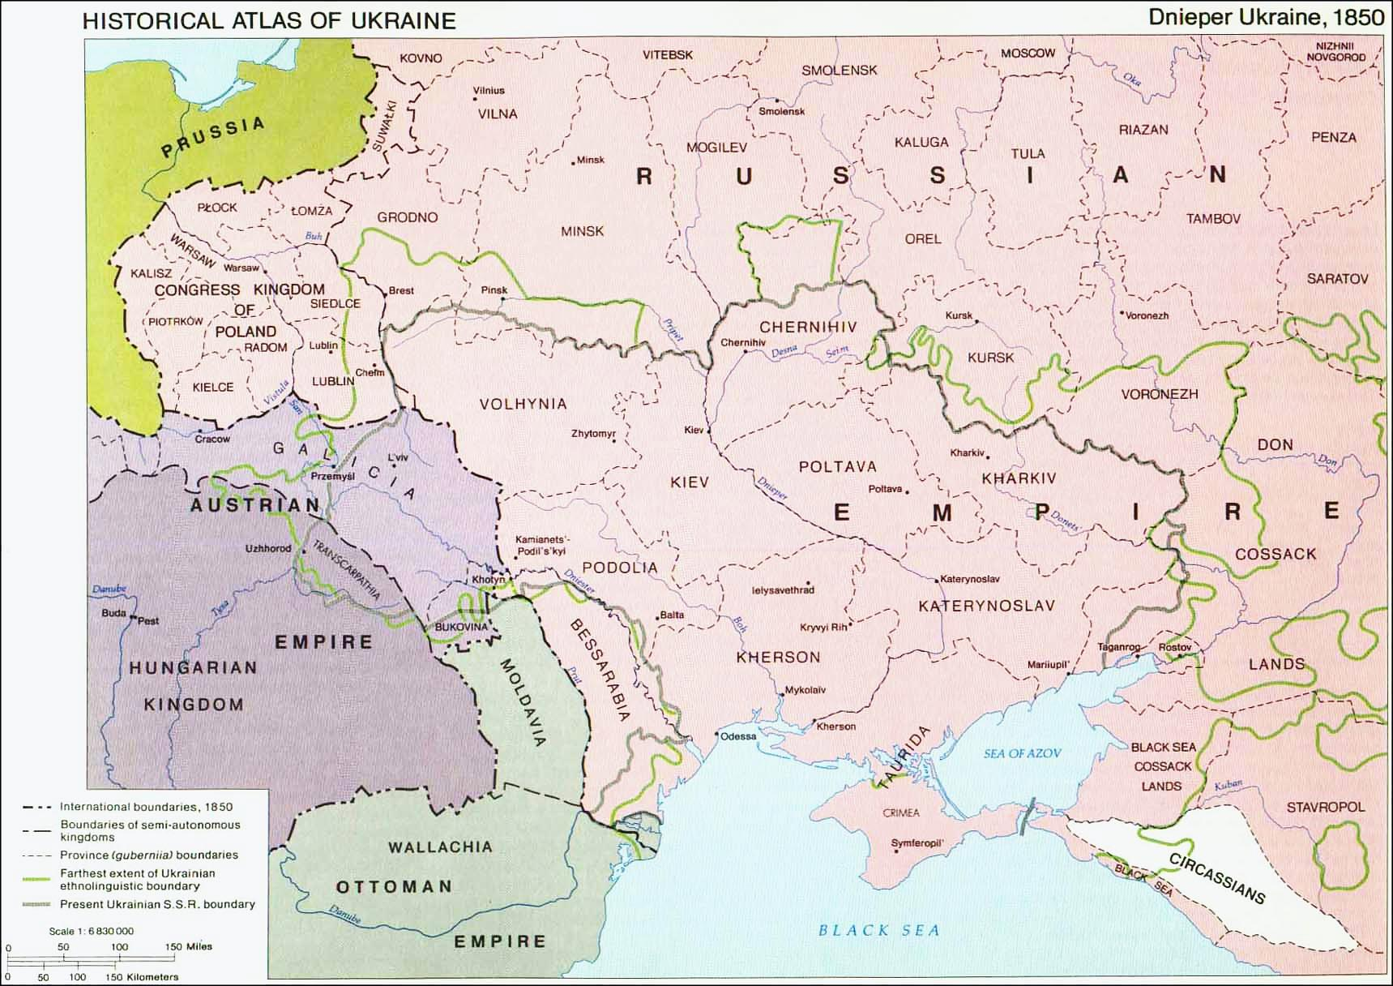
Notes:
5

Slide 6
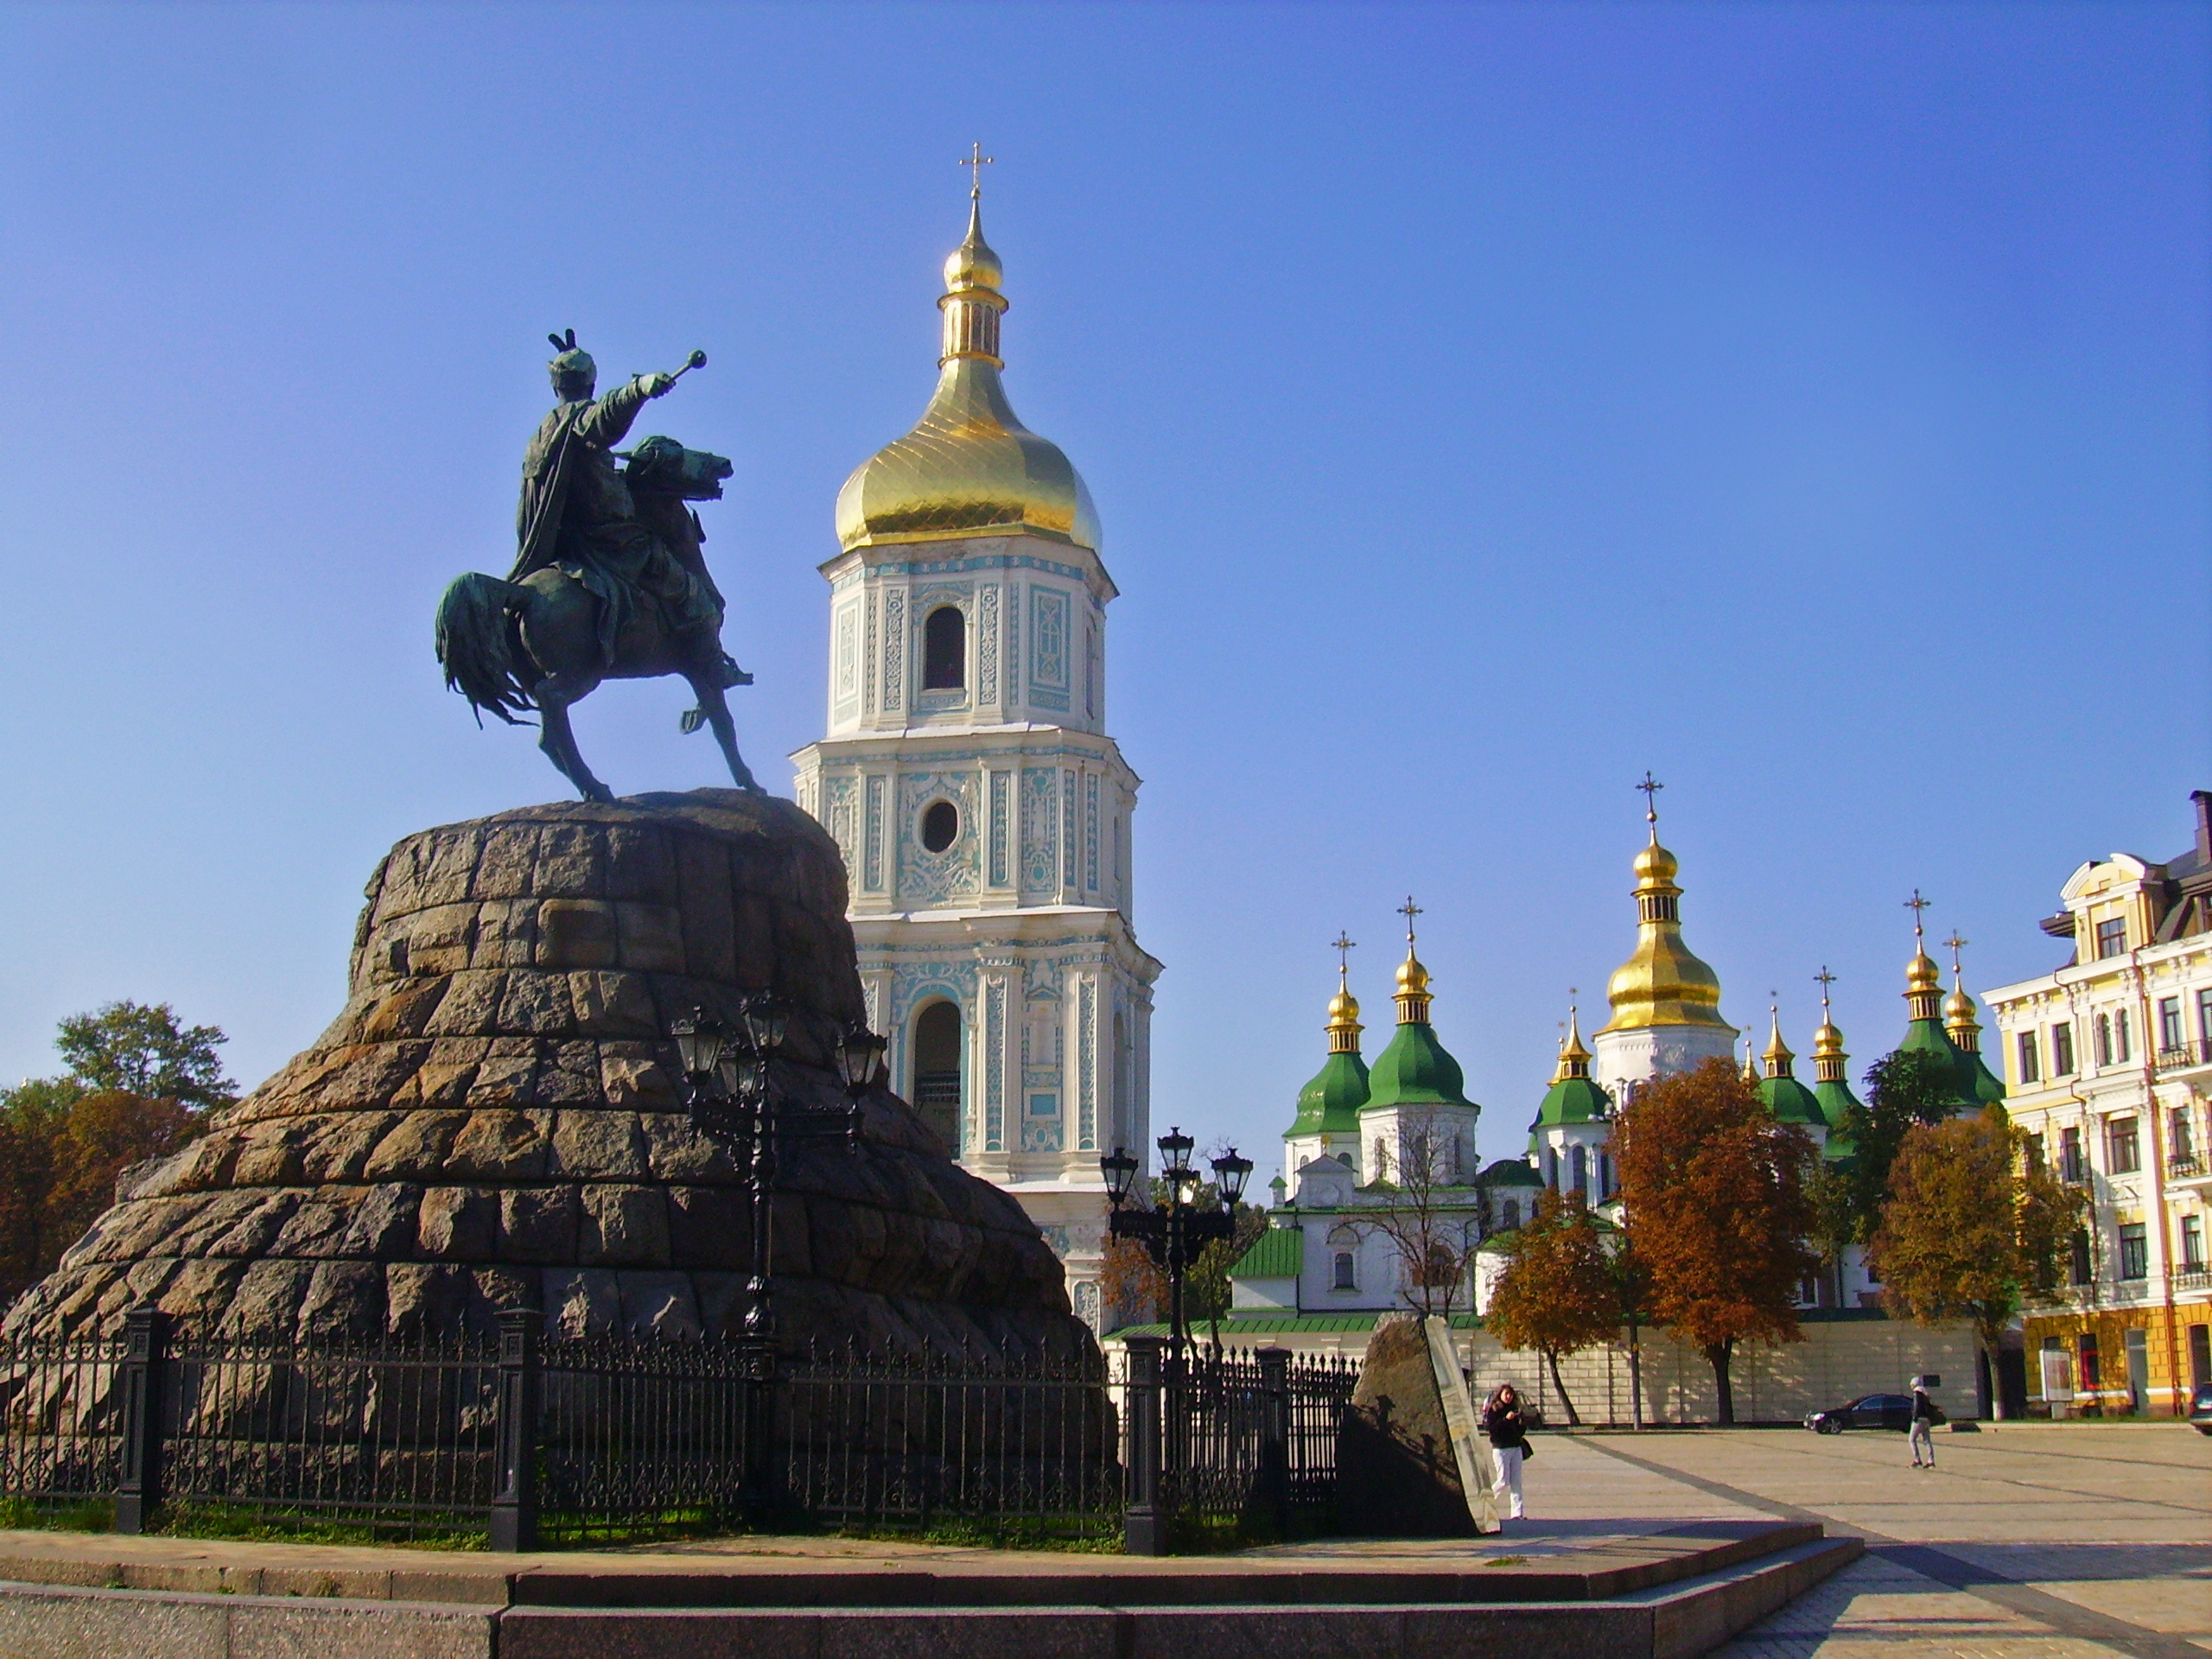
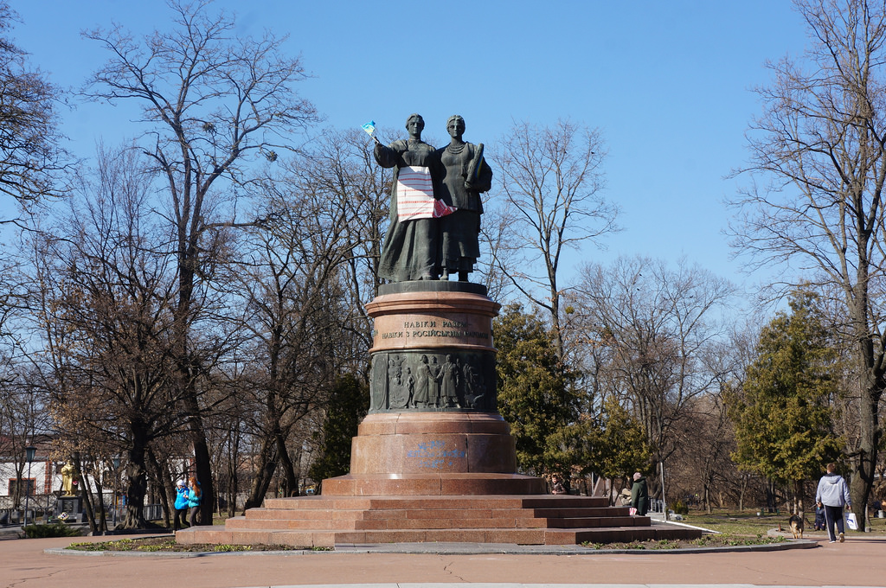
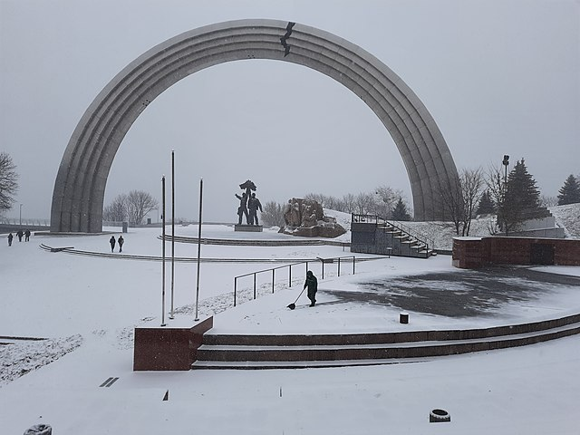
Treaty of Pereyaslav Monument, Pereyaslav Khmel’nyts’kyj
1961
Khmel’nyts’kyj monument Kyjiv
1888
People’s Friendship Arch, dedicated to the unification of Russia and Ukraine
Completed in 1982
The crack was added in 2014.

Slide 7
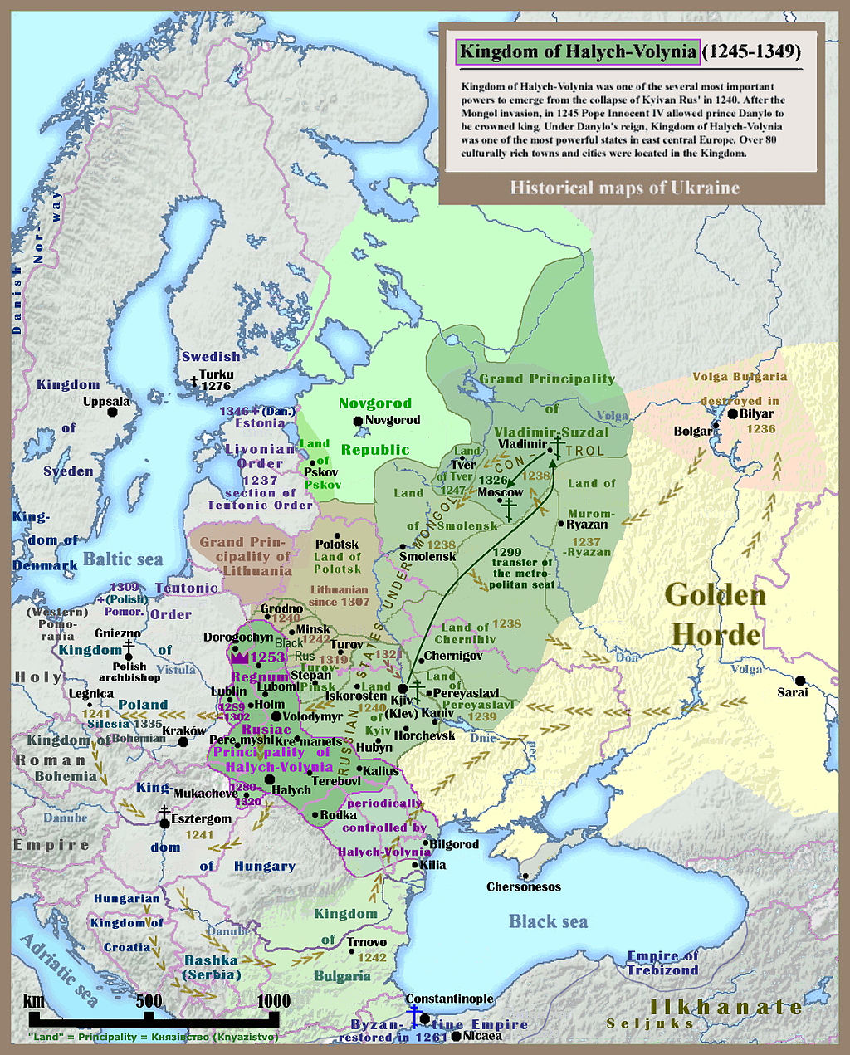
Contested History
Map of Kievan or Kyjivan Rus (Principality of Kiev Kyjiv), 1245-1349

Slide 8
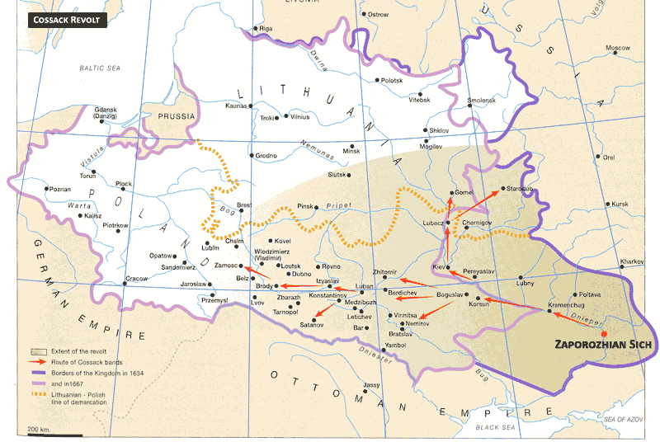
Map of Cossack wars 17th century

Slide 9
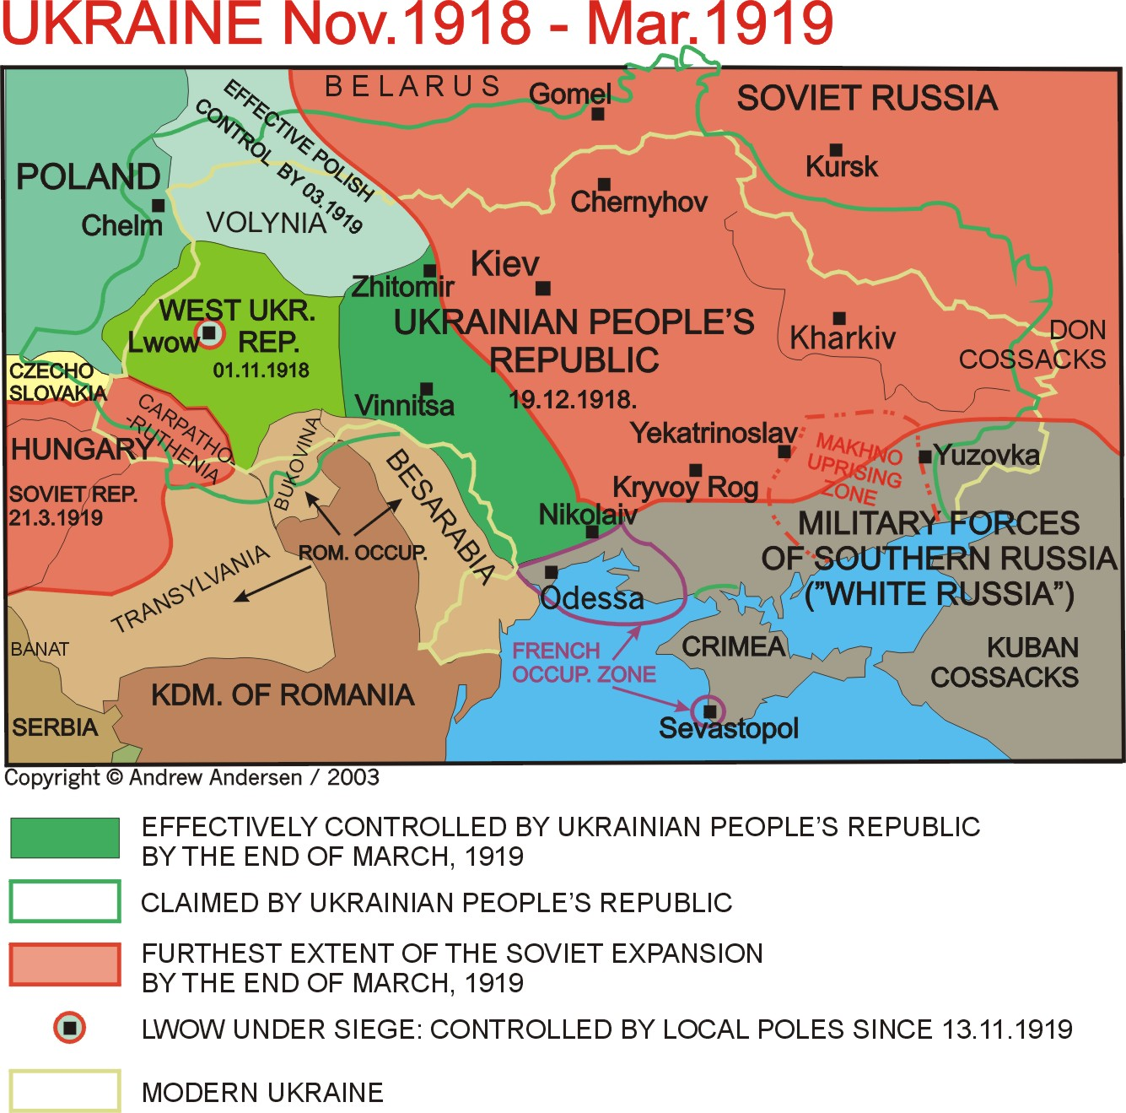

Slide 10
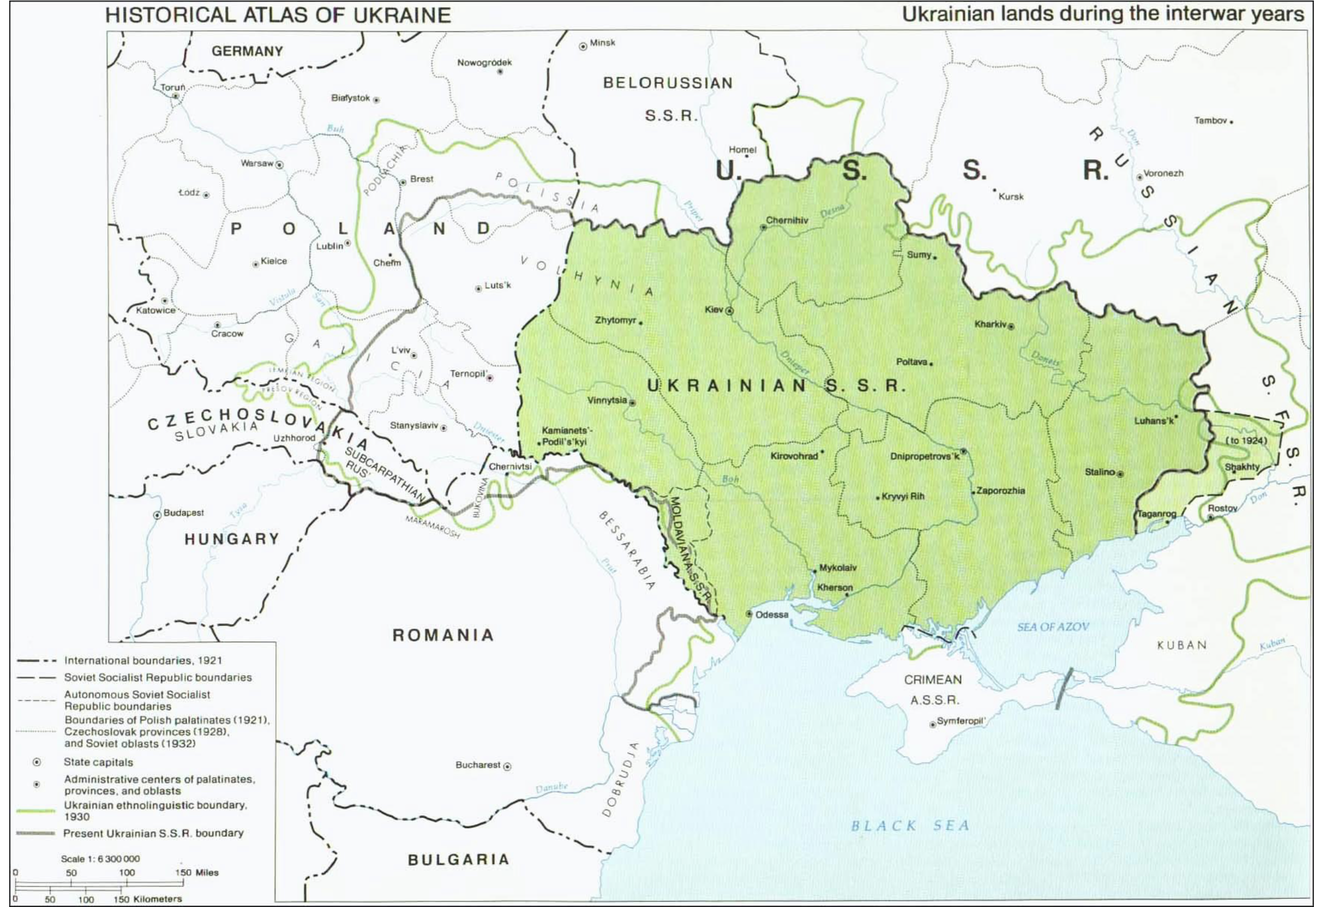

Slide 11
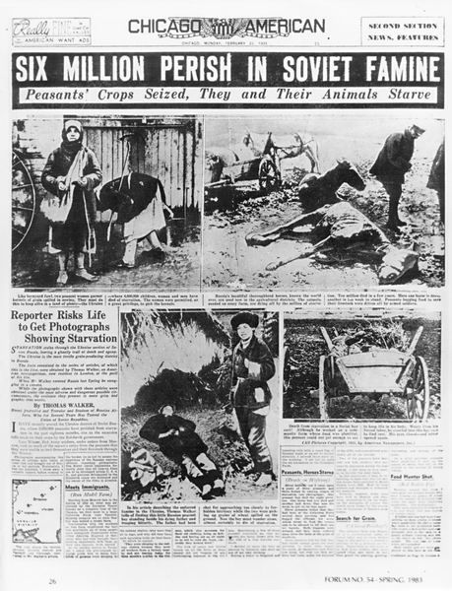
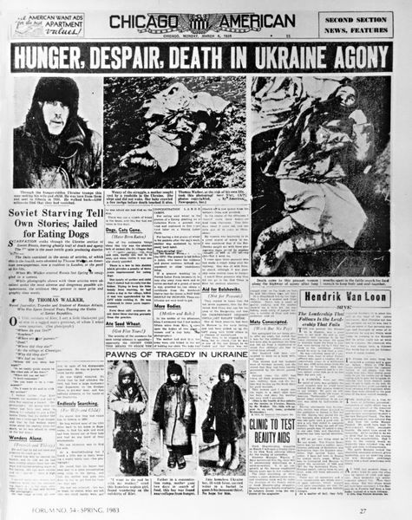
http://www.holodomor.org/
Notes:
11

Slide 12
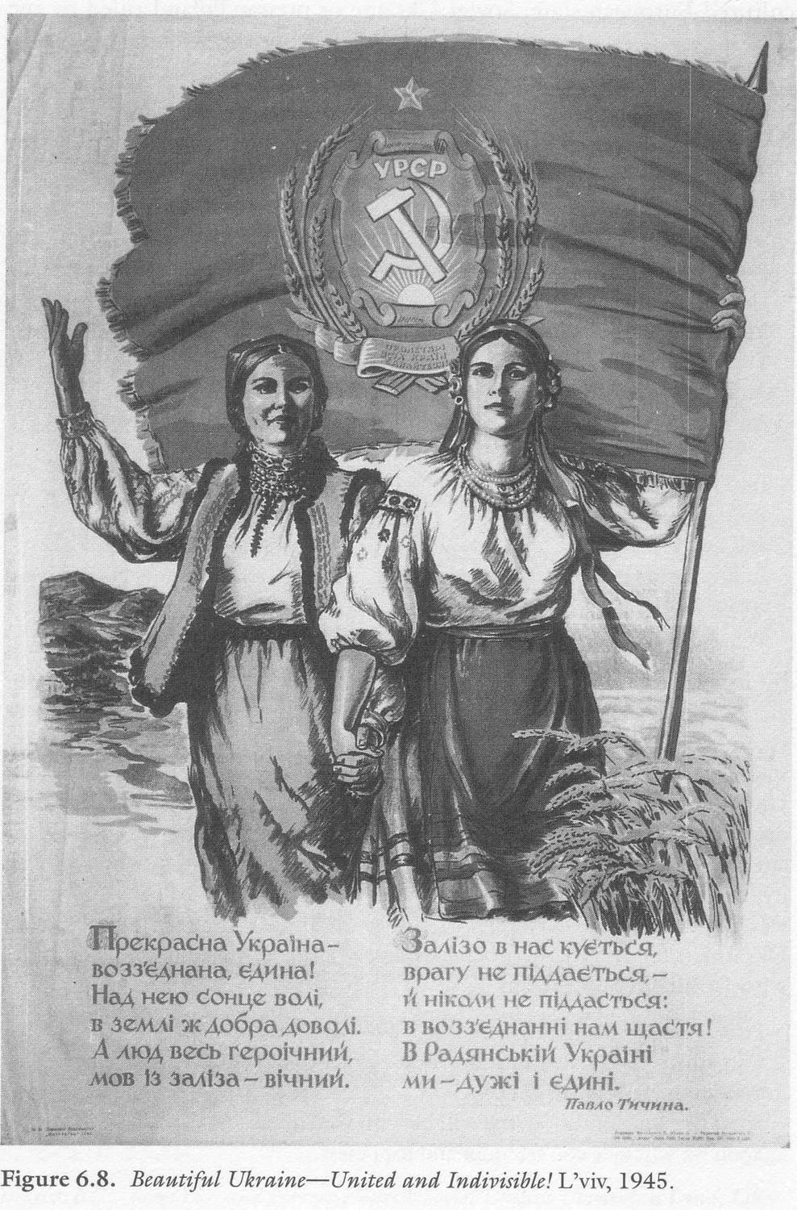
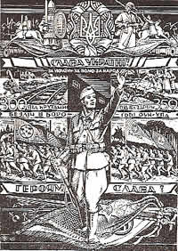
WWII Propaganda poster of the Organisation of Ukrainian Nationalists (OUN)
Soviet propaganda poster 1945

Slide 13
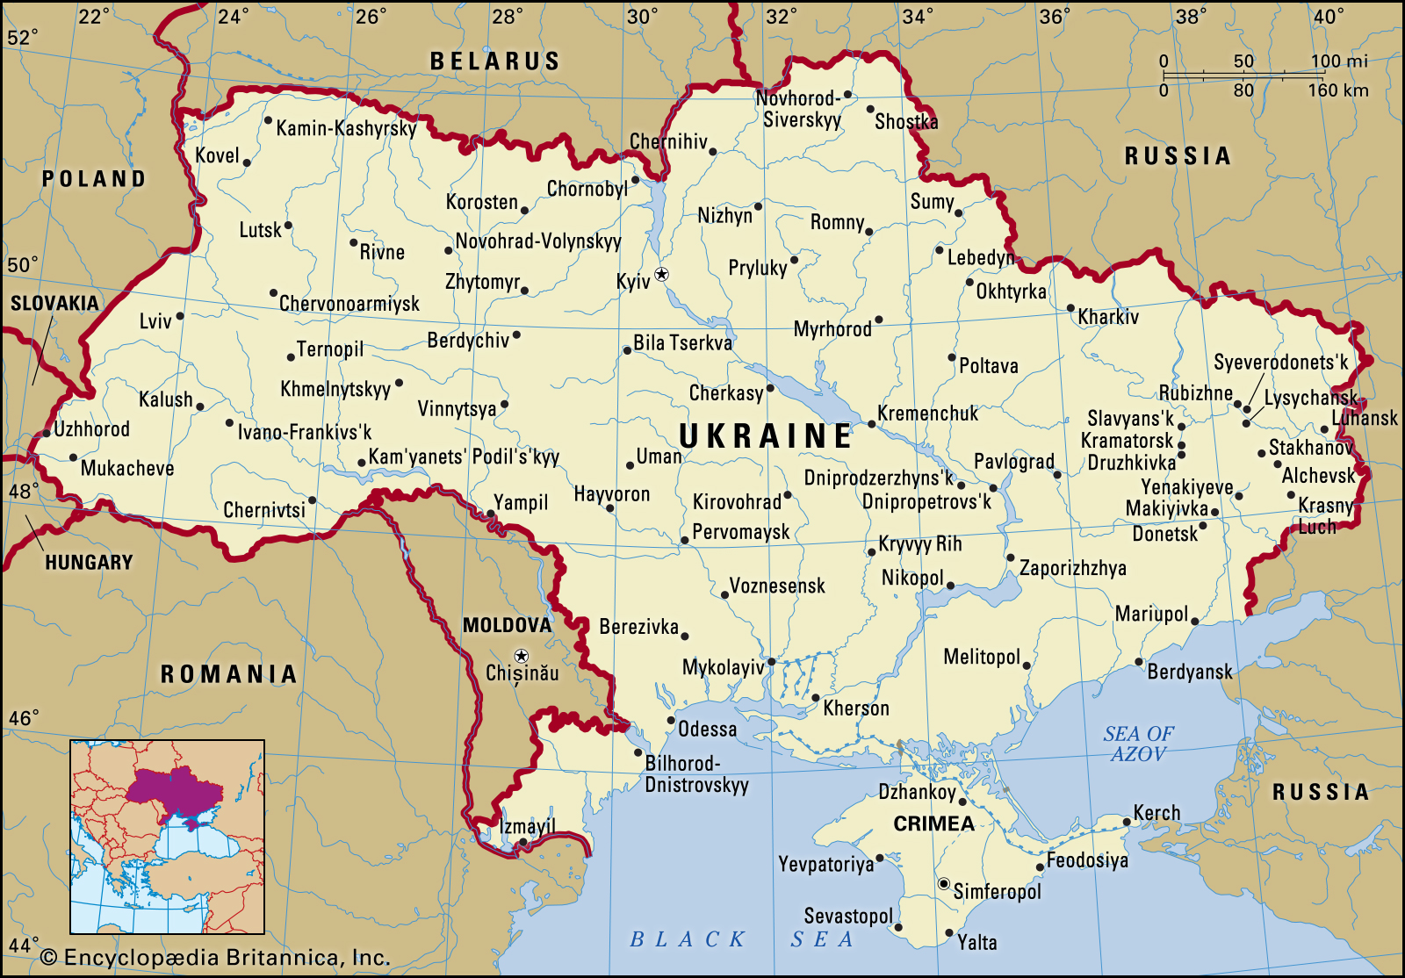

Slide 14
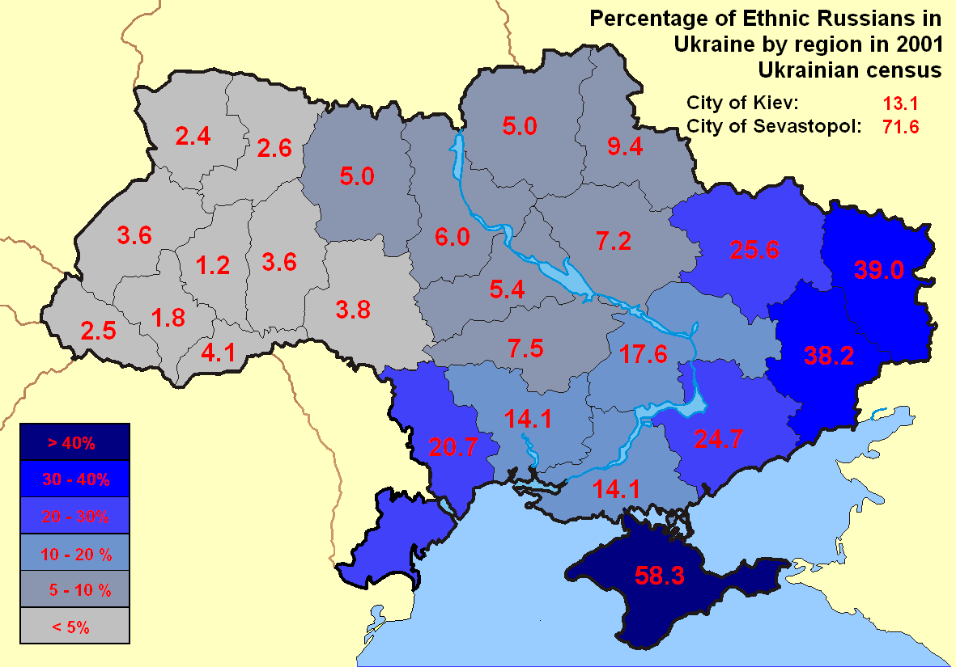
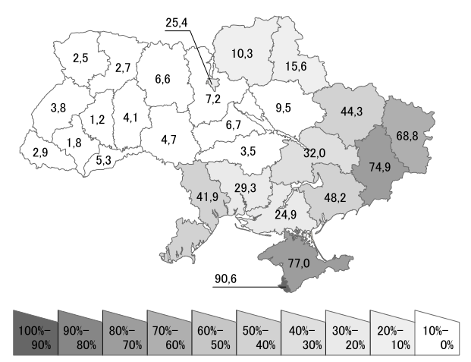
Percentage of Russian speakers in Ukraine by region in 2001 Ukrainian census

Slide 15
