Slide 1
Nation and Memory in Russia, Poland, Ukraine
What about the Jews?

Slide 2
Schedule
Historical Background
Emancipation
Rise of modern nationalism and anti-Semitism
Options
Conclusion

Slide 3
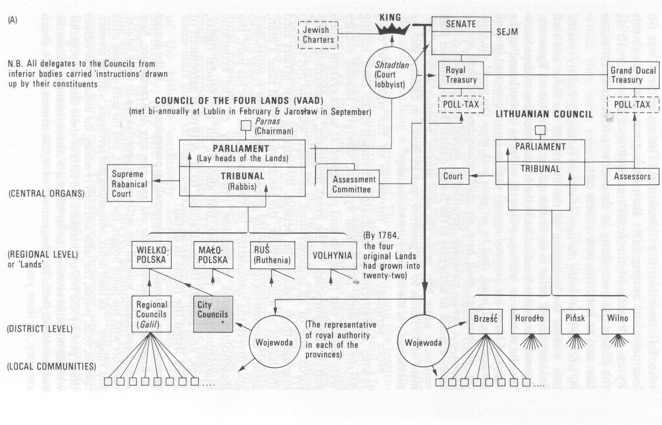
Jewish self- administration
Norman Davies: God‘s Playground. A History of Poland. Vol 1. New York 1982
Notes:
3

Slide 4
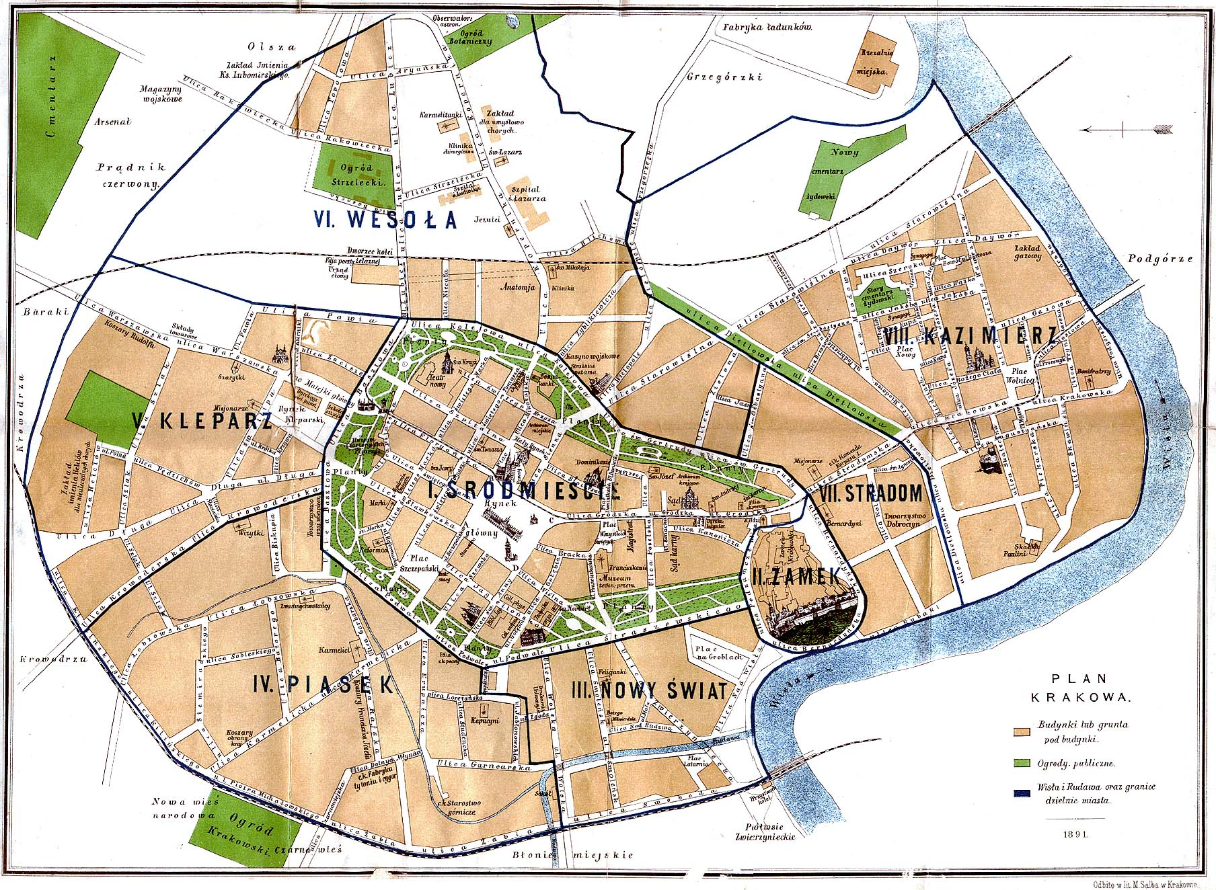
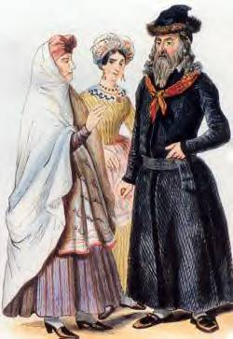

Slide 5
Schedule
Historical Background
Emancipation
Rise of modern nationalism and anti-Semitism
Options
Conclusion

Slide 6
Haskalah
Jewish Enlightenment
Maskilim - enlightened, learned, scholarly
Promoting Enlightenment values in Jewish community, working for better integration of Jews in society, emphasis on secular education and modern science/scholarship

Slide 7
Emancipation – the perspective of an enlightened politician during the French Revolution
“ But, they say to me, the Jews have their own judges and laws. I respond that is your fault and you should not allow it. We must refuse everything to the Jews as a nation and accord everything to Jews as individuals. We must withdraw recognition from their judges; they should only have our judges. We must refuse legal protection to the maintenance of the so-called laws of their Judaic organization; they should not be allowed to form in the state either a political body or an order. They must be citizens individually. But, some will say to me, they do not want to be citizens. Well then! If they do not want to be citizens, they should say so, and then, we should banish them. It is repugnant to have in the state an association of non-citizens, and a nation within the nation. . . . In short, Sirs, the presumed status of every man resident in a country is to be a citizen.
Comte de Clermont–Tonnerre, "Speech on Religious Minorities and Questionable Professions" (The French National Assembly 23 December 1789)

Slide 8
Jewish Responses to emancipation and rise of modern nations
Assimilation
Reform
Tradition

Slide 9
Hasidic Courts, Dynasties and Disciples of the BeSHT (Baal Shem Tov)

Slide 10
Schedule
Historical Background
Emancipation
Rise of modern nationalism and anti-Semitism
Options
Conclusion

Slide 11
The ‘Jewish Problem’
economic, legal, political
Can Jews be fully integrated in the German, French, Russian, Polish etc. nation?
Will they be loyal, unconditionally support the respective nation?
need/craving for self-definition and self-expression
Does being Jewish mean to belong to an ethnic group, to a nation, to a religious group, to a ‘race’, or something else?

Slide 12
Anti-Semitism
anti-Semitism is a new term (19th century) drawing on “scientific” anthropology and physiology, coincides with emergence of nationalism
easily adapted for other tasks and easily absorbs earlier anti-Jewish rhetorics

Slide 13
Pale of Settlement

Slide 14
Major Ethnic Groups in the Russian Empire 1897 (125,640,000)
Russians 44.31%
Ukrainians 17.81%
Belarusians 4.68%
Poles 6.31%
Jews 4.03%
Other ethnic groups in the West 4.47%
Ethnic groups in the North 0.42%
Ethnic groups Volga/Ural 5.85%
Ethnic groups in Siberia 0.99%
Ethnic groups in the Steppe 1.99%
Ethnic groups in the Transcaucasia 3.53%
Ethnic groups in the Caucasus 1.05%
Ethnic groups in Central Asia 5.69%
Diaspora groups (1.43% Germans) 1.91%

Slide 15
Pogroms in Russian Empire
In Odessa: 1821 and 1859 perpetrators mainly Greeks, in 1871 many Russians joined Greeks, 1905 over 400 Jews killed (perpetrators: Russians, Greeks, Ukrainians)
1881-1884 over 200 anti-Jewish events in Russian Empire (pogroms in Kiev, Warsaw, Odessa, etc.)
1903-1906 more pogroms, compared to earlier pogroms, many more Jews were killed

Slide 16
Schedule
Historical Background
Emancipation
Rise of modern nationalism and anti-Semitism
Options
Conclusion

Slide 17
Jewish Responses to emancipation and rise of modern nations
Assimilation
Reform
Tradition
Converting to Christianity
Ultra- Orthodox
Modern Orthodox
Jewish Poles, Russians, Ukrainians, Germans, French etc
Yiddishism
Zionism
Labour (Socialist) Z.
Secular Z.
Religious Z.
Hasidism
Atheism, Socialism/Communism

Slide 18
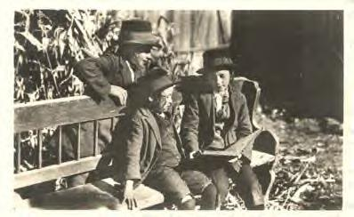
The Ultra-Orthodox attitude
The Exile is the punishment of god. It will end by a miracle redemption and the coming of the messiah. He will come if people will continue to pray and to observe Jewish laws and tradition

Slide 19
Jewish nationalism
Diaspora Nationalism
  historical: Simon Dubnow
  socialist: Bund
Zionism
  political: Herzl
  cultural: Ahad ha-Am (Asher Ginzberg)
  Secular vs religious Zionism

Slide 20
Diaspora Nationalism (late 19th/early 20th centuries)
Jews as separate ethnic group
achieve minority rights within multi-national empires
give up claim to independent state in return for national status
Jewish self-defense

Slide 21
Simon Dubnow
Jewish people evolved from racial-ethnic to territorial-political to cultural-historical
For the last - spiritual - stage a state with land, language, and sovereignty is not needed
the nation must redefine itself through secular institutions
error of religious reformers to define the group religiously
Volkspartei (People’s Party)

Slide 22
Bund
Jewish socialists: language Yiddish but strong connection to Russian Social Democratic Party
Algemeyner Yidisher Arbeiter Bund in Lite, Poylin und Rusland (General Worker’s Union in Lithuania, Poland and Russia)
est. 1897 in Russian Empire (Vilnius one of main centres)
aim to escape particularism and parochialism
young socialists are shocked by popular anti-Semitism and its acceptance by the left
Jewish masses suspicious of assimilationists
Jewish interests are separate

Slide 23
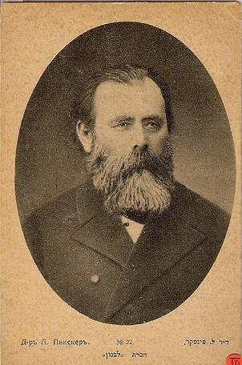
Leon Pinsker, Auto-Emancipation! (1882), written after the Odessa Pogrom
Since the Jew is nowhere at home, nowhere regarded as a native, he remains an alien everywhere. That he himself and his ancestors as well are born in the country does not alter this fact in the least (…)
(…) to the living the Jew is a corpse, to the native a foreigner, to the homesteader a vagrant, to the proprietary a beggar, to the poor an exploiter and a millionaire, to the patriot a man without a country, for all a hated rival.
Leon (Yehudah Leib) Pinsker, 1821-1891

Slide 24
Zionism
From biblical ”Zion”, often synonymous with Jerusalem and the Land of Israel (Eretz Yisrael)
= Jewish nationalism, Jewish national movement
Definition of the Jews as an ethnic group
Response to anti-Semitism and perceived failure of assimilation
Solution: homeland, preferably in Palestine
For the moment: organisation of Jewish self-defense

Slide 25
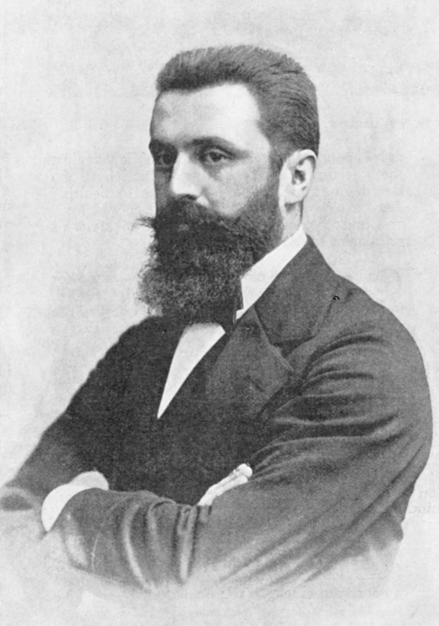
Theodor Herzl (1860 – 1904)
Timeline
Pogroms 1881 and May Laws (confirming restriction for Jews and Pale of Settlement)
Dreyfus trial 1896
Jewish State 1896
First Zionist Congress 1897 in Basel

Slide 26
The First Zionist Congress in Basel in August 1897:
According to the Basel Program Zionism wants to create for the Jewish people a home in Palestine

Slide 27
Jewish settlement in Palestine
organized help for settlers
impact of pogroms on migration -- 1872; 1881
Bilu – movement to promote agricultural settlement of Jews in Palestine
First Aliya (1882-1903)
Second Aliya (1905-1914)

Slide 28
Schedule
Historical Background
Emancipation
Rise of modern nationalism and anti-Semitism
Options
Conclusion

Slide 29
Nationalism and anti-Semitism
The ’Jewish question’
Exclusion and self-exclusion
Zionism vs. the concept of national (personal) autonomy
Hebrew vs. Yiddish
Revolutionary socialism
What will the future bring?

