Slide 1
Nation and Memory in
Russia, Poland, and Ukraine
Lecture 18
Memory Conflicts: Sites of Mourning - Sites of Glory
Week 10, Spring Term
In 2021/22 moved to Week 1 Summer Term
Notes:
1

Slide 2
Outline
Russia: great victory - gigantic monuments
Ukraine: divided memory - contested monuments
Poland: official memory vs. private memory
Conclusion
Notes:
2

Slide 3
The Great Patriotic War and Soviet memory policy
Strengthened the legitimacy of the Soviet political system
Second founding myth of the Soviet Union
Part of personality cult of Stalin, replaced later by cult of Red Army and Communist Party
Celebration of Soviet (Russian) heroism in interest of both – veterans and government
Since Brezhnev: monumentalisation of war remembrance
Parades on Red Square: demonstration of strength and unity
Giving meaning to war was quite successful: acceptance of heroic fight against foreign aggression – justification for suffering, for many war veterans and also civilians: most important event of their life. Feeling of unity between regime and population.

Slide 4
The Great Patriotic War and the Soviet memory policy
Excluded from official memory
Experiences of Ostarbeiter [Eastern workers] and Soviet prisoners of war (at best held to be weak, at worst considered traitors),
Collaboration and Anti-Soviet attitudes
Defeats at the beginning of the war (retreat presented as result of superior strategy)
Secret articles of the German-Soviet non-aggression treaty, August 1939
Katyn and the murder of Polish officers, deportation of Poles, Ukrainians, Jews, Latvians, Estonians, Lithuanians between 1939-1941
Mass rapes 1944/45 in Germany
Enormous number of dead Red Army soldiers
Invalids: did not conform to image of strong Red Army Soldier, mutilated bodies do not fit in with the heroic image of Great Patriotic War, their experiences marginalised and ignored

Slide 5
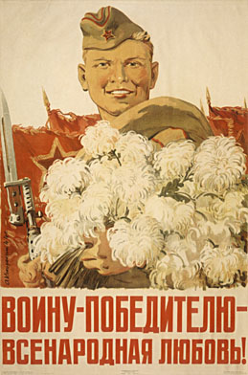
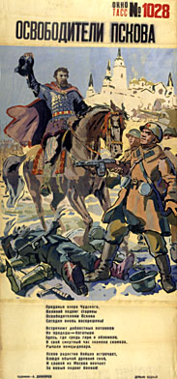
A.A. Kokorekin, The love of the whole nation for the victorious fighter, 1944
A.T. Danilichev, The Liberator of Pskov, 1944

Slide 6
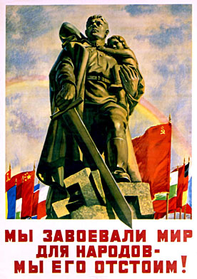
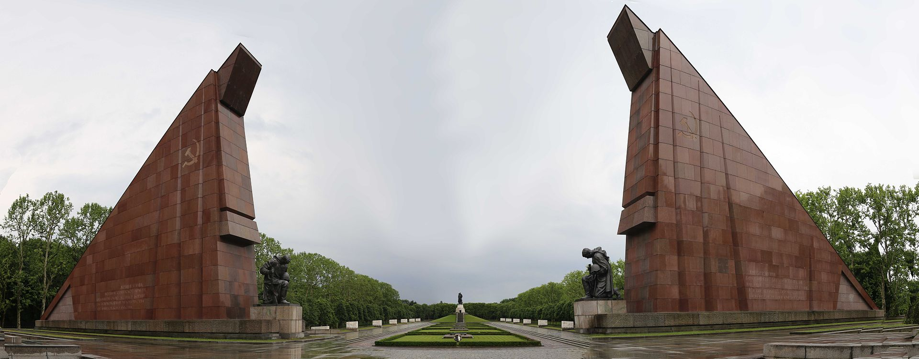
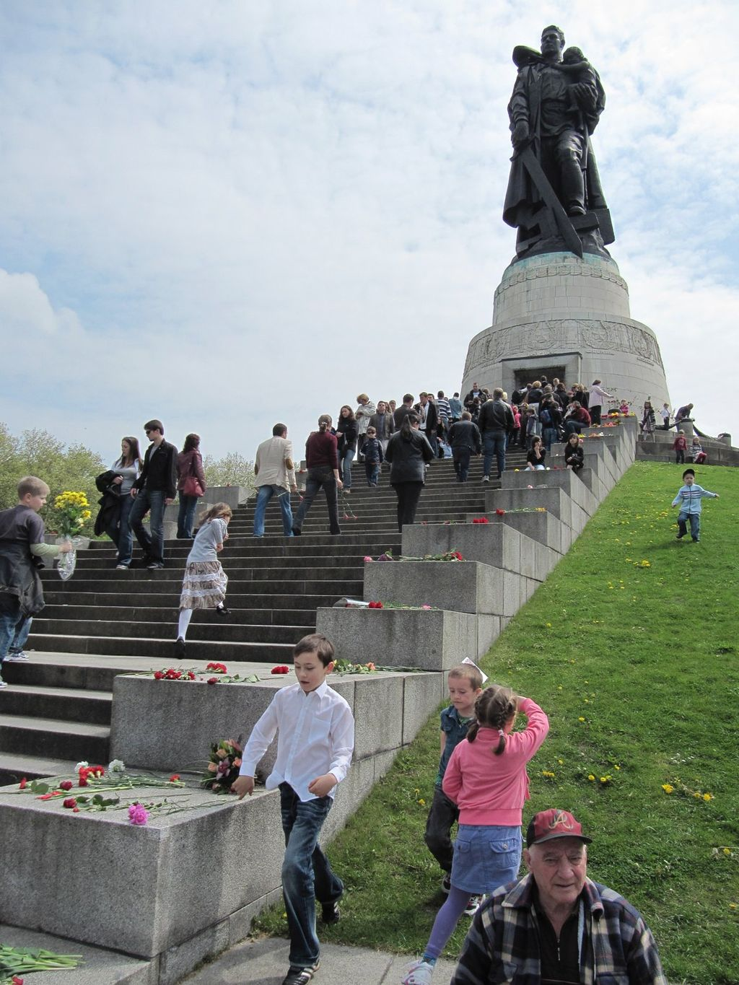
Soviet War Memorial at Treptower Park, Berlin.
N.N. Zhukov, We have fought for peace for the nations – we will defend it!
Moscow, Leningrad, 1950
Sculptor: Yevgeny Vuchetych. Unveiled 8 May 1949 to commemorate the Soviet soldiers fallen in the Battle of Berlin

Slide 7
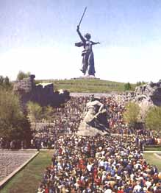
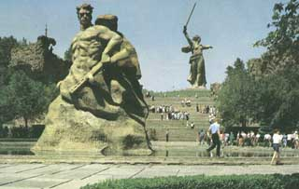
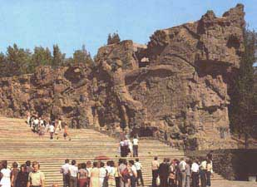
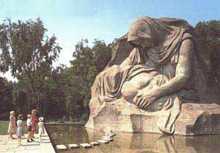

Slide 8
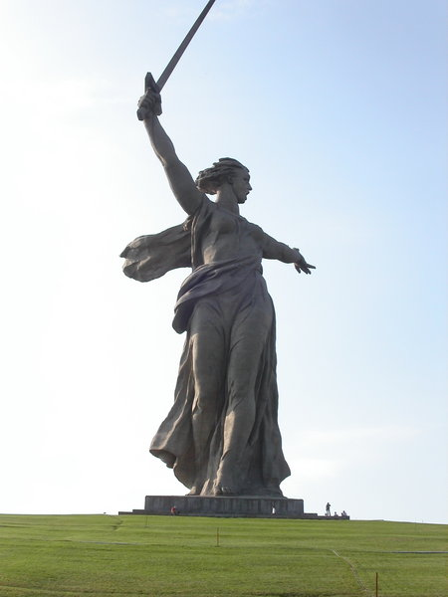
Motherland monument in Stalingrad/Volgograd, Mamayev Kurgan

Slide 9
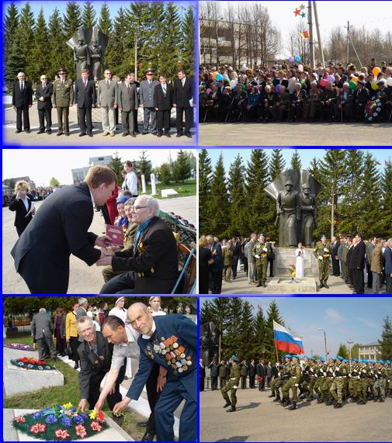
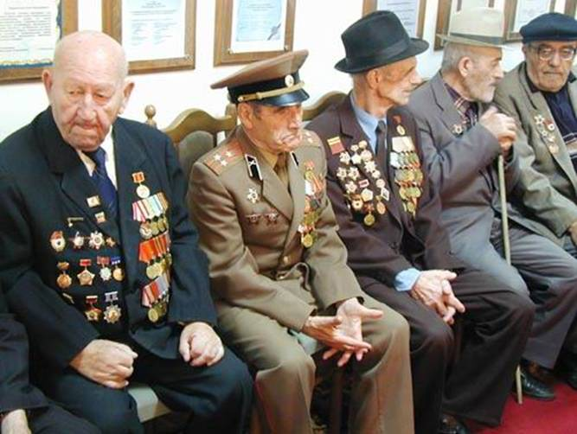
Soviet war veterans
2005
Victory day

Slide 10
Outline
Russia: great victory - gigantic monuments
Ukraine: divided memory - contested monuments
Poland: official memory vs. private memory
Conclusion
Notes:
10

Slide 11
Ukraine – the divided memory until 2014/22
Eastern Ukraine (= in Soviet period official memory for all Ukraine)
Heroes: Red Army soldiers
Close to Soviet interpretation
Liberation and unification of Ukraine – culmination of Ukrainian history thanks to brotherhood with Soviet Union and Russian nation
Ukrainian national partisans, collaborators with Germans, German agents, traitors to Ukrainian nation
No issues with suppression of Greek-Catholic Church
Western Ukraine (exile and private)
Heroes: nationalist partisans
Official interpretation contradicts own view
Several years’ fighting against incorporation in Soviet Union
Problem of collaboration with Germans, Wolhynian massacres and anti-Semitic attitude of integral nationalists
Ukrainian partisans recognised as soldiers and fighters for liberty, heroes of Ukraine
Forced unification of Greek-Catholic Church with Russian Orthodox Church in 1947 = attack on key component of Western Ukrainian identity
Changes after 2014, accelerating after Russian attack: Soviet era monuments are pulled down
Idea of brotherhood of Ukrainians and Russians destroyed: renaming of streets, removal of monuments celebrating Russian-Ukrainian friendship
Growing influence of Western Ukrainian view in Central Ukrainian but not clear yet whether there will eventually be a generally accepted view of WWII
In Russian controlled regions: return of Soviet monuments

Slide 12
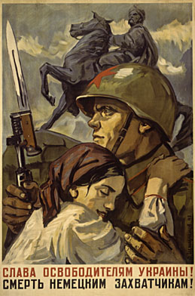

D.A. Shmarinov,
Glory to the liberators of Ukraine!
Death to the German invaders!
Moscow, Leningrad 1941

Slide 13
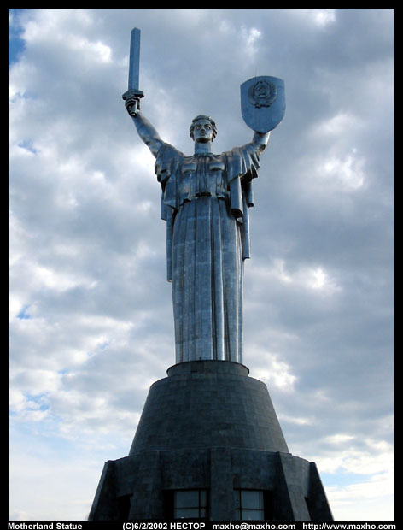
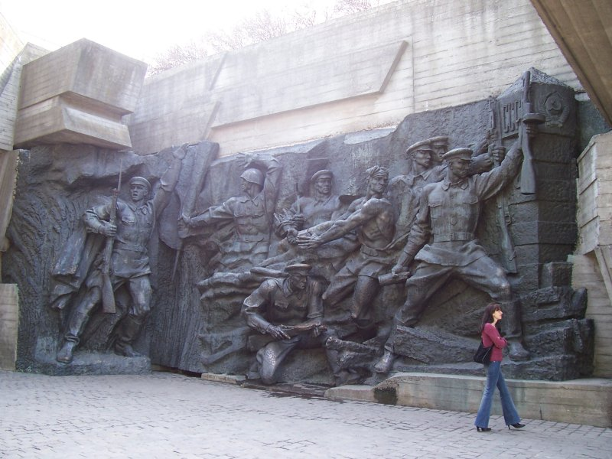
Motherland statue, Kiev, 1981, 62 m
National Museum of the History of the Great Patriotic War of 1941-1945 years

Slide 14
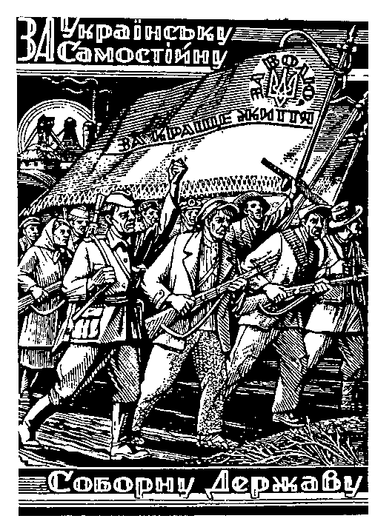
"For an independent and sovereign Ukrainian State"
On the flag: "For Liberty and a better life."
A woodcut by Nil Khasevich, an underground UPA artist

Slide 15
Kyiv - Monument to Soviet Citizens and POW‘s shot at Babi Yar (1976)
Kyiv - Monument to the Jews massacred at Babi Yar (unveiled on Sept. 29, 1991)
Kyiv - Wooden cross in memory of the 621 Ukrainian nationalists (murdered by the Germans in 1942 (installed in 1992)

Slide 16
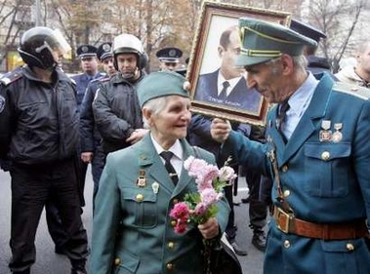
Veterans of the wartime Ukrainian Insurgent Army (UPA) talk as one holds a portrait of UPA leader Stepan Bandera during skirmishes which broke out at rallies in central Kiev on October 15, 2005, a day devoted to remembering the 63rd anniversary of the founding of UPA. Communists, leftists and some liberals denounce any notion of official recognition for the UPA, which fought both Nazi invaders and Soviet troops in the war (and was responsible for the murder of 70,000 Polish civilians, an unknown number of Jews and Ukrainians who opposed the OUN(b))

Slide 17
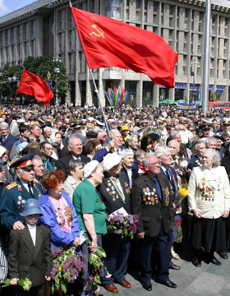
Victory Day in Kiev 2004

Slide 18
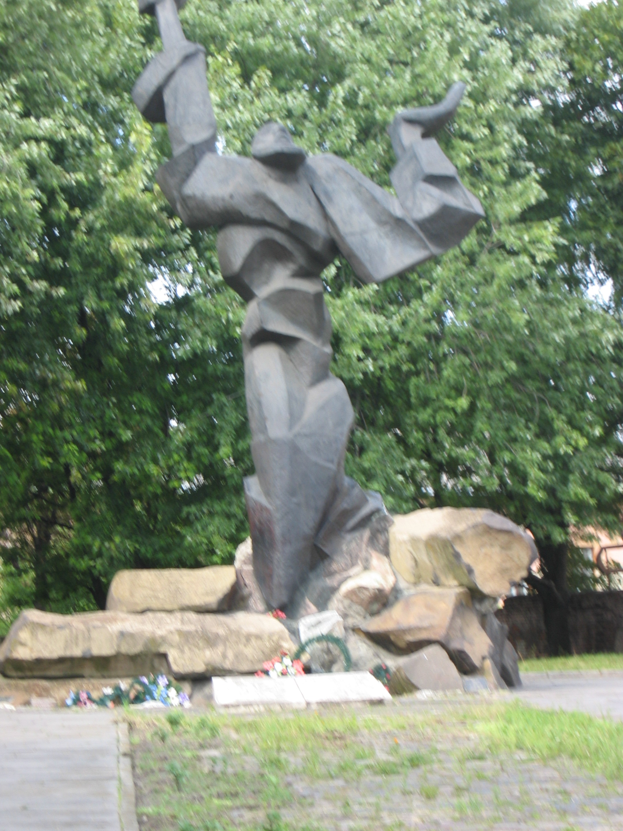
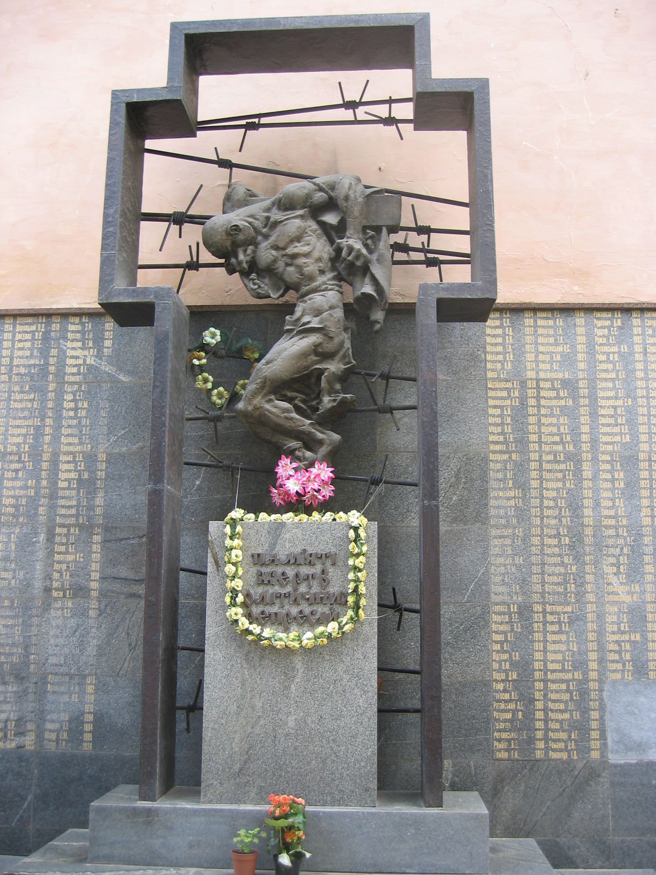
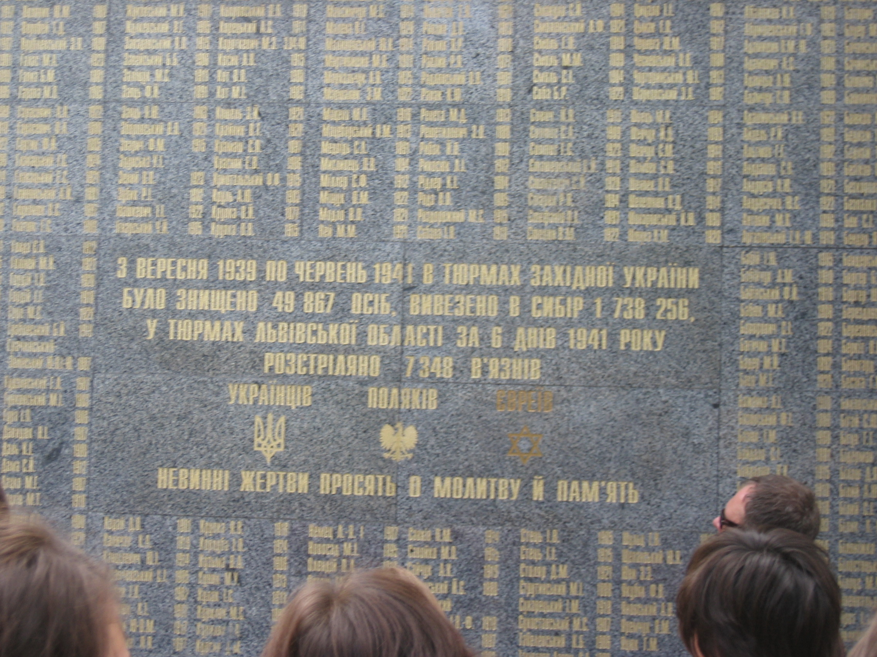
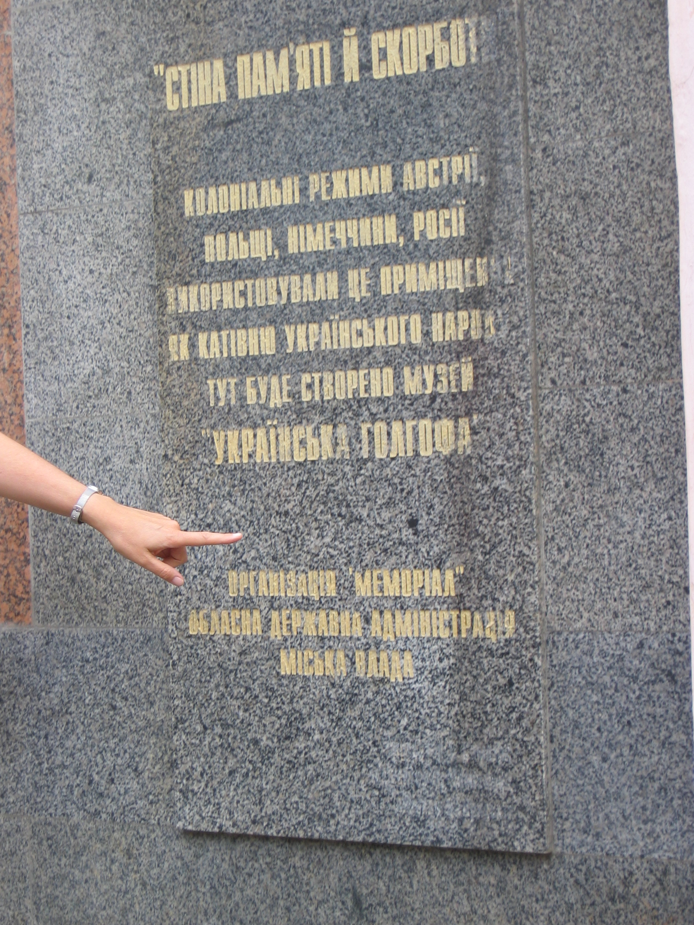
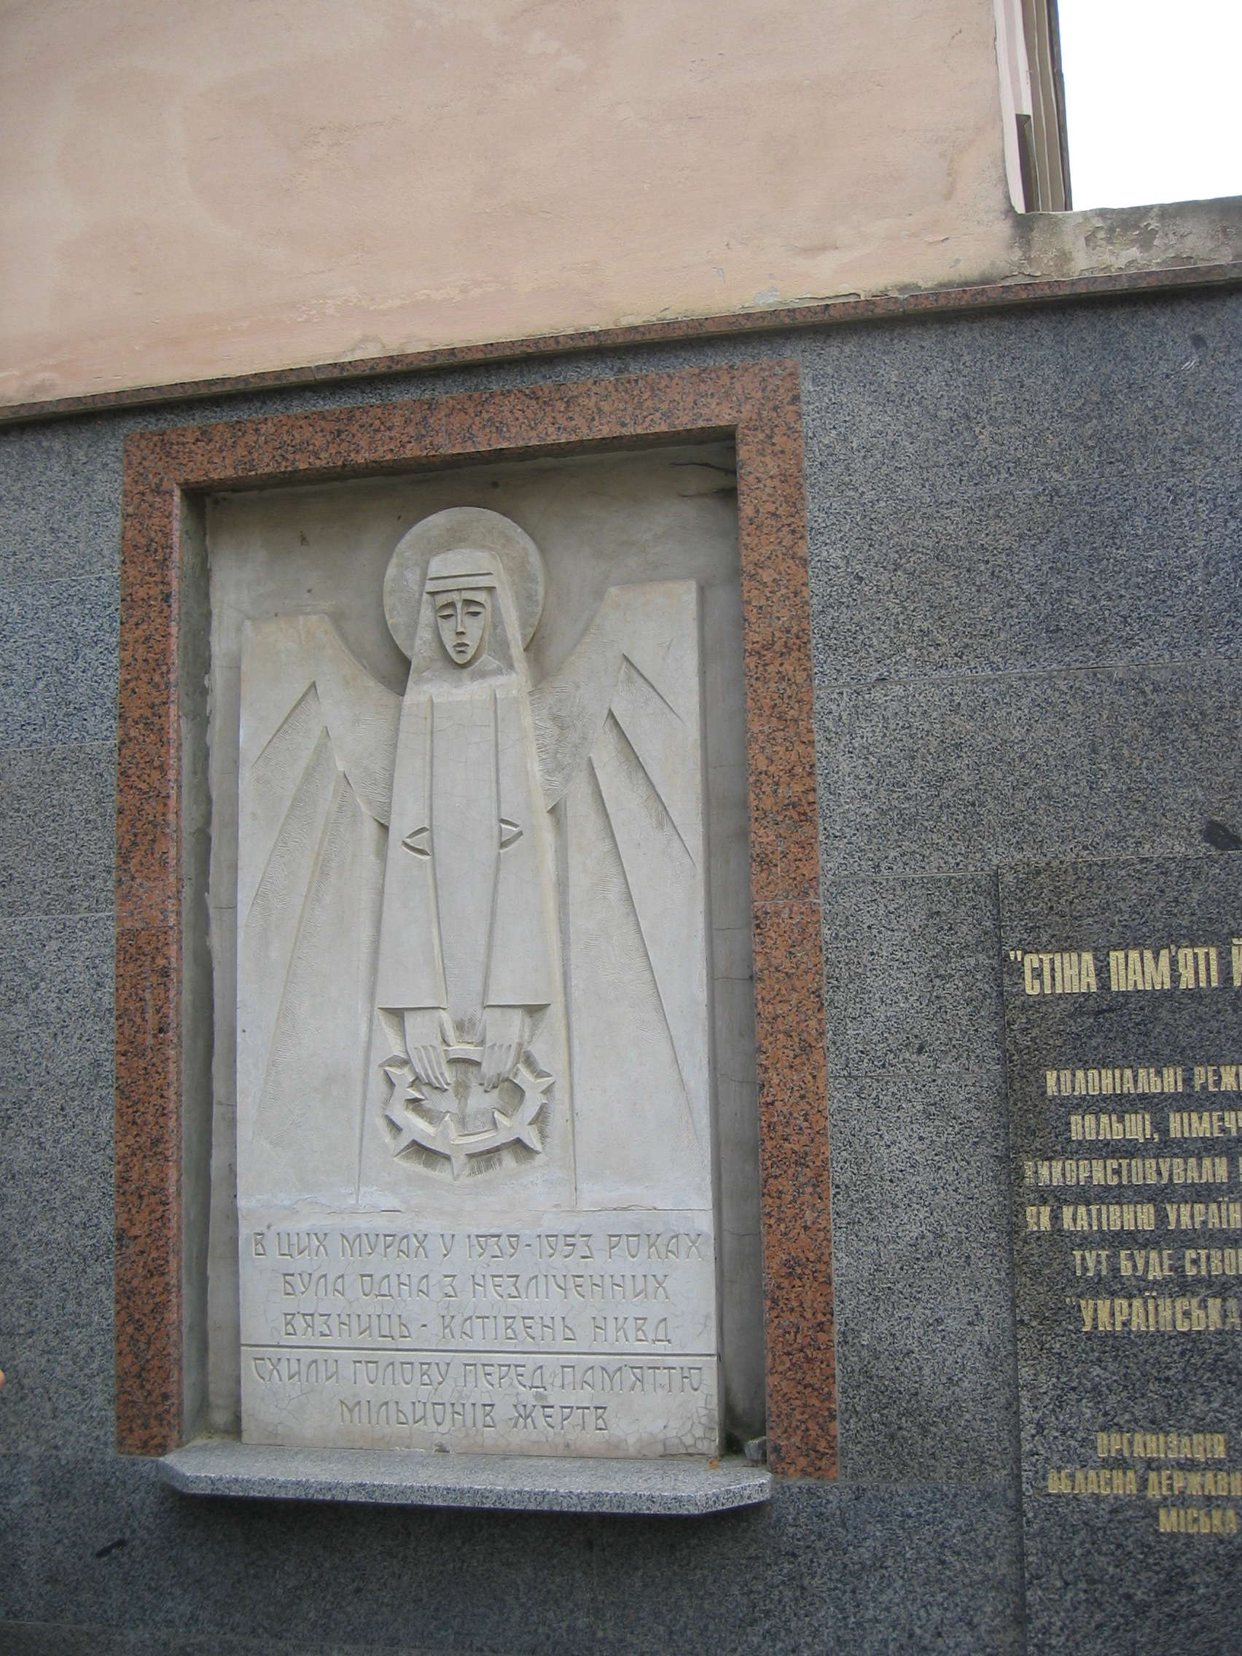
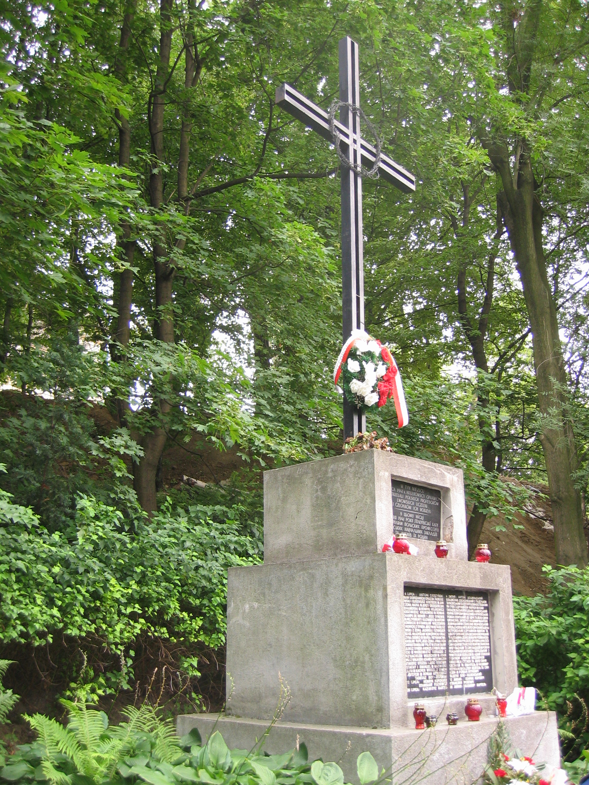
Lviv - „From September 1939 to June 1941 49867 people were killed in the prisons of Western Ukraine. 1738256 were deported to Siberia, during 6 days in 1941 7348 prisoners were shot in the prisons of the Lviv region
Ukrainians Poles Jews“
Lviv - Monument to the victims of the ghetto (1992)
Lviv - „To the memory of the victims of political repression“
Lviv - Cross at the place where 25 Polish professors and members of their families were shot by a German unit in July 1941 (1992)
Lviv - Here the museum „The Ukrainian Golgotha“ will be built

Slide 19
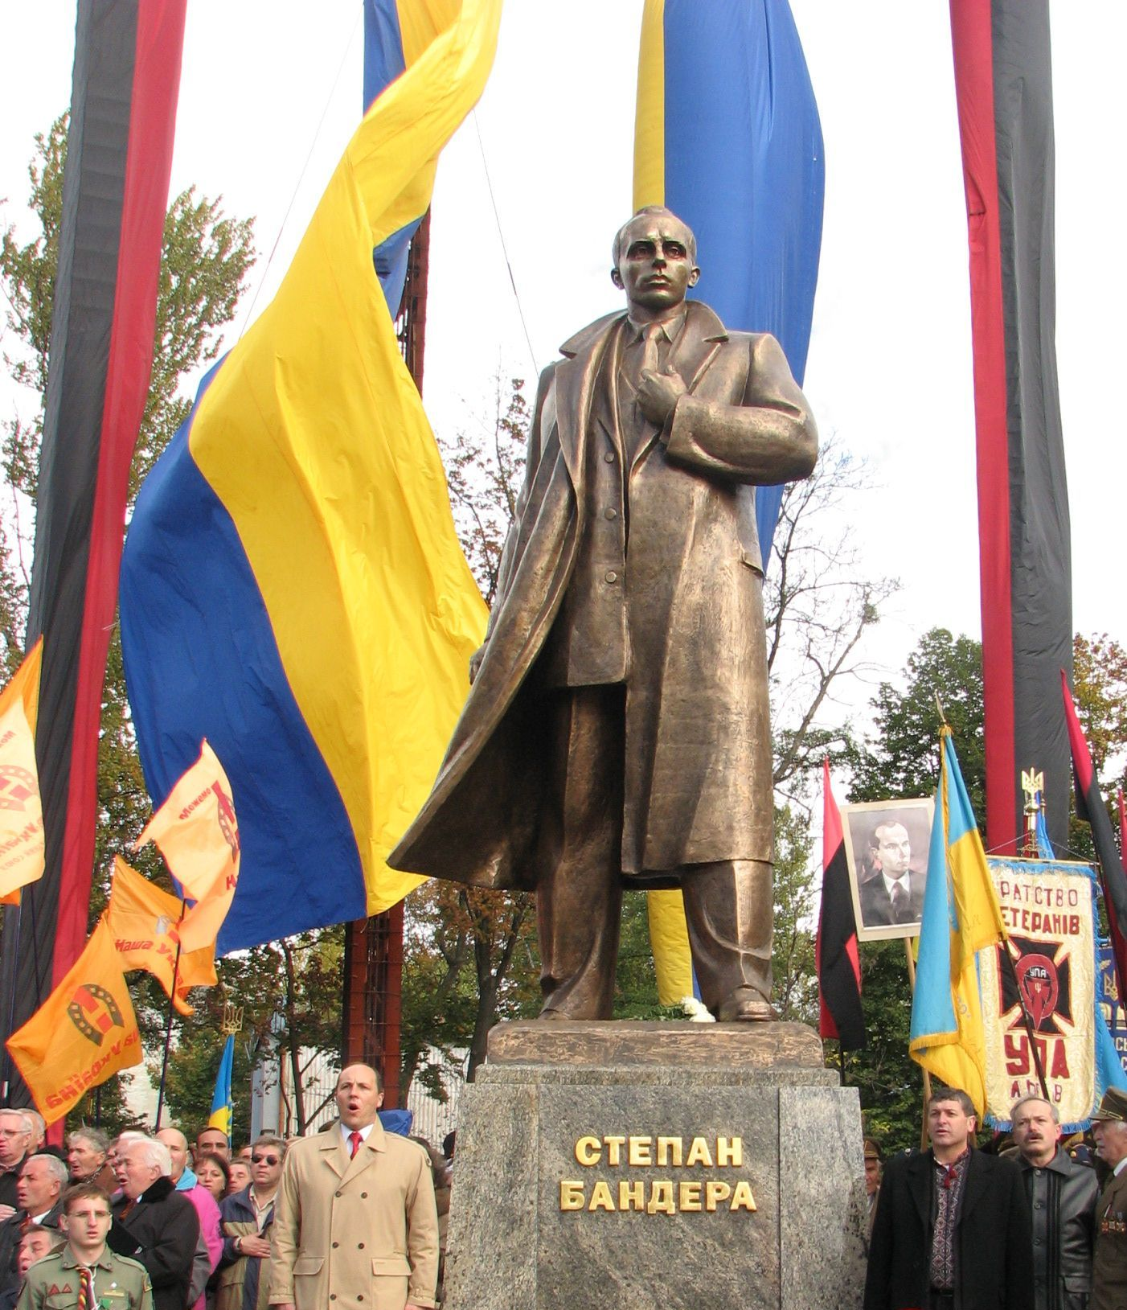
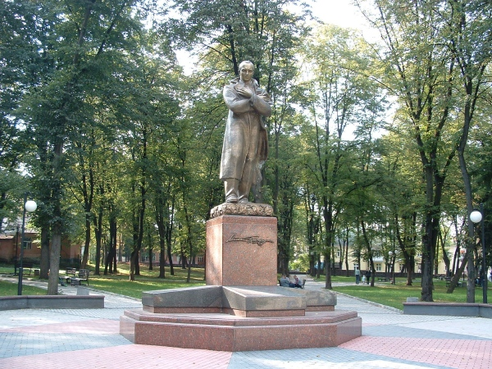
Lviv - Monument of the leader of the Organisation of Ukrainian Nationalists (B), Stepan Bandera, unveiled in November 2007 in Lviv
New monument of Stepan Bandera in Drohobych, Western Ukraine
Notes:
19

Slide 20
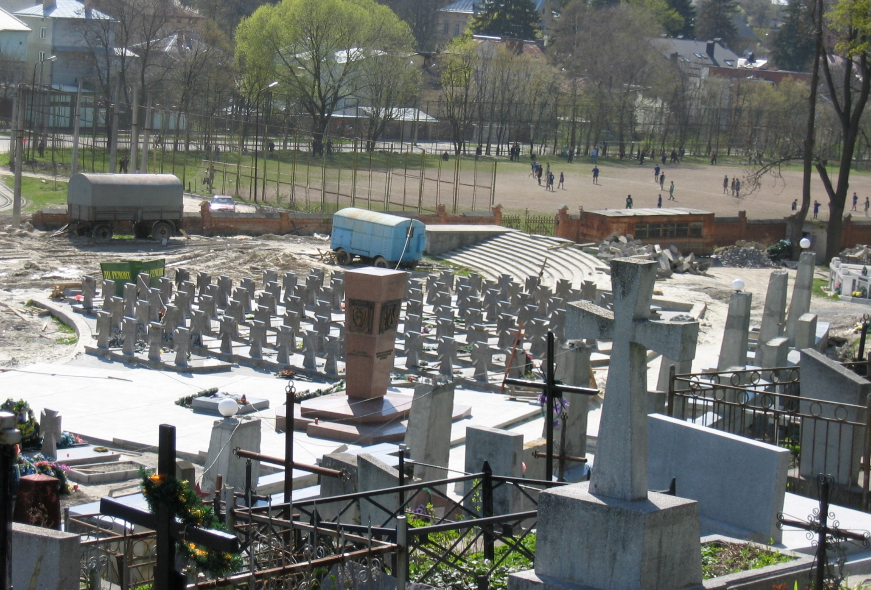
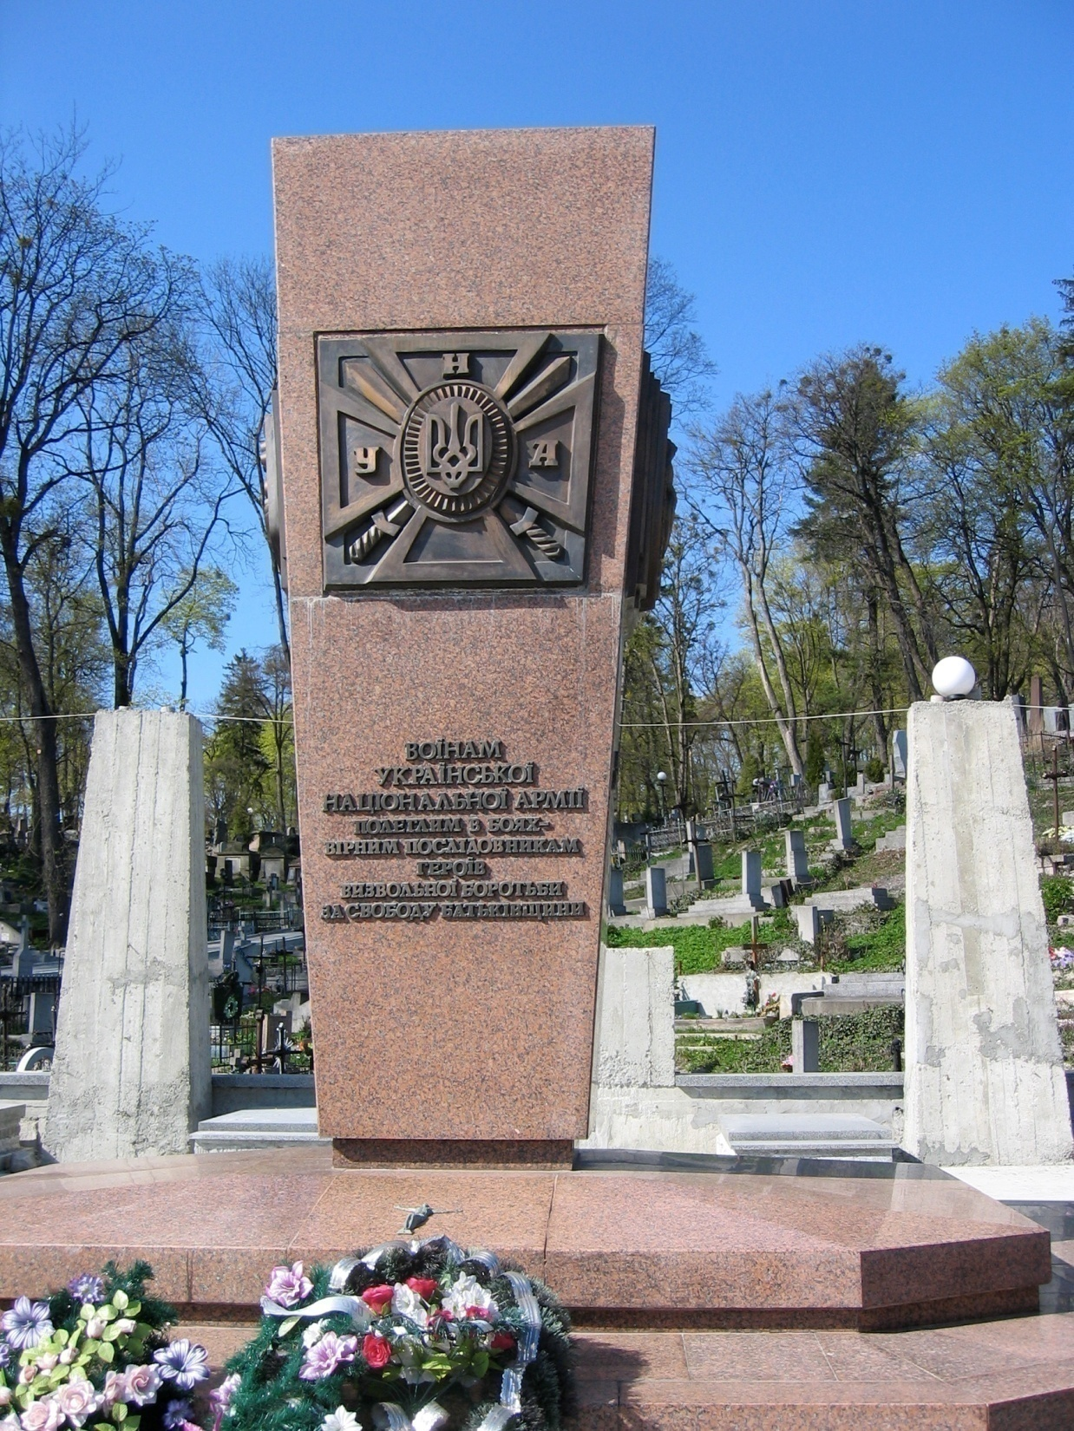
Lviv - Monument and cemetery of the soldiers of the two Ukrainian SS divisions
Lviv - Monument on the new Ukrainian memorial
„To the soldiers of the Ukrainian National Army, fallen in battle - faithful successors of the heroes of the fight for liberation for the freedom of the Fatherland“
Notes:
20

Slide 21
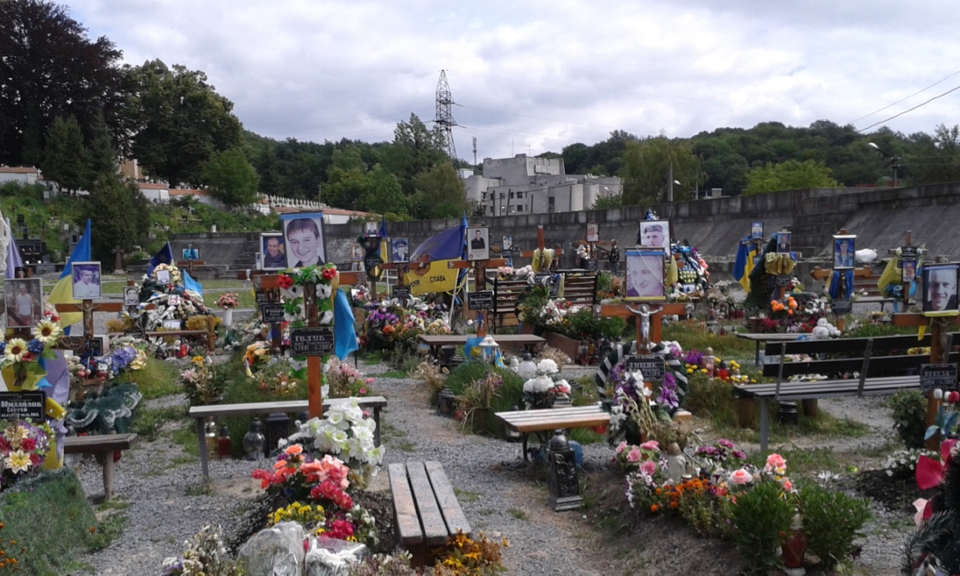
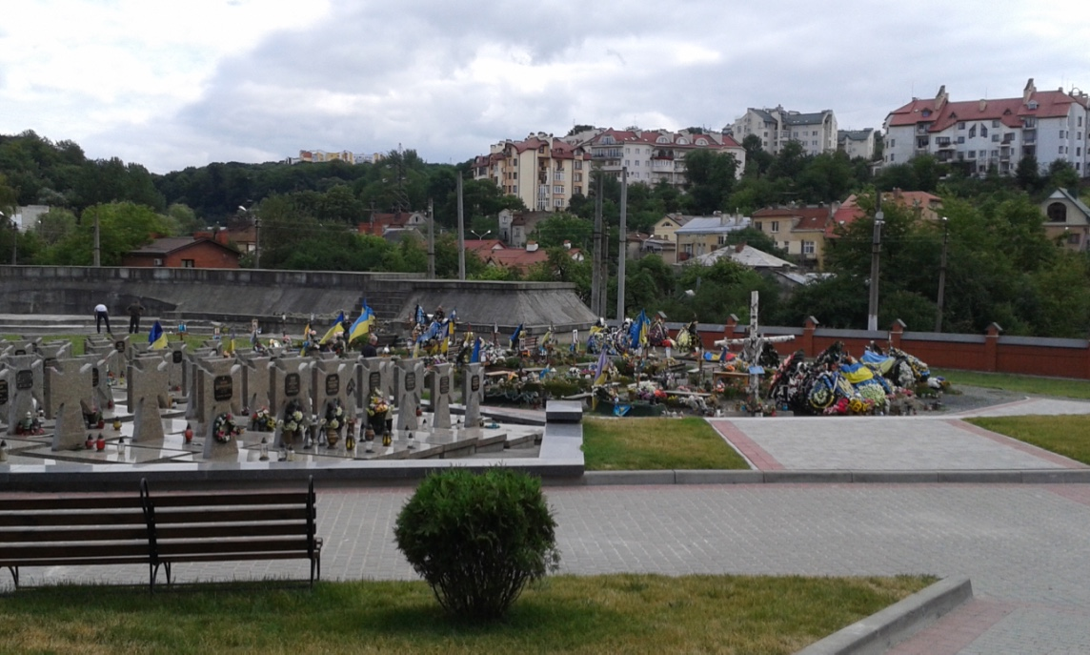

Slide 22
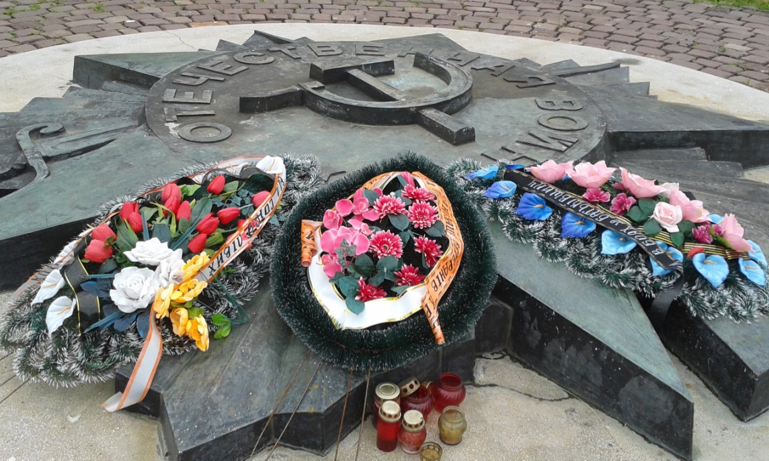
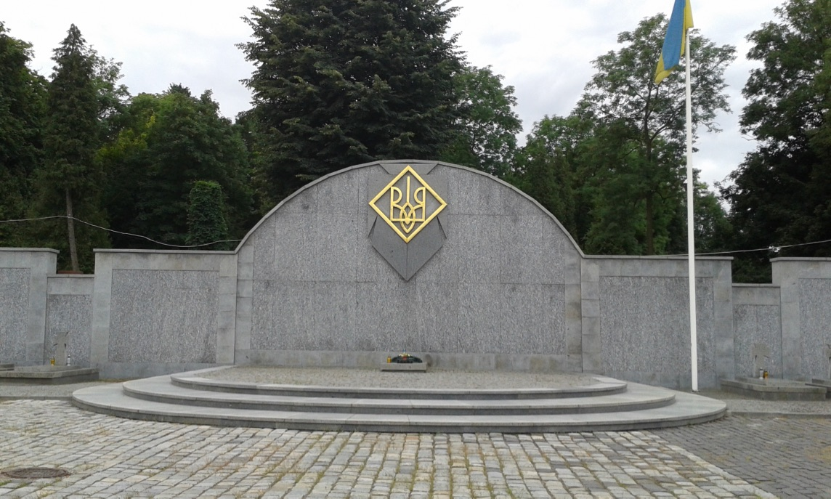
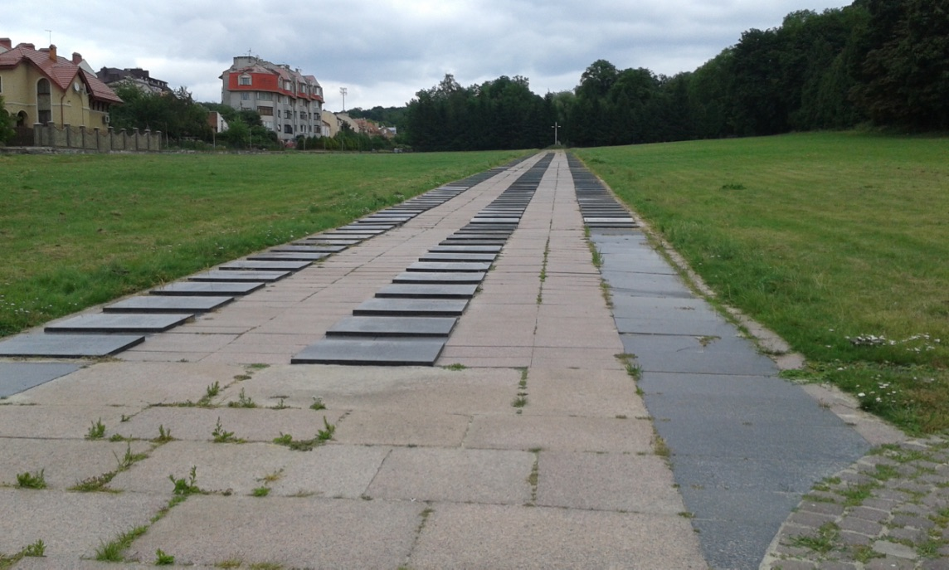
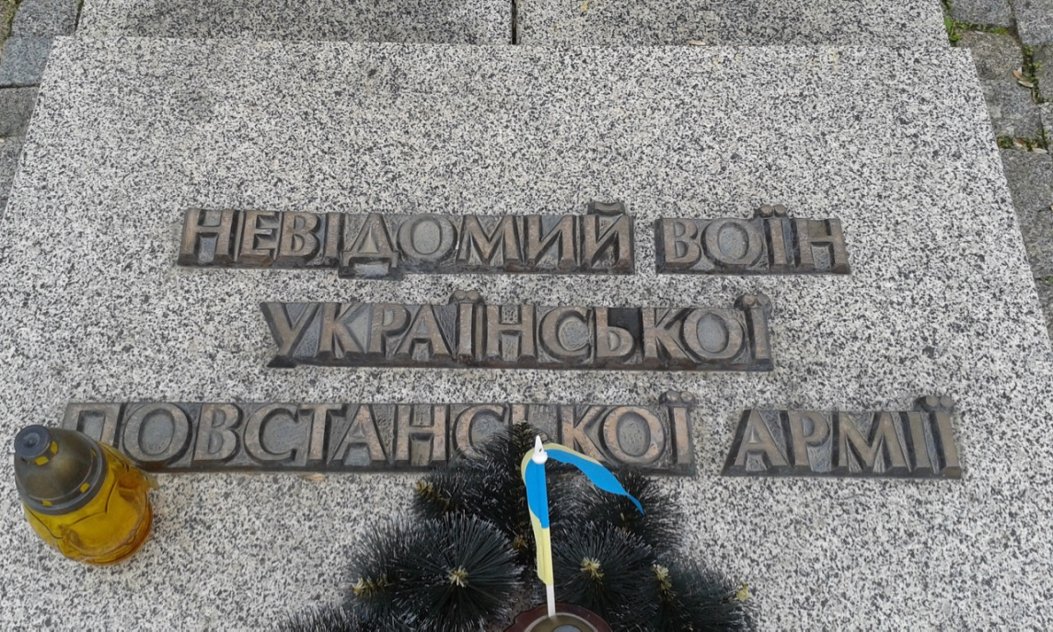
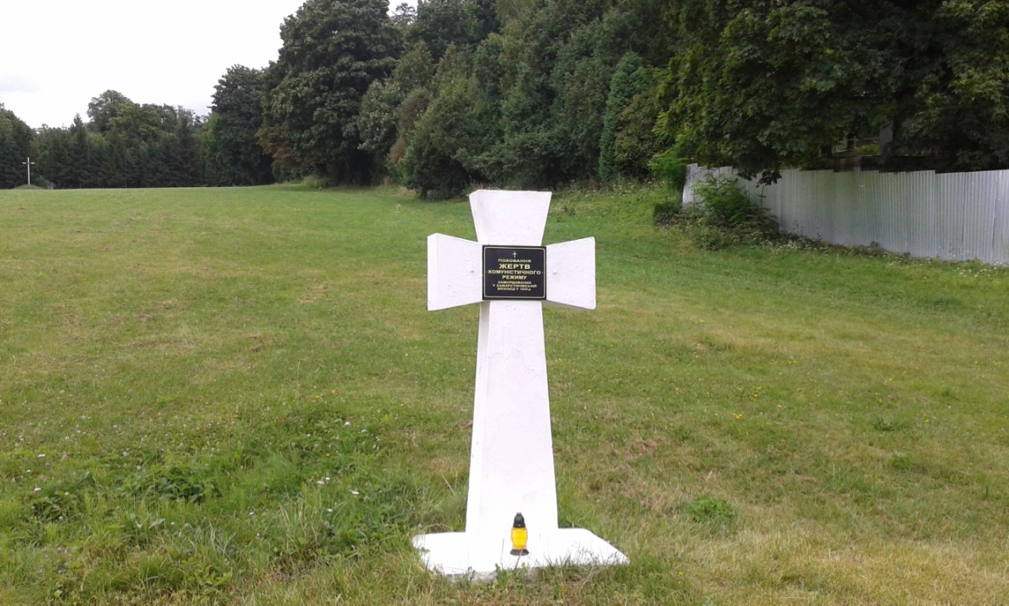

Slide 23
Outline
Russia: great victory - gigantic monuments
Ukraine: divided memory - contested monuments
Poland: official memory vs. private memory
Conclusion
Notes:
23

Slide 24
Poland and the Memory of WWII
Communist Poland
Liberation by Red Army, Brotherhood with Soviet Union
People’s Republic of Poland culmination of Polish history
Polish suffering and heroism: Communist resistance within the Polish tradition of fighting for liberty
Armia Krajowa: at best marginalisation of its role, at worst accused of collaboration with the Germans
Warsaw Uprising: act of irresponsible people or even criminals – anti-Soviet dimension
Anti-German propaganda linked to pro-Russian and pro-Soviet propaganda
Collaboration and Polish anti-Semitism denied
Dominant in public space
Opposition view (exiles, church, samizdat, private memory)
Liberation by Red Army, but followed by oppression
People’s Republic – dominated by Moscow
Polish suffering and heroism: resistance of Armia Krajowa, no collaboration, in the tradition of uprisings
Warsaw Uprising: mixed feelings, but mainly positive connotation – Polish heroism against overwhelming enemy
anti-German attitudes accepted
Collaboration and Polish anti-Semitism denied
Often present in private space
Official memory only reflects part of private memory and personal experiences

Slide 25
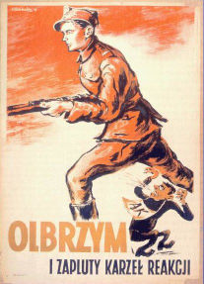
Polish Communist propaganda poster, 1940s
The Giant and the dwarf of reactionism

Slide 26
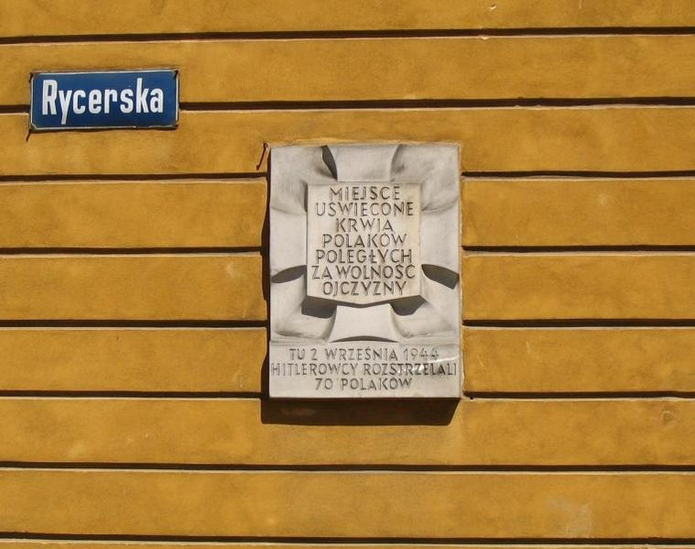
Remembering Polish victims of Nazi terror, 1960s – 1980s

Slide 27
Poland and the Memory of WWII
Communist Poland
Liberation by Red Army, Brotherhood with Soviet Union
People’s Republic of Poland culmination of Polish history
Polish suffering and heroism: Communist resistance within the Polish tradition of fighting for liberty
Armia Krajowa: at best marginalisation of its role, at worst accused of collaboration with the Germans
Warsaw Uprising: act of irresponsible people or even criminals – anti-Soviet dimension
Anti-German propaganda linked to pro-Russian and pro-Soviet propaganda
Collaboration and Polish anti-Semitism denied
Dominant in public space
Opposition view (exiles, church, samizdat, private memory)
Liberation by Red Army, but followed by oppression
People’s Republic – dominated by Moscow
Polish suffering and heroism: resistance of Armia Krajowa, no collaboration, in the tradition of uprisings
Warsaw Uprising: mixed feelings, but mainly positive connotation – Polish heroism against overwhelming enemy
anti-German attitudes accepted
Collaboration and Polish anti-Semitism denied
Often present in private space
Official memory only reflects part of private memory and personal experiences

Slide 28
Warsaw - Monument to the Little Insurgent (sculptor: Janusz Jaruszkiewicz
Unveiled, 1 October 1983)

Slide 29
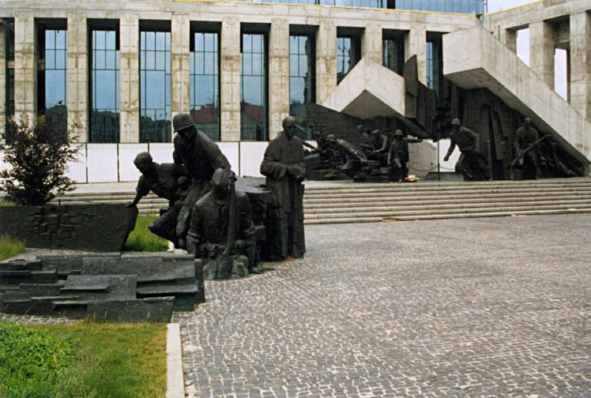
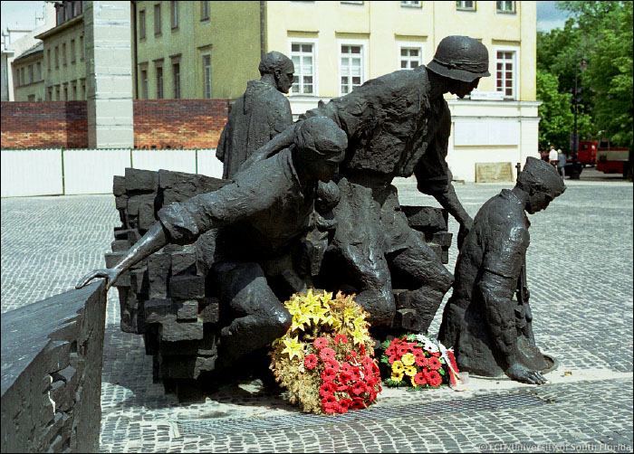
Part of the new monument of the Warsaw Rising in Warsaw

Slide 30
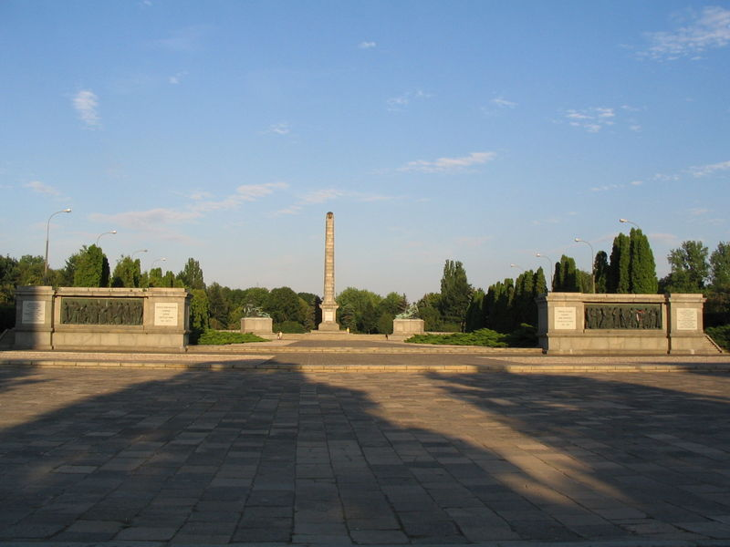
Soviet War Memorial in Warsaw

Slide 31
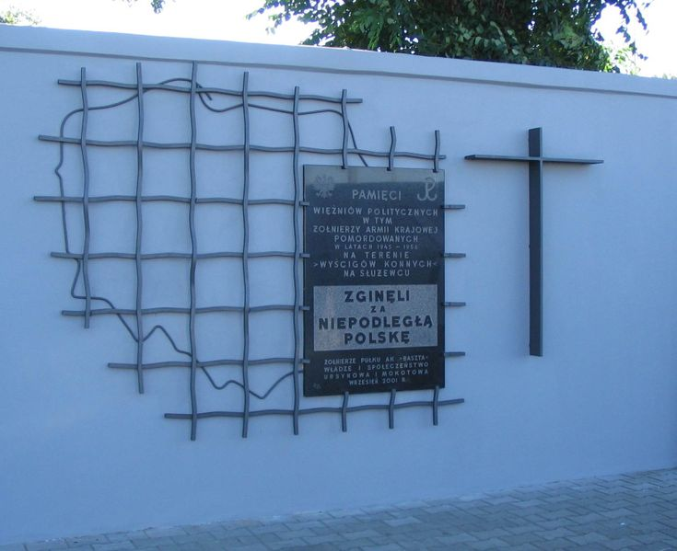
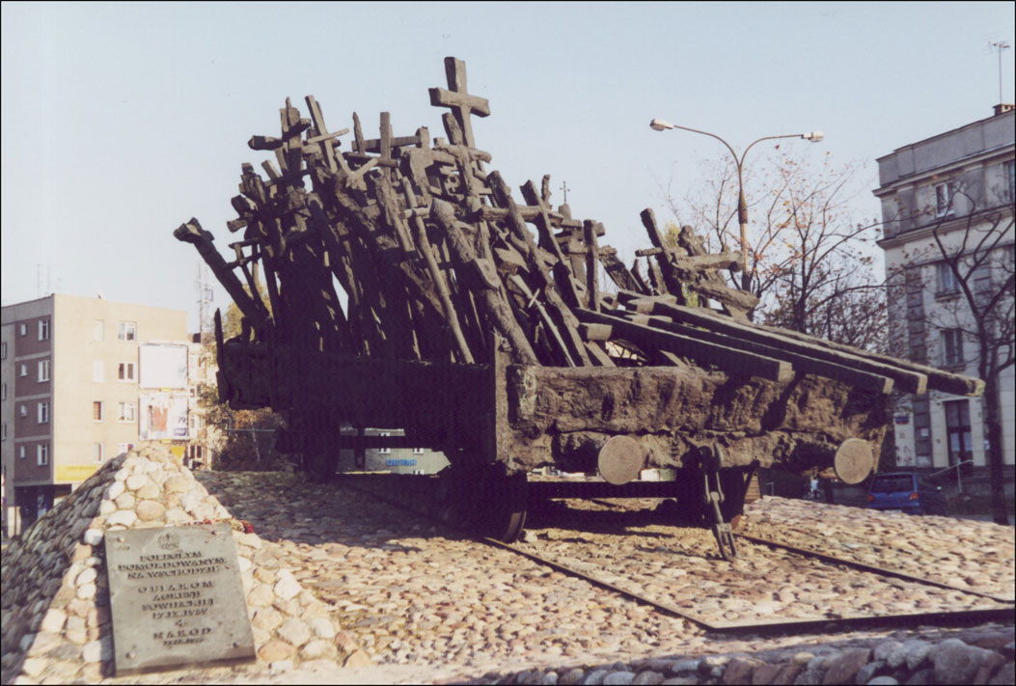
New Polish monument, remembering the Polish victims of the NKVD and the Soviet terror
Monument to the Victims of the Soviet Aggression of 17th September 1939, Warsaw, Poland

Slide 32
Poland and the Memory of WWII
Communist Poland
Liberation by Red Army, Brotherhood with Soviet Union
People’s Republic of Poland culmination of Polish history
Polish suffering and heroism: Communist resistance within the Polish tradition of fighting for liberty
Armia Krajowa: at best marginalisation of its role, at worst accused of collaboration with the Germans
Warsaw Uprising: act of irresponsible people or even criminals – anti-Soviet dimension
Anti-German propaganda linked to pro-Russian and pro-Soviet propaganda
Collaboration and Polish anti-Semitism denied
Dominant in public space
Opposition view (exiles, church, samizdat, private memory)
Liberation by Red Army, but followed by oppression
People’s Republic – dominated by Moscow
Polish suffering and heroism: resistance of Armia Krajowa, no collaboration, in the tradition of uprisings
Warsaw Uprising: mixed feelings, but mainly positive connotation – Polish heroism against overwhelming enemy
anti-German attitudes accepted
Collaboration and Polish anti-Semitism denied
Often present in private space
Official memory only reflects part of private memory and personal experiences

Slide 33
Outline
Russia: great victory - gigantic monuments
Ukraine: divided memory - contested monuments
Poland: official memory vs. private memory
Conclusion
Notes:
33

Slide 34
Conclusion
Poland: official vs. private memory of the Second World War: reflects legitimacy and acceptance of People’s Republic of Poland – deep conflict in some key questions between private experiences and official memorial culture deepened conflict between regime and society. After 1989 change and modification of narrative
Russia: quite successful official memorial culture, did reflect views and expectations of many Russians, integrationist and legitimizing function of political system, after 1990 no fundamental change but more plural, stabilises Russian government and state, but party no longer key part of memorial culture
Ukraine: Soviet interpretation and ideology of “friendship of nations” until recently quite successful in Eastern Ukraine, much less successful in Western Ukraine (similar to Poland), after 1990 different war experiences and memory divides Ukrainian nation. Result: political struggle and fight for a national narrative which has unifying effect – might emerge as a result of Russian attack on Ukraine

