Slide 1
Nation and Memory in Russia, Poland, and Ukraine
Post-Memory

Slide 2
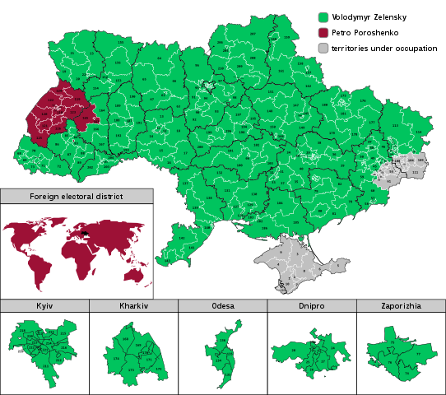
By Tohaomg - Own work, CC BY-SA 4.0, https://commons.wikimedia.org/w/index.php?curid=77765377

Slide 3
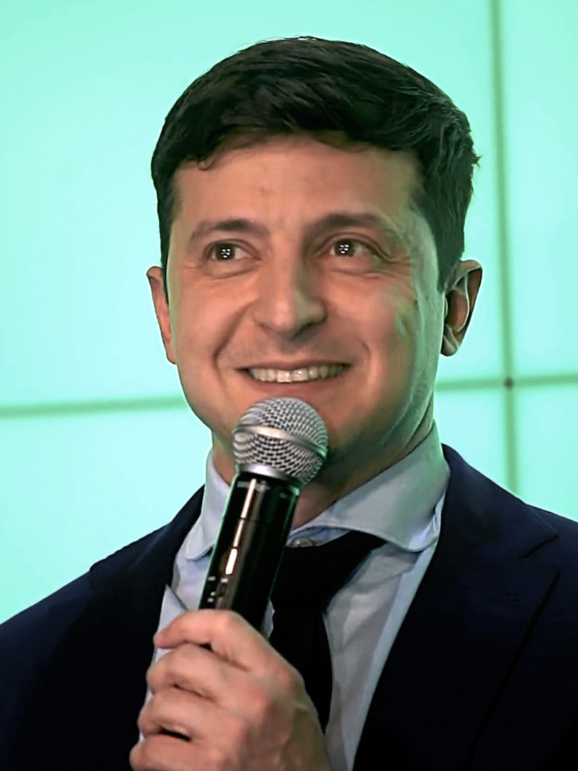

Slide 4
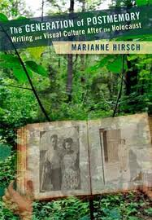
Marianne Hirsch’s The Generation of Postmemory
Memories of the next generation
Oral recollections (Story telling)
Use of photography
Relationship of second generation to traumatic experiences preceding their birth
Transmitted to them by generation who made these experiences
https://www.postmemory.net

Slide 5
Example Holocaust
Trans-generational transmission of trauma
Family as context in which experience is transmitted
‘Sense of living connection’ even after generation of survivors have gone

Slide 6
How?
Storytelling
Photography
Artwork

Slide 7
A powerful form of memory
Postmemory is a powerful form of memory precisely because its connection to its object or source is mediated not through recollection but through projection, investment, and creation. This is not to say that survivors’ memory itself is not mediated but it is more directly connected to the past.
Postmemory characterizes the experience of those who grew up dominated by narratives that preceded their birth ...(Hirsch, p. 8)

Slide 8
Post-memory and Trauma
It is a question of adopting the traumatic experience of others as one’s own life history. It is a question of conceiving oneself as multiply connected with others of others of the same, of previous, and of subsequent generations, of the same and of other-proximate or distant-cultures and subcultures. It is a question, more specifically, of an ethical relation to the oppressed or persecuted other for which postmemory can serve as a model: as I can “remember“ my parents' memories, I can also “remember" the suffering of others, of the boy who lived in the same town in the ghetto while I was vacationing, of the children who were my age and who were deported. (Hirsch, p. 9)

Slide 9
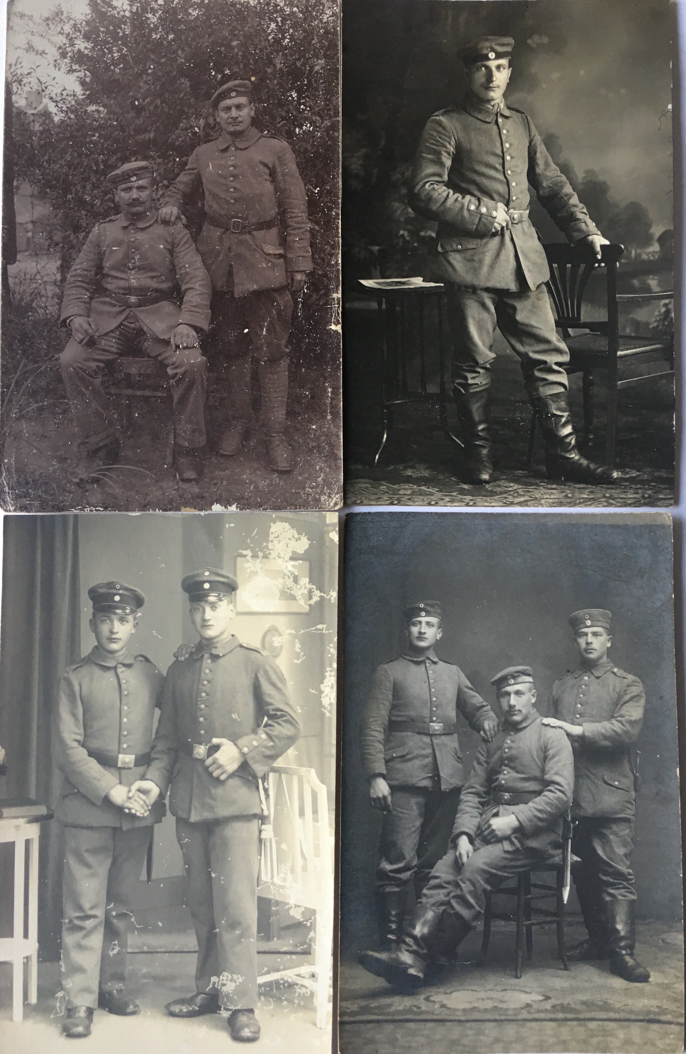
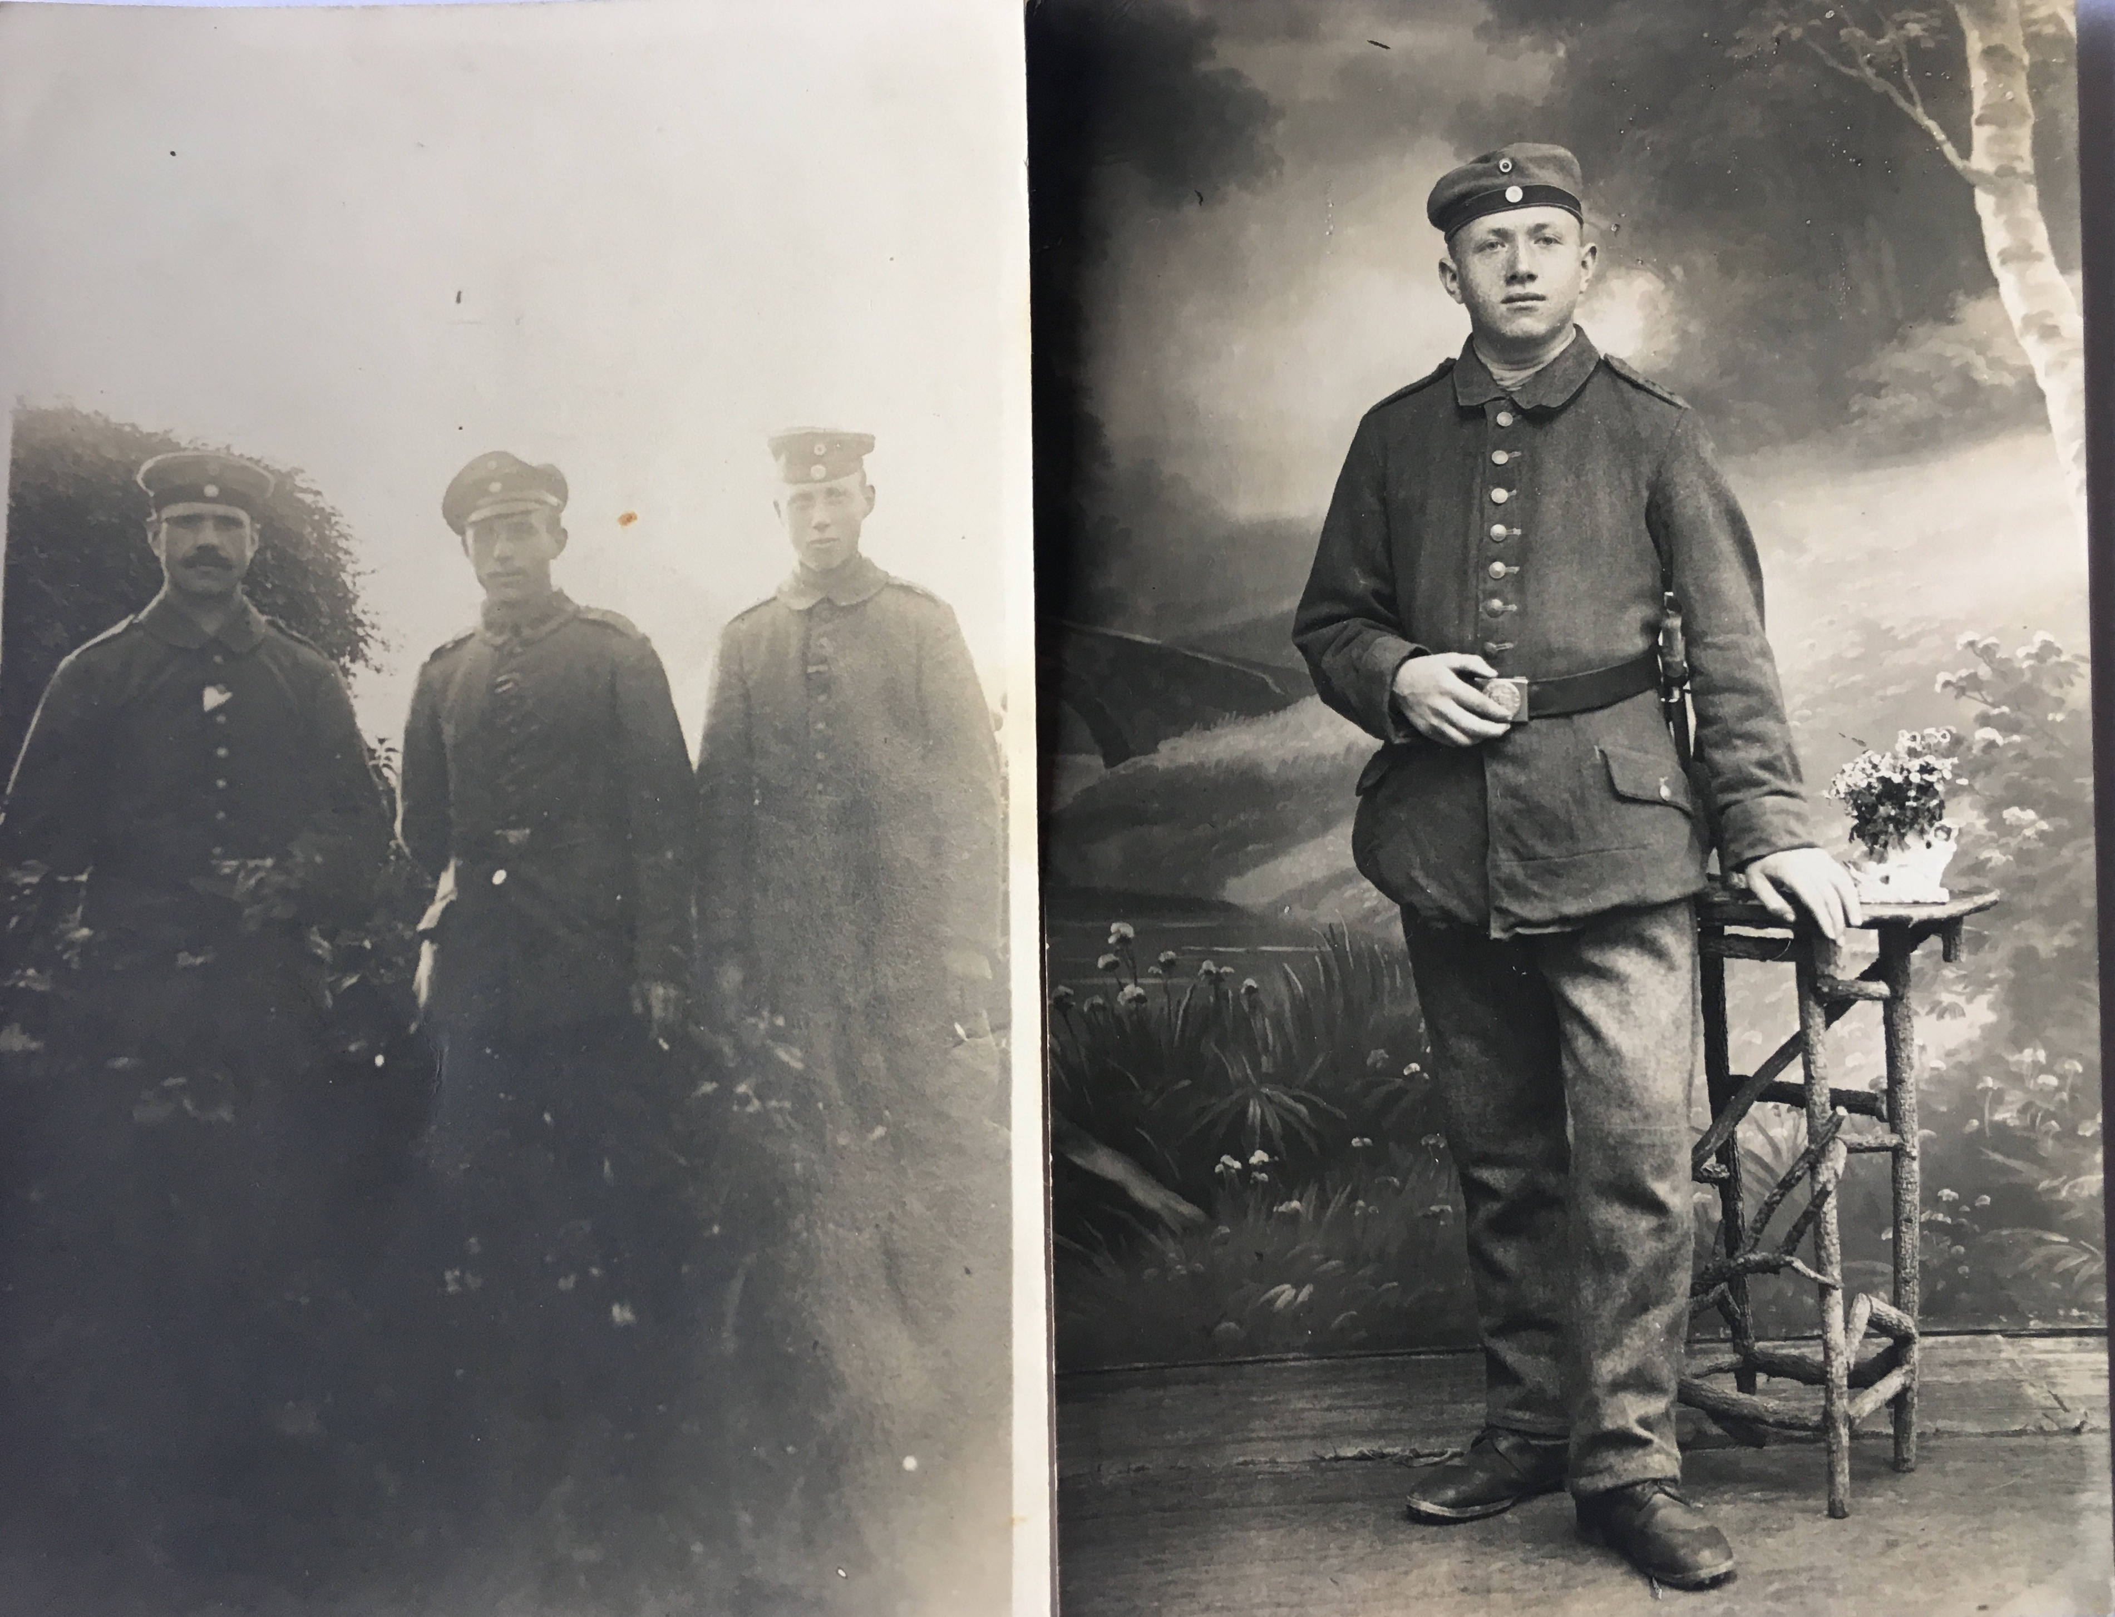
Jakob (27), Otto (25) and August Dejon (24) in 1914
Reinhard (26), Friedrich (22), Albert (18) in 1914, and Otto Maurer (17 in 1918)
Reinhard (17) and Richard (20) Dejon and three comrades

Slide 10
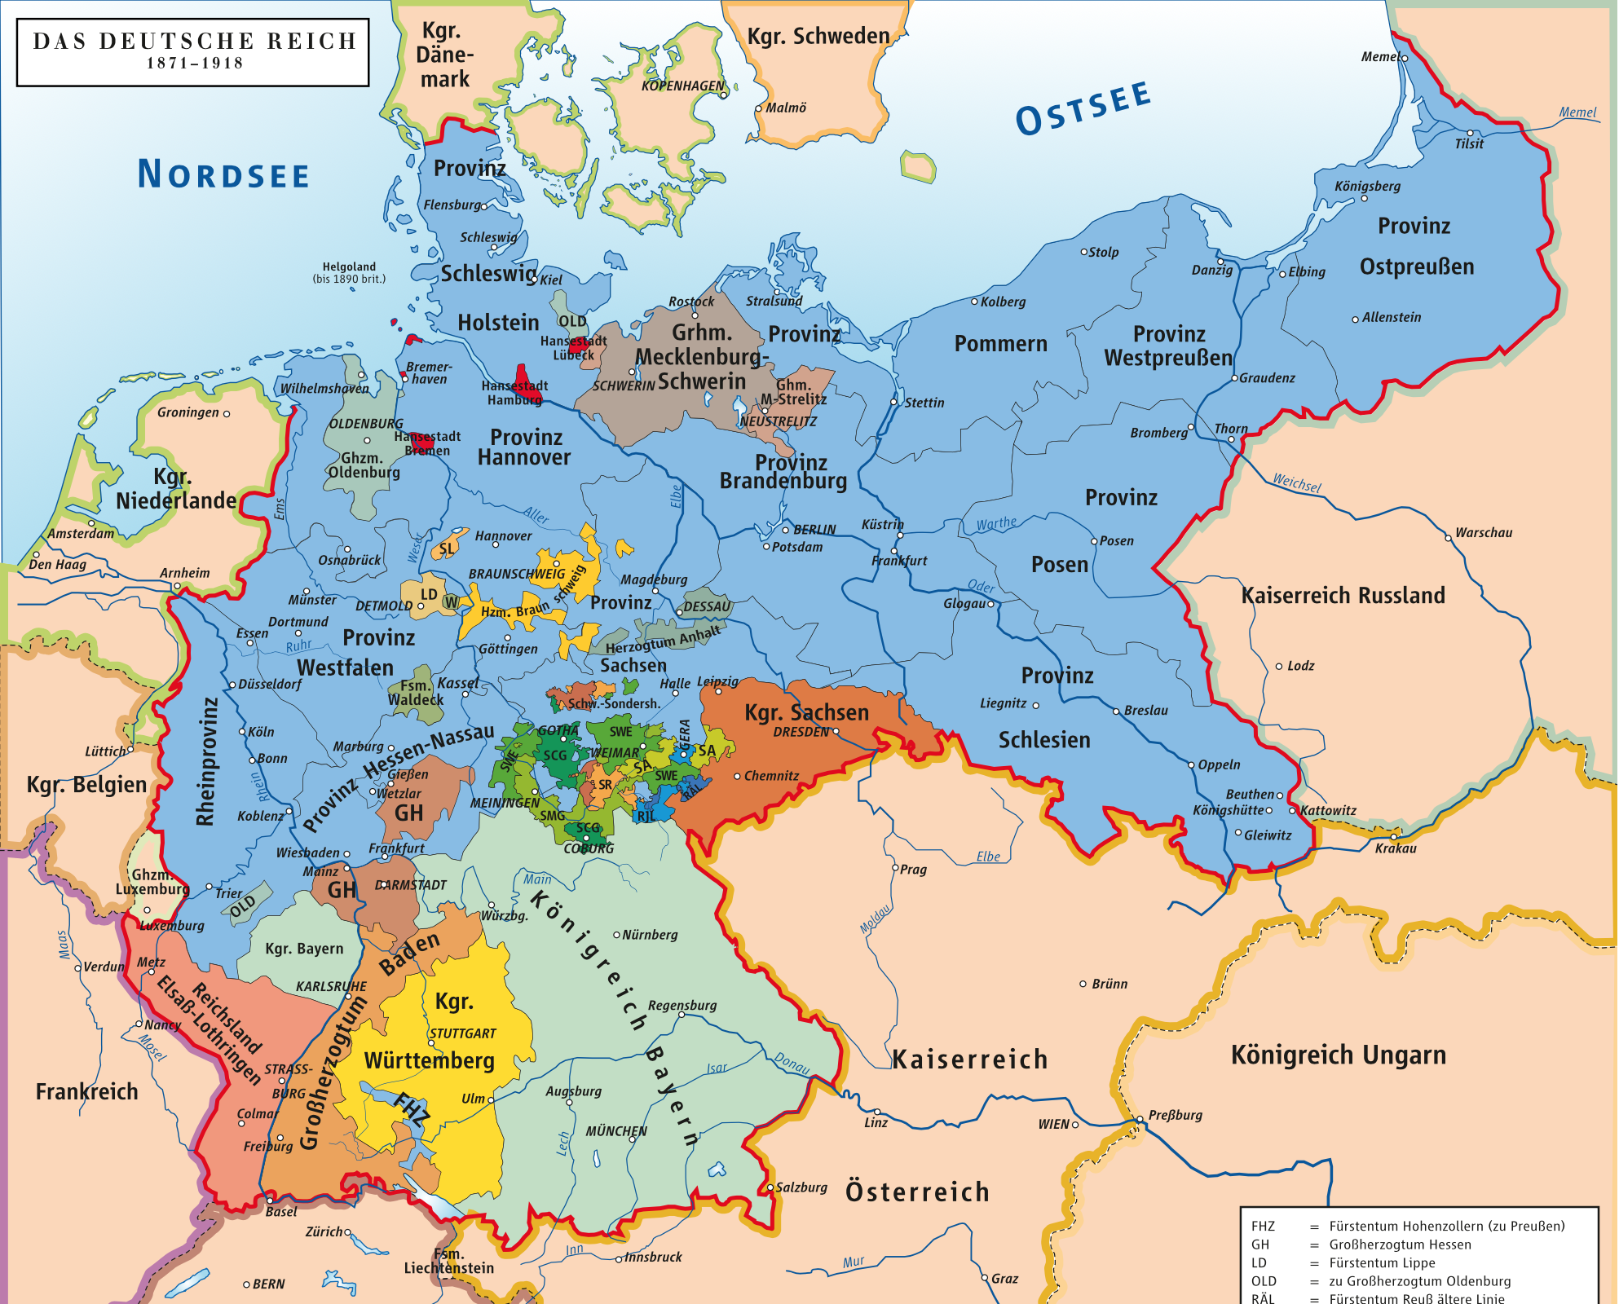

Slide 11
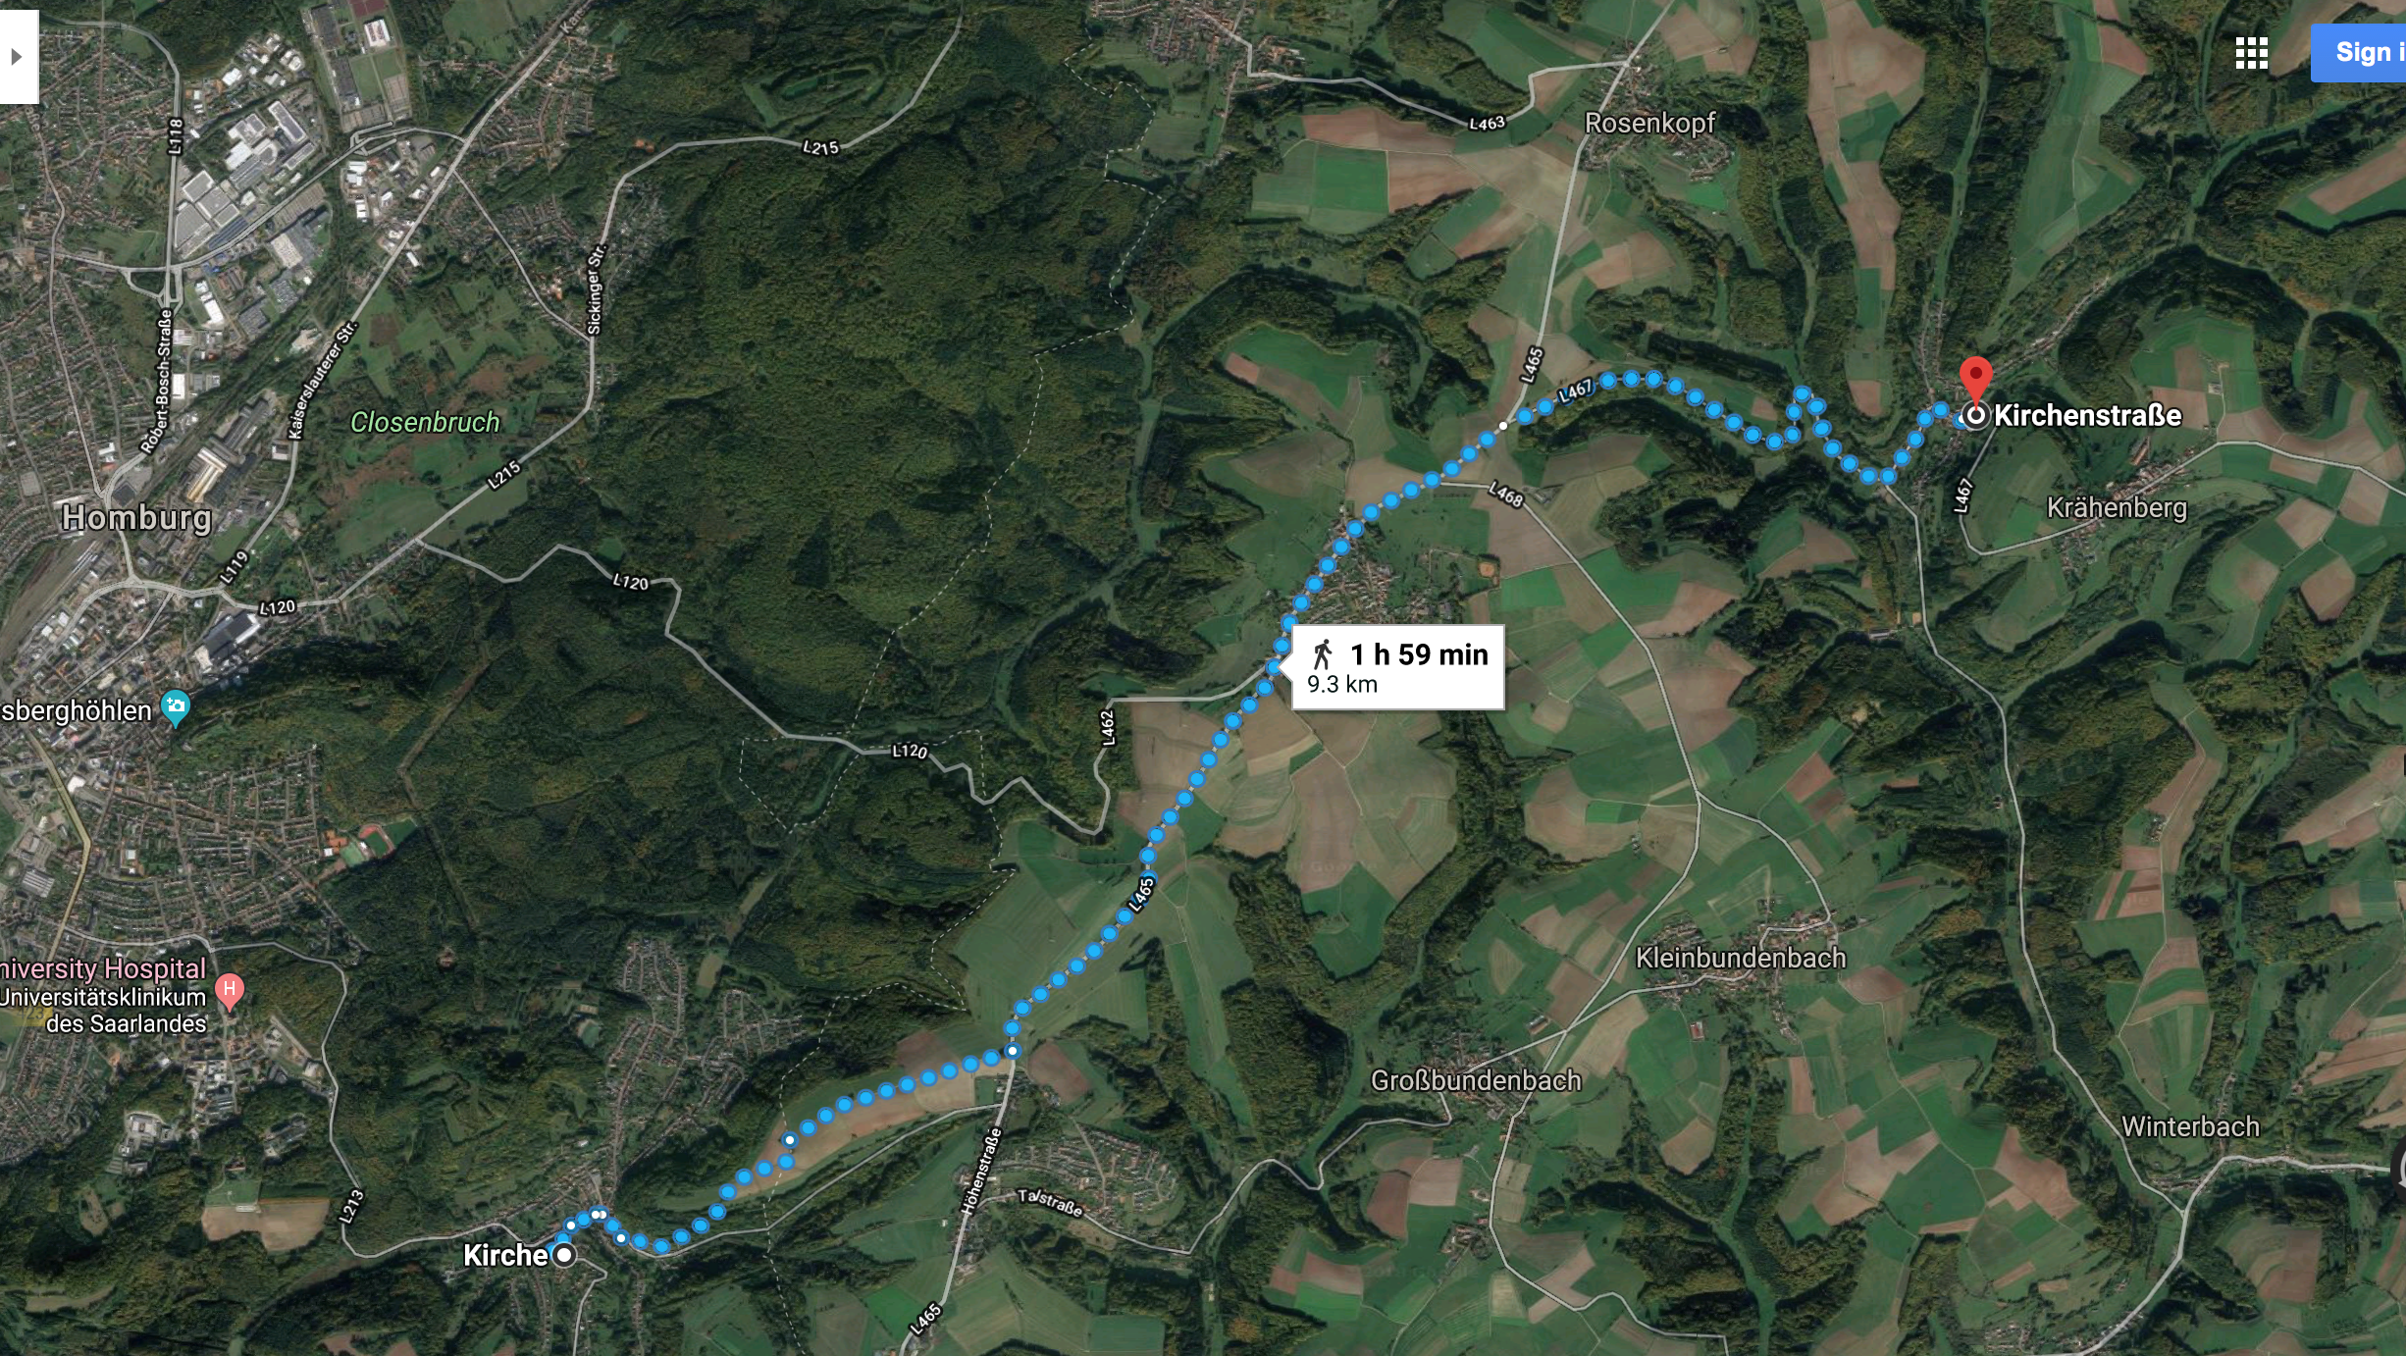

Slide 12
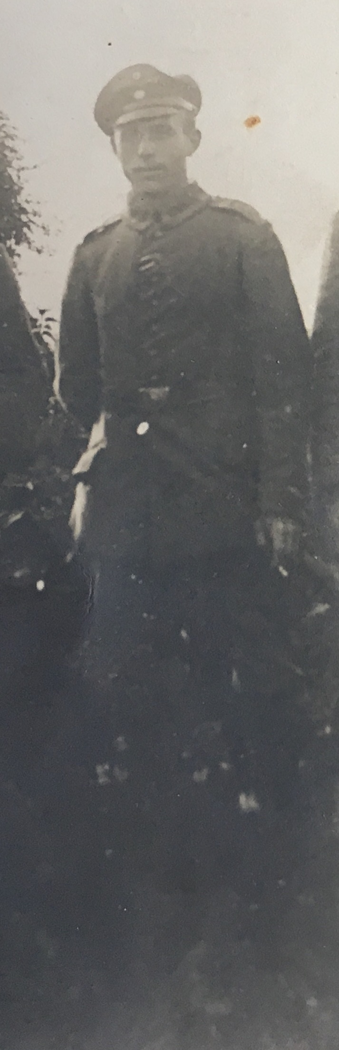
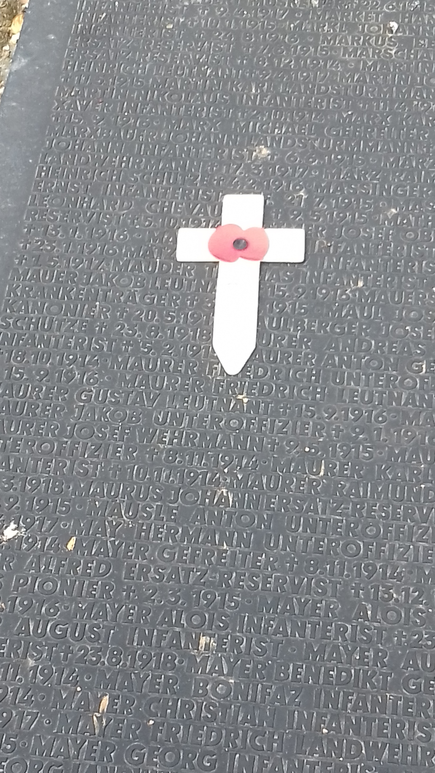
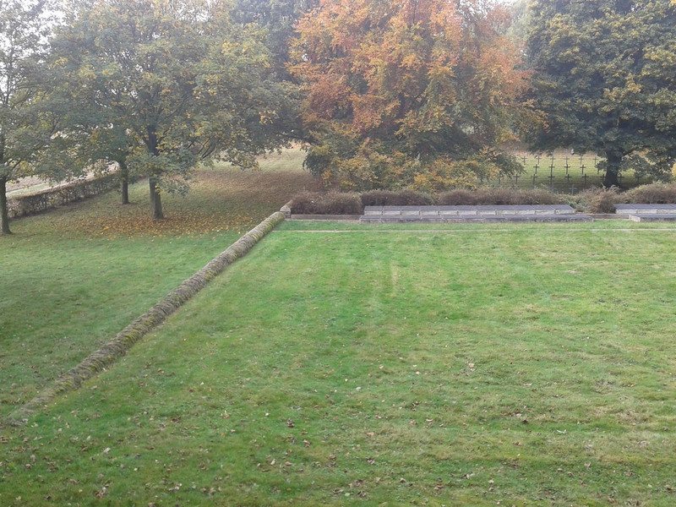

Slide 13
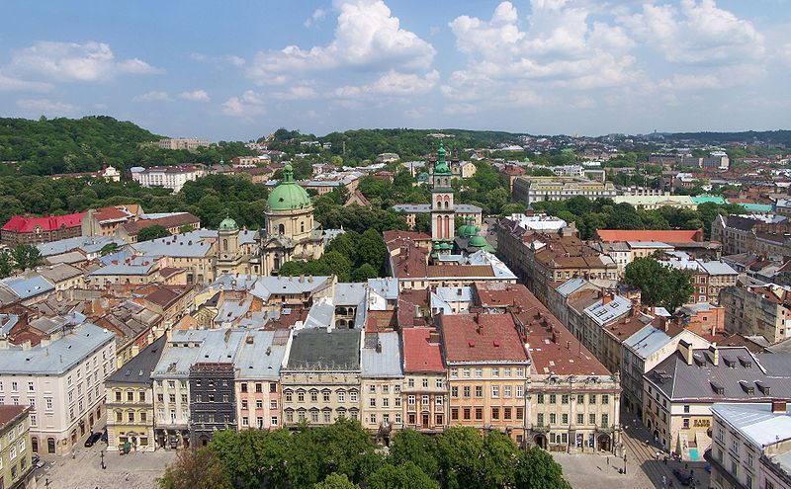

Slide 14
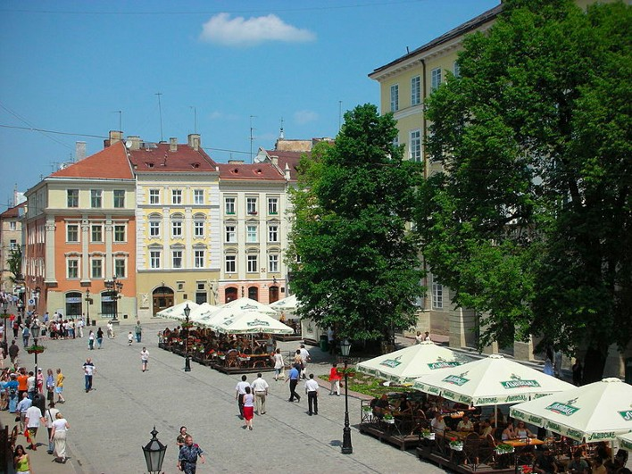

Slide 15
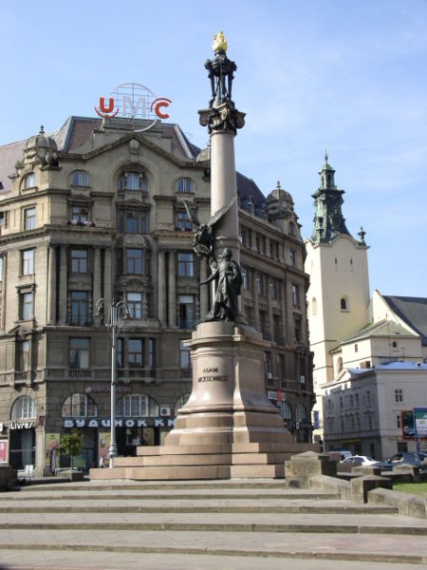
Lemberg, Lwów, Lviv

Slide 16
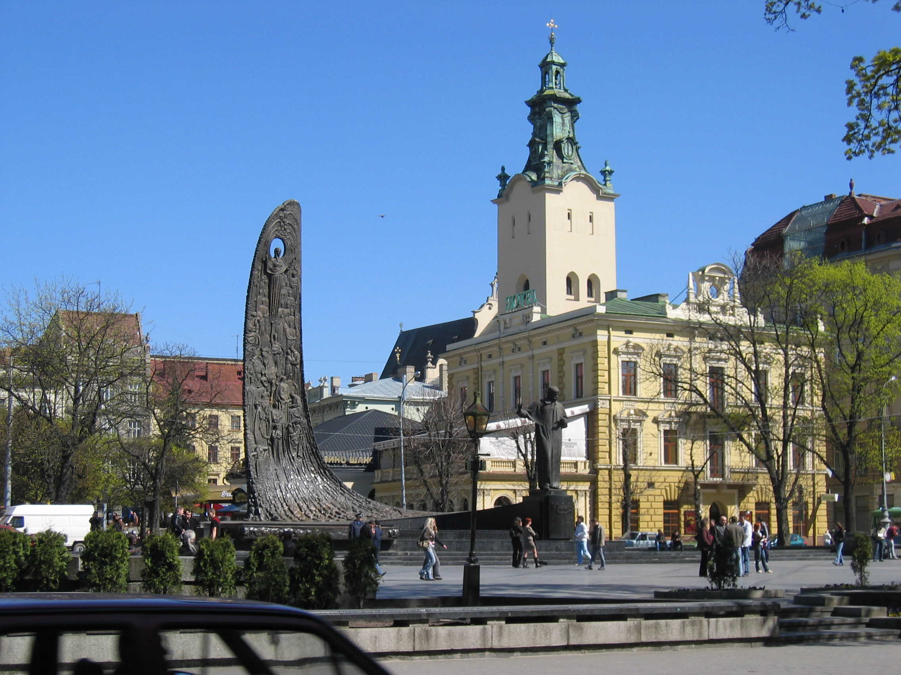
Monument of Taras Shevchenko and the “Ukrainian wave”, in the background the tower of the Latin Cathedral

Slide 17
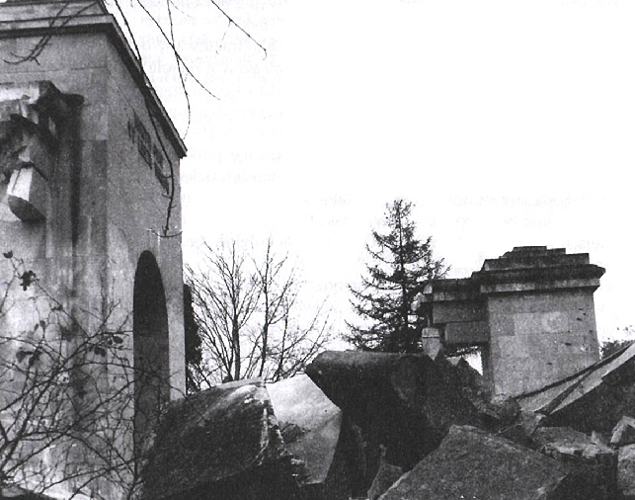

Slide 18
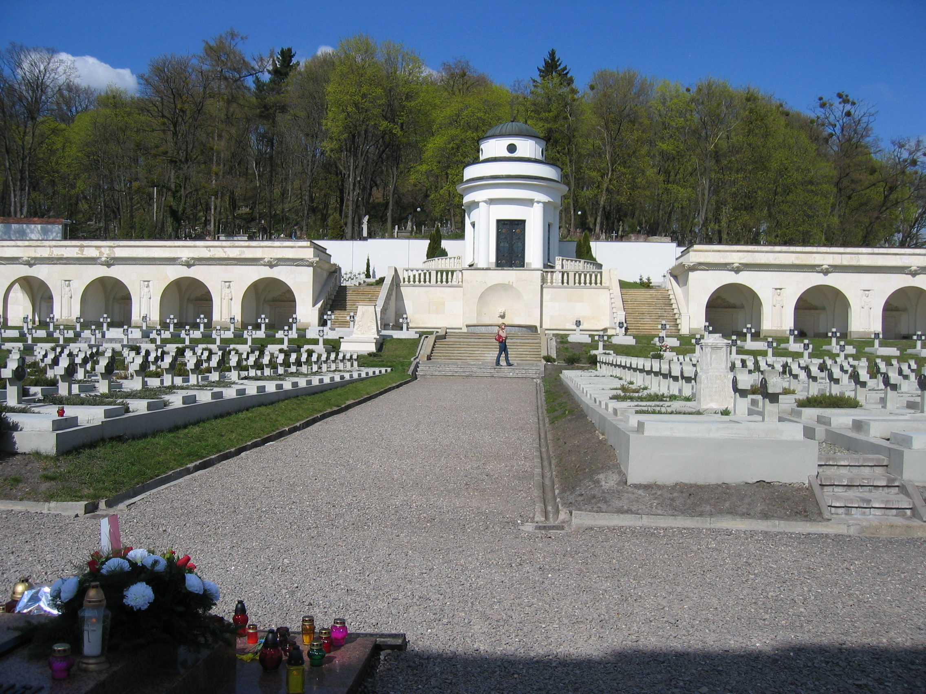

Slide 19
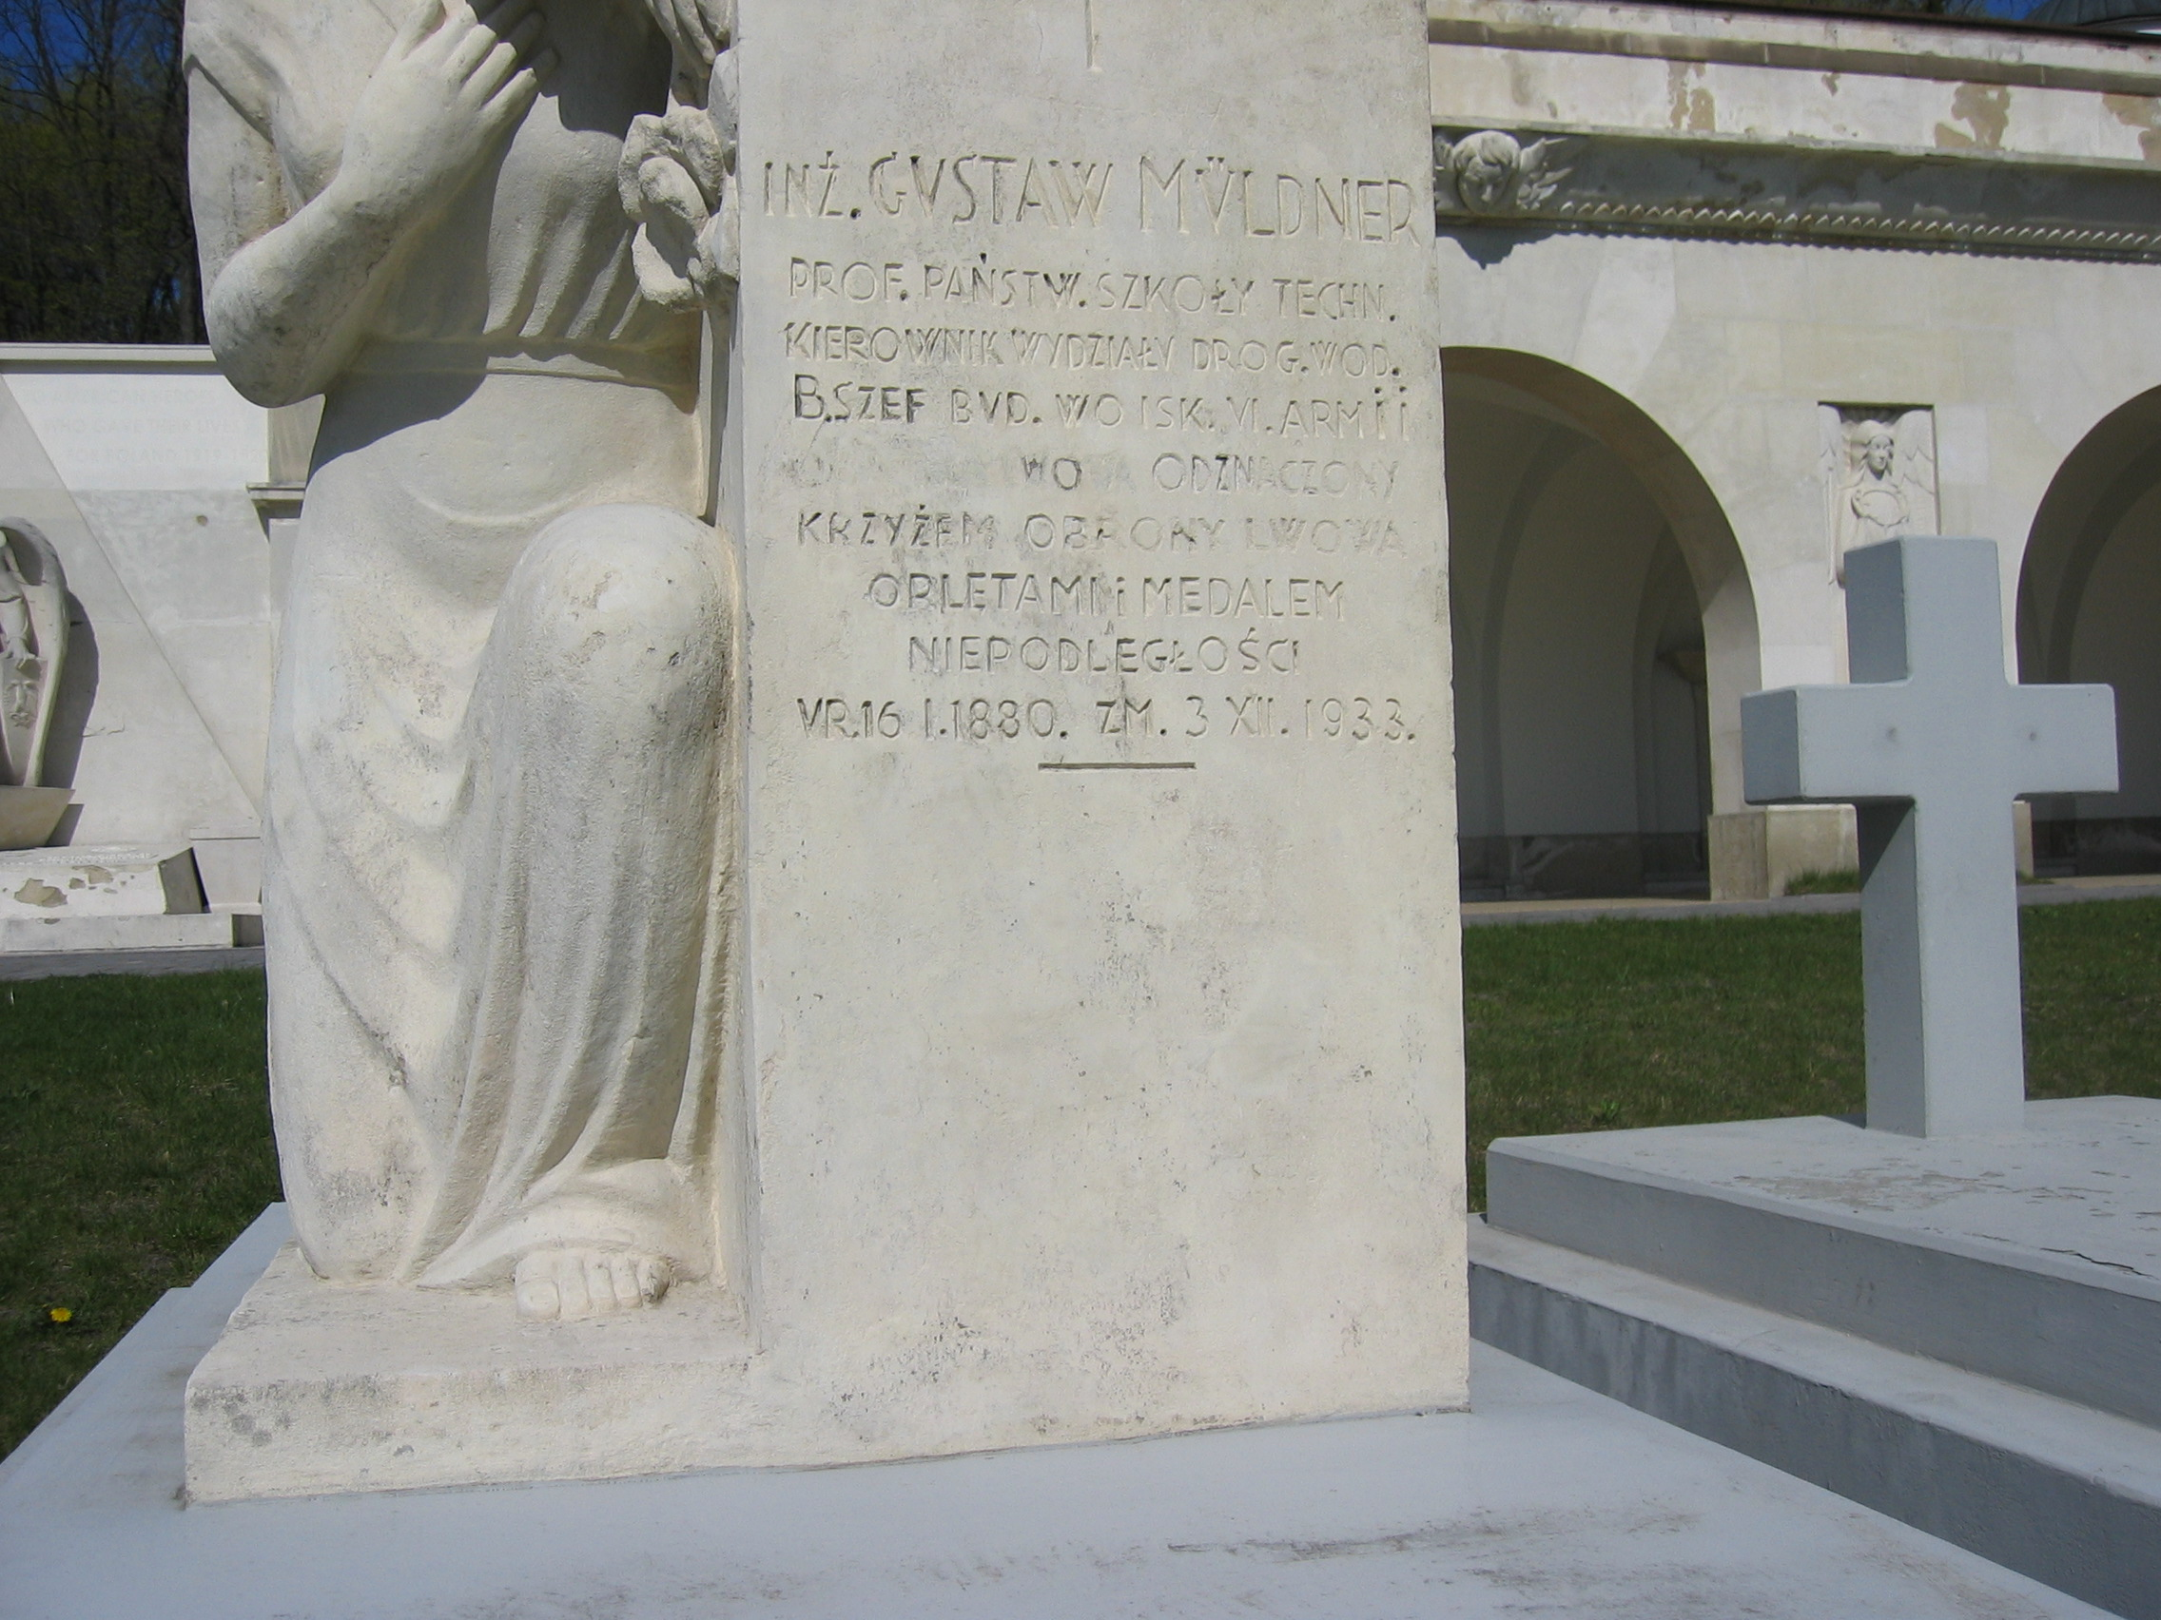

Slide 20
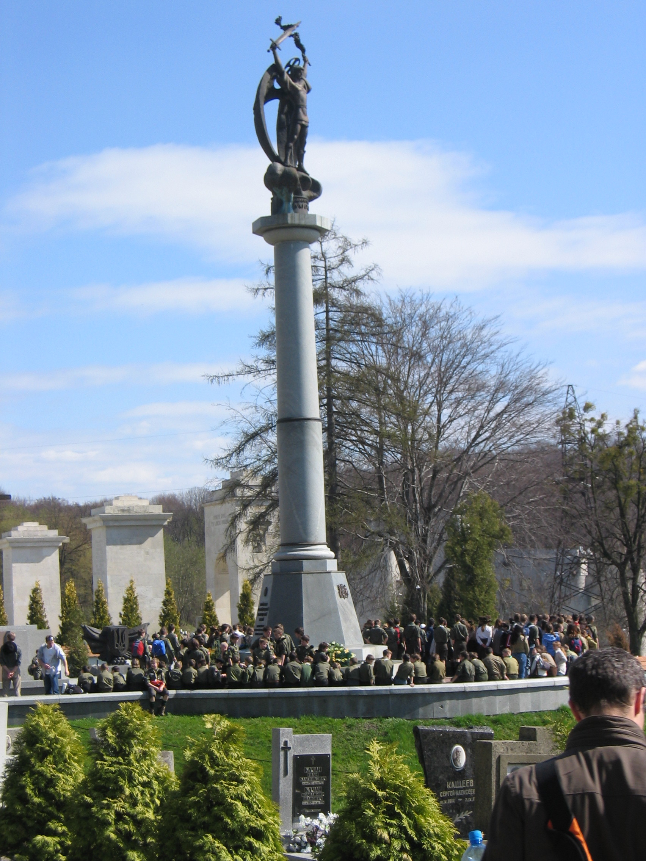
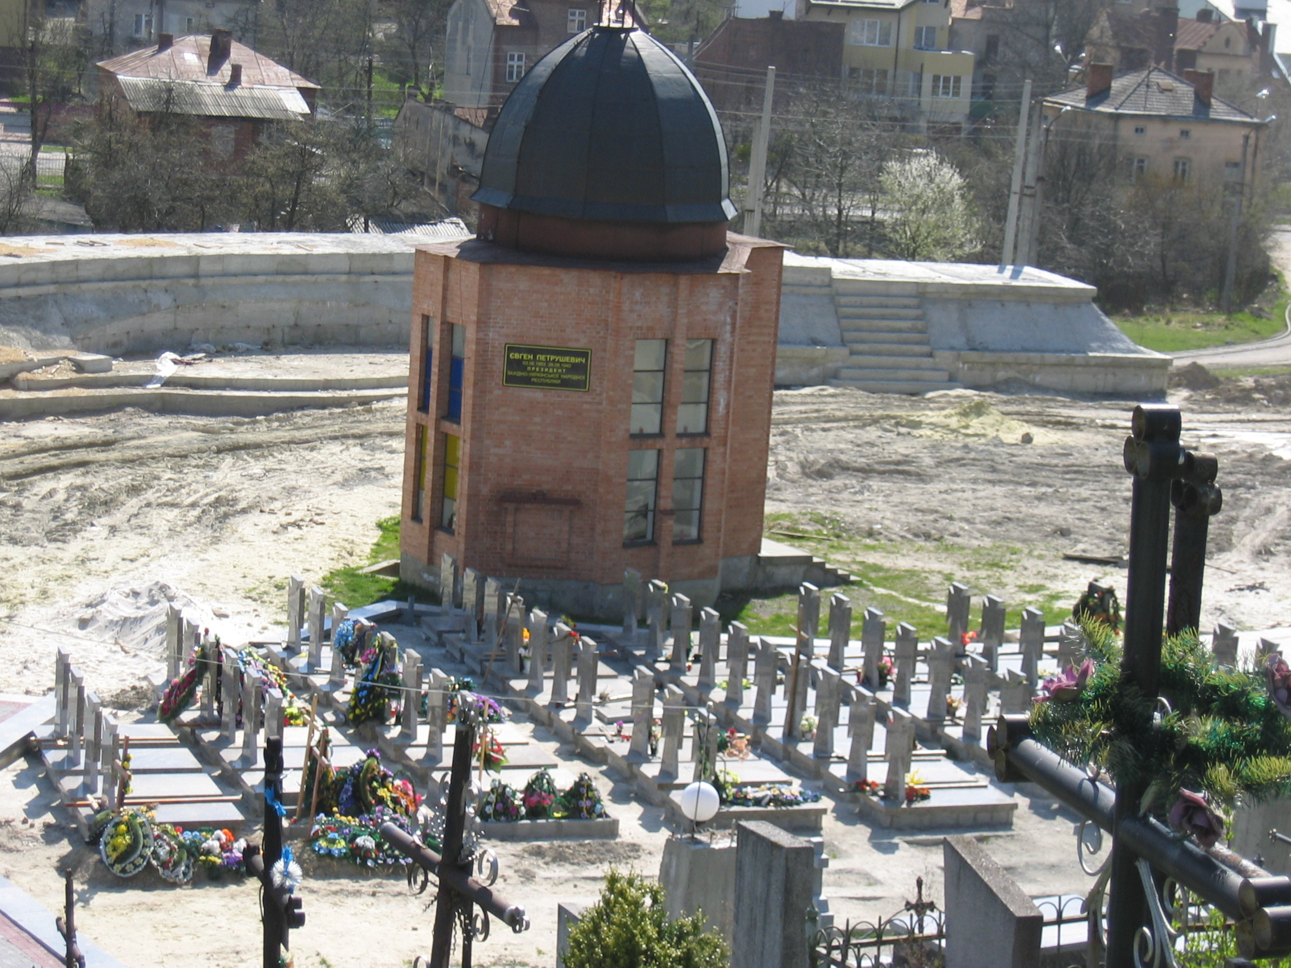
Monument to the (Ukrainian)
Defenders of Lviv 1918/19

Slide 21
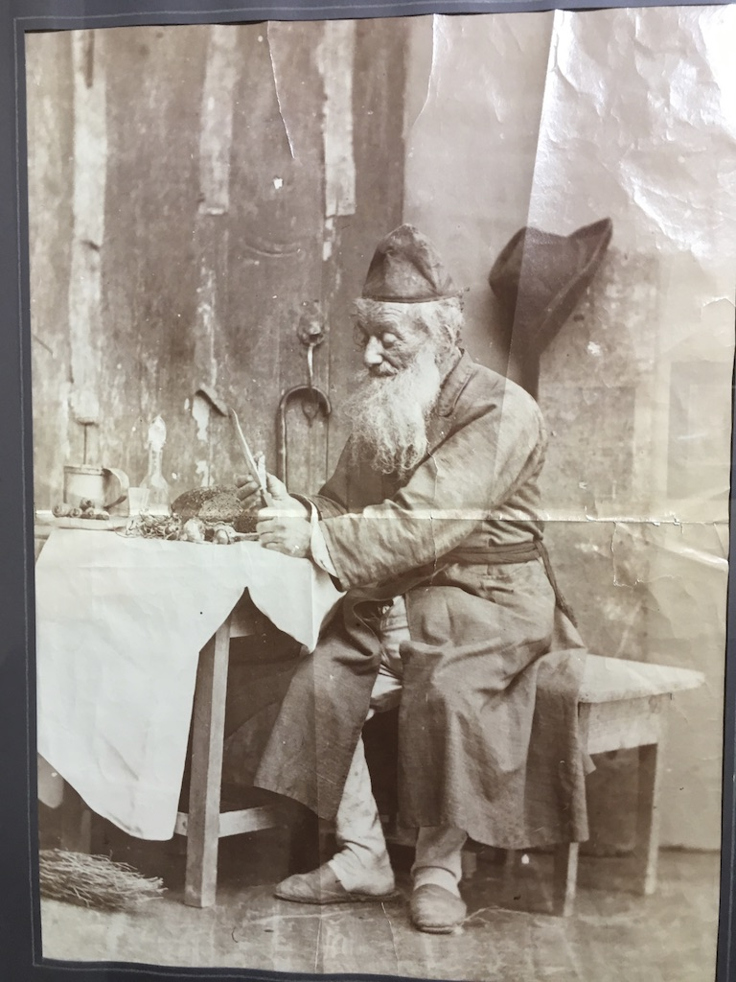

Slide 22
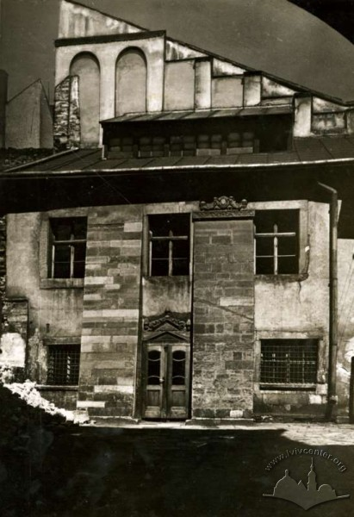
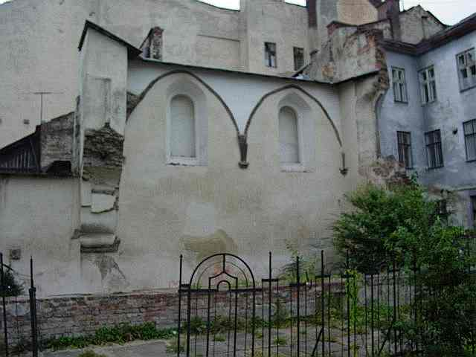
Golden Rose Synagogue, Lviv 1938
today

Slide 23
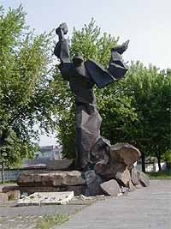
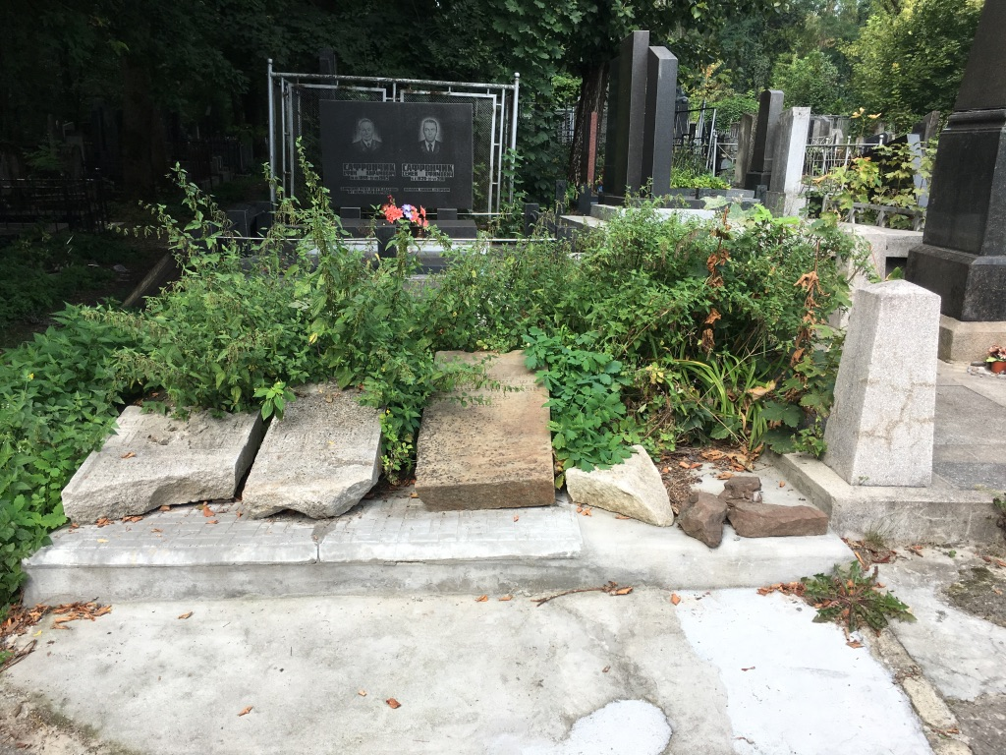
Monument to the victims of the Lviv ghetto (1992)
Tombstones from the Jewish cemetry

Slide 24
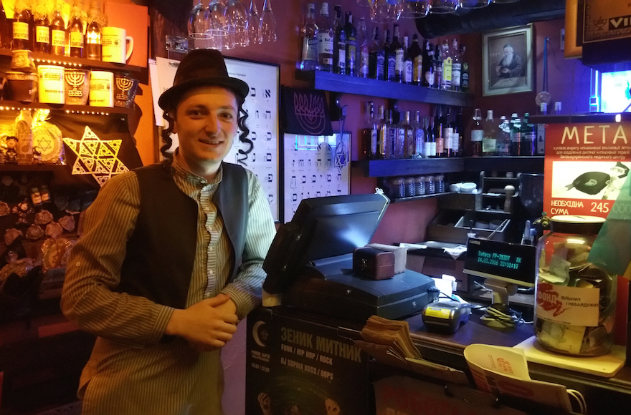
‘Jewish’ Restaurant in Lviv, 2016

