Slide 1
Nation and Memory in Russia, Poland, and Ukraine
Lecture 20
Russia, Poland, Ukraine
Post-Memory and Conclusion
Week 2, Summer Term

Slide 2
Schedule
Introduction
Post-Memory
History Matters
The War in Ukraine
Consequences
Conclusions

Slide 3
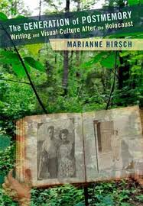
Marianne Hirsch’s The Generation of Postmemory
Memories of the next generation
Oral recollections (Story telling)
Use of photography
Relationship of second generation to traumatic experiences preceding their birth
Transmitted to them by generation who made these experiences
https://www.slideshare.net/Art37/czernowitz-my-place-of-birth
http://czernowitz.ehpes.com (home of the Czernowitz-L discussion group)
https://www.postmemory.net

Slide 4
Example Holocaust
Trans-generational transmission of trauma
Family as context in which experience is transmitted
‘Sense of living connection’ even after generation of survivors have gone

Slide 5
A powerful form of memory
Postmemory is a powerful form of memory precisely because its connection to its object or source is mediated not through recollection but through projection, investment, and creation. This is not to say that survivors’ memory itself is not mediated but it is more directly connected to the past.
Postmemory characterizes the experience of those who grew up dominated by narratives that preceded their birth ...(Hirsch, p. 8)

Slide 6
Post-memory and Trauma
‘It is a question of adopting the traumatic experience of others as one’s own life history. It is a question of conceiving oneself as multiply connected with others of others of the same, of previous, and of subsequent generations, of the same and of other-proximate or distant-cultures and subcultures. It is a question, more specifically, of an ethical relation to the oppressed or persecuted other for which postmemory can serve as a model: as I can “remember“ my parents' memories, I can also “remember" the suffering of others, of the boy who lived in the same town in the ghetto while I was vacationing, of the children who were my age and who were deported.’ (Hirsch, p. 9)

Slide 7
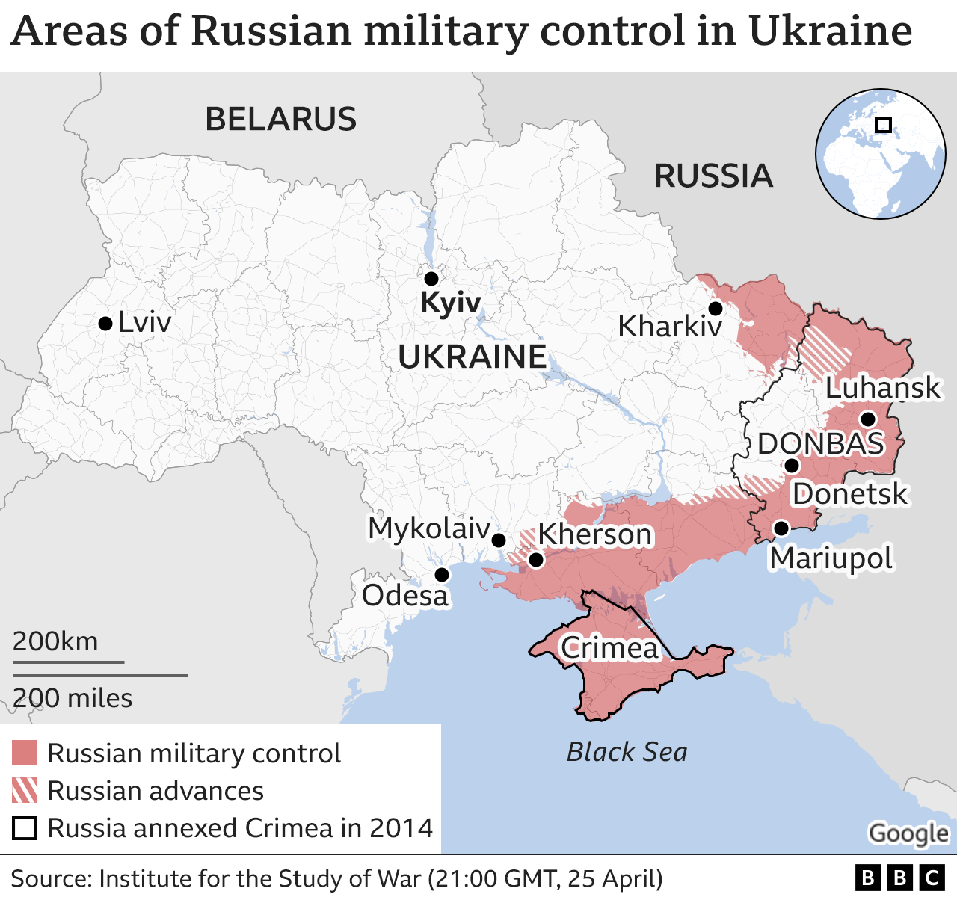

Slide 8
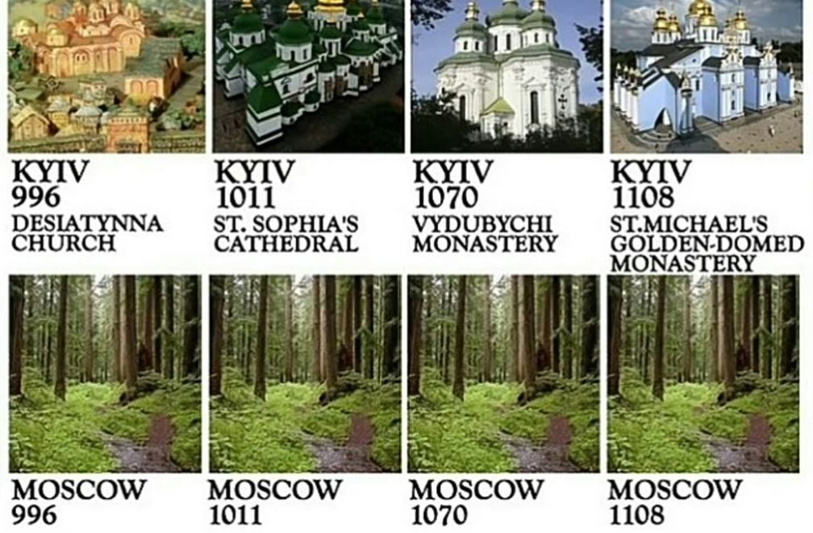
Tweeted recently by the US Embassy in Kyiv

Slide 9
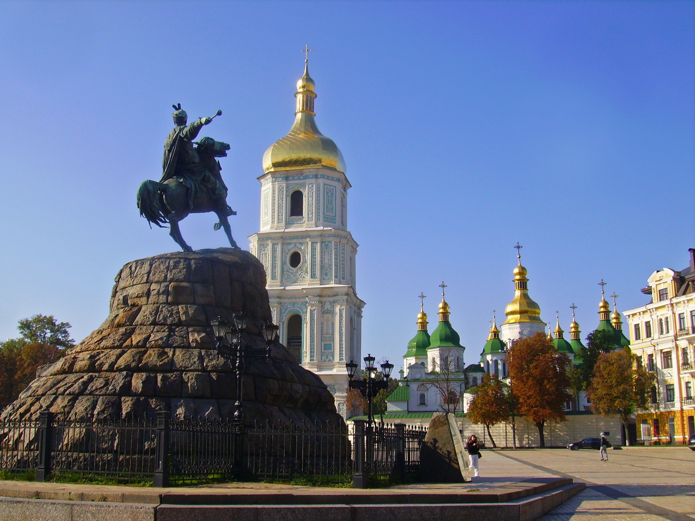
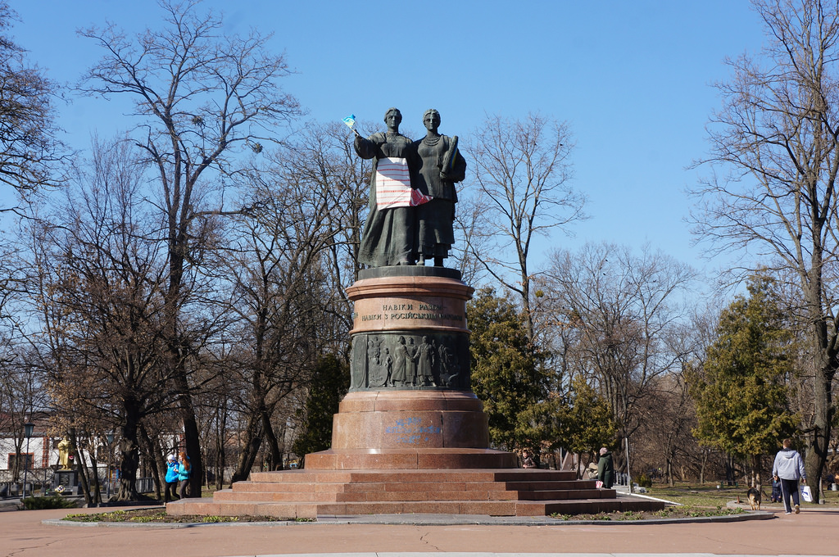
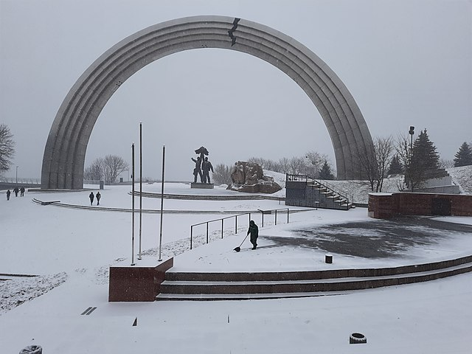
Treaty of Pereyaslav Monument, Pereyaslav Khmel’nyts’kyj
1961
Khmel’nyts’kyj monument Kyjiv
1888
People’s Friendship Arch, dedicated to the unification of Russia and Ukraine
Completed in 1982
The crack was added in 2014.

Slide 10
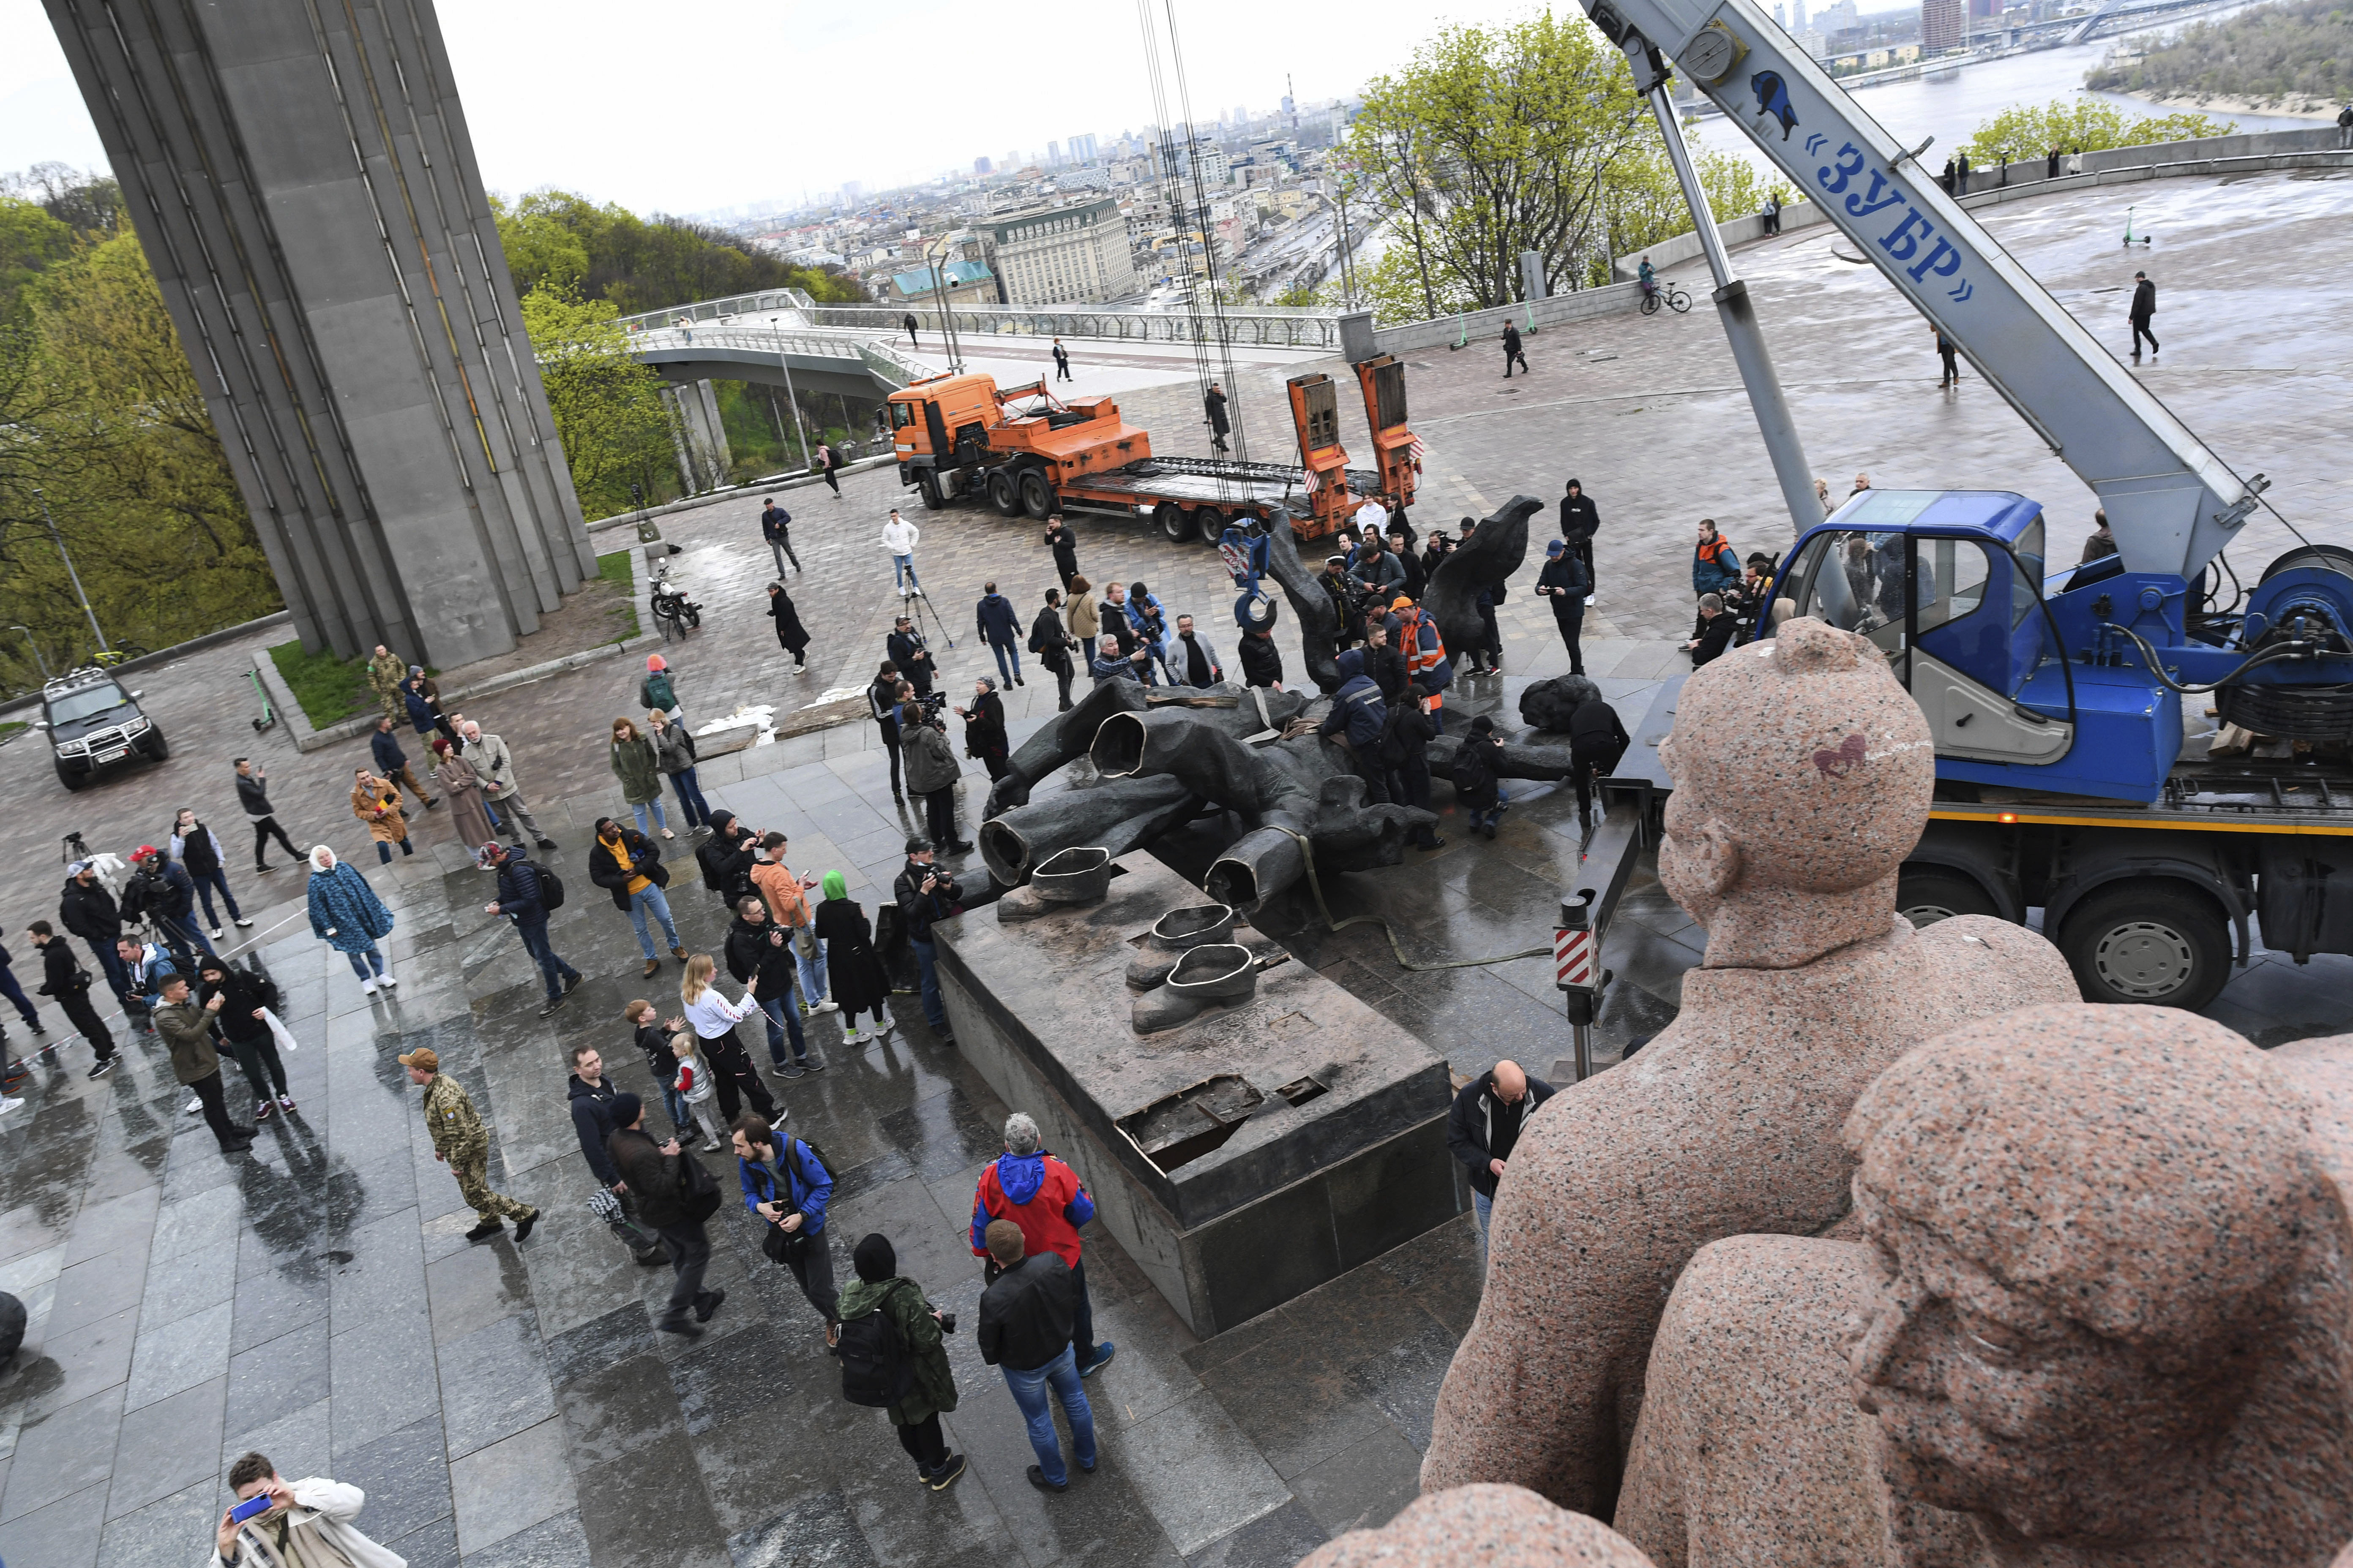

Slide 11
Relevance
All three nations struggle with history
Putin and historical justifcations of his policy towards Ukraine – common heritage, Crimea and Russia, Russian speaking minority in Eastern Ukraine
Divided memory – divided nation: Ukraine - Holodomor and WWII
The suffering and heroic nation: Poland – the history policy of the new government, problem of anti-semitism during WWII (Jedwabne)

