Slide 1
Making of the Modern World
Lecture
Week 2 Spring Term
Nationalism
Christoph Mick
Notes:
1
1
1

Slide 2
Outline
1. Introduction
2. What is a nation?
4. Do nations need navels?
5. Nationalism and national indifference
6. Conclusion
Notes:
2
2

Slide 3
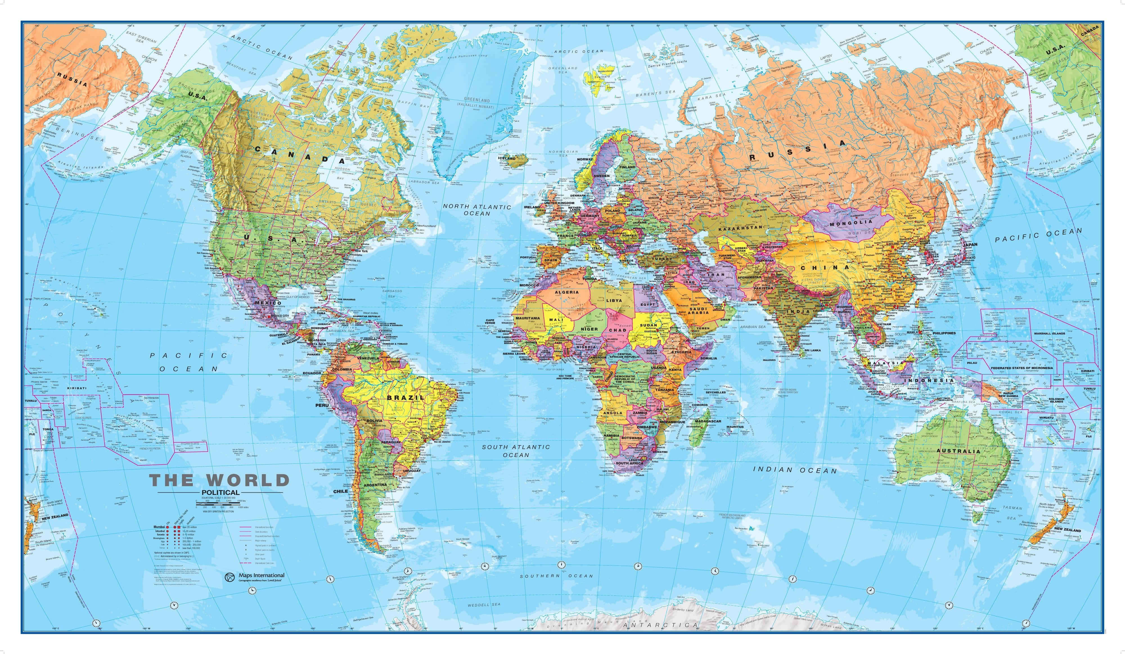

Slide 4
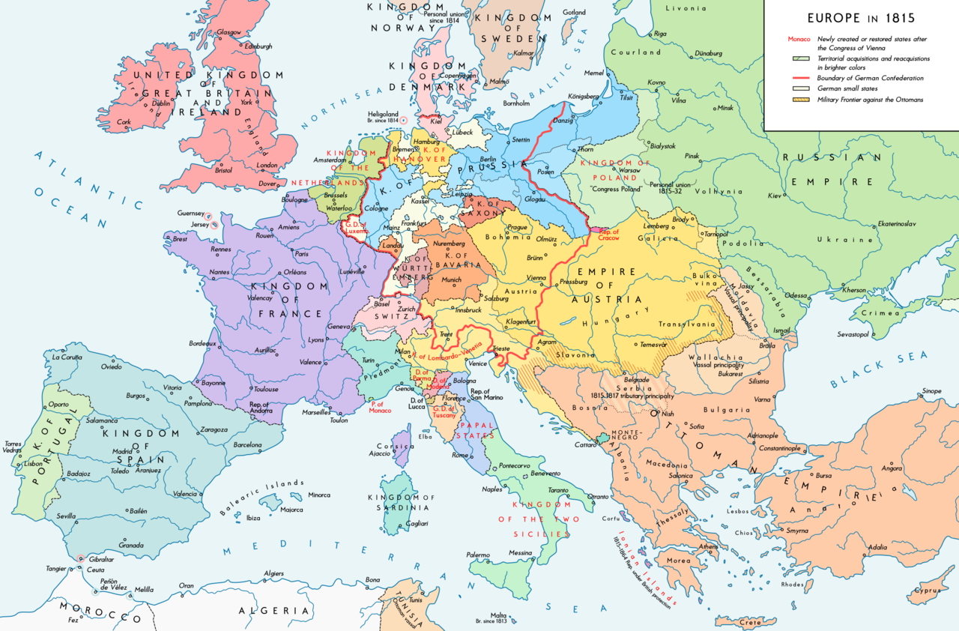
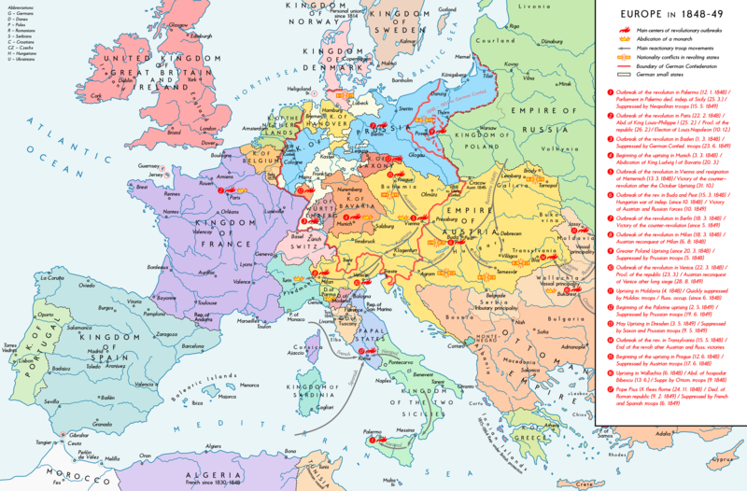
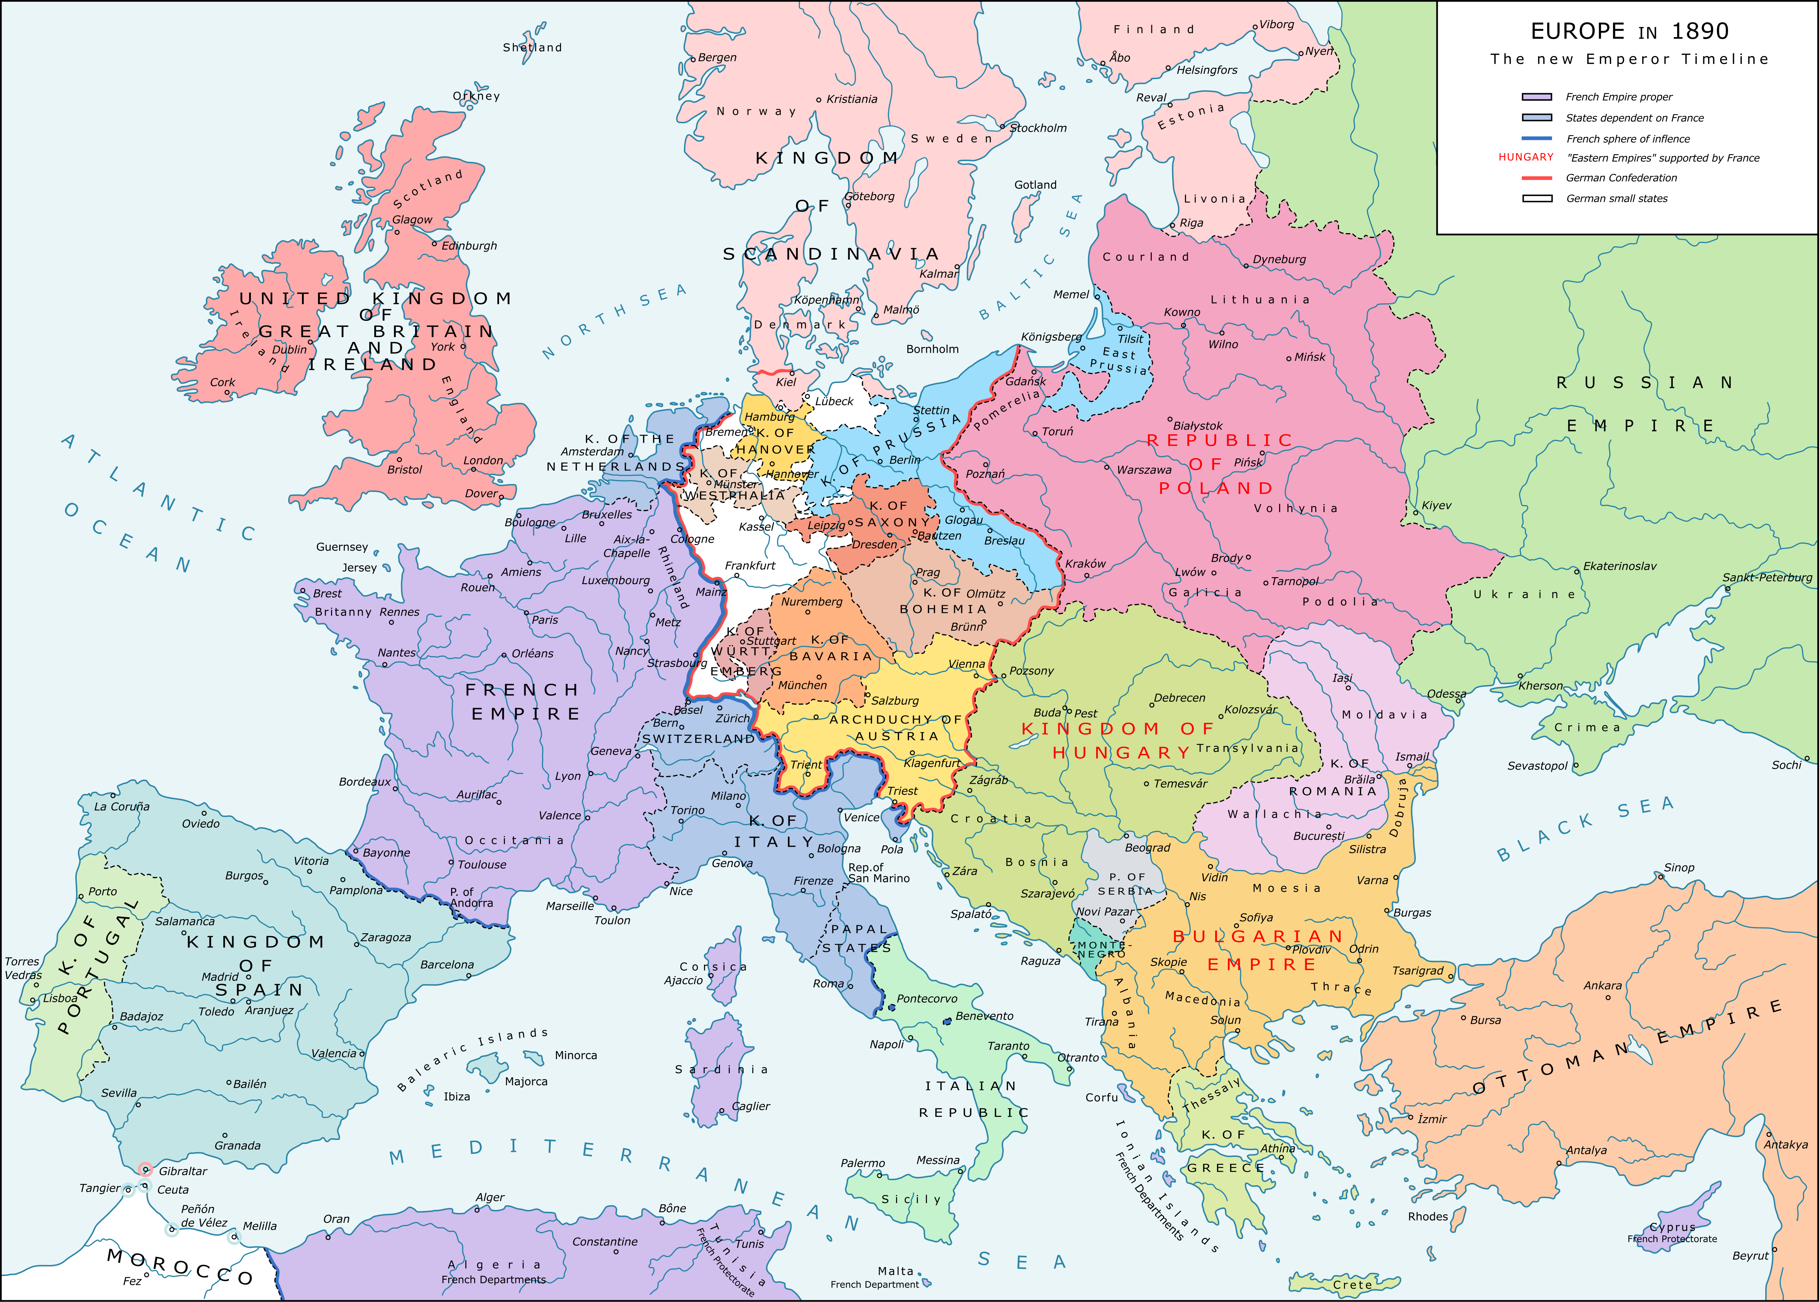
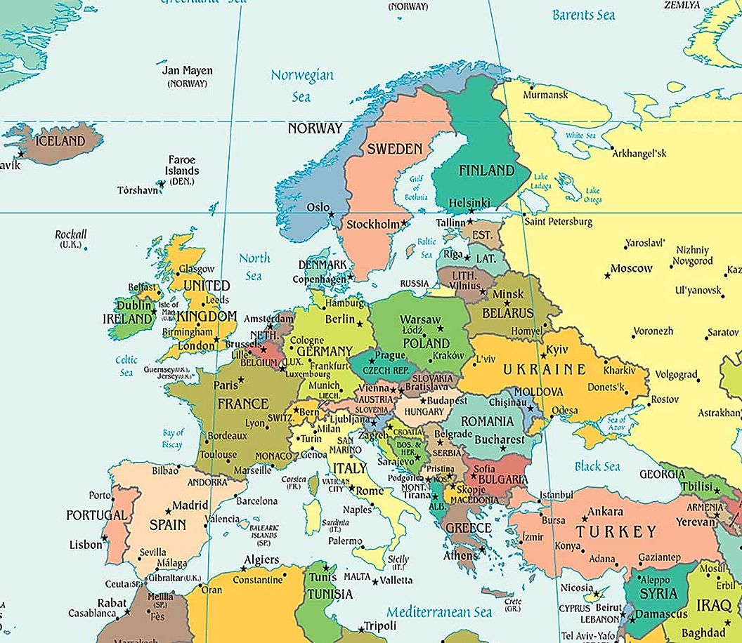
Notes:
4
4

Slide 5
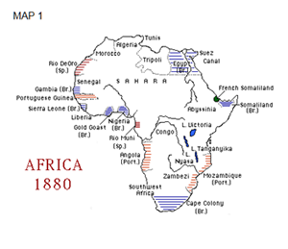
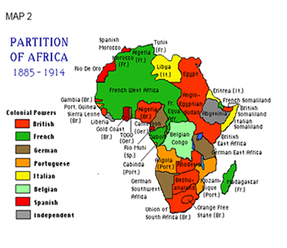
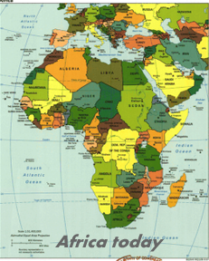

Slide 6
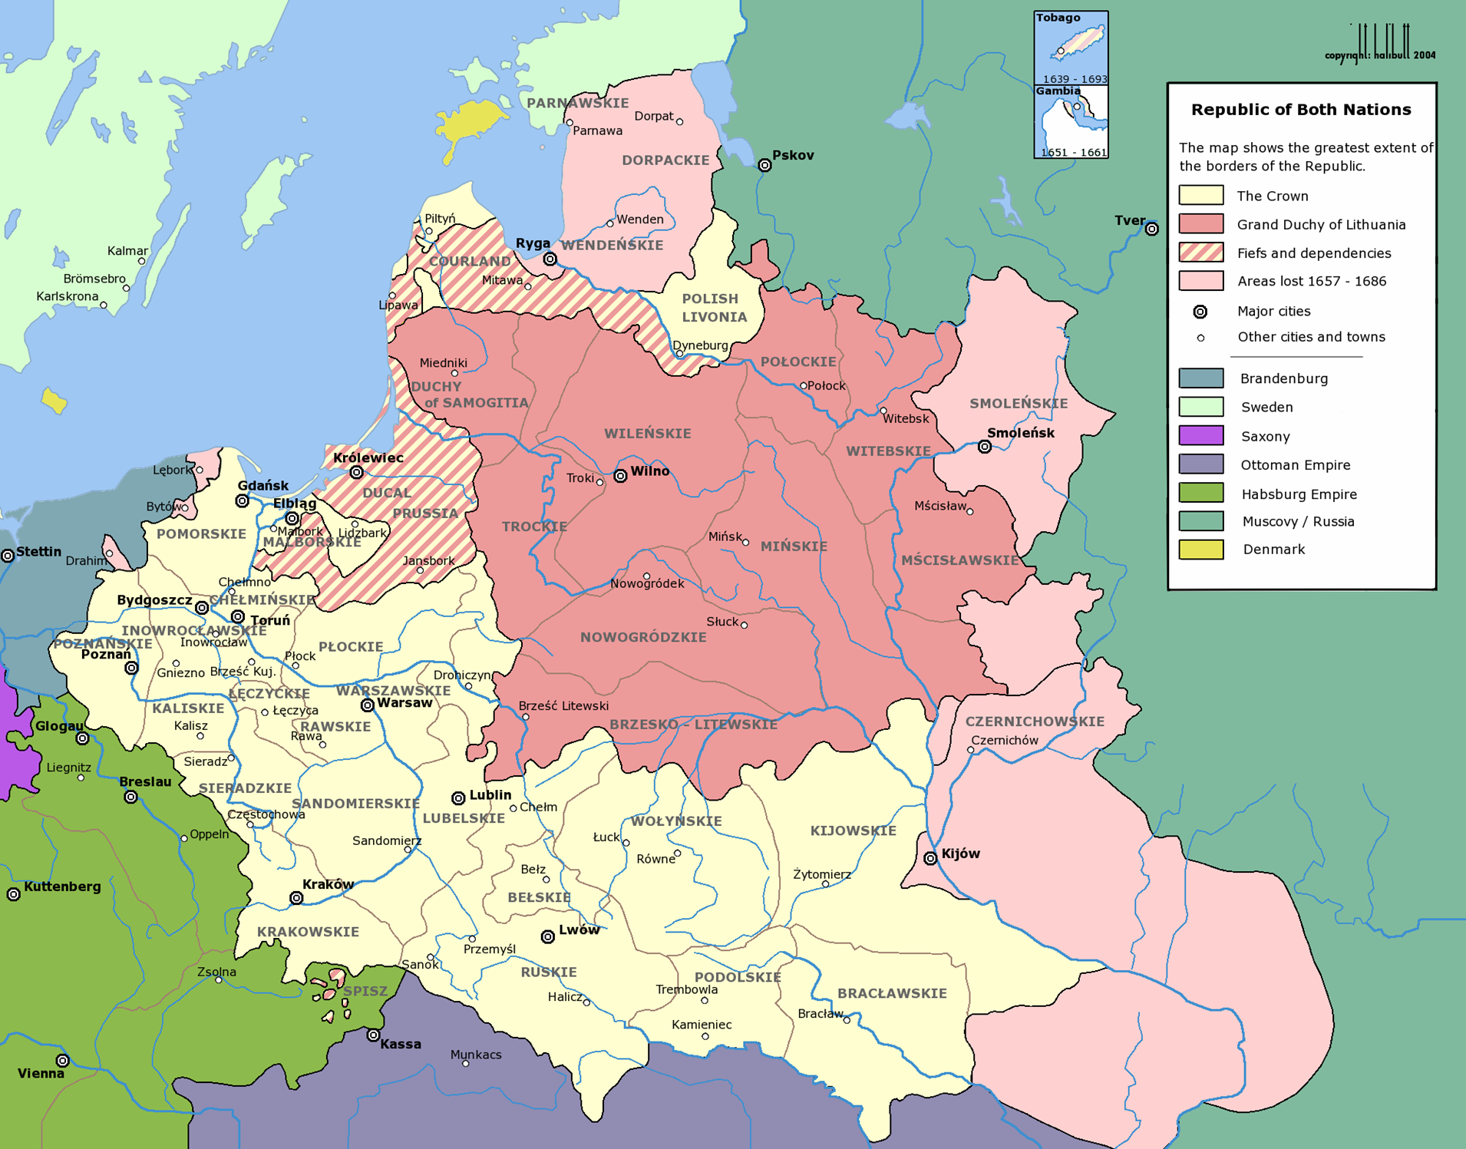
The Polish-Lithuanian Commonwealth in 1569
Notes:
6

Slide 7
Outline
1. Introduction
2. What is a nation?
4. Do nations need navels?
5. Nationalism and national indifference
6. Conclusion
Notes:
7
7

Slide 8
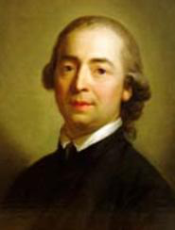
Nature brings forth families; the most natural state therefore is also one people, with a national character of its own.
For thousands of years this character preserves itself within the people and, if the native princes concern themselves with it, it can be cultivated in the most natural way: for a people is as much a plant of nature as is a family, except that it has more branches. Nothing therefore seems more contradictory to the true end of governments than the endless expansion of states, the wild confusion of races and nations under one scepter. An empire made up of a hundred peoples and a 120 provinces which have been forced together is a monstrosity, not a state-body.
Materials for the Philosophy of the History of Mankind (1784)
Johann Gottfried von Herder (1744-1803)
No greater injury can be inflicted on a nation than to be robbed of her national character, the peculiarity of her spirit and her language.
Notes:
8
8

Slide 9
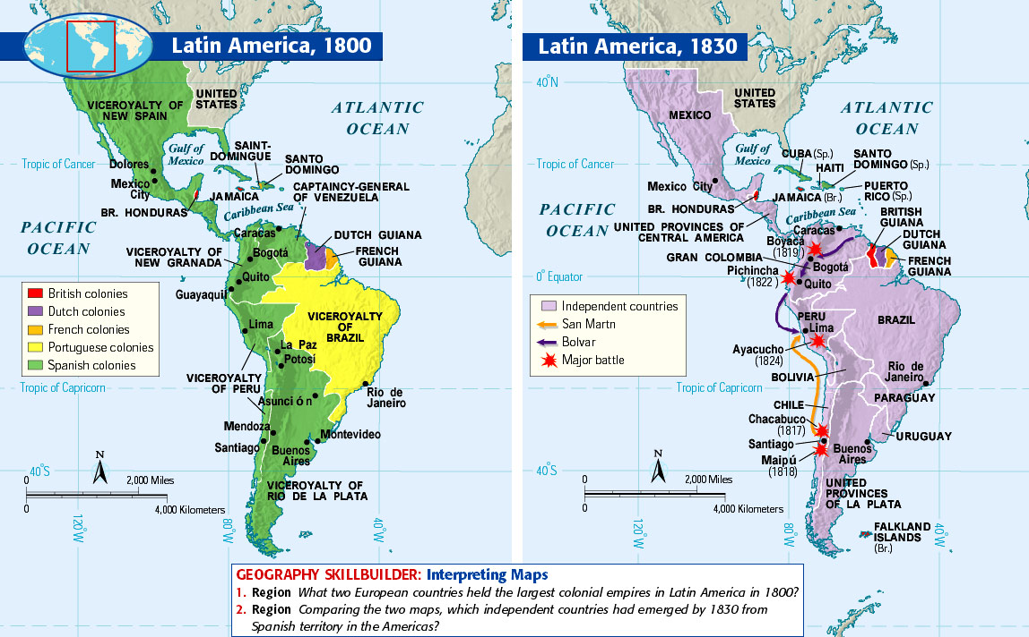

Slide 10
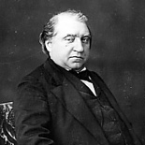
“Man is a slave
neither of his race
nor his language,
nor of his religion,
nor of the course of rivers nor of the direction taken by mountain chains.”
Ernest Renan, 1823-1892, “What is a nation?“
“A nation is a soul, a spiritual principle. Two things, which in truth are but one, constitute this soul or spiritual principle. One lies in the past, one in the present. One is the possession in common of a rich legacy of memories; the other is present-day consent, the desire to live together, the will to perpetuate the value of the heritage that one has received in an undivided form”
Notes:
10
10

Slide 11
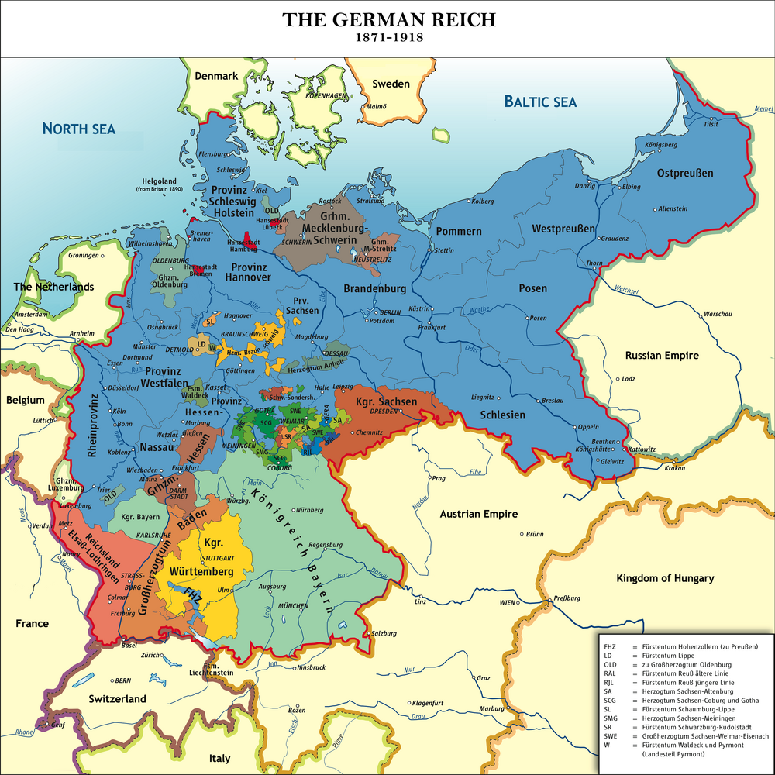

Slide 12
Outline
1. Introduction
2. What is a nation?
3. Do nations need navels?
4. Nationalism and national indifference
5. Conclusion
Notes:
12
12

Slide 13
Primordialist view Key assumptions Nations are real process National sentiment is no construct It is rooted in a feeling of kinship Nations are eternal or at least go back to ancient times
Notes:
13
13

Slide 14
Modernist view
“Nation as a natural, God-given way of classifying men, as an inherent … political destiny, are a myth; nationalism, which sometimes takes preexisting cultures and turns them into nations, sometimes invents them, and often obliterates preexisting cultures: that is a reality”.
(Ernest Gellner)
Notes:
14
14

Slide 15
Ernest Gellner
Nations accompany the transition from agrarian societies to modern industrial societies
Nations are functional for modern industrial society.
The most important tool in forming nations is the modern education system
The replacement of “low” by “high” cultures marks industrial society and nation building.
Nationalism imposes the new high culture on the population and uses material from old “low” cultures as raw material see also “The invention of tradition” (Eric Hobsbawm)
Nations are necessary, every single nation is contingent
Ernest Gellner, Nation and Nationalism
Notes:
15
15

Slide 16

“Nations do not make states and nationalisms but the other way round”.
(Eric Hobsbawm)
Notes:
16
16

Slide 17
Benedict Anderson
Preconditions of nations
Capitalism as a modern system of production and productive relations
Print as a modern technology of communication
Human linguistic diversity
Notes:
17
17

Slide 18
Modernist view Key assumptions Nations are a product of modernity Nations are constructed by elites Nationalists created nations
Notes:
18
18

Slide 19
Critics of the modernist position
“For the diffusion of national ideas could only occur in specific social settings. Nation-building was never a mere project of ambitious or narcissistic intellectuals… Intellectuals can “invent” national communities only if certain objective preconditions for the formation of a nation already exist.”
Miroslav Hroch, From National Movement to the Fully-Formed Nation, p. 61
Notes:
19
19

Slide 20
“A nation can therefore be defined as
a named human population
sharing an historic territory,
common myths and historical memories,
a mass public culture,
a common economy
and common legal rights and duties for all members.“
Anthony D. Smith: National Identity. Reno, Las Vegas, London 1991, p. 14.
http://nationalismproject.org
Notes:
20
20

Slide 21
Intermediary position (Anthony D. Smith) Key assumptions Nations are a modern phenomenon, but have roots in pre-modern eras and cultures Modern nations are directly or indirectly related to older ethnies with their distinctive mythology, symbolism and culture Nations are expression of the “need for collective immortality through posterity” Nations are both construct and real process
Notes:
21
21

Slide 22
Ethnicity (Fredrik Barth)
Ethnicity is a social product
Importance of interaction
Ascribed and self-ascribed
Categorical ascription
Importance of ‘the Other‘
“To the extent actors use ethnic identities to categorise themselves and others for the purposes of interaction, they form ethnic groups in this organisational sense.”
“The critical focus of investigation from this point of view becomes the ethnic boundary that defines the group, not the cultural stuff it encloses.”
Fredrik Barth (ed.), Ethnic Groups and Boundaries (Boston, 1969), pp. 14-15

Slide 23
War and Nation
There is a link between war and nation building
To what extent are nations made in wars?
In anti-colonial wars and uprisings globally
In secessionist wars
In wars of unification
In World Wars

Slide 24
Outline
1. Introduction
2. What is a nation?
4. Do nations need navels?
5. Nationalism and national indifference
6. Conclusion
Notes:
24
24

Slide 25
Nationalism
Identical movement for attaining and maintaining the autonomy, unity and identity of an existing or potential “nation”.
(Anthony D. Smith, The Origins of Nations, p. 108)
Notes:
25
25

Slide 26
Nationalism
A theory of political legitimacy
“which requires that ethnic boundaries should not cut across political ones, and in particular, that ethnic boundaries within a given state … should not separate the power-holders from the rest.”
Ernest Gellner, Nation and Nationalism, p. 1
Notes:
26
26

Slide 27
“A nationalist argument is a political doctrine built upon three basic assertions:
There exists a nation with an explicit and peculiar character.
The interests and values of this nation take priority over all other interests and values.
The nation must be as independent as possible. This usually requires at least the attainment of political sovereignty.”
John Breuilly, Nationalism and the State (Chicago, 1985), p. 3
Notes:
27
27

Slide 28
Types of Nationalism (Michael Hechter)
State-building nationalism: England, France
Peripheral nationalism: Quebec, Scotland, Catalonia
Irredentist nationalism: Sudeten Germans, Hungarians in Romania
Unification nationalism: Germany, Italy
Michael Hechter, Containing Nationalism (Oxford, New York, 2000), pp. 15-17
Notes:
28
28

Slide 29
Problem with eurocentrism of typologies of nationalism
What about anti-colonialism or anti-colonial nationalism?
Many states (and nations) globally are a result of this struggle
Nation states did not just simply spread from Europe to the rest of the world. South and Central American nation states are older than many European nation states

Slide 30
National indifference
Not liked by nationalists – Ideally everyone (who nationalists consider to be a member of the nation) should identify with the nation, should have a ‘national consciousness’
National indifference was and is more common than nationalists like/liked and not just an expression of ‘backwardness’
One example of national indifference are ‘tutejszi/tutejshi’ in Eastern Poland in the inter-war period
Hybrid, fluid and circumstantial identities
Mixed heritage families
National indifference or ambiguity can be a conscious choice but often wars and conflicts take this option away
Tara Zahra, ‘Imagined Communities: National Indifference as a Category of Analysis’, Slavic Review, 69 (2010), pp. 93-119

Slide 31
Schedule
Introduction
What is a nation?
Nationalism
German nation building
Conclusion
Notes:
31
31
31

Slide 32
Conclusion: some problems and questions
Are nations really contingent (occur by chance)?
Do nations need ‘navels’?
Why did the identification with the nation have a greater impact on behaviour than religious, regional, class or gender identifications?
Is is this true and how important was (and is) ‘national indifference’?
National mass education is only possible after having a nation state, it does not explain the nationalism before and the emergence of national movements in “backward” agrarian societies.
Importance of war and anti-colonial struggle for nation building

