Slide 1
The historical background of the Russian attack on Ukraine
Open Day, 27 April 202
Christoph Mick, University of Warwick

Slide 2
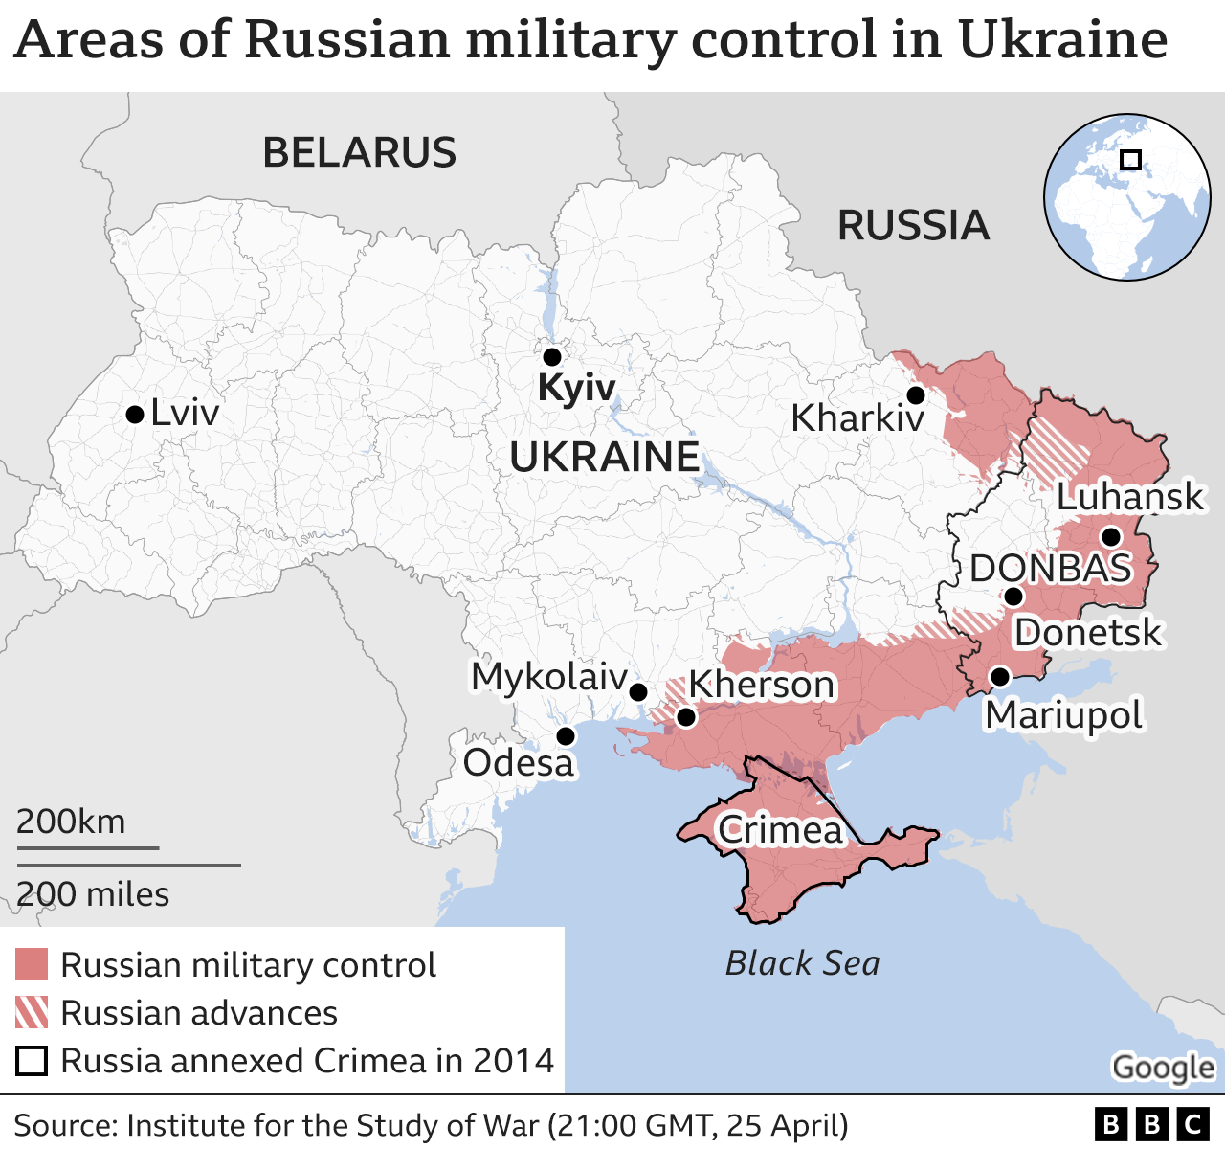

Slide 3
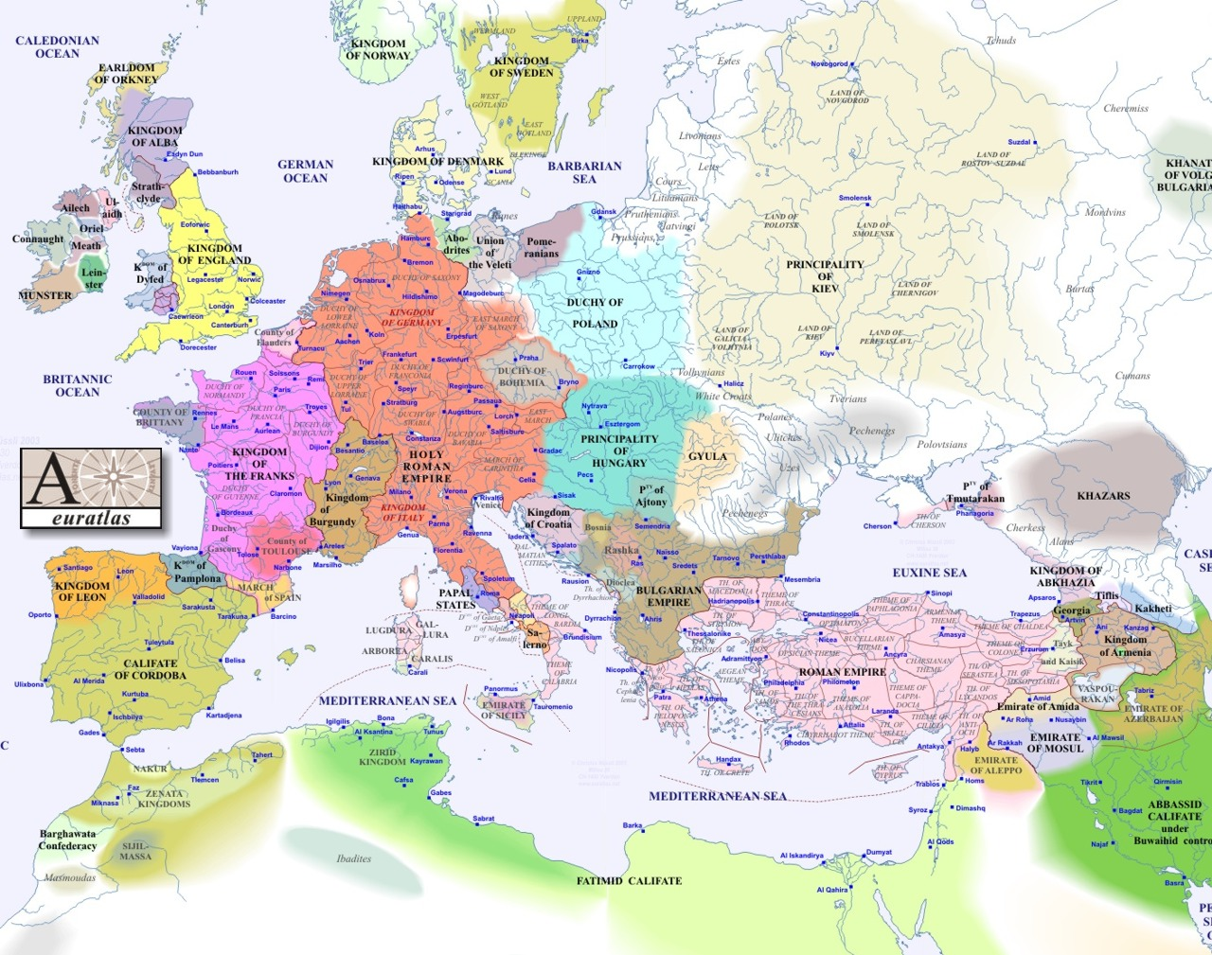
1000

Slide 4
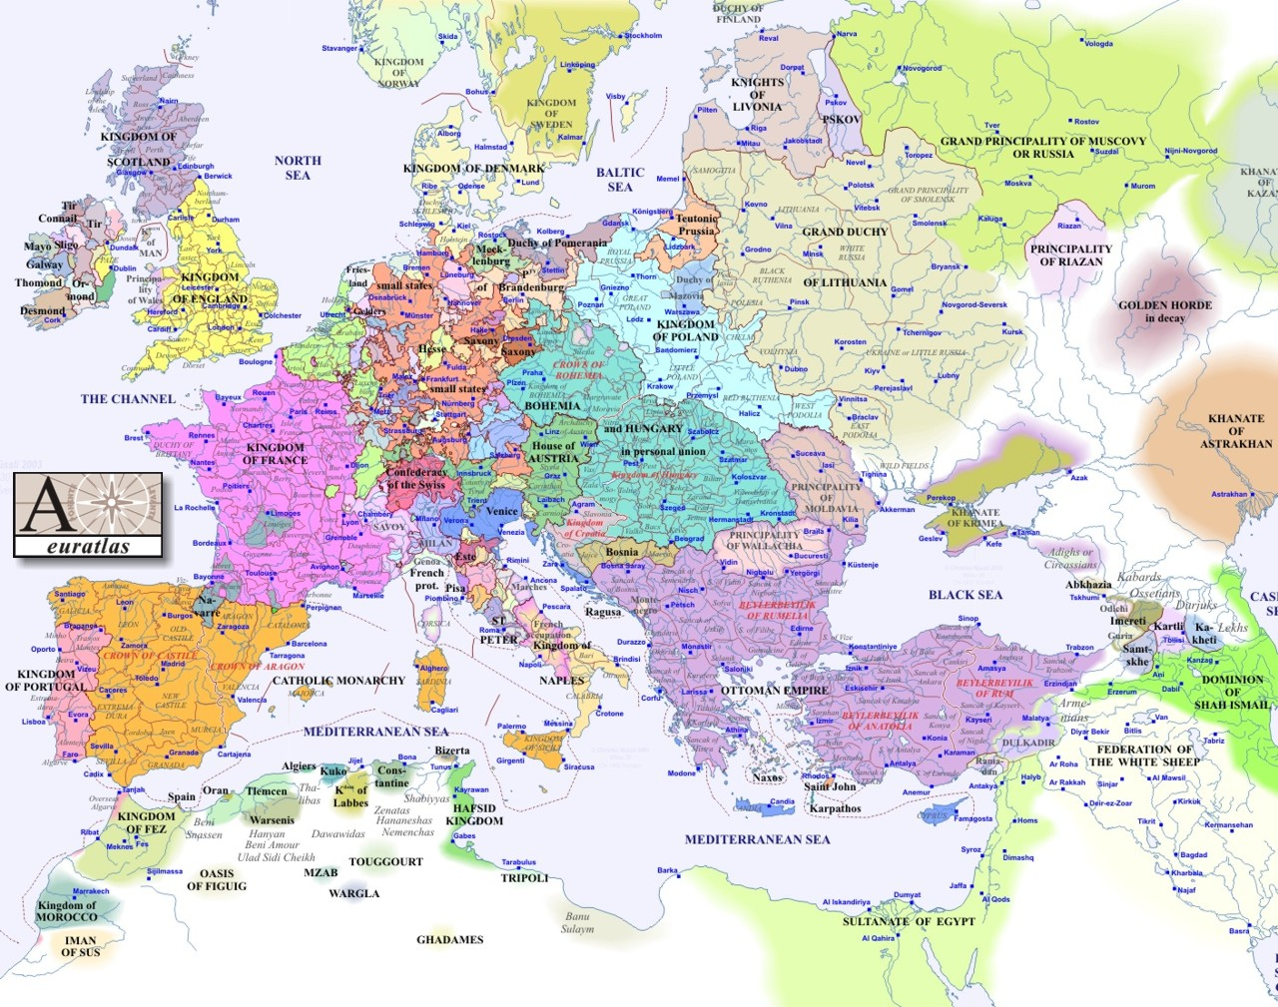
1500
Notes:
4
4

Slide 5
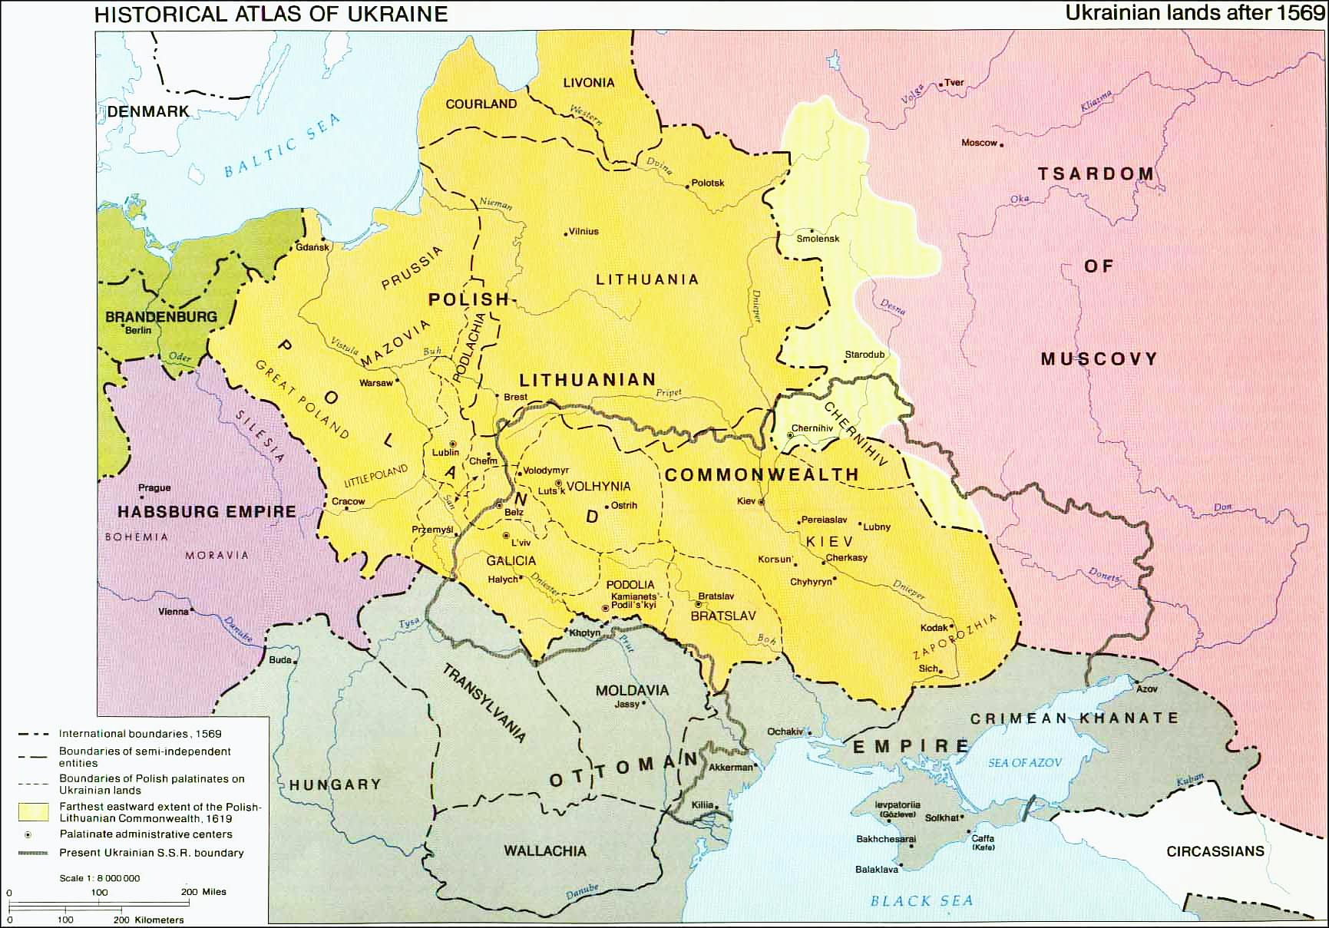
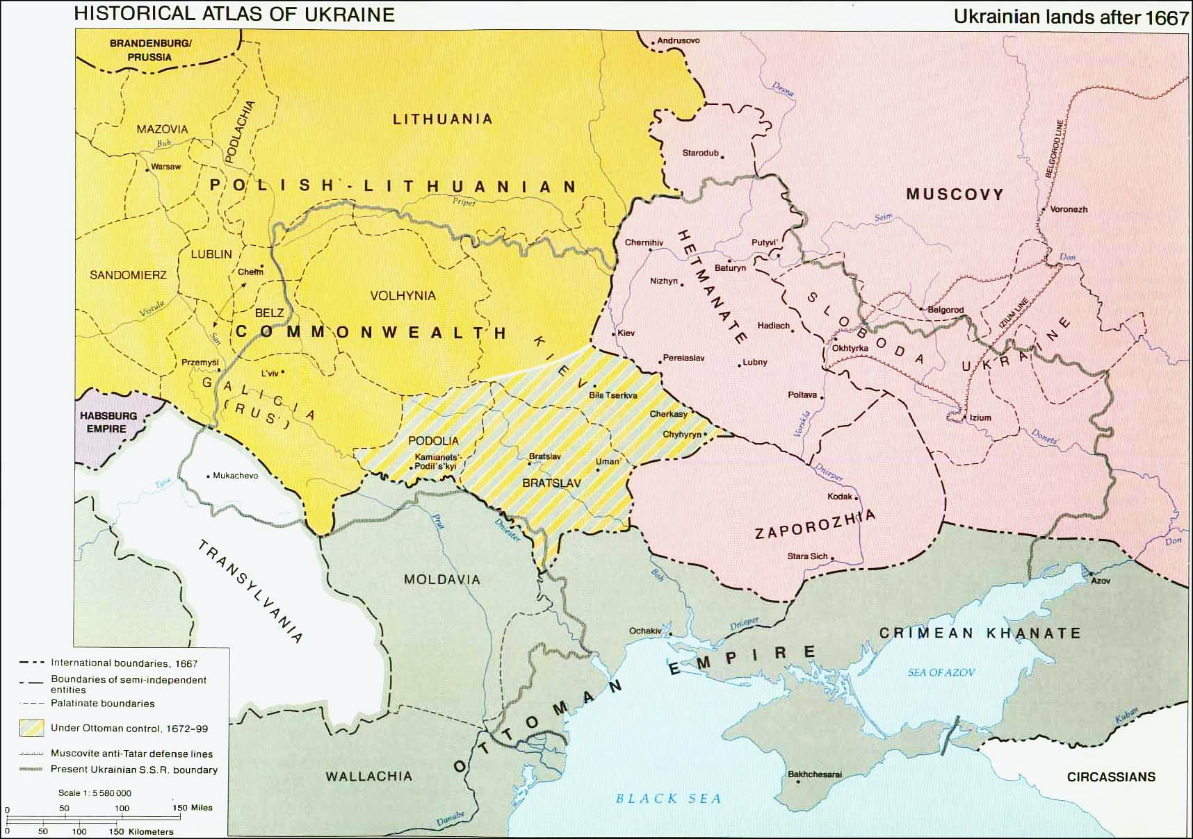
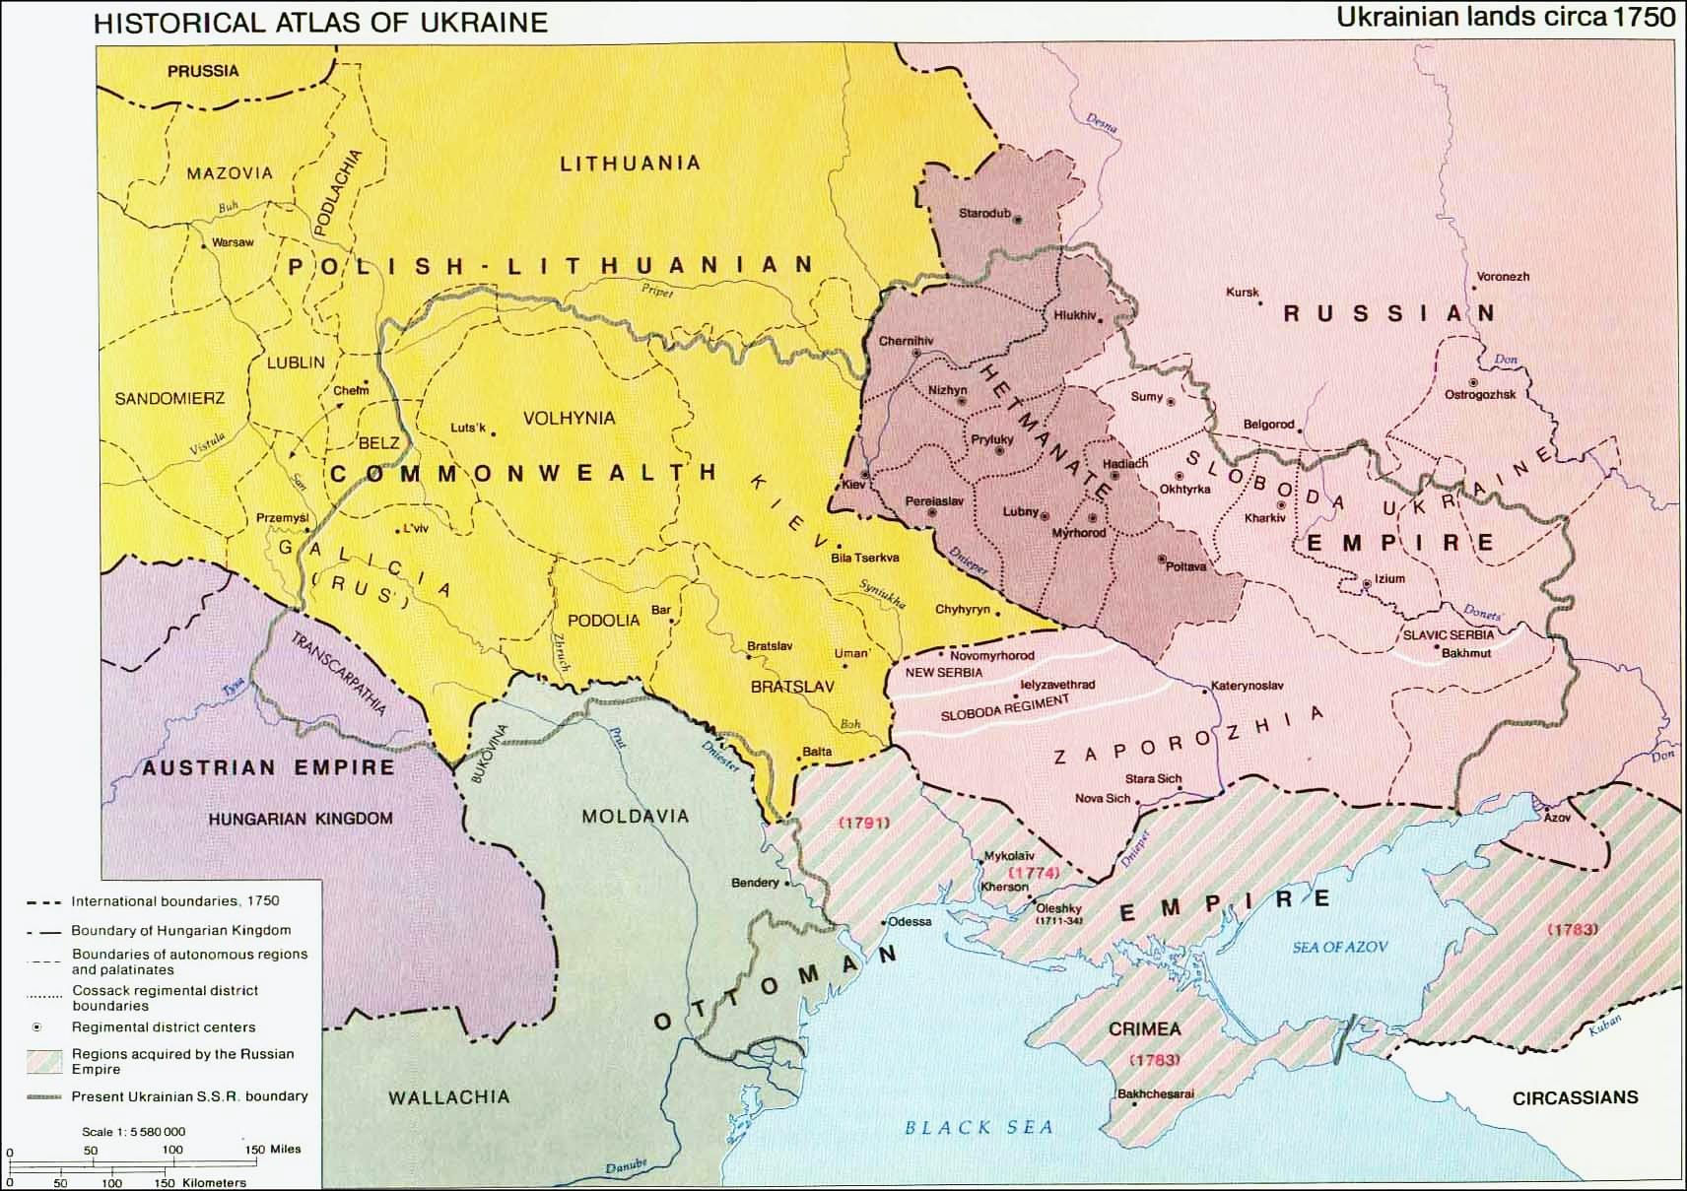
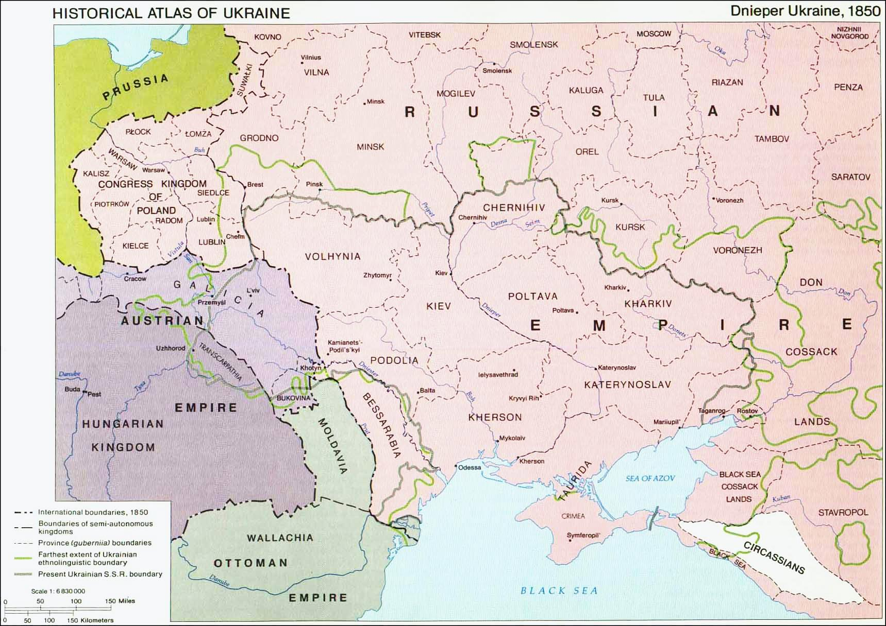
Notes:
5

Slide 6
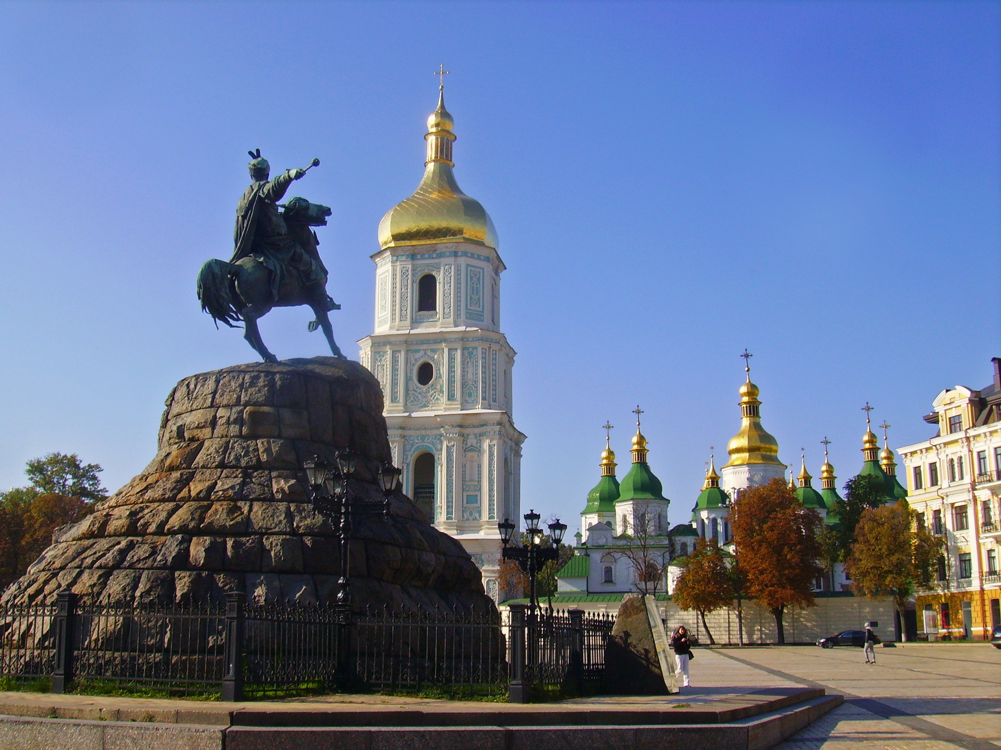
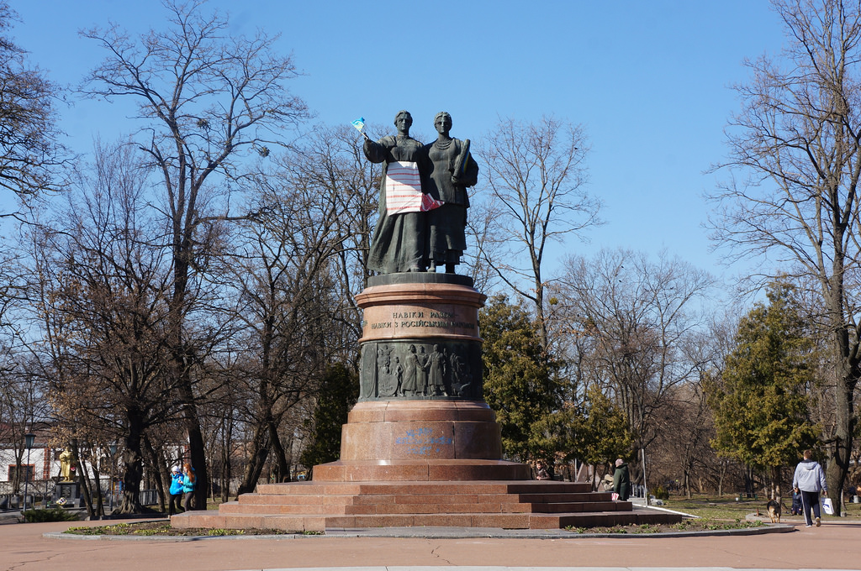
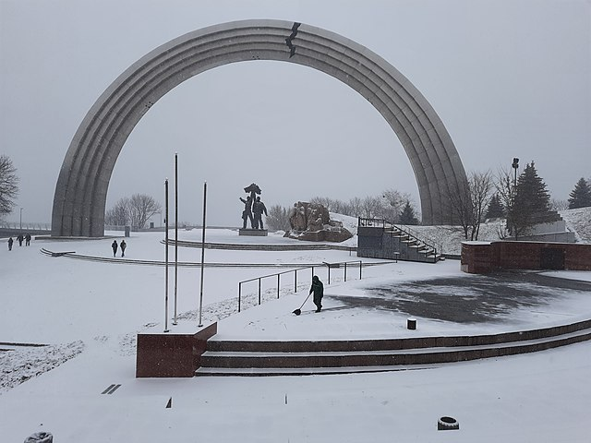
Treaty of Pereyaslav Monument, Pereyaslav Khmel’nyts’kyj
1961
Khmel’nyts’kyj monument Kyjiv
1888
People’s Friendship Arch, dedicated to the unification of Russia and Ukraine
Completed in 1982
The crack was added in 2014.

Slide 7
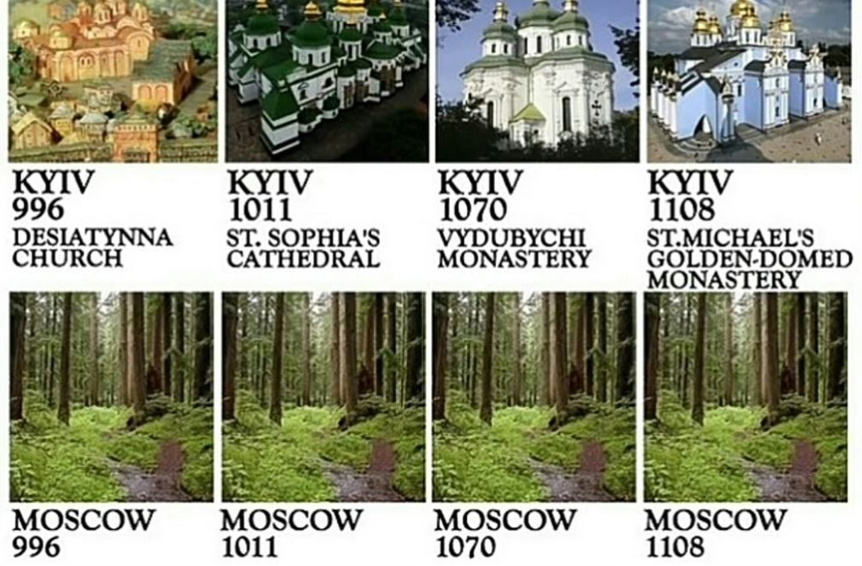
Tweeted recently by the US Embassy in Kyiv

Slide 8
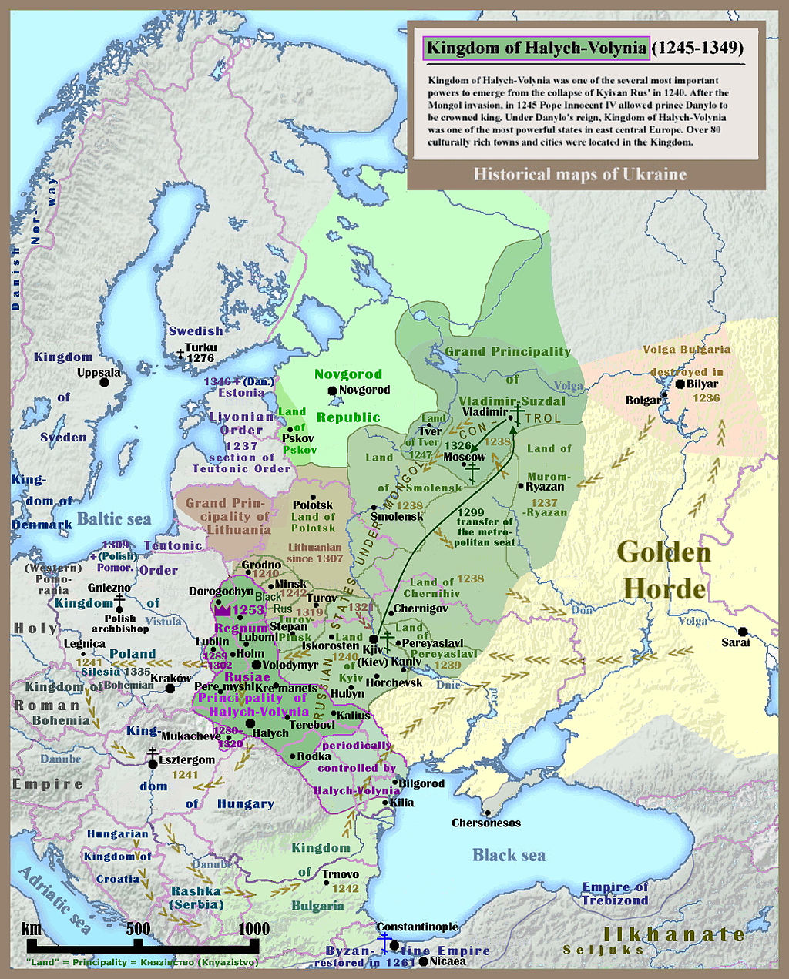
Contested History
Map of Kievan or Kyjivan Rus (Principality of Kiev Kyjiv), 1245-1349

Slide 9
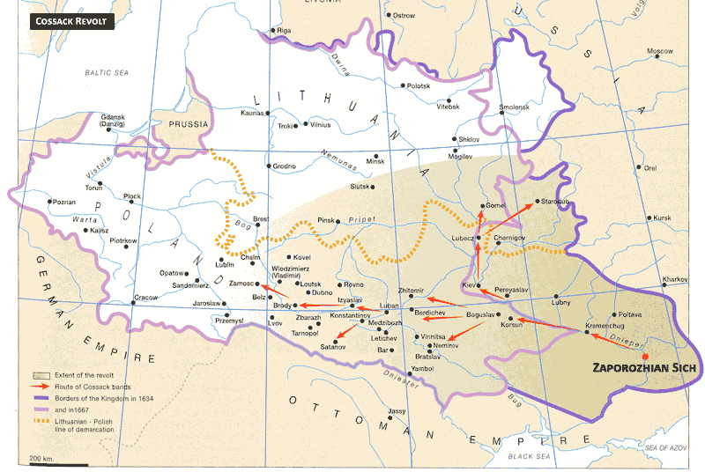
Map of Cossack wars 17th century

Slide 10
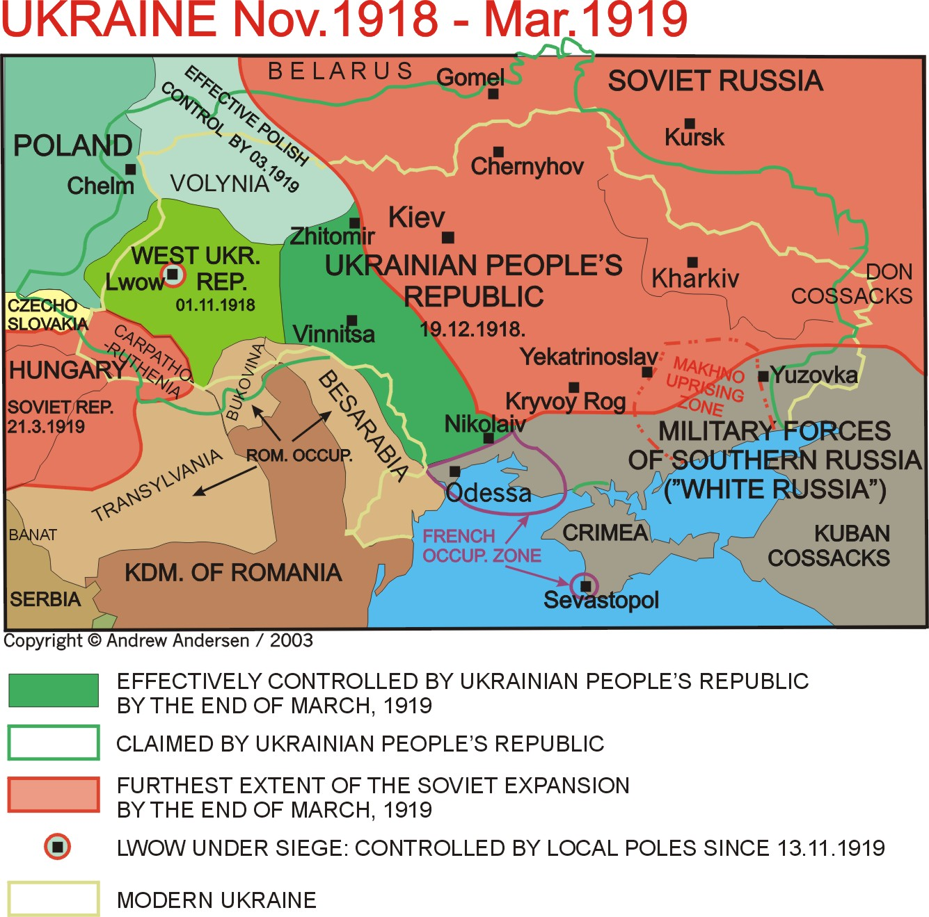

Slide 11
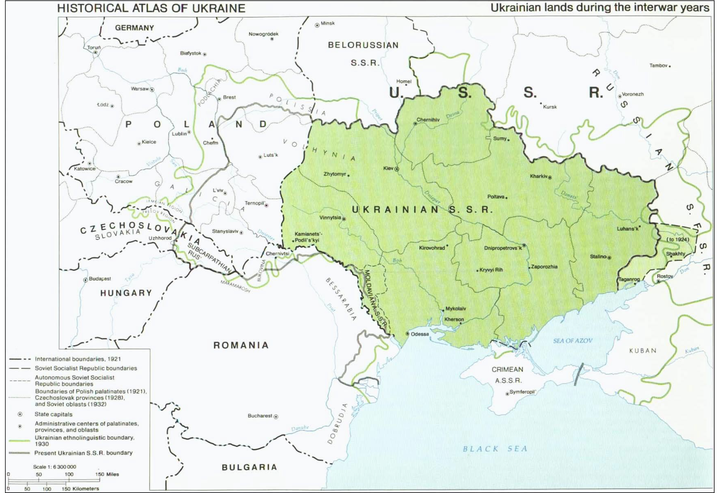

Slide 12
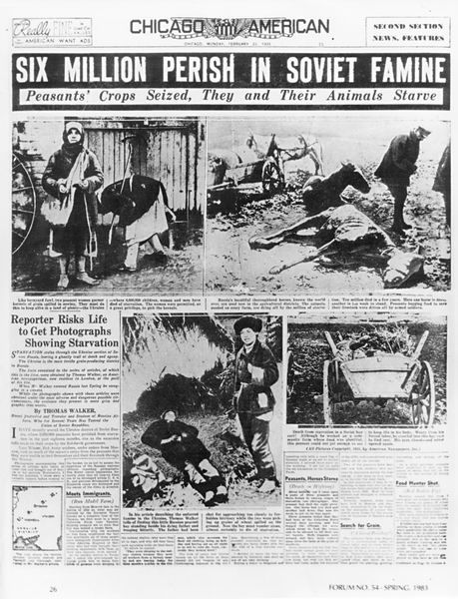
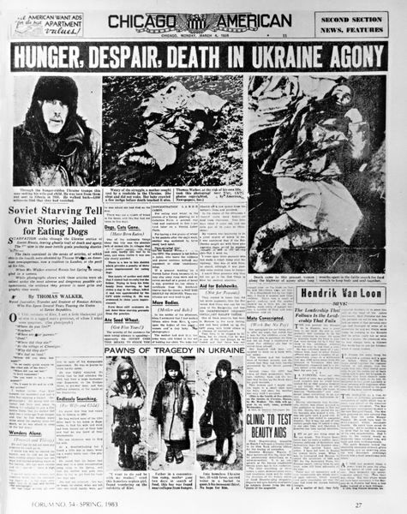
http://www.holodomor.org/
Notes:
12

Slide 13
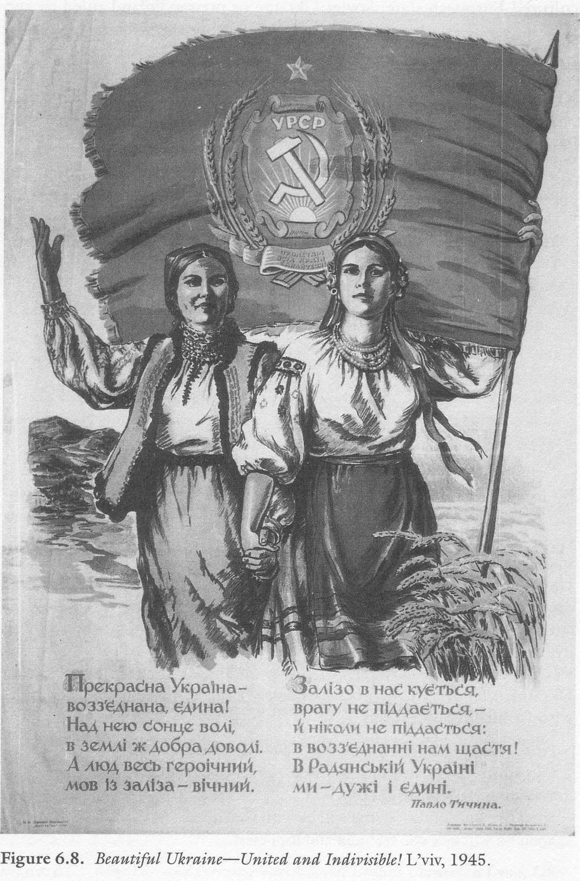
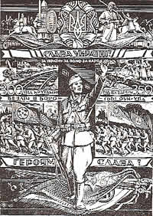
WWII Propaganda poster of the Organisation of Ukrainian Nationalists (OUN)
Soviet propaganda poster 1945

Slide 14
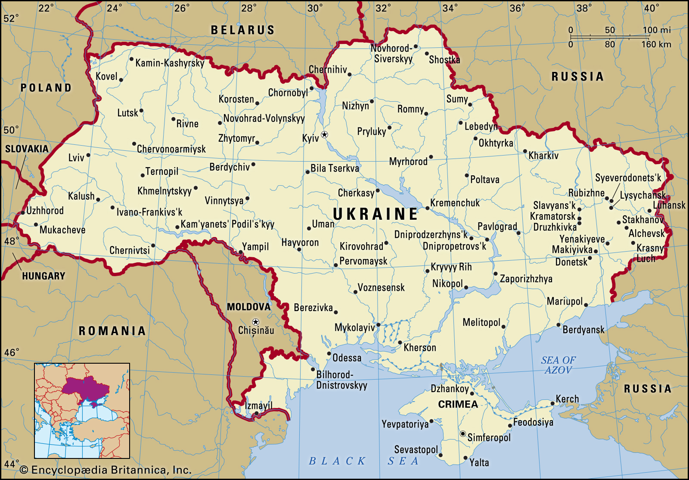

Slide 15
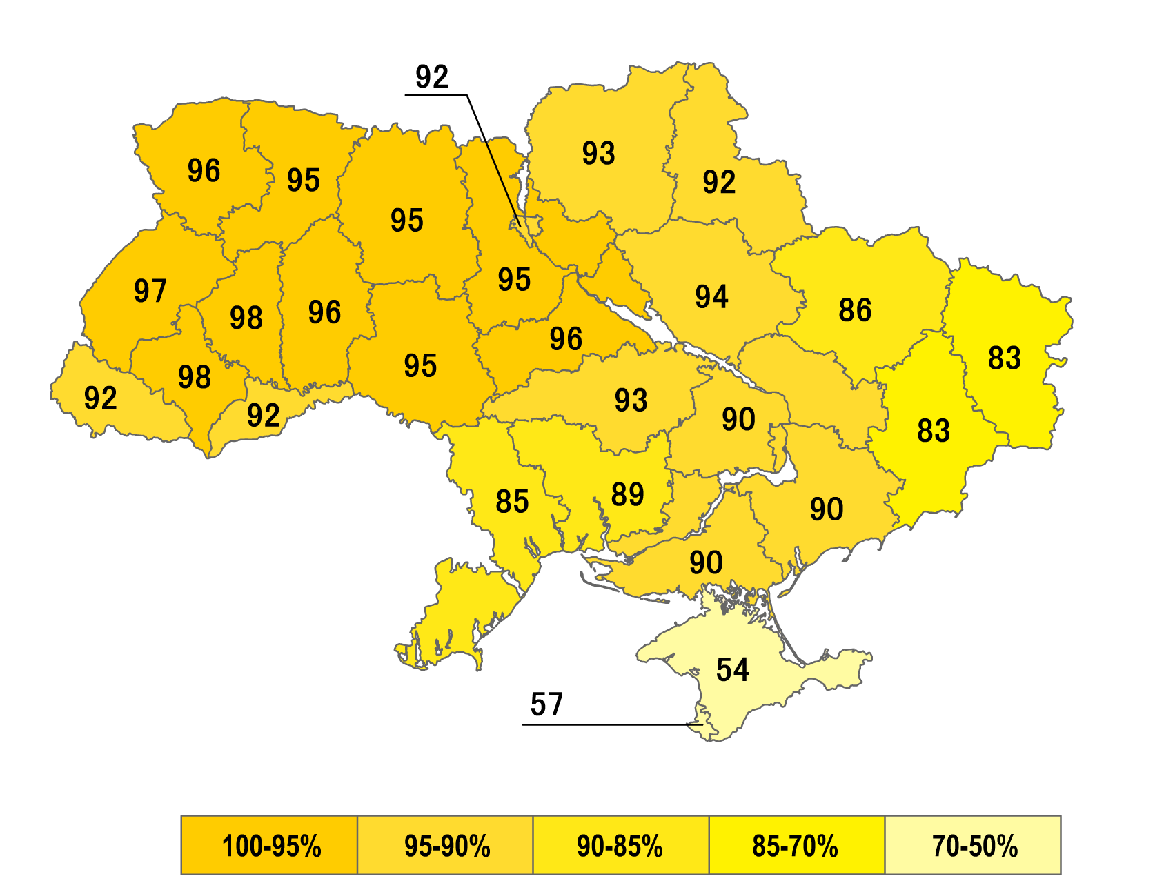
Referendum 1 December 1991: "Do you support the Act of Declaration of Independence of Ukraine?”?"

Slide 16
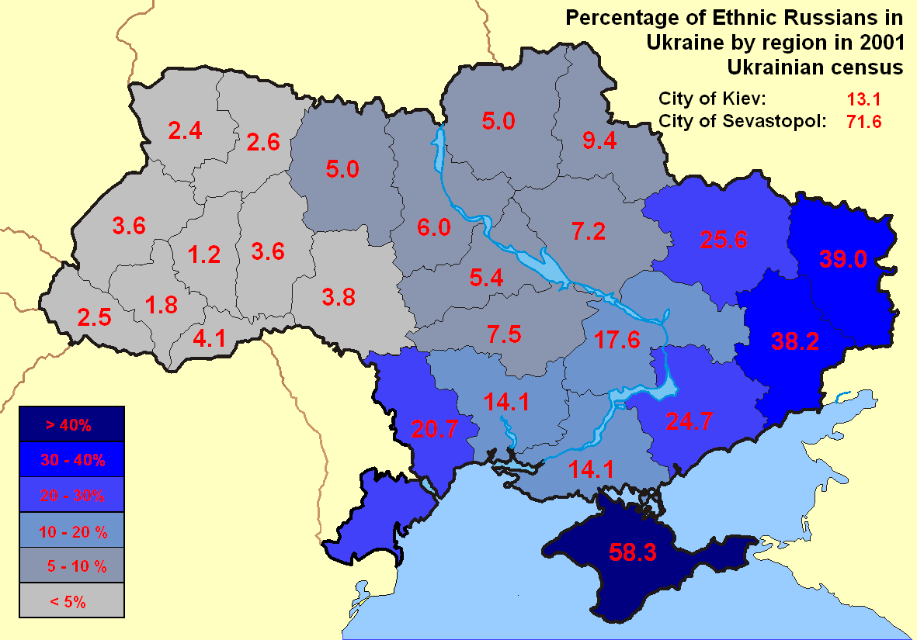
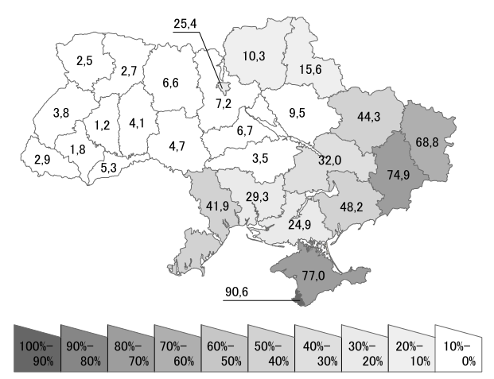
Percentage of Russian speakers in Ukraine by region in 2001 Ukrainian census

Slide 17
