Slide 1
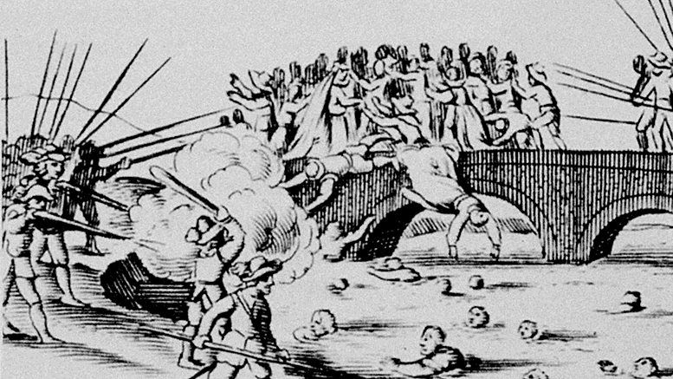
“A TRUE AND CREDIBLE RELATION OF THE BAROUROUS CURLETIE AND BLOUDY MASSACRES OF THE ENGLISH PROTESTANTS THAT LIVED IN THE KINGDOME OF IRELAND”
WEEK 8: CHARLES I AND THE ROAD TO CIVIL WAR
KAAN DAL

Slide 2
CONTEXT TO THIS SOURCE
Plantation culture in Ireland to consolidate the Reformation in Elizabethan times
Earl of Strafford and Earl of Antrim were in discussions with the King to raise troops for a potential war, 1638-1640
The Irish Rebellion of 1641 – fearful of the Long Parliament and Scottish Covenanter movement, the Catholic gentry wanted to guarantee Catholic rights, so launched a coup of sorts
A distinctly ’British problem’ – Conrad Russell and revisionists
Involved massacres of Protestants as a feature of the Rebellion – what this source is about

Slide 3
OVERVIEW OF THE SOURCE
One argument running throughout – the Irish were a barbaric people that should not be trusted
“cowardly and treacherously, without respect of persons, to rob them of all they have”
Use of women and children in this as a way of portraying the Irish as particularly barbaric
Link between barbarism and the Catholic faith of the murderers - various anecdotes
“the Jesuits, those firebrands of hell… plotters of this and other treasons”

Slide 4
WHY WOULD THIS SOURCE BE WRITTEN?
An author that was forced to flee Ireland with his family to London due to fear of the rebels A personal link to the massacres; increases the height of emotion in the source, and also the motivation for writing this – “O mercylesse and cruell murtherers!
The source is a personal account – freedom to express personal views regarding the Irish
Growth of anti-Catholic sentiment in England and Scotland during this period; an opportunity to unify the ’three kingdoms’ which would provide strength in a potential war through unity of belief

Slide 5
THIS SOURCE AS A PIECE OF PROPAGANDA
An intricate propaganda campaign led by the Scottish Covenanters and Long Parliament from 1640 onwards through the Bishops’ Wars
The graphic detail of the source and emotion behind the argument gives it great persuasive potential
  ’stript them naked, as they did many thousands of men, women and children in other parts of the kingdome of Ireland upon the same day’
  Written at the beginning of 1642, so was the prime time to stoke up anti-Catholic sentiment among the Parliamentarians and English
  - ‘’fit subjects for the Jesuits’

Slide 6
The ACTUAL IMPACT OF THIS SOURCE
Conrad Russell – the ‘billiard ball’ effect – sources like this contributed to this
Made the Parliamentarians vociferously anti-Irish
  Mark Stoyle - The massacre of Colonel Willoughby’s men in Pembroke; this marked the ending of Irish troops being sent to fight on the Royalist side
  Such emotive eye-witness accounts also transformed the opinion of the average Englishman regarding the Irish
  Treatment of Irish – defeat at the Battle of Nantwich, protests in Somerset against the Irish
  Ultimately, only the King’s closest men supported the use of Irish troops in the Civil War; also unified the three kingdoms in their opposition to Catholicism

Slide 7
Questions?
Were Protestant responses to this massacre (ie massacre of Colonel Willoughby’s troops) justified given the barbarity of the actions of the Irish Catholics?

