Slide 1
The Cold War dimensions of decolonization
HI277 I Africa and the Cold War I Week 3 I Dr. Natalia Telepneva
Office Hourse: 1-3pm (H343)

Slide 2
Key Questions
Last week
Was the Nation in Africa inevitable?
How was African nationalism affected by Cold War?
This week
Was decolonisation inevitable?
How was decolonisation and the Cold War intertwined?

Slide 3
Historiography
Imperial historians: institutional structurs, changing attitudes in the metropole
Historians of Africa (first generation): African nationalism, ‘pushed out’
Now: Global and transnational connections – the global Cold War, impact of anticolonial revolution elsewhere in the world

Slide 4
Lecture Outline
Aftermath of the Second World War
Paths towards Statehood (negotiated vs. violent)
Africa and the Superpowers

Slide 5
1. Aftermath of WWII: Crisis of Colonialism
Destruction in Europe
British Withdrawal from India, 1947
First Indochina War and the Battle of Dien Bien Phu, 1954
Struggles in India and Vietnam were both inspirations to African nationalists
Indian and Nigerian troops bathe together during the Burma campaign

Slide 6
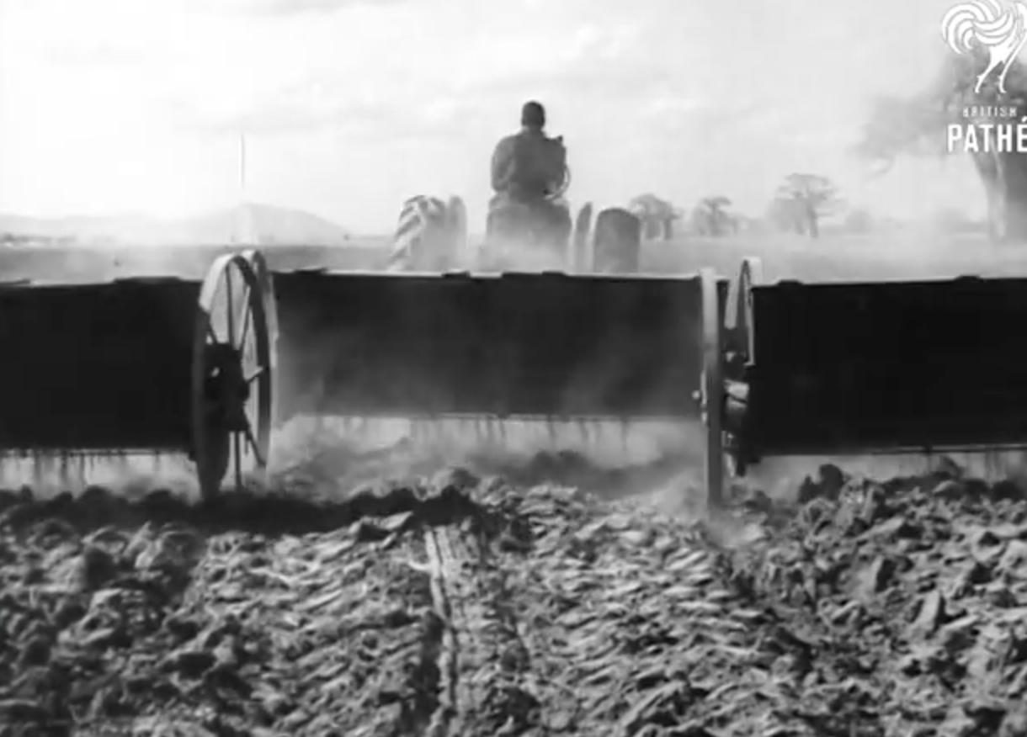
1. Aftermath of WWII: ‘New Colonialism’ in Africa
Britain: Economy in trouble
US loan and ‘Sterling Convertibility Crisis, 1947’
Cash Crop Production
Development as ‘anti-communism
French Empire Reform
Groundnut scheme in Tanganyika, 1949

Slide 7
2. Paths Towards Statehood: Negotiated Exits
Julius Nyerere and the Duke of Edinburgh at Tanganyikan independence, 1961

Slide 8
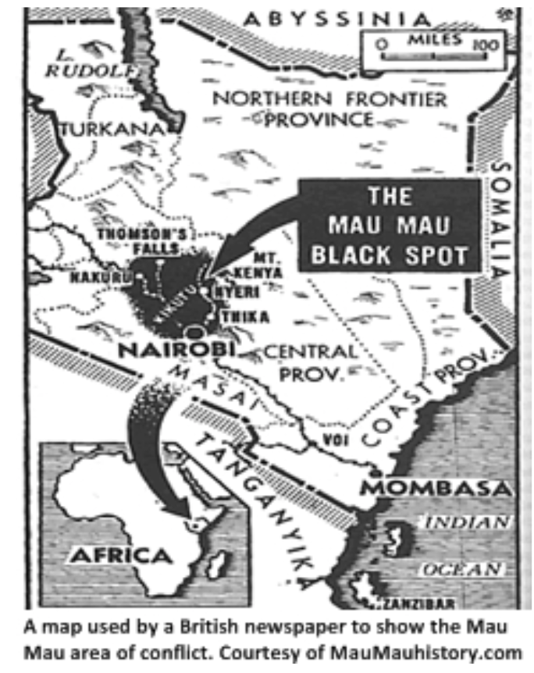
2. Paths towards Statehood: Violent Exits – Kenya, Mau Mau
British soldiers assisting police searching for Mau Mau soldiers in the village of Kariobangi near Nairobi in 1954.

Slide 9
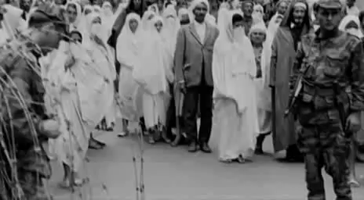
2. Paths Towards Statehood: Violent Exits – Algerian War, 1954-1962
Video: A scene from Gillo Pontecovo’s “Battle of Algiers, made in 1966

Slide 10
2. Paths Towards Statehood: Violent Exits – Fanon on Violence
Franz Fanon (1925-1961)
The Wretched of the Earth, 1961

Slide 11
2. Paths towards Statehood: Violent Exists – Algeria as “Diplomatic Revolution”
Matthew Connelly: Algeria as a “diplomatic revolution”
Use of international fora– UN, propaganda campaigns
French response: propaganda campaign, in terms of human rights
Prince Hassan of Morocco with FLN leaders en route to Tunis, 1956

Slide 12
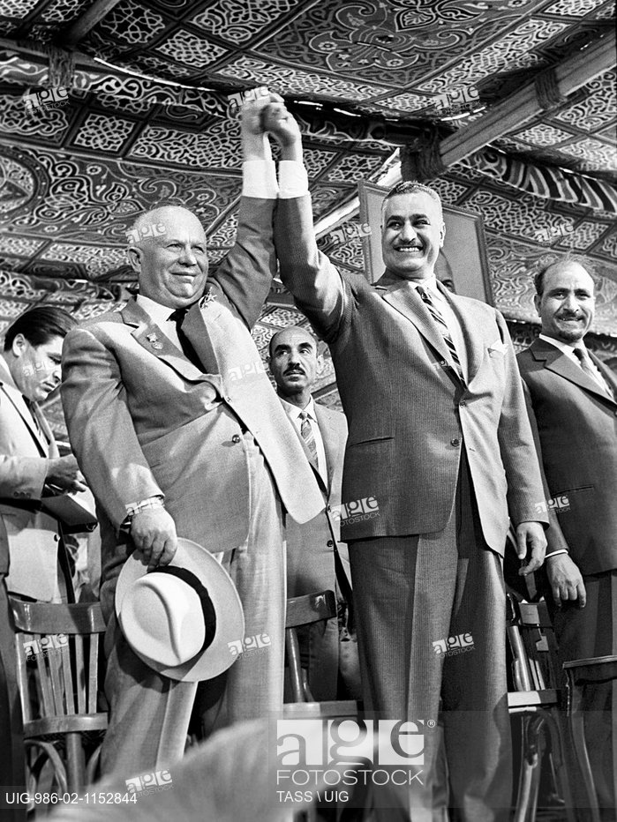
3. Africa and the Superpowers: Soviet rediscovery of the Third World
Stalin’s lack of interest in the Third World
Policy shift under Nikita Khrushchev, 1953
Targeted financial aid, practical training, student scholarships
Using the colonial endgames for leverage elsewhere in the world
Nikita Khrushchev with Egypt’s Gamal Abdel Nasser, 1964

Slide 13
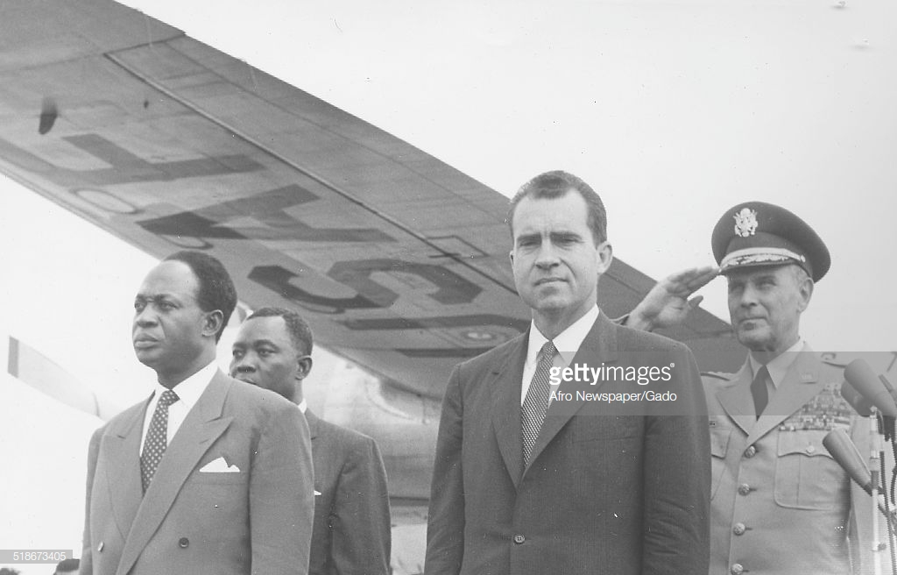
3. Africa and the Superpowers: American Dilemma
US Anti-Imperialism
Dwight Eisenhower: European patronage preferred
1957: Change of Policy –Nixon’s Trip to Africa
Vice President Richard Nixon with Kwame Nkrumah in Ghana, 1957

Slide 14
3. Africa and the Superpowers: Suez Crisis, 1956
1952, Free Officers’ Coup in Egypt
July 1956: Nasser declares nationalization of the Suez Canal
Israel, Britain, France invade to retake control—unsuccessful
Key turning point
Nasser in Cairo, 1956

Slide 15
Conclusions
Multiple paths to independence
Global repercussions of anti-colonial movements, such as FLN’s campaign in Algeria
‘Neocolonial’ relationships – maintaining ties with the metropole
Cold War conflicts in Africa stemmed from grievances at the post-colonial settlement
Opportunities or dangers for the superpowers. A period of optimism for prospects of both socialism and capitalism in Africa

