Slide 1
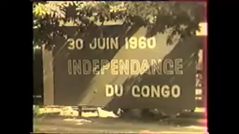
CRISIS IN CONGO, 1961-1965
HI277: Africa and the Cold War
Term 1
Week 5
Dr. Natalia
Telepneva
Song Playing: Independence Cha Cha by group L’African Jazz (1960)

Slide 2
My argument: The Congo Crisis was a turning point for the Cold War in Africa
Patrice Lumumba, 1 Dec 1960

Slide 3
Lecture Outline
Phase One: From a Local Conflict to Cold War Hotspot, June 1960-January 1961.
Consequences of Lumumba’s Murder
Phase Two: JFK and End to Katanga’s secession, 1961-1963
Phase Three: Simba Rebellions, 1963-65

Slide 4
1. Congo’s Significance
2/3 the size of Western Europe
Mineral wealth
Geopolitical significance
Africa is a revolver, Congo its trigger
-Frantz Fanon

Slide 5
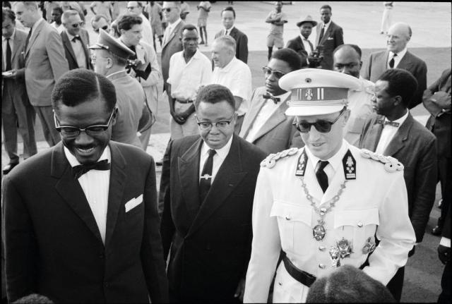
1. Belgian Withdrawal. The Crisis Unfolds: July 1960
1959: Violent protests in the Congo
April 1960: Elections
30 June 1960: Lumumba’s speech
July 1960: army mutiny, general strike, violence
11 July: Katanga province secedes from the Congo (followed by Kasai province). Why important?
Left to right: PM Patrice Lumumba, President Joseph Kasa-vubu, and King Baudouin on Independence Day, 30 June 1960

Slide 6
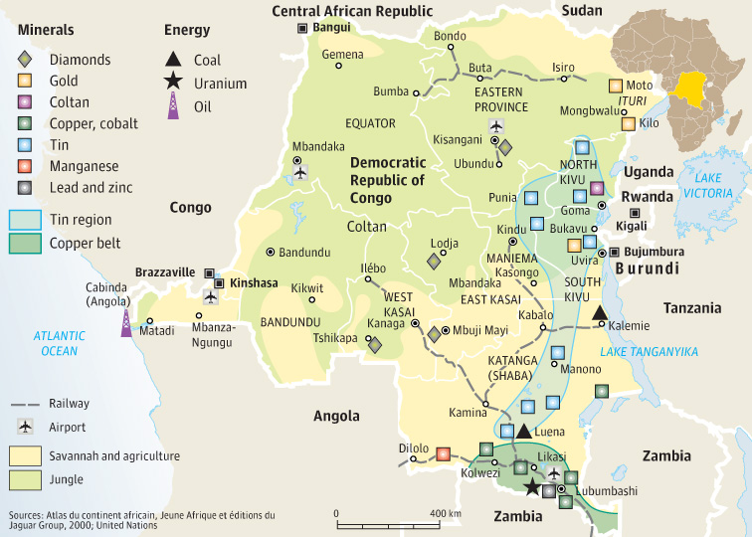
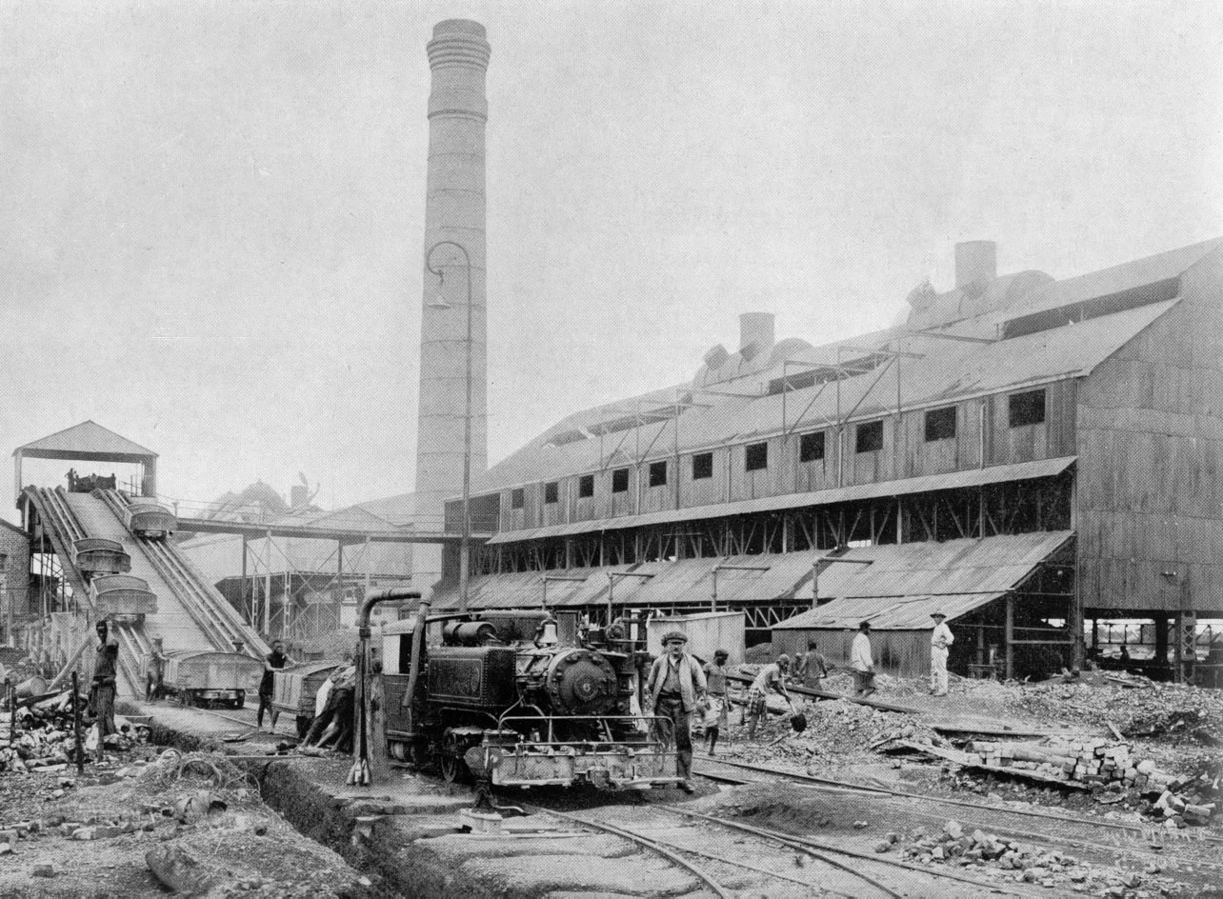
1. Katanga’s Resources
Mining Union of Upper Katanga processing ore in Elizabethville (Lubumbashi)
Map of the Congo with the distribution of mineral resources

Slide 7
1. Katanga’s Secession and Belgian Intervention
Reasons for secession
1958: Conféderation des Associations Tribales du Katanga (CONAKAT).
Belgian support: army, advisers, economy
Secession shaped by Western economic interests or Katanga’s nationalism?
CONAKAT leader Moïse Tshombe in Elisabethville, 1960

Slide 8
1. UN Operation in the Congo
14 July 1960: UN Operation in the Congo. 19,000 UN troops by end of 1960
US dominance
UN General Secretary Dag Hammarskjöld
Lumumba with Hammarskjöld in New York, 25 July 1960
Lumumba

Slide 9
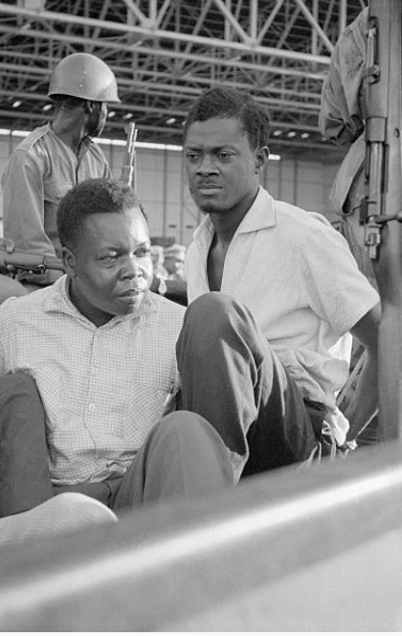
1. Mobutu’s coup and Lumumba’s Assasination
US: Lumumba as “Castro or worse”
14 September 1960: Mobutu ousts Lumumba
17 January 1961: Lumumba murdered by Katangese enemies

Slide 10
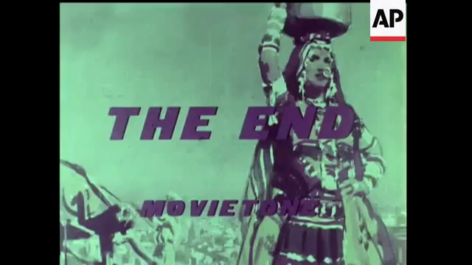
Consequences: Rise of Anti-American Sentiment

Slide 11
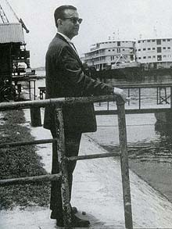
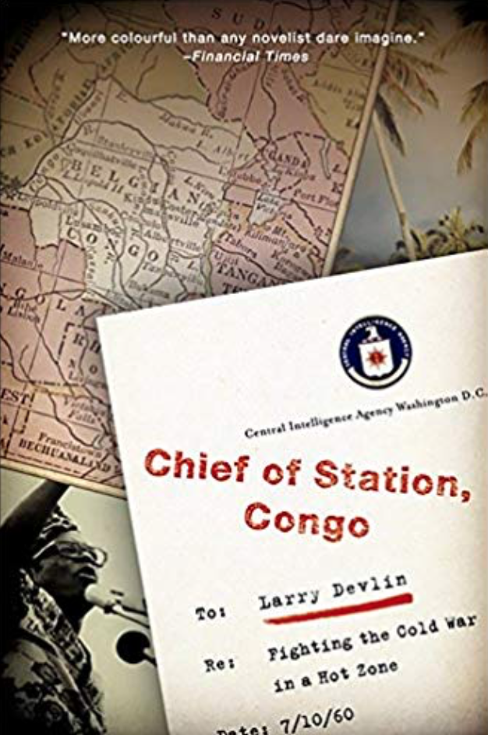
Consequences: Concerns over Cold War Interventions and Subversion
Larry Devlin: CIA chief of Station in Leopoldville (Kinshasa), 1960
Devlin: Eisenhower authorized to poison Lumumba

Slide 12
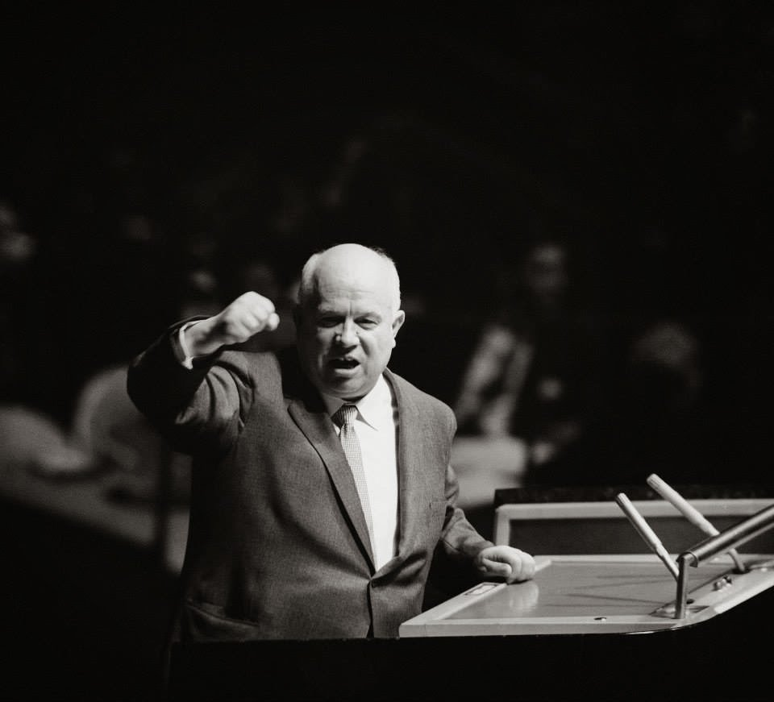
Consequences: UN Reform
Khrushchev calls for radical UN reform
UN eventually address dominance of Western personnel at Secretariat
Influence UN missions (Iandolo)
Nikita Khrushchev at the UN, September 1960

Slide 13
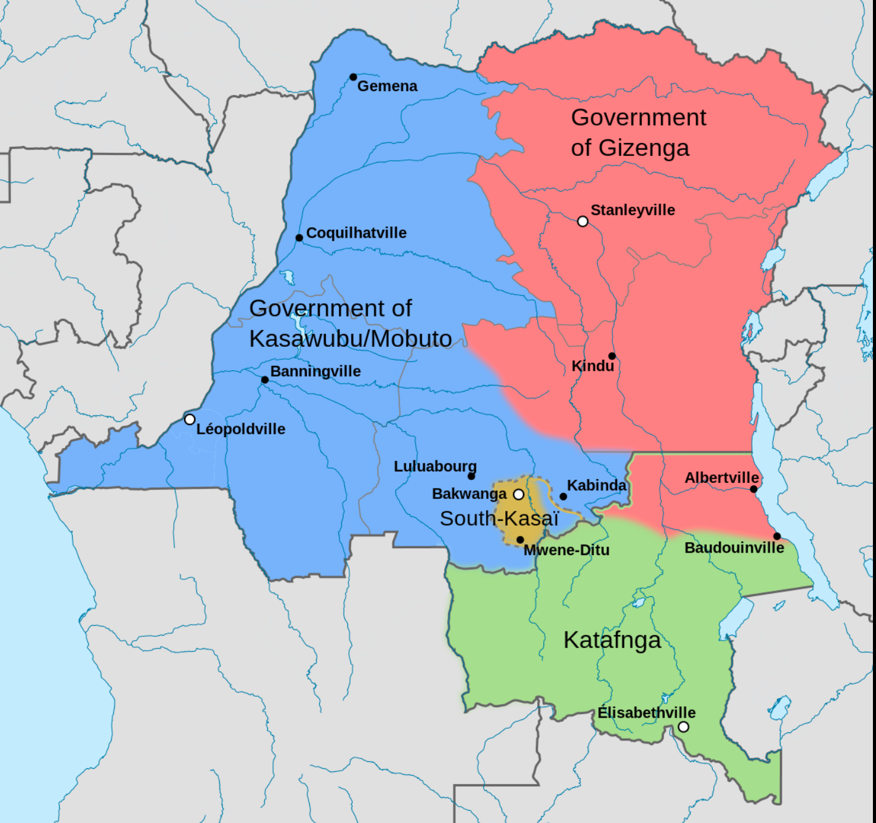
2. Kennedy’s New Policy: Compromise at Lovanium, August 1961
January 1961: Congo divided between rivals forces
1961: Lovanium Conference: compromise reached,
BUT!
Real Power with Mobutu
Congo’s Division, January 1961

Slide 14
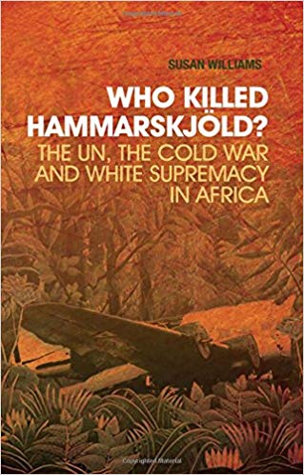
2. 2. Kennedy’s New Policy: End to Katanga’s Secession
Kennedy and Hammarskjold support end to Katanga’s session
18 September 1961: Hammarskjold dies in a plane crash close to Ndola
Susan Williams: “Who Killed Hammarskjöld”
End of 1963: Katanga’s Rebellion brought to an end—Mobutu’s power increases

Slide 15
3. Simba Rebellions, 1963-1965
End of 1963: ‘Simba rebellions’ begin
July 1964: Tshombe returns as PM

Slide 16
3. Operation Dragon Rouge – Stanleyville, November 1964

Slide 17
3. Che Guevara in the Congo: April-June 1965

Slide 18
Conclusion: Congo Crisis as Turning Point for CW in Africa
US intervention and support for anti-communist ‘strongmen’. Rise of Mobutu
Soviets disillusioned with ‘peaceful competition’
→militarisation of the Cold War in Africa
Fears of Neo-Colonialism and Calls for African Unity
Borders –> OAU, 1963

