Slide 1
Searching for alternatives
Bandung, pan-Africanism, and non-alignment

Slide 2
Lecture Outline
Bandung
Non-Aligned Movement
Pan-Africanism
4. Problems
5. Conclusion

Slide 3
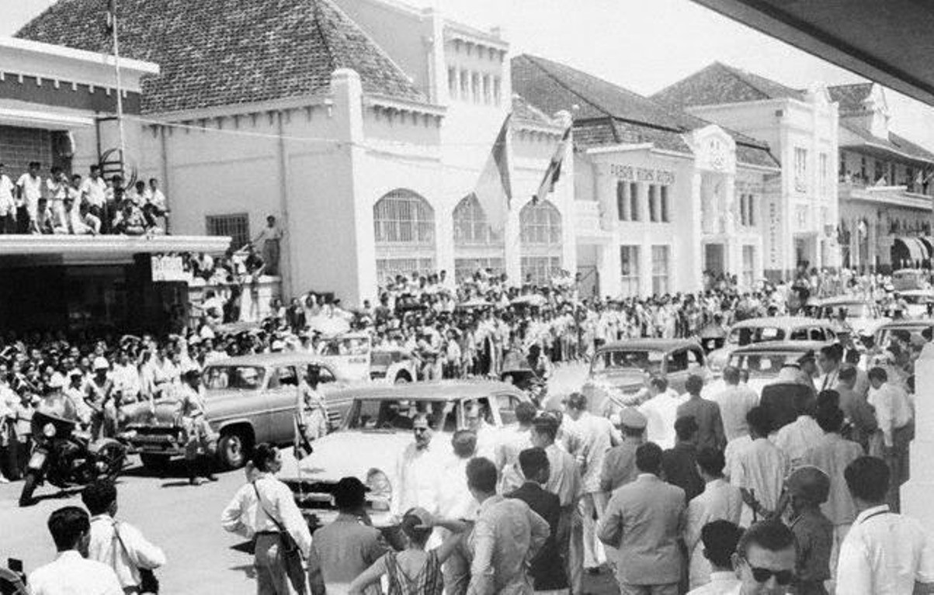
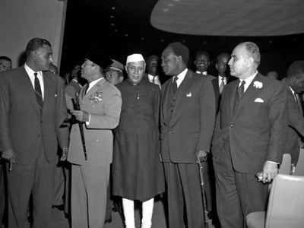
1. Bandung Conference: April 18-24, 1955
Bandung, Indonesia
Left to right: Nasser, Sukarno, Neru, and Nkrumah at Bandung
Bandung: 29 states, representing 1.4 billion people
Sub-Saharan Africa under-represented

Slide 4
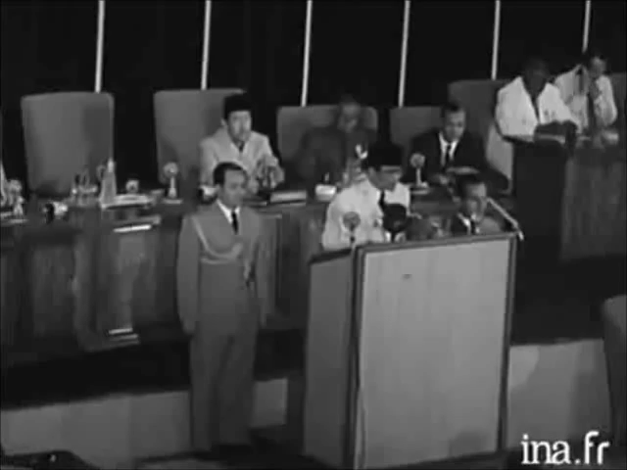
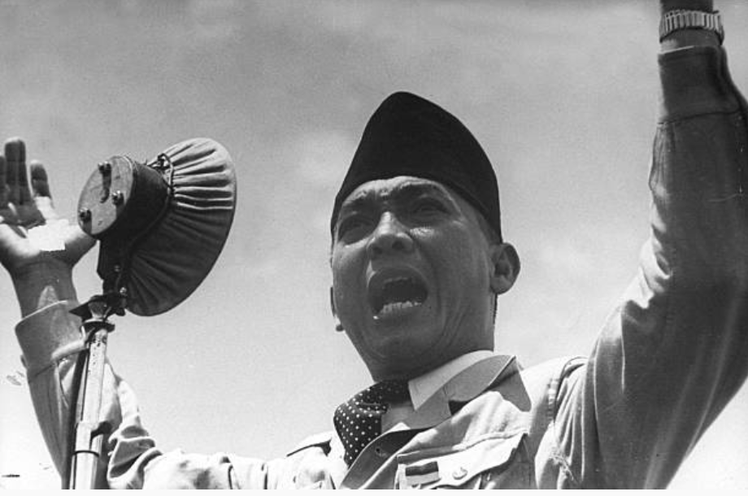
1. Bandung: Sukarno
Video: Sukarno opens the Bandung conference, 1955
Sukarno (1901 –1970)
We are united by a common detestation of colonialism in whatever form it appears. We are united by a common detestation of racialism. And we are united by a common determination to preserve and stabilize peace in the world- Sukarno at Bandung

Slide 5
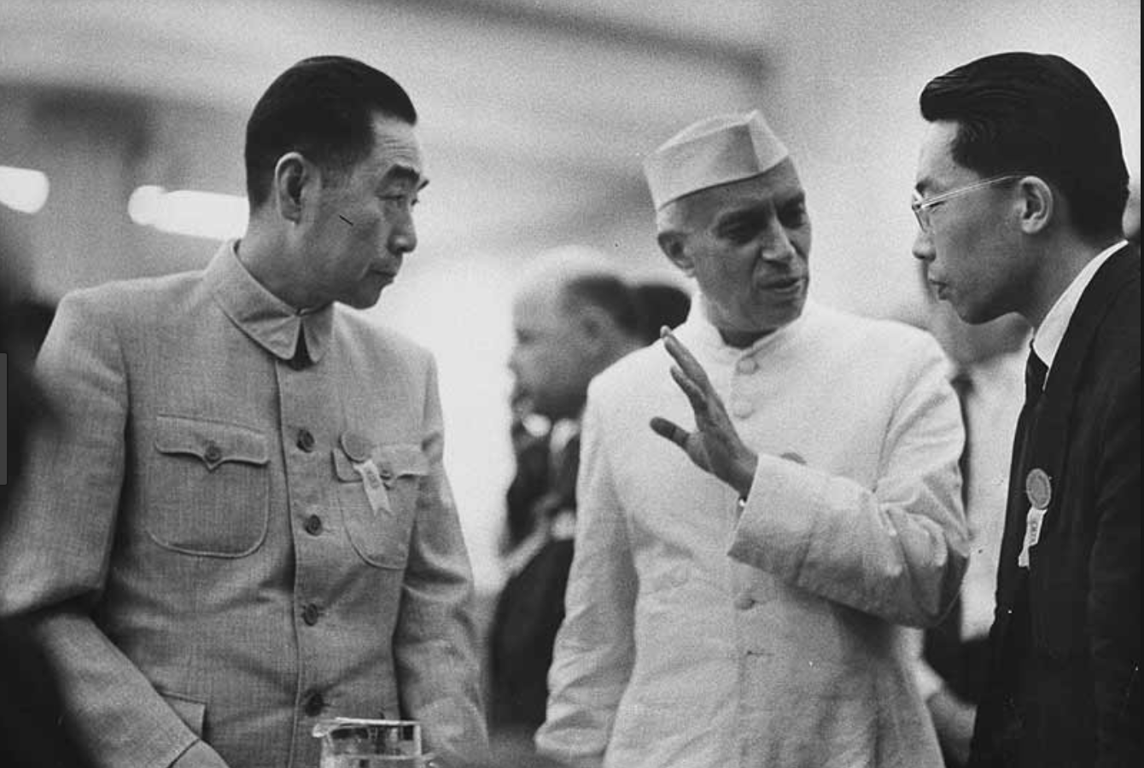
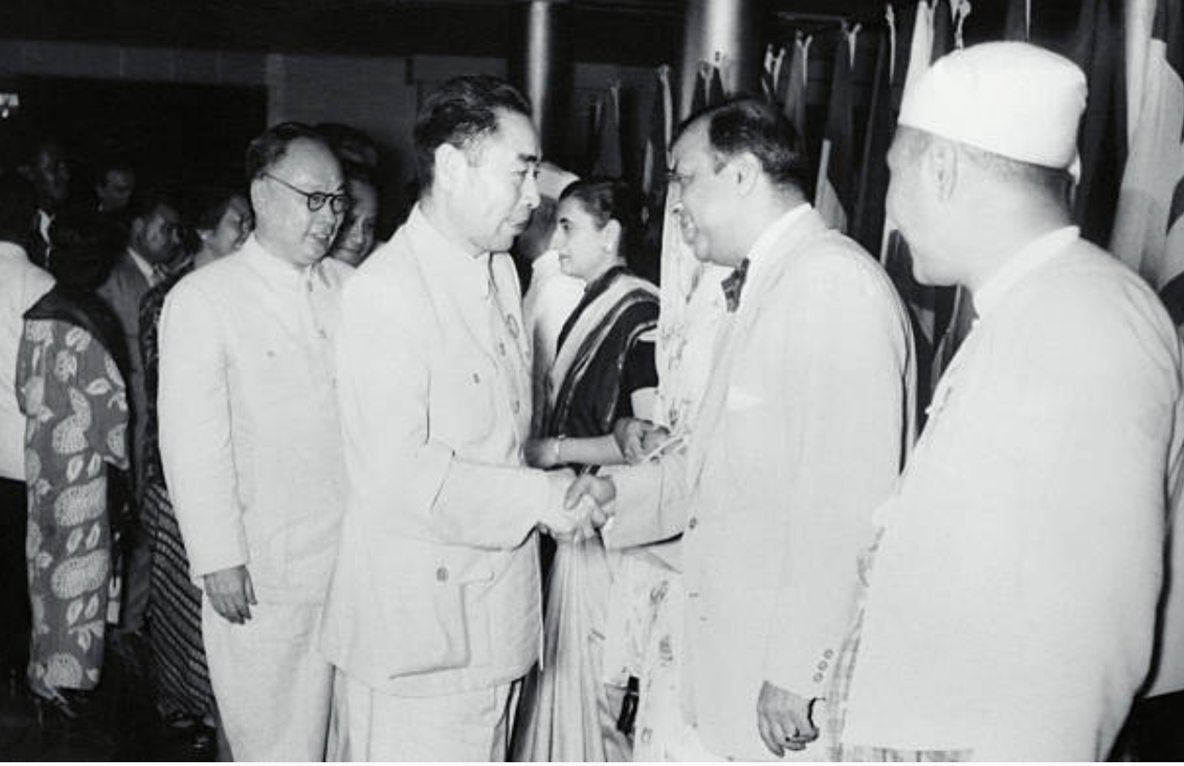
1. Bandung: Divergent Views
Left to right: Chou Enlai, Jawaharlal Nehru and translator at Bandung, 1955
Left to right: Chou Enlai shaking hands with Pakistan’s Prime Minister Muhammad Ali

Slide 6
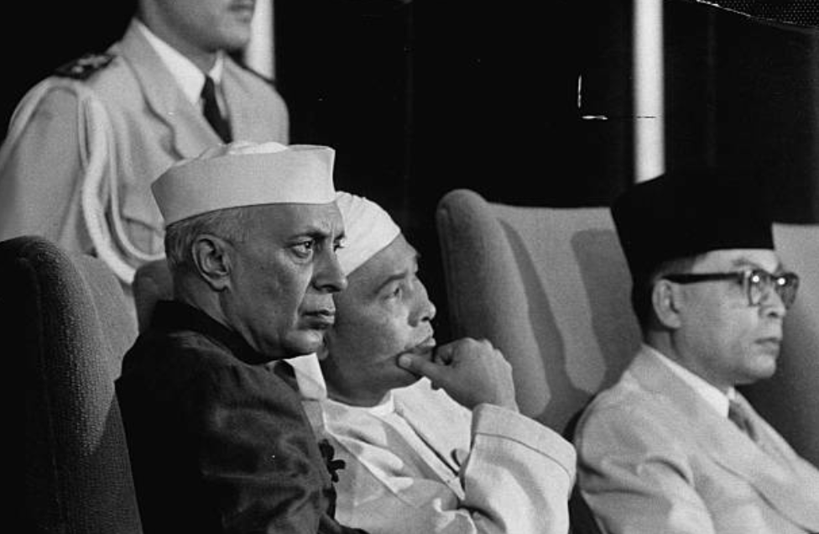
1. Bandung: Nehru
“If all the world were to be divided up between these two big blocs what would be the result? The inevitable result would be war. Therefore every step that takes place in reducing that area in the world which may be called the “unaligned area” is a dangerous step and leads to war – Nehru at Bandung
Left to right: Nehru with Sukarno (black hat) at Bandung

Slide 7
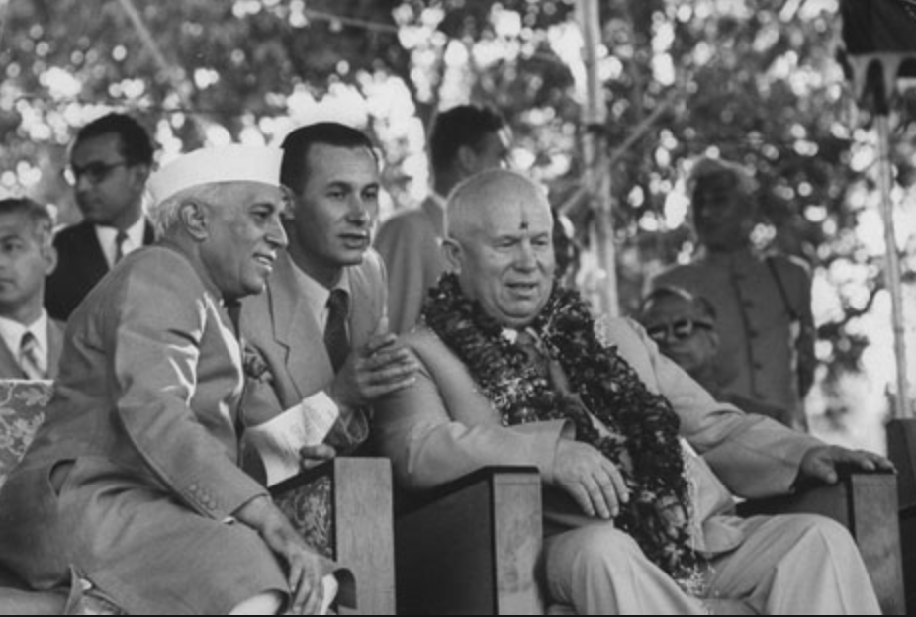
1. Bandung: Reaction of the Soviet Union and the US
Soviet Union: publicly supportive, but tried to dominate forums such as the
Afro-Asian People’s Solidarity Organisation ( Cairo, 1957)
USA: openly hostile
Nehru with Khrushchev in India, 1955

Slide 8
1. Bandung: Key Outcomes
Albert Sauvy and the ‘Third World’
Emergence of China as ‘anti-imperialist state’
Origins of Afro-Asian bloc at the UN
Principles of disarmament, human rights and non-intervention → charter of the International Atomic Energy Agency, 1957
Aspirations for economic and cultural cooperation →Creation of Organization of the Petroleum Exporting (OPEC) in 1960

Slide 9
2. Non-Aligned Movement: Brioni Meeting, July 1956
The new ‘big three:’ Nasser, Nehru, and Tito in Brioni, 1956

Slide 10
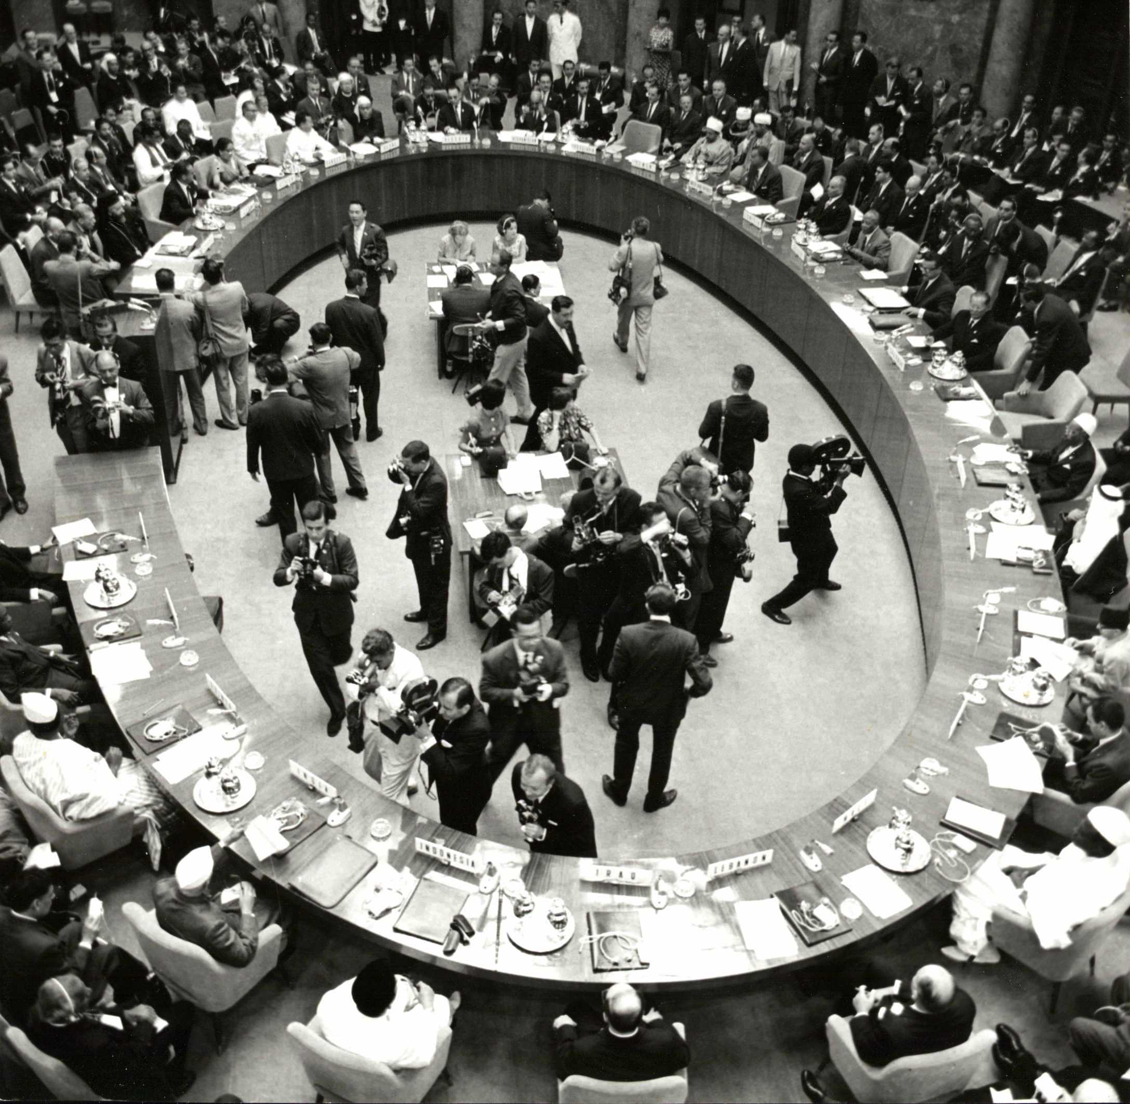
2. Non-Aligned Movement: Belgrade, 1961
September 1961: Meeting of non-aligned states in Belgrade, Yugoslavia
Disagreements
What is the connection between Bandung and Belgrade?

Slide 11
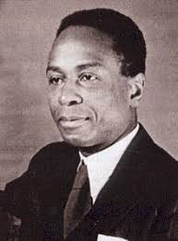
3. Pan-Africanism: Origins
W. E. B. du Bois and the Pan-African Congress (Paris, 1919)
Marcus Garvey: ‘Africa for the Africans’
George Padmore: Africans should liberate themselves
Pan-African Congress, 1945
George Padmore (1903-1959)

Slide 12
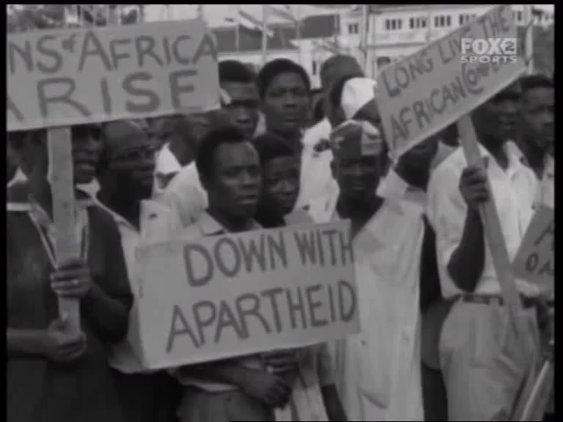
3. Pan-Africanism and Kwame Nkrumah
First All-African Peoples’ Conference in Accra, Ghana, 1958 (video)
Divisions:
  ‘Casablanca group’: Morocco, the Algerian FLN, Egypt, Libya, Ghana, Guinea, and Mali vs. Monrovia group
  ‘Monrovia group’: Liberia, Nigeria, and most Francophone sub-Saharan states.
1963: Organisation of African Unity (OAU), founded in Addis Ababa, Ethiopia. Victory of conservatives
Was Manchester Congress the highpoint of Pan-Africanism?
Video: Nkrumah at the First All-African People’s Conference in Accra, Ghana in 1958

Slide 13
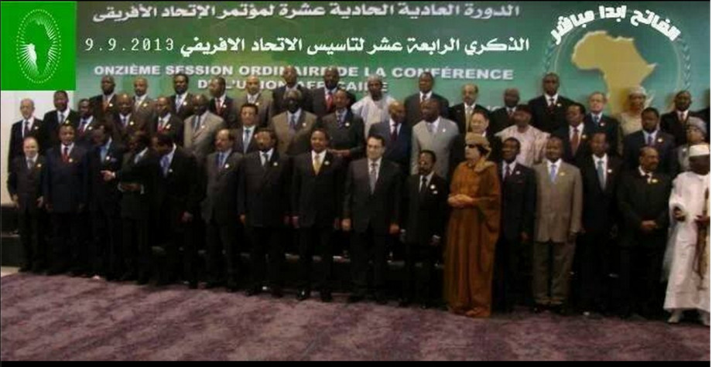
Sirte Declaration
3. Pan-Africanism: Modern Manifestations
OAU (1963) → African Union (2001). Sirte Declaration

Slide 14
4. Problems
Divisions (e.g. Sino-Indian border war, 1962)
Coups
Support from the superpowers: opportunities, but also risks (e.g. Lumumba in the Congo)
Economic realities

Slide 15
Conclusions
Was Bandung and Non-Aligned Movement responses to the Cold War?
Yes, but need to look at pre-war trends, spread of mass communications, Afro-Asian connections (globalisation?)
As political projects, pan-Africanism, Afro-Asianism, and non-alignment all failed… but what was their wider significance?
Take ideas seriously, but avoid romanticism (Vitalis)

