Slide 1
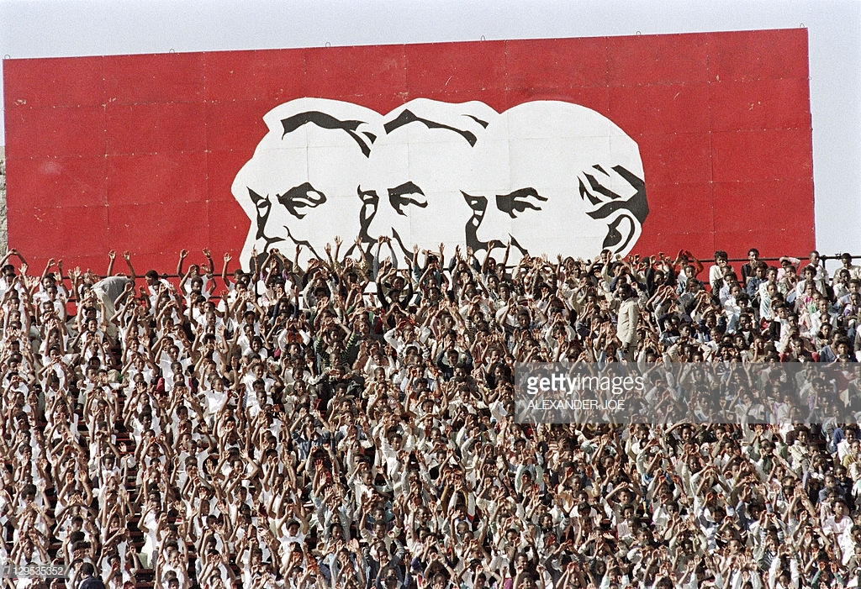
HI277 | Africa and the Cold War
Term 2 | Week 12
Dr Natalia Telepneva
Pic: Supporters celebrate 13th anniversary of Ethiopian Revolution, 13 September 1987
Notes:
Efforts to relax tensions with the Iron Curtain had begun in Europe in the late 1960s, where the West German chancellor, Willy Brandt, proposed a series of openings to USSR and East Germany. What Brandt wanted was, at first, durable peace in Europe and eventually German unification. Brandt’s Ostpolitik (Eastern policy) included a series of approaches to the Soviet Union, Poland and East Germany. The emphasiswas on reconciliation, which was simbolied by Branddt falling to his knees in front of the Nazi-era monument to the Warsaw Ghetto uprising. Ostpoitik led to West Germany formally recognizing its border with Poland and the formal recognition of the GDR.
These developments in Europe coincided with superpower détente. The Soviet Gen Secretary Leonid Brezhnev experienced horrors of war first hand and he was keen to deescalate tensions with the United States. The main issue was arms control. After several years of intensive talks, in 1972, Nixon and Brezhnev signed an agreement to limit the build-up of antiballistic missiles, the Strategic Arms Limitation Treaty (SALT I).

Slide 2
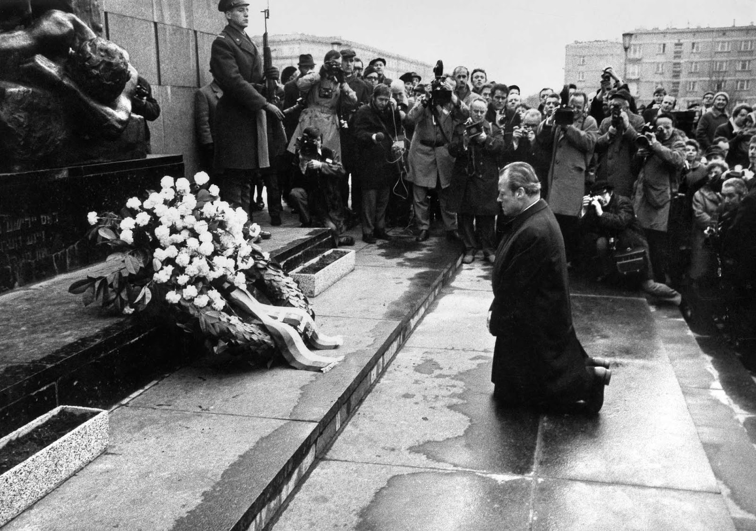
Context: Detente
7 December 1970: West German Chancellor Willy Brandt falls to his knees in front of the monument of the Nazi-Era Warsaw Ghetto Uprising, Warsaw.
May 26, 1972, in Moscow: US President Richard Nixon and Gen. Secretary Leonid Brezhnev sign SALT I agreement

Slide 3
Key Questions/Debates
Dilemma: Why did the superpowers intervene in Africa, détente notwithstanding?
What was the nature of revolutionary regimes?
How did interventions in Africa affect détente?

Slide 4
Lecture Outline
Ethiopia
Somalia
Superpowers in the Horn of Africa
Ethiopian Revolution, 1974

Slide 5
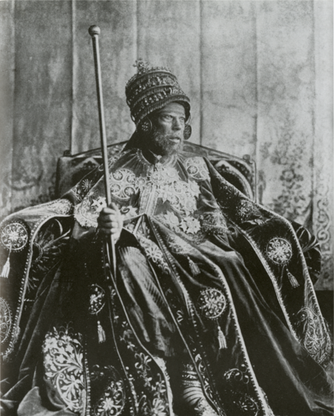
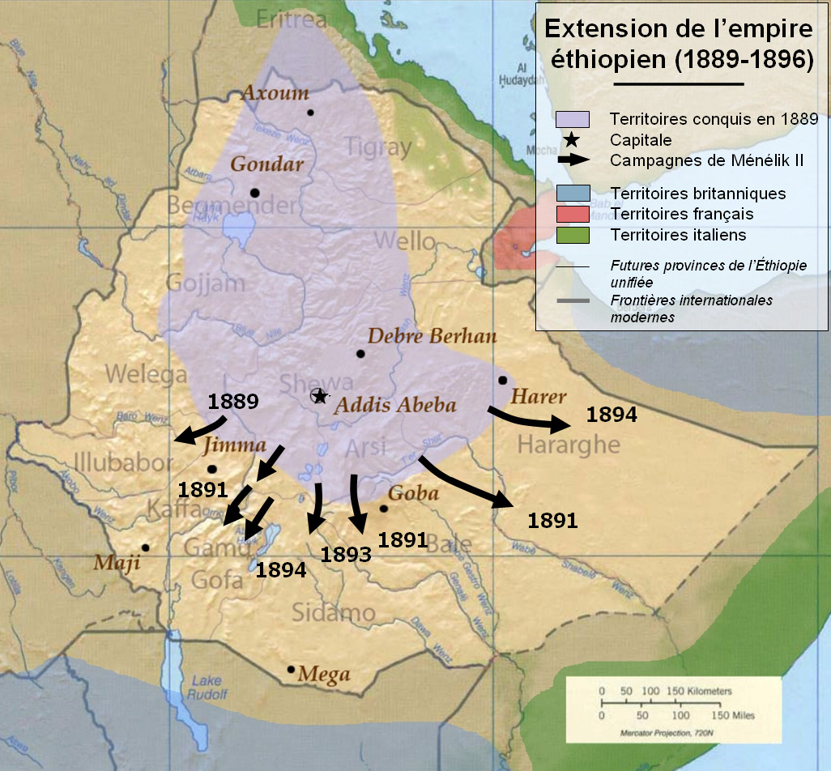
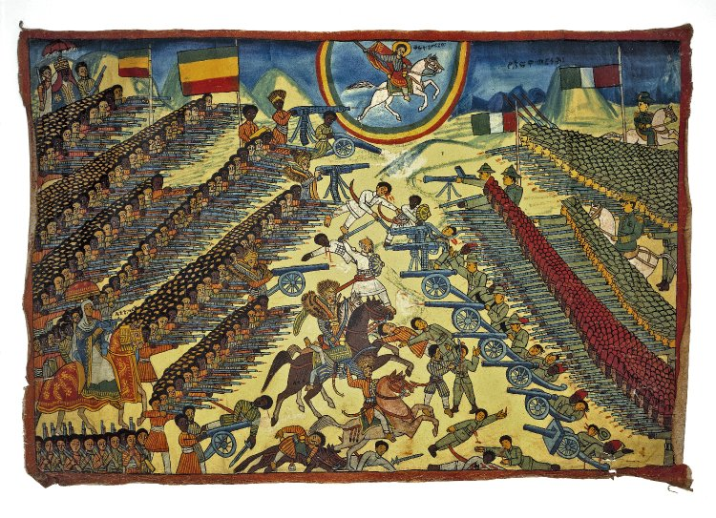
1. Imperial Ethiopia
Menelik II, 1889 -1913.
Bottom right: Ethiopian representation of the Battle of Adwa (1896). British Museum
Expansion of the Ethiopian Empire under Menelik II
Notes:
The lands that are currently Ethiopia saw some of the earliest human settlement and development of a centralised polity centred on Aksum. In the 13th century, rule over Ethiopia was assumed by the Christian Solomonic dynasty who claimed their descent from King Solomon and the Queen of Sheba.
Italy; Battle of Adwa 1896
Menelik II aspired to a Modern Ethiopia. He oversaw the building of a railway, a modern capital city in Addis Ababa, a banking and a communications infrastructure.

Slide 6
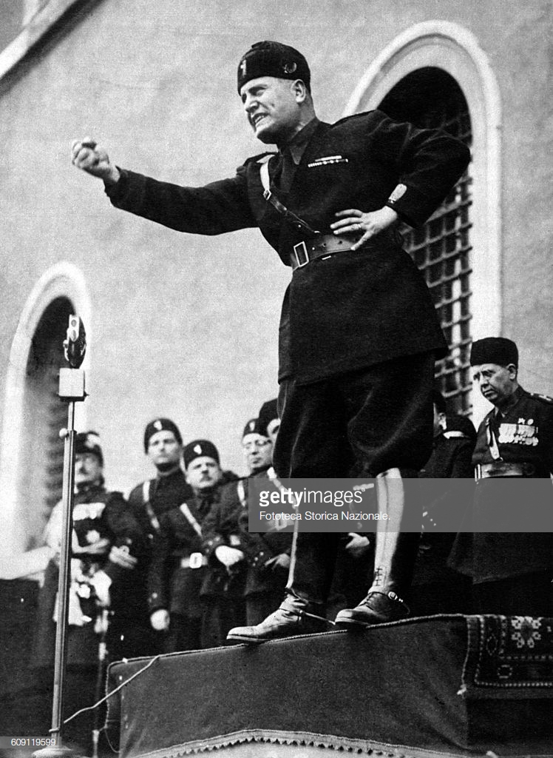
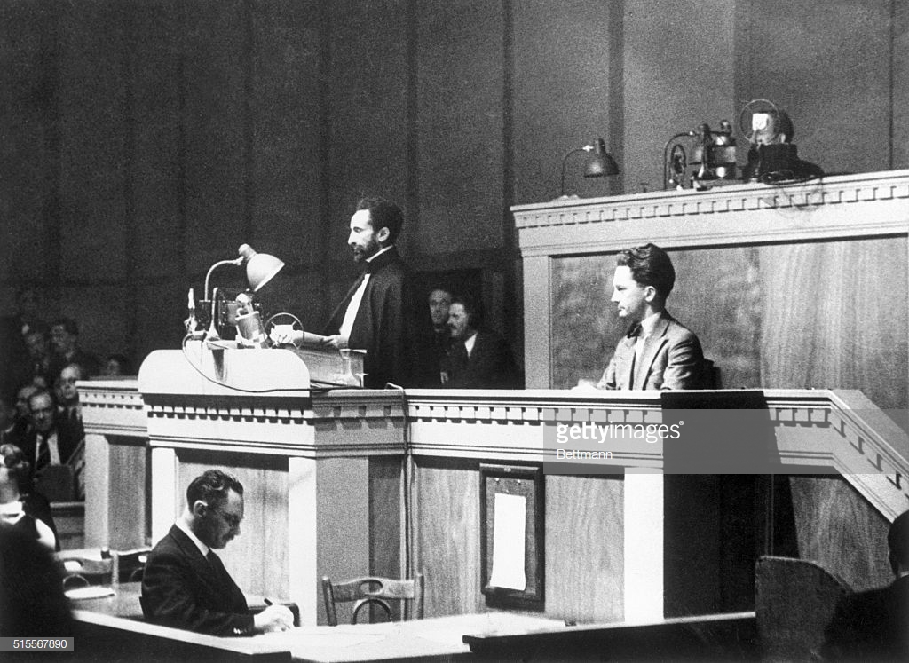
1. Italian Invasion
Left: Benito Mussolini announces Italy’s invasion of Ethiopia by Italy ( Rome, October 3, 1935
Right: Emperor Haile Selassie argues for protection at the League of Nations, 1936
Notes:
October 1935: Italy under Mussolini invade Ethiopia under a pretext; this time a much more mechanized army
Haile Selassie leaves the country; goes and presents his case at the UN
Importance of ‘hands off Ethiopia’ movement; sparks anti-colonial activism across the world, incl. George Padmore in London

Slide 7
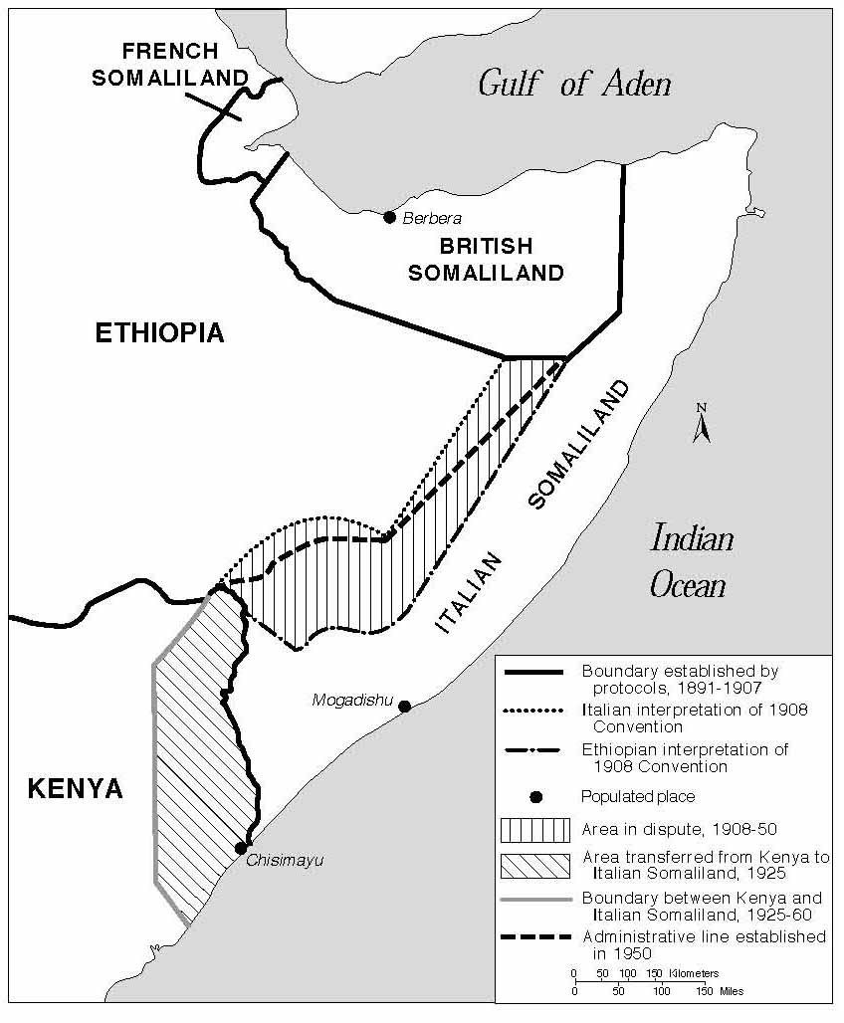
2. Somalia: Colonial Division
Division of Somalian peninsula, 19th century:
  French Somaliland (1883-1967)—Djibouti (1967)
  British Somaliland (1988-1960).
  Italian Somaliland (1880s-1960 with exception of WW2)
  1 July 1960: Somalia becomes independence (merger of British Somaliland and Italian Somalia)
Notes:
1960, Independence. Somalia became an independent country in 1960, as a result of merger of British Somaliland and Italian Somalia. The first Prime Minister of Somalia was Abdirashid Ali Shermarke, the leader of the Somalia Youth League (SYL). However, the new government was deeply dissatisfied with the post-colonial settlement. Somalia disputed and committed itself to the idea of ‘GREATER SOMALIA’
Somalis beyond Somalia: in Djibouti, northeasters Kenya, and a desert known as the Ogaden.
1946: British propose to establish ‘greater Somalia’ –this proposal taken up by the Somali Youth League (1941). More information in Cedric Barnes

Slide 8
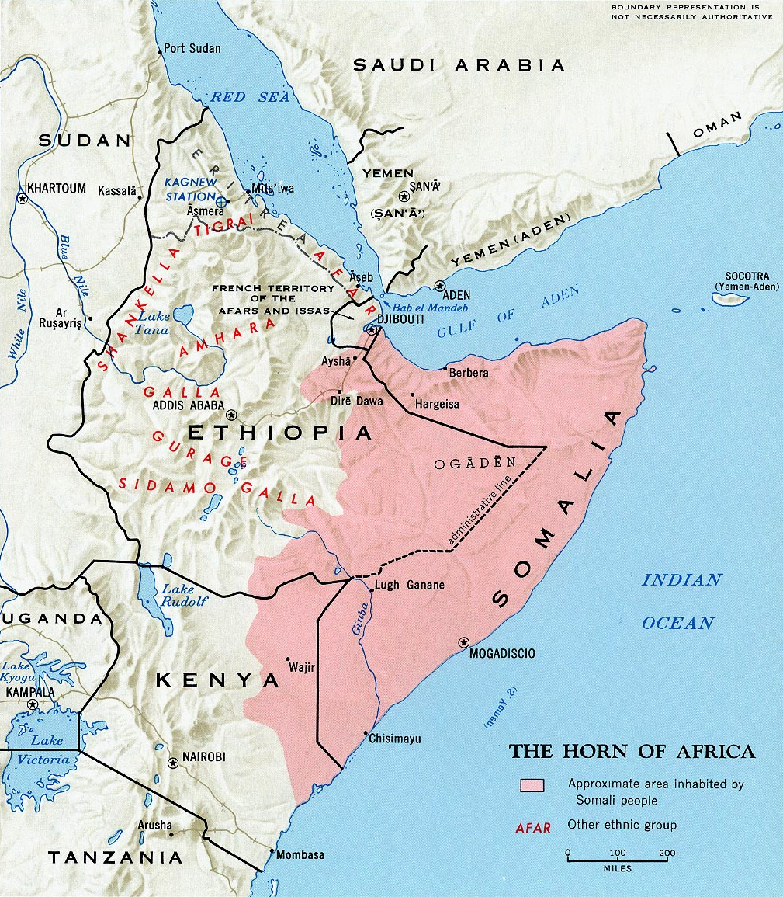
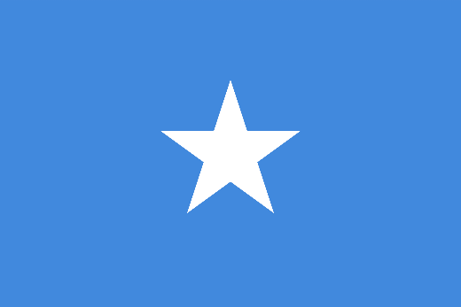
2. Somalia: In Search of a Nation
Somali Youth League and ‘Greater Somalia’ Idea
Somali flag: unity of southern Somalia, northeast Kenya, Ogaden, Djibouti, and British Somaliland
Conflicts over Borders:
‘Shifta War’ with Kenya (1963-1967)
Ethiopian-Somali Border War (1964)
Shaded area indicates areas inhabited by Somali people. Top right: Somali national flag
Notes:
Somalia – in search of a nation
The present day state of Somalia was governed by multiple European powers during the first half of the nineteenth century.
Italy governed Italian Somaliland (South Somalia) until the Second World War, when it was handed to the British.
French Somaliland, near the mouth of the Red Sea, did not become independent until 1967, under the name of Djibouti.
Five points on Somali flag: Southern Somalia, Somaliland, Djibouti, Northeastern Kenya (Northern Frontier District), Ogaden = a commitment to irredentism to unite the Somali nation and to take territory from three of its neighbours, thereby disrupting sovereignty.
Recall here with the establishment of the OAU in 1963, colonial borders were declared to be inviolable; no intervention in the internal affairs of other independent states. Support for a ‘Greater Somaliland’ threatened this.
From 1960 onwards, Somalia provided support for liberation movements in the Ogaden region of Ethiopia; the Somali military operated here under the guise of rebels. Ethiopia retaliated and supported rebel groups in Somalia.
In the run up to independence in neighbouring Kenya, the government there toyed with idea of allowing Northern Frontier District to be given to Somalia. In 1961, this was put to a plebiscite. British tried to placate Somalia because the Soviet Union was supporting Mogadishu, since it had an interest in deep water ports on the East African coast. But Kenya’s leading political parties decided against any secession.
In the plebiscite, 87% voted to join Somalia, prompted a British u-turn and the outbreak of the Shifta War, in which the rebels were supported by the Somali government.
So again, we have a problem of borders and national sovereignty in post-colonial Africa – like we saw in Congo.

Slide 9
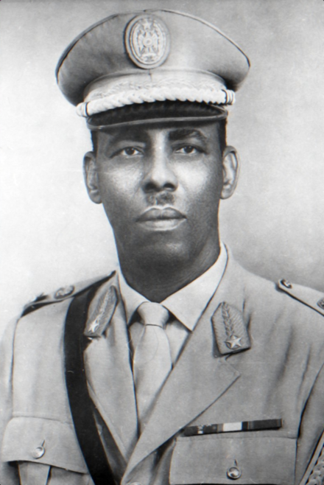
2. Somalia under Siad Barre
October 1969: Military Coup. Siad Barre in power (1969-1991
‘Scientific socialism’ in Somalia
Police State and pan-Somali Nationalism
Military portrait of Major General Mohamed Siad Barre, c. 1970
Notes:
Between 1960 and 1968, Somalia was described as Africa’s most democratic country; large numbers of elections; high turnout. But the government was also corrupt and dogged by rivalries among the clans.
In October 1969, Somalia’s president, Abdirashid Ali Shermarke, was assassinated. This was followed by a military coup. The parliamentary system was replaced with the Supreme Revolutionary Council, headed by Siad Barre, an Italian-trained soldier.
Scientific socialism in Somalia’: partial nationalisation, but ownership of livestock and bananas in private hands; war against ‘tribalism’
Police State:

Slide 10
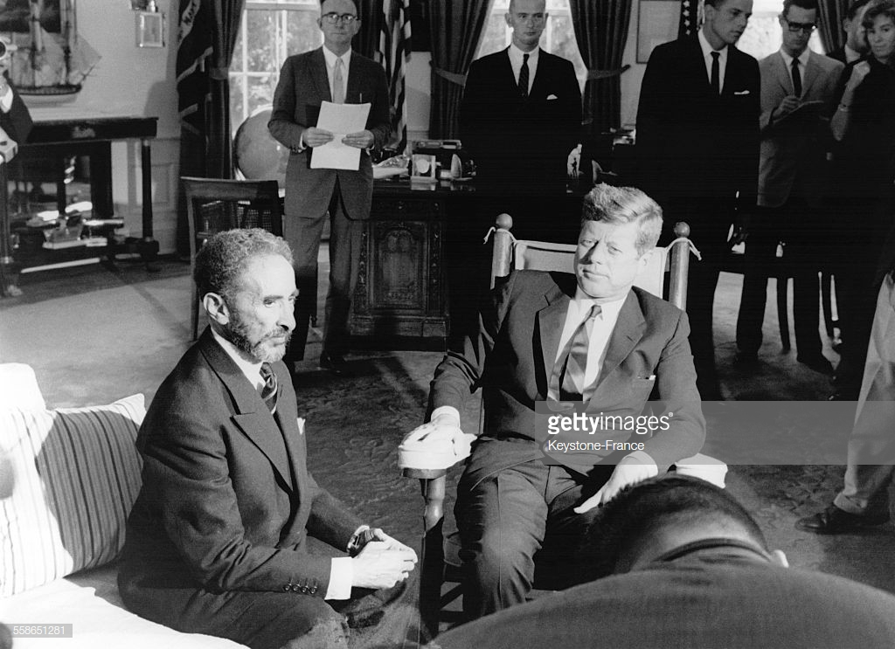
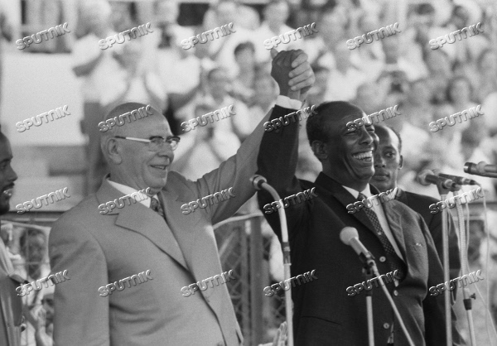
3. Superpowers and the Arms Race in the Horn of Africa
6 October 1963: Emperor Haile Selassie with Kennedy in the Oval Office, Washington
14 July 1973: Siad Barre with the Chairman of the Soviet Supreme Soviet, Nikolai Podgornyi, in Somalia
US: geopolitical (access to Red Sea and Gulf of Aden); Kagnew station (Asmara, Eritrea)
USSR: geopolitical, counter US influence in Ethiopia. Increased support for Barre
Notes:
USA: To the USA, the strategic importance was more important that that of Somalia because of the Kagnew listening post. Located new Asmara, in present-day Eritrea, Kagnew was a very valuable facility at a strategic crossroads. The USA really needed access to Kagnew and therefore they:
supported Ethiopia’s claims on Eritrea
provided increasing amounts of arms to Ethiopia (Lefebre)
USSR: aware about strategic importance of the region; start arming the Somalis (1963), engaged in other modernistion projects
Barre’s coming to power: Soviet aid increased, after initial reluctance (importance of ‘ideological inclination’)

Slide 11
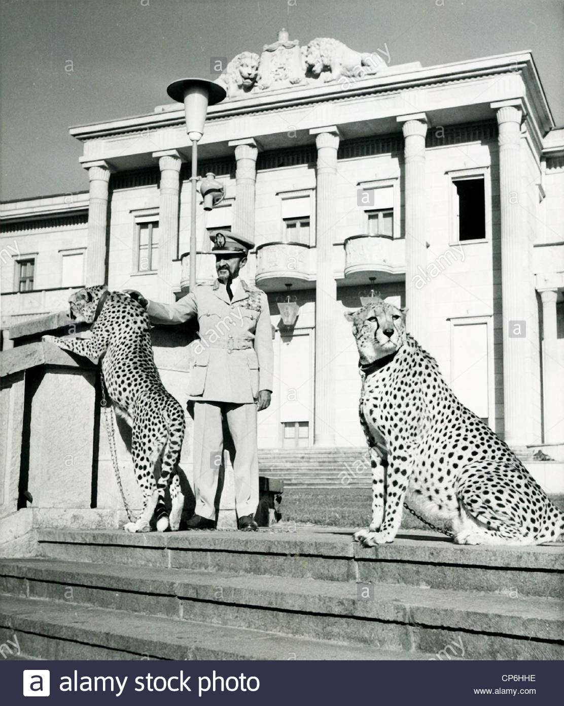
4. The Ethiopian Revolution, 1974: Reasons
Feudal system – land owned by aristocracy
Internal war against Eritrean People’s Liberation Front (EPLF), which received Soviet and Cuban support
Growth of Western-educated middle-class in Addis. Marxist views
Famine in Sahel Belt, 1972-73
1973 oil crisis: balance of payments crisis→ rise in prices, decline in wages
Emperor Haile Selassie of Ethiopia with Pet Cheetahs at Palace
Notes:
Ethiopia under the emperor
The Ethiopian state was headed by the aging, remote figure of Emperor Haile Selassie, who oversaw what was essentially a feudal, autocratic system. Land was owned by an aristocracy that owed its personal loyalty to the emperor.
29 million of the 32 million-strong population were tenant farmers, who worked the land of others for little reward. Much of their produce went to the landowners in the form of rent. Many had to work the land of the aristocracy as unpaid labour.
While the regime talked of American-style modernisation, there was little agricultural development, nor much incentive for the peasantry to produce more. Only two percent of the national budget was allocated to supporting farmers.
Internal wars against insurgency against Eritrea People’s Liberation Front (EPLF), a Marxist group that received support from Somalia, as well as the Soviet Union, Cuba, and East Germany.
Disastrous famine which swept over the Sahel belt – killed maybe 200,000 Ethiopian peasants in 1972-3 – but largely hidden from the public because of government controls on the press.
Then the impact of the 1973 oil crisis, as discussed in the previous class on military regimes.
In face of mounting economic difficulties, Haile Selassie remained intransigent- 1972 opulent birthday celebration; see Ryszard Kapuscinski, The EMPEROR
Student radicalism
Growth of a Marxist intelligentsia in Addis Ababa, influenced by Marxism in Western Europe rather than Eastern Europe.
Beginning with the ‘Crocodile Society’ in the early 1960s, students called for political and economic reforms, especially on the key land issue to end the feudal system.
Protest was concentrated in the urban centre of Addis Ababa.
Land issue: 29 million of the 32 million-strong population were tenant farmers, who worked the land of others for little reward. Much of their produce went to the landowners in the form of rent. Many had to work the land of the aristocracy as unpaid labour.
Little agricultural development
Growth of Marxist intelligentsia, ‘Crocodile society’, many educated in the west
Severe economic crisis

Slide 12
4. The Ethiopian Revolution, 1974: Outline
January
  army mutinies
  street protests in Addis Ababa, involving students and taxi drivers
February
  Haile Selassie announces concessions to student demands
  establishment of army committee, dominated by young, radical junior officers
March-May
  waves of general strikes in Addis Ababa
June
  formal establishment of the Derg – committee of junior officers
September
  documentary film The Unknown Famine broadcast on Ethiopian television
  formation of Provisional Military Administrative Council (PMAC)
  Derg decides to arrest Haile Selassie – killed in 1975
Notes:
January 1974 – army mutinies demonstrate fragile nature of the regime.
Student discontent at political backwardness and deteriorating economic crisis spread to other sectors in Addis Ababa – joined by taxi drivers, who brought the city to a standstill.
February 1974: emperor promised in a TV and radio address that many of the protesters’ demands would be met and increased army pay.
However, it was too late – the imperial regime’s authority was threadbare and the army became increasingly assertive in political affairs. An army committee was set up – designed as a coordinating committee, dominated by younger members of the military, with more radical inclinations.
March 1974 – huge general strike in Addis, to which the government lacked the ability to offer a satisfactory response. Its power gradually ebbed away to the army committee. In June, this committee was formally established as the Derg.
Haile Selassie seemed oblivious to the disintegration of his crumbling edifice of power. During the height of the famine, the British journalist Jonathan Dimbleby made a documentary called The Unknown Famine, which detailed the devastation wrought by the famine and the negligence of the imperial government. In September, an edited version of the film was shown on Ethiopian television, which effectively set images of starvation alongside clips of the emperor feeding meat to his pet dogs and lions. This created outrage among the middle classes.
The day after the film was broadcast, the Derg formed the Provisional Military Administrative Council (PMAC) to replace the government. Haile Selassie was taken from his palace in the back of an old Volkswagen Beetle. He was never seen again. In 1975, he was killed by the new military regime and his body was buried in an unknown location.

Slide 13
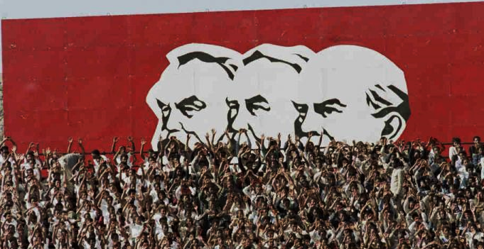
4. The Derg in power: a Marxist regime?
Early 1975: Mengistu announces ‘National Democratic Revolution’: nationalisation of banks, industry, businesses
March 1975: Derg nationalised all land
‘Live Aid’ famine of early 1980s > mass villagisation scheme
Notes:
The Derg in power
The revolution did not end with the death of the emperor. The years that followed were characterised by infighting within the Derg and a series of purges.
The Derg moved steadily to the Left, appropriating the Marxist-Leninist ideology of the students and intelligentsia. At the same time, the students were marginalised from affairs and the military took complete control. Many students were sent to the countryside, to carry out revolutionary reforms – this had the effect of removing them from the capital.
In early 1975, the Derg nationalised banks, industry, and commercial enterprise. Mengistu proclaimed a ‘National Democratic Revolution’ which he claimed would create prerequisites for ‘scientific socialism’
In March 1975, the Derg nationalised all land. Yet with no effective administration or modernisation of agricultural practice, this proved a popular measure with disastrous consequences.
Derg’s policies contributed to the ‘Live Aid’ famine of the early 1980s, which were then used by the state to justify forced resettlement of the rural population into mass villages, where they could be more easily supervised by the state.
How Marxist was the Derg?
Mengistu et al had radical tendencies in early 1974, for sure. But their adoption of Marxism-Leninism was motivated to gain control of revolutionary discourse from the students.
Real debate among historians and political scientists about the Marxist character of the regime. Signs in Addis Ababa carried slogans like ‘The Victory of Socialism is Inevitable’ and ‘Proletarians of the World, Unite’, alongside paintings of Marx, Engels and Lenin. Did this represent genuine commitment to doctrine? Did it map onto to Soviet visions? Was it merely a strategy for political mobilisation and a justification for authoritarianism? A means of setting distance between the archaic regime of Haile Selassie and the new, modernising state led by Mengistu?

Slide 14
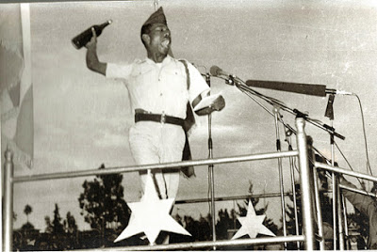
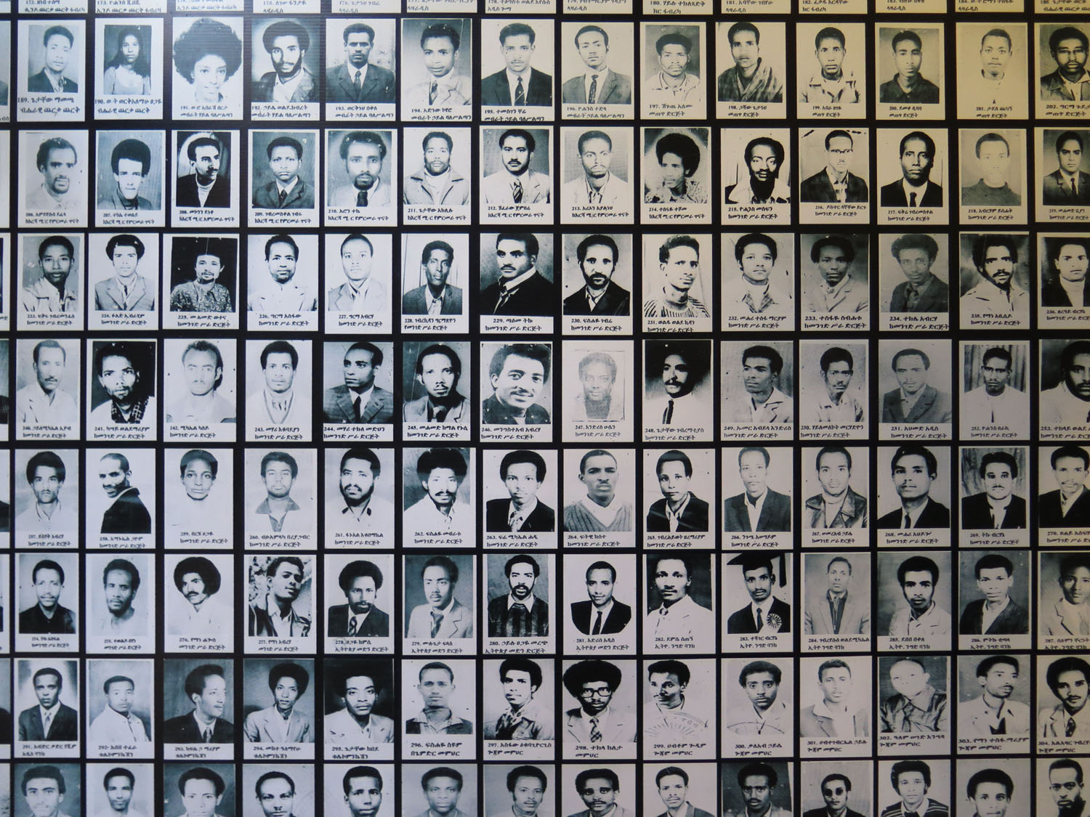
4. The Red Terror
April 17, 1977: Mengistu Haile Mariam makes a public speech and throws bottles with red liquid to authorise Red TERROR
Victims of Red Terror (Red Terror Museum, Addis Ababa)
Notes:
1977: Mengistu victorious after a palace coup. He proceeds to call for revolutionary violence with a violent speech in Addis Ababa. Throws bottles with red liquid.
Hereafter follows a bloody urban war – the ‘Red Terror, as opponents of the Derg were rounded up and executed. [Wiebel’s article)
By 1978: over, becomes more bureaucratised, changes the nature of Ethiopia (wiebel)

Slide 15
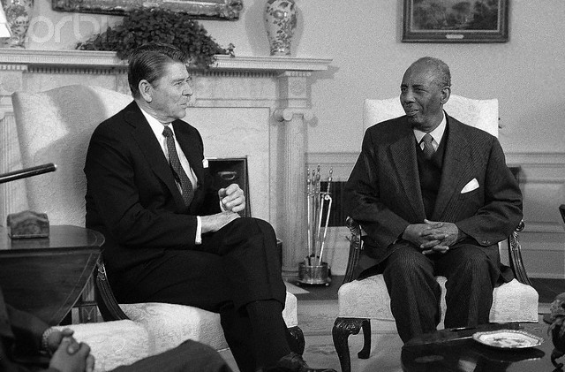
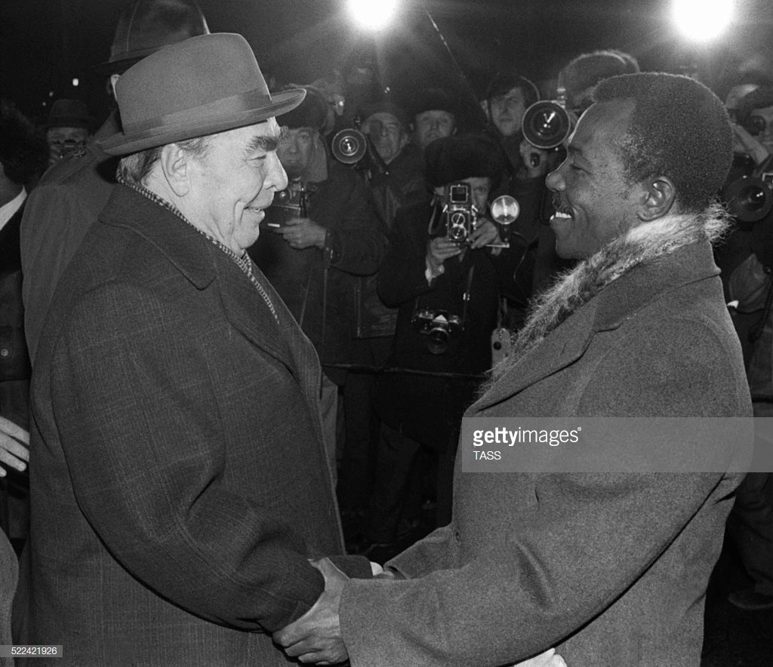
4. Superpower Response
Ronald Reagan with Siad Barre at the Oval Office, 11 March 1982
Brezhnev with Mengistu in USSR, 1978
Response: Both USSR and Soviet Union initially reluctant to embrace new partners. However, by 1978, they switch support
Notes:
The superpower response
The Soviet Union had initially been very wary of the new regime in Addis Ababa. As Westad shows, it was the Derg which approached Moscow first in 1974 – not the other way around. The Derg wanted a clean break with the imperial past and Haile Selassie’s reliance on the United States. An alliance with Moscow would also strengthen the Derg’s legitimacy within Ethiopia, especially given the existence of numerous rival left-wing groups in the country, before they were liquidated during the Red Terror.
However, the Soviet Union was reluctant to sacrifice relationship with Somalia + not sure about the nature of Ethiopian Regime. However, the Soviet embassy in Addis Ababa (Ambassador Ratanov) was impressed by the ideological approach undertaken by the Derg and supported its repeated requests for military support. As Mengistu eliminated his enemies, the Derg emerged as the single claimant of Marxist-Leninist leadership within Ethiopia. Moscow’s confidence in the regime grew.
United States and the emergence of human rights as a new approach to foreign policy, especially with the election of Jimmy Carter in 1977. In his inauguration speech, ‘Our commitment to human rights must be absolute. Because we are free we can never be indifferent to the fate of freedoms elsewhere. Our moral sense dictates a clearcut preference for those societies which share with us an abiding respect for individual human rights.’
Initially, the United States had supported the Derg, concerned about their relationship with a key regional ally, especially as Soviet arms kept arriving in Mogadishu. But the Red Terror proved a step too far.

Slide 16
Conclusions
Ideological Aspects. How Marxist-Leninist?
Deep roots of conflict, but made worse by colonial divisions and post-war settlment
Geopolitical significance of the Horn for the superpowers →increased leverage for local actors. Militarisation of Conflict

