Slide 1
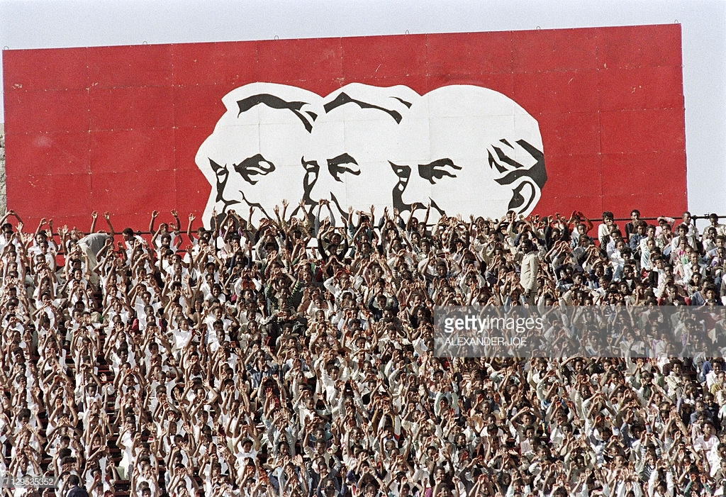
HI277 | Africa and the Cold War
Term 2 | Week 12
Dr Natalia Telepneva
Pic: Supporters celebrate 13th anniversary of Ethiopian Revolution, 13 September 1987
Notes:
Efforts to relax tensions with the Iron Curtain had begun in Europe in the late 1960s, where the West German chancellor, Willy Brandt, proposed a series of openings to USSR and East Germany. What Brandt wanted was, at first, durable peace in Europe and eventually German unification. Brandt’s Ostpolitik (Eastern policy) included a series of approaches to the Soviet Union, Poland and East Germany. The emphasiswas on reconciliation, which was simbolied by Branddt falling to his knees in front of the Nazi-era monument to the Warsaw Ghetto uprising. Ostpoitik led to West Germany formally recognizing its border with Poland and the formal recognition of the GDR.
These developments in Europe coincided with superpower détente. The Soviet Gen Secretary Leonid Brezhnev experienced horrors of war first hand and he was keen to deescalate tensions with the United States. The main issue was arms control. After several years of intensive talks, in 1972, Nixon and Brezhnev signed an agreement to limit the build-up of antiballistic missiles, the Strategic Arms Limitation Treaty (SALT I).

Slide 2
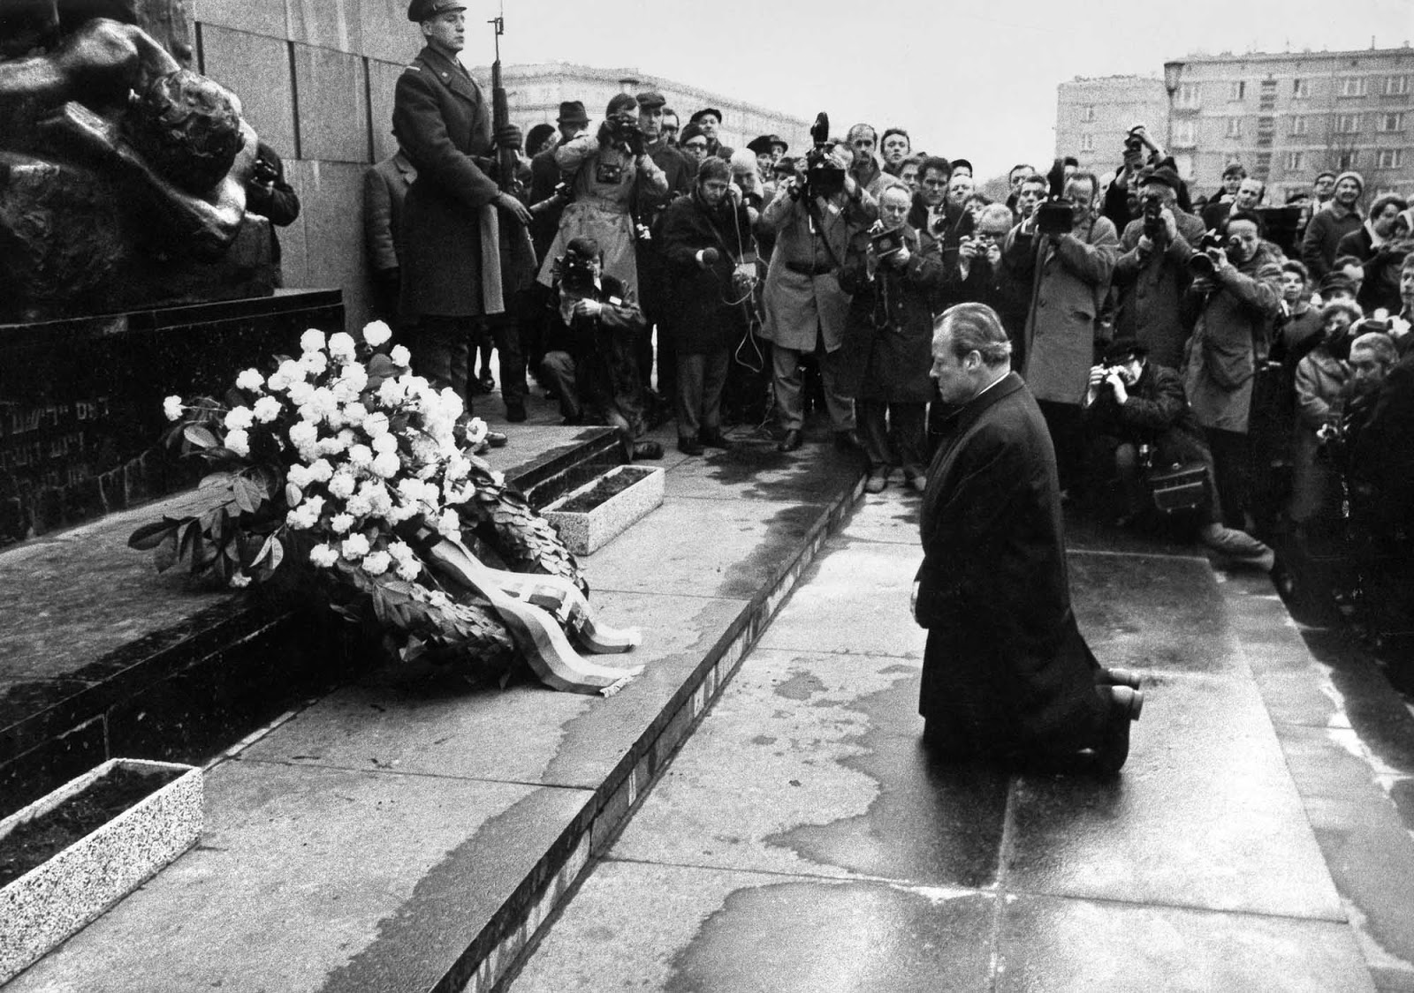
Context: Detente
7 December 1970: West German Chancellor Willy Brandt falls to his knees in front of the monument of the Nazi-Era Warsaw Ghetto Uprising, Warsaw.
May 26, 1972, in Moscow: US President Richard Nixon and Gen. Secretary Leonid Brezhnev sign SALT I agreement

Slide 3
Key Questions/Debates
Dilemma: Why did the superpowers intervene in Africa, détente notwithstanding?
What was the nature of revolutionary regimes?
How did interventions in Africa affect détente?

Slide 4
Lecture Outline
Ethiopia
Somalia
Superpowers in the Horn of Africa
Ethiopian Revolution, 1974

Slide 5
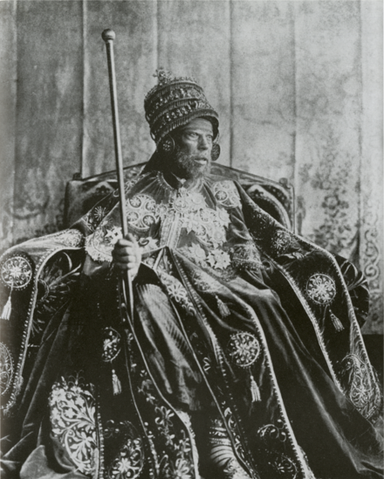
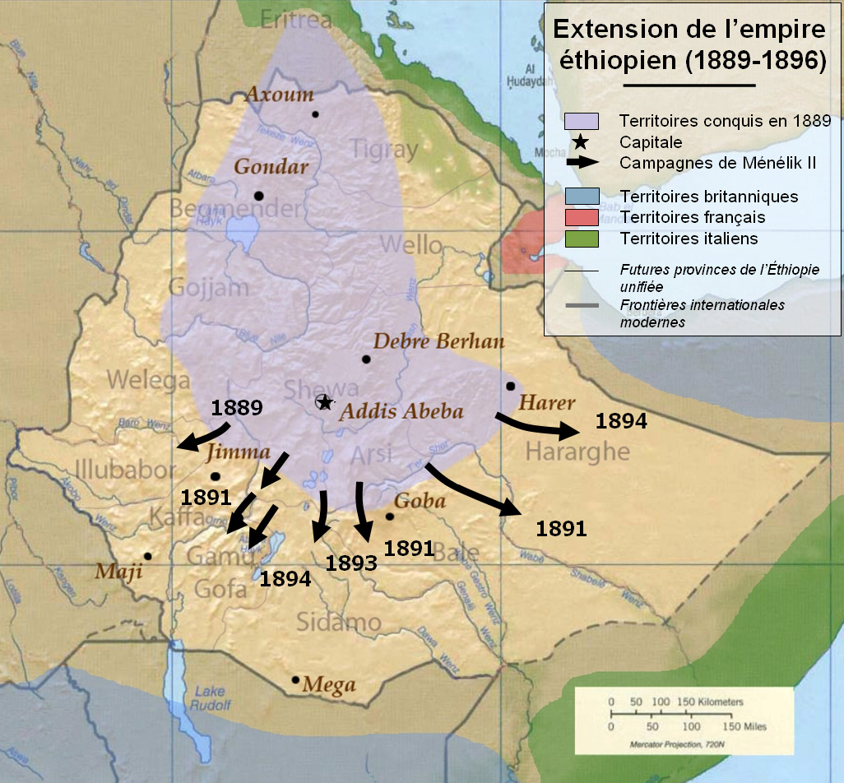
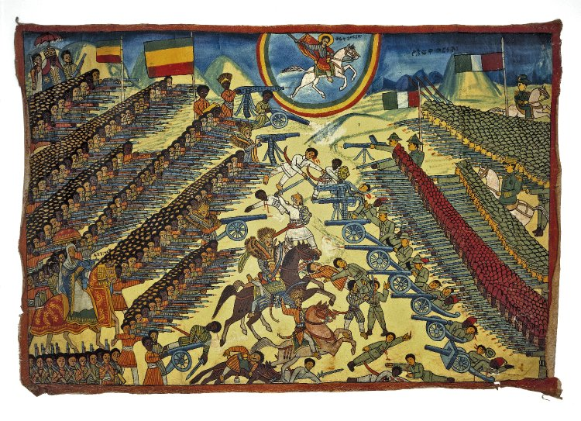
1. Imperial Ethiopia
Menelik II, 1889 -1913.
Bottom right: Ethiopian representation of the Battle of Adwa (1896). British Museum
Expansion of the Ethiopian Empire under Menelik II
Notes:
The lands that are currently Ethiopia saw some of the earliest human settlement and development of a centralised polity centred on Aksum. In the 13th century, rule over Ethiopia was assumed by the Christian Solomonic dynasty who claimed their descent from King Solomon and the Queen of Sheba.
Italy; Battle of Adwa 1896
Menelik II aspired to a Modern Ethiopia. He oversaw the building of a railway, a modern capital city in Addis Ababa, a banking and a communications infrastructure.

Slide 6
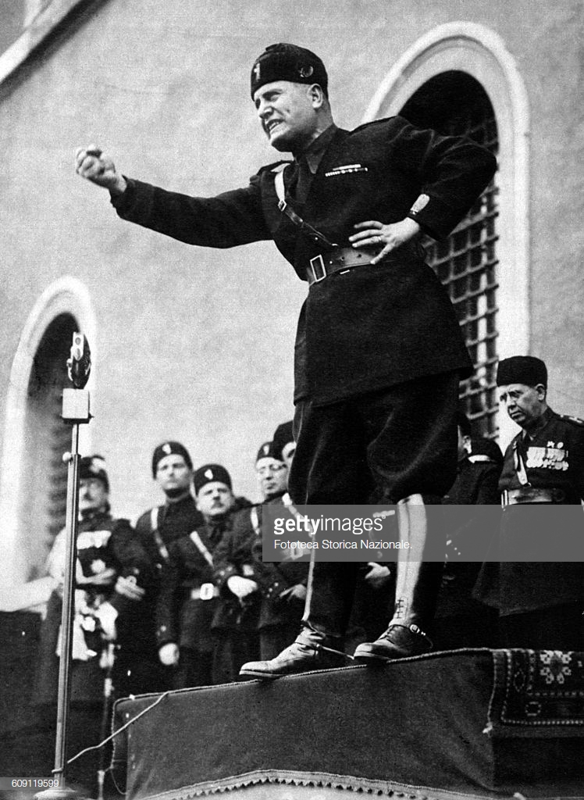
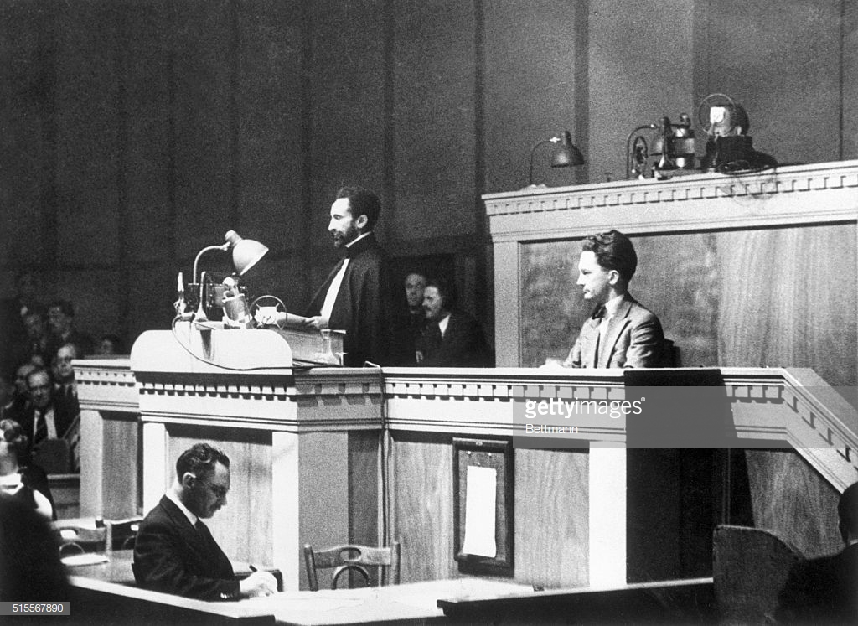
1. Italian Invasion
Left: Benito Mussolini announces Italy’s invasion of Ethiopia by Italy ( Rome, October 3, 1935
Right: Emperor Haile Selassie argues for protection at the League of Nations, 1936
Notes:
October 1935: Italy under Mussolini invade Ethiopia under a pretext; this time a much more mechanized army
Haile Selassie leaves the country; goes and presents his case at the UN
Importance of ‘hands off Ethiopia’ movement; sparks anti-colonial activism across the world, incl. George Padmore in London

Slide 7
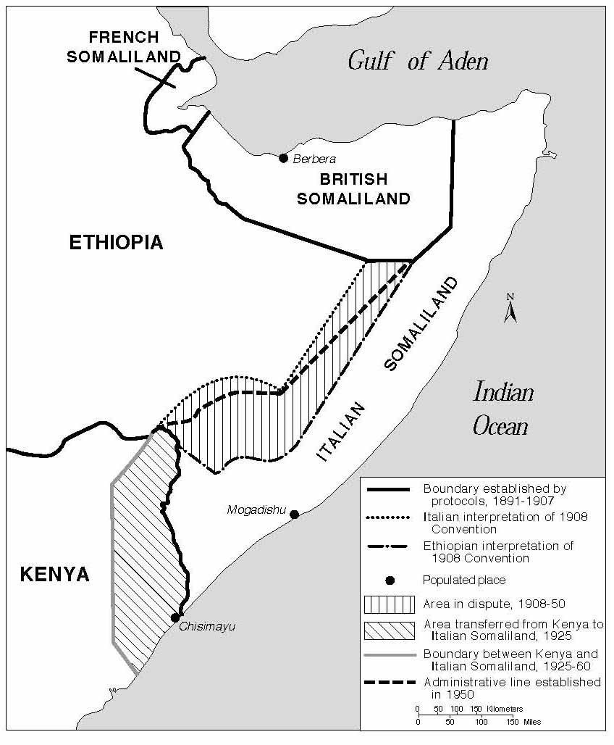
2. Somalia: Colonial Division
Division of Somalian peninsula, 19th century:
French Somaliland (1883-1967)—Djibouti (1967)
British Somaliland (1988-1960).
Italian Somaliland (1880s-1960 with exception of WW2)
1 July 1960: Somalia becomes independence (merger of British Somaliland and Italian Somalia)
Notes:
1960, Independence. Somalia became an independent country in 1960, as a result of merger of British Somaliland and Italian Somalia. The first Prime Minister of Somalia was Abdirashid Ali Shermarke, the leader of the Somalia Youth League (SYL). However, the new government was deeply dissatisfied with the post-colonial settlement. Somalia disputed and committed itself to the idea of ‘GREATER SOMALIA’
Somalis beyond Somalia: in Djibouti, northeasters Kenya, and a desert known as the Ogaden.
1946: British propose to establish ‘greater Somalia’ –this proposal taken up by the Somali Youth League (1941). More information in Cedric Barnes

Slide 8
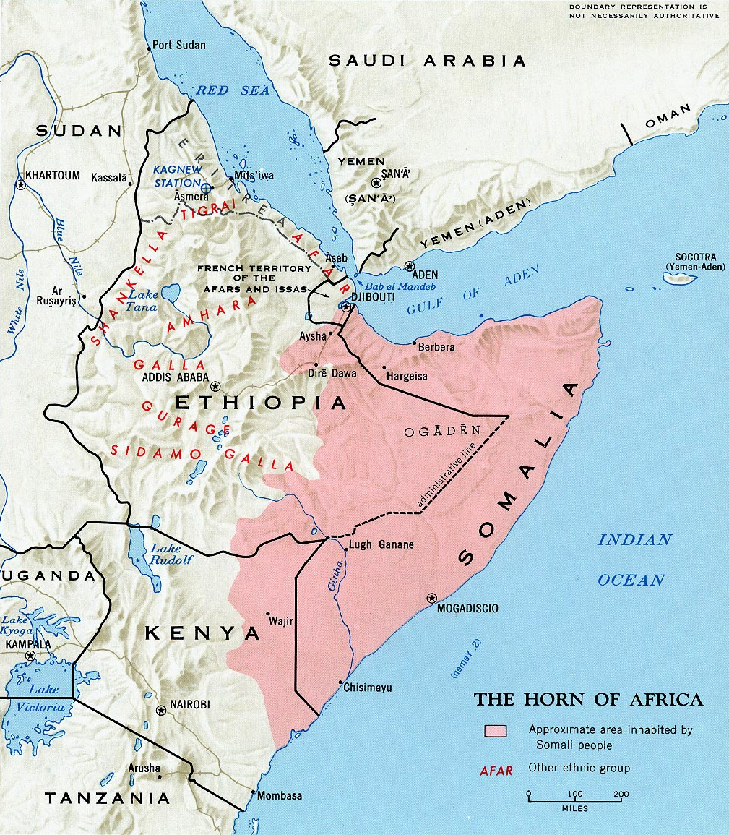
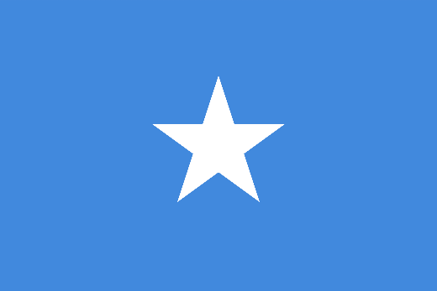
2. Somalia: In Search of a Nation
Somali Youth League and ‘Greater Somalia’ Idea
Somali flag: unity of southern Somalia, northeast Kenya, Ogaden, Djibouti, and British Somaliland
Conflicts over Borders:
‘Shifta War’ with Kenya (1963-1967)
Ethiopian-Somali Border War (1964)
Shaded area indicates areas inhabited by Somali people. Top right: Somali national flag

Slide 9
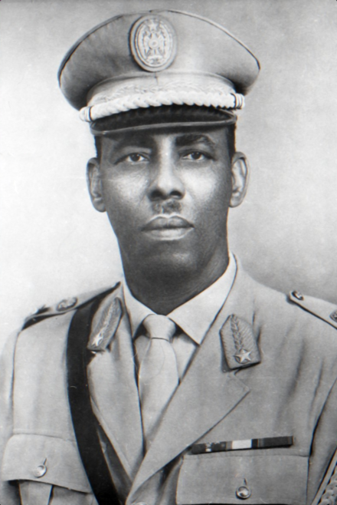
2. Somalia under Siad Barre
October 1969: Military Coup. Siad Barre in power (1969-1991
‘Scientific socialism’ in Somalia
Police State and pan-Somali Nationalism
Military portrait of Major General Mohamed Siad Barre, c. 1970
Notes:
). In October 1969, Somalia’s president, Abdirashid Ali Shermarke, was assassinated. This was followed by a military coup. The parliamentary system was replaced with the Supreme Revolutionary Council, headed by Siad Barre, an Italian-trained soldier.
Scientific socialism in Somalia’: partial nationalisation, but ownership of livestock and bananas in private hands; war against ‘tribalism’
Police State:

Slide 10
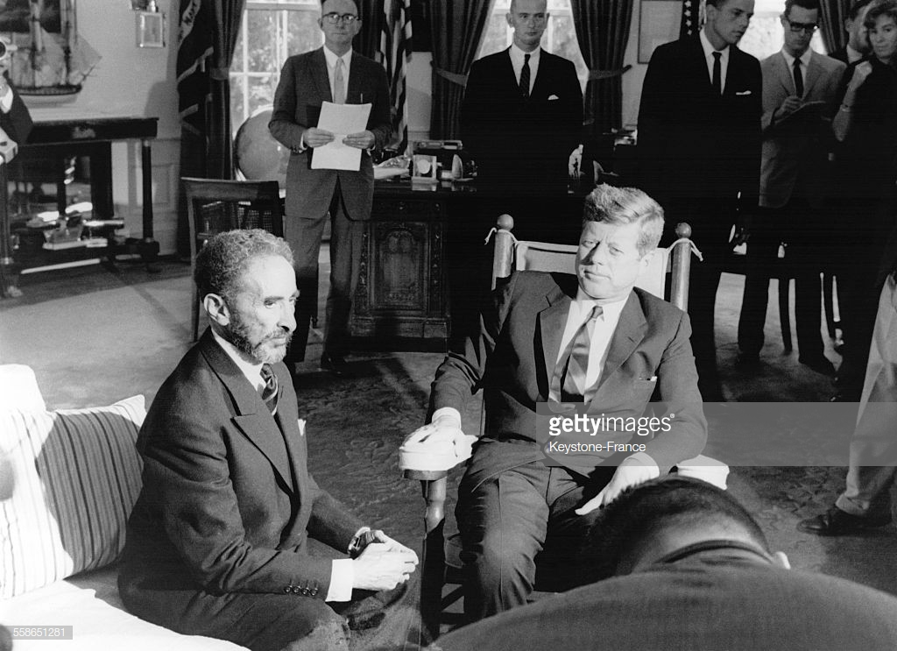
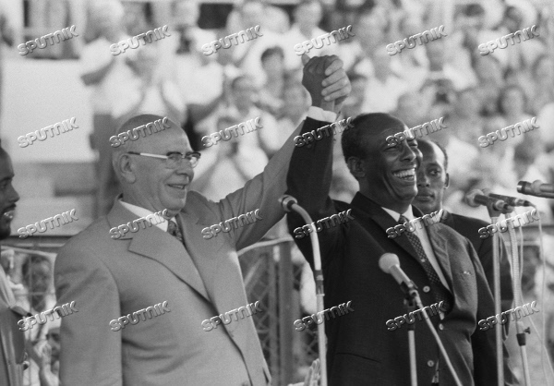
3. Superpowers and the Arms Race in the Horn of Africa
6 October 1963: Emperor Haile Selassie with Kennedy in the Oval Office, Washington
14 July 1973: Siad Barre with the Chairman of the Soviet Supreme Soviet, Nikolai Podgornyi, in Somalia
US: geopolitical (access to Red Sea and Gulf of Aden); Kagnew station (Asmara, Eritrea)
USSR: geopolitical, counter US influence in Ethiopia. Increased support for Barre
Notes:
USA: To the USA, the strategic importance was more important that that of Somalia because of the Kagnew listening post. Located new Asmara, in present-day Eritrea, Kagnew was a very valuable facility at a strategic crossroads. The USA really needed access to Kagnew and therefore they:
supported Ethiopia’s claims on Eritrea
provided increasing amounts of arms to Ethiopia (Lefebre)
USSR: aware about strategic importance of the region; start arming the Somalis (1963), engaged in other modernistion projects
Barre’s coming to power: Soviet aid increased, after initial reluctance (importance of ‘ideological inclination’)

Slide 11
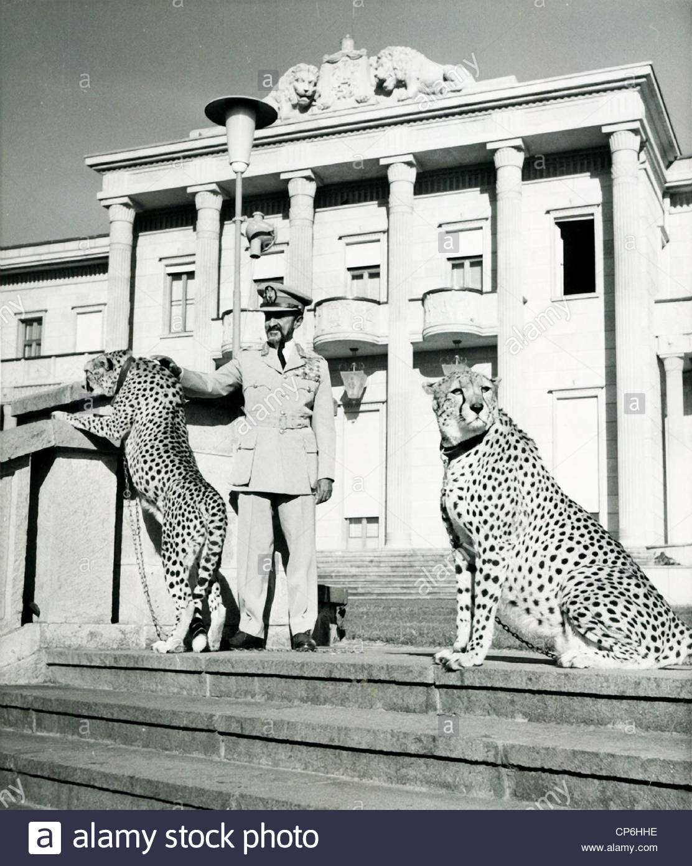
4. The Ethiopian Revolution, 1974: Reasons
Feudal system – land owned by aristocracy
Internal war against Eritrean People’s Liberation Front (EPLF), which received Soviet and Cuban support
Growth of Western-educated middle-class in Addis. Marxist views
Famine in Sahel Belt, 1972-73
1973 oil crisis: balance of payments crisis→ rise in prices, decline in wages
Emperor Haile Selassie of Ethiopia with Pet Cheetahs at Palace
Notes:
Land issue: 29 million of the 32 million-strong population were tenant farmers, who worked the land of others for little reward. Much of their produce went to the landowners in the form of rent. Many had to work the land of the aristocracy as unpaid labour.
Little agricultural development
Growth of Marxist intelligentsia, ‘Crocodile society’, many educated in the west
Severe economic crisis
Haile Selassie aloof- 1972 opulent birthday celebration; see Ryszard Kapuscinski, The EMPEROR

Slide 12
4. The Ethiopian Revolution, 1974: Outline
January
army mutinies
street protests in Addis Ababa, involving students and taxi drivers
February
Haile Selassie announces concessions to student demands
establishment of army committee, dominated by young, radical junior officers
March-May
waves of general strikes in Addis Ababa
June
formal establishment of the Derg – committee of junior officers
September
documentary film The Unknown Famine broadcast on Ethiopian television
formation of Provisional Military Administrative Council (PMAC)
Derg decides to arrest Haile Selassie – killed in 1975

Slide 13
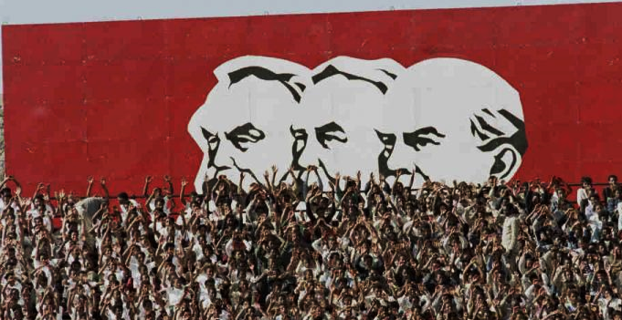
4. The Derg in power: a Marxist regime?
Early 1975: Mengistu announces ‘National Democratic Revolution’: nationalisation of banks, industry, businesses
March 1975: Derg nationalised all land
‘Live Aid’ famine of early 1980s > mass villagisation scheme

Slide 14
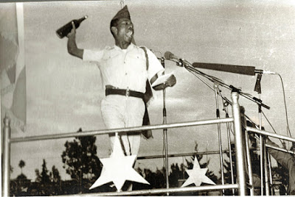
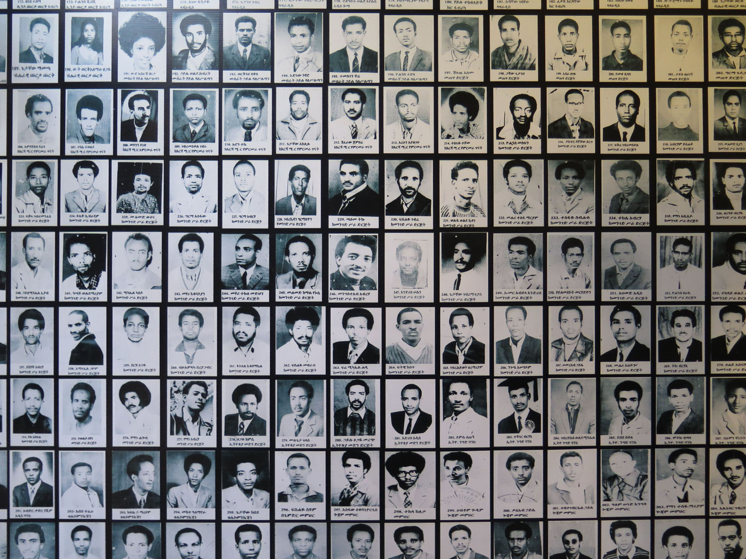
4. The Red Terror
April 17, 1977: Mengistu Haile Mariam makes a public speech and throws bottles with red liquid to authorise Red TERROR
Victims of Red Terror (Red Terror Museum, Addis Ababa)

Slide 15
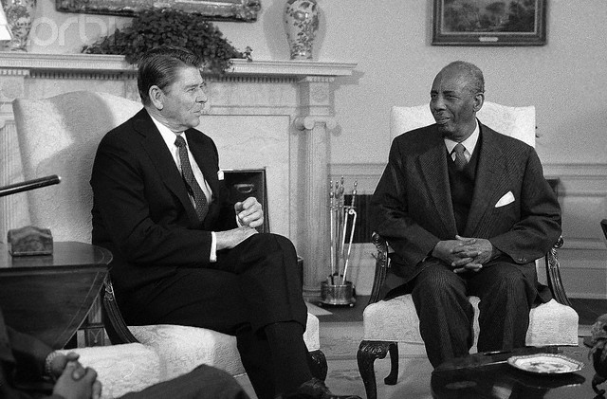
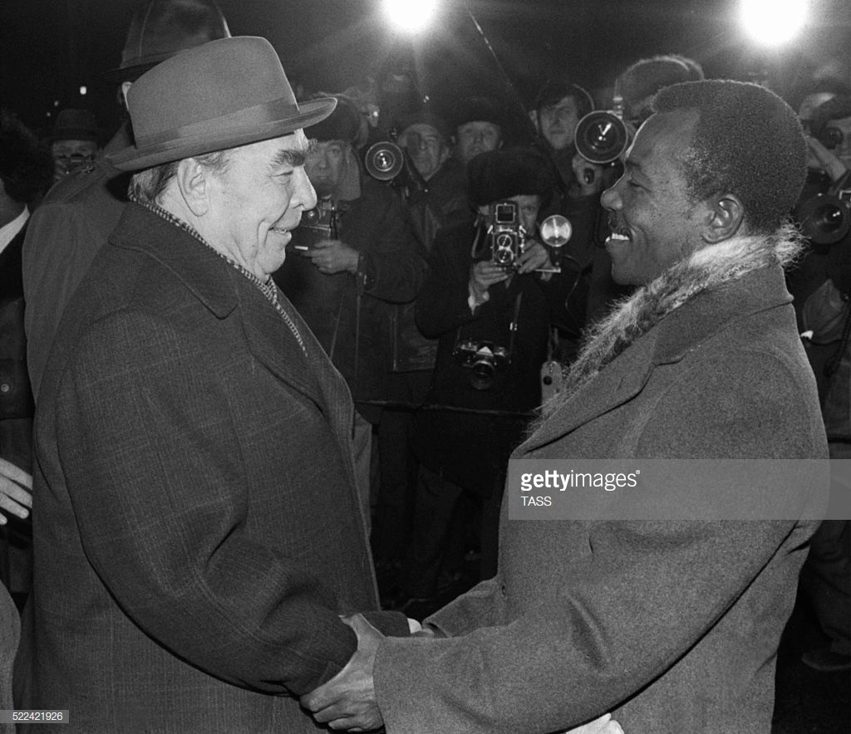
4. Superpower Response
Ronald Reagan with Siad Barre at the Oval Office, 11 March 1982
Brezhnev with Mengistu in USSR, 1978
Response: Both USSR and Soviet Union initially reluctant to embrace new partners. However, by 1978, they switch support

Slide 16
Conclusions
Ideological Aspects. How Marxist-Leninist?
Deep roots of conflict, but made worse by colonial divisions and post-war settlment
Geopolitical significance of the Horn for the superpowers →increased leverage for local actors. Militarisation of Conflict

