Slide 1
Proxy war? The Ethiopia-Somalia conflict, 1977-78
HI277 | Africa and the Cold War
Term 2 | Week 3
Anna Bruzzone
Somali refugee camps during the Ogaden War

Slide 2
Lecture outline
Somali irredentism
Somalia in the 1970s
The Derg and the threat of invasion
The Somali invasion of Ethiopia
The Soviets choose sides
Cuban support to the Derg
Somalia’s defeat and its consequences
The fate of Ethiopian socialism
A failure of US foreign policy? Towards the ‘second Cold War’
The post-Cold War Horn of Africa: a re-emerging hotspot

Slide 3
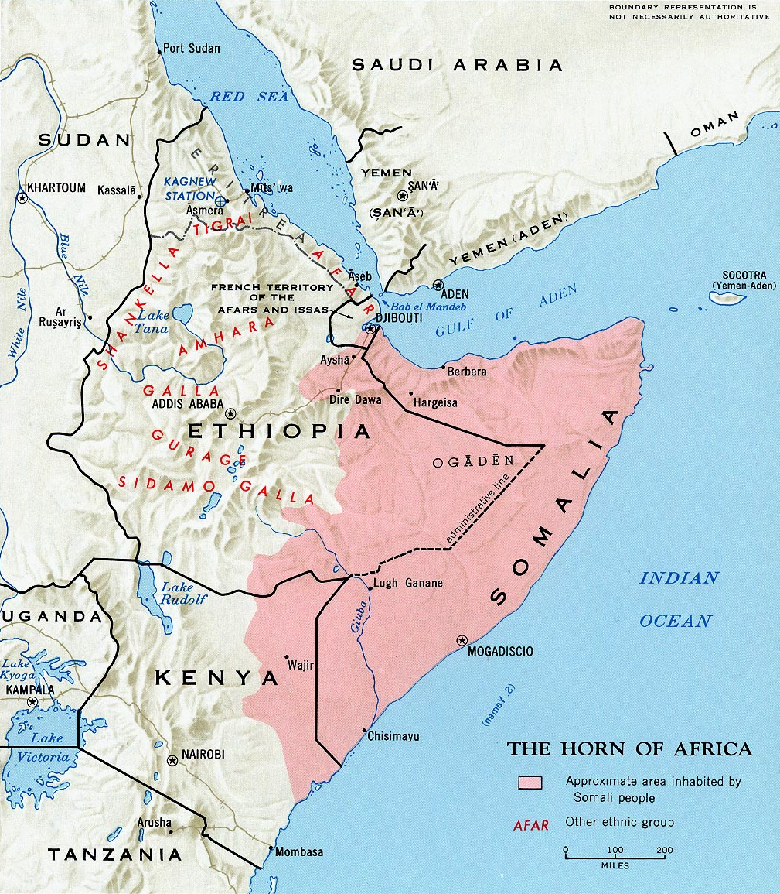
Somali irredentism
Barre continued to support irredentism in Ethiopia and Kenya, despite Soviet opposition and despite a peace treaty with Kenya
Formation of Western Somali Liberation Front (WSLF) in Ogaden in 1975 to fight for secession of the region
Ethiopia responded by funding insurgency in Somalia from 1971
Somalia received support from the Arab world, especially as Ethiopia was supporting South Sudanese separatist movements

Slide 4
Somalia in the 1970s
Aspirations of the Somali Democratic Republic to a greater regional role
  1974 Somalia joined the Arab League
  1974 Siad Barre chaired the OAU summit in Mogadishu
Dependence on foreign aid – Barre’s attempts to diversify the country’s foreign support
11 July 1974: Somali-Soviet Treaty of Friendship and Cooperation
1976: Creation of the Somali Revolutionary Socialist Party to prove the regime’s socialist credentials
A struggling economy; 1974-1975 severe drought
Popular discontent

Slide 5
The Derg and the threat of invasion
Somali army well equipped with Soviet weapons; had three times as many tanks as Ethiopia
Somalia sought to exploit political turmoil in Ethiopia: early 1976, rumours of an imminent invasion
Derg inherited imperial Ethiopia’s wars against Eritrean and Tigrayan separatists – spread Ethiopian army thin
Failure of talks with Barre in Addis Ababa in January 1976

Slide 6
The Somali invasion of Ethiopia
February 1977: 1,500 Somali troops invade Ogaden
By July 1977, there were 40,000 Somali soldiers in Ethiopia

Slide 7
The Soviets choose sides
February 1977
  United States cuts military aid to Ethiopia
  Podgorny and Castro in Addis Ababa
May 1977
  Mengistu in Moscow: $350-450m arms deal
  (48 MiG aircraft, 200 tanks, anti-tank/-aircraft missiles)
October 1977
  Mengistu complained that Soviet Union still aiding Somalia
  Moscow ceased arms supply to Somalia
  Barre evicted Eastern Bloc and Cuban advisers
November 1977
  Soviet Union begins airlift of arms and aid to Ethiopia

Slide 8
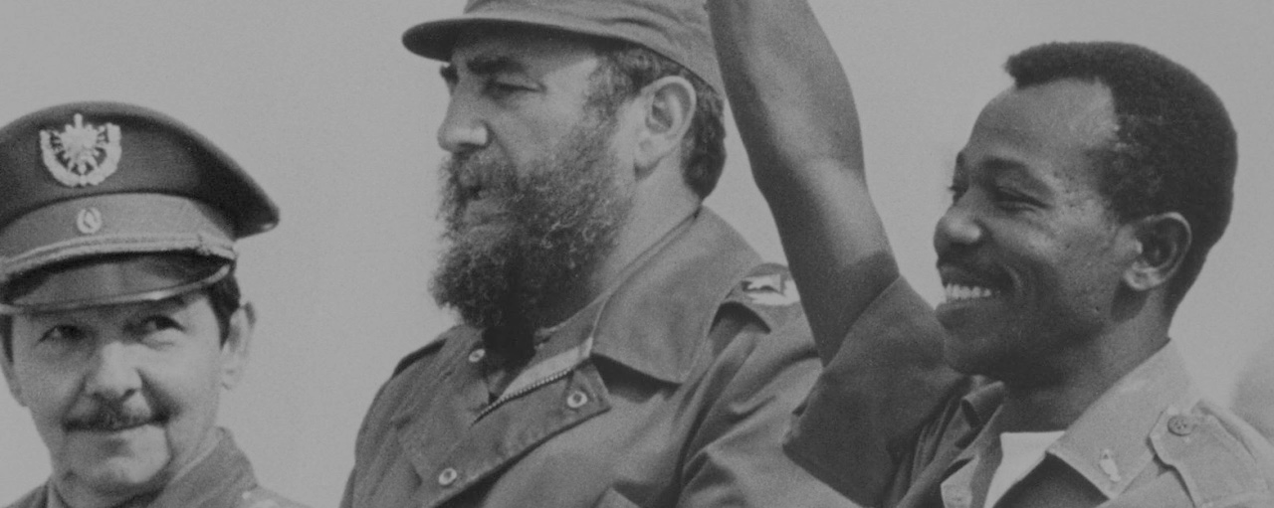
Cuban support to the Derg
Castro initially tried to act as a peacemaker – sought to create socialist confederation in region
Cubans initially turned down repeated Ethiopian requests for aid… until they joined the Soviet airlift operation in November 1977
Problematic implications of Cuba’s aid for the Derg; Havana refused to support war against Eritrea and Tigray

Slide 9
Somalia’s defeat and its consequences
November 1977
Soviet Union began six-week airlift and sealift
Total $1-2bn arms and equipment
12,000 Cuban troops plus 6,000 advisors
March 1978
Somalia withdrew from the Ogaden
30,000 Somalis taken prisoner
April 1978
Attempted coup against Barre‘s regime
1980s
By May 1980, one person in four in Somalia was a refugee from Ethiopia. Official figure was 1,400,000 refugees
Plundering of Somalia‘s economy
Rise of armed opposition movements. Ethiopian support to Somali Salvation Democratic Front (SSDF) and Somali National Movement (SSDF)

Slide 10
The fate of Ethiopian socialism
Scorched-earth policy in the Ogaden; separatist guerrillas – Ogaden National Liberation Front (ONLF), founded in 1984, seeks self-determination for ethnic Somalis in the Ogaden region
Continued war within Ethiopia, against the Eritrean People’s Liberation Front (EPLF) and Tigrayan People’s Liberation Front (TPLF)
1983-4 ‘Live Aid’ famine
By 1986, 4.6m people were resettled in villagisation programme
Moscow distanced itself from Addis Ababa after Gorbachev came to power in 1985

Slide 11
A failure of US foreign policy?
President Jimmy Carter
Zbigniew Brzezinski
National Security Adviser
Cyrus Vance
Secretary of State
…towards the ‘second Cold War’

Slide 12
The post-Cold War Horn of Africa: a re-emerging hotspot
End of the Derg and flight of Mengistu, 1991
  Independence of Eritrea in 1993
  1998-2000 - Eritrea-Ethiopia war
  Rapid economic growth… but authoritarian government, unrest, ethnic/regional conflicts
  2016-2018 – Mass protests demanding political reforms
  2 April 2018: Abiy Ahmed becomes Prime Minister; he is the country‘s first Oromo leader. A new age of reforms?
Fall of Barre and state collapse in Somalia
  American intervention and withdrawal – ‘Operation Restore Hope’ (1992-1994) failed – ‘Black Hawk Down’
  Civil war - the rise of the Islamic Courts Union and the war in Mogadishu (2002-2006), Ethiopian intervention (2006) and the rise of Al Shabaab
  Kenya’s invasion of Somalia (2012); African Union Mission in Somalia (AMISOM)
Repercussions of the US-Chinese competition and the Gulf Crisis on the Horn of Africa – a re-emerging hotspot

Slide 13
Conclusions
Why did Moscow intervene in the Horn? Was it successful?
What were the consequences of the war for the United States?
Was the Ogaden War a watershed moment in the Cold War?
Did Ethiopia ‘win’ the conflict?
Domestic + regional + international politics

