Slide 1
A luta continua! Liberating southern Africa
HI277 | Africa and the Cold War
Term 2 | Week 5
ANC guerrillas training in Zambia, 1977
https://www.youtube.com/watch?v=jn3gsLo8pGE

Slide 2
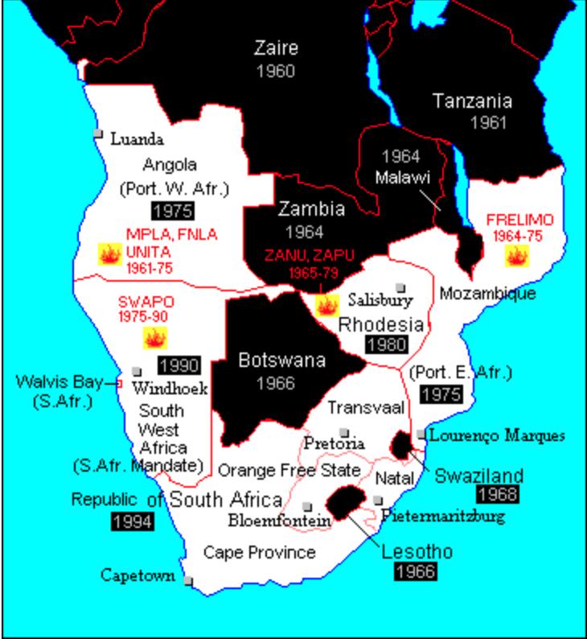
Southern Africa
White minority rule:
South Africa
South-West Africa (Namibia)
Southern Rhodesia (Zimbabwe)
Portuguese colonies:
Angola
Mozambique
Liberation movements:
Tanzania, Zambia, Angola and Mozambique (after 1975)
Southern Africa in 1970 with dates of independence. “Fire” sign indicates armed movements

Slide 3
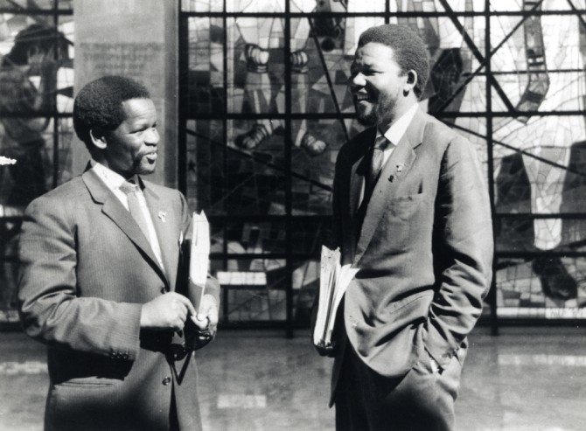
South Africa
African National Congress (ANC), founded 1912
ANC’s Youth League (Mandela, Tambo)
1948: The National Party wins elections in South Africa. Institutes apartheid
1960. Sharpeville Massacre
Rivals: Pan-Africanist Congress (PAC)
1961. Turn to violence. ANC establishes armed wing, Umkonto weSizwe (Spear of the Nation)
Oliver Tambo (left) with Nelson Mandela (right)
Notes:
1912: ANC founded as organization dedicated to campaigning for voting rights
1944: ANC’s Youth League: established by younger, more radical members who are inspired by independence movements (Oliver Tambo and Mandela)
Oliver Tambo: a long-term leader of the ANC, 1948: he was accosted and spat on when walking along the streets
1948: Elections. White supremacist National Party (Afrikaner Nationalism) wins elections and insitutes policy of total segregation – aka apartheid
1952 Defiance campaign: ANC launches peaceful campaign to protest against apartheid laws; many ANC members start to consider armed struggle
1960. ‘Sharpeville massacre’: South African police shoot at peaceful protestors --> Turning point in the transition to violence.
1961 “Umkonto weSizwe (abbreviation MK) – armed wing of the ANC
1961-1963: MK starts to attack government buildings (sabotage), not particularly successful. Much of leadership (incl. Mandela) arrested
Oliver Tambo-ANC leader in exile

Slide 4
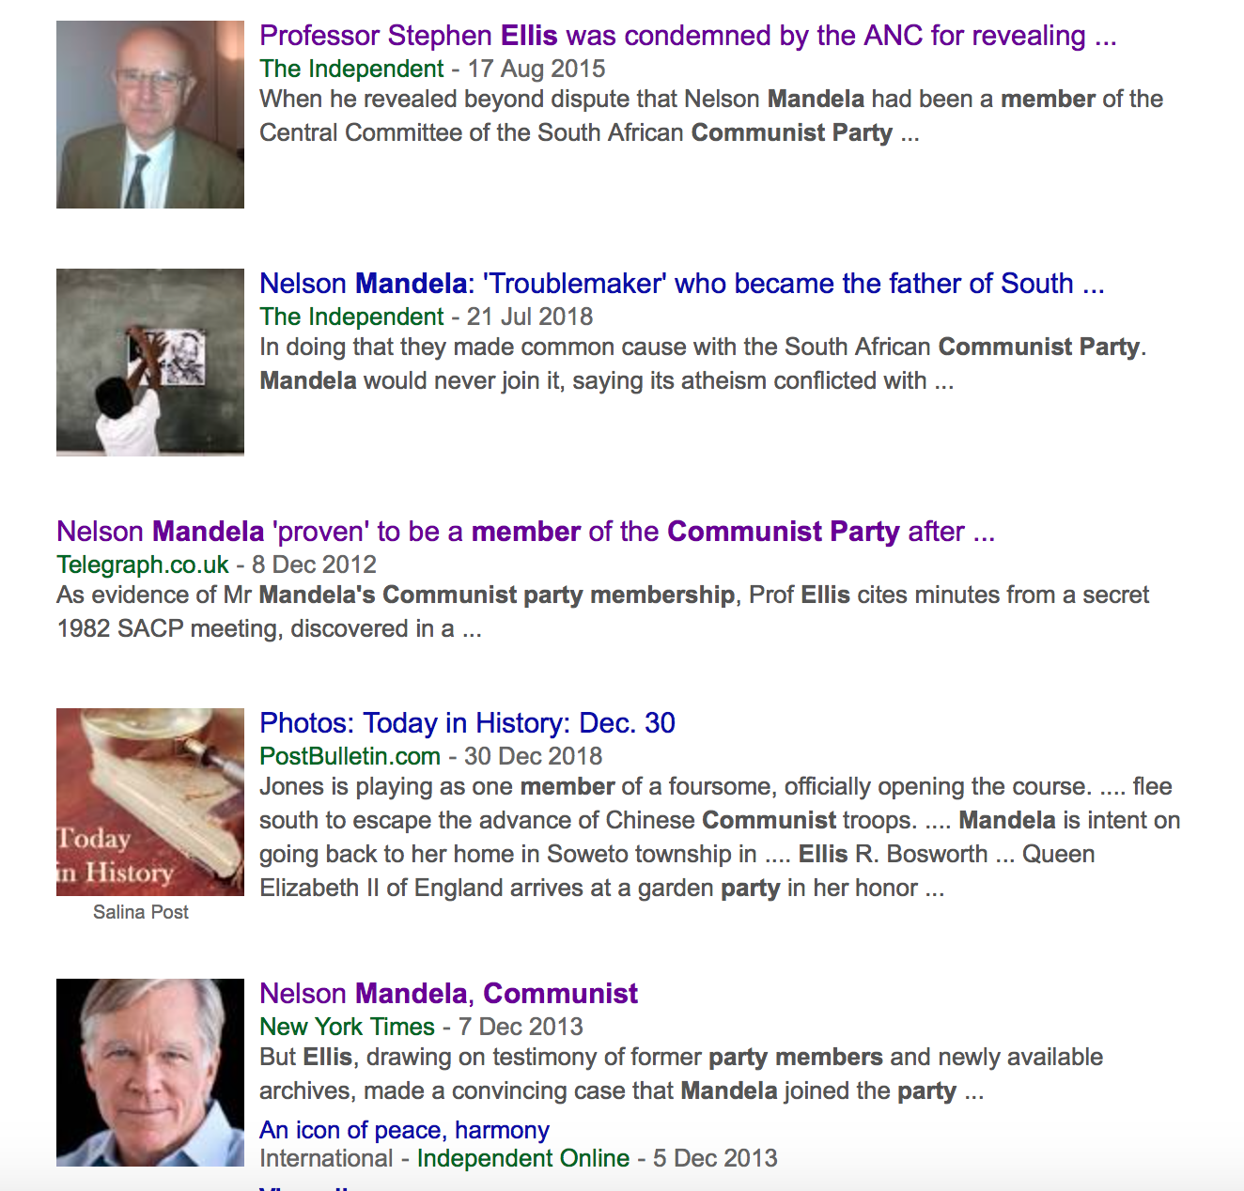
Was the ANC controlled by communists?
1921: Communist Party of South Africa (CPSA). Branch of the Comintern
1950: CPSA banned, reconstitutes as South African Communist Party (SACP)
By 1960s: alliance between the ANC and SACP.
Debate: Stephen Ellis vs. Hugh Macmillan
Response to Stephen Ellis’s book (news)
Notes:
The transition to violence methods of struggle against apartheid has excited enormous passions among historians and the general public
One of the most controversial issues in the history of the ANC was its relationship with the South African Communist Party
Communist Party of South Africa (CPSA): close relations with the Comintern (inter-war period)
1950: CPSA banned – members go underground, but reconstitute party as South African Communist Party (SACP) - >join other organizations, including ANC
Did Nelson Mandela also join the ANC? –enormous debate. Allegedly, one of those who joined the SACP was Nelson Mandela. During his lifetime, Mandela always denied he was ever a member. This issue of Mandela’s membership has caused enormous and very heated, bitter debate among historians in recent years. One of the prominent proponents of this theory, that Mandela was a member, was the late historian Stephen Ellis. He argued not only that Mandela was a member of the SACP, but that the communists played a crucial role in the ANC and its armed wing, Umkomto weSizwe. He argues that it was the SACP members who pushed for armed struggle in 1960 and, what is more, the ANC adopted many methods such as the suppression of dissent by the feared intelligence service, which was widespread in the Umkonto weSizwe camp in Angola during the 1970s. : Stephen Ellis’s book has caused a wave of reactions, with many arguing against it. Among the most prominent critics was historian Hugh Macmillan. According to Macmillan, Mandela was never part of the SACP, but what is more important perhaps is that the ANC was never controlled by the communists. I encourage you to delve into this debate and see where you stand. A lot of this is really detailed and focuses on the year 1960 when the ANC moved away from peaceful resistance to violent sabotage tactics…and the role the Soviet Union played in it.

Slide 5
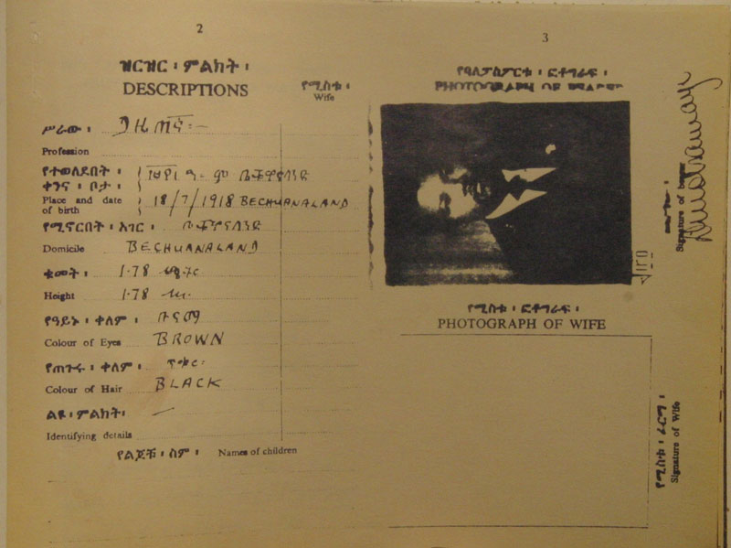
Nelson Mandela’s Ethiopian passport (1962)

Slide 6
RHODESIA/ZIMBABWE ANGOLA
ZANU - Zimbabwe African National Union
Led by Ndabaningi Sithole and Robert Mugabe
Supported by China
ZAPU - Zimbabwe African People’s Union
Led by Joshua Nkomo
Supported by Soviet Union
MPLA - Popular Movement for the Liberation of Angola
Marxist, support in urban areas, led by Agostinho Neto
FNLA - National Liberation Front of Angola
Support from Bakongo ethnic group; led by Holden Roberto
UNITA - National Union for Total Independence of Angola
Central-south Angola, relations with China, and later South Africa
Led by Jonas Savimbi

Slide 7
NAMIBIA MOZAMBIQUE
SWAPO - South-West African People’s Organisation
Led by Sam Nujoma
South-West Africa: mandated to the UK, the administered by South Africa
SWAPO founded in 1960
Strong South African police and military presence (Caprivi Strip)
SWAPO bases in Angola, Zambia, Tanzania and Mozambique
FRELIMO - Mozambique Liberation Front
Led by Eduardo Mondlane (1962-69); Samora Machel (1970-)
Shift towards a more Marxist, Soviet-aligned approach
Based in Dar es Salaam
Training camps in Tanzania, Zambia and northern Mozambique

Slide 8
EXTERNAL SUPPORT WESTERN DILEMMAS
Communist powers:
Soviet Union
Eastern Bloc states
China
Cuba
Social democratic European states (non-lethal aid):
Denmark, Norway, Finland, Sweden, Netherlands,
Ireland,
& network of pro-liberation pressure groups and networks in Europe and North America, (e.g. Anti-Apartheid Movement)
Dissociation from Marxist guerrilla movements – in the case of the Portuguese colonial wars, fighting against a NATO ally?
Engagement with liberation movements as potential future governments?
Dilemma made clear by Salazar’s stance over the Azores air base and American votes in the UN.
Shifting American policy over time: more critical approach under Kennedy, Nixon more supportive of white minority regimes.

Slide 9
“Africa is fighting, Africa will win!” (1971)

Slide 11
Fidel Castro and Julius Nyerere, Tanzania, 1977

Slide 12
African support
Support from radical African governments in Algeria, Egypt, Ghana, Tanzania… Algiers, Cairo, Accra, Dar es Salaam become centres of activity
Formation of OAU Liberation Committee in 1963, based in Dar es Salaam
Frontline states provided training camps, passports, radio broadcasts
Dangers of hosting liberation movements
Reprisals: e.g. FRELIMO’s Mondlane assassinated, 1969; South African bombings in Dar es Salaam, 1972
Influx of arms from the superpowers
Urban disorder and tensions in training camps
Destabilising effects on local politics, e.g. coup plot against Nyerere in 1969 leads to ANC being thrown out of Tanzania

Slide 13
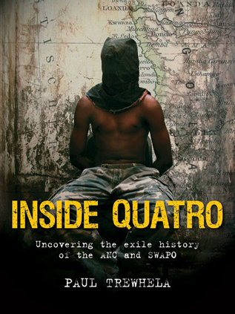
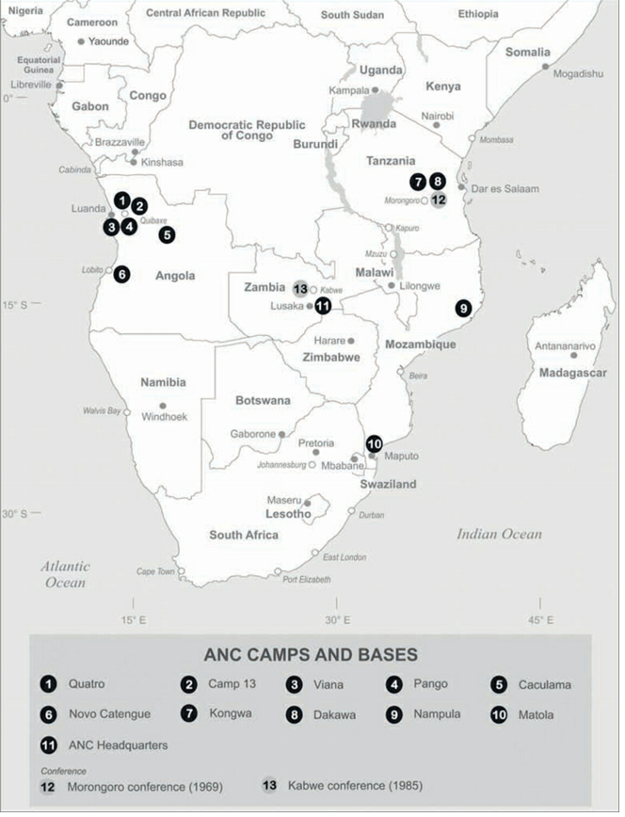
ANC and SWAPO: How did they deal with dissent?
Military training in Soviet Union and Eastern bloc
Camps established in ‘Frontline states’
Targeted by South African, Rhodesian and Portuguese forces
Desertion and dissent among cadres
Discipline and martial law imposed – executions and purges

Slide 14
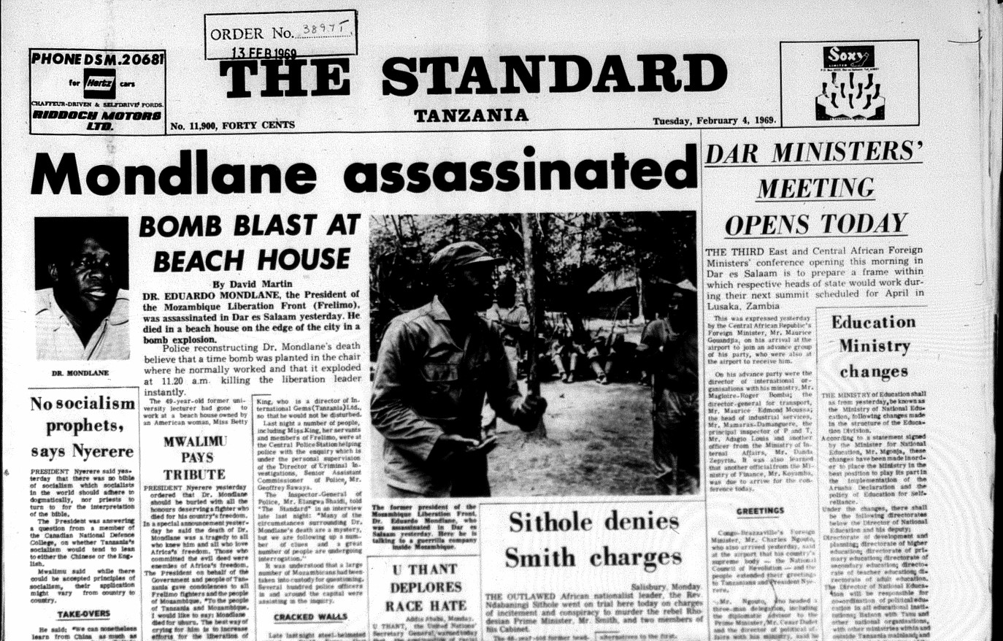
Tanzanian press reports on (1969) assassination of FRELIMO’s president, Eduardo Mondlane

Slide 15
Unhappy families
Ethnic divisions
Makonde in FRELIMO sought separate state in northern Mozambique
Ideological divisions
e.g. FRELIMO:
Mondlane (president) – moderate socialist
Uria Simango (vice-president) – Maoist
Marcelino dos Santos (external affairs) – pro-Soviet Marxist
Samora Machel (defence) – pro-Soviet Marxist
Personal rivalries
Leadership versus rank-and-file
Social issues in camps

Slide 16
Conclusions
Contentious historiographies (nationalist hagiographies?)
e.g. was Nelson Mandela a member of the SACP?
How do the liberation movements behave once in power?
Where does power lie here? Issues of agency
Does the Cold War unite liberation movements… or divide them?
How successful was armed struggle?
How did Frontline States experience the liberation struggle?

