Slide 1
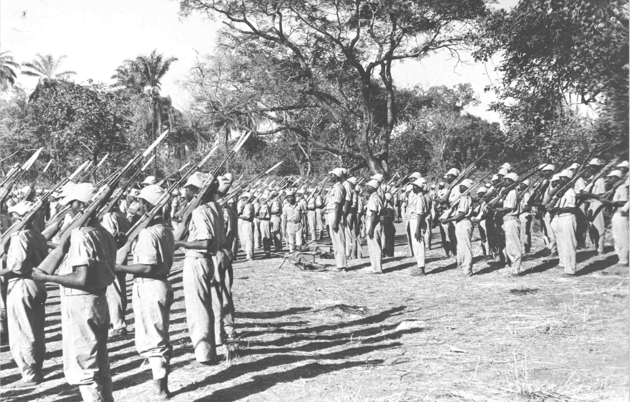

A luta continua! Liberating southern Africa
HI277 | Africa and the Cold War
Term 2 | Week 4
Dr. Natalia Telepneva
Picture: military parade of the PAIGC armed forces, casacomum.org

Slide 2

Introduction: “Free Nelson Mandela” by the Special A.K.A. 1984

Slide 3
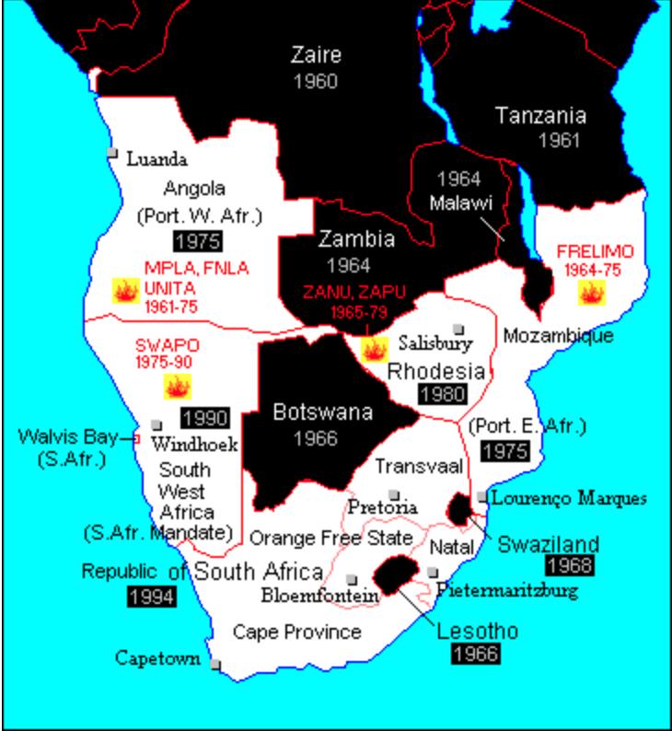
Southern Africa
White minority rule: South Africa, Namibia (South West Africa), Zimbabwe (South Rhodesia)
Portuguese colonies: Angola, Mozambique, Guinea-Bissau and Cape Verde
Bases for liberation movements: Tanzania, Zambia, Guinea, Angola and Mozambique (after 1975)
Southern Africa in 1970 with dates of independence. “Fire” sign indicates armed movements

Slide 4
Lecture Outline
1. Profiles of liberation movements
2. External Support: USSR, China, Cuba
3. African Support
How did the CW affect the liberation movements and vica versa?

Slide 5
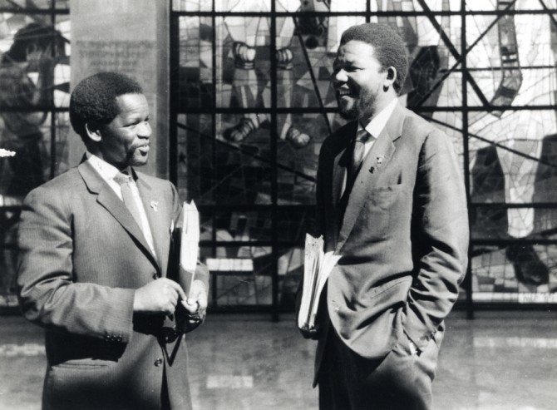
South Africa
African National Congress (ANC), founded 1912
ANC’s Youth League (Mandela, Tambo)
1948: The National Party wins elections in South Africa. Institutes apartheid
1960. Sharpeville Massacre
Rivals: Pan-Africanist Congress (PAC)
1961. Turn to violence. ANC establishes armed wing, Umkonto weSizwe (Spear of the Nation)
Oliver Tambo (left) with Nelson Mandela (right)
Notes:
1912: ANC founded as organization dedicated to campaigning for voting rights
1944: ANC’s Youth League: established by younger, more radical members who are inspired by independence movements (Oliver Tambo and Mandela)
Oliver Tambo: a long-term leader of the ANC, 1948: he was accosted and spat on when walking along the streets
1948: Elections. White supremacist National Party (Afrikaner Nationalism) wins elections and insitutes policy of total segregation – aka apartheid
1952 Defiance campaign: ANC launches peaceful campaign to protest against apartheid laws; many ANC members start to consider armed struggle
1960. ‘Sharpeville massacre’: South African police shoot at peaceful protestors --> Turning point in the transition to violence.
1961 “Umkonto weSizwe (abbreviation MK) – armed wing of the ANC
1961-1963: MK starts to attack government buildings (sabotage), not particularly successful. Much of leadership (incl. Mandela) arrested
Oliver Tambo-ANC leader in exile

Slide 6
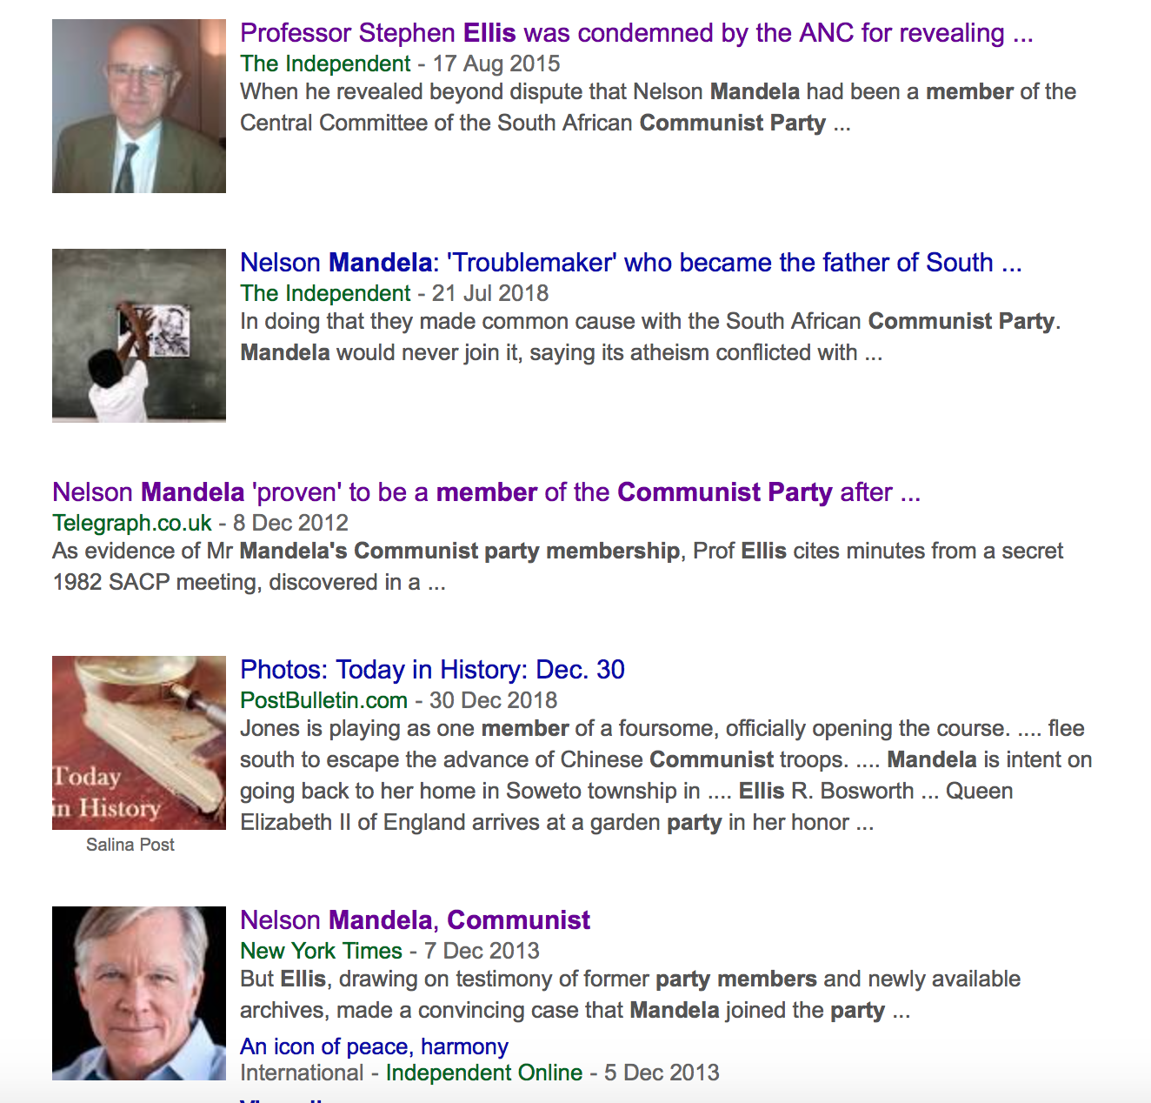
Was the ANC controlled by communists?
1921: Communist Party of South Africa (CPSA). Branch of the Comintern
1950: CPSA banned, reconstitutes as South African Communist Party (SACP)
By 1960s: alliance between the ANC and SACP.
Debate: Stephen Ellis vs. Hugh Macmillan
Response to Stephen Ellis’s book (news)
Notes:
The transition to violence methods of struggle against apartheid has excited enormous passions among historians and the general public
One of the most controversial issues in the history of the ANC was its relationship with the South African Communist Party
Communist Party of South Africa (CPSA): close relations with the Comintern (inter-war period)
1950: CPSA banned – members go underground, but reconstitute party as South African Communist Party (SACP) - >join other organizations, including ANC
Did Nelson Mandela also join the ANC? –enormous debate. Allegedly, one of those who joined the SACP was Nelson Mandela. During his lifetime, Mandela always denied he was ever a member. This issue of Mandela’s membership has caused enormous and very heated, bitter debate among historians in recent years. One of the prominent proponents of this theory, that Mandela was a member, was the late historian Stephen Ellis. He argued not only that Mandela was a member of the SACP, but that the communists played a crucial role in the ANC and its armed wing, Umkomto weSizwe. He argues that it was the SACP members who pushed for armed struggle in 1960 and, what is more, the ANC adopted many methods such as the suppression of dissent by the feared intelligence service, which was widespread in the Umkonto weSizwe camp in Angola during the 1970s. : Stephen Ellis’s book has caused a wave of reactions, with many arguing against it. Among the most prominent critics was historian Hugh Macmillan. According to Macmillan, Mandela was never part of the SACP, but what is more important perhaps is that the ANC was never controlled by the communists. I encourage you to delve into this debate and see where you stand. A lot of this is really detailed and focuses on the year 1960 when the ANC moved away from peaceful resistance to violent sabotage tactics…and the role the Soviet Union played in it.

Slide 7
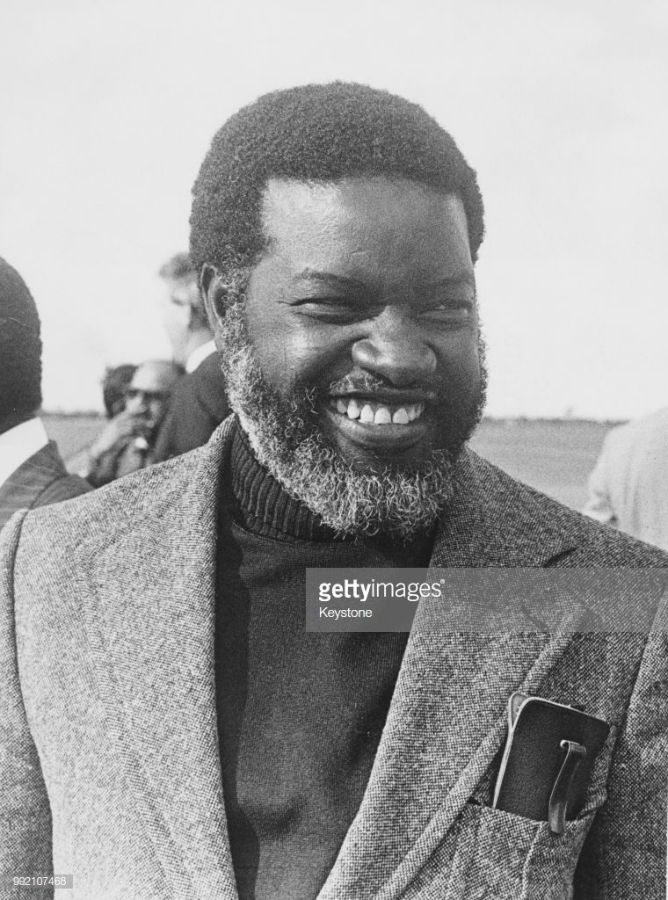
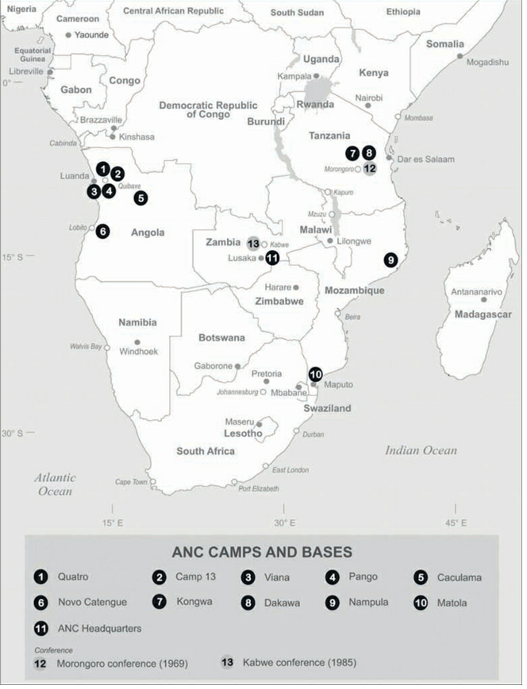
:
Namibia
South-West Africa: administered by South Africa
1960: South-West African People’s Organisation (SWAPO). Sam Nujoma leader
Picture centre: Sam Nujoma, the leader of SWAPO; picture right: ANC bases. Source: Ellis, “External Mission”
Notes:
South-West Africa: acquired importance after independence of Angola because the ANC set up its camps in Angola →d

Slide 8
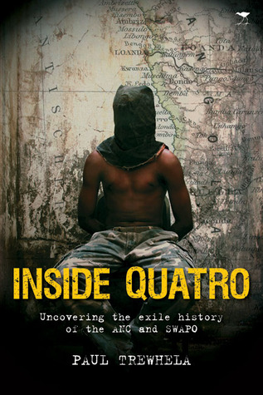
ANC and SWAPO: How did they deal with dissent?
Source: Ellis, “External Mission”

Slide 9
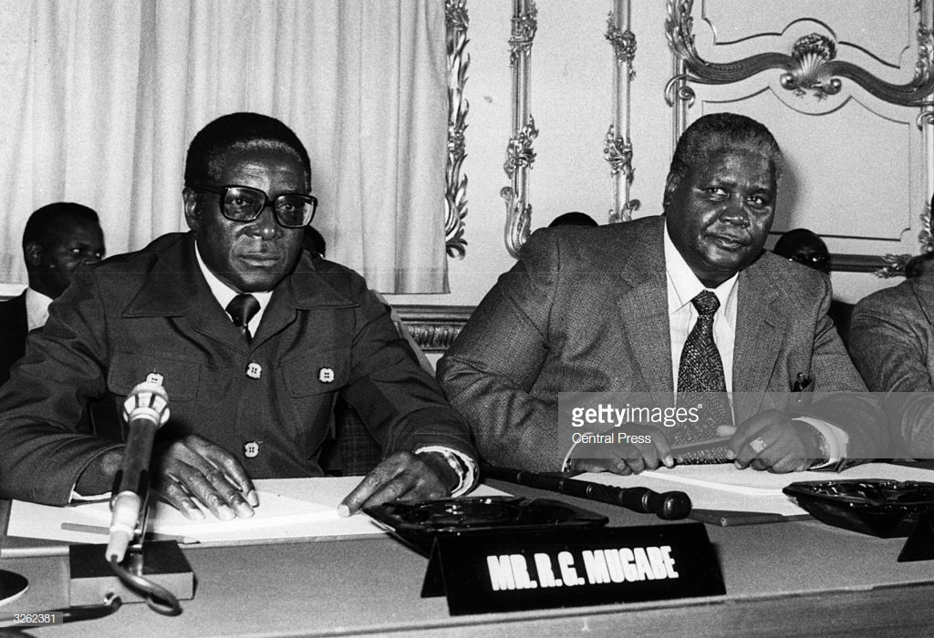
:
Zimbabwe (South Rhodesia)
1961: Zimbabwe African People’s Union (ZAPU). Leader Joshua Nkomo
1963: Zimbabwe African National Union (ZANU). Leaders: Ndabaningi Sithole, Robert Mugabe (since 1975)
Picture from left to right: Robert Mugabe (ZANU) with Joshua Nkomo (ZAPU) at the Constitutional Conference on the future of Zimbabwe, Lancaster House, London, 10 September 1979
Notes:
REASONS. The reasons for the split are still debated. There had been complaints about Joshua Nkomo’s leadership for years. Many objected when Nkomo proposed to set up a government in exile and negotiate with the British in the case of Rhodesian independence. Years later many would argue that the split was ethnic, with Ndebele people following Nkomo and Shona joining ZANU. Indeed, the leadership of ZANU were all Shona speakers. But some say neither party had real support among either group in the 1960s. The dispute was about leadership and mass mobilization. The Rhodesian government took advantage of the split. Nkomo, Sithole and Mugabe spent the next decade in prison. Both ZANU and ZAPU would launch underground guerrilla operations against the government in Rhodesia in 1960s. Mugabe assumed sole leadership of ZANU in 1975

Slide 10
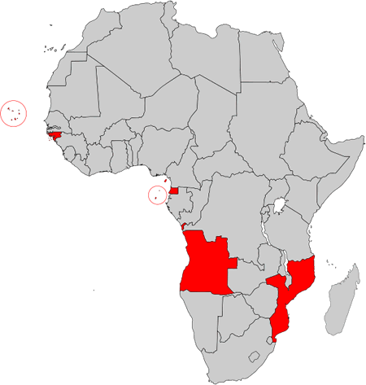
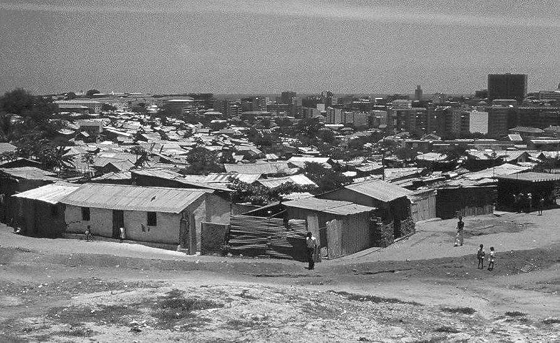
Portuguese Colonies in Africa
1961: Angolan Uprising (turning point for lusophone liberation movements)
Left: Portuguese colonies in Africa: Angola (largest), Mozambique, Guinea-Bissau and Cape Verde
Right: Luanda: the city and the musseques (shantytowns), 1974

Slide 11
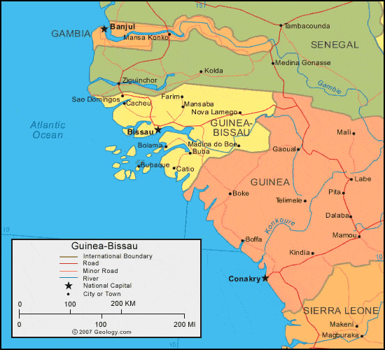
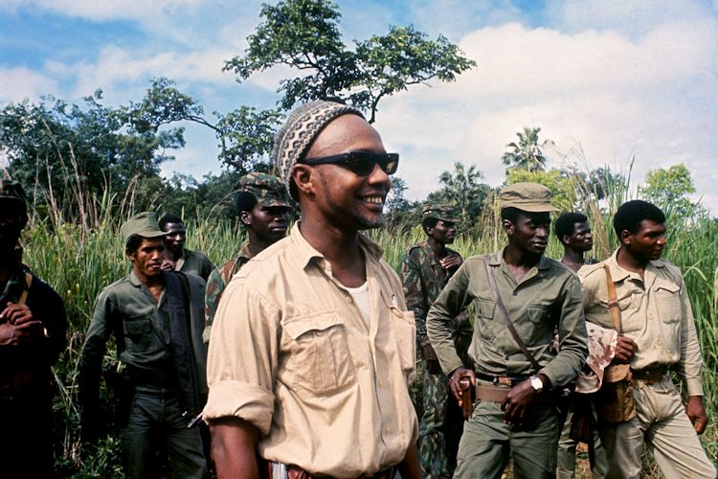
:
Guinea-Bissau
1959: Party for Independence of Guinea-Bissau and Cape Verde (PAIC)
Leader Amilcar Cabral: talented diplomat, theoretician of armed struggle, proponent of ‘scientific socialism’ (don’t confuse with “African socialism”)
Divide: Cape Verdean origin and those from Guinea-Bissau
January 1973: Cabral assassinated in a coup attempt in Conakry
Picture: Amilcar Cabral with PAIGC soldiers in Guinea-Bissau, 1971

Slide 12
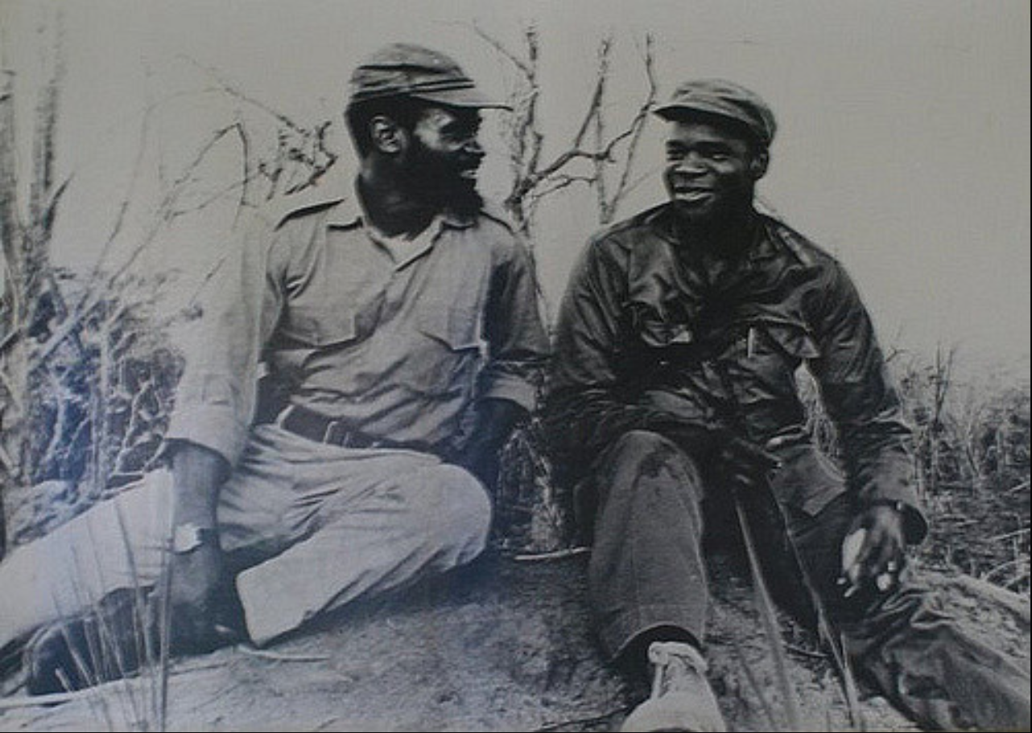
:
Mozambique
1962: Front for the Liberation of Mozambique (FRELIMO)
1960s: Several waves of crisis
1969: First president Eduardo Mondlane assassinated in Dar es Salaam
1969: Samora Machel the new president (1969-1986)
Picture: Samora Machel (left) with Eduardo Mondlane
Notes:
Seminar discussion

Slide 13
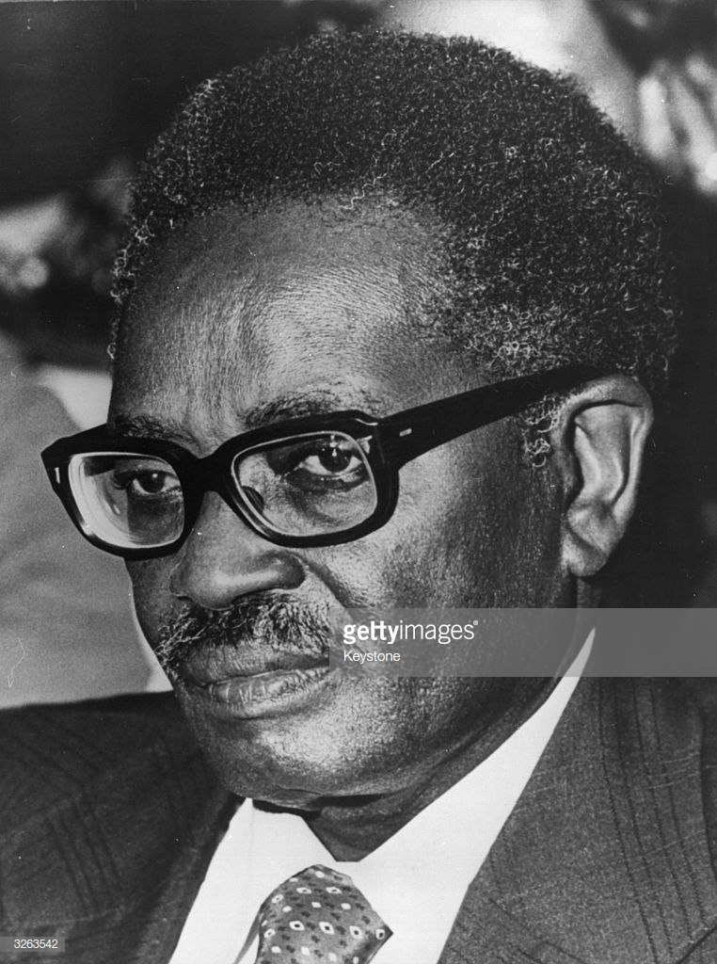
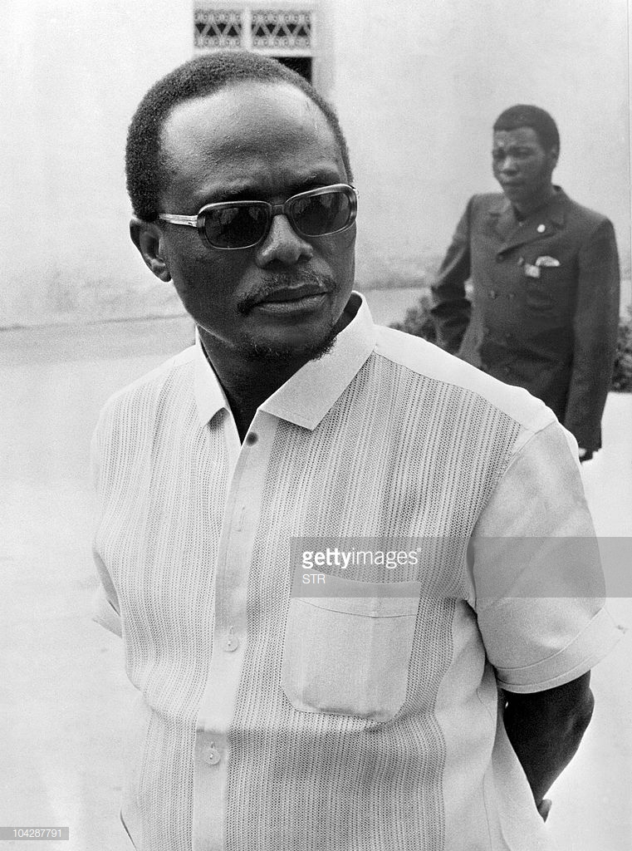
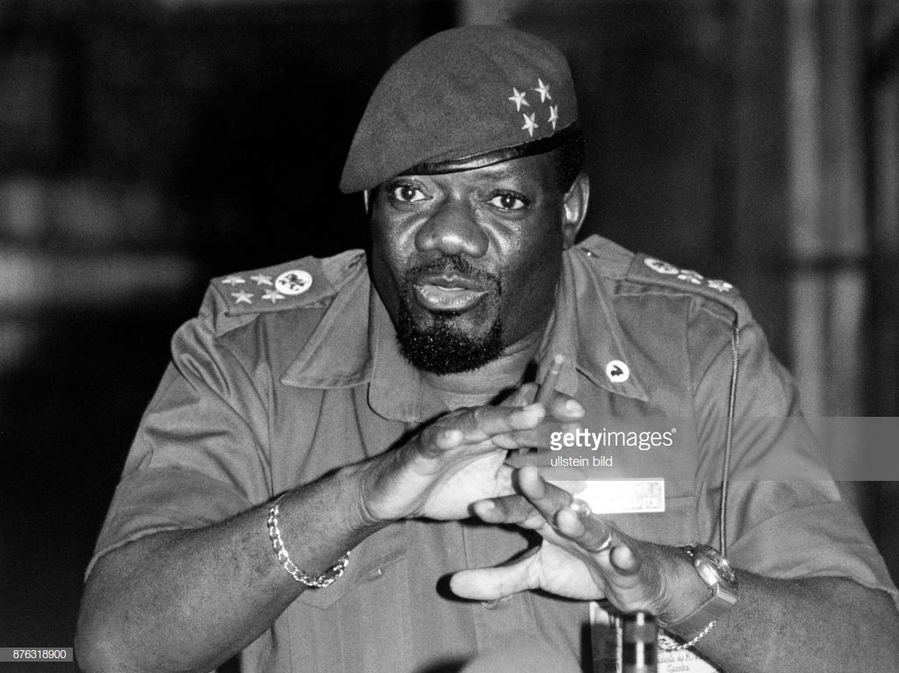
:
Angola
The Popular Movement for Independence of Angola (MPLA). Agostinho Neto
The National Front for the Liberation of Angola (FNLA). Holden Roberto
The National Union for the Total Independence of Angola (UNITA). Jonas Savimbi
Pictures from left to right: Agostinho Neto (glasses), Holden Roberto (sunglasses) and Jonas Savimbi (hat)
Notes:
MPLA: rooted in Mbundu (around Luanda)
FNLA: rooted in Bakongo of northern Angoal. Many lived in Congo-Leopoldville. FNLA based in Leopoldville! Most members spoke French, not Portuguese, close links with Congolese elites (Mobutu)
Savimbi: first joins the FNLA, then founds his own party in 1966 (disagreements over methods of armed struggle, foreign policy, see Bridgeland, “Jonas Savimbi”)…

Slide 14
Key Points
Divisions on ethnic, ideological, and personal basis.
Abuse of power and suppression of dissent (long periods in exile, need to organise an armed movement)
Marxist sympathies because Marxism offered:
a language of political mobilisation;
a means of overcoming ethnic divisions;
a blueprint for building a new postcolonial state;
a means of extracting support from China, the Soviet Union, and Cuba
Notes:
Many of the liberation movements were divided, on ethnic and ideological basis. There were also frequent arguments about the tactics of liberation struggle and popular mobilization and personal rivalries. As a result, in each of the countries, there were competing organisations or groups with claims to represent the would-be independent nation. Some liberation movements (PAIGC, Frelimo, ANC) would manage to push aside local rivals (South Africa, Guinea-Bissau, Mozambique). Others did not (Angola, Zimbabwe). Very often, these became connected to Cold War sponsorship from (usually) China or the Soviet Union. For example, ZAPU was supported by Soviet Union and the splinter ZANU by China. Still, many internal divisions remained.
ABUSE of POWER. Very often, these divisions would led to internal crackdowns, abuses and assassinations. This still remains a highly controversial point, especially since the majority of these organisations are still in power.
IDEOLOGICAL ORIENTATION: Many of these liberation movements had Marxist sympathies, attracting support from the communist world and hostility from the West. To them, Marxism offered:
a language of political mobilisation;
a means of overcoming ethnic divisions
a blueprint for building a new postcolonial state, especially given resources had been in the hands of white settler populations.
a means of extracting support from China, the Soviet Union, and Cuba

Slide 15
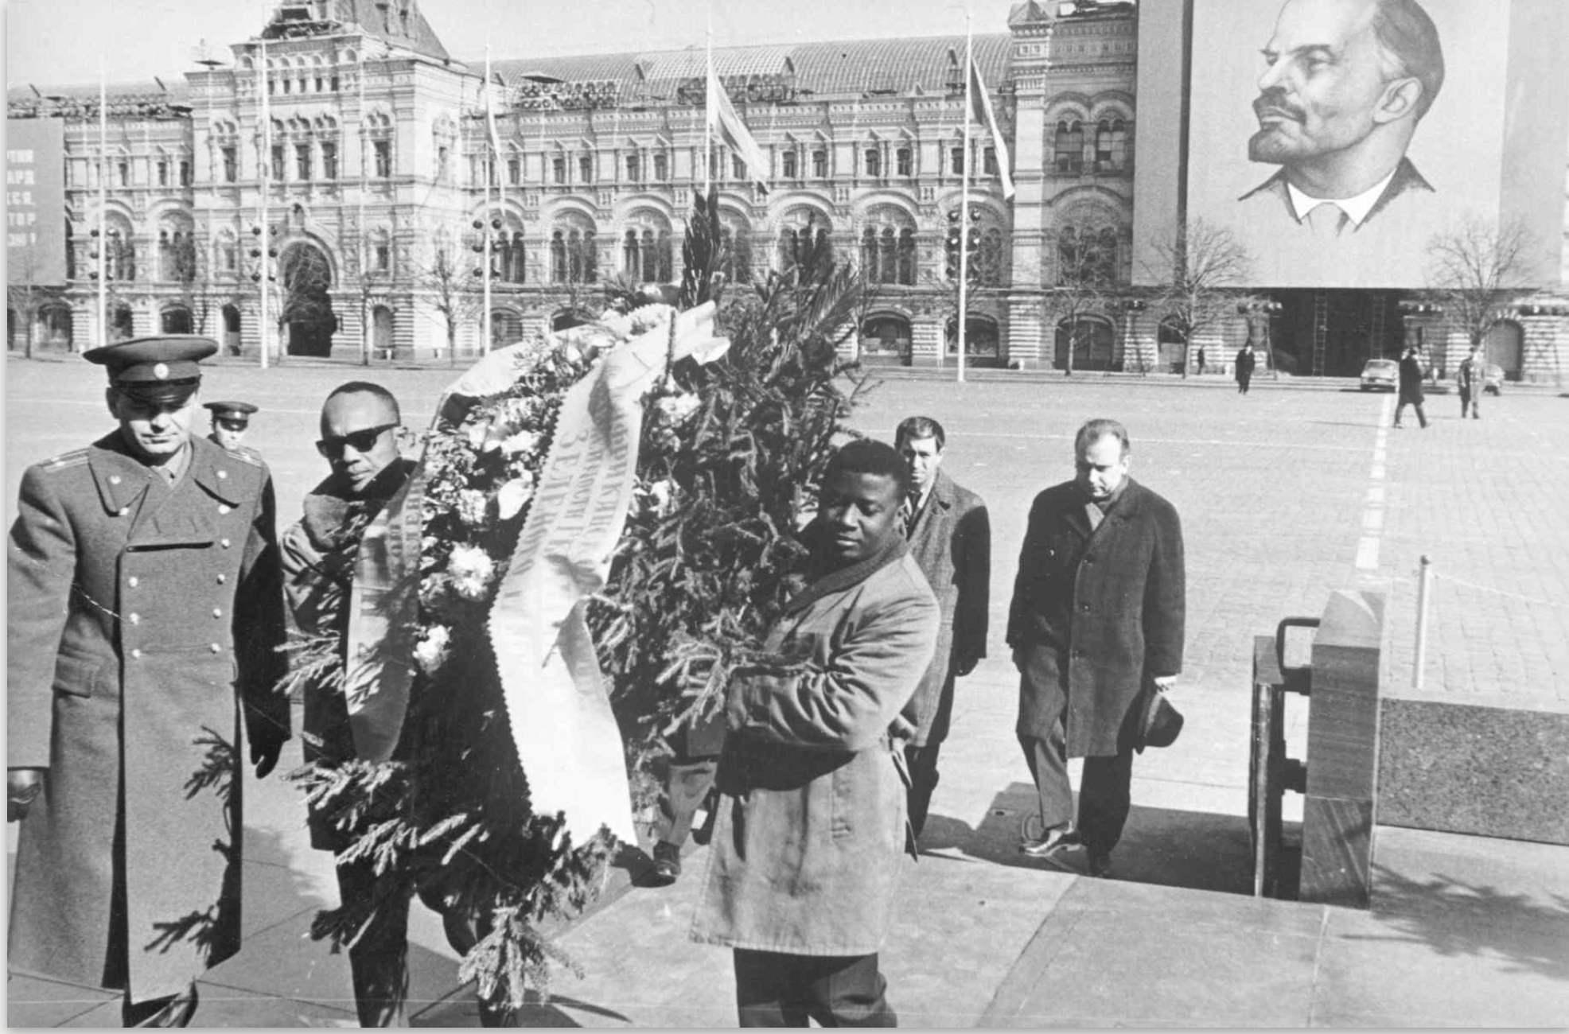
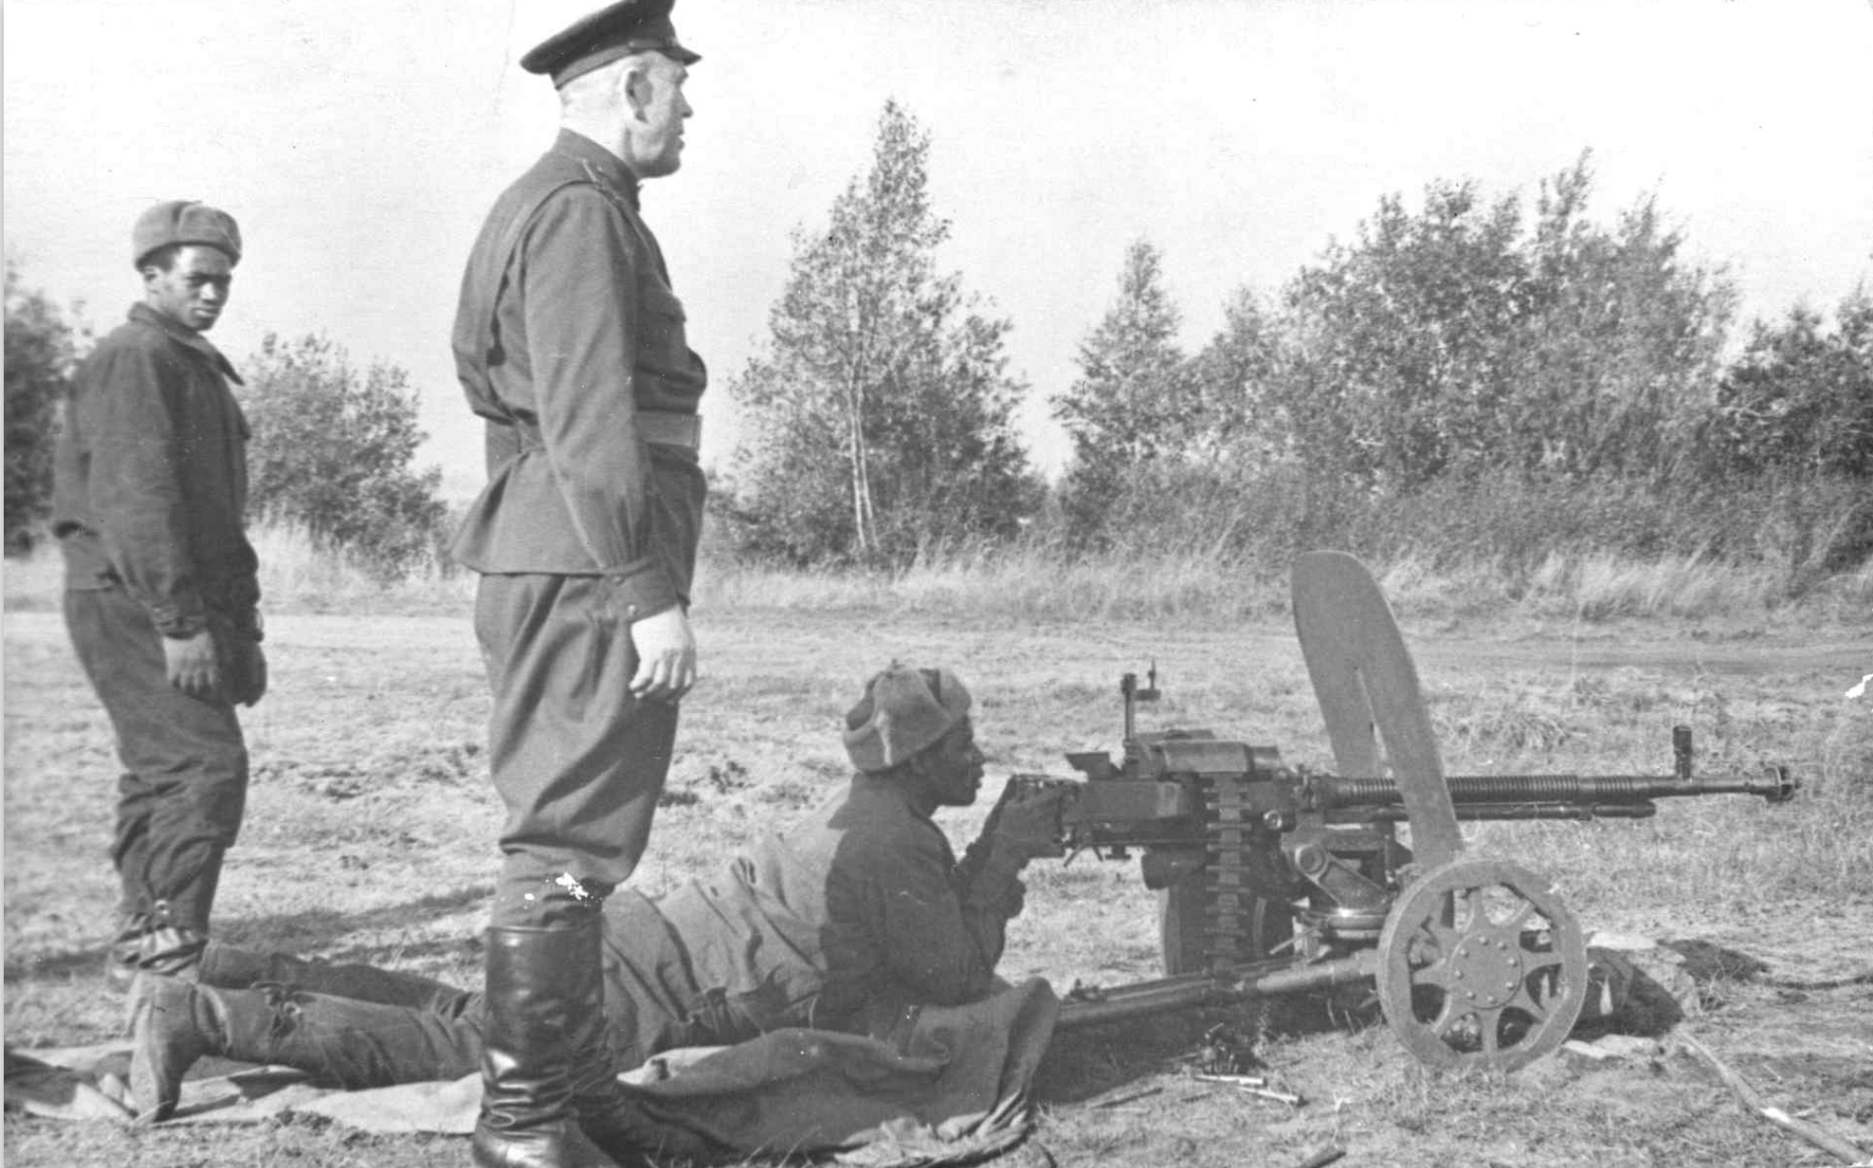
:
External Support: Soviet Union
ANC: close relations. $300,000 a year to the ANC
PAIGC: close relations with Cabral: thousands of soldiers trained
Eastern Europeans: Czechoslovakia, GDR, Bulgaria all supported liberation movements with arms, training, cash (approx 21 million roubles in military equipment, 1973-74 RGANI archive)
Picture left: Amilcar Cabral and Saude Maria (PAIGC) lay flowers in front of Lenin’s mausoleum, Red Square, Moscow
Picture right: PAIGC soldiers undergoing training in Perevalnoye, Soviet Ukraine (Source: casacomum.org)

Slide 16
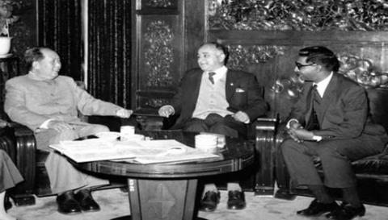
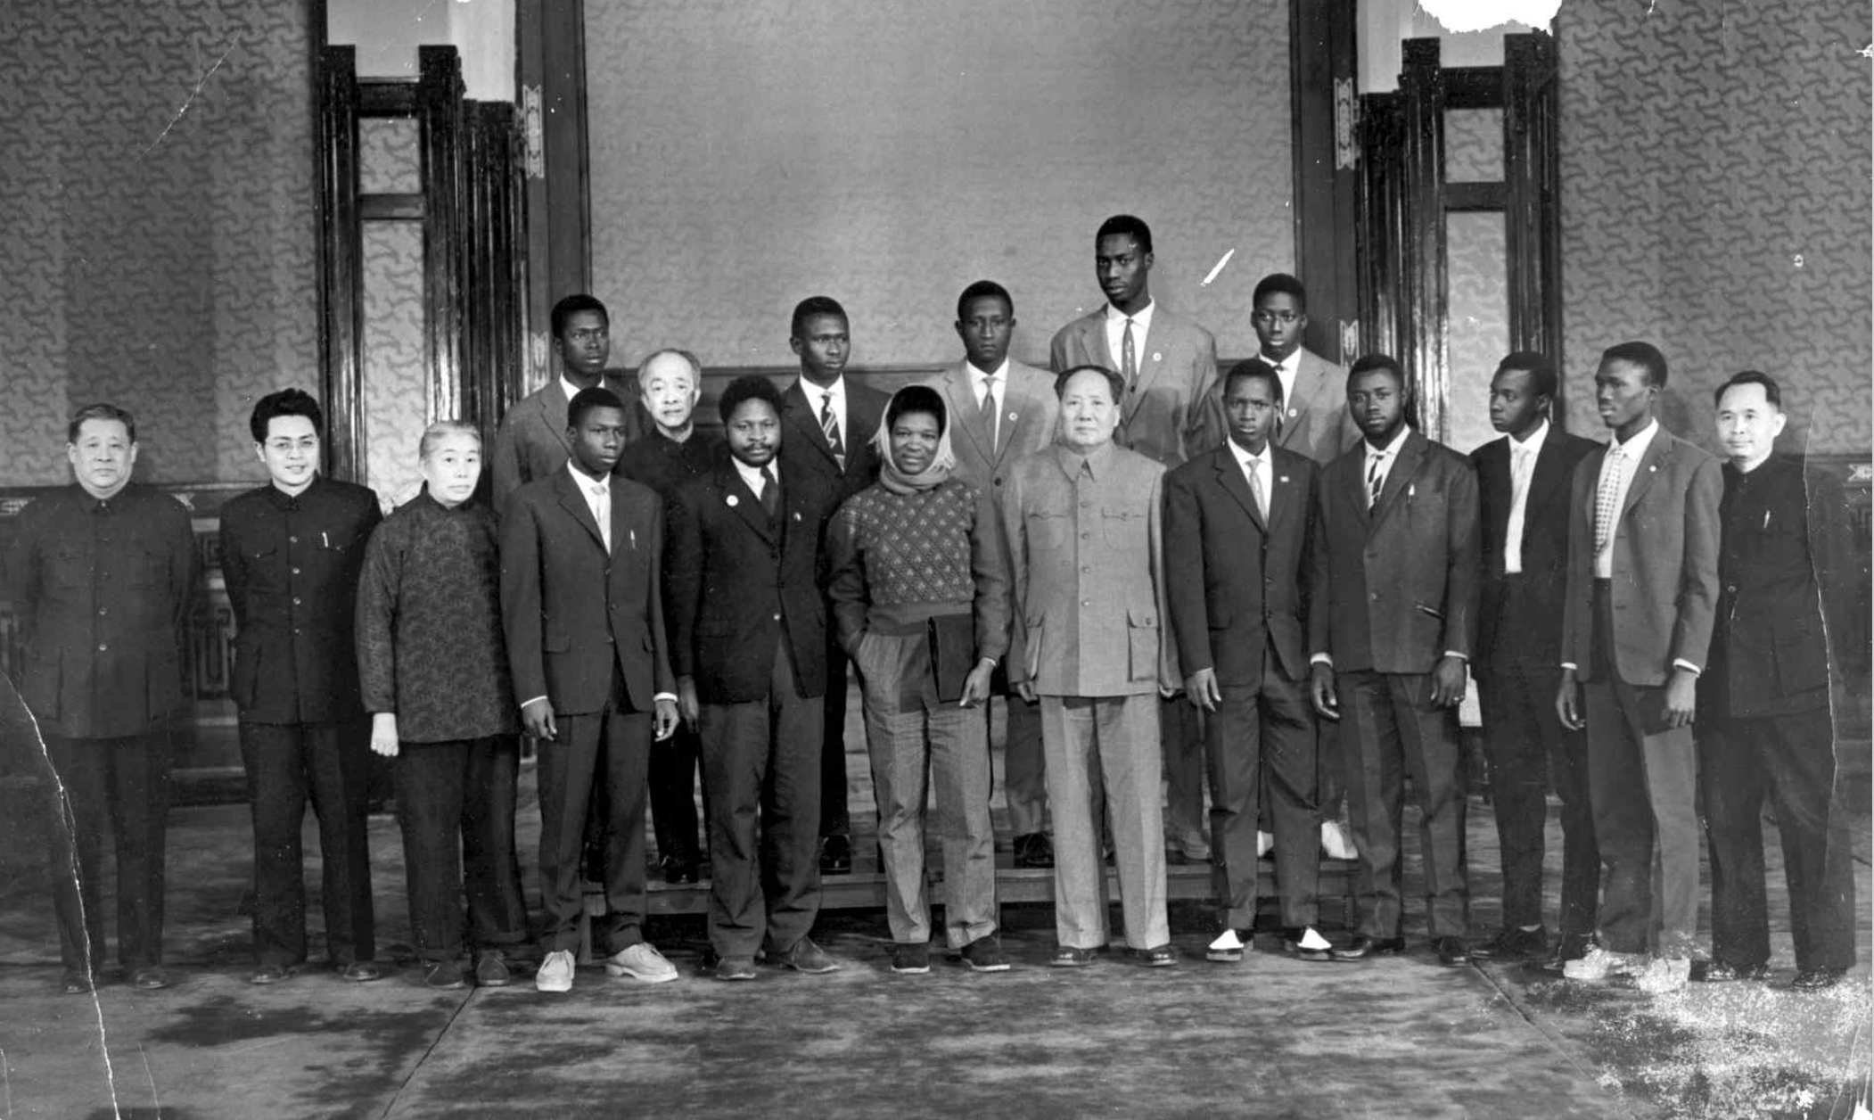
:
External Support: China
Sino-Soviet Split → China increases support for anti-colonial movements (cash, military training in Nanjing)
Cultural Revolution: Beijing withdraws, but provides support for Maoist groups and splinter nationalist movements
Picture left: Mao Zedong with SACP members Yusuf Dadoo (middle) and Vella Pillay (right), 1960
Picture right: Mao with members of the PAIGC on training in China, 1961 (casacomum,org)

Slide 17
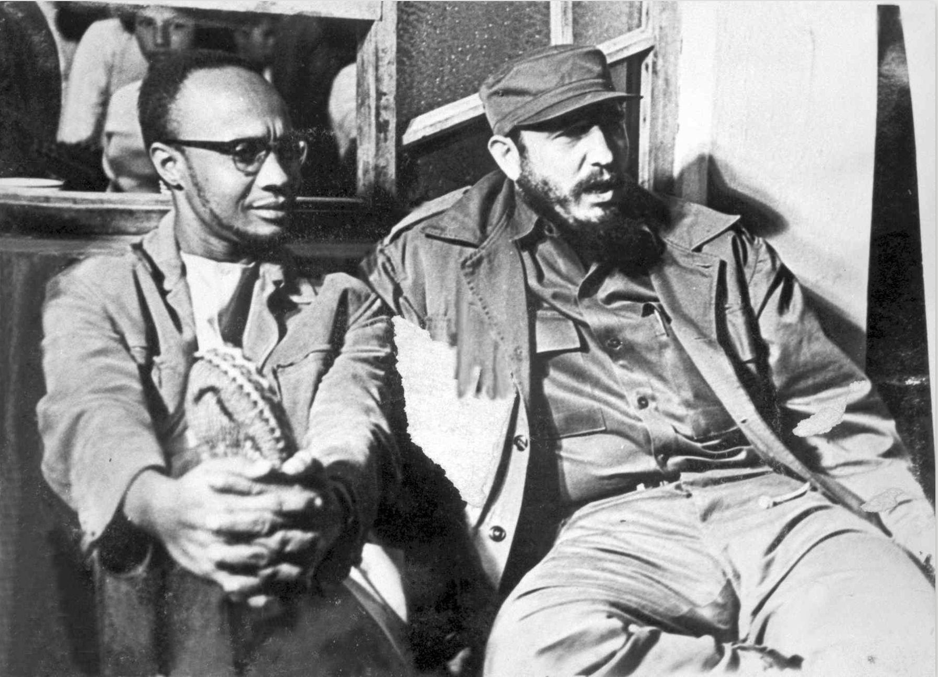
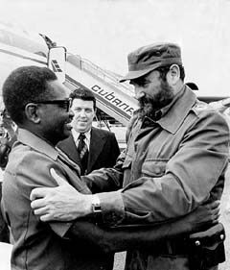
:
External Support: Cuba
Cuba: key player in Africa since 1960s. Motivations: export revolutionary tradition
Supported PAIGC (1964-1975)
MPLA (1964 onwards….)
Picture left: Fidel Castro with Amilcar Cabral (PAIGC), 1967, in Havana
Picture right: Fidel Castro with Agostinho Neto (MPLA)

Slide 18
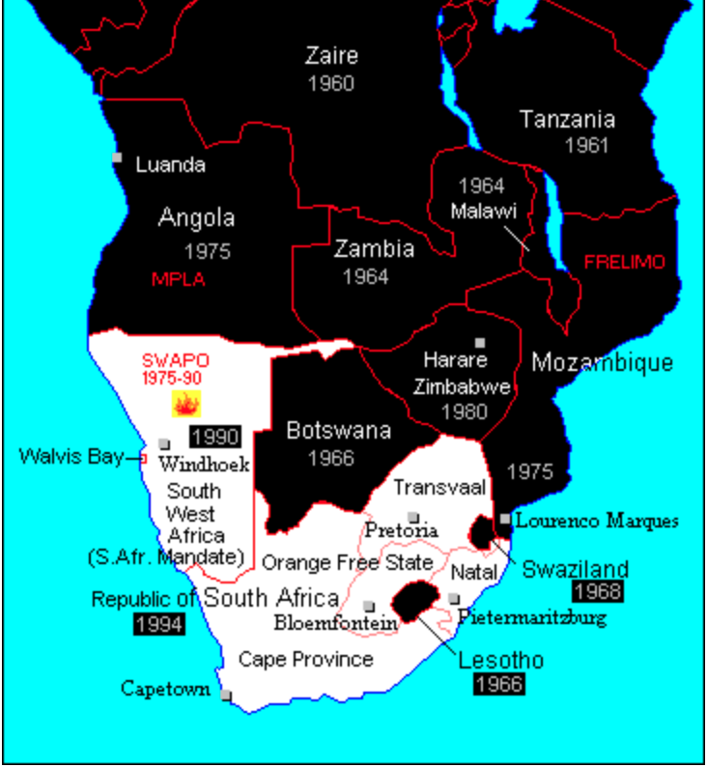
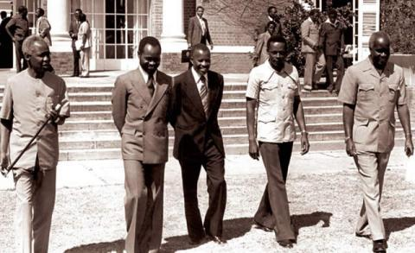
:
External Support: Africa
Radical anti-colonial states, such as Ghana (under Nkrumah) and Algeria
‘Frontline states’: originally these were Tanzania, Zambia and Botswana. After the fall of Portuguese Empire, Angola and Mozambique were added to the list
Problems: retaliation, internal destabilization
Picture left: Map of southern Africa in 1980
Picture right: leaders of the Front Line States (from left) Tanzania’s Julius Nyerere, Mozambique’s Samora Machel, Botswana’s Quett Masire, Angola’s Eduardo dos Santos and Zambia’s Kenneth Kaunda, 1980s
Notes:
FRONTLINE STATES: All the liberation movements were based in independent African states, neighbouring their countries. Therefore, they depended on the patronage of African states for their own survival, obtaining passports, maintaining offices – so they competed for interest among African leaders, as well as among potential foreign sponsors. In 1975, Botswana, Tanzania and Zambia were officially recognised as “frontline states”—those that were officially dedicated to ending white minority rule in South Africa. After Portuguese colonies and Zimbabwe became independent, they also became ‘frontline’ states and allowed SWAPO and ANC to operate from their territories
PROBLEMS: The liberation movements posed a number of challenges to their hosts, the ‘frontline states’.
RETALIATION. Supporting the liberation movements opened up frontline states to retaliation raids from white minority governments. For example, the Portuguese launched several coups in Guinea, trying to capture the leadership of the PAIGC based in Conakry
DESTABILIZATION. Their presence also had destabilising effect on local politics. Often, liberation movements become engrained in rivalries within the postcolonial state. For example, in 1969, guerrillas approached to provide military support for a coup plot against Nyerere. Partly in response, the ANC were ordered out of Tanzania – thousands of MK cadres were flown to the Soviet Union to continue their training there.

Slide 19
Conclusions
How accurate is the narrative of ‘national liberation struggle? –often divided over ethnic and ideological grounds, over strategy of popular mobilization →exile politics led to suppression of dissent
Did the Cold War unite or divide these movements? –yes, to a certain extent
Did liberation movements have powers over international donors? –yes, agents of their own liberation
Notes:
How accurate are narratives of united ‘National Liberation Struggle’?: After independence, all liberation movements assumed power. (THEY ARE STILL IN POWER!). In Angola and Mozambique, these were states with strong Marxist influence, which carried over fight against imperialism into both their domestic and foreign policy. Actually, there are STILL IN POWER, 20 years on! Oftentimes, their legitimacy dependent on a glorious narrative of unified struggle in exile. But as we’ve seen, they were very much divided movements
Did the Cold War unite or divide these movements? There are still debates about the impact of armed struggle on the organisations that came out of these movements. Some have argued that authoritarian modes of organisation were required to establish effective armed movements and obtain external support. These authoritarian practices were carried into the post-independence period. At the same time, the Cold War allowed for rival factions to appeal to international donors. Some have argued that Cold War divided these movements, rather than united them
Did liberation movements have powers over international donors? Support from the socialist countries was fundamental to armed struggle. However, these organisations were not controlled by Moscow. In fact, it was them who had to approach and lobby international donors for continuous support. In the case of Angola, this had particularly precarious consequences, as we will see next week.

