Slide 1
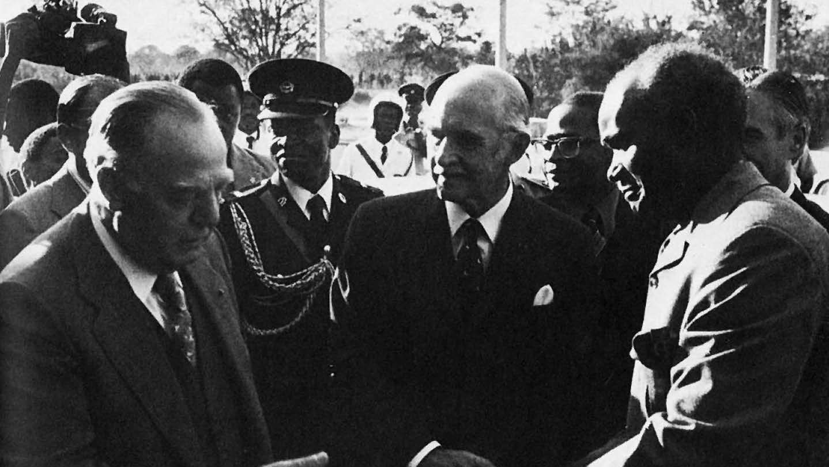
Defending white minority rule
HI277 | Africa and the Cold War
Term 2 | Week 7
Détente in action: South Africa’s Prime Minister B. J. Vorster meets Zambian President Kenneth Kaunda, Victoria Falls, 1975

Slide 2
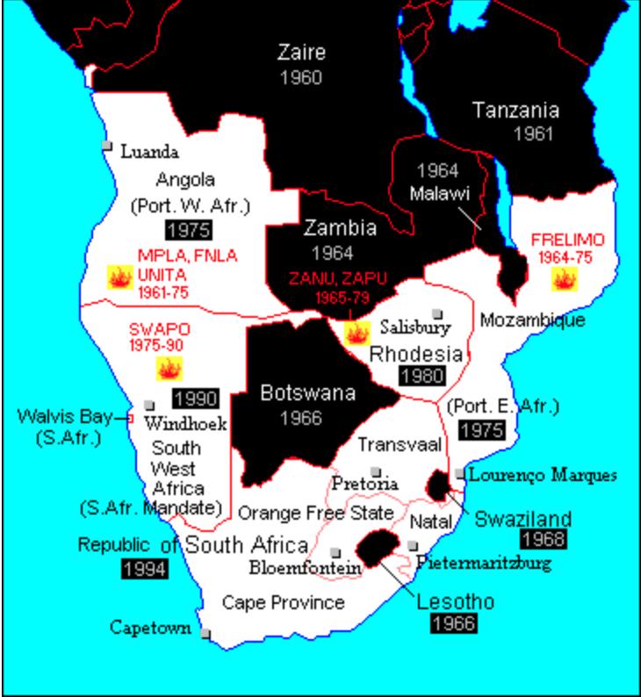
MAP
Frontline States

Slide 3
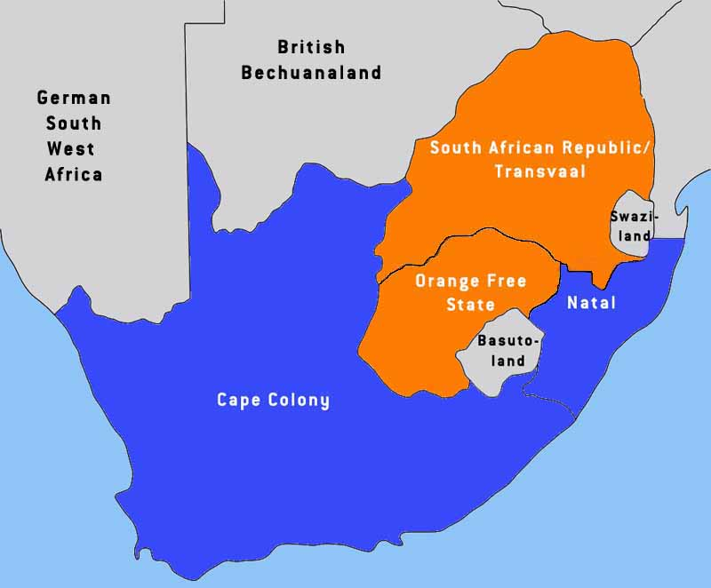
South Africa: Background
Economic powerhouse:
Kimberley diamond diggings, 1867-
Witwatersrand gold mines, 1880s-
-->mines required cheap labour →development of racial hierarchy
Afrikaner Nationalism: ‘Great trek’; Boer wars (1880-81 and 1899-1902)
1914: National Party formed
1948: National Party victory – apartheid imposed
Southern Africa colonies, c. 1900
Notes:
Land, Labour and Gold: The key focal point of white minority rule was South Africa. First a British colony, in the late 19th century, gold was discovered in the Transvaal region of South Africa. As mining developed on a large scale, it became clear that South Africa would become an economic powerhouse in the continent. Indeed, South Africa would become one of the most industrialised countries in Africa, which required cheap access to African labour. At the same time, European and Dutch colonisation led to the development of a substantial settler community, often with competing interests. As a result, there developed a racial hierarchy, with white settlers on top, subordinate role for Cape Coloured and Indian minorities, black African majority at the bottom, who were denied political and economic privileges.

Slide 4
South Africa: Elections 1948
Jan Smuts
(United Party)
F. D. Malan
(National Party)
What was the impact of the collapse of the Portuguese Empire?
versus
Notes:
Afrikaner Nationalism and the National Party (1914): Souh Africa had a complex history of ‘white settlement’ and colonisation. One group of settlers were known as AFRIKANERS. They were the descendants of 17th century Dutch, German and French settlers. In the late 19th century, Afrikaners found themselves in conflict with the British and moved eastwards, founding the independent republics of Transvaal and the Orange Free State. However, with the discovery of gold in Transvaal, Afrikaners were set on the course of conflict with the British. In the early 1920s century, the British fought 2 campaigns against the Afrikaners in the Boer wars and annexed Transvaal and the Orange Free State.
While South Africa became independent after World War I, the interwar period saw a rise of Afrikaner nationalism, which focused on protecting Afrikaner culture and identity. Africankers believed they were white Africans who tamed the landscape and occupied ‘empty lands’. One consequence was the emergence of the National Party. Founded in 1914, it originally campaigned to protect interests of Afrikaners within South Africa. However, the party was divided, and by the start of the Second World War there emerged a radical facton of the National Party. Led by Daniel Francois Malan, it stood for the total segregation of the races—the policy of apartheid
SLIDE 1948: Elections: United Party (Ian Smuts) vs. National Party (Daniel Francois Malan). Onset of Apartheid.
While other European colonies in Africa moved towards decolonisation after the Second World War, South Africa went in precisely the opposite election. The post-war period in South Africa saw very heated debate about race relations in South Africa. These crystallised around the elections of 1948. Two main competing parties, the United Party led by Ian Smuts and the white supremacist National Party led by Malan stood on very different positions towards segregation. Malan’s National Party won the elections and formally instituted the system of segregation under a regime known as apartheid. Africans were confined to reserves and non-whites had to carry pass books to regulate their travel to white areas.

Slide 5
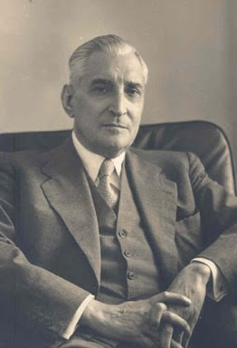
Portuguese Empire in Africa
Complex society: white Portuguese; black Angolans; mesticos (mixed-race) population; assimilados (educated Africans)
Labour scarcity →development of hierarchical social order
Lack of investment in social welfare
1932-1968: Antonio Salazar’s comes to power in Lisbon. Establishes Estado Novo (‘New State’) in 1933.
1951 – Angola, Mozambique, Guinea-Bissau, Cape Verde made overseas territories
1961: Angolan Uprising and the start of anti-colonial wars
António de Oliveira Salazar. PM 1932-1968
Notes:
MIXED POPULATION: The Portuguese were among the first to explore the coasts of Africa where since the 15the century, they established a series of ports and often dominated the slave trade, which actually depopulated Angola. Hundreds of years of Portuguese presence led to the emergence of a very mixed population of mestiços (mixed race), especially in places like Cape Verde and urban centres. Another feature of Portuguese Empire in Africa was land scarcity. LABOUR In Angola, Mozambique and Guinea-Bissau, land was plentiful, but the population was very scarce. That created problems for the Portuguese after the abolition of slavery in the 19th century because there were NOT ENOUGH people to develop cash crops. The response of the Portuguese and ‘men on the ground’ was to develop a racial-based hierarchy to make it easier to acquire enough people to work the plantations of cotton, coffee, sisal, peanuts etc.
RACIALISED SOCIAL ORDER: The racialised order was based on the distinction between indigena (indigenous) and the majority nao-indigena (non-indigenous) Africans. The non-indigenous category also included a tiny minority of ‘assimilado’ (assimilated) category of Africans who could prove they had become Portuguese. This involved a series of humiliating and expensive tests to show that the candidate could speak Portuguese, dressed, ate and slept in a certain way and could pay a fee to the colonial authorities.
LACK OF DEVELOPMENT: As one of the poorest European country, Lisbon did not have resources to invest in colonial development. As a result, the majority of schooling was done by Christian missionaries. There was also little infrastructural development. Portuguese settlers were often quite poor and often competed with established, middle-class African or mixed-race families.
SALAZAR AND ESTADO NOVO (1932-1974). These distinctions only hardened under the rule of Antonio de Oliviera Salazar, a prime minister who came to power in early 1930s as a result of tremendous economic problems. While Salazar sorted Portugal’s finances, he also issued a new constitution of Estado Novo (new State), which enshrined authoritarian, traditionalist and ultraconservative Catholic values – similar approach to Franco’s Spain.
The colonies were fundamental to Salazar’s vision of Estado Novo. He believed they were fundamental to Portugal’s economy and place in the world. Salazzar’s vision put pressure on Africa labour (remember it was fairly scarce), with Africans FORCED to grow certain crops and engage in public works. A punitive labour and taxation regime was the reason why so many crossed the borders and settled in neighbouring colonies.
1961 Angolan Uprising and the Start of Anti-Colonial Wars.

Slide 6
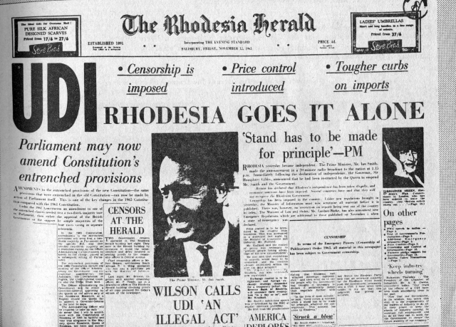
1953 – Central African Federation formed (N. Rhodesia, S. Rhodesia, Nyasaland)
1961 – Sharpeville Massacre, ANC banned in South Africa. UN sanctions.
1963 – Rivonia Trial and imprisonment of ANC leadership
1963 – CAF collapses due to nationalist pressure
1964 – Simba Rebellion and South African mercenaries in Stanleyville
1965 – Ian Smith made Unilateral Declaration of Independence in South Rhodesia
1966 – UN imposed mandatory sanctions against Rhodesia

Slide 7
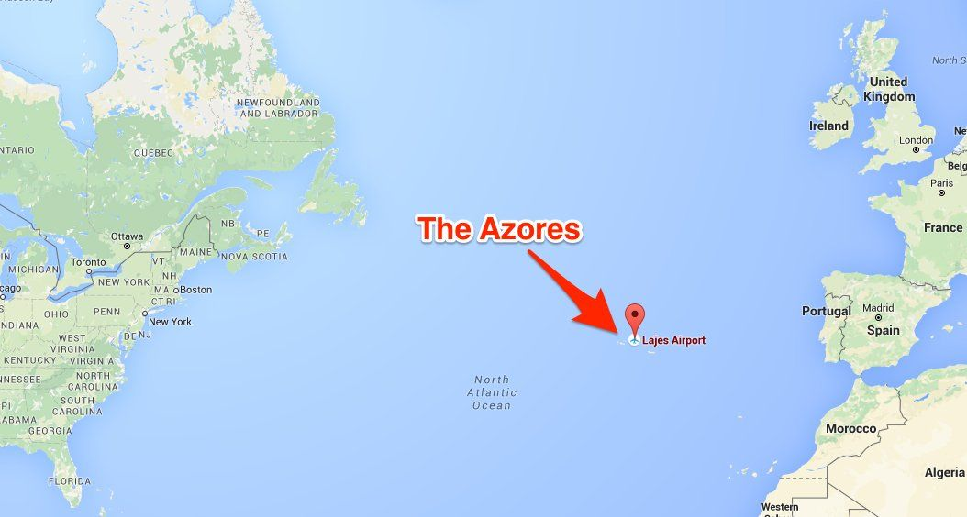
Who supported the white minority states?
Portugal and NATO allies. Importance of the Azores
Location of the Azores archipelago. NATO military base at Lajes
Notes:
Overall, policy towards these regimes was quite confused and often contradictory.
US/Salazar’s regime: Portuguese colonialism was embarrassing for its allies. However, Portugal was an ally in NATO. Portugal was important because it owned the Azores, which became and important military base for the USA and Britain during the Second World War. Unsurprisingly, USA wanted to hold on to the base and it was one of the reaons it was actually admitted to NATO.
At the same time, Portuguese Empire seemed to be a relic of the past. This was became particularly an issue in 1961, when news of revolt in Angola and brutal retaliation hit international headlines. John Kennedy had a very complicated relationship on the issue. On one hand, he wanted Portugal to abandon colonial rule and tried to put pressure on Salazar. He also started to forge contacts with Angolan nationalists. At the same time, Kennedy still realised that US needed the Azores base. This was an issue of considerable debate, but eventually those who advocated to tone down pressure on Portugal won the day. Cold War was really important here because it increased the importance of the base in times of crisis, such as Berlin and Cuban Missile Crisis.

Slide 8
Support for white minority states -
U.S.A.
Portugal and NATO solidarity in Europe
United States and South Africa
  Economic interests – 20% of FDI from US by 1980
  Technological expertise – development of nuclear programme
  Regional policeman against communism in Africa
  Shifting position:
    1963 – supported voluntary UN embargo on arms sales to South Africa
    Johnson and especially Nixon much more tolerant of apartheid
    Carter and human rights – voted to render UN arms embargo mandatory

Slide 9
Support for white minority states –
Britain
Europe
Israel
Africa
Britain – ambiguous support
  Conservative governments more tolerant; Labour more critical
  Heath government and proposed sale of helicopters to South Africa, 1971
  Thatcher opposed economic sanctions against South Africa… but did negotiate the settlement in Rhodesia in 1979-80
  Beyond the government…
    Conservative ‘Monday Club’ – e.g. involvement in O’Brien Organisation
France, West Germany
Israel
Problematic position of frontline states, especially Kaunda’s Zambia and Banda’s Malawi

Slide 10
An ‘Unholy Alliance’? Exercise ALCORA
South Africa saw Rhodesian and Portuguese colonies as a cordon sanitaire against the liberation movements
South Africa’s ambiguous support for Rhodesian UDI
Evading embargos, e.g. Portuguese provided oil to Rhodesia
Institutionalised collaboration as Exercise ALCORA, 1970
How effective was cooperation among the white minority states?
Was it too dependent on South Africa?
If it did fail, why?

Slide 11
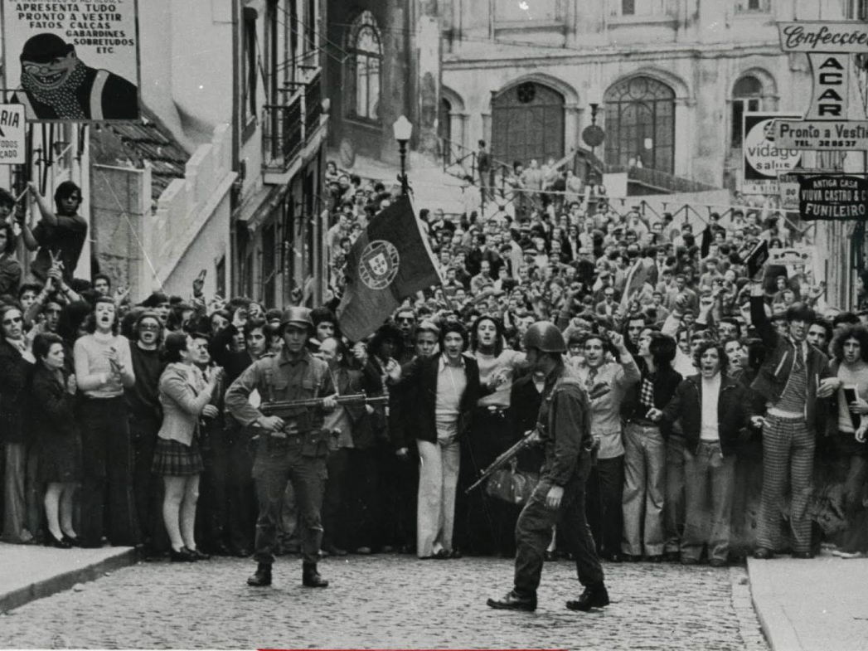
25 April 1974: Revolution in Lisbon

Slide 12
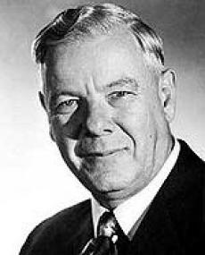
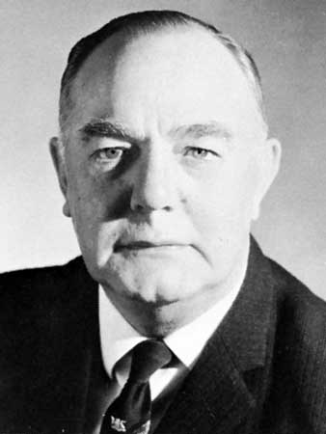
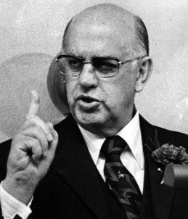
Hawks and doves: shifts in South African foreign policy
Hendrik Verwoerd (Prime Minister 1958-66)
  Hardliner, creation of ‘Bantustans’ – reserves for African population
Balthazar Johannes Vorster (1966-78)
  Legitimising apartheid regime via African diplomacy; Bantustans as self-determined nations
  Courting support in Africa, e.g. efforts to buy cotton from Chad in late 1960s
Impact of collapse of the Portuguese Empire
  Vorster and détente – saw Rhodesia as a liability, negotiated with Zambia
  Opposition from the hawks, especially Defence Minister P. W. Botha – ‘total onslaught’
South African ‘recce’ forces and reprisals against frontline states
  Bombings in Dar es Salaam, 1972
Need to integrate developments into story of domestic politics in South Africa, too
Verwoerd
Vorster
P. W. Botha

Slide 13
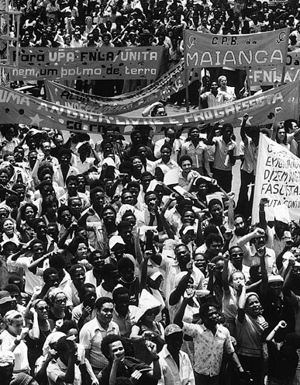
Towards the Angolan war
January 1975 – Alvor Agreement
Portuguese withdrawal by 11 November
transition of power to a coalition government
Fighting broke out between MPLA, FNLA, and UNITA
Soviet Union increased its support for MPLA
South African hawks pushed for action…
Independence Day
11 November 1975, Luanda

Slide 14
Conclusions
Late 1970s – Rhodesia forced into negotiations with liberation movements; Lancaster House talks in 1979; independence in 1980
South Africa ‘outsourced’ its defence to Portugal and Rhodesia – left Pretoria dangerously exposed as both regimes collapsed in 1970s
Multiple perspectives…
Domestic – politics in Portugal, Rhodesia, South Africa
Regional – Exercise ALCORA, relations with frontline states
Continental – Vorster’s détente
Global – the Cold War – playing on fear of communism

