Slide 1
Cuba, South Africa & the struggle for Angola, 1974-89
CNN
HI277 – Africa and the Cold War
Week 8 | 2 March 2026

Slide 2
From the White House…
Ronald Reagan and Jonas Savimbi
Washington, DC, 1986

Slide 3
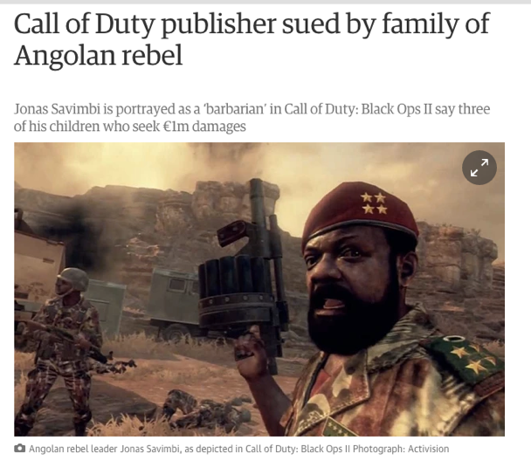
…to Call of Duty

Slide 4
Lisbon, 25 April 1974: Carnation Revolution

Slide 5
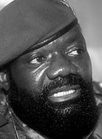
The Angolan Civil War
MPLA
FNLA
UNITA
Agostinho Neto
Holden Roberto
Jonas Savimbi
Alvor Agreement settles independence for November 1975… but civil war immediately breaks out

Slide 7
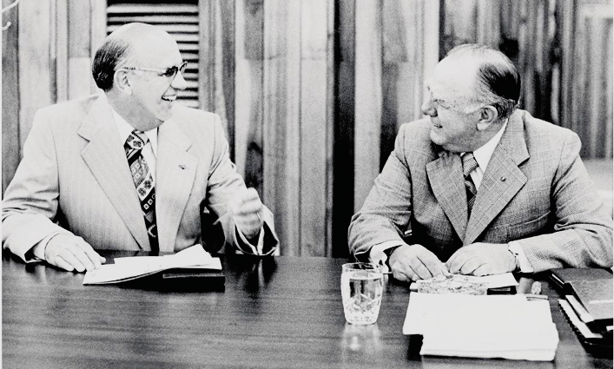
Operation Savannah: South Africa invades Angola
network24.com
P. W. Botha and John Vorster at a cabinet meeting

Slide 8
‘What is looming…is a spreading proxy war between China and Russia in Africa, in which the two Red powers, not ready for the long predicted day of reckoning on the Asiatic borders, are skirmishing, as Hitler and Stalin did in Spain, for imperialist advantage.’
– Die Burger, 21 July 1975
network24.com

Slide 9
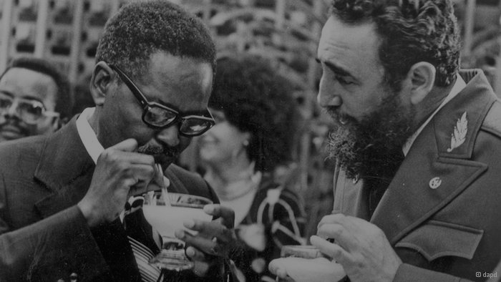
The Cuban response: Neto and Castro
network24.com

Slide 10
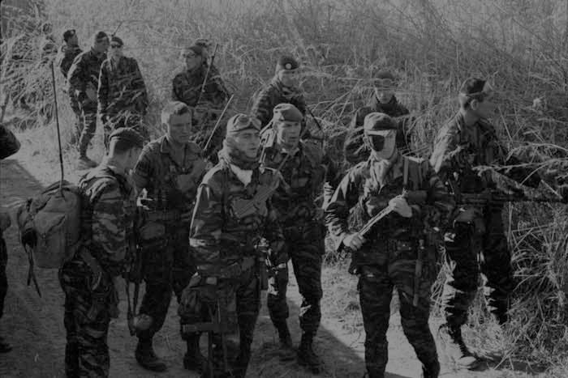
The Shaba invasions, 1977-78
foreignlegion.info
French Foreign Legion troops on patrol in Zaire, 1978

Slide 11
The bombing of Cassinga, 4 May 1978
network24.com
wikipedia

Slide 12
UN Security Council Resolution 435 (1978)
Provided for independence of Namibia, with supervised transition to democracy
South Africa would not tolerate any SWAPO government
Pretoria sought to bring to power Democratic Turnhalle Alliance
Pik Botha told US: ‘a SWAPO victory will mean a Soviet presence in Namibia… you cannot have Nujoma without a red flag’
Cubans refused to withdraw until South Africa did so and Pretoria ended its own support for UNITA
US developed concept of ‘linkage’... but South Africa would not cooperate...
network24.com

Slide 13
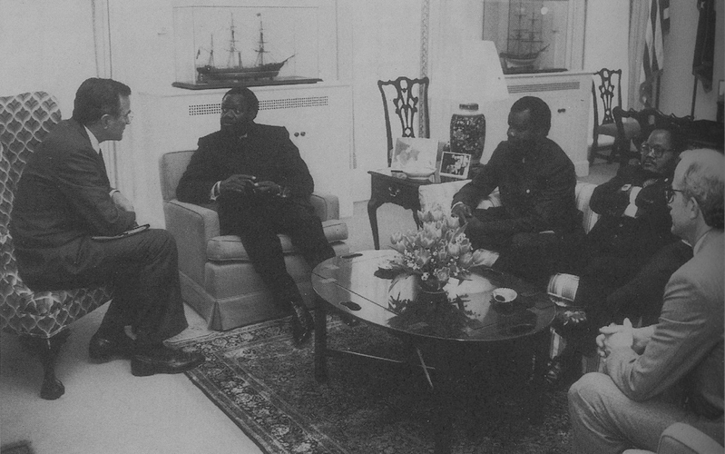
Ronald Reagan and ‘constructive engagement’
Chester Crocker and Jonas Savimbi in Washington, 1986

Slide 14
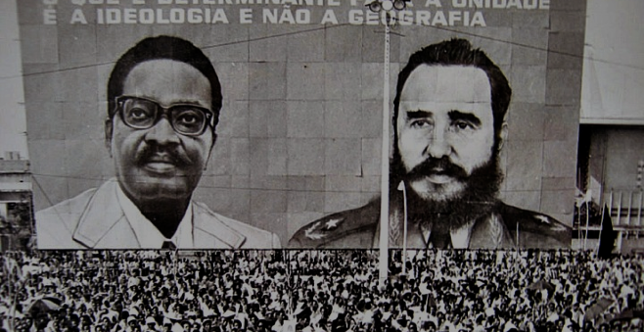
Angolan agency? Support for Shaba II Lusaka Agreement, 1984 Paying for civilian aid from Cuba

Slide 15
Black South Africans in arms: 32 Buffalo Battalion
volkstaat.net
network24.com
32 ‘Buffalo’ Battalion troops, 1986
South African Military Museum,
Johannesburg

Slide 16
The Angolan endgame: Mavinga to Cuito Cuanavale
network24.com
volkstaat.net
monthlyreview.org

Slide 17
The New York Accords, 22 December 1988
South African troops to withdraw from Namibia within 3 months
Namibia to become independent
South Africa to cease aid to UNITA
Cuban troops to withdraw from Angola within 27 months
…but the civil war in Angola lasted until Savimbi’s death in 2002
network24.com

Slide 18
Conclusions
One war, multiple conflicts:
Civil war between Angolans – pursued own interests
Ideological Cold War conflict
Racial war – defending white minority rule
Angolan War and the end of détente…
...but affected by developments elsewhere – ‘Second Cold War’
Beyond the superpowers: why did Cuba and South Africa intervene?
Divided Cold War actors
network24.com

