Slide 1
The Cold War and the end of apartheid
HI277 – Africa and the Cold War
Week 9 | 9 March 2026
De Klerk, Mandela, and Mbeki, 1994

Slide 2
Gorbachev‘s Reforms in USSR
Economic problems in the USSR
1985. Gorbachev’s reforms: perestroika (restructuring), glasnost (openness)
Imperial ‘overstretch’
Disappointment with Marxist regimes in the Third World –By 1988: withdrawal from Afghanistan, cutback on support for Ethiopia and Angola
Mikhail Gorbachev
Notes:
n 1985, Mikhail Gorbachev replaced a series of half-dead leaders as the General Secretary of the Soviet Union. Gorbachev was a young Soviet party cadre who was elected because everyone realised the Soviet Union need reform. The economy was stagnating, and the country as feeling the impact of so-called ‘imperial overstretch’-in Afghanistan, Angola and Ethiopia
REFORMS: Shortly after coming to power, Gorbachev announced a series of measures glasnost (openness) and perestroika (restructuring). These were meant to reform socialism and introduce a degree of democratisation. However, these led to greater demands for reform.
US: At the same time, Gorbachev wanted to improve relations with the USA and unilaterally initiated a series of conversations on arms control to deescalate tensions
THIRD WORLD: By the time Gorbachev had come to power, many Soviet officials had expressed intense scepticism about Soviet policy in the Third World. For the most part, the Marxist regimes they thought they were backing were not living up to expectations and only leading to expensive confrontations with the United States.
AFGHANISTAN. Gorbachev originally continued policies of his predecessors. For example, he stepped up efforts to win the war in Afghanistan and reassured about Soviet commitments in southern Africa. By 1988, Gorbachev had decided to withdraw forces from Afghanistan. Gorbachev also decided to reduce spending on ANGOLA –a decision he communicated clearly to the Ronald Reagan in Washington.
ETHIOPIA: In 1987, Mengistu, the leader of famine-stricken Ethiopia, met Gorbachev. Mengistu asked the general secretary for a new aid deal. Gorbachev told him to look for supplies elsewhere and showed him the door

Slide 3
Revolutions in Eastern Europe
Crumbling support for regimes in Eastern Europe.
1988-1991: 30% fall in the production of oil in the USSR→acute economic crisis. Rivalry with Boris Yeltsin
December 8, 1991: Belovezha Accords, USSR dissolved
N.B. no-one expected this at all at the time
People climbing the Berlin Wall in front of the Brandenburger Gate. The Berlin Wall came down on 9 November 1989: The Berlin Wall Comes Down
Notes:
We don’t have the time to go into the details of how communist regimes collapsed in Eastern Europe; it differed in each case. But what definitely mattered was Gorbachev’s unwillingness to use force to prop up regimes in Eastern Europe.
The leaders of Eastern European states didn’t realise this until it was too late. Without Soviet support, many crumbled under waves of popular pressure and somewhat ‘accidentally’. Such was the case when on 9 November 1989, East German citizen decided to breach the BERLIN WALL. The guards –or the communist party did not resist, leading to the downfall of the Berlin Wall
Revolutions of 1989 in Eastern Europe.
PROBLEMS IN the USSR: One reason why the Soviets did not react was because they were in the grips of their own economic crisis. If in the early 1980s the economy only stagnated, by 1988, the price and the production of oil in the USSR collapsed. This did not make the Soviet collapse inevitable, but it made Gorbachev increasingly desperate and dependant on Soviet aid.
The democratisation reforms he unleashed also led to the emergence of opposition that crystallised around Boris Yeltsin. In DECEMBER 1991, after a failed rightist coup in Moscow, Yeltsin and leaders of 3 other Soviet republics signed the so-called BELOVEZHA agreement that dissolved the Soviet Union.
N.B– with the benefit of hindsight, we might be tempted to read a degree of inevitability into the collapse of the Soviet Union and communism in Eastern Europe. However NO ONE EXPECTED THIS AT THAT TIME!

Slide 4
Toward democracy in sub-Saharan Africa
Economic crisis, especially after OPEC oil crisis of mid-1970s
Rising concern about human rights abuses
Structural adjustment reforms: reducing state sector, liberalisation of African economies
End of the Cold War pulled away pillars of external support
Wave of democratisation in early 1990s
Precedents provided by Eastern European revolutions?
network24.com

Slide 5
Tanzanians recognise that ‘events in Eastern Europe signify a very important shift away from the old assumptions and certainties, and they also feel that these events provided us with object lessons on how our own societies should be governed, the relationship between the rulers and the ruled, how power should be shared and who should allocate the sharing. And above all they all appreciate the moral force for change based on “people’s power.”’
A. M. Babu, ‘Open Letter to CCM Chairman’, New African, February 1990

Slide 6
F. W. de Klerk at the state opening of parliament,
2 February 1990

Slide 7
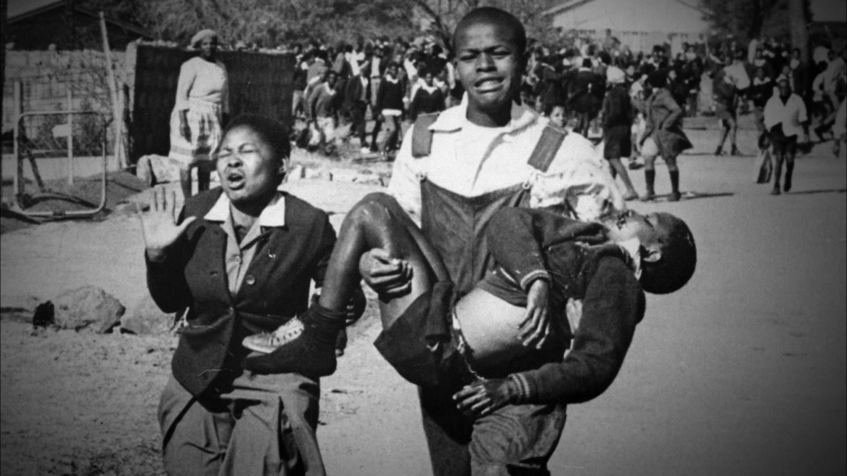
Soweto Uprising, 1976
June 1976 – Soweto Uprising
1980s – formation of United Democratic Front
1985 – P. W. Botha declares state of emergency
What role did the ANC play?
Hector Pieterson being carried by Mbuyisa Makhubo after being shot by South African police. His sister, Antoinette Sithole, runs beside them. Pieterson was rushed to a local clinic and declared dead on arrival. This photo by Sam Nzima became an icon of the Soweto uprising.
Notes:
SOWETO. A key turning point took place in the history of struggle against apartheid was the SOWETO Uprising of 16 June 1976. The uprising started when the government tried to impose Afrikaans (the language of apartheid) the language of primary education across South Africa. Protests started in Soweto, then spread to other townships. This was the biggest protest against the apartheid government since the Sharpeville massacre of 1960.The army was deployed and started shooting at protesters, many school students. The official death toll was put at 575, but many believe it was double that.
IMPACT. Soweto and Biko’s death galvanised many more young people to actively oppose South African government. The pictures like these also led to increasing international criticism
What role did the ANC play here? Remember, it had been forced into exile after the Rivonia Trial of 1963. Mandela and much of the leadership were in prison. It had no initial involvement in the Soweto uprising – afterwards it recognised the need to engage with the struggle inside South Africa, rather than solely trying to court military and diplomatic support from the outside.
1980s and formation of the United Democratic Front. The 1980s, saw the united opposition in urban areas and townships, bringing together student, churches, women, and youth groups – more demonstrations, huge wave of strikes, met by more violence. These were far more important in creating internal pressure against apartheid than the ANC’s own activities. South Africa was becoming ungovernable.
In 1985, P. W. Botha declared a state of emergency was declared…

Slide 8
Black protest in South Africa
Steve Biko and ’black consciousness’ movement
June 1976 – Soweto Uprising
September 1977 – Biko beaten to death in police custody
1980s – formation of United Democratic Front
1985 – P. W. Botha declares state of emergency
Steve Biko
network24.com

Slide 9
The malaise of the apartheid state
1978 – Vorster forced to resign as prime minister, replaced by P. W. Botha
Botha bolstered executive – centralisation of power
Superficial political change designed to gain support of coloured and Asian population
A shift in Afrikaner mentality? Less committed to apartheid as a racial order
Exodus of young white South Africans – manpower shortage
network24.com

Slide 10
Sanctions, boycotts, and isolation
Sanctions
  1986 – Congress passes Comprehensive Anti-Apartheid Act
Foreign direct investment dries up – government keeps economy growing by increasing public expenditure
International/transnational protest
  Anti-Apartheid Movement
Boycotts
  Barclays Bank and student boycott in UK
Cultural isolation
    Cricket and rugby teams refused to play/tour South Africa
network24.com

Slide 11
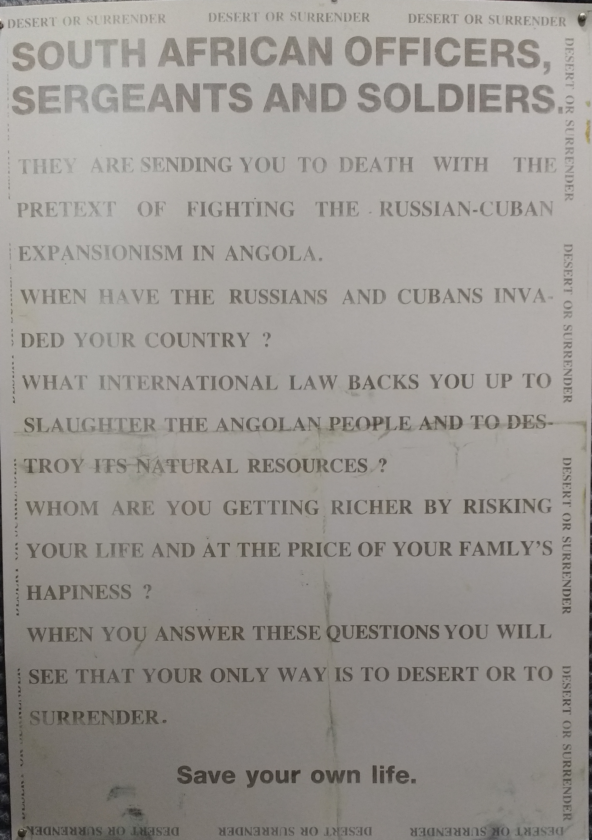
Impact of the war in Angola
Shortage of [white] troops in Angola
Conscription led to draft-dodging
New York Accords , 1988
US no longer had a Cold War reason to prop up South Africa… in Western eyes, the apartheid state had lost its raison d’être
network24.com

Slide 12
The transition to democracy
Protracted, fractious negotiations between NP and various opposition parties following the release of Mandela in 1990
What was the National Party prepared to concede?
Divisions and unresolved issues within the ANC
Continued activity of apartheid security apparatus and white extremists
Violence among supporters of African nationalist parties
1993 – 3,794 people died in violence in South Africa
1994 – multiparty elections; ANC won 63%; Mandela elected president
network24.com

Slide 13
The ANC and the National Party
ANC drop its commitment to public ownership of industry before the revolutions in Eastern Europe… but Mandela continued to talk about nationalisation until 1992
Soviet Union encouraged ANC to negotiate with the apartheid regime
August 1989 – ANC accepted idea of a negotiated settlement
South Africa forced to accept SWAPO government in Namibia… but turned out to be liberal, not Marxist
When did de Klerk accept the need for negotiations?
Did this predate the end of the Cold War in Europe?
network24.com

Slide 14
Conclusions: why did apartheid collapse?
What are the connections between global changes and local changes?
Individual agency versus structural factors?
Internal developments in South Africa versus international pressure?
Paradox… how does the collapse of the Soviet Union strengthen the ANC’s position? Did de Klerk underestimate the ANC?
What effect did the ANC military struggle have on the collapse of apartheid?
ANC’s support now fading away – younger generation have no memory of liberation struggle, dissatisfaction with the direction of the country...
network24.com

