Slide 1
New dawns? Africa after the Cold War
HI277 | Africa and the Cold War
12 March 2023
Child Soldiers in Sierra Leone – Human Rights Watch

Slide 2
ANC supporters, 1994

Slide 3
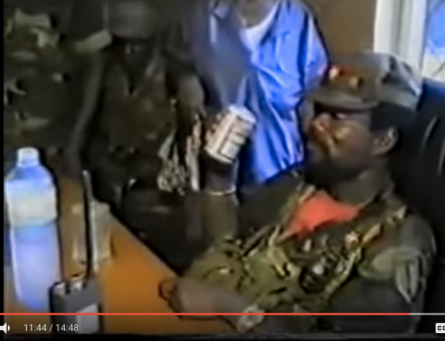
The murder of Samuel Doe, Liberia, 1990

Slide 4
Structural adjustment and democratisation
African states in economic crisis
  OPEC oil crisis
  Commodity price crash
  Economic mismanagement and corruption
  Weak post-colonial economic structures
= structural adjustment programmes (SAPs)
  Cutting back on public sector
  Liberalisation of economy
Wave of democratisation in early 1990s

Slide 5
Conflict and state collapse
Somalia
  Collapse of Siad Barre’s dictatorship with withdrawal of American support
Liberia
  Samuel Doe versus Charles Taylor’s National Patriotic Front
Sierra Leone
  Corrupt regime weakened by SAPs
  Invasion from Liberia by Revolutionary United Front

Slide 6
From Kigali to Kinshasa – ‘Africa’s World War’
Rwandan genocide, 1994
  ‘Ethnic’ tensions between majority Hutu and minority Tutsi
  Presidential plane of Hutu president Juvenal Habyarimana shot down
  500,000-800,000 Rwandans killed, vast majority Tutsi
  Tutsi Paul Kagame’s Rwandan Patriotic Front takes power
  Hutu flee over border into Congo…
Congo wars
  Uganda and Rwanda supported anti-Mobutu alliance in eastern Congo
  Mobutu swept from power in 1997 by rebel forces of Laurent Kabila
  Assassination of Kabila (2001) and ‘second Congo war’ (1998-2003?)
  Nine African states involved... Impossible to know how many deaths

Slide 7
American foreign policy after the Cold War
A moment of triumph?
Fukuyama and the End of History
Successful intervention in Iraq during First Gulf War (1990-1)
The ‘lonely superpower’?
Humanitarian intervention in Somalia leads to ‘Black Hawk Down’ incident (1993)

Slide 8
American ‘Afropessimism’
‘West Africa is reverting to the Africa of the Victorian atlas’
– Robert D. Kaplan, ‘The Coming Anarchy’ (1994)
‘A part of West Africa today suffers insensate and feral struggle devoid of political or ideological purpose, conducted by uprooted, ignorant, anomic young men serving Caligulan warlords. This is a postmodern barbarism unconnected to any African past. The Uganda of Idi Amin and the Central African ‘Empire’ of the egregious Jean-Bédel Bokassa seem rational enterprises compared with the inadvertent and apocalyptic nihilism practiced there and in Rwanda.’
– William Pfaff, ‘A New Colonialism? Europe must go back into Africa’ (1995)

Slide 9
Africa’s post-Cold War conflicts
Borders no longer respected – and are shown to be porous
State actors now also violate sovereignty
  e.g. Ethiopian invasion of Eritrea, multiple states in Congo wars
Violence as a political strategy
Transnational armed groups
  Lord’s Resistance Army in Central African Republic and Uganda
Exploitation of mineral resoures: blood diamonds, coltan
Collapse of superpower support > fall of ancien régimes

Slide 10
Africa and the ‘War on Terror’
Shortlived moment of ‘liberal interventionism’; Blair’s ’Chicago Doctrine’
11 September 2001 as a turning point: the invasions of Afghanistan and Iraq
‘War on Terror’ as a new, overarching matrix for American foreign policy and stretched into Africa…
  American attacks on Al Qaeda training camps in Sudan
  War against Al Shabaab in Somalia
  Islamic extremism in the Sahel – transnational groups
  Alienation of African Muslims...
  African governments using language of ’War on Terror’ for leverage...

Slide 11
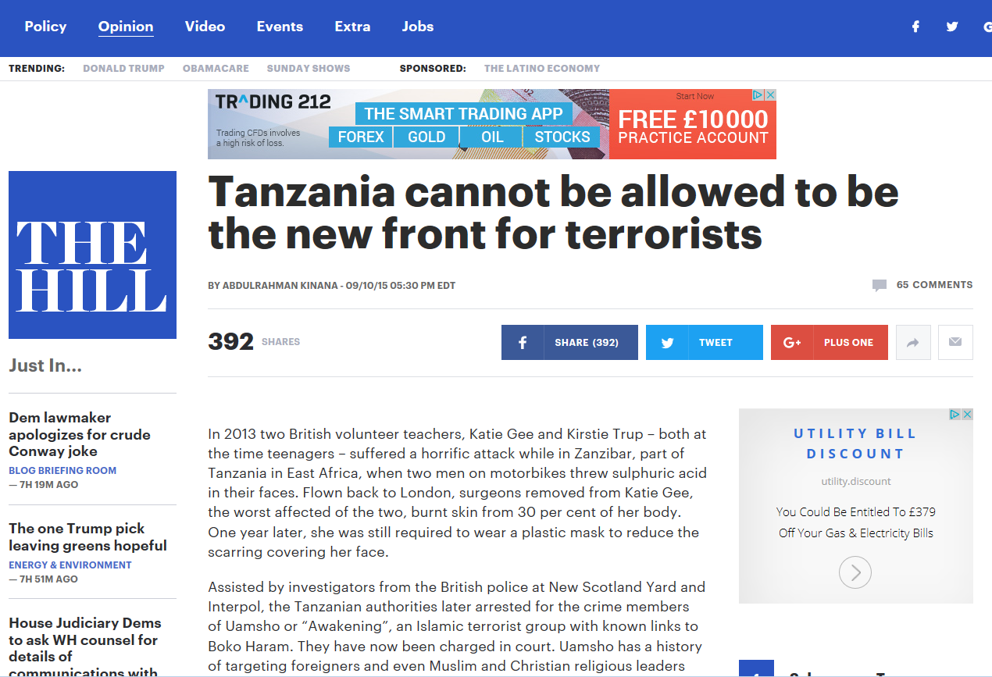

Slide 12
British and French interventions in Africa
France continues to have close relationship with La Francophonie
  Removal of Laurence Gbagbo in Ivory Coast (2012)
  Operations in Central African Republic (2013)
Britain – more hands off
  Operation Palliser – intervention in Sierra Leone civil war
Waging the ‘War on Terror’
  French intervention in Mali (2013)
  British providing training for Kenyan police... Extrajudicial killings of Muslim preachers ‘suspected’ of promoting terrorism in Mombasa
Cameron and Sarkozy’s intervention in Libya – American proxy?

Slide 13
Martin Rowson, Guardian, 19 March 2011

Slide 14
China in Africa

Slide 15
China in Africa
Robert Mugabe in Beijing, 2014

Slide 16
Democratisation: a mixed record?
Some successes, e.g. Ghana
Seemingly unmovable dominant parties
  Chama Cha Mapinduzi in Tanzania – in power since independence
Other ruling parties and de facto autocrats hang on
  Pierre Nkurunziza in Burundi – extending term limits
  Joseph Kabila and delaying elections in Congo – glissage (‘slippage’)
The developmentalist state
  Paul Kagame in Rwanda
  Yoweri Museveni in power since 1986 in Uganda
  Ethiopia after Mengistu
Democracy: a Western imposition?

Slide 17
A Pan-African revival?
Failure of the Organisation of African Disunity Unity
Sirte Declaration (2001) and birth of the African Union
More interventionist approach
  AMISOM in Somalia in the war against Al Shabaab
  The ‘blowback’
  World Cup final bomings in Kampala (2010)
  Westgate mall attacks, Nairobi (2013)
  Garissa University massacre (2015)
  ECOWAS intervention in Gambia to push Yahya Jammeh from power (2017)

Slide 18
Resistance to the International Criminal Court
Uhuru Kenyatta uses ICC case in successful election campaign in Kenya (2013)

Slide 19
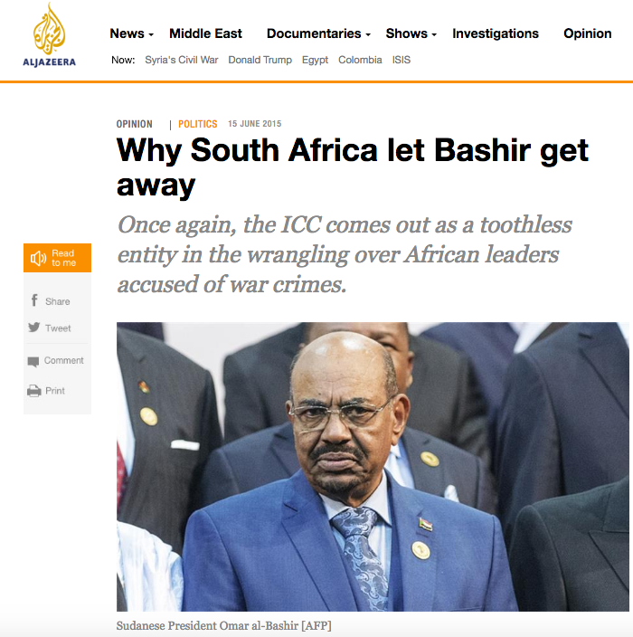

Slide 20
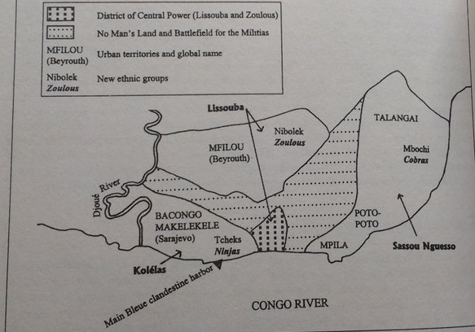
Residual Third World solidarities
Florence Bernault, ‘The political shaping of local sacrality in Brazzaville, 1959-1997’, in David M. Anderson and Richard Rathbone (eds), Africa’s Urban Past (2000)

Slide 21
Residual Third World solidarities
Daladala, Dar es Salaam

Slide 22
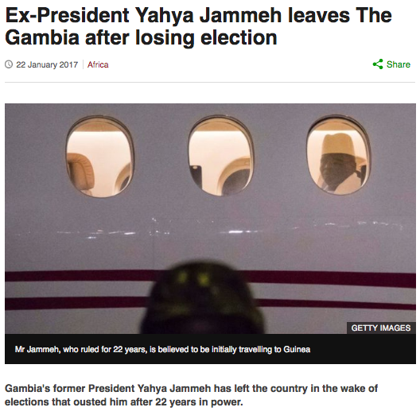
The continent of the future?
’Africa Rising’ in 2010s
Emergence of a creative, cosmopolitan middle class
Dynamic business environment
Rapidly growing cities
Recent examples of handovers of political power...
  Ghana
  The Gambia
  Somalia

