Slide 1
New dawns? Africa after the Cold War
HI277 | Africa and the Cold War
Dr Natalia Telepneva| Term 2, Week 9
Child Soldiers in Sierra Leone – Human Rights Watch

Slide 2
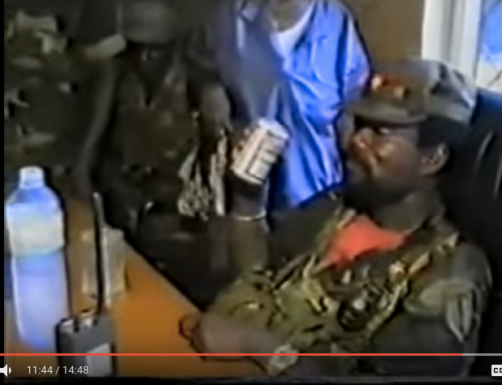
The murder of Samuel Doe, Liberia, 1990

Slide 3
Lecture Outline
1. End of Cold War and Violence
2. Reactions: From “Liberal Interventionism to War on Terror”
3. Outcomes: democratisation, new pan-African solidarities

Slide 4
1. End of the Cold War, Structural Adjustments and Democratisation
Collapse of support from superpower backers--> wave of democratization, often intensified internal rivalries. Violence ensured
African states in economic crisis
  OPEC oil crisis
  Commodity price crash
  Economic mismanagement and corruption
  Weak post-colonial economic structures
= structural adjustment programs (SAPs)
  Cutting back on public sector
  Liberalisation of economy
Conflict: Somalia, Liberia and Sierra Lone

Slide 5
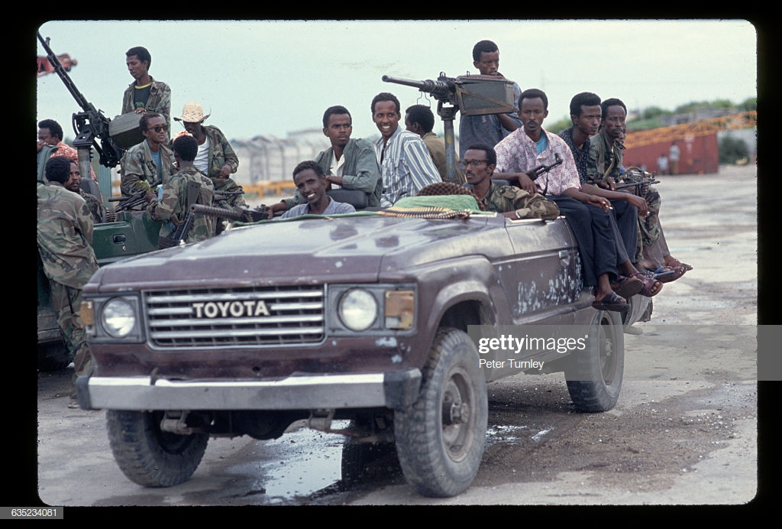
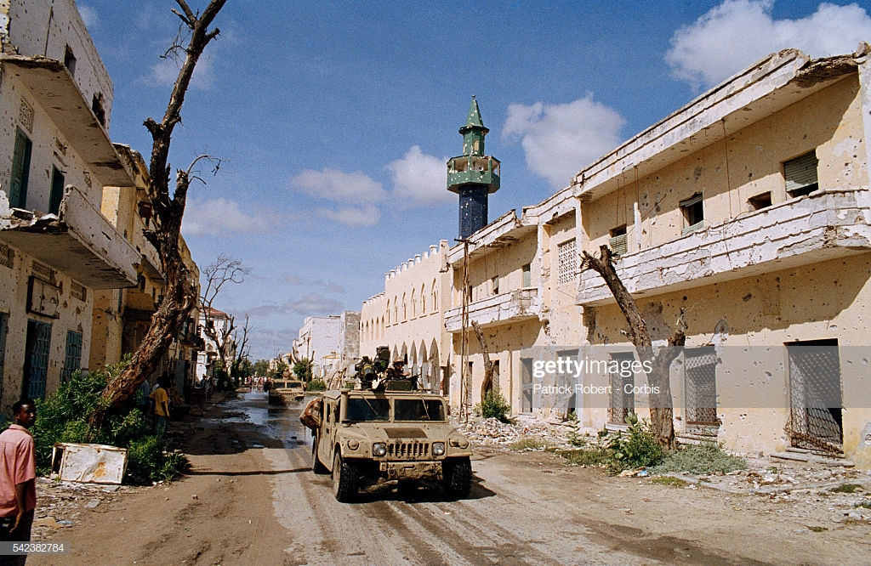
1. Somalia: Collapse of Siad Barre, 1991
U.S. Marines drive past damaged buildings while stationed in Somalia for Operation Restore Hope, the codeword for the American military mission protecting United Nations relief workers during the Somalian Civil War
Militamen, part of a factional group fighting in the civil war, gather in a Toyota 'technical car' just prior to the arrival of U.S. and international troops to defend the port

Slide 6
1. Liberia and Sierra Leone
Liberia
  1989: Libara invaded by Charles Taylor’s National Patriotic Front. Samuel Doe killed in 1990
Sierra Leone
  Corrupt regime weakened by Structural Adjustment Programs (SAPs)
  1991: invasion from Liberia by Revolutionary United Front
Charles Taylor, Liberia’s President from 1997-2003. In 2012, Charles Taylor was convicted of abetting the rebel forces in in Sierra Leone and imprisoned in the UK for 50 years. His conviction was the first for war crimes by a former head of state in an international court since the Nuremberg trials of Nazi leaders after World War II.

Slide 7
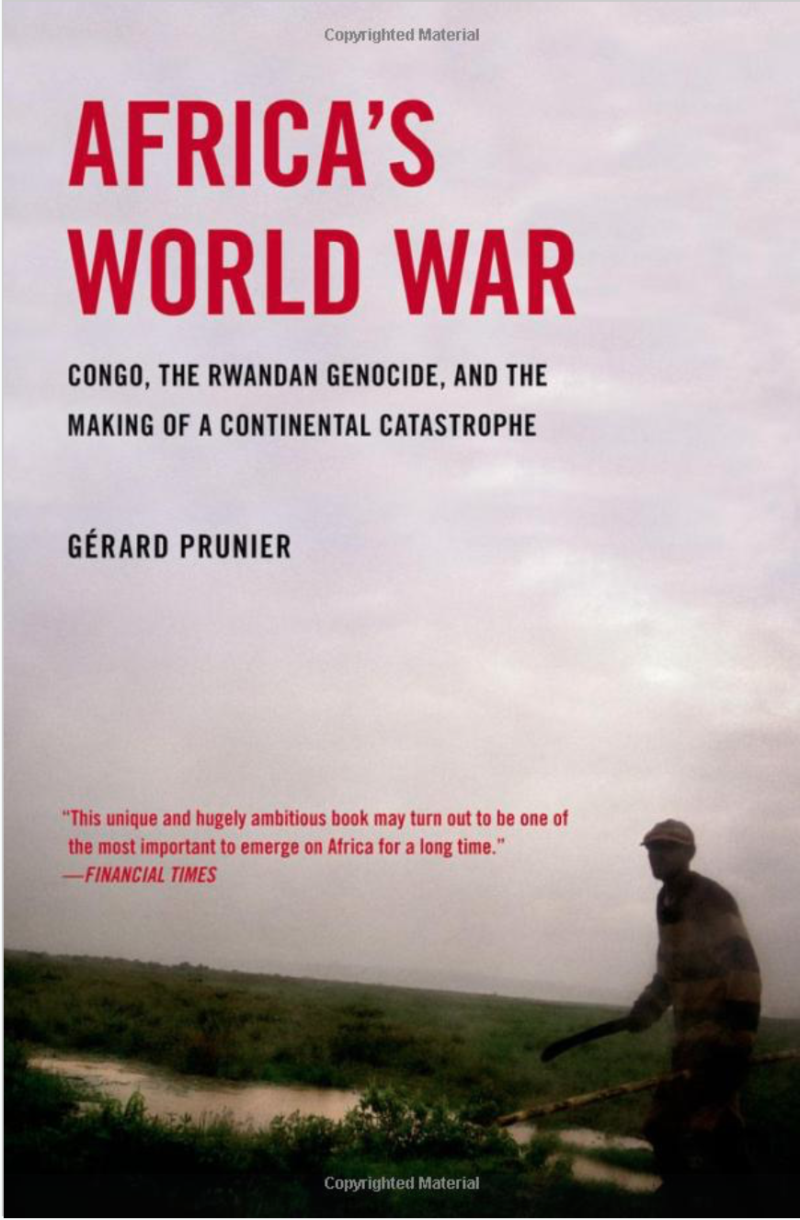
1. From Kigali to Kinshasa – ‘Africa’s World War’
Rwandan genocide, 1994
  ‘Ethnic’ tensions between majority Hutu and minority Tutsi
  Presidential plane of Hutu president Juvenal Habyarimana shot down
  500,000-800,000 Rwandans killed, vast majority Tutsi
  Tutsi Paul Kagame’s Rwandan Patriotic Front takes power
  Hutu flee over border into Congo…
Congo wars
  Uganda and Rwanda supported anti-Mobutu alliance in eastern Congo
  Mobutu swept from power in 1997 by rebel forces of Laurent Kabila
  Assassination of Kabila (2001) and ‘second Congo war’ (1998-2003?)
  Nine African states involved... Impossible to know how many deaths...Up to 200,000 dead

Slide 8
2. American foreign policy after the Cold War
A moment of triumph?
Fukuyama and the End of History
Successful intervention in Iraq during First Gulf War (1990-1)
The ‘lonely superpower’?
Humanitarian intervention in Somalia leads to ‘Black Hawk Down’ incident (1993)

Slide 9
2. American ‘Afropessimism’
‘West Africa is reverting to the Africa of the Victorian atlas’
– Robert D. Kaplan, ‘The Coming Anarchy’ (1994)
‘A part of West Africa today suffers insensate and feral struggle devoid of political or ideological purpose, conducted by uprooted, ignorant, anomic young men serving Caligulan warlords. This is a postmodern barbarism unconnected to any African past. The Uganda of Idi Amin and the Central African ‘Empire’ of the egregious Jean-Bédel Bokassa seem rational enterprises compared with the inadvertent and apocalyptic nihilism practiced there and in Rwanda.’
– William Pfaff, ‘A New Colonialism? Europe must go back into Africa’ (1995)

Slide 10
2. Making sense of Africa’s post-Cold War conflicts
Borders no longer respected – and are shown to be porous
State actors now also violate sovereignty
  e.g. Ethiopian invasion of Eritrea, multiple states in Congo wars
Violence as a political strategy
Transnational armed groups
  Lord’s Resistance Army in Central African Republic and Uganda
Exploitation of mineral resoures: blood diamonds, coltan
Collapse of superpower support > fall of ancien régimes

Slide 11
2. Africa and the ‘War on Terror’
Short-lived moment of ‘liberal interventionism’; Blair’s ’Chicago Doctrine’, 1999
11 September 2001 as a turning point: the invasions of Afghanistan and Iraq
‘War on Terror’ as a new, overarching matrix for American foreign policy and stretched into Africa…
  American attacks on Al Qaeda training camps in Sudan
  War against Al Shabaab in Somalia
  Islamic extremism in the Sahel – transnational groups
  Alienation of African Muslims...
  African governments using language of ’War on Terror’ for leverage...

Slide 12
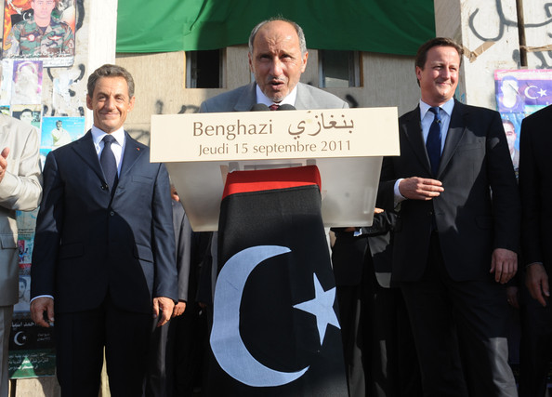
2. British and French interventions in Africa
France continues to have close relationship with La Francophonie
  Removal of Laurence Gbagbo in Ivory Coast (2012)
  Operations in Central African Republic (2013)
Britain – more hands off
  Operation Palliser – intervention in Sierra Leone civil war
Waging the ‘War on Terror’
  French intervention in Mali (2013)
  British providing training for Kenyan police... Extrajudicial killings of Muslim preachers ‘suspected’ of promoting terrorism in Mombasa
Cameron and Sarkozy’s intervention in Libya – American proxy or vanity projects?
Leader of Libya's interim government, Mustafa Abdul-Jalil makes a speech, flanked by French President Nicolas Sarkozy and Prime Minister David Cameron, during their visit to Benghazi as part of their trip following the country's revolution on September 15, 2011 in Benghazi, Libya
Notes:
Kenya: extrajudicial killings of Muslim preachers in coastal Kenya. Watch an Al Jazeera documentar: https://www.aljazeera.com/indepth/opinion/2014/12/trap-insecurity-extrajudicial-ki-20141288552608186.html

Slide 13
2. Russia’s Resurgence in Africa?
Russian President Vladimir Putin with the president of Central African Republic, Faustin Archange Touadera. Russia, 2018.

Slide 14
2. China’s Presence in Africa

Slide 15
3. Democratization: a mixed record?
Some successes, e.g. Ghana, Ethiopia
Other ruling parties and de facto autocrats hang on and delay elections
The developmentalist state
  Paul Kagame in Rwanda
  Yoweri Museveni in power since 1986 in Uganda
  Ethiopia after Mengistu. New PM: Abiy Ahmed: “Africa’s New Talisan”
Democracy: a Western imposition?

Slide 16
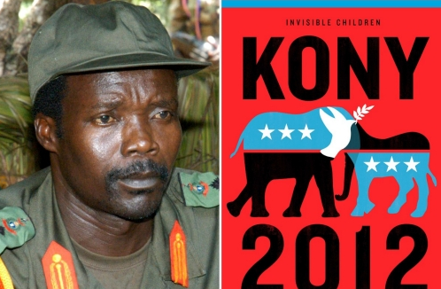
3. New Pan-African Solidarities?
2001: Foundation of African Union, more interventionist (e.g. The African Union Mission in Somalia )
Resistance to the International Criminal Court
Defending against ‘Western’ cultural influences
African solutions for African problems
What role should the West have?
Kony 2012 campaign poster (and documentary). The campaign was produced by an American organization, Invisible Children, which campaigned to capture Joseph Kony (Lord Resistance Army). Heavily criticized
Notes:
New Pan-African Solidarities?
Does the ‘Bandung moment’ still have echoes in Africa? Have these connections been intensified by globalising economy and media environment, failure of Cold War development models, alienation because of structural adjustment programmes… There has been search for new identities that draw on other solidarities.
By the 1990s, the Organisation of African Unity was no longer relevant. But could it be revived for a post-Cold War world?
In 2001, the Sirte Declaration established the African Union. This was driven by Lybia’s M. Gaddafi and South Africa’s Thabo Mbeki.
Some say, the AFRICAN UNION has been more interventionist, getting involved in Somalia (The African Union Mission in Somalia)
Resistance to the International Criminal Court. A number of African states have resisted prosecutions against Africans at the International Criminal Court. Many see the court picking on easy black African targets, while ‘war criminals’ like Bush and Blair go unpunished.
Post-election violence in Kenya in 2007 – dropping of cases against a number of prominent Kenyans, like Uhuru Kenyatta.
South African government’s refusal to arrest Omar Al Bashir…
Now many African states are withdrawing from the ICC…
Defending Africans against Western cultural influences…
AIDS and homosexuality as a particularly African example here…
→DEFINITELY THERE HAS BEEN A SENCE THAT THERE SHOULD BE “African solutions for African problems’. However, African leaders do not shy away of using international law and appeal to human rights when politically necessary (the case of Lord’s Resistance Army and ill-conceived Kony 2012 –a campaign to capture Joseph Kony has raised questions about the nature of Western role in these conflicts, esp. by well-wishers who know little about the causes of these conflicts). Watch the documentary “Kony 2012” at home

Slide 17
3. The continent of the future?
--economic growth (2010s ‘Africa rising’), emergence of cosmopolitan middle-class, growing cities, handovers of power (Nigeria, Ghana, Gambia, Ethiopia)

Slide 18
Concluding Thoughts
1. What was the relationship between end of the Cold War and violence that erupted in Africa in the 1990s?
2. How prevalent is anti-Americanism in Africa and is it a legacy of the Cold War?
3. What is the nature of Western interests in Africa?

