Slide 1
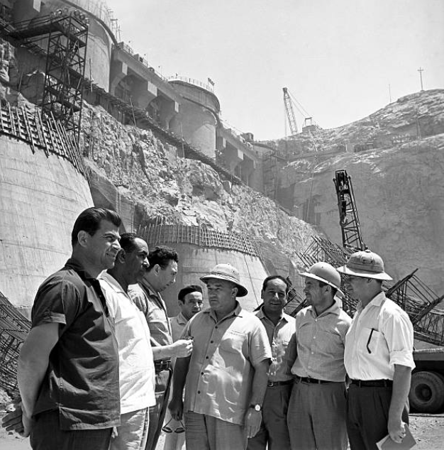
Capitalism, Socialism or African Socialism? Struggles over Economic Growth
HI277 Term 1 Week 8
Dr. Natalia Telepneva
Office Hours: Mondays, 1-3pm

Slide 2
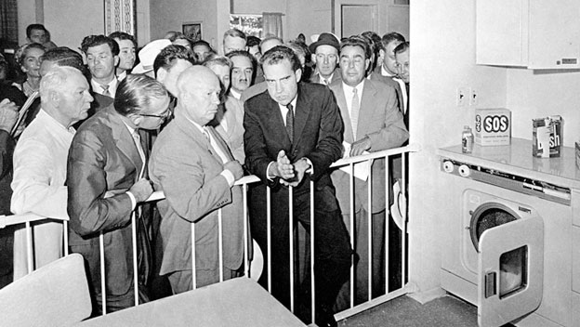
‘Kitchen Debate’, 1959
Nikita Khrushchev and Vice President Richard Nixon debate socialism and capitalism, while looking at US model kitchen on display at the USA Trade and Cultural Fair in Sokolniki Park, Moscow ( July 1959)

Slide 3
Lecture Plan
Soviet model of development
USA and ‘Modernisation theory’
African Socialism: Ghana, Tanzania
New International Economic Order
1970s: From pragmatism to Neo-Liberalism

Slide 4
Key Argument
Struggles over the Economic Growth were crucial for Cold War in Africa
The perceived failure of socialist-inspired projects in Africa and elsewhere undermined the socialist project in the USSR and vice versa: the collapse of state socialism in USSR and Eastern Europe undermined those in Africa

Slide 5
1. Soviet model of development
  Recipe for development:
  A centrally-devised plan for modernisation, with an emphasis on industry and large infrastructural projects;
  nationalisation of key enterprises;
  and collectivization of agriculture
  New concepts: ‘non-capitalist development’ and ‘national democracy’. Jump stages

Slide 6
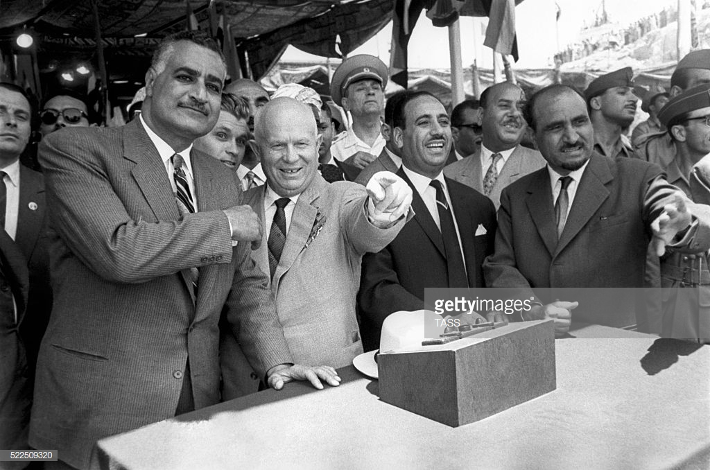

1. Egypt: Aswan Dam, 1960-1970
Left: Nasser and Khrushchev inspecting the site for the construction of the Aswan Dam, 1964
Right: The construction of the Aswan dam with Soviet technicians

Slide 7

2. USA and ‘Modernization Theory’
Walt Rostow, The Stages of Economic Growth: A Non-Communist Manifesto (1960):
All societies developed along the same trajectory
‘take-off’ required investment in infrastructure and ‘export industries’

Slide 8
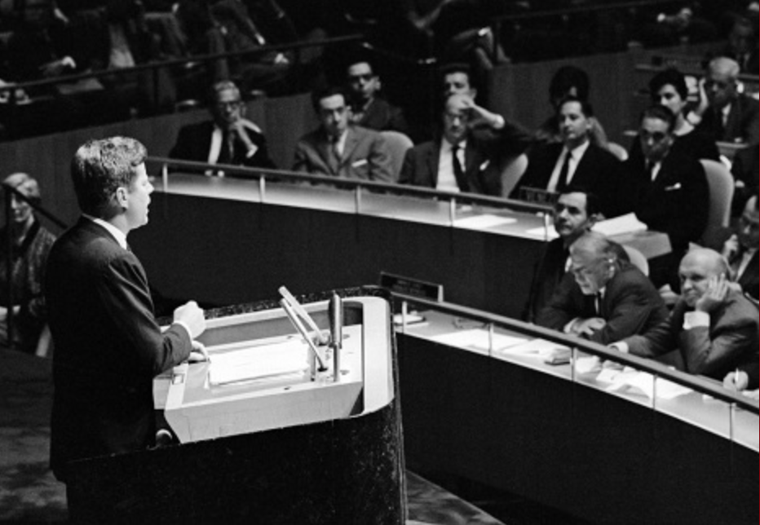
2. Rostow and John F. Kennedy
Kennedy’s policy in Africa
Modernization theory as bulwark against Soviet communism
Measures: Agency for International Development; Peace Corps
JFK launches ‘decade of development’ at the UN General Assembly on 25 September 1961, watch at https://www.americanrhetoric.com/speeches/jfkunitednations.htm

Slide 9
How different were Soviet and American models?

Slide 10
3. African Socialism: Reasons
Concerns with ‘neo-colonialism’
‘indigenous way of development’
Inspired by Soviet planning
need to adapt socialism to African context.
African socialism= strategy of ‘indigenous development’

Slide 11
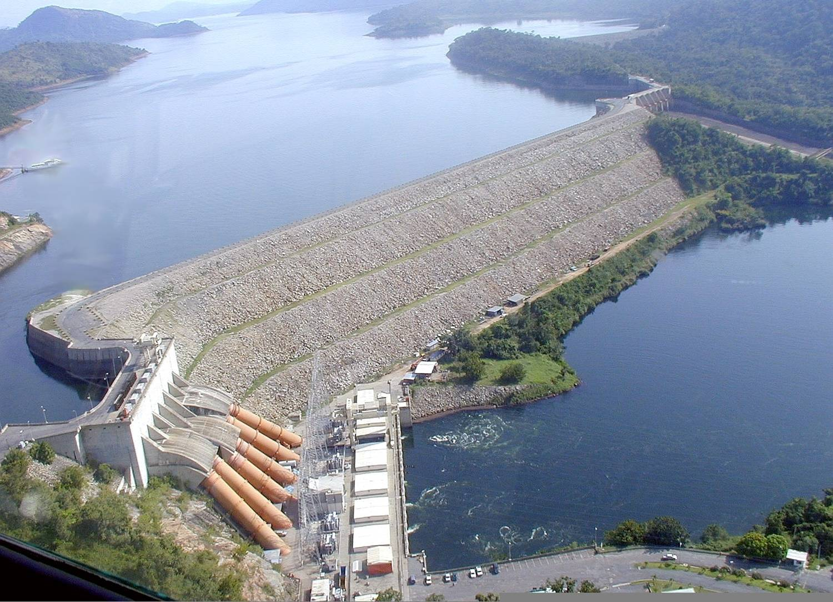
3. Examples: Ghana
Arthur Lewis’s plan
1958: Trip to the USA. Support for the Volta River Project
1961: Nkrumah moves to the left. Authoritarian Rule
February 1966: Nkrumah toppled
Location and aerial view of Akosombo dam on the Volta Riveron

Slide 12

3. Examples: Tanzania
1961-3: Modernization Theory and World Bank
Nyerere’s dissatisfied with pace of change
1967: Arusha declaration. Mass resettlement into ujamaa villages
Women working in a communal village in Tanzania

Slide 13
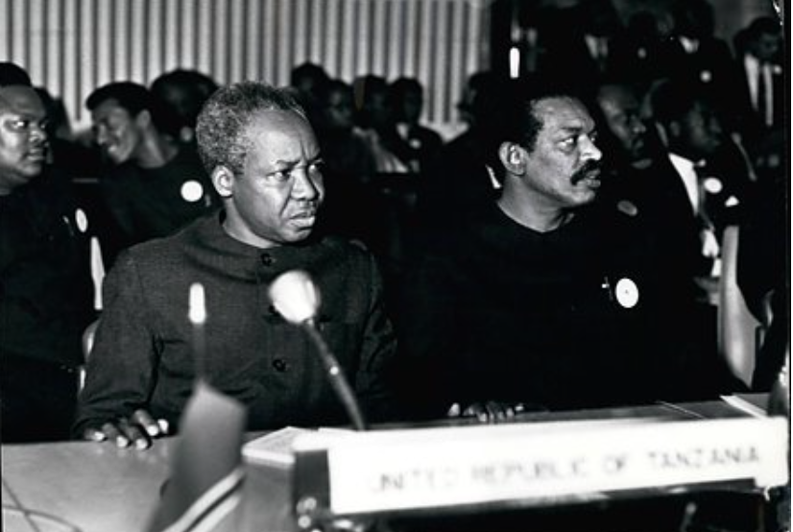
3. Babu vs. Nyerere
Babu’s proposals:
Establish large large state farms;
invest in irrigation and flood control to increase food production;
opposed nationalization of trade
Book: African socialism or socialist Africa? (1981)
Nyerere with Babu at OAU meeting in 1970

Slide 14
4. New International Economic Order (NIEO) and its Discontents
Raul Prebisch and ‘Dependency theory’
1964: UN Conference on Trade and Development
1974: UN General Assembly adopts NIEO and demands:
greater aid for developing states;
preferential trade concessions;
right to nationalise natural resources;
regulation of multinational corporations
Nyerere on NIEO: “trade union of the poor”
Outcomes: little support from the West, growing debt

Slide 15
Was NIEO a failure?

Slide 16
5. From pragmatism to a Neo-Liberal Turn: USSR
Soviet disillusionment:
Pace of transformation; ‘ungrateful leaders’
Congo Crisis: ‘peaceful competition’ was not possible
Emphasis on ‘mutual economic advantage’
Yet, interventionism in the 1970s. Aid to Ethiopia
1980s: Domestic changes: Gorbachev’s ‘reform and opening’. Shift in priorities. Economic crisis

Slide 17
5. From pragmatism to a Neo-Liberal Turn: USA
1970s: technocratic solutions: ‘miracle rice’ and population control
Pursued in Vietnam, India, Pakistan-limited results in reducing poverty
1980s: crisis of Keynesian economics and ‘neo-liberal arguments’ →embrace the markets
Debt crisis →Structural adjustment (Washington Consensus). In many countries, this led to human misery, as govts clamped down on welfare spending

Slide 18
Concluding Thoughts
Why did socialism in Africa fail?
‘there was never one project’
‘socialism from above’ & lack of socialized democracy (Vijay Prashad)
Structure of the global economy. Oscar Sanches-Sibony: The Soviets never meant to replace the West.
Failure of Socialist Projects ←→Soviet Collapse

