Slide 1
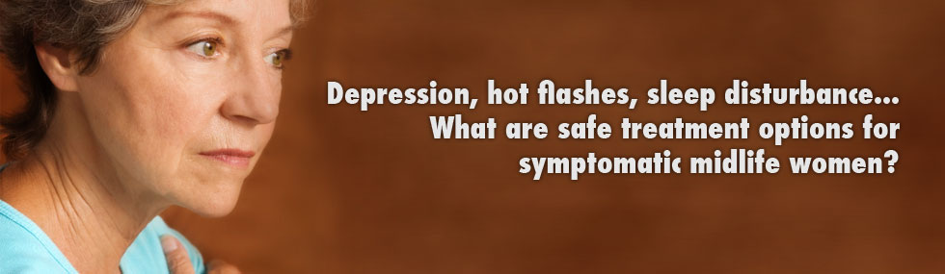
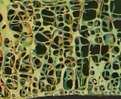
Middle Age I: Menopause
From Cradle to Grave
Term 2, Lecture 7 (week 9)

Slide 2
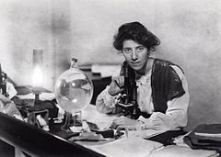
Marie Stopes, Change of Life in Men and Women (1936)
The ‘crises’ of a woman’s life have been much descanted upon by men medical writers [and] perhaps the most artificially created has been her ‘change’.

Slide 3
Themes and Questions
Is menopause a natural process or pathological/disease – medicalisation?
Aging and menopause
What does it tell us about attitudes to women? And older women? Connections to family, marriage and workplace?
Impact and responses of feminism – 1st and 2nd wave
Role of pharmaceutical industry
Sources – Lancet, archives of Women’s Medical Federation, magazines, advice literature – all debate menopause
Excellent case study of connections between gender and medicine

Slide 4
The ‘clinical’ change
When in life cycle? Average age 51. Usually occurs between ages of 45 and 55.
The ‘climacteric era’
Peri-menopause – according to orthodox medicine ‘ovaries start to fail’ a year or two prior to menopause proper
Process can take up to 4 years
Symptoms? hot flushes, irregular menstruation, emotional change
Post-menopause – time following permanent cessation of menstruation
The menopause is caused by a change in the balance of the body's sex hormones i.e.
  During peri-menopause oestrogen and progestrogen levels decrease, causing the ovaries to stop producing an egg each month (ovulation). Oestrogen is the female sex hormone that regulates a woman's menstrual cycle.

Slide 5
Medical debut
Menopause made ‘debut’ as medical entity in early C19th though physicians elaborated on it in C18th
Linked increasingly to ‘pathology’/disease not ‘normality’
Diseases peculiar to women (across reproductive life cycle) – doctors identify a series of unpleasant, even fatal, complaints
Language of ‘symptoms’ - hot flushes, sweats, weight gain, backache, fatigue, headache, dizzy spells, irritability, nervousness, apathy, depression, emotional instability, feeling of suffocation, forgetfulness, insomnia, panic, chest pain, breast pain, constipation, diarrhoea, changes in libido, anxieties about the body
More recently concern with osteoporosis – this not specifically associated with menopause, but part of aging process and also effects men
More generally problems of aging confused with menopause

Slide 6
18th century interpretation
Dr John Hunter (1728-1793): ‘The female, at a much later time of life, when the powers of propagation cease, loses many of her peculiar properties, and may be said, except from mere structure of parts, to be of no sex, even receding from the original character of the animal, and approaching, in appearance, towards the male, or perhaps more properly towards the hermaphrodite.’
Yet social standing of post-menopausal women might be high in early modern period.

Slide 7
C19th pathology
Samuel Ashwell (1798-1852) - ‘organic maladies’ more likely to take place than at any other time
Characterised by physical decline, disorder and diminished functions (even though women lived longer than men and in better health).
Seen as final stage before death – N.B.‘relative’ old age began at 45 in C19th (F.B. Smith, The People’s Health)
‘The vigour of the reproductive system begins to decline about the age of forty or forty-two; and from this period to the age of forty-nine, there is a state of the system analogous to that of the period when it first developed…’ (Thomas Laycock, The Morbid Phenomena of Menopause, 1840)

Slide 8
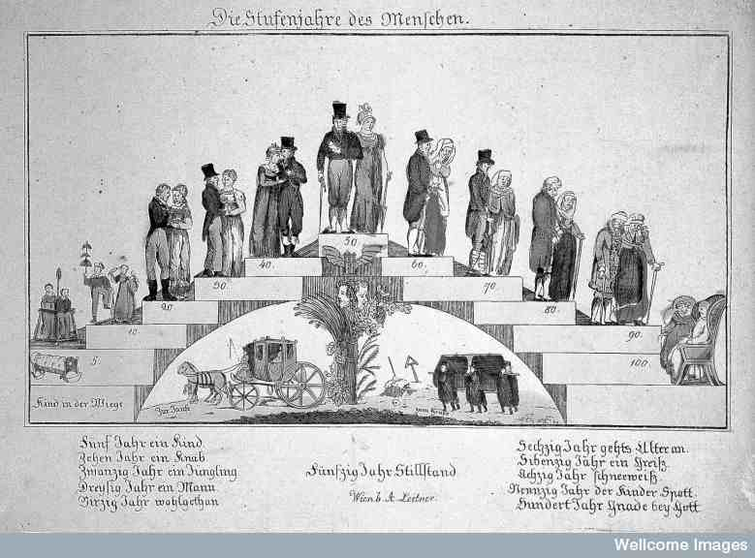
Ages of man and woman – prime of life?

Slide 9
C19th pathology: Michael Ryan, A Manual of Midwifery (1841)
‘Cessation of menstruation. Senile sterility. The menstrual secretion ceases, in temperate countries, about the forty-fifth or fiftieth year… When menstruation is about to cease, the period is called critical, ‘the change, or turn of life, the climacteric period;’ and many important changes take place in the constitution at this epoch. All the characters of puberty and the peculiarities of women cease, the breasts collapse… the skin shrivels, … and many diseases develop… in the womb, ovaries and breasts, which had lain dormant for years… When this period has, however, passed, women often enjoy better prospects of health and of long life and the other sex, and become remarkably corpulent.’
(See Jalland and Hooper extracts for more e.g.s)

Slide 10
The Menopause and Mental Illness –
Climacteric Insanity
C19th ‘climacteric insanity’ or ‘involutional melancholia’ or ‘old maids’ insanity’
‘Climacteric perturbation (1873)
‘Climatic convulsive diseases. At the ‘turn of life’ … the nervous system… exhibits frequent and various perturbations. Thus we find giddiness, vertigo… impairment of memory, mental irritability… culminating in some cases… in epilepsy, and even in insanity… It is a stage of transition and trial for all. These perturbations may persist for months, even for years, before the balance is restored… many women may have passed through the trials of puberty and of child-bearing without serious nervous disorder, and will break down at the menopause. Often, no doubt, this is the climax, the last ounce of a long-troubled sexual life’.
Robert Barnes, in Lancet, 26 April 1873

Slide 11
Evidence from case books (Wellcome Library WMS5158, Holloway Sanatorium, Case Book No 4, females admitted July 1890-June 1891, pp.29-30)
Patient No. 665, admitted Aug 13 90
Ada Marianne R., 47, single, no occupation. Ch of England. Previous abode Besborough [Benborough?] Gardens, Pimlico.
This is the first attack of two months duration, age on attack being 47. Supposed cause previous illness- the Climacteric. Is subject neither to epilepsy, nor suicide, is not dangerous to others.
R [reception] order: Charles Matthew Cloke [?]
1st Certif: Very wild in conversation and restless. [illegible] thieves in the home and sees the back of the house lit up like a fire
Thos. Langton
2nd Certif: Rambles incoherently says that I am not Dr Pearce she was acquainted with. Sometimes is violent in attempts to leave her nurses.
George Pearce.
Fam Hist: [blank]
Previous Hist: [blank]
Condition on Admission
A:Physical: Tall thin woman, bluish green eyes, pupils equal and react. Light brown hair, pale, anaemic, freckled complexion, haggard, anxious expression, sunken cheeks, prominent [illeg, malar?] bones. Complains of headache, bowels constipated, tongue coated with thick moist fur, tremulous, appetite bad, sparely nourished and thin, but presents no physical sign of disease in thoracic and abdominal organs.
B:Mental: Acute Melancholia. Restless, agitated, confused, incapable of settling down to any occupation. Hallucinations of taste and hearing, delusions of identity respecting clothing, refuses all food and says that she is a great sinner.

Slide 12
George Savage, ‘Mental Diseases of the Climacteric’, Lancet October 31(1903), pp.1209-1213. Available through library.
‘She is restless, she is here, there, and everywhere upsetting everything and everybody… The unfortunate husband suffers grievously under such conditions. .. Kleptomania is more commonly met with in the climacteric women than in any others… But I think you have already perceived that disorders of the menopause are, in the greater proportion of cases, of a depressed type, melancholic, hysterical, with ideas of misery and persecution and watching…A considerable number of these patients make an end of themselves, drowning perhaps being the most common means…’

Slide 13
Menopause and meaning
If meaning of Victorian women’s life was characterised by maternity, was the end of reproduction typified by loss of meaning?
Social predicament of women in C19th?
Simone de Beauvoir – if medical discourse invested reproductive femininity with elements of ‘service’, the same discourse rendered women useless after the cessation of reproductive life. Rich in experience and ‘in full possession of her powers’, women of 50 were retired.
Simone De Beauvoir, The Second Sex (1949).

Slide 14
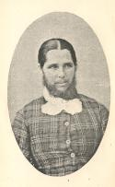
Menopause and mannishness
Masculine Character
‘When the change [of life] is past, the mind emerges from the dark clouds in which it has seemed lost. Thankful that they have escaped from real sufferings, women cease to torture themselves with imaginary woes. They feel the ground grow steadier underfoot, they are less dependent on others, - for like the body, their mental faculties assume a masculine character… it imparts a firmness of purpose… whether it be to govern a household, to preside in a drawing-room, or to thread and unravel political entanglements. When women are no longer hampered by a bodily infirmity periodically returning, they have more time at their disposal,… and the faculties of mind become endowed with new vigour.’
E.J. Tilt, The Change of Life in Health and Disease, 2nd edn, 1857

Slide 15
Medicalisation
Ivan Illich – ‘medicalisation of life’. Rapidly expanding medical profession of C19th faced with healthier population, medicated normal life events, turning risks into diseases and pathologising normal processes.
I.K. Zola - ‘medicine is becoming a major institution of social control… the new repository of truth, the place where absolute and often final judgements are made by supposedly morally neutral and objective experts’.
Are women’s experiences more likely to be medicalised than men’s? Why?
What are the strengths and weaknesses of medicalisation theory? How does it effect women’s experiences and agency?

Slide 16
Current depression
Those who argue that depression is caused by endocrine changes believe it is curable by re-establishing hormonal balance.
Psychiatrist Dr Raj Persaud defined menopause as ‘disease’. Though a ‘completely normal biological event’ it ‘attracts quite problematic medical symptoms’. These should be treated not because normal or abnormal but because ‘desirable’ if leads to suffering.
So should life itself be medically treated?
(See Persaud’s Gresham College Lecture 2005)

Slide 17
Hormones
Endocrinology… After 1910 research on menopause dominated by study of hormones
A woman became a ‘plaything of her glands’ – remodelled menopause as hormone deficiency disease
Medications addressed hot flushes, mood swings, palpitations, etc caused by the change in the balance of hormones in the body
HRT – oestrogen used since 1930s to treat hot flushes. After 1960s use of hormones increased – possibility of remaining ‘feminine forever’ (Dr Robert A. Wilson). Huge market for pharmaceutical companies. Debate continues about benefits and risks….

Slide 18
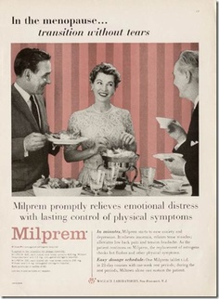
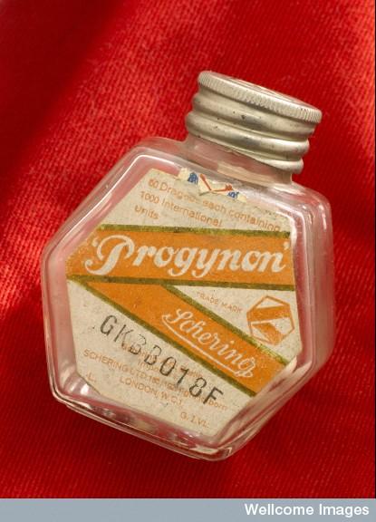
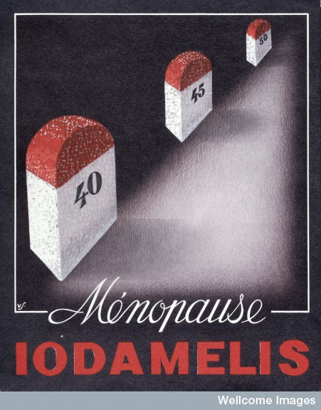
Menopause and pharmaceutical industry

Slide 19
Medical Women’s Federation research
(See J.-M.Strange, ‘In full possession of her powers’, SHM, 25, no.3 (2012), pp.685-700)
Initiated research on menopause 1926 after their campaign aimed at adolescent girls on menstrual health – which urged good menstrual hygiene while challenging disability associated with menstruation.
Letitia Fairfield – survey of professional women and absenteeism 1922. Concluded ‘critical time’ had limited impact on women’s abilities. Criticised earlier work which related ill health between ages of 40-55 to menopause as lazy diagnosis.
MWF sub-committee – 1,220 questionnaires. Results published in Lancet (1933). Symptoms of menopause muted for many women. 90% claimed that they ‘carried on their daily routine without a single interruption due to menopausal symptoms’.
Served economic and ‘political’ purpose – survey used to justify women’s work in Second World War.

Slide 20
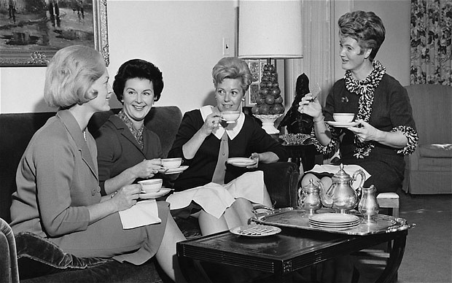
Women’s voices
From late C19th advice to women on health in popular media. Consider female life cycle as whole.
e.g. magazine Quiver series of articles on middle age and its management by Elizabeth Sloan Chesser (eugenicist physician).
WMF report developed responsibility of women and their newsletter also advertised tonics to treat older women’s complaints.
Dr Josephine Barnes (1912-99) – radio broadcasts 1948 – hormonal changes, menopause and cancer. Janet Quigley Woman’s Hour – hush-hush topics into open (1950).
Marie Stopes and Joan Malleson, Change of Life (1936, 1948)
Jenni Murray, author of Is It Me or Is It Hot in Here: A Modern Woman’s Guide to the Menopause (2003?):
‘The menopause can be the
scariest of rites of passage for a
woman.’

Slide 21
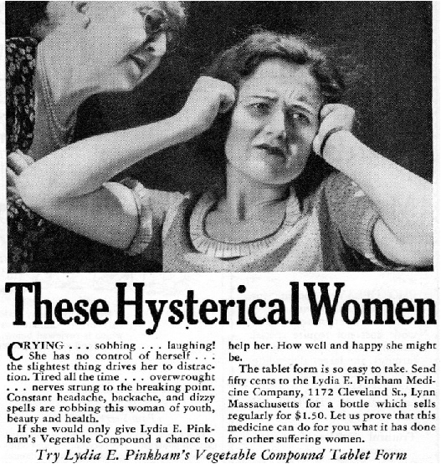
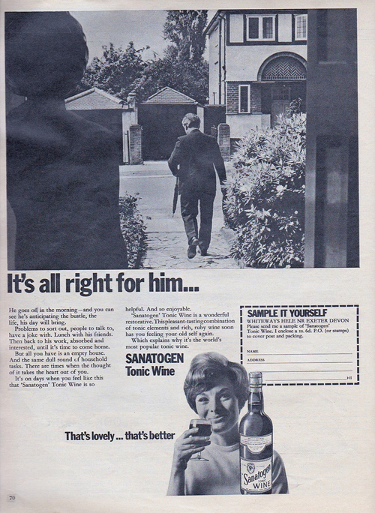

Tonics

Slide 22
Feminist responses
In 1970s feminists began to challenge orthodox medical model of menopause – viewed it as a positive transformation.
They suggested its medicalisation was a conspiracy to produce a submissive female patient who could be treated with drugs.
1945 Helen Deutsch referred to menopause as a ‘partial death’ in which ‘everything [a woman] acquired during puberty is lost piece by piece…’
No evidence of increase in depression. Though Greer in 1992 writes of the menopause as ‘a time for mourning… the menopausal woman should be allowed her quiet time and her melancholy’.

Slide 23
Male menopause
1910 - nerve doctor Kurt Mendel introduced idea of male menopause. Attracted much attention early part of C20th
Associated with sexual and physical decline
Concern about sexual decline – efforts at medical rejuvenation. Serge Voronoff – monkey gland operation (mid-1920s)
Poet W.B.Yeats’ vasectomy – revive sexual and creative power (1934)
Hormonal treatments for impotence introduced in late 1920s. 1935 testosterone isolated and Organon manufactured Testosteron in 1937.
Sex aids to Viagra (1998)
Lived on in popular press more than medical literature 1950-1990s

Slide 24
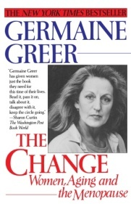
Conclusion
In what ways is the menopause a valuable case study for considering the relationship between gender and medicine?
How has menopause been re-conceptualised since the 19th century?
How have older women’s experiences been medicalised – if you agree they have been?
How useful did you find Greer’s book, The Change?

