Slide 1
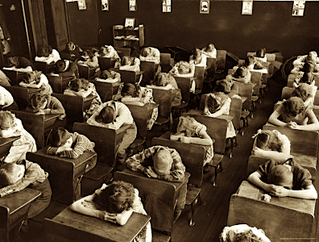
Lecture 4 From Cradle to Grave
Medicine at School

Slide 2
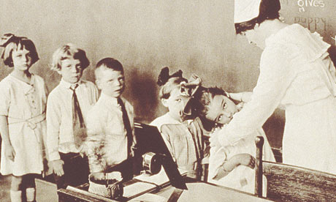
Themes
State – parents – children: who is responsible for health? Who pays and who provides?
School as a new site of health interventions
Visibility of school children and their health problems

Slide 3
Lecture Outline
Legislative Reforms
Education
Liberal Reforms
Children and Reform
Health provision through school
Free School Meals/Milk
Medical inspection
Schools as sites of health
Sport
Domestic science
Sex educaion

Slide 4
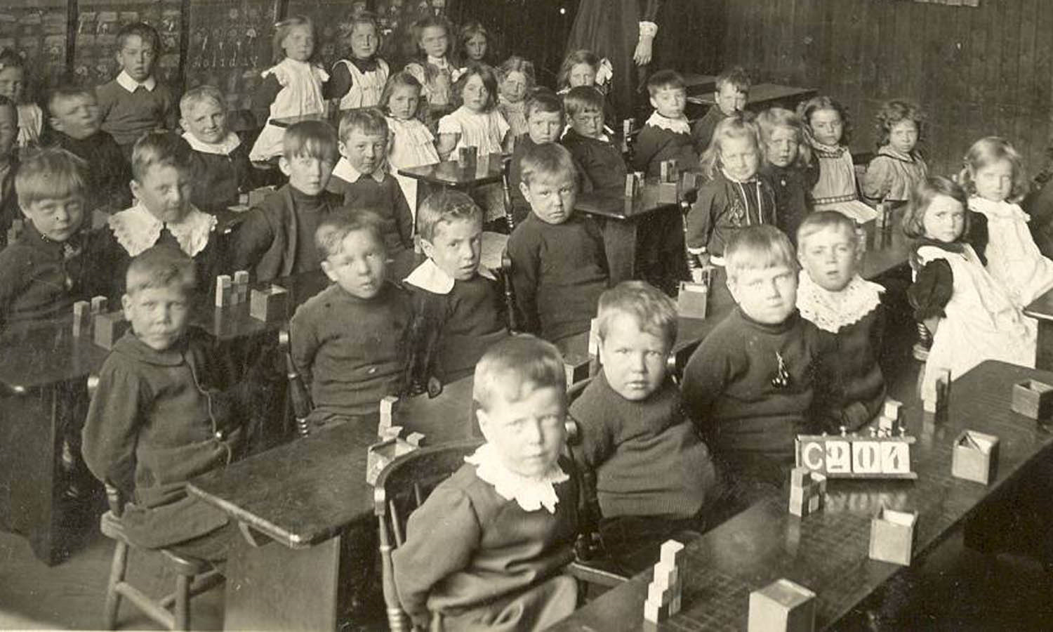

Slide 5
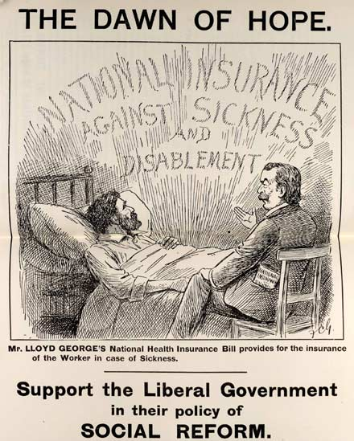
Liberal Reforms
Key period: 1906-14
Liberals win 1906 General Election
Shift in outlook from laissez-faire to more collectivist approach
Reforms often seen as the emergence of the ‘modern welfare state’

Slide 6
Reasons for Reforms
Concerns about poverty influenced by social inquires e.g. Charles Booth and Seebohm Rowntree
Concerns about physical (and mental) deterioration (Boer Wars).
Concerns about Germany and their commitment to national efficiency.
Threat of Labour Party and trade unions
Emergence of New Liberalism (e.g. David Lloyd George)

Slide 7
Areas of reform
Birth
1907 the Notification of Births Act
Children
1906 free school meals for the necessitous
1907 medical inspection in schools
Elderly
In 1908, Old Age Pensions for those over 70
5s a week to single men and women
7s 6d to married couples, on a sliding scale
Workers
1911 National Insurance Act (Part I) and (Part II)
9s p/wk for 26 wks of sickness (Part I)
7s6d p/wk for unemployment (Part II)

Slide 8
Children and Reform
In 1906 Education (Provision of Meals) Act
1906 Board of Education Report on Infant Education
1907 Medical inspections of schoolchildren introduced
1907, number of free scholarship places in secondary schools increased
1907 Probation Act
1908 Children and Young Person's Act and Children’s Charter

Slide 9
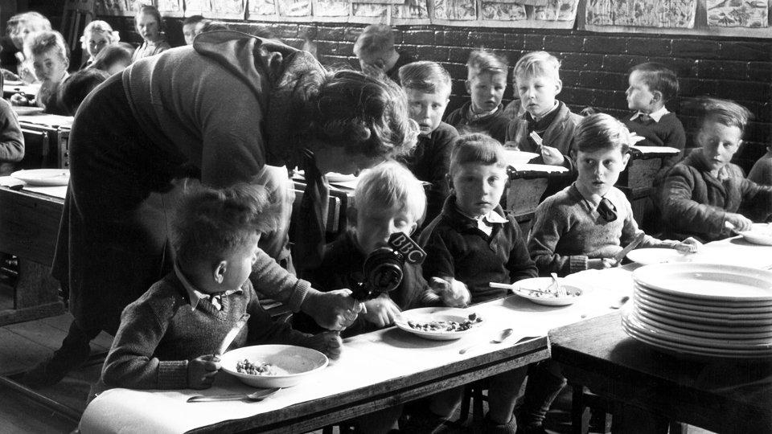
Free school meals

Slide 10
Free school meals
After 1870s schoolchildren more visible
From Mid-1870s local initiatives in some schools e.g. Mid-1880s Penny Dinners provided Birmingham, Bristol and London
1888 - 45,000 children at 48 school boards in London dependent on school meals.
1906 Education (Provision of Meals) Act. Meals free for the necessitous only
Controversial. A voluntary system and many local councils ignored it.
1914 made compulsory -14 million meals per school day were served (compared with 9 million per school day in 1910

Slide 11
Opposition to school meals provision
‘The individual and the family, as well as for their own good as for the common good, should provide themselves with the necessaries of maintenance, by their own exertions and out of their own resources. By such action [introduction of free school meals] the motive for a sound and well-ordered family life is weakened… By a law of social development… the individual and the family under normal conditions have to maintain themselves…’
B. Bosanquet, Lectures on Charitable and Social Work (1901)

Slide 12
Elimination of malnutrition?
1932 Board of Education - 1% of schoolchildren malnourished.
Chief Medical Officer claimed ‘the schoolchildren of this country are better nourished than at any previous time of which we have record’.
1934 School milk scheme
Great regional variation
Social surveys - e.g. John Boyd Orr claimed high incidence of rickets, dental decay and anaemia in 1936, and suggested 20% of children malnourished.

Slide 13
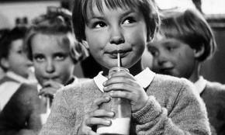
Provision of meals and milk
1938 - 268 LEAs provided
free school meals
635,000 children receiving
free milk
176,000 children receiving
free meals

Slide 14
Health of school children
1909 in Stockport MOH inspected 4,000 children
59% had ‘various defects’
600 dirty heads
800 ‘mouth breathers’
300 heart disease and anaemia
65 ringworm and skin diseases

Slide 15
Medical inspection of school children
After 1870s children and their defects more ‘visible’.
1896 committee Mental and Physical Condition of Children
Child Study Association/Childhood Society
1890 London School Board appointed first school medical officer, Bradford 1893.
1907 medical inspection of school children introduced
1912 medical treatment provided, largely ignored by local authorities

Slide 16
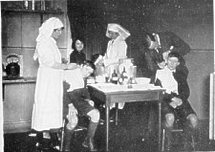
Opposition to School Medicine
Parents suspicious – a new method/technique
Hospitals didn’t want departments overrun with children and their families
GPs wanted to be the ones to treat – afraid of damage to professional interests and loss of income

Slide 17
Impact of School Medical Service
Inspections by doctors and nurses increased
School clinics established as main form/site of care and treatment
System gradually expanded – by 1930s almost every LEA offered treatment for minor ailments such as dental defects and defective vision
New treatments introduced e.g. artificial light for treating rickets, lupus and non-pulmonary TB
Major deficiencies in service
Provision varied from locale to locale

Slide 18
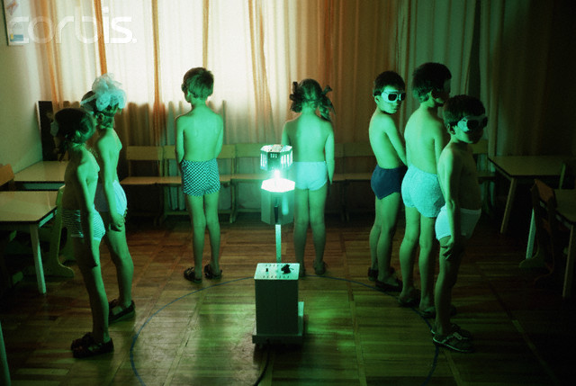
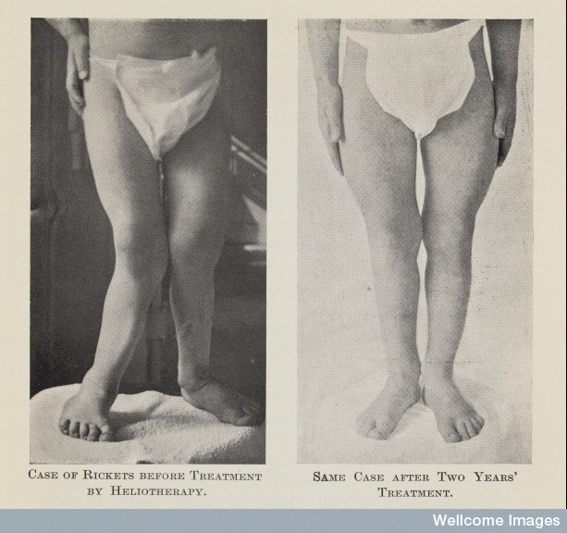
Light therapy
Agreement is almost unanimous as to the tonic effect of ultra-violet radiation on debilitated children, [as] shown by their improved appetite, activity and nervous stability’.
(George Newman, Board of Education, 1928)

Slide 19
Local authorities providing medical treatment
Year Provision Clinics Hospital Spectacles
1908 55 7 8 24
1914 266 179 75 165
1917 279 231 95 223
1920 309 288 168 282
Number of LEAs between 328 and 317
Table from J.David Hirst, ‘The Growth of Treatment Through the School
Medical service, 1908-18, Medical History, 33 (1989), pp.318-342, p.330.

Slide 20
Just poor children….?
‘E.B. Rheumatic. Heart weak. Gymnastics good for her, but she needs to be carefully watched’.
‘L.B. Slight and delicate. R. lung not quite sound. Gymnastics very useful but care to be taken’.
‘E.P. A nervous excitable child subject to headaches. Weak trunk muscles and chest habitually contracted... Must rest between all the exercises longer than the others and not go in when she has a headache or a period’.
North London Collegiate School Archives (NLCSA): Mrs Hoggan’s private notes, RS 1i, 29 September 1882, 5 October 1882, 22 February 1884

Slide 21
Schools as sites of sport, exercise and remedial medicine
Attempts to introduce exercise to schools of all kinds
Boys from mid-19th, girls towards end of 19th century – in schools for middle- and upper-class wide range of sports
The poor had ‘drill’
Martina Bergman Ősterberg, Superintendent of Physical Education London School Board in 1880s - Swedish system or Ling
By 1909 London School Board included marching, dancing, skipping and gymnastic games.
Physical education and interests of state/citizenship

Slide 22
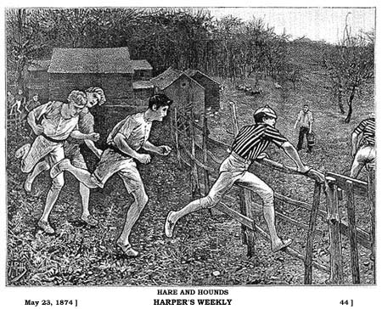
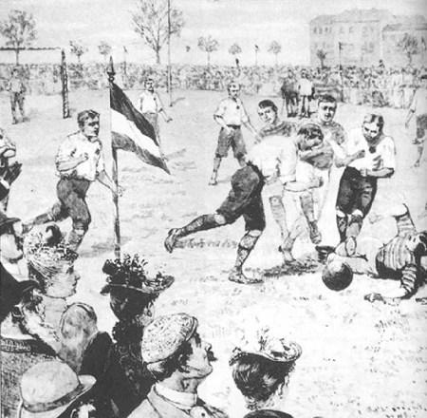
Sport, Manliness and Empire

Slide 23
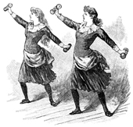
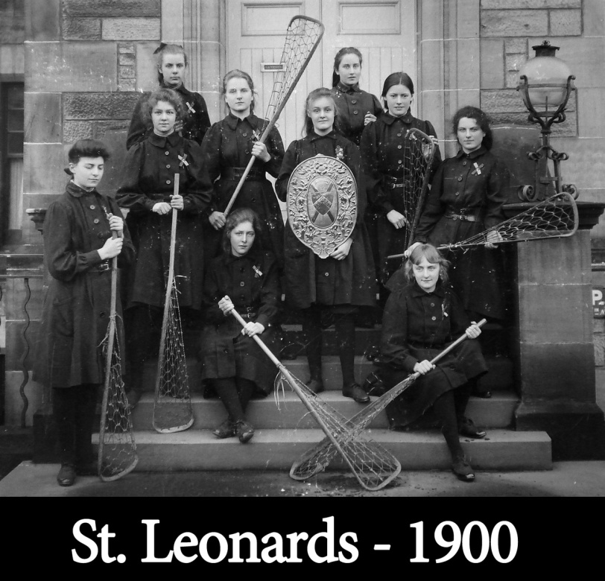
Girls, Empire, Sport and Motherhood
Warnings of over-exertion
Dr Mary Scharlieb – excessive athletics could produce a ‘neuter’ type of girl
Sara Burstall, headmistress Manchester Girls School ‘They have only a certain amount of available energy’.

Slide 24
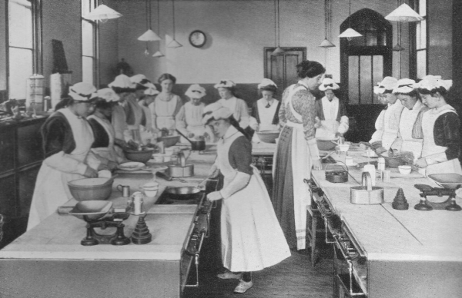
Domestic science

Slide 25
Domestic Science
Complex relationship between girls and education – teaching domestic skills and broader education
Girls as future home makers/mothers (national efficiency)
1878 teaching of domestic economy compulsory for girls; grants for teaching cookery 1882, laundry 1890.
Concerns about industrial employment for poorer girls and for better off women new opportunities in professions – deskilling for both!
Effort to make domestic skills more scientific – emphasis on nutrition, public health, hygiene, scientific practice of housework - contributing to home, community, nation

Slide 26
Sex education
Increasingly schools seen as appropriate places for dissemination of health education and sex education
Debate about who was responsible for such interventions. Role of parents, school or state?
Controversy in 1940s about introduction of sex education in schools
Many pupils reported ‘Oh no, nothing, we didn’t learn anything’ – sex education often incidental rather than part of curriculum and emphasis on VD.
Reticence amongst teachers about providing sex education – and amongst children. Often taught indirectly as part of biology or botany.

Slide 27
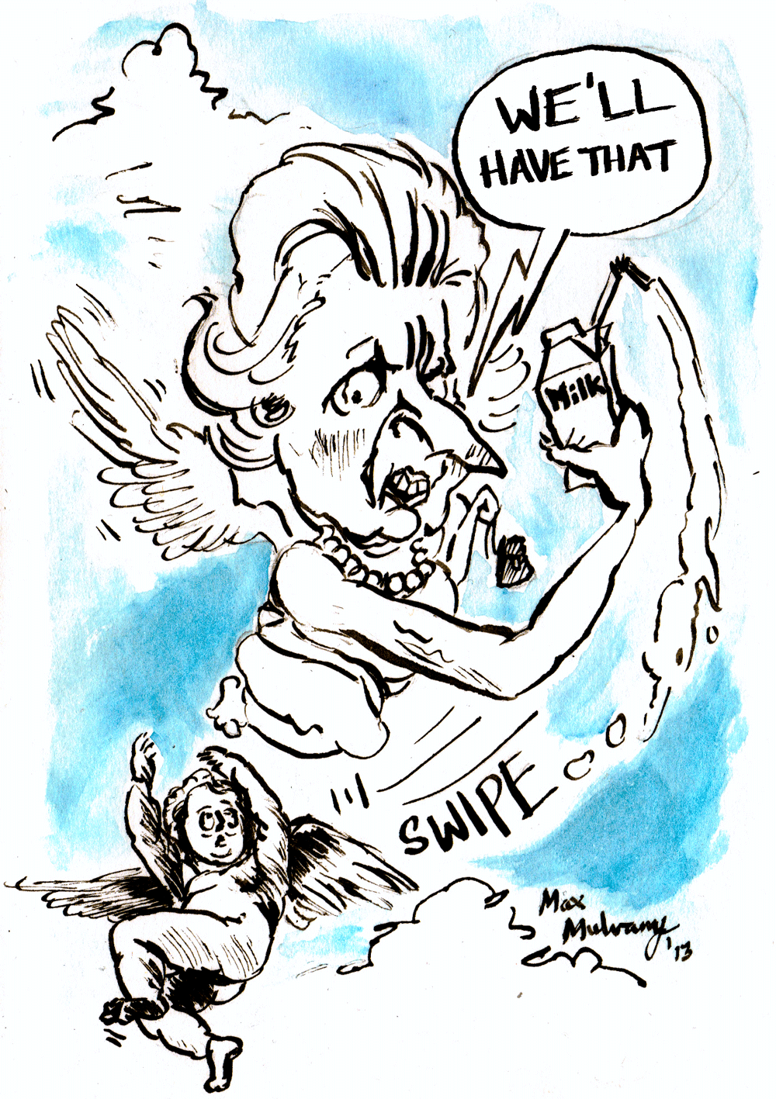

Maggie Thatcher ‘Milk Snatcher’

Slide 28
Conclusions
Key debates: who is responsible for health of school child, who should pay for provisions, how extensive should interventions be?
Schools came to provide a wide range of health and medical provisions: medical inspection, milk and meals, exercise and sport, domestic science teaching, sex and health education and special interventions, e.g. vaccination

