Slide 1
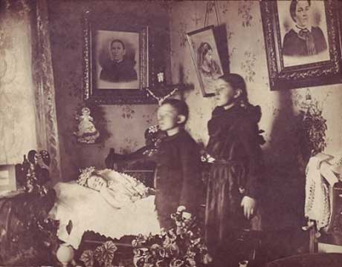
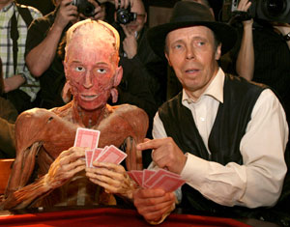
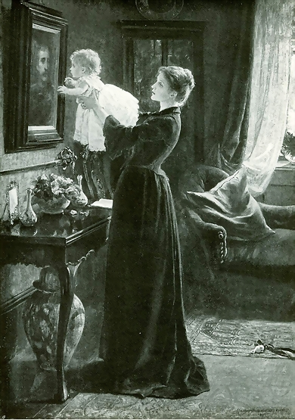
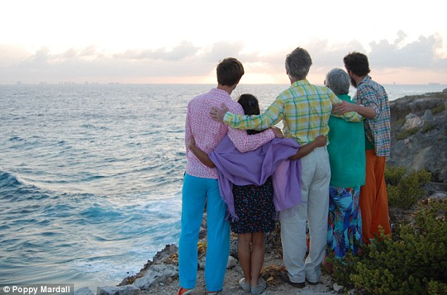
Death in Modern Britain
Cradle to Grave Term 3, Lecture 1

Slide 2
Themes
The ‘good death’ - how does this change over time?
  Actors (dying, family, community, doctors, undertakers) and institutions/ professionals vs private
  Material culture
  Emotion
Religion/spiritualism vs medicine/science?
  Was the modern period marked by a shift from emphasis on spiritual preparation for death to ideas of death as failure of professional medicine?
  Is the history of death best envisaged as ‘a linear chronology whereby a sacred and community-centred culture eventually gave way to a privatized and sanitized culture of death’?
  (Julie-Marie Strange)

Slide 3
Change over time
Phillipe Aries’ The Hour of Our Death (1981) – western attitudes to death from C12th to C20th
The story:
  Enlightenment death explained in increasingly rational terms of biological change.
  Romanticism and market in mourning paraphernalia ‘transformed death into a dazzling display of sentiment and status’ in Victorian period.
  Key factors influencing attitudes
    Declining mortality rates after 1870s
    Medicine’s growing expertise
    Mass bereavement of Great War
  By mid-C20th death was ‘secularized’.
  Death and hospital - ‘sanitised’, private, ‘sterile’
Historians have pointed to death ‘as a site where competing narratives of secularism and science, rationality and spirituality, the private and public are contested’.
For an overview see Julie-Marie Strange, ‘Death’, in Mark Jackson (ed.), The Oxford Handbook of the History of Medicine (2011)

Slide 4
What is death?
When does death happen? Shifting notions of timing of death – biologically and spiritually
Types of death – organ? (which ones? brain, heart etc.) Molecular? Flatline on EEG,ECG?
How to detect death? Who has right to detect or declare death? Medical profession’s ability to judge signs of death
Terminology and temporality – e.g. ‘stillbirth’ used to classify babies who had lived for several days
Official death - Registration of death 1837 (cause of death, statistics)
A process of social organization, cultural responses and acknowledgement – resurrection, spiritual journey, withdrawal of terminally ill or elderly from social world, burial rituals, funerals
What is an appropriate age to die? – note age of death in obituaries!

Slide 5
A ‘good’ death
Partly shaped by resources – spiritual preparation and putting affairs in order (this changes over time, but arguably still important)
‘Comfort’ of religion - psychological function
Death anticipated – high mortality e.g. of children – religion offered explanation for untimely death
‘Bad’ death? Dying ‘uncomfortably’? (Jalland)

Slide 6
Who was dying?
Up to 2ndWW witnessing of death was common.
Most people still died at home.
IMR high until late 19th/early 20thC – 163 per 1,000 in many poor areas 1900 – and adolescent deaths also high.
Maternal mortality also high till interwar period.
By mid-20thC:
  deaths of infants and mothers drastically reduced
  increasing chance of death taking place in hospital.
1897 13% of deaths in hospital, 1967 58%
Life expectancy increased dramatically:
  1826 1 person in 15 aged over 60
  1 in 13 1911
  1 in 8 1931
  1 in 6 1951.

Slide 7
Death of a Daughter: Little Emma
Families wrote frequently about grief at loss of child – itself a frequent occurrence.
‘You will be grieved to hear that a slight ailment of our dear little Emma Cecily proved to be scarlet fever or some form of it, and convulsions coming her little life soon ebbed out – God be praised for All his Mercies which are great indeed – I feel this to be a serious call to us and beg your prayers that may be blessed to us… I suppose the little one’s remains will be laid by her sister’s…’
Thomas to Lydia Acland n.d. [1851], Devon Record Office, Acland MSS (1148 M/16/2)

Slide 8
Suicide
Worst death – grevious sin, and social, legal and religious sanctions meant that death customs and inheritance rights forfeited
Some historians have suggested suicide secularised by early 19thC (Murphy and MacDonald) – social problem or result of mental illness rather than moral crime – but this view has been contested
Attitudes of church – refused to conduct burial service - and also popular resistance to burial of suicides in consecrated ground
Suicide a crime until 1961 in Britain
Suicide also breached opportunity for ‘good’ death and customs surrounding death

Slide 9
Burial
Burial grounds traditionally near church/in heart of population centres.
By 19thC concern about overcrowded graveyards – sanitary problem/public health.
1852 Metropolitan Burial Act, followed by provision in provinces – granted local gov’t right to establish municipal burial boards charged with opening and operating public cemeteries.
Private, commercial cemeteries – joint-stock companies established late 19thC.
Cemeteries allowed for religious freedom, dignity for dead and social competitiveness – memorial culture.
Cremation Society 1874 – superior hygiene and economy shifted to egalitarianism and respect for dead. 1901 Cremation Act and 1907 13 crematoria in England.

Slide 10
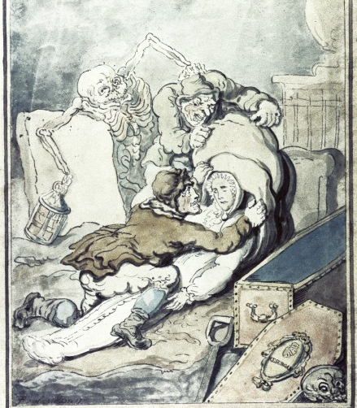
Grave robbers
Two grave robbers stealing a corpse, while death grabs one of robbers from behind.
Thomas Rowlandson, 1775

Slide 11
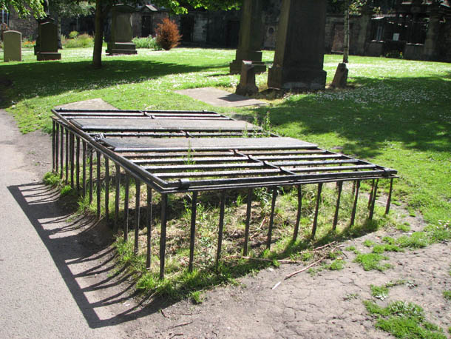
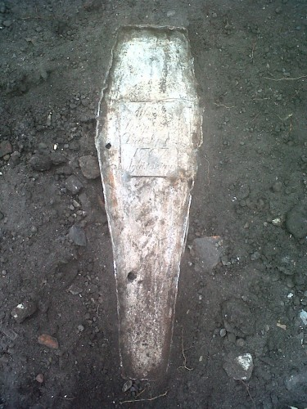
Caged grave , Greyfriars Kirk, Edinburgh
Infant burial, Lead Coffin, Inscription reads 1767.

Slide 12
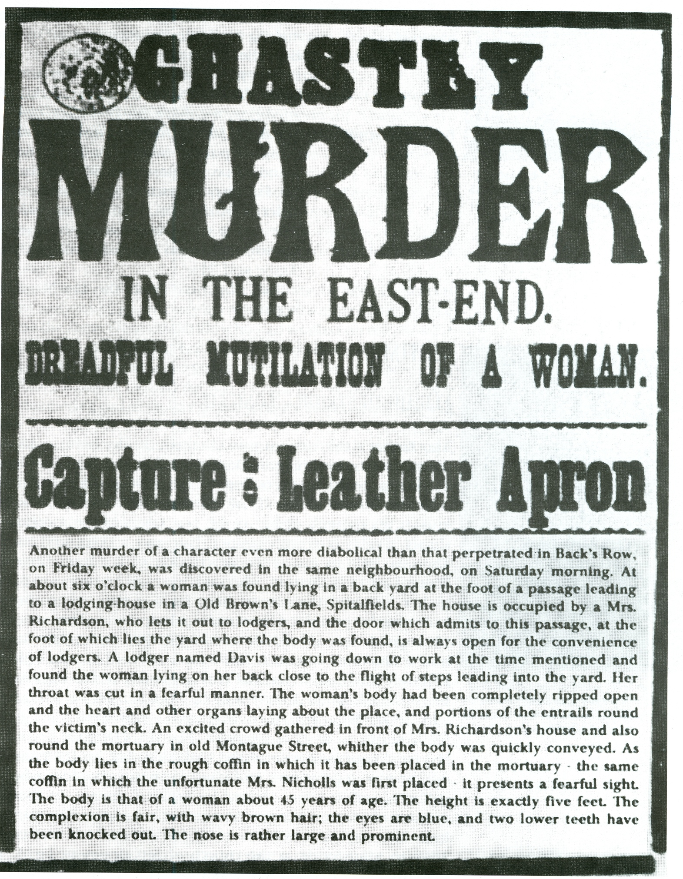
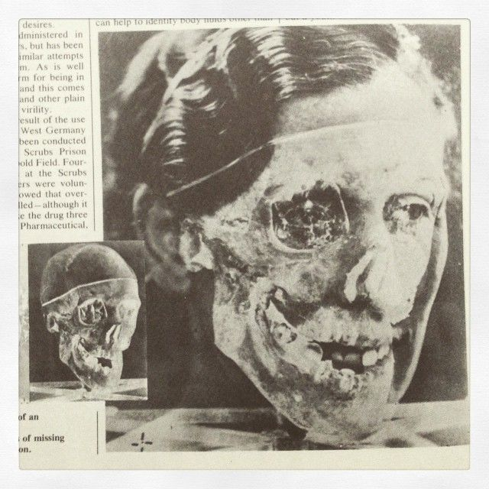
Forensic evidence presented at the case of the murder of Isabella Kerr against her husband Buck Ruxton
See: http://www.fmap.archives.gla.ac.uk/Case%20Files/Ruxton/Case_File9.html
Newspaper broadsheet on the crimes of ‘Jack the Ripper’

Slide 13
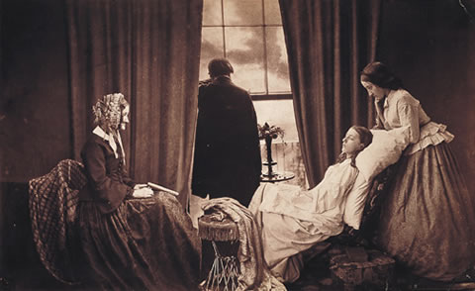
Romanticism and cult of death (idealisation of disease such as consumption, celebration of grief in art)
Fading Away, Henry Peach Robinson, 1858

Slide 14
Death of Emily Brontë: Pulmonary Tuberculosis 1848
[21 Dec 1848]
‘Emily suffers no more from pain or weakness now. She never will suffer more in this world. She is gone, after a hard, short conflict… I thought it very possible she might be with us still for weeks; and a few hours afterwards, she was in eternity. Yes; there is no Emily in time or on earth now. Yesterday we put her poor, wasted, mortal frame quietly under the Church pavement. We are very calm at present. Why should we be otherwise? The anguish of seeing her suffer is over; the spectacle of the pains of death is gone by; the funeral day is past. We feel she is at peace. No need now to tremble for the hard frost and keen wind. Emily does not feel them. She died in a time of promise. We saw her taken from life in its prime. But it is God’s will and the place where she is gone is better than that she has left….’
Charlotte Brontë, letters quoted by E.C. Gaskell, The Life of Charlotte Brontë, New York, 1857, vol. 2.

Slide 15
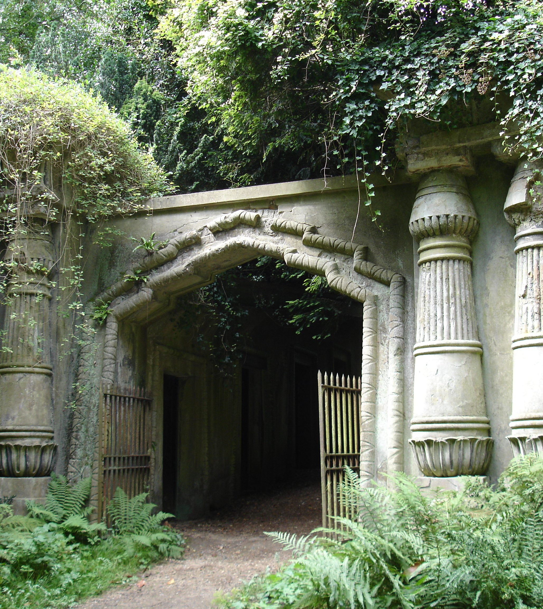
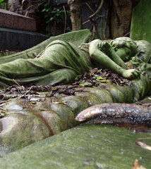
Kensal Green and Highgate

Slide 16
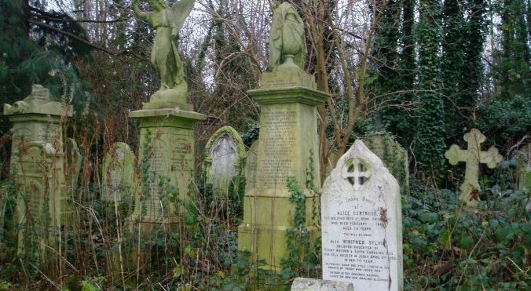
Stoke Newington Cemetery

Slide 17
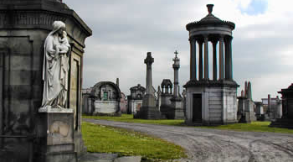
Necropolis Glasgow

Slide 18
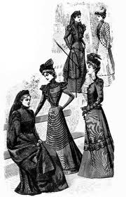
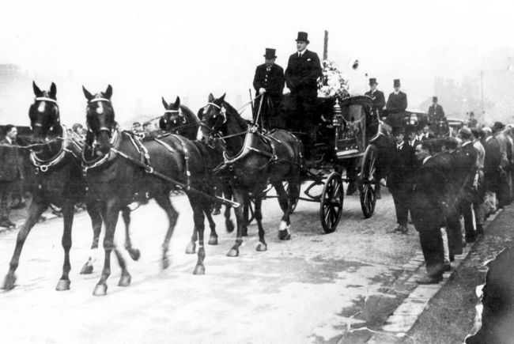
Victorian funeral

Slide 19
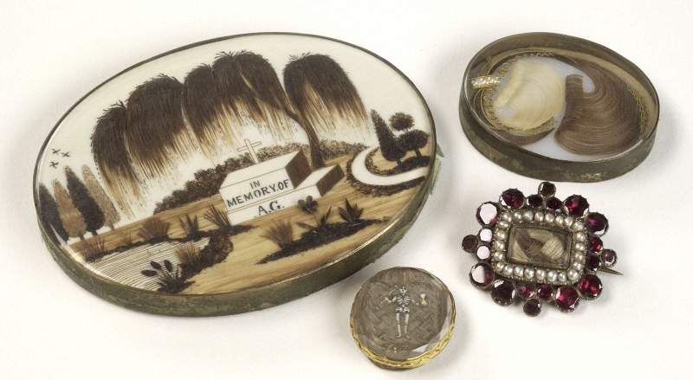
Mourning broaches with hair of relative, 19th century

Slide 20
Death and Mourning
By 19thC natural perceptions of death shaped increasingly by science and ‘preventive medicine’ e.g. vaccination, but existed side by side with religious ideas
Jalland shows how doctors and Christians worked together to ease pain and anxiety – even as medical culture worked to prevent or delay death
Management of death taken over by funeral profession – National Association of Funeral Directors established in 1905
Bereavement psychologised and pathologised – bereavement guidance, stages, consolation task of professional
Yet parallels to older approaches preparing for death and mourning rituals

Slide 21
Class and Death
Could poor afford luxury of grieving?
‘The loss of a close relation was so bound up with the material problems of life that at worst it seemed no more than an intensification of the misery of existence’ – precluded ‘pure grief’ (David Vincent, ‘Love and Death and the Nineteenth-Century Working Class’, Social History, 5 (1980), 223-47)
Challenged by Strange (seminar reading)
  Though mortality declined, poor more familiar with death
  Desire to keep dying at home
  Important to distinguish ‘particular’ responses to death from ‘general’ fatalism
  Importance of ‘decent’ burial

Slide 22
London’s Pulse (MOH reports) – Irish customs
REPORT on the SANITARY CONDITION OF ST. MARY, ISLINGTON,
FOR FEBRUARY, 1867.
No. CXVIII.
The mortality of the parish during the month of February has again been below the average. The number of deaths of residents which were registered is 314, while the corrected mean of the corresponding period for ten years is 334.
Small-Pox has continued to prevail extensively, more so even than in the month of January. An outbreak in some gipsies' tents in Upper Holloway, gave us some trouble at the close of last month; but, at last, the father of the family being attacked, they were all got away into the Small-Pox Hospital, but not before much alarm had occurred in the neighbourhood, and the Sanitary Act had been put in operation.
A serious outbreak of Typhus has also occurred in the Irish Courts, which has been traced to the removal of the body of a Typhus patient from the Hospital to Swan-yard, where a wake was held; several of those attending it being seized with the disease and spreading it in their own houses.
EDWARD BALLARD, M.D.,
Medical Officer of Health.

Slide 23
Decline in religion
Church attendance declined (1851 census) but religion pervasive in everyday life.
Boom in spiritualism in late C19th into C20th.
For many people difficult to access either medicine or religion.
  Growth of town populations – rupture with church.
  Cost of medical treatment limited care and nursing of dying – concerns about body snatching, death in workhouse, families diverted funds to pay for respectable funeral.
Religious missions supplied both spiritual and practical care in large towns.
Friendly societies insured poor against sickness and death (burial societies). Poor dreaded pauper burial.

Slide 24
Rupture of war
Decline in mortality and Evangelical fervour 1870s and 1880s
Claimed 1stWW significant turning point – civil religion following mass deaths.
National memorial and civic mourning – new forms of remembrance (memorial culture). War memorials, tomb of Unknown Solder, Armistice Day. Collective mourning.
Bereavement never more widespread than after 1stWW – death of adult children, young men. Associated with violence, distance, denial of conventional burial – resulted in chronic and unresolved grief (David Cannadine)
Destroyed positive meaning of death – broke link with idea of good death.

Slide 25
Palliative Care and Euthanasia
Well into 20thC role of doctor largely to predict and fix moment of death and relieve pain.
Late 19thC medical study of death – mid-20th increasing ability to delay death. Death ‘enemy to be conquered’. Also rise in post-mortems/forensic science – more knowledge of dead body
Interest in Victorian period in alleviating pain in terminal illness (palliative care).
William Munk, Euthanasia: or Medical Treatment in Aid of an Easy Death (1887) – geared towards soothing dying.
Easing death rather than hastening it. Both secular/medical e.g. use of opium and avoiding treatment that would prolong dying process but also urged peaceful death. Holistic approach.
Nursing increasingly about practical care but also emotional support for sick, dying and bereaved.

Slide 26
Hospice movement
Both response to and example of medicalisation of death.
Took off 1960, though first hospices established by religious groups in mid- to late 19thC for respectable poor – in London e.g. St Luke’s Home for the Dying Poor (1893). Religious and philanthropic basis – emphasis different from charitable hospitals which aimed to cure and devoted to treatable cases (Clare Humphreys).
Cecily Saunders (1918-2005) – movement for modern hospice. Holistic package – medical, psychological, spiritual and emotional needs. St Christopher’s Hospice, London 1967.
Also sought to address the lack of services for dying and poor care at home e.g. lack of pain relief, but also absence of emotional support. Combined personal calling with professional care.

Slide 27
The Dead Body
Domestic display of body declined late 19thC – removed from public display (chapels of rest established 1890s).
Death extended and more inclusive category - and preoccupation of late 20thC (Roger Cooter) e.g. cot death, brain death, organ donation and transplantation, doctor-assisted suicide, post-mortem pregnancies and assisted death.
‘Burgeoning ethics industry’ – technical advancements ‘blur the boundaries between life and death’ e.g. Human Tissue Act 1961, brain death laws and protocols.
Medical management of dead and dying will continue to be fashioned in relation to possibilities and constraints of scientific, professional, commercial, political, legal, religious and social interests and cultural norms – ‘in a deeply furrowed dialectic between that which is possible and that which appalls’ (Roger Cooter).

