Slide 1
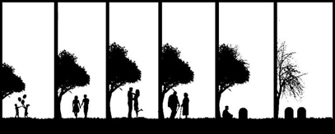
From Cradle to Grave: Health, Medicine and Lifecycle in Modern Britain (HI278)
Lecture 1: Being Interdisciplinary and Watching the Media: How to Approach this Module

Slide 2
LECTURE OUTLINE
Administration
Course Overview
The Social History of Medicine: Historiography
Changing Experiences of Health in the 20th Century
Health and the Media

Slide 3
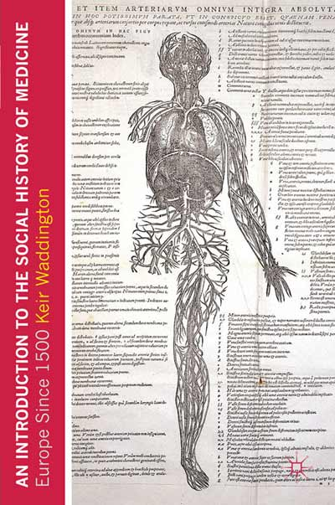
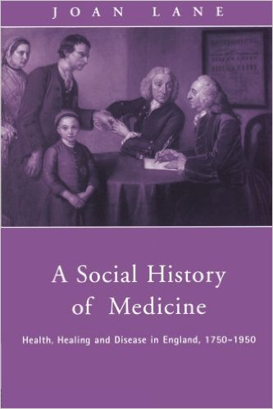

Slide 4
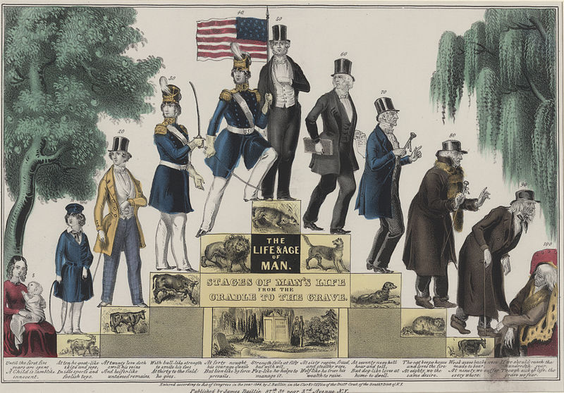
James Ballie, The Life and Age of Man. Stages of Man’s Life, from the Cradle to the Grave (1848)

Slide 5
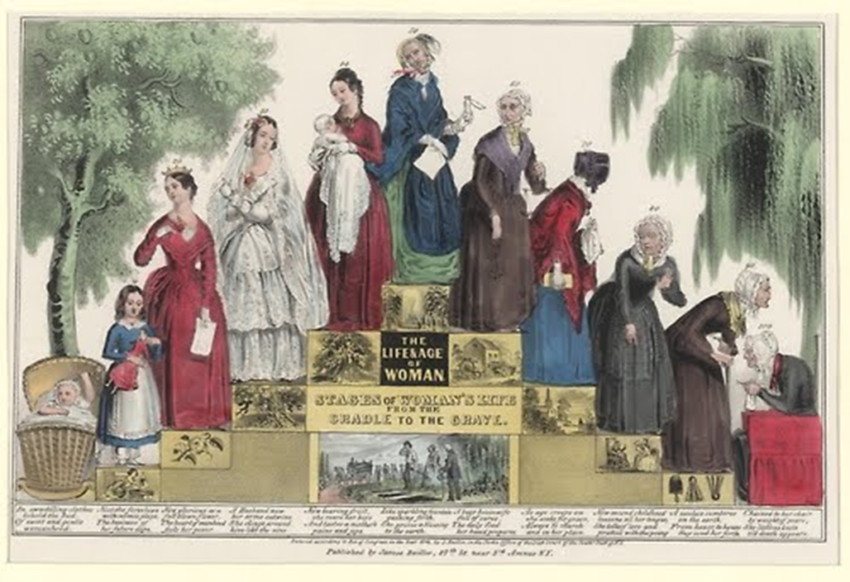
James Ballie, The Life and Age of Woman. Stages of Woman’s Life, from the Cradle to the Grave (1848)

Slide 6

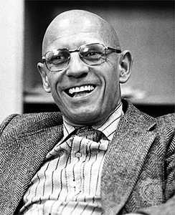

Slide 7
‘[it] is for us to promote the study of the entire spectrum of medical history utilising the values and techniques of the new 'social history'. This is not simply a matter of adopting the broader rather than narrower conception of social medicine. Rather it involves, relegating to a subordinate place any linear account of medical progress, in favour of an approach which is primarily concerned with contributing to an understanding of the dynamics of any particular society.’
Charles Webster (1974)

Slide 8
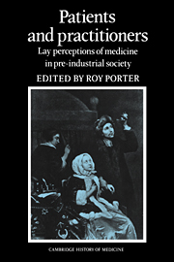
‘It takes two to make a medical encounter - the sick person as well as the doctor...Indeed it often takes many more than two, because medical events have frequently been complex social rituals involving family and community as well as sufferers and physicians. Moreover a great deal of healing in the past has involved practitioners only marginally, or not at all, and has been primarily a tale of medical self-help, or community care.’

Slide 9
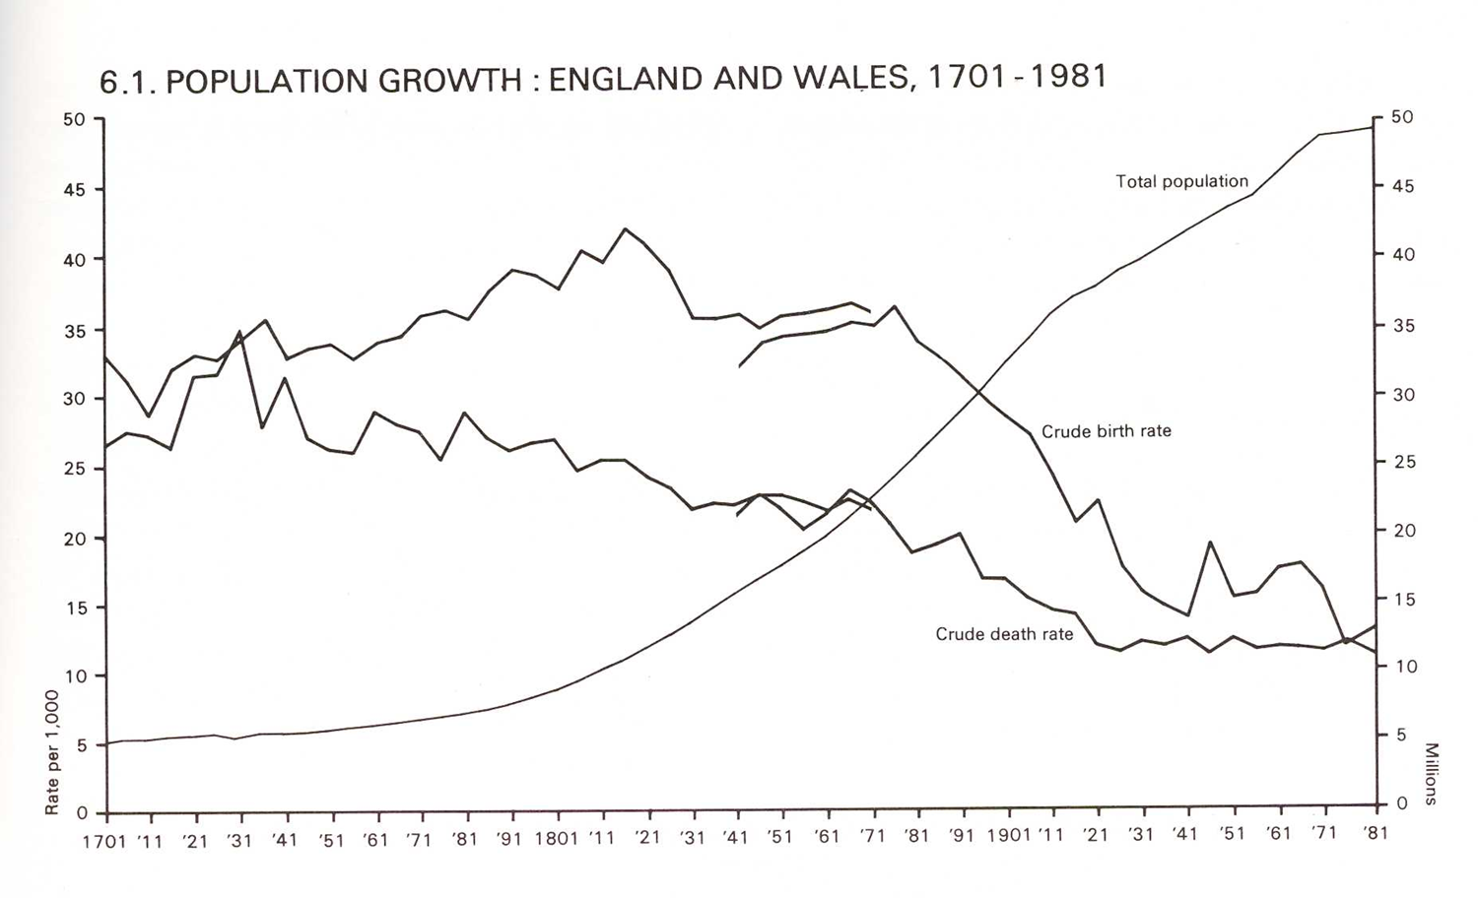

Slide 10
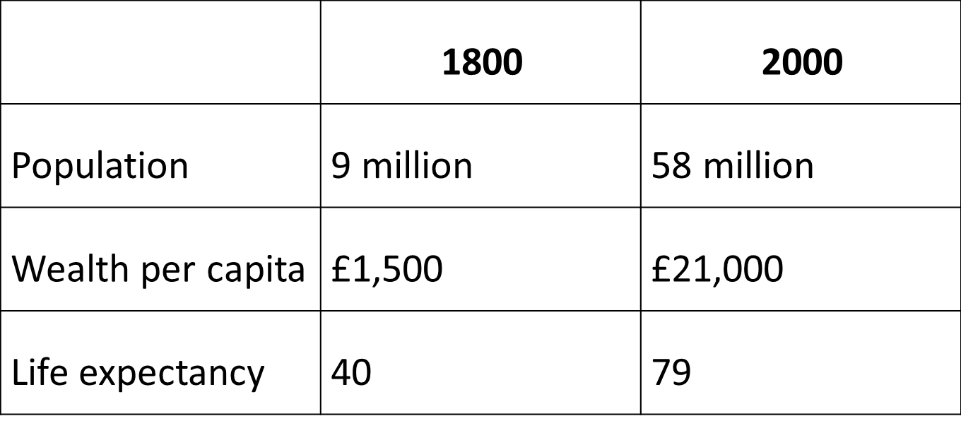

Slide 11

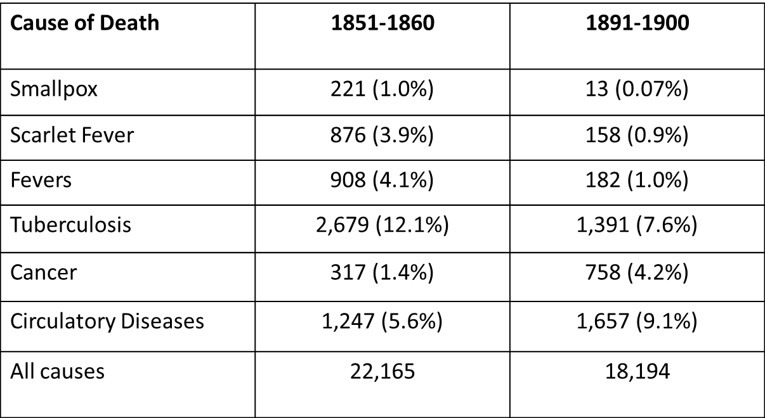

Slide 12
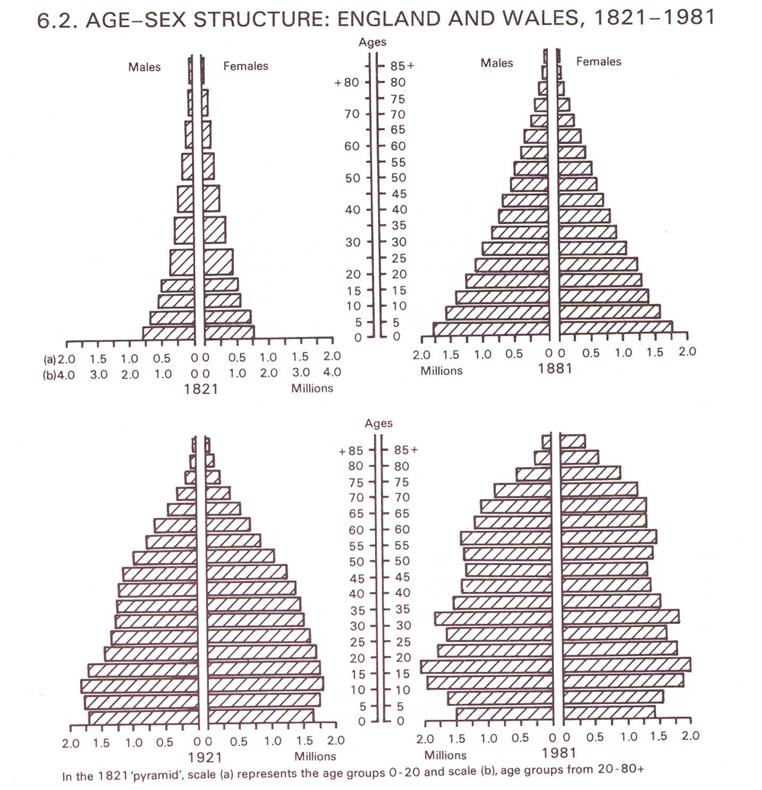

Slide 13
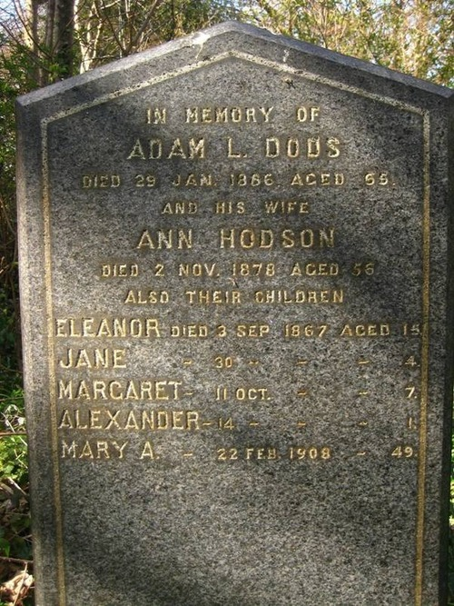
Infant mortality figures:
1900 – per 1000 live births, 154 died before 1st birthday
1950 – 30 deaths
1985 – 9 deaths

Slide 14
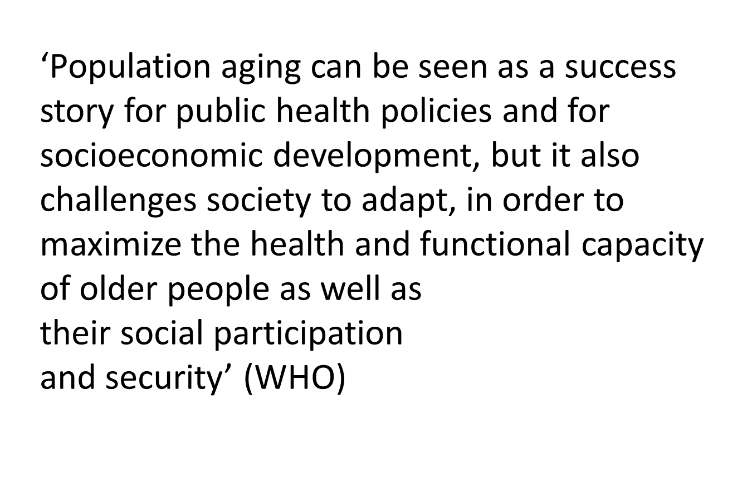
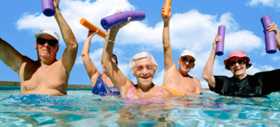

Slide 15
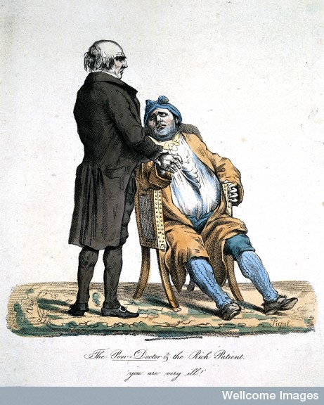
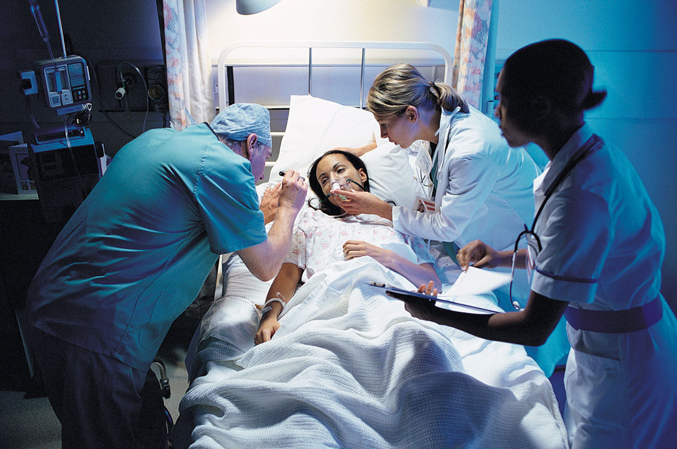

Slide 16
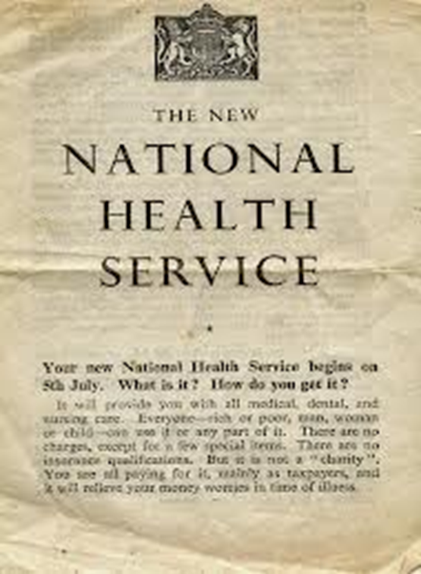

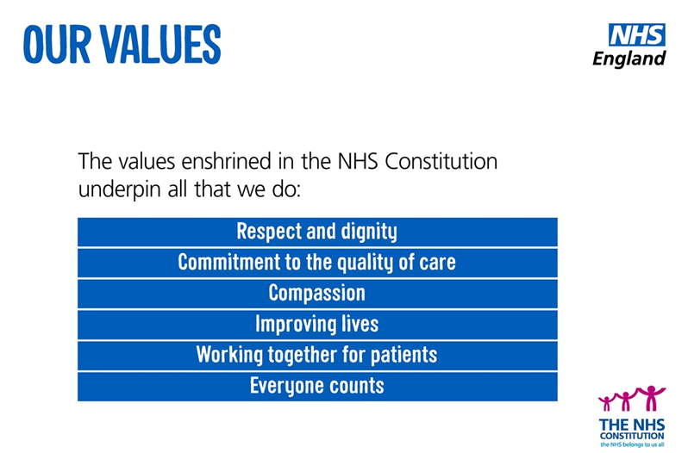
NHS Employment Figures
Total employment: 1.6 million people
40,236 general practitioners (GPs)
351,446 nurses, 18,576 ambulance staff
111,963 hospital and community health service medical and dental staff.

Slide 17
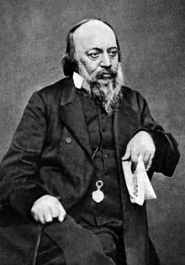
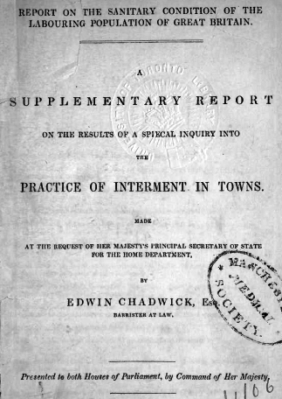

Slide 18
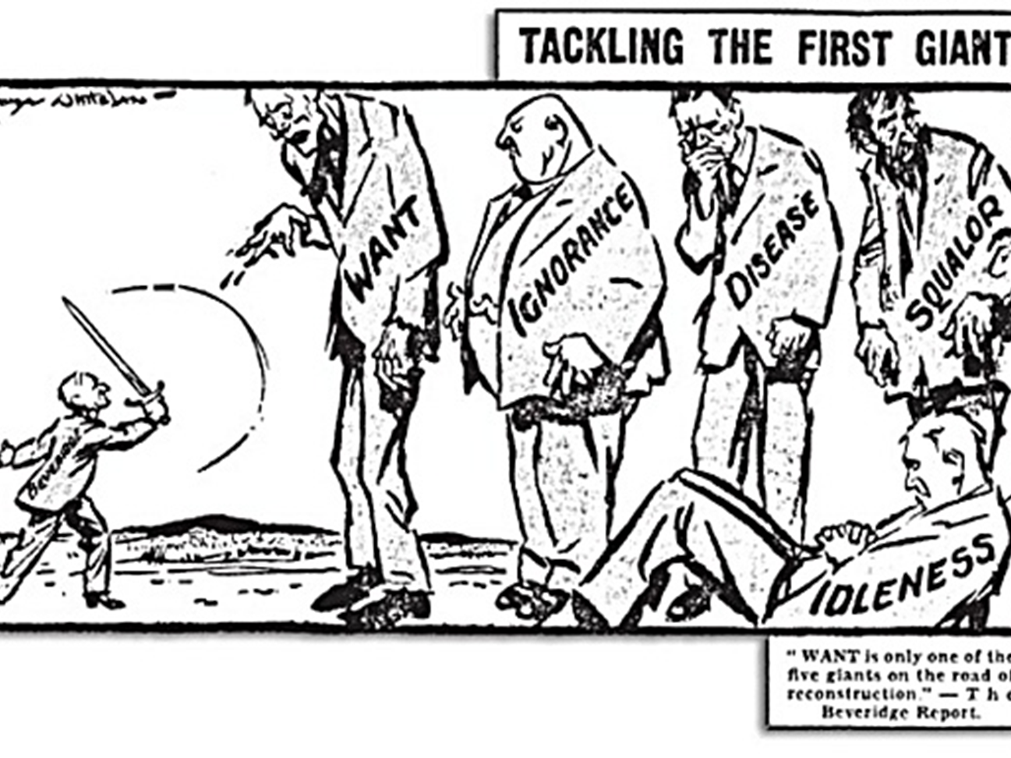

Slide 19


Slide 20
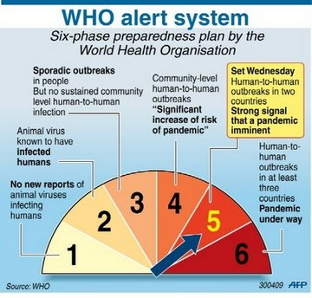
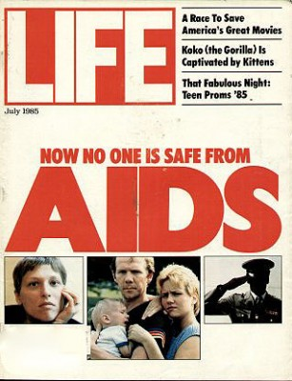

Slide 21
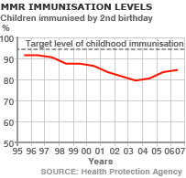
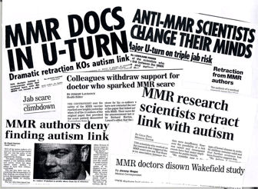
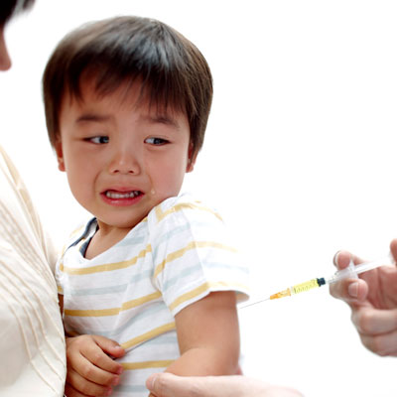

Slide 22

