Slide 1
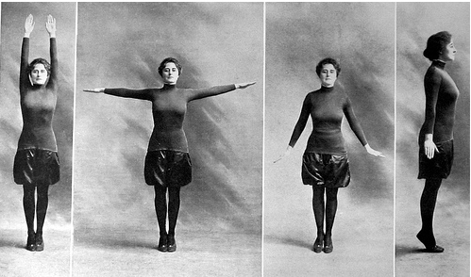
Healthy Lifestyles: Exercise, Sport and Health
Cradle to Grave Lecture 8 Week 9

Slide 2
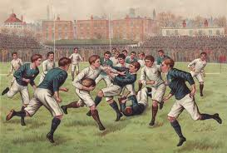
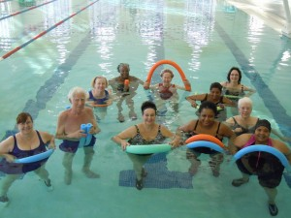
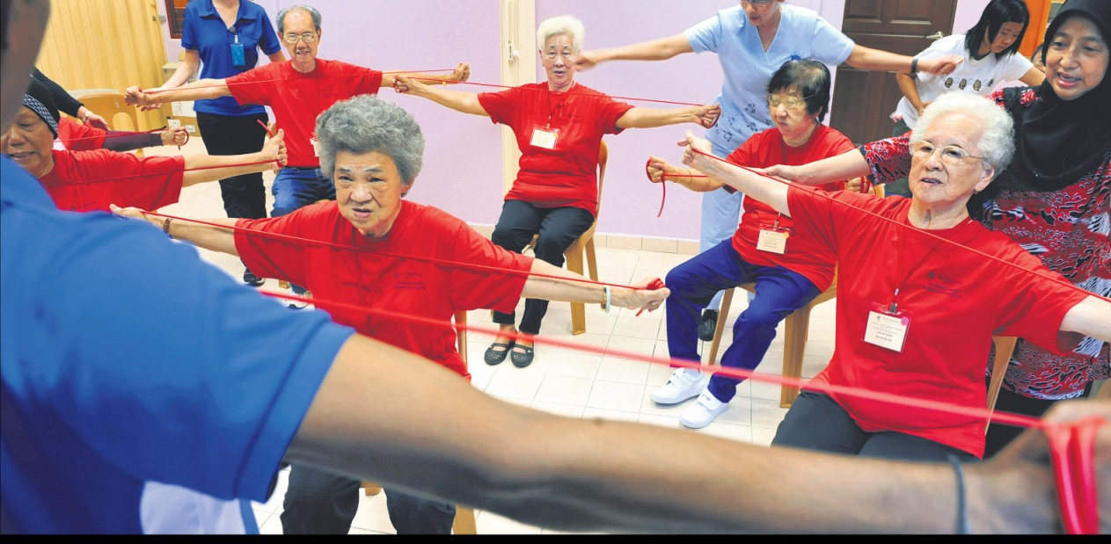
Life cycle and fitness

Slide 3
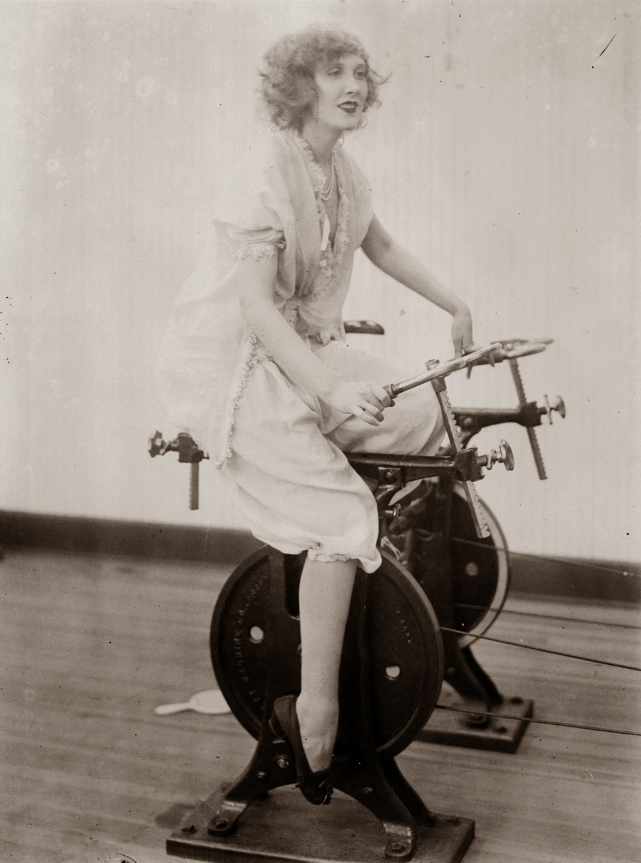
Themes
School Sport for Boys
Exercise for Girls
Physical Culture
Physical Education
Voluntary Organisations, the State and the Promotion of Health

Slide 4
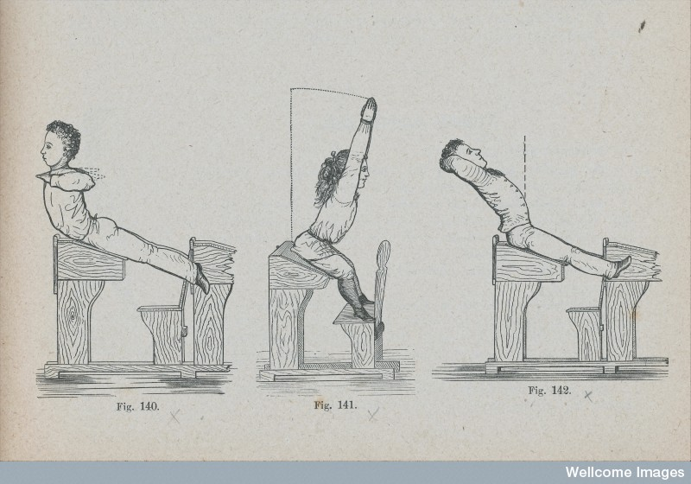
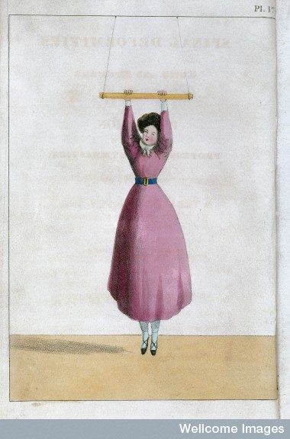
Late 19th century – rediscovery of the Graeco-classical ideal: Mens sana in corpore sano (healthy mind healthy body).
Physical exercise and body management became a key concern for school teachers, reformers, campaigners, doctors and policy makers.
School was an early site of sport and exercise.

Slide 5
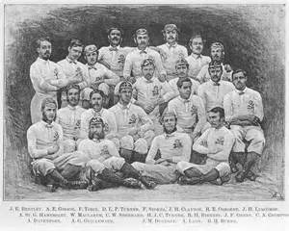
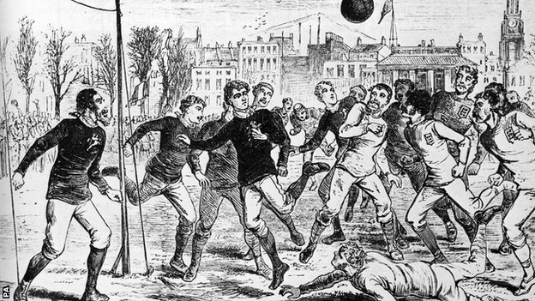
Sport, public schools, masculinity and empire
Regulated games and sports (cricket, rugby, football, fencing) emerged in public schools.
Thomas Arnold at Rugby – ‘muscular Christianity’
E.L. Cotton at Marlborough – way of instilling discipline and cultivating a gentlemanly ‘character’
Empire concerns – emphasis on national efficiency, and team spirit, building character. Preparation for the military/officer roles.

Slide 6
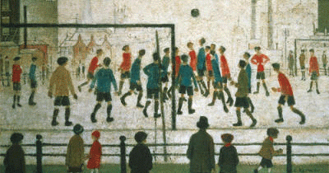
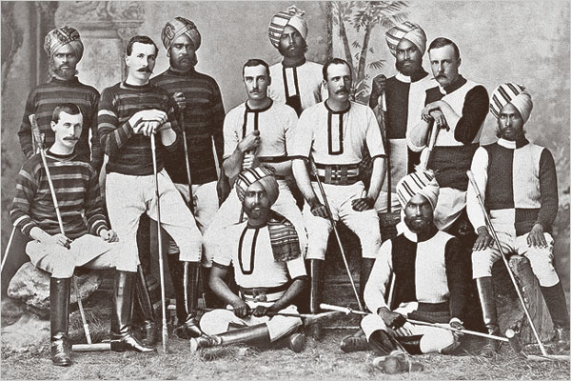
Sport becomes more accessible
Sport quickly taken up by the middle classes – physical prowess signified respectability and associated e.g. with temperance.
Effort to promote sport among the working classes to produce physical improvement in ‘degenerate populations’.
Football quickly became a popular spectator sport and taken up by many working-class men.
As sports were shipped across the empire and national they took on a imperial dimension e.g. cricket exported to colonies – 1909 Imperial Cricket Conference, foundation of Test Matches.

Slide 7
Women and exercise
Late 19th century – idea that women should exercise emerged – elite girls schools and content of advice literature.
Debates on suitability, etiquette and appropriateness of female exercise – walking, dancing, croquet and calisthenics thought most appropriate.
Commentators became increasingly critical that girls did not have the same sporting opportunities as boys.
Herbert Spencer – does ‘the constitution of a girl differ so entirely from that of a boy as not to need these active exercises? Is it that a girl has none of the promptings to vociferous play by which they boys are impelled.’

Slide 8
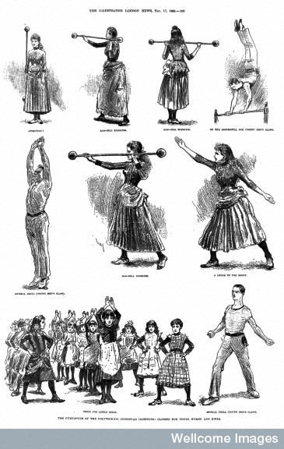
Gymnastics
In schools including elementary schools for girls (Martina Bergman Ősterberg, London School Board)
Private gymnasia for girls set up and promoted in girls’ magazines.
1899 Girl’s Realm magazine advised ‘modern girls’ to pay weekly visit to gym.

Slide 9
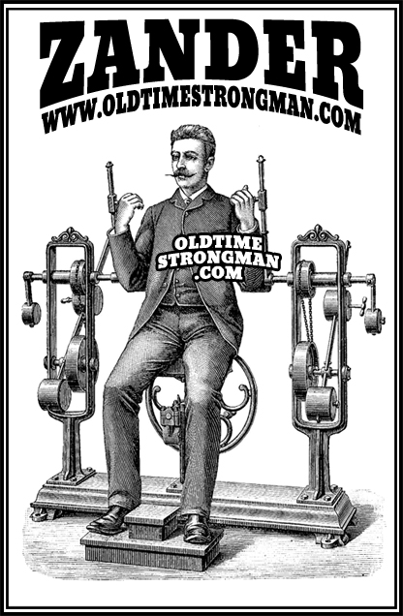
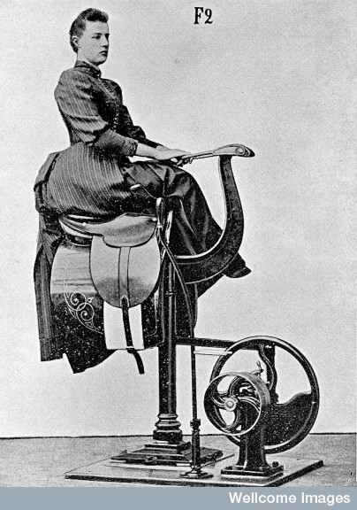
Zander’s exercise equipment

Slide 10
Cycling and health
Popular female pastime from the 1880s onwards
Cycle craze of mid-1890s (1.5 million cyclists in UK, 1898 2,000 cycle clubs, by 1896 one-third women’s cycles).
Filtered down social hierarchy.
Concerns about the impact on women’s health:
accidents, overstrain, infection of bladder, overtaxing muscles, hernias, nervous disorders – disorders such as ‘bicycle hand’, ‘cyclists spine’ and vibration and fatigue fever.
Short lived concern about potential damage to female reproduction.
Archive of National Cycle Association in Modern Records Centre at Warwick.

Slide 11
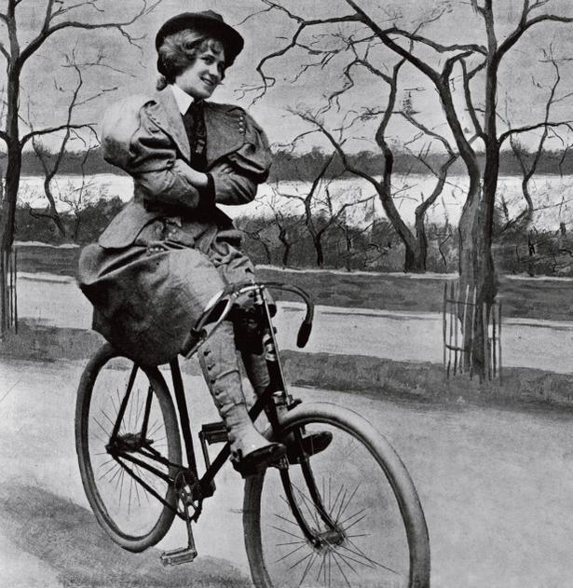
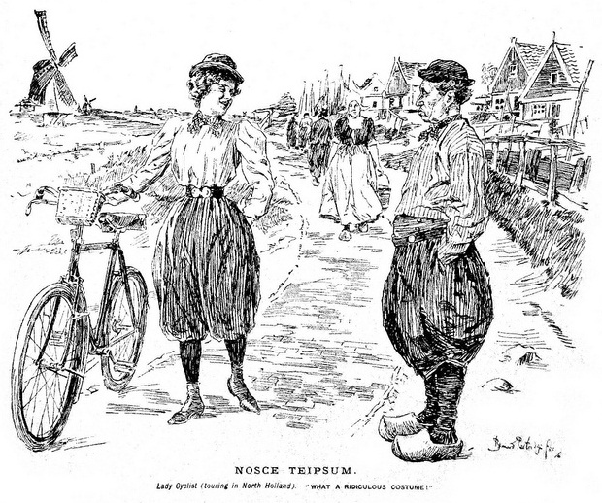
Cycling and risk
Anxieties about the deterioration in female character - over-athleticism and loss of femininity.
Complaints about female cycling fashions – culottes. Associated with campaign for dress reform, Rational Dress Society.
Women were satirised for cycling in magazines like Punch.
But promoted by feminists, New Woman and headmistresses.

Slide 12
Constance B., admitted Holloway Sanatorium, May 13 1898, Case Book No. 11 Females: Certified female patients admitted May 1898-May 1899 WMS 5159, Wellcome Collection, London, pp.5-6
Single, aged 24. Congregationalist. Prev: abode 127 Fordwych Rd, West Hampstead. 1st attack of about a week’s duration. Supposed cause “bicycle accident”. Not E. S. or D.
1st Certif: She is morose. Says she has committed the unpardonable sin; that devils have taken possession of her and that she is hopelessly lost. She is violent at times and her manner and conduct are totally at variance with her usual habits (contd) refuses her medicine on the grounds that her friends are trying to poison her.
May 13, 1898 (signed) F.B. Wells M.B.
Of 107 Fordwych Rd West Hampstead
2nd Certif: corroborates
May 13 1898 (signed) C.A.A. Coulthard
Of 27 Fordwych Rd NW
Prev:Hist: Has always been neurotic and “hysterical” – had attacks of “acute hysteria” – youngest of 5.
3 wks ago had a bicycle accident – was run into by a cab, received no injury but suffered much from shock. Since then much depressed with paroxysm of excitement in which she screamed and cried. Has developed delusions of unpardonable sin and of her having committed some great crime. Has been under the charge of 2 nurses, taking food fairly, has had several morphia injections.
Gen health fair – but has frequent attacks of severe dyspepsia . Jaundice 7 years ago.
Catamenia regular – no dysmenorrhea but has always been “odd” at her monthly times.
Habits erratic – needlework, games, a little tennis and croquet, but has never [illeg] to any occupation.
Family Hist: Said to be nil.

Slide 13
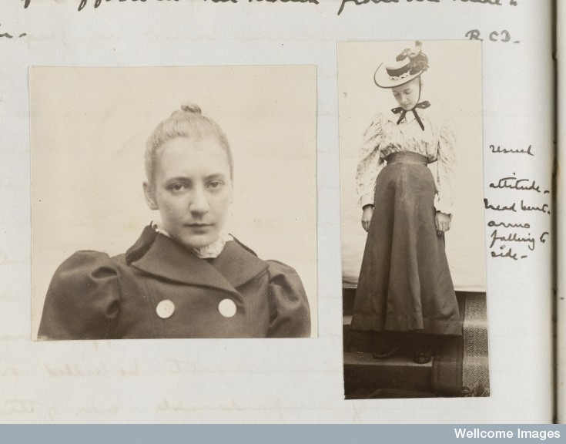
Photographer unknown, Two photographs of Constance B., Holloway Sanatorium, CB No.11 Females (Certified patients admitted May 1898-May 1899), 6.7x6.5cm and 3.4x8.5cm, WMS 5159, p.7. WL:L0049041.

Slide 14
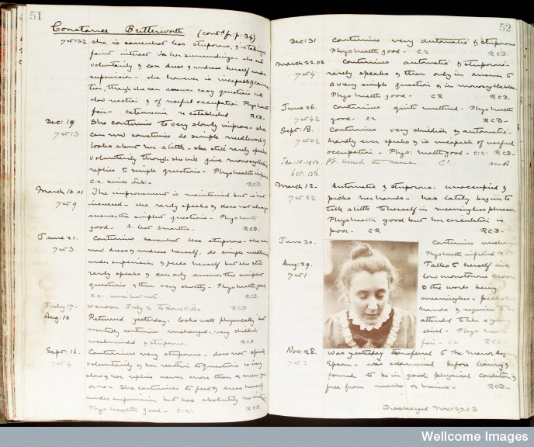
Constance B.’s case notes, Holloway Sanatorium, CB No.11 Females (Certified patients admitted May 1898-May 1899) WMS 5159, pp.51-52, WL: L0033810

Slide 15
Health in Moderation
‘Archery improves the chest, throws back the shoulders, thus improving the figure, and develops the muscles… Croquet has improved the health and happiness of womankind more than any game before invented….’
Dr Pye Henry Chavasse, Advice to a Mother, 1889.
‘The young women of to-day are finer to look at, straighter, taller, more wholesome looking, than were those of thirty years ago… The girl who formerly was lackadaisical and languid – never absolutely ill… but never at the same time entirely well, always suffering from some trifling ailment, which made her and every one with whom she came into contact miserable – becomes literally a “new woman”’.
Exercise according to educator Ernest Lowe, Chambers’ Journal, 1899.

Slide 16
Physical culture
Entrepreneurs –Bernarr MacFadden (1868-1955) and Eugen Sandow (1867-1925).
Coincided with revival of Olympic Games early 20th century.
Sandow - physical training empire. Institute of Physical Culture - magazines and books – ‘educator and savior-by-example’ in improving physical stock of deteriorating nations (Dorothy Porter)
MacFadden - American physical culturist with publishing empire (Physical Culture).

Slide 17
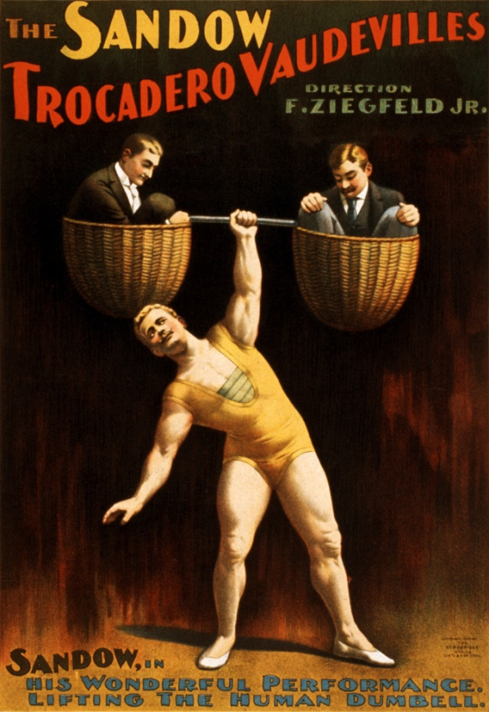
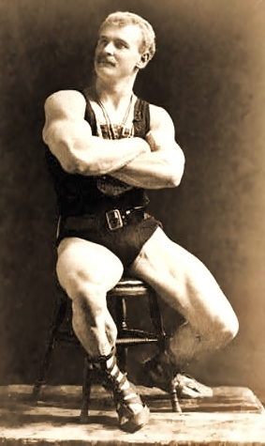
Eugen Sandow (1867-1925) showman and body builder

Slide 18
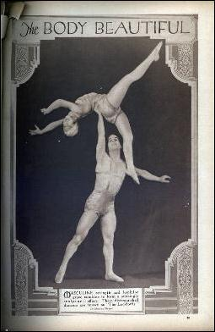
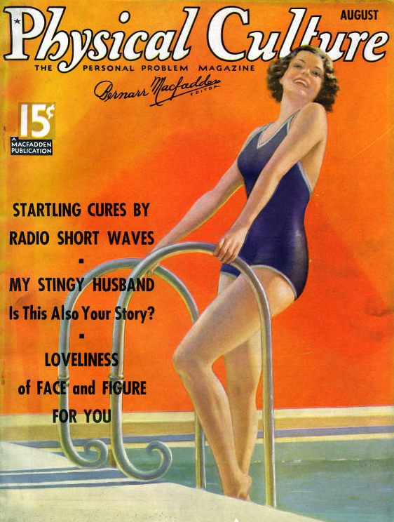
Physical Culture

Slide 19
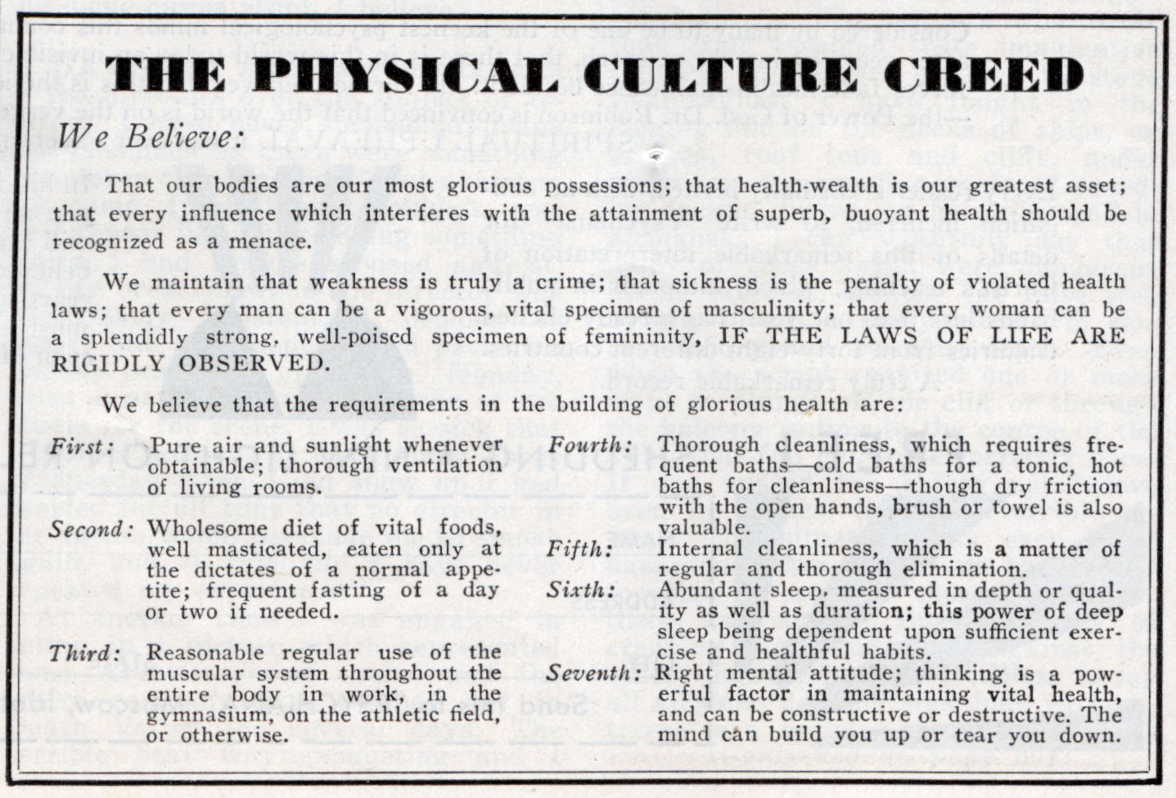
Physical Culture Creed, c.1934

Slide 20
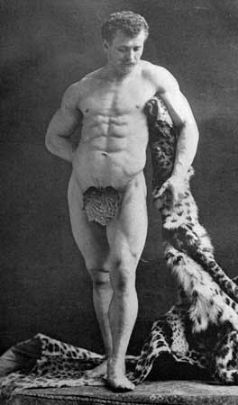
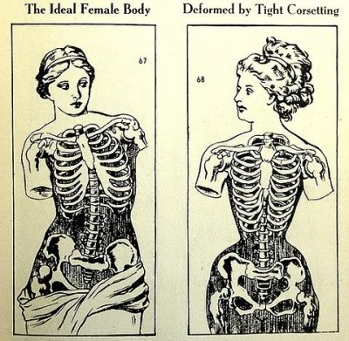
Bodily Ideals of Physical Beauty – Hercules/Venus de Milo

Slide 21
Health and Beauty
‘there can be no beauty without health.’
Dr Gordon Stables, 1891
‘No amount of “making up” can replace the glow of health in a clean skin, the gloss of well-nourished hair, and the full development of trained muscles. The girl who would be attractive to look upon must be good throughout.’
Amy Barnard, 1909
‘If a girl sits down to a potato and pickles, strong tea, pies, cakes, ices, and fiery condiments, she will not hold her beauty. As a result, when the girl is twenty her eyes are dull, teeth yellow, gums pale, lips wan, flesh flaccid, and skin unyielding. Recourse is had to padding, face washes, stains and belladonna.’
article in Good Health magazine, 1895

Slide 22
Ideas of health and the healthy body
Social medicine, physical culture, eugenics, concerns about national efficiency (Boer War) and empire led to the formation of voluntary physical health organisations.
Health education campaigns promoted by groups like:
New Health Society (1925) and Sunlight League (1924).
1920s saw the emergence of the vegetarian movement, nudism, as well as campaigns via advice literature, newspapers (e.g. Daily Mail) and film. Health exhibitions, health weeks and public talks.
‘Physical culture patriotism’ endured until WW2 – focus on physical fitness, dietary reform, hygiene, alternative healing, dress reform, sun bathing, hiking, etc.
Encouraged by increasing leisure, rising affluence, reduced hours of work, holidays

Slide 23
New Health Society
Founded by Sir William Arbuthnot Lane 1925
To convert a rapidly degenerating community into a nation of ‘healthy, vigorous members’
Social Darwinism, ideas of national fitness and eugenics combined with utopian body practices and progressive gender ideology.
Largely ignored relationship between poverty and ill health – emphasised character and self-discipline ‘managing the body’

Slide 24
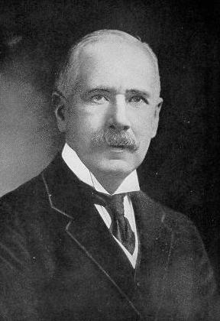
Sir William Arbuthnot Lane (1856-1943)
Health rules – diet, fresh air, sunlight, loose clothing (dress reform), lots of whole grains personal hygiene and exercise.
Based on eugenic beliefs encouraged birth control and racial health.
Society folded 1937 but journal New Health continued.

Slide 25
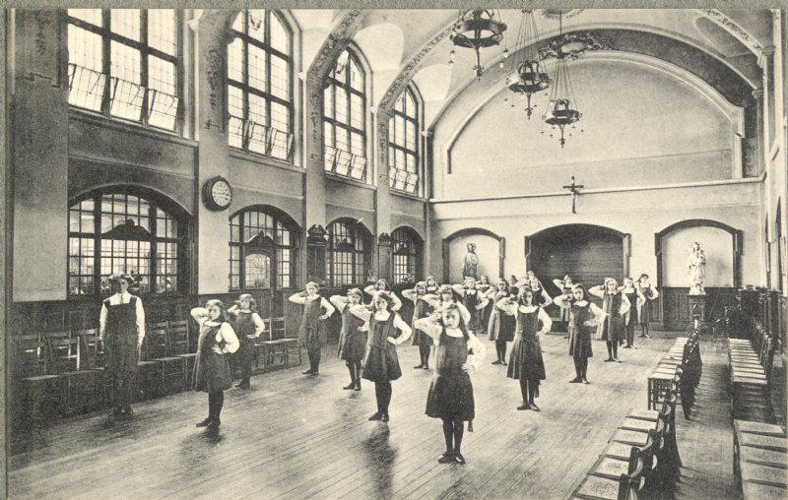
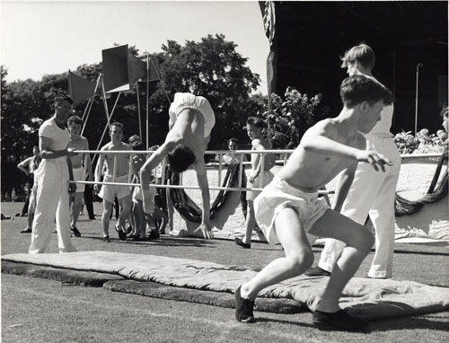
Physical education
Since late 19th century attempts to provide PE in schools (initially largely drill based on military training).
A means of ameliorating impact of urban life/encouraging discipline.
Belief gymnastics/sport could relieve health problems - shift from environment to personal health. Cheap way of improving children’s health.
1904 Report on Physical Deterioration recommended LEAs provide playgrounds and indoor facilities.
Expansion of school sports associations – National League for Physical Education and Improvement, 1905.
1907 Medical Inspection of schoolchildren introduced. Board of Education drew up syllabus including marching, dancing, skipping and indoor games.

Slide 26
Obstacles to PE in schools
Emphasis on training physical training instructors to address shortage.
Shortage of playing fields and playgrounds. National Playing Field Association 1925 (voluntary organisation).
Lack of suitable clothing and footwear.
1937 Physical Training and Recreation Act – provided LEAs with funding for development of PE.
Physical education: ‘I would bank on this more than almost anything else during school life as a means of rearing a healthy race of people’ (George Newman, 1922). Also intended to ‘mask’ problems of malnutrition and poverty in children.

Slide 27
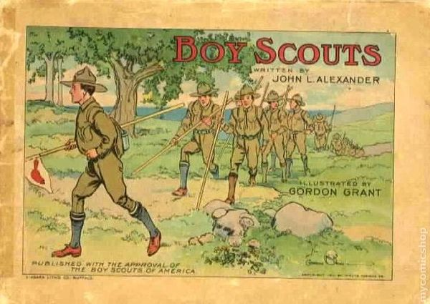
Voluntarism
Voluntary organisations for youths encouraged outdoor exercise:
Scouts (1907)
Guides (1910)
Boys and girls clubs
Youth Hostel Association
Ramblers Association promote exercise and outdoor pursuits.
Though had imperial designs, also set up to promote health and inclusiveness.

Slide 28
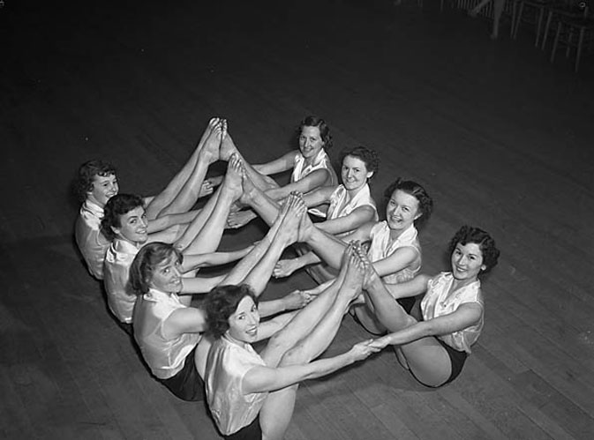
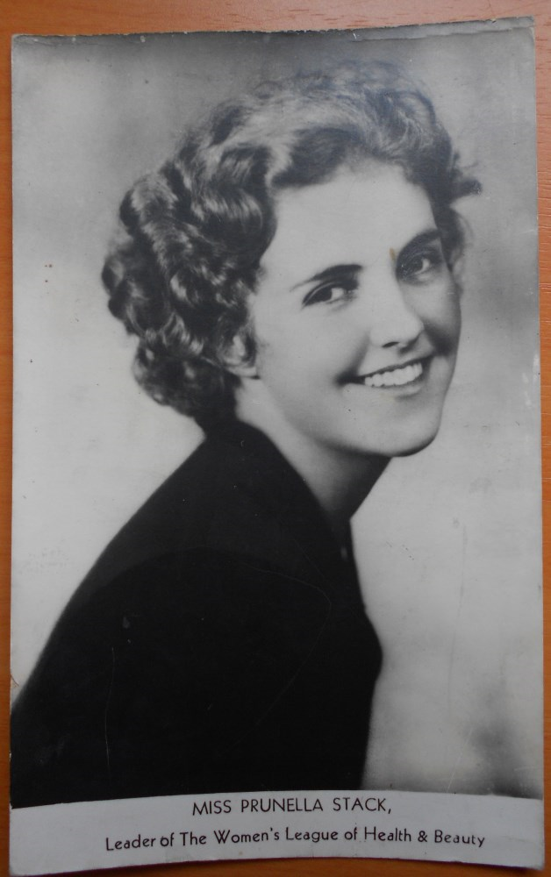
Women’s League of Health and Beauty

Slide 29
State involvement
Central Council for Health Education (Society Medical Officers of Health) formed in 1927
Released the Better Health journal – 57,000 sold in the first year.
Local authorities organise Health Weeks and lectures but much of this activity remains voluntary.
1937 Physical Training and Recreation Act – established local authority facilities, particularly sports grounds (after 1936 Berlin Olympics!)

Slide 30
Health and sport from 1950
Second phase of growth in culture of getting fit in 1980s – aerobic exercise, fitness training.
Healthy body is ‘a social map of economic power’ (still associated with responsibility and social duty – ‘elite citizenship’ according to Dorothy Porter)
White Paper, Saving Lives: Our Healthier Nation (1999) argues ‘good physical education and school sports provision essential to the foundation of lifelong positive attitudes towards health and fitness’.
Sport for girls said to increase confidence, reduce incidence of eating disorders and even unplanned pregnancies.

Slide 31
Conclusion
Many aspects of sport and exercise cultures in C20th deep-seated political connections/relationship with ideas of citizenship
Relationship with gender and particularly women’s emancipation
Sport and exercise promoted as key aspect of building blocks of health
Harnessed media and commerce
Limited role for state – despite fact largely about nation’s health
Expansion of interest in and promotion of sport and exercise across the life cycle.

