Slide 1
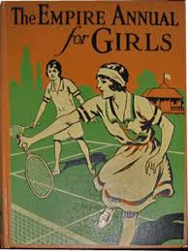
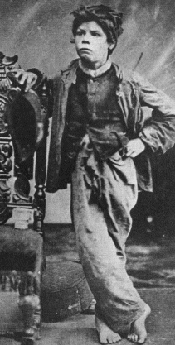
Cradle to Grave Lecture 7
The Challenges of Youth

Slide 2
Themes
Medical debates about youth and adolescence 1880-1930.
Medical debates concerning menstruation, hysteria and anorexia.
The dangers of youth – overwork/overstudy, masturbation, delinquency and venereal disease.
Changing ideas and experiences of youth 1920-1960.

Slide 3
Youth – the context
Late C19th - youth begins to be defined as a separate stage in life cycle
Associated particularly with eugenic concerns – role of environment and heredity
Captured interest of doctors, educationalists, social workers and psychologists
Concerned with physical, mental and sexual development, as well as ‘race’ more broadly
Rise in ‘youth’ culture – timing of this?

Slide 4
J. Mortimer Granville and the ‘Perils of Puberty’
Many ‘lurid’ accounts of youth and its challenges e.g.
J. Mortimer Granville, Youth: Its Care and Culture. An Outline of Principles for Parents and Guardians (London: David Bogue, 1880).
Girls were prone to palpitations, hysterics, fainting fits, giddiness, blood disorders, moodiness, nocturnal tooth grinding, nightmares and sleep walking, consumption, rheumatism.

Slide 5
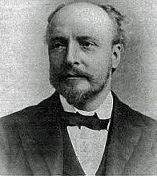
J. Mortimer Granville on boys
Also seen as corruptible and likely to go astray – lazy, untruthful, moody ‘girlish’ or weak.
However subject less to illness and needed training (including sport and outdoor activities) to develop their positive traits of energy and enterprise.

Slide 6
A fixed fund of energy
The ‘economic model’ explained how women’s reproductive systems interacted with other parts of body, especially the brain (Inspired by Herbert Spencer)
Body as a ‘closed system in which organs and mental faculties competed for a finite supply of physical or mental energy; thus depletion in one organ resulted in exhaustion or excitation in another part of the body’.(Moscucci The Science of Woman (1990), p.104.
Associated with American physician, Edward Clarke (Harvard Professor) and prominent psychiatrist Dr Henry Maudsley in UK.

Slide 7
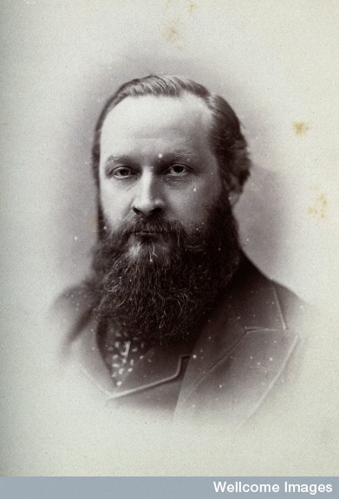
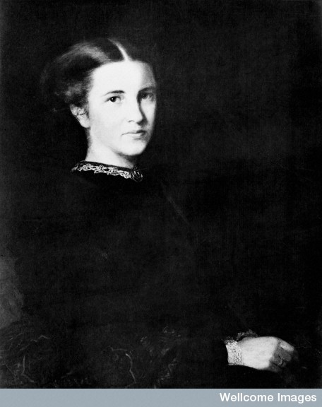
Maudsley vs. Garrett Anderson (1874)

Slide 8
Maudsley vs. Garrett Anderson (1874)
Henry Maudsley ‘Sex in Mind and in Education’, Fortnightly Review, new series, 15 (April 1874), 466–83 Full text available via ProQuest through library.
Maudsley argued that:
Women should not attempt to run alongside men: ‘they cannot choose but to be women; cannot rebel successfully against the tyranny of their organisation’.
‘The important psychological change which takes place during puberty… may easily overstep its health limits, and pass into pathological change… nervous disorders of a minor kind, and even such serious disorders as chorea, epilepsy, insanity, are often connected with irregularities or suspension of these important functions’.
‘for one quarter of each month during the best years of life [they are]... more or less sick and unfit for hard work’.

Slide 9
Elizabeth Garrett Anderson’s response
Elizabeth Garrett Anderson, ‘Sex in Mind and Education: A Reply’, Fortnightly Review, new series, 15 (May 1874)
‘There is no tonic in the pharmacopoeia to be compared with happiness, and happiness worth calling such is not known where the days drag along filled with make-believe occupations and dreary sham amusements’.

Slide 10
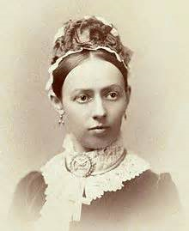
Eugenicists
‘Probably the most important years in anyone’s life are those eight or ten preceding the twenty-first birthday. During these years Heredity, one of the two great developmental factors, bears its crop, and the seeds sown before birth and during childhood come to maturity. During these years also the other great developmental force known as Environment has full play, the still plastic nature is moulded by circumstances, and the influences of these two forces is seen in the manner of individual that results.’
Mary Scharlieb and F. Arthur Sibly, Youth and Sex: Dangers and Safeguards for Boys and Girls (London: T.C. & E.C. Jack, 1919), Part 1: ‘Girls’, by Mary Scharlieb, p. 7.

Slide 11
Particular risk for girls
‘a girl when becoming a woman should not have any mental or bodily labour to perform. She should therefore neither study nor work, but have only good food, exercise, sleep, and clothing. If she accomplishes the beginning of this important phase of her life with vigour and success, she will have secured one of the chief ends of her existence’.
Robert Reid Rentoul, The Dignity of Woman’s Health and the Nemesis of its Neglect (A Pamphlet for Women and Girls) (London: J. & A. Churchill, 1890),p. xxviii.

Slide 12
Rentoul contd.
‘Show an uninterested observer an ovary. To such it appears only a bit of flesh. Yet on two such little organs… depend not only the future of the world’s population, but also the health and happiness of their owner.’
‘What is the use of sacrificing health for the sake of “grinding up” a little history, geography or music?’ Girls were urged to rest ‘until the system becomes used to the new condition… The effort to develop into womanhood requires all the best energies and strength a girl can possess.’
Robert Reid Rentoul, The Dignity of Woman’s Health and the Nemesis of its Neglect (A Pamphlet for Women and Girls) (London: J. & A. Churchill, 1890), pp.xvi, xxx, xxviii, 45-46

Slide 13
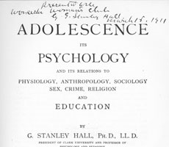
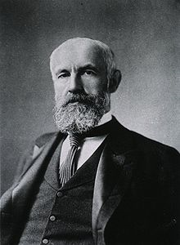
Eugenicists
Strongly influenced by G. Stanley Hall, American psychologist, educator and eugenicist (Adolescence 1904 and Youth 1906). Warned of ‘instability’ of adolescence.
‘Another principle should be to broaden by retarding… a purely intellectual man is no doubt biologically a deformity, but a purely intellectual woman is far more so’.
G. Stanley Hall, Youth: Its Education, Regimen, and Hygiene (New York, 1906)
Also influenced work of J.W. Slaughter who introduced Stanley Hall’s work to audiences of youth workers and teachers in UK – The Adolescent (1907)

Slide 14
Arabella Kenealy (feminist eugenicist)
‘From having been a strong, young, active, boy-like creature, now – provided her development be allowed to take the normal course – the girl loses physical activity and strength. A phase of invalidation sets in. Instinctively, she no longer runs and romps. New langours invest her in mind and in body. She is indisposed to brain-work or too much exertion. She lounges and muses… She suffers from lassitudes… She becomes a complex of disabilities…. which indelicate, sickly or over-taxed girls show in chlorosis, anaemia, hysteria and other ills’.
Arabella Kenealy, Feminism and Sex-Extinction (London: T. Fisher Unwin [1920]), p. 110.

Slide 15
Menstruation
Superstition, myth, taboo, uncleanliness, pollution
Jules Michelet - 15-20 days out of every 28, women were ‘wounded invalids’ (Jules Michelet, L’Amour (Paris: L. Hachette & Cie, 1858)
Menstruation could cause weakness, mental illness, and be painful and debilitating . Pathological vs. natural
An important epoch on route to ‘womanhood’
Medical Women’s Federation (founded 1916) and advice literature for girls – advocate that menstruation should not disrupt schooling but urged attention to hygiene and self-care

Slide 16
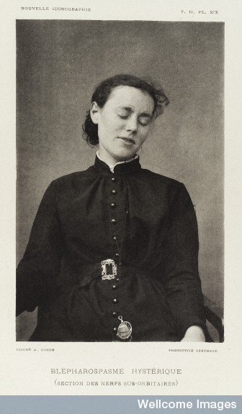
Hysteria
The ‘Daughters’ disease’?
A Victorian epidemic?
Connections to social class? Did the working class get it?
‘Social’ and ‘medical’ causes
Over-work?/Over-education?
A form of protest against patriarchy?
Rebellion?
A rich visual archive...

Slide 17
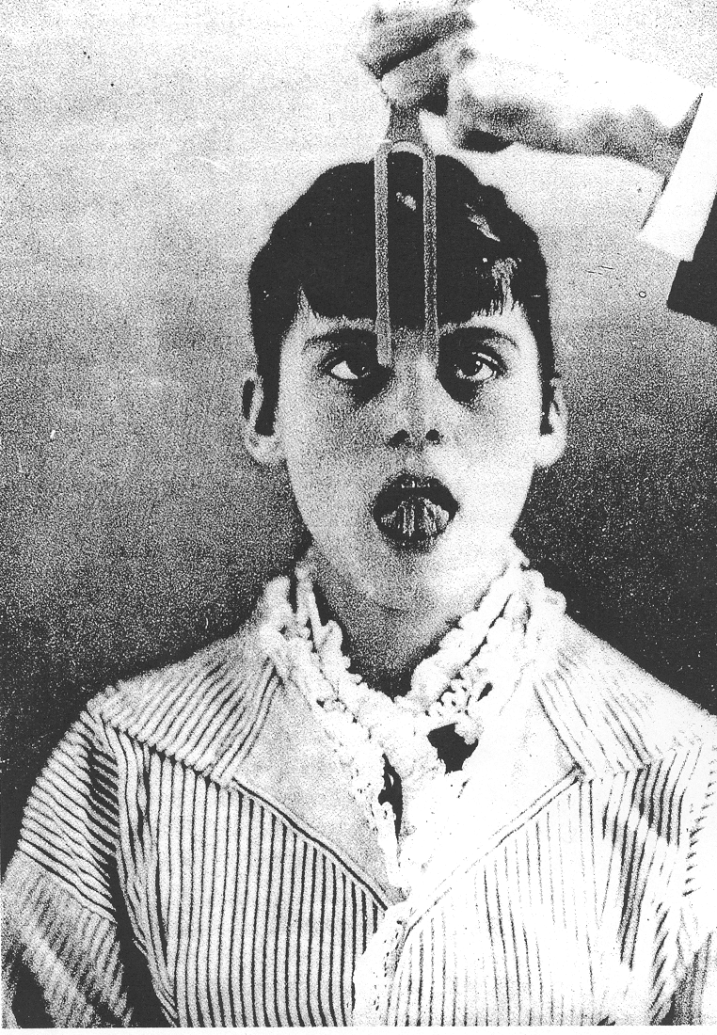
The hypnotized patient and tuning fork, from Paul Richer, “Gonflement du cou chez un hysterique”, Nouvelles Iconographie de la Salpetriere, 2, (1889), plate 34, reproduced from Sander L. Gilman, “The Image of the Hysteric”, in Sander L. Gilman, Helen King, Roy Porter, G.S.Rousseau, Elaine Showalter, Hysteria Beyond Freud, (Berkeley, London: University of California Press, 1993) pp.345-452,p.351

Slide 18
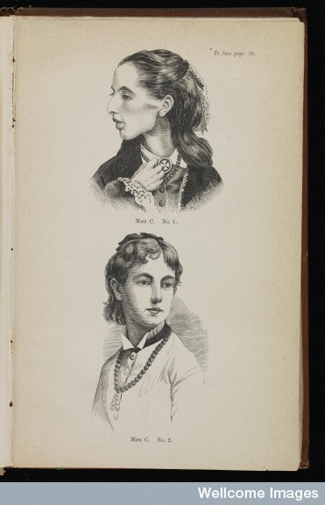
Anorexia
Defined 1873 by Sir William Gull in England and Charles Lasègue in France
Strongly associated with young, often ‘wilful’, women
Associated with extreme weight loss
Related to family dynamics of middle class and manipulation

Slide 19
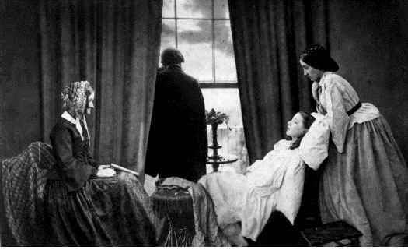
‘Fading Away’, Henry Peach Robinson, 1858

Slide 20
What ailed boys?
Overstrain/concerns about schooling applied to both sexes
Youth problem – fears of ‘juvenile underclass’ and juvenile delinquency. Borstal system 1908
Dangers of masturbation
Signs of pathological or abnormal psychology – a medicalised debate
‘Medicalisation of normality and abnormality’ and emotional maladjustment
Concern about physical fitness and exercise cultures, regulation, management

Slide 21
Dangers of masturbation
‘There are no acute symptoms, the onset of the disease being most gradual. The patient becomes offensively egotistic and impracticable; he is full of self-feeling and self-conceit; insensible to the claims of others upon him and of his duties to them; interested only in hypochondriacally watching his morbid sensations and attending to his morbid feelings. His mental energy is sapped; and though he has extravagant pretensions, and often speaks of great projects engendered by his conceit, he never works systematically for any aim, but exhibits an incredible vacillation of conduct, and spends his days in indolent and suspicious self-brooding.’
The prognosis: “they die miserable wrecks at the last”.
Henry Maudsley, Body and Mind: An Inquiry into their Connection and Mutual Influence, Specially in Reference to Mental Disorders (London: Macmillan & Co., 1870), pp.86-87.

Slide 22
Psychology and delinquency
‘The study of the criminal thus becomes a distinct department of this new science – a branch of individual psychology; and the handling of the juvenile offender is, or should be, a practical application of known psychological principles. To whip a boy, to fine him, to shut him up in a penal institution, because he has infringed the law is like sending a patient, on the first appearance of fever, out under the open sky to cool his skin and save others from infection’.
Cyril Burt, Report on Juvenile Delinquency (London, HMSO, 1920).

Slide 23
Borderland of normality
Mental deficiency – Mental Deficiency Act 1913 – efforts to set up institutional care. ‘Borderlands of imbecility’ (Mark Jackson) – crucial to identify and separate mentally deficient child in battle against ‘race suicide’
Special institutions for ‘idiot’ children and ‘feeble-minded’ with emphasis on training
Dangers of feeble-minded and need to provide ‘maintenance, protection, training, and employment for boys and youths who are mentally incapacitated from earning their own living and who are yet so far intelligent as not to be eligible for any asylum for the imbecile or insane’ (British Medical Journal, Dec. 1894)

Slide 24
Venereal disease
Especially a concern around time of 1st World War
Concerns about moral deterioration in war conditions, illegitimacy and risk of venereal disease, especially syphilis (factory work/war work)
‘Moral panic’ about girls falling into sexual delinquency
Yet also period when very little information about their bodies and sexuality
Council of Public Morals for Great and Greater Britain and National Council for Combating Venereal Diseases set up WWI
Warned of desertion of girl, loss of character, and venereal disease which could affect all classes
Syphilis also deadly in this period!

Slide 25
Counter-forces – positive changes
New Woman – new models of womanhood and girlhood – expansion of schooling
Advice literature for young women and boys – also expanding number of magazines for young women
Becoming modern – engaging in public life, sport, and politics.
Organisations – clubs for the poor, YMCA and YWCA (archives in Modern Records Centre)
Health of children and young people generally improving

Slide 26
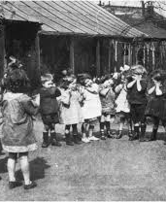
Role of schooling
Head teachers important role in shaping health of young through sport and facilitating balance between school and home.
School medical officers – important in identifying sickness
Health problems identified even among middle class children e.g. girls subject to weakness, TB, rheumatism
Margaret Macmillan Camp School Deptford (c1910) – treated minor ailments, provided remedial gymnastics and meals in a garden setting to deprived children for children aged 6-14.

Slide 27
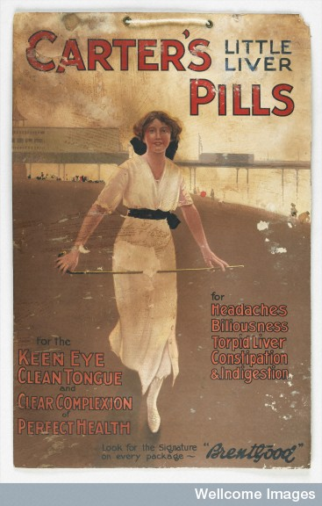
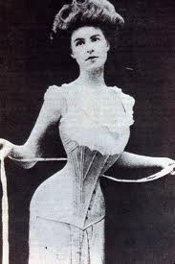
Girls’ health – ‘corset mania’ to robust good health

Slide 28
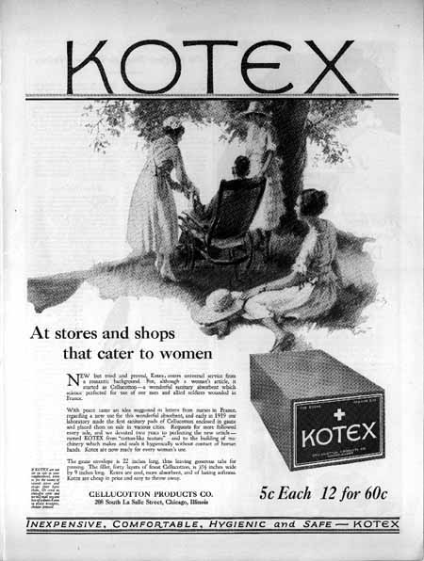
Menstrual hygiene

Slide 29
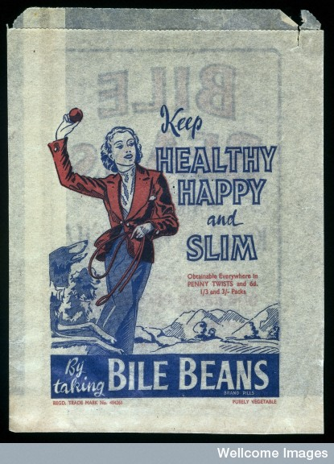
Links to present
Fashion
Diet
Advertisements
Media images
From corsets and tight-lacing to heroin chic
What parallels can be drawn in the history of diet or body image in our period?

Slide 30
First teenagers?
When does ‘youth culture’ begin?
David Fowler - first teenagers date from 1950s and 1960s
But earlier beginnings?
Ideas of girlhood and boyhood?
Mathew Thomson’s Lost Freedom (2013)– after 2ndWW child segregated from outside, often urban space, to home and family, driven by public anxiety.
What is the role of medical discourse / ideas in thinking about youth during this period? Medicine has to relate to other experts, including social workers, child guidance clinics, schools, sporting organisations

Slide 31
Conclusions
Relatively recent historiographical interest.
After the 1960s policy makers and doctors have started to differentiate medical care of adolescents from younger children e.g. in treatment of cancer. Recognition they have different needs, concerns and conceptualisations of illness than younger child.
More focus too on issues such as menstrual health, anorexia and sex education.
Youth, however, remains a point in the life cycle associated with psychological turmoil and potential ill health?

Slide 32


New challenges
High incidences of depression noted amongst young people in last couple of decades.
Anorexia increasingly affecting young men.
Debates contraception for under 16s etc.

