Slide 1
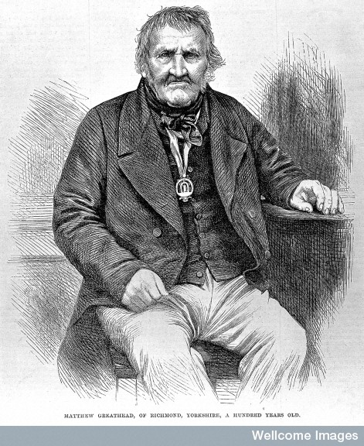
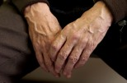
Ageing, Medicine and Society
Cradle to Grave
Term 3, Week 1

Slide 2
Issues
Relatively new subject for the history of medicine – key and very readable author Pat Thane
Do ageing and medicine go hand in hand? (see Susannah Ottaway)
What is a ‘good age’? Shifting perceptions here. Breaking age barrier, extension of working life, ‘grey pound’ and greying of society
Ideas of old age influenced ‘by our own fears of those later years of unpredictable length and unknowable condition’ (Thane)

Slide 3
Themes
Changing conceptions of ageing – longevity
Medicine and old age
Rise of geriatric medicine
Provision of care – hospitals and community care
War and elderly
Changes post-NHS
Ethical issues

Slide 4
Category of old age
Do people age in same way and at same rate?
Did people age, physiologically, at earlier ages in past?
Some historians argue, especially for women, 50 was common marker of old age
Yet from ancient societies through to modern period 60 most often depicted as start of declining capacities including ability to work.
Old age broad category – from 60 to 100?

Slide 5
Change over time/longevity
C20th – first time it’s normal to grow old
C16th-18th – over 65 = 8-10% population
C19th – over 65 = 5% (N.B. life expectancy figures confused by high IMR)
1900 - over 65 = 5% population aged over 65
1951 – over 65 = 11%
1991 – over 65 = 16% (of whom one-quarter aged 80+)
2017 – over 65 = 18% (2.4% aged 85+)
Aging a largely female experience since 1837 but liable to worse old age
Decline of IMR and mortality e.g. from disease, meant proportion of older people in society increased
But many healthier in old age – lifetime experience of health tends to be better, and people ‘age later’
None the less striking economic and social implications – cost and care

Slide 6
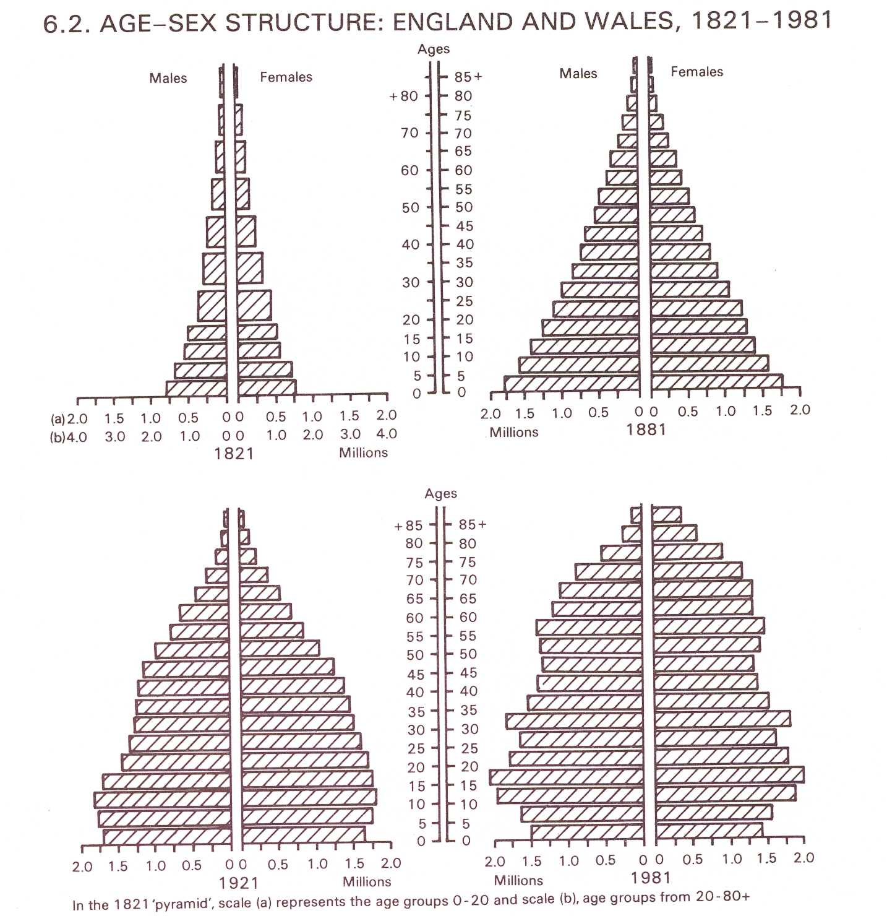

Slide 7
Experiences of ageing
20 March 1903, aged 87
‘This is a sad letter – I am so crippled with Rheumatism from the constant damp that I can hardly walk upright now. I know if fine weather and spring days will give me back my elasticity. I shall be 88 this year and I think a pair of crutches is more likely to be my portion…’
(Ann Clive to Mary, Lady Minto,
National Library of Scotland)
‘Louise is hopelessly crippled and creeps about the house. Her mind is clear and old age and helplessness have softened her outlook on the world… but she is desperately lonely and bored with existence…. The plain truth is that the aged feel that their children… are thinking about: “If you are not enjoying life, why don’t you die and be done with it”.’
(Beatrice Webb, Diaries, 1930s)

Slide 8
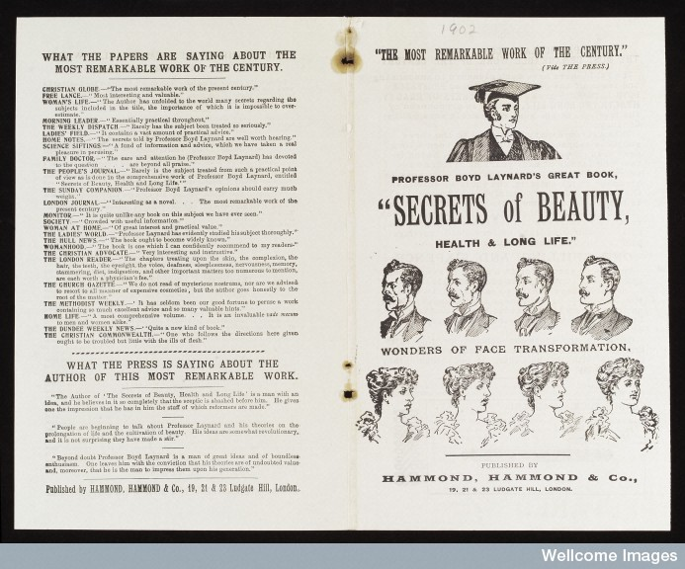
Leaflet for the book ‘Secrets of Beauty, Health & Long Life - Wonders of Face Transformation’ by Professor Boyd Laynard, 1902

Slide 9
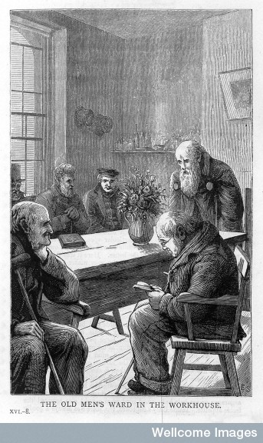
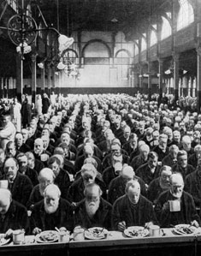
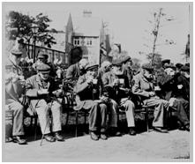
The workhouse experience
Workhouse where many elderly and infirm ended up. Also housed chronically ill and some insane/feebleminded relegated. (Anne Digby and Anne Crowther have useful books on workhouse and its inmates, including elderly)

Slide 10
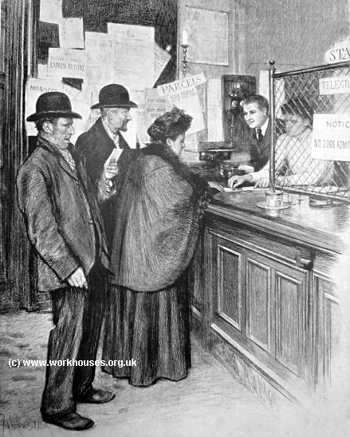
Pensions and Retirement
1908 British state pensions introduced – paid at 70
Part of Liberal Reforms
Why 70? Popular/medical view considered people old enough to need these at age of 60 or 65.
Reduced 1925 to 65, and for women 1940 to 60

Slide 11
Medicine and old age
C19th new challenges of urbanisation
social and medical (changes in family structure, migration, challenges of large towns)
Little attention to old age - many conditions, e.g. heart disease, not associated with old age
Idea elderly ‘incurable’ dominated
C20th greater attention to health of elderly - Is ageing itself a disease?
Late C19th geriatrics emerges as specialism (Ignatz Nascher in US) – spread slowly in C20th. Still thought uninteresting by many medical professionals
Nascher talked of need to treat disease of elderly not as part of old age, but as curable illness
Medical journals included sections on health of elderly from early C20th
1938 – first international gerontology conference

Slide 12
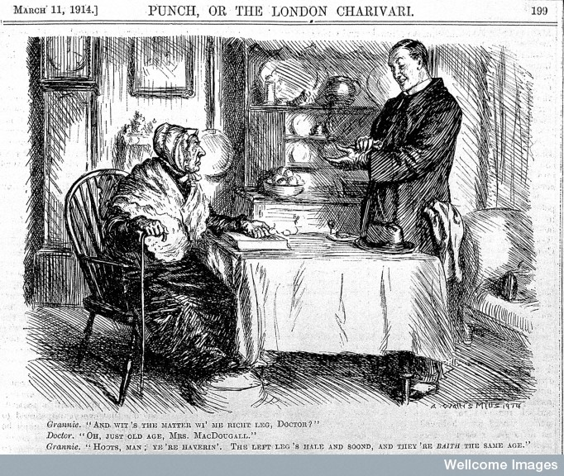

Slide 13
Medicine and Old Age
1935 Modern British geriatrics – Dr Marjorie Warren (formerly Poor Law Infirmary)
Warren responsible for 700 mainly bed-ridden elderly ‘hopeless’ patients.
She improved wards and diagnosed patients, promoted physiotherapy.
Discovered cure or improvement possible, though more difficult than for younger patients.
Elderly often had multiple conditions; many depressed; many lacked family and support networks (combination of social and medical problems).
After rehabilitation 200 of initial patients left hospital.
Also this situation fairly new – more elderly patients surviving acute illness by 1930s such as pneumonia or stokes due to improved nursing and sulphonomide drugs.
More elderly in hospital for longer periods

Slide 14
First World War
In general elderly suffer in wartime
difficulties with fuel and food supply
declining standard of living
stress of working in war industries
Deaths rose from heart disease and respiratory infections
Also rise in mortality attributed to depression and despair
Death rates related to loss of sons and grandsons in conflict and deep grief.
London death rates of over 60s rose between 1913-18 – 22,929 in 1913, 25,857 in 1918
See (Jay Winter and Jean-Louis Robert (eds), Capital Cities at War (Cambridge, 1997), p.463.
War bad for health of elderly – repeated Second World War

Slide 15
World War II
Rapid evacuation to residential and care homes (140,000 in 2 days!)
Set precedent for establishing residential homes for elderly.
Some elderly found respite from bombing in residential hostels and others billeted to countryside
Increased death rates among over 65s England and Wales
Old people had low expectations of health, a view shared by most people, including medical profession.
Elderly as low priority
Many treated by panel doctors.
Beveridge Report 1942: ‘It is dangerous to be in any way lavish to old age until adequate provision has been assured for all other vital needs, such as the prevention of disease and the adequate nutrition of the young’.
Elderly problem population for local government health services – families increasingly reluctant to care for elderly.
After war, housing shortage exacerbated situation.

Slide 16
Post-War
1948 70,000 hospital beds occupied by old people (many long term, chronic cases, national average for women 260 days)
2 major shifts in post-war period:
Rise in community care – for vulnerable social groups (residential care, domiciliary after-care and support systems)
Geriatrics emerged as specialism 1950s – British Geriatrics Society established 1948. Recognised specialist care could solve medical problems . 60 geriatric units established in 1950s – yet demand/need outstripped facilities
Also more emphasis on rehabilitation of elderly and expansion of meals on wheels and old people’s clubs

Slide 17
‘Normal’ Ageing (in post-war years)
To what degree was old age unavoidably associated with ill-health?
Nuffield Foundation survey 1945-7 Dr J.H. Sheldon, Wolverhampton.
2.5% confined to bed, 8.5% to houses, 22.5% to immediate neighbourhood – increased with age and rare below age of 70
Few had much contact with doctors
Before 70 ailments much the same as remainder of adult population
After 70 specific set of problems emerged e.g. weakness, loss of confidence, spondylitis (inflammation of vertebrae) – mix of social and medical
Women had poorer health, though more vigorous – carried on with domestic tasks
Many older people disabled not by major illness, but minor and curable conditions – bad feet, defective vision and hearing, incontinence
Concluded health of elderly better outside of institutions
Depression often caused by loneliness, economic worries, poor general health or limited mobility

Slide 18
Scotland
Picture different – less separation between teaching and chronic hospitals
Ferguson Anderson – shocked by condition of elderly sick in pre-War Poor Law hospitals in Glasgow, conditions worsened with onset of NHS, with emphasis placed on treatment of young. Inspired by Marjorie Warren’s work.
Established small units for diagnosis of elderly in Glasgow Central hospitals. Worked with Dr Nairn Cowan at Rutherglen Centre of Older People 1953 – examined people aged over 55 to understand normal aging.

Slide 19
Anderson’s findings
Emphasised interaction of medical and social problems
Symptoms insidious and older people have more things wrong with them
Importance of treating mundane conditions
Emphasised older people better off in own homes if fit to stay there
Older people had immense capacity for recovery
Were real physiological differences in older people – loss of elasticity in skin, bone, lungs, arteries, brain and loss of reserve function in heart, liver, kidneys, brain
Important to have regular check-ups to catch disease in early stage
Tendency to over-prescribe drugs
Older people also had lower standard of service

Slide 20
Failure of NHS hospital provision?
NHS promised elderly people access to consultant services
‘As one of the main users of hospital services, the elderly had a great deal to gain from the new system’. (Charles Webster)
Facilities for chronically ill elderly remained poor
Fear that elderly would ‘block’ hospital beds
Geriatric medicine slow to be incorporated into medical training so less likely to be pushed as priority
1950s high waiting lists and many elderly sick admitted to mental hospitals given shortage of hospital beds – this continued into 1970s
1953 Hornsby-Smith, junior minister Ministry of Health, explicitly linked rising cost of hospital care to elderly:
the ‘vastly increasing aged population [was] the biggest challenge to the welfare state’
Efforts to introduce a ‘bed norm’, to restrict number of hospital admissions for elderly
1960s modernised geriatric services introduced some hospitals but overall provision meant long waiting lists
Acute care takes priority over complicated long-term care of patients with multiple conditions and poor prognosis

Slide 21
Community care
Local Government Act 1929 urged setting up of specialised facilities, including elderly care homes
1948 National Assistance Act converted these Public Assistance institutions into old people’s homes
1980s rise of private facilities – increased from 18% in 1980 to 85% end of century
Desirability of elderly staying at home emphasised – need for family support
Many struggled on pensions – suffered malnutrition, poor living conditions, false incontinence
Improved community care emphasised from mid-1950s, but action limited – low cost benefit from extending lives! Also emphasis on family care maintained.
Still case end of C20th – though more people wish to live independently away from families (rising affluence)

Slide 22
Medicine for ageing
Diseases of ageing persistent problem
Limited improvement – partly due to complex familial situations, but also because doctors continued to associate symptoms with ageing rather than illness.
Diseases are resistant to treatment e.g. Mental frailty, osteoporosis, arthritis, heart disease, stroke, cancer
Medical breakthroughs
cardiac pacemakers 1960s
kidney dialysis late 1960s
coronary artery surgery 1970s
cataract, hip, knee and organ replacement surgery.
Most recent innovations in medical technology benefit over-50s
All costly interventions and many need them
Much improvement in health due to life style changes – exercise and diet
Alternatives to medicines – social remedies?

Slide 23
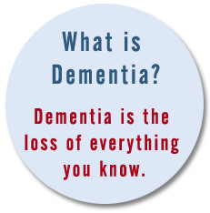
Mental health and ageing
Alois Alzheimer (1834-1915) helped redefine understanding of senile brain disease – Alzheimer’s disease labelled 1906 (form of dementia)
Lillien J. Martin, Salvaging Old Age (1930) discussed stress in later life
Many elderly patients
ended up in mental
hospitals up to mid-
C20th

Slide 24
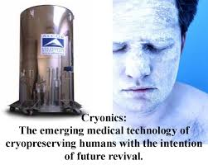
Prolongevity or experimental gerontology
How to prolong life/delay death long preoccupation of medicine
Enlightenment optimism C18thC – fascination with instances of longevity.
Emphasis on regimen – eat moderately, exercise, and be of cheerful temper
Also opportunity for quack medicine and patent medicine
Cosmetic interventions, anti-
ageing cryonics

Slide 25
Ethical dilemmas
Debates about aged-based rationing of treatment e.g. in cancer care
Medicine now able to keep patients technically ‘alive’ indefinitely….
Still limited services e.g. for counselling, social services stretched
Britain has poor results – higher mortality rates e.g. for heart disease and stroke than other developed countries
Concerns about the rise in dementia – people kept alive with diminishing functional capacity
Scandals...

Slide 26
“Scandal of elderly forced into A&E as faith lost in care outside hospitals.
Number of vulnerable patients going to casualty up 93 per cent in five years as senior doctors warn patients and health professionals are "losing faith" in care outside hospital.” Telegraph, 28 Jan. 2014
“Hospitals are ‘very bad places’ for elderly people, according to the head of the NHS.
Sir David Nicholson said they were not the right place to care for ‘old, frail people’, and called for community care to be expanded to accommodate the growing elderly population.
He compared modern treatment of the elderly to the ‘national scandals’ of the Sixties and Seventies caused by treating mental health patients in large asylums.
‘If you think about the average general hospital now, something like 40 per cent of the patients will have some form of dementia,’ Sir David told The Independent.”
Mail Online, 21 Jan 2013

Slide 27
Finding your own sources
Search newspaper archives for ‘Alzheimers’, ‘dementia’, ‘elderly and care’, ‘geriatric’ etc.
BBC news items e.g. http://www.bbc.co.uk/news/uk-28202717
http://www.bbc.co.uk/news/health-26861924
Wellcome Images – punch cartoons, early NHS leaflets about dentures, hearing aids etc.
Charities and lobbyists – Age UK, Campaign to End Loneliness, Dementia UK

