Slide 1
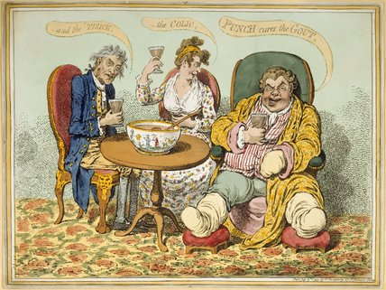
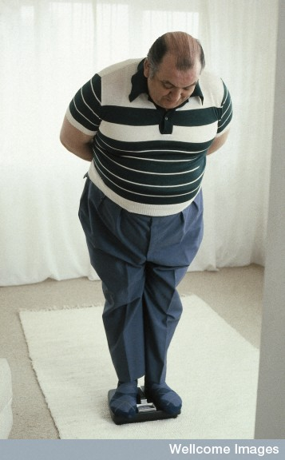
Keeping Young, Keeping Alive: Middle Age
Term 2, Lecture 9, WEEK 10
From Cradle to Grave

Slide 2
Changing expectations, changing time frames
‘It isn’t such a very great advantage to be young… The best years should be after forty years of age. All the work and effort, the struggle and stress of youth, both physical and mental, should yield rich harvests of bodily and mental health in the forties. The healthy man at forty is in the prime of life. As for the woman of forty, she has attained her physical maturity… Far too many people in middle life are depressed, dull, uninterested, slack, and sick of their lives. And the great fundamental cause is ill health.’
(Elizabeth Sloan Chesser, ‘Health in the Forties’, The Quiver 49 (March 1914).

Slide 3
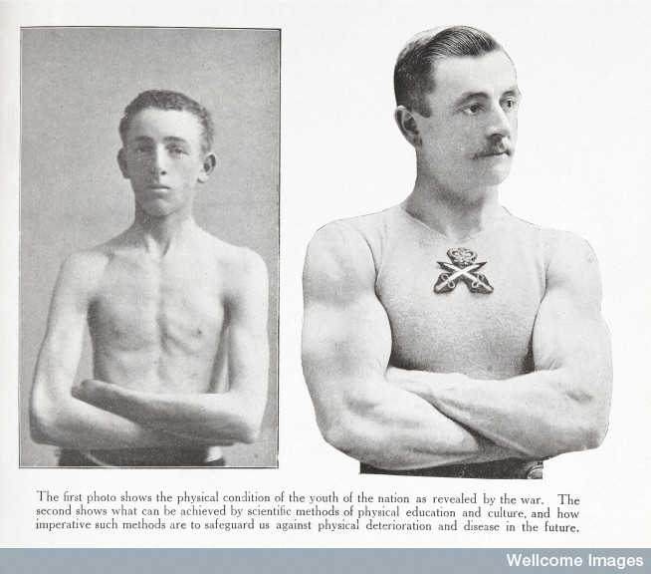
Themes
Patterns of disease, illness and death
Chronicity –TB, cancer and diabetes
Health education
Holding back time – diet, cosmetic interventions

Slide 4
Epidemiological transitions
Abdel Omran, ‘The Epidemiological Transition: A Theory of the Epidemiology of Population Change’, Milbank Memorial Fund Quarterly, 49 (1971), pp.509-38
The epidemiological transition is a stage of development characterised by a shift in population growth, life expectancy and disease patterns.
3 stages in terms of epidemiological change:
Pestilence and famine – dearth and epidemic
Receding pandemics – rise of medical science
Degenerative and man-made diseases – rise in chronic conditions
Led to (misguided?) notion that chronicity only problem of C20th
New stages added since 1980s:
Age of delayed degenerative disease
Age of obesity and inactivity (though Ina Zweiniger-Bargielowska suggests this already issue early C20th)

Slide 5
Patterns of disease, illness and death
Patterns of mortality changed over Europe C19th-C20^{th :}
Infectious diseases gradually brought under control (public health/medical interventions – N.B. McKeown thesis again).
Life expectancy increased – more people lived till older age/birth rate declined – Result = ageing population
Degenerative diseases associated with ageing caused more deaths than acute illnesses
People became ill and recovered but took more time off work/spent more time getting better
OR/AND learnt to manage chronic disease but did not recover from it

Slide 6
Comparison of mortality with sickness recorded by friendly societies c.1900
Leading causes of sickness, 3 friendly societies 1896-1919
Cause % of total
Accidents 16
Poorly identified 13
Influenza and catarrh 13
Bronchitis 9
Rheumatism 4
Lumbago 4
Gastritis 2
Carbuncle 2
Tonsillitis 1
Skin ulcers 1
Leading causes of death in men 1908
Cause % of total
Heart disease 14
Tuberculosis 14
Old age 8
Cancer 8
Bronchitis 7
Pneumonia 7
Cerebral bleeding 5
Accidents 5
Bright’s disease 3
Influenza 3
Apoplexy 2

Slide 7
Friendly societies and chronic ill health
Friendly societies set up from late C18th but most significant C19th, especially in industrialising areas
Offered health care and sick pay to those of working class able to pay a small weekly subscription – also funeral/insurance benefits
Usually members male though some female societies
Small local societies and also larger affiliated societies like United Society of Oddfellows
Some subscribed to hospitals and many employed a club doctor to treat their members
Enabled some form of independence and self-reliance amongst members
Strict rules for conduct of members

Slide 8
Problems of friendly societies
By late C19th some of smaller ones running out of money… because their membership aging:
More members taking time off work so costs rose (benefits due, treatments needed)
Related to diseases of middle age/chronic conditions (members working in often awful industrial conditions).
Most common complaints:
Respiratory – influenza, colds, bronchitis
Joint and muscle problems – rheumatism, lumbago.
Few reported sick with degenerative diseases. TB chronic but only disabling in latter stages.
Many societies fail in late C19th – to a certain extent National Insurance (1911) steps in to fill their place

Slide 9
Sickness and class (different classes have different complaints)
GPs treated the same complaints as Friendly Societies:
respiratory disorders, rheumatism (poor living conditions, more common in winter)
digestive complaints (related to poor food hygiene, most common in summer)
Rickets (poor nutrition, lack of sunlight)
GPs working in industrial areas saw many cases of accidents and occupational diseases e.g. miners suffered from pleurisy, pneumonia and bronchitis
Men saw GPs more than women. Women suffered from headaches, anaemia, ‘bad legs’ and gynaecological problems
GPs could do little about degenerative conditions e.g. cancer, except give pain relief
Middle- and upper-classes consulted doctors about gout, obesity and nervous complaints, conditions rarely reported by working-class

Slide 10
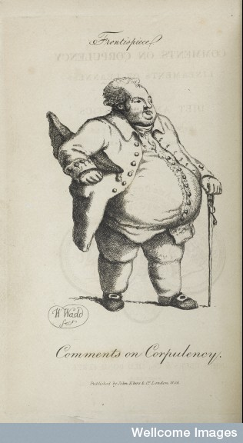
Chronicity
‘Chronic’ – traditionally means ‘persistent’. Perhaps ‘incurable’?
The idea that chronic diseases replaced acute and infectious conditions oversimplifies things e.g. even if recovered from TB remained ill.
Chronic disease before C20th to a
certain extent masked by
high mortality from infectious disease.
Chronicity evident earlier e.g.
Obesity problem for rich long before C20th
Culture of invalidism in C19th (described by literary
scholars)
Ivan Illich defined chronic disease as disease of civilisation – alienating process of modern life and failure of modern medicine.

Slide 11
TB – as chronic disease
Nomenclature: tuberculosis vs. consumption (not necessarily pulmonary TB). Associated with deterioration of patient – sometimes rapid/sometimes slow
Consumption as wasting diseases e.g.
Scurvy (deficiency disease)
Scrofula (swelling of lymph nodes)
Various forms of cancer (‘tubercles’ in lung probably cancer)
Conditions like asthma and dropsy (accumulation of fluid) also linked to consumption
Idea that person had ‘predisposition’ (personal quality) – poor inheritance, weak constitution, nervous disposition – chronic illness signalled weak constitution combined with careless life or living in unfavourable conditions.

Slide 12
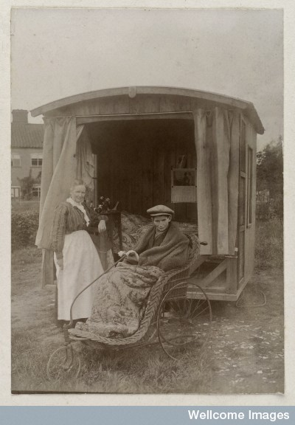
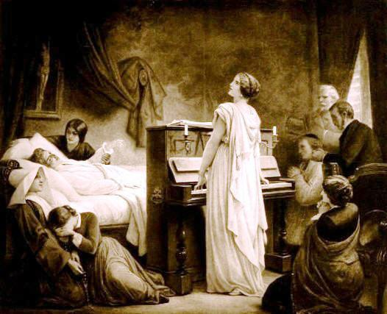
Romance and invalidism

Slide 13
TB and poverty
Sentimentalism shifted to interest in social problems in mid-C19th.
Victorian workhouses (and other institutions) filled with sufferers from incurable illness or too infirm to work.
Engels talked of ‘the multitudes on their way to work, one is amazed at the number of persons who look wholly or half consumptive’.
‘Multitudes of sufferers from chronic diseases, chiefly those of premature old age, crowd the so-called ‘infirm’ wards… Examples are not uncommon in which the really able-bodied form but a fourth, a sixth, or even an eighth of the total number of inmates.’ (Lancet, 1865)
TB chronic, incurable disease till mid-C20th – antibiotic streptomycin 1940s (by then had declining incidence probably due to improved SofL). In meantime ‘managed’ by sanatoria treatment.

Slide 14
Diabetes
Diabetes mellitus – a chronic disease that turns into an incurable but ‘manageable’ condition.
Known since ancient times – characterised by unquenchable thirst, copious urination and wasting.
1850 Claude Bernard’s research on sugar in the body began proper understanding of diabetes.
Two forms:
Type 1, juvenile diabetes
Type 2, late onset diabetes – associated with obesity and life style
Frederick Banting and Charles Best isolated insulin in 1921.
Almost immediately started to treat patients with pancreas extract.
Insulin soon available commercially (Eli Lilly). First available Britain 1923.
Allowed patients to manage illness and lead relatively normal lives, but could not be cured and reliant on frequent injections.
Self-injection by patient part of new normality as was management of diet.

Slide 15
Cancer
Described as ‘malignant disease’ in the returns of Registrar General – deaths rose steadily 1837 onwards.
After 1840 both cancer and heart disease rise – similar pattern.
Fourfold increase cancer 1840 and 1894 (1:129 of deaths to 1:23). Rising as death rate from TB halved.
Sanitarian and statistician Dr Arthur Newsholme put this down to better diagnosis and also public awareness.
Shift from detecting external cancers e.g. face, bones; by 1901 internal cancers more prominent e.g. stomach, lung, intestine
Some physicians also attributed increase to changes in life style e.g. meat consumption, poor life style choices. Others related it simply to extended longevity

Slide 16
Cancer
Growing medical knowledge and expertise certainly responsible for apparent increase (identified more). Also found more commonly during surgery and in post mortem examinations.
Fears of raising expectations about treatment. Public knowledge – managing expectations. Public education largely role taken on by cancer charities.
Public health officials and medical practitioners pursued anti-cancer crusade after WWI. 1923 Ministry of Health set up Departmental Committee on Cancer.
Focused on early detection message.
Lectures, health exhibitions, clubs, community associations.
1950s Doll and Hill made link between cancer and cigarette smoking....

Slide 17
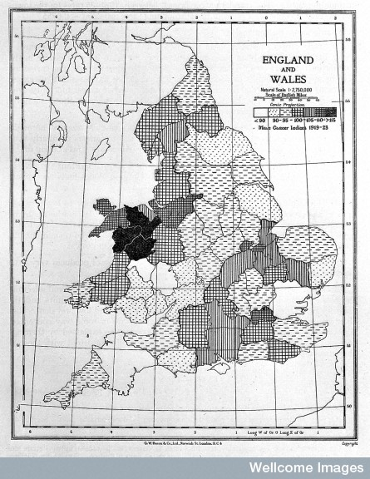
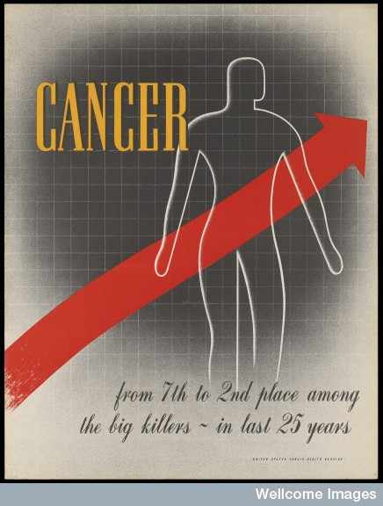
British Empire Cancer Campaign, 1928/poster 1941

Slide 18
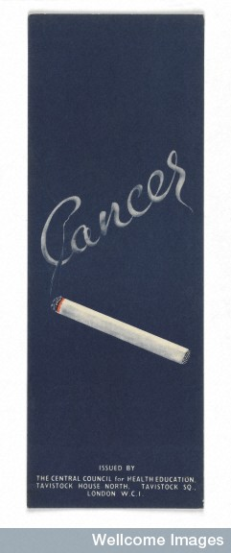
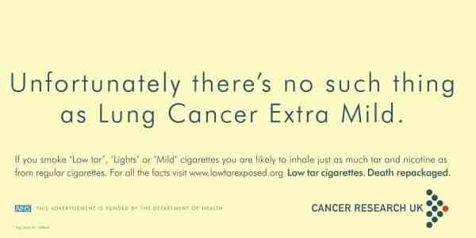
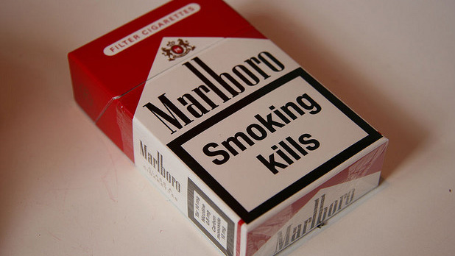
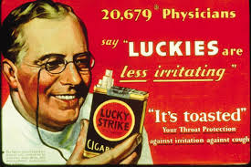

Slide 19
Change in post-war years
TB figures peaked for last time after 2nd WW, infectious disease in decline
Deaths in childhood and early adulthood declined – more people lived through and past middle-age
Interest in non-communicable diseases – suggested ‘new epidemics’ of heart disease, stroke and cancer were imminent. 1980 heart disease identified as number one killer in England and Wales
These were more visible in population that lived longer

Slide 20
Public health responses
Prevention became more significant for public health policy and interventions.
E.g 1962 Report by the Royal College of Physicians on Smoking and Health, showed mortality from respiratory diseases in men aged between 45-64.
In 1950 for first time, mortality from TB lower than cancer, and lung cancer to blame for this increase. Associated with smoking.
Richard Doll and Austin Bradford Hill work on lung cancer and smoking
Also associated smoking with heart disease.
Life insurance companies joined forces with public health bodies to produce statistics to show rise in chronic illnesses.
In UK strong link with occupational health
E.g. 1949 Jerry Morris research on cardiovascular disease – compared sedentary London bus drivers with conductors who climbed stairs . Associated exercise with reduction in heart disease.
People still dying until recently from industrial diseases e.g. asbestosis

Slide 21
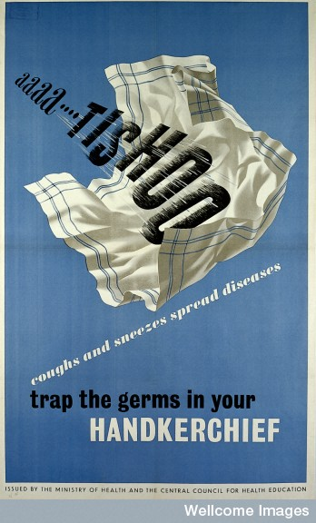
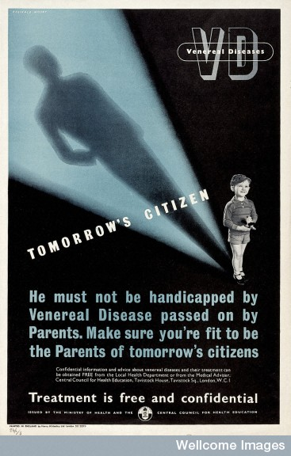
Health education WW2

Slide 22
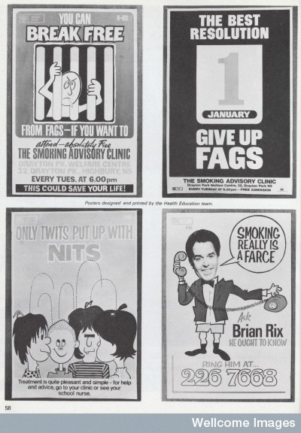
Public Health Posters
Public health posters, 1974
Top left: You can break free from fags – if you want to
Bottom left: Only twits put up with nits

Slide 23
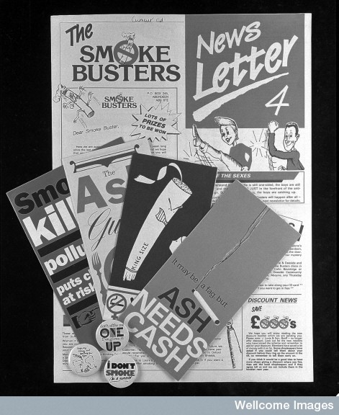
Anti-smoking campaigns
Montage of leaflets and badges from Action against Smoking and Health (ASH)

Slide 24
Health Education
Health Education Council (HEC) set up 1968 – 1987 Health Education Authority
Both Conservative and Labour parties – cautious about whole-hearted campaign against tobacco industry. BMA, Royal College of Physicians and Action on Smoking and Health (ASH) actively opposed. Pressed for policies to discourage smoking, e.g. banning advertisements and taxing tobacco heavily
Much health education seeks to change individual behaviour and encourage healthy lifestyle.
After 1970s move away from secondary, hospital based treatment to primary care – increase in chronic illness meant long-term care and support needed.

Slide 25
Chronic illness and its commentators
Rise of chronicity lead to reflective literature – own illness object of analysis.
Arthur Kleinman in late 1980s focused on narratives to recover hidden meaning of chronic illness.
E.g. philosopher Havi Carel – insightful reflections on social world of chronic illness, embodied experience
New challenges – type 2 diabetes, asthma incidence rising in older people, rising heart disease in women.

