Slide 1
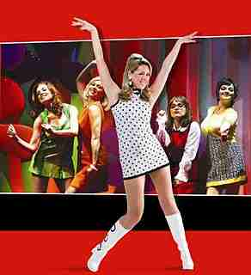
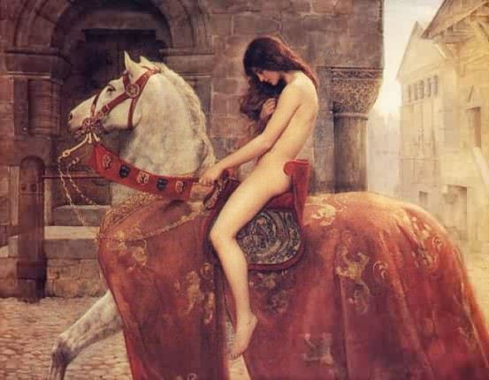
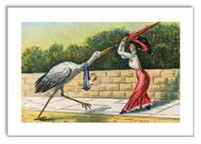
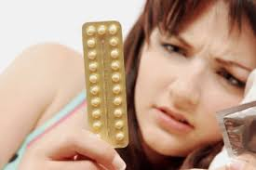
Sex and Sexuality: Lecture 9 From Cradle to Grave

Slide 2
History of sexuality
History of sexuality flourishing field – linked to histories of demography, gender, medicine, anthropology and sociology, and strongly interdisciplinary.
Rich methodological and interpretative diversity.
Prism for observing social, cultural and political issues and changes.
Spurred on by interest in ordinary lives, the home (domestic sphere) and private lives, and feminism and gay liberation movements post 1960s.
As Gayle Davis states: ‘the history of sexuality has become “sexy”’.
Primary sources – vast range of medical textbooks, fiction, diaries, memoirs, letters and oral histories, institutional accounts (clinics), case notes and court records, newspapers, sex surveys.

Slide 3
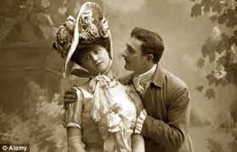
Lecture Outline
Sex and the Victorians
Venereal disease, Contagious Disease Acts and moral panics
Sexology
Birth control
The permissive society?

Slide 4
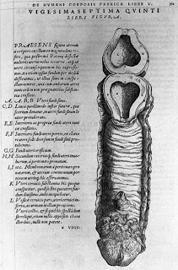
One-sex model
Before the 18th century sex and gender were believed to exist on the ‘sliding scale’.
Thomas Laqueur has described this as the ‘one-sex’ model of sexual difference
Women were considered ‘inferior’ versions of men in medical terms – two different forms of one essential sex.
Women were understood to have same basic reproductive structures as men but tucked inside the body (vagina/penis; ovaries/testicles)

Slide 5
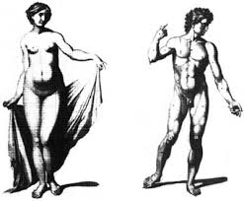
Two-Sex Model
Around 18th century the two sexes began to be seen as fundamental opposites – differences in the bones, nerves and minds of men and women were emphasised.
Laqueur refers to this as the ‘two-sex’ model of sexual difference.
By the late 18th century only male orgasm seen as essential to conception and active sexuality a masculine trait.
‘Normal’ women were not believed to have sexual desires and thus female sexual activity abhorrent (in opinion of physicians, clergymen, some novelists).

Slide 6
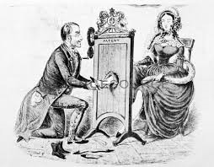
Sex and the Victorians
Idea of ‘passionless’ woman reflected wider ideas in Victorian Britain.
‘Separate spheres’ of wholesome domestic environment and polluting public sphere - though this sharp division questioned in recent scholarship.
Yet clear that separate spheres gave tacit acceptance to men’s greater sexual needs – ‘double-standard’.
English physician William Acton (1813-75) ‘classic example’ of Victorian prudery: ‘the majority of women (happily for them) are not very much troubled by sexual feelings of any kind’

Slide 7
Sex, Pathology and Psychiatry
Prostitution represented all that was ‘pathological’ about female sexuality – though prostitutes considered by some a ‘necessary evil’. Also a public health problem, Contagious Diseases Acts of 1860s.
Prostitutes were also ‘psychiatrised’ – wilful rejection of the ‘angel in the home’ ideal linked to mental instability.
Hysteria linked to female sexual arousal, mania typified by overtly sexual behaviour, and nymphomania defined in late 19th century.
‘Take, for example, the irritation of ovaries or uterus, which is sometimes the direct occasion of nymphomania – a disease by which the most chaste and modest woman is transformed into a raging fury of lust’. Henry Maudsley, Body and Mind (1873)
Related to female instability and instability of reproductive organs.
Clitoridectomy extreme manifestation of dread of female sexuality, 1,000s of ovariotomies performed (see Jalland and Hooper extracts)

Slide 8
Masturbation, onanism or the ‘Secret Sin of Self-abuse’ and homosexuality
Male ‘wasting of seed’, would lead to debility, insanity and even death (idea of fixed reservoir of sexual energy)
Considered pre-cursor of homosexual acts
Homosexuality considered ultimate threat – pathological and danger to state. Reconceptualised from ‘sin’ to ‘crime’. Oscar Wilde case (charged with gross indecency).
Yet at same time a number of sexologists, notably Dr Havelock Ellis protested against homosexual laws.
In 1950s Wolfenden Committee recommended decriminalisation of homosexual behaviour.
1967 Sexual Offences Act decriminalised homosexual activities in private for adults, yet in 1970s attempts to ‘treat’ homosexual men peaked.
1973 DSM (Diagnostic and Statistical Manual of Mental Disorders) dropped ‘homosexuality’ as diagnostic category.

Slide 9
The Dangers of Self-abuse (Girls)
‘this specific sin of Self-abuse is related to a whole set of sinful corruptions, impurity of thought and imagination leading the way into the bestial realm of impure literature, art, and the whole science of sin… I tell you in plain words, your body cannot be abused without injury to the life forces, which will bring in its train all kinds of complaints and diseases. Even now I have in my mind’s eye a young woman who is thought to be in consumption, whilst all the time it is the secret sin of Self-abuse that is sapping the vital strength and bodily vigour…. The face loses its colour, and the eye grows dull, heavy, and weak, the hands feel soft and clammy, and often the smell of the feet is unbearable. Inwardly the ravages are more serious, nervous exhaustion and hysteria, loss of energy, memory, &c. These are only the heralds of more terrible things to come, such as epilepsy, insanity, and a mighty host of innumerable evils, all of them paving the way too sadly, and too surely, to a premature grave.’
Priscilla Barker, The Secret Book… for Women and Young Girls (1888).

Slide 10
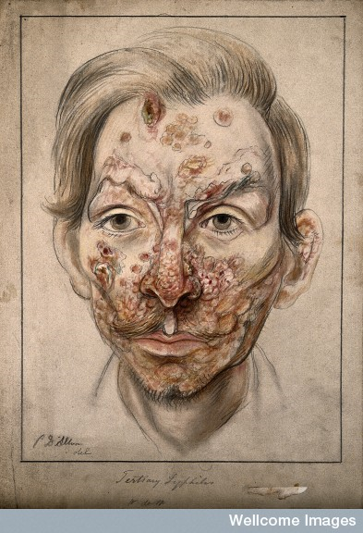
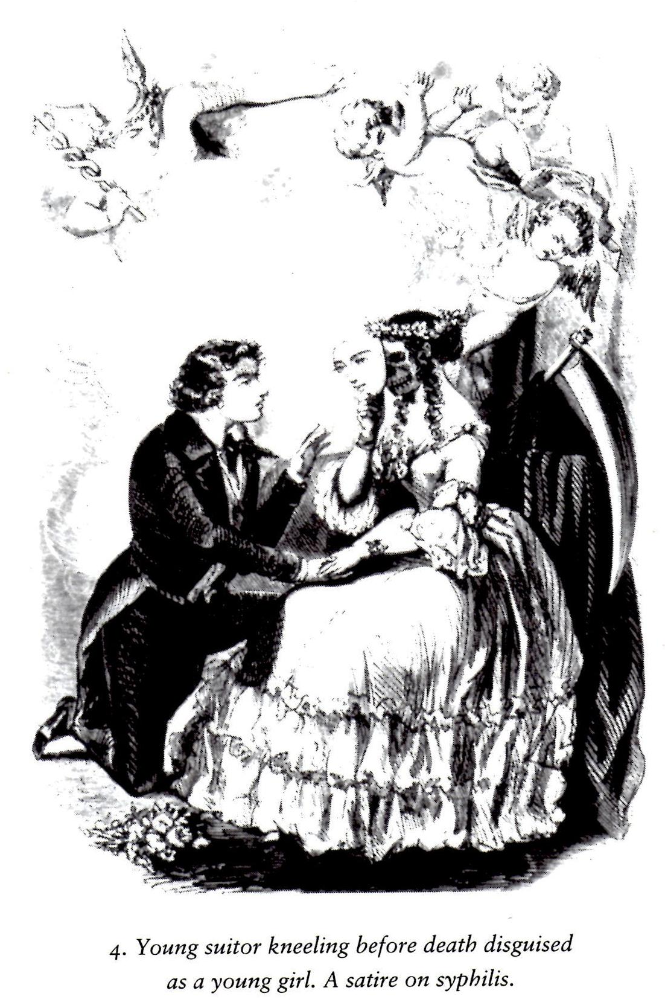
The dangers of syphilis
A young suitor kneeling before death: satire on syphilis

Slide 11
Contagious Disease Acts
19th century - women and especially prostitutes considered ‘vectors’ of venereal disease.
CDAs required prostitutes to be medically examined.
Forcible treatment in lock hospital for 3-6 months if found to be infected.
1864 applied to garrison towns, in 1866 and 1869 extended to other districts.
BUT - Strong opposition to acts….
Ladies’ National Association (civil liberties campaigns, feminists – Josephine Butler)
Objected to brutal examinations; blaming prostitutes rather than men; double standard, for men biological necessity while women depicted as ‘depraved’
1886 Contagious Disease Acts repealed
See Frank Mort, Dangerous Sexualities (1987)

Slide 12
First World War and VD
Defence of the Realm Act 1914 – introduced powers to stop soldiers being solicited and clamp down on prostitution.
Concern about health of troops – national efficiency.
Also huge concern about young women entering munitions factories and their exposure to risk – idea of risk changing, ‘easy’ or ‘amateur’ girl replaced prostitute as cause of anxiety/object of fear.
Venereal Disease Act 1916 -
Set up National Council for Combating Venereal Disease
Further Act of 1918 targeted those with VD, allowing for compulsory treatment if suffering from disease
DORA revoked as war ended

Slide 13
Venereal Diseases Act 1916
Free diagnosis and treatment in local authority run clinics and salvarsan supplied free to GPs. Clinics protected patient’s anonymity.
Health education – based on ideas of ‘moral behaviour’, poster campaign. Banned quack remedies .
Recommended diagnosis and treatment of VD added to the medical curriculum – venereology had low status.
1905 bacteria causing VD identified, Wasserman blood test developed for screening 1906, Salvarsan effective cure from 1910s (Paul Ehrlich), and within 3 years claimed to have treated 10,000 syphilitics successfully.
1917 – 113 treatment centres treating 29,000 patients; 1920 – 190 centres treating 105,185 patients.
Treated more men than women; some patients did not complete treatment (1920 c.40%).

Slide 14
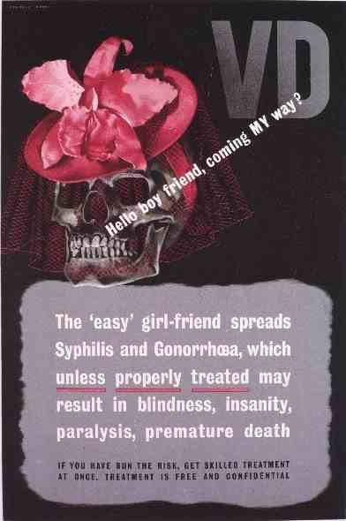
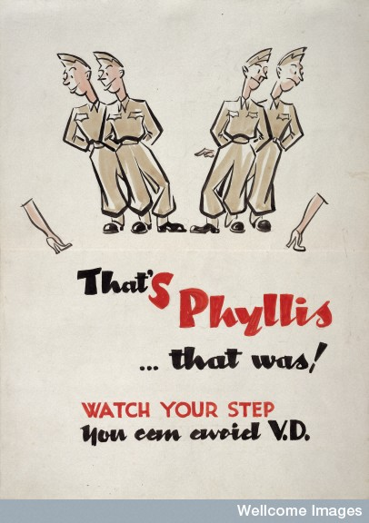
VD poster campaigns
Reginald Mount, VD poster, 1943
Anti-VD campaign amongst Allied troops in Italy, 1943-44

Slide 15
HIV/AIDS
Few decades after mass distribution of penicillin marked end of VD, acquired immune deficiency syndrome (AIDS) made its appearance.
1988 reported in 138 countries. Soon established that spread result of human immunodeficiency virus (HIV), caused by sexual contact or infected blood which crippled the body’s immune system, causing severe morbidity and high mortality.
Parallels with VD:
Attempts to establish principal vectors – separation of guilty from innocent victims; conflict between individual liberty and communal good in official responses (initially labelled ‘gay related immune deficiency’, ‘gay plague’).

Slide 16
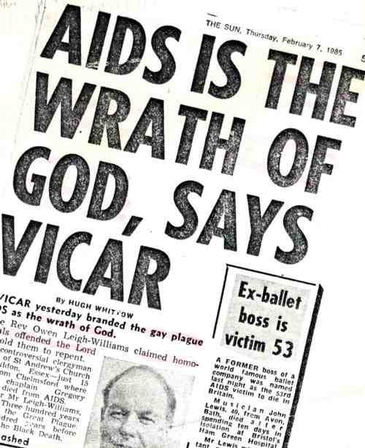
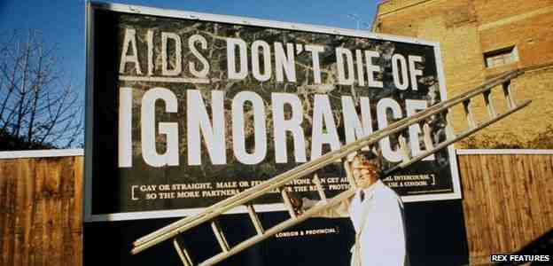


AIDS posters
http://www.nationalarchives.gov.uk/films/1979to2006/filmpage_aids.htm

Slide 17

Sexology
From mid-19th century attempts to subject sexual variation to scientific scrutiny – deviance pathologised, and ‘sin’ and ‘excess’ replaced with medical or psychological categories such as ‘degeneracy’, ‘disease’ and ‘insanity’ .
William Acton, Functions and Disorders of the Reproductive Organs (1857); Havelock Ellis, Studies in the Psychology of Sex (1897-1928); Richard von Krafft-Ebing, Psychopathia Sexualis (1886)
Coined and classified sexual transgressions – adultery, homosexuality, transvestism, sadism, etc.
Alfred Kinsey and sex therapists – mid-20thC – Kinsey’s reports revealed high levels of same-sex attraction and sexual activity. Castigated by conservative moralists.
Medical involvement in sexology ambiguous – Krafft-Ebing’s work deemed ‘morally disgusting’ by the BMJ, Kinsey’s funding withdrawn.

Slide 18
Birth control
19th-century medical profession largely rejected involvement with contraception as ‘improper’
Some rudimentary techniques available and became part of growing commercial sector in medical appliances and products late 19th century – condoms and diaphragms.
Birth control reformers: Charles Bradlaugh; Annie Besant.
Bradlaugh republished Charles Knowlton’s The Fruits of Philosophy (1862) and together with Besant tried for publishing obscene material.
Malthusian League 1877, set up to promote birth control –published The Malthusian 1879-1921.
Marie Stopes (1880-1958), sexologist, birth control reformer, botanist and ‘agony aunt’.

Slide 19
Simon Szreter, Fertility, Class and Gender in Britain, 1860-1940 (1996)
Coitus interruptus was the most important form of birth control before the Great War in Britain.
Abstinence was the ‘English way’ of adjusting fertility in response to the perceived relative costs of having children - escalating ‘costs’ of childrearing provided the conscious motivation to control births .
But it was the anti-sexual culture which was both conducive to the use of abstinence as the method to achieve that goal and, also, essential, in providing married men and women with a legitimating, anti-sexual rationale .
The regime of attempted abstinence was probably at its most prevalent as a general practice during the period 1870-1920, but it cast a ‘long cultural shadow’ extending until the 1960s.

Slide 20
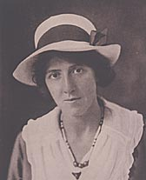
Marie Stopes (1880 - 1958) was a campaigner for women's rights and a pioneer in the field of family planning.
1918 Married Love and 1922 Wise Parenthood
Marie Stopes Mother’s Clinic opened in Holloway, north London in 1921 – offered free contraceptive advice for married women
Slogan ‘Children by choice not chance’
(letters in Wellcome Library)
1930 National Birth Association established (later Family Planning Association, 1939)
Local authority clinics opened inter-war period
1930 -16 clinics- 21,000 clients
1939 - 65 clinics

Slide 21
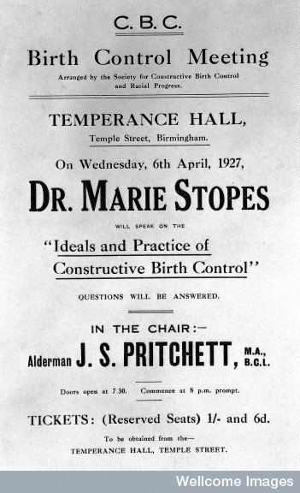
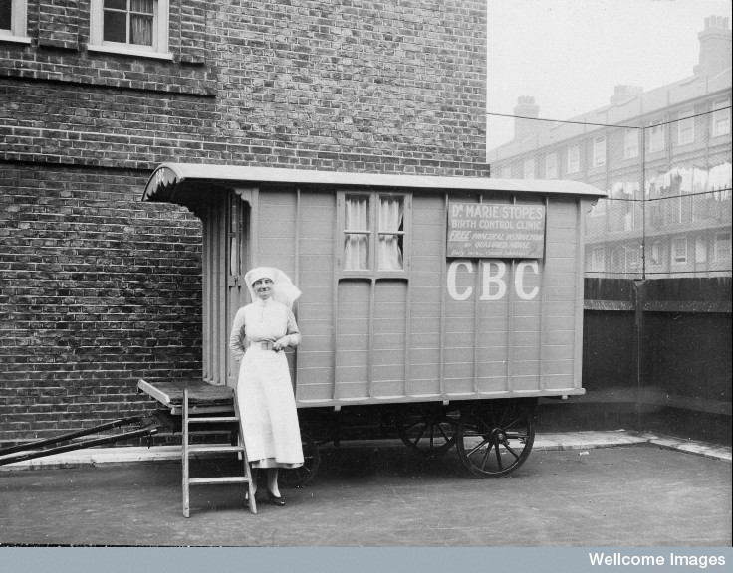
Stopes’ birth control work

Slide 22
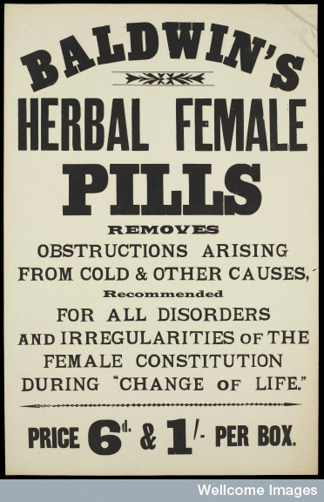
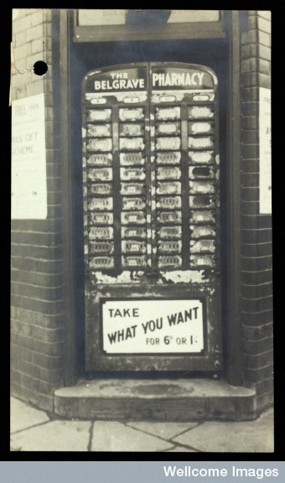
Commercialisation of birth control and abortion

Slide 23
NORMAN DENNIS, FERNANDO HENRIQUES AND CLIFFORD SLAUGHTER, COAL IS OUR LIFE (1969)
‘When Mary and Jean were told repeatedly of the ease of birth control under modern clinical supervision, they reacted… in a manner illustrative of… the conditioning of women in Ashton to a narrow and traditional range of activity, ideas and personality. Jean was at first unreceptive to the idea of birth-control appliances. She had a feeling that there was something unnatural about it; she would feel awkward and embarrassed about going to the clinic. Secondly, and very significantly, she thought her husband would not favour the idea; once, she said, she had brought home some rubber sheaths sold to her by the chemist and her husband had thrown them on the fire, saying that they took all the enjoyment out of sex, and were no safer than withdrawal. She thought Stanley would ridicule the appearance of the appliance which was shown. She had no bathroom, and she would find it very awkward to use the equipment correctly’.

Slide 24
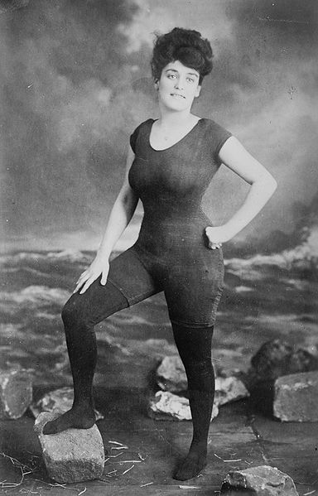
Liberal ideas
From Victorian period onwards, a fringe element offered more liberal approaches and advice on sexuality.
Birth control reformers.
Bernaar Macfadden promoted physical love and openness about sexuality; Annette Kellerman role of sexual attracted and woman’s part in seeking partner.
Dutch gynaecologist, Theodoor Hendrick van de Velde (1873-1937) Ideal Marriage: Its Physiology and Technique – educated couples in sexual anatomy, and encouraged mutual pleasure.

Slide 25
Permissive Society
Cultural stereotype of 20thC – 1960s witnessed a ‘sexual revolution’, permissiveness around sex, drugs and rock and roll, nudity, free love, mini skirts
Sexual reform movements had impact on social life and many countries relaxed restrictive legislation, including that covering homosexuality and abortion. Abortion Act 1967
Sexual surveys revealed transformation in public attitudes and in sexual behaviour
Medical interventions – including treatment of VD with antibiotics and the oral contraceptive pill – divorced sex from reproduction, and made pre-marital sex more common. Combined pill first prescribed at FPA clinics 1961, first for married women only
Age of marriage began to rise, divorce rate increased and birth rate declined

Slide 26
Conclusions
Did the 1960s signal a revolution in behaviour or was change more subtle? Did the permissive society liberate women finally from ‘double standard’?
Huge changes in attitudes to sexuality over last 150 years
1980s and 1990s seen as characterised by backlash and retribution – HIV/AIDS, rise in sexually transmitted disease, teenage pregnancy and rise in divorce rates

