Slide 1
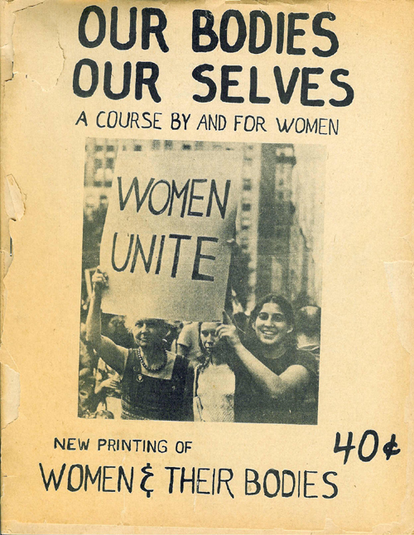
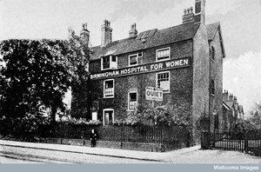
Women, Medicine and Life Cycle
Cradle to Grave Term 2, Lecture 4
(lecture 12)

Slide 2
Lecture Outline
Historiography
  Emergence of research area – women and medicine/history of gender/patients’ view
  Feminism and health – women’s health movement
Sex difference (revisited quickly)
Specialists fields - gynaecology and psychiatry
Female ‘diseases’: puerperal insanity and hysteria
Women and agency
Women treating women – female doctors
20th-century women’s health

Slide 3
Women, health and medicine
Currently there is a huge interest in women’s health and medicine.
Second Wave Feminism from 1960s/70s onwards provided political rationale for research.
Encouraged women to think about their health and bodies differently – Our Bodies Ourselves: A Health Book by and for Women (1978).
Interdisciplinary – social history of medicine, sociology, gender and literary studies
Joan Scott, ‘Gender: A Useful Category of Historical Analysis’, American Historical Review, 91, 1986, pp.1053-76.
    Critiques interchangeability of ‘women’ and ‘gender’ as terms
    Gender can and should be used to analyze social/cultural/political relations
    Interrogation of power and repression e.g. male power/female patient
Women depicted as prone to ideologically driven interventions e.g. ideals of domesticity and patriarchal society in the 19th century and imperatives of state, nation and scientific motherhood 20th century.

Slide 4
Women’s Bodies
The female body – particular interest to contemporaries and historians
Women seen as being inherently more physical or corporeal than men – uniquely beholden to their bodies (e.g. governed by need to reproduce etc., less mental capacity)
Impact of male science on female bodies –possession, exploration, penetration, understanding, control, repression, subjugation?
But also issue of whether when women qualify in medicine they practice differently than men/women’s agency.

Slide 5
The one-sex/two-sex model
Thomas Laqueur, Making Sex: Body and Gender from the Greeks to Freud (1990).
One-sex model: pre-Enlightenment women appear to have been considered ‘inferior’ versions of men in medical terms i.e. two different forms of one essential sex. Women and men had same basic reproductive structures, tucked inside the body (vagina=penis, ovaries=testicles). Both male and female orgasm were essential for successful conception.
Two-sex model - 18th century onwards the two sexes began to be seen as opposites. Only male orgasm seen as essential to conception and active sexuality a masculine trait. ‘Normal’ women were not believed to have sexual desires (because unnecessary and unnatural) and thus female sexual activity aberrant in views of physicians, clergymen, novelists etc.

Slide 6
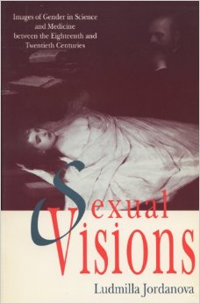
Oppression and Agency
Ludmilla Jordanova, Sexual Visions: Images of Gender in Science and Medicine between the Eighteenth and Twentieth Centuries (1989) – argues that power relations between men and women, are not clear cut or one-dimensional.
Theory/rhetoric and practice – not necessarily the same – gap between what is said and what is practised.
Women’s agency important – as carers, doctors and patients.

Slide 7
Victorian doctors
Anne Digby, ‘Women’s Biological Straitjacket’, in Mendus and Rendall (eds), Sexuality and Subordination: Interdisciplinary Studies of Gender in the Nineteenth Century (London and New York, 1989), pp.192-220.
The relationship between women and medicine not just caused by Victorian patriarchal society – by 1700 women were already depicted as frail and unstable, ‘medically unique but inferior… whose health was determined by her femininity’.
BUT These ideas gain resonance from mid-19th century because of:
  growing professional interest in ‘diseases of women’ (emergence of specialisms of obstetrics, gynaecology, and psychiatry)
  adoption of more political stance by individual doctors who invested in ideas of gender difference (connection to female education, suffrage, etc).
Women seen as important client group – in competitive medical marketplace.

Slide 8
Obstetrics and Gynaecology
Part of story of professionalisation and specialisation
New hospitals for women e.g. Birmingham Women’s Hospital, Elizabeth Garrett Anderson Hospital, alongside maternity hospitals and wards treating women’s disorders.
‘Diseases of women’ become a special category – tied to both obstetrics and gynaecology.
Increasingly depicted women’s health as problematic and pathological and to a certain extent ‘inescapable’ – victim of weak female nature, body and mind, which endured throughout life cycle.
Surgical interventions introduced e.g. for hysteria or unacceptable behaviour or pain or reproductive problems.
Clitoridectomy extreme manifestation of dread of female sexuality, 1,000s of ovariotomies performed.

Slide 9
Surgical approaches
‘Before the recent advances of gynaecology, women, sane and insane, had to suffer from ills, now known to be curable… [ovarian or uterine] diseases we know are apt to entail nervous disorders, and we have seen that nervous disorders, when complicating disease of the sexual organs, are frequently cured when the diseased organs are removed….’
Robert Barnes, ‘On the Correlations of the Sexual Functions and Mental Disorders of Women’, British Gynaecological Journal, 6 (1890-91).
Yet gynaecologists divided between ‘conservative’ (reluctant to use surgical approaches) and ‘radical’.

Slide 10
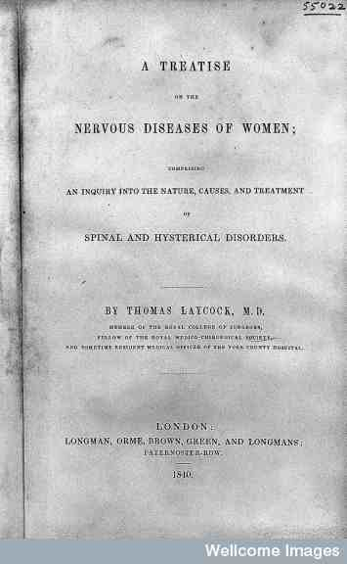
Diseases of women
Thomas Laycock one of many authors on subject from mid-19thC onwards.
He had special interest in hysteria and nervous disorders but other authors focused more on gynaecology and the difficulties of parturition/childbearing

Slide 11
Sex, Pathology and Psychiatry
Relevance of prostitution - represented all that was ‘pathological’ about female sexuality and became a public health problem (Contagious Diseases Acts 1860s)
Female sexuality and women more generally – ‘psychiatrised’; unruly women were mentally unstable
Sexual behaviour linked to diagnosis:
  Hysteria and female sexual arousal
  Mania typified by unfeminine/overtly sexual behaviour
  Nymphomania defined in late 19th century.
Mental conditions overtly related to female instability and instability of reproductive organs

Slide 12
Women and psychiatry
Women’s relationship with psychiatry – repression? control? behaviour?
Institutions/growth of asylums in 19th century. Elaine Showalter in The Female Malady suggested the majority of patients were women.
Recent work has suggested that gender played less of a role than suggested in psychiatric diagnosis and also looks increasing at masculinity and mental breakdown (see e.g. Akihito Suzuki, Mark Micale, Martin Stone, Digby and Andrews (eds))
Reassessment of the asylum – refuge? respite care? temporary?
Acknowledgement that doctors saw female vulnerability to mental breakdown rooted in wide set of social, economic and circumstantial factors not just female life cycle and weakness/biological predisposition.

Slide 13
Puerperal insanity
First defined/labelled in 1820 by Robert Gooch.
Accounted for increased admissions to asylums – around 10% of female admissions and often more and many treated as private patients at home and occasionally in maternity hospitals.
Contested between obstetricians and psychiatrists – both claimed expertise to cure.
Seen as likely to reoccur and related not only to female biology and strains of childbirth, but also to worries about motherhood, poverty, domestic problems (insanity of lactation particularly associated with poor nutrition of mother, exhaustion and having too many children in quick succession).
Catch all diagnosis – rich and poor (excessive luxury and poverty), young and old, first time mothers and those who had many children.

Slide 14
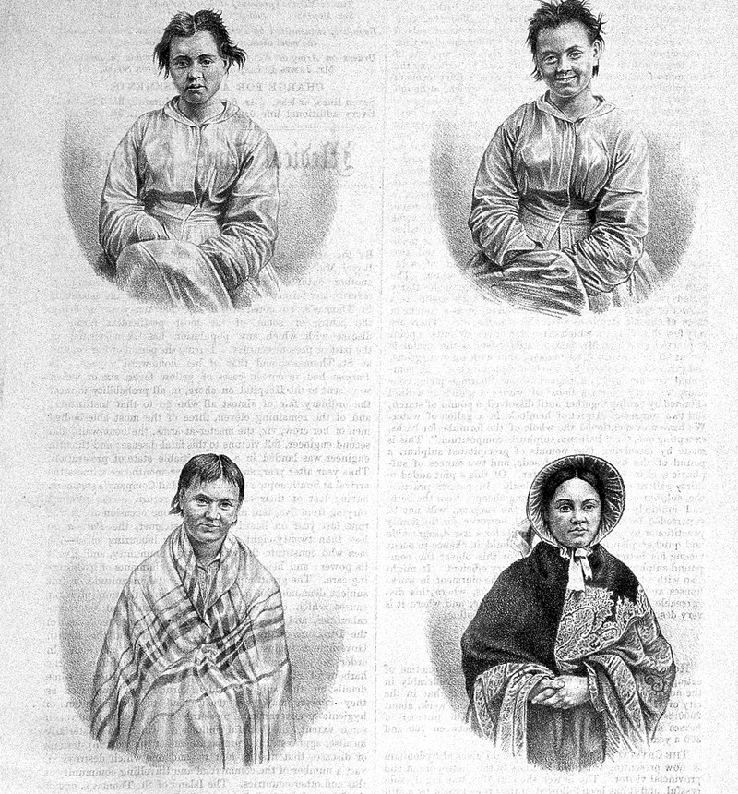
Puerperal insanity
Robert Gooch, On some of the most important diseases peculiar to women (1831), p.54.
W.H. Bagg, after a photograph by H.W. Diamond, Puerperal Mania in Four Stages, from John Conolly, “Case Studies from the Physiognomy of Insanity”, The Medical Times and Gazette (1858)
‘During that long process, or rather succession of processes, in which the sexual organs of the human female are employed in forming; lodging; expelling, and lastly feeding the offspring, there is no time at which the mind may not become disordered; but there are two periods at which this is chiefly likely to occur, the one soon after delivery, when the body is sustaining the effects of labour, the other several months afterwards, when the body is sustaining the effects of nursing’.

Slide 15
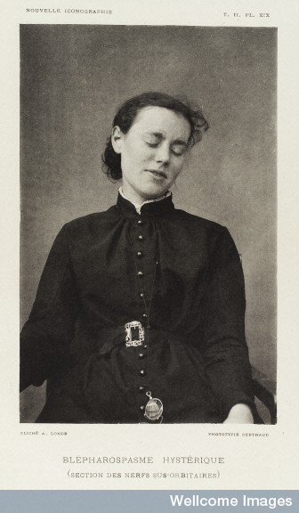
Hysteria
The ‘daughters’ disease’?
A Victorian epidemic?
Connections to social class? Did the working class get it?
‘Social’ and ‘medical’ causes
Over-work?/over-education?
A form of protest against patriarchy?
Allowed women to assume the ‘sick role’/invalid?
Rebellion?
A rich visual archive

Slide 16
Women’s agency?
Culture of invalid– could be utilised by women
Birth control – many of its advocates were women
Women’s move into medical practice as doctors, professional nurses, health visitors, etc. – focus on women and children’s medicine, often advocate for women
Women direct household income, which for some meant exercised choice in who to employ as doctors.
Some interventions beneficial e.g. B’ham Women’s Hospital treated many women with severe gynaecological problems, problems of multiple births etc. – prolapsed womb, varicose veins, etc. Women also had real sufferings and complaints.
Household medicine – women as medical activists or day to day practitioners and carers.

Slide 17
Women doctors
Only 25 in England and Wales 1881, 495 1911 – impact out of all proportion to numbers
Many were feminists – Elizabeth Garrett Anderson and Sophia Jex-Blake
Worked in obstetrics, paediatrics, public health, school medicine, birth control (in early C20th) and private practice with women. Small number set up hospitals. Also produced health advice literature for women.

Slide 18
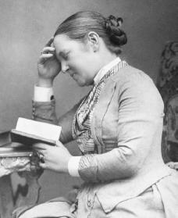
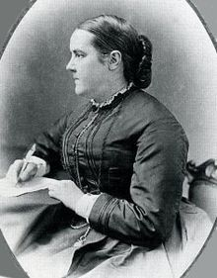
Elizabeth Garrett Anderson and Sophia Jex-Blake

Slide 19
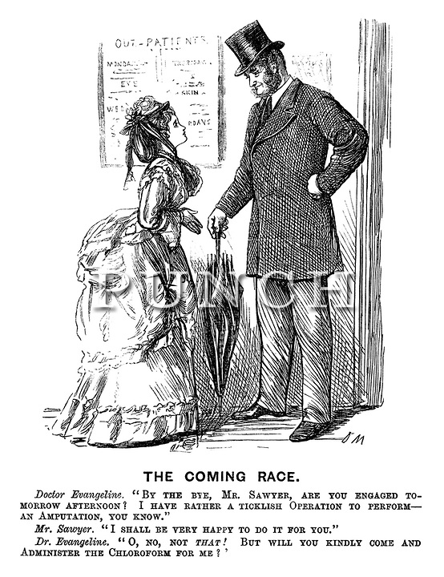
Medical Women
Fashionably dressed female doctor claims greater surgical competence than a male practitioner
Punch, 14 September 1872

Slide 20
Women’s health in 20th century
Health disadvantage - class, gender and ethnicity.
Heavy burden (work/home), childbearing - ‘double burden’.
Women tended to have less access to health care.
Yet also responsible for care of family, especially children – mothercraft, infant welfare, children’s health, nutrition and hygiene.
Blamed and responsibility for families’ ill health and their own – alleged ignorance on health and reluctance e.g. to attend clinics.
Seen as vulnerable to mental illness and depression – continues into 20th century.
See Lucinda Beier – working class women’s health, but also connected literature - birth control, adolescence, midwifery and maternity.

Slide 21
Interwar years
Medical Research Council (MRC) 1924 Report on miners and families – ill health but due to ‘failure’ of mothers (poor home care, hygiene, cooking).
1935 Report on Maternal Morbidity in Scotland – 57% antenatal deaths due to women not following advice and failing to attend clinics.
1933 Women’s Health Inquiry Committee – explored experiences of 1,250 working-class women. Found enormous amount of ill health amongst married women. Illness often ‘hidden’ and took ill health for granted.
Report recommended: higher wages, better social service provision for children, family allowances, improved maternal health services, subsidised housing, extension of NI for women, better education in home management, etc.
MOsH more sympathetic to women’s plight.
Background of Depression and housing shortage – feeding and clothing children remained main preoccupation of women.

Slide 22
2nd WW and NHS
Dual burden continued for women – domestic labour and war work.
Continuity - Women’s role still regarded as wife and mother: William Beveridge ‘housewives as mothers have vital work to do in ensuring the adequate continuance of the British race…’
Rationing improved diet in latter years of war – led to improved health, women’s wages often improved SofL of family.
1945 Family Allowances introduced – end of long campaign.
Women’s access to health care improves with introduction of NHS but still inequalities based on gender, class, locale and ethnicity.

Slide 23
Feminist strategies
1970s onwards women’s health had higher profile inspired by women’s movement (influence of US)
  e.g. refuges for women suffering domestic violence
Urged women to learn more about their bodies and exercise more control over their health – Well Women Clinics (WWCs). Holistic approach, but also checked for female cancers, reproductive health matters. Advice to women – Our Bodies, Ourselves (1973)
Much of women’s time though still dedicated to looking after others – women outlive men, but tend to be more unhealthy, WHY?
  Related to more contact with medical professionals, but also lingering assumptions about women’s health and capabilities: weaker sex (more mental health problems) and women more likely to express stress through illness.
Continuing impact of ‘double burden’?

